Slide 1

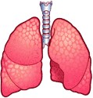
CHRONIC OBSTRUCTIVE PULMONARY DISEASE

Slide 2
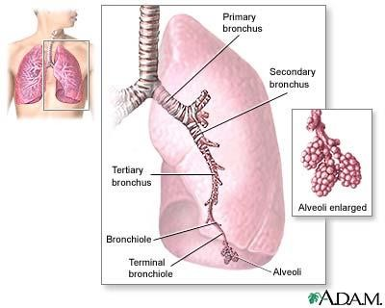
MORPHOLOGY OF LUNGS

Slide 3
INTRODUCTION
Chronic obstructive pulmonary disease (COPD) is characterized
by airflow limitation that is not fully reversible.
The airflow limitation is usually both progressive and associated with an abnormal inflammatory response of the lungs.
Cigarette smoking (> 20 PACK YEAR)is the primary cause of COPD
Chronic obstructive pulmonary disease generally refers to
Emphysema or Chronic bronchitis.

Slide 4
Emphysema is characterized by alveolar wall destruction and abnormal, permanent enlargement of air–space.
Chronic bronchitis associated with chronic or recurrent excess mucus secretion into the bronchial tree with chronic cough for at least 3 months for 2 consecutive years.

Slide 5
PATHOLOGICAL CHANGES
Effect 4 different compartments of lungs:
Central airways
Peripheral airways
Lung parenchyma ( Bronchioles, alveoli, capillaries)
Pulmonary vasculature

Slide 6
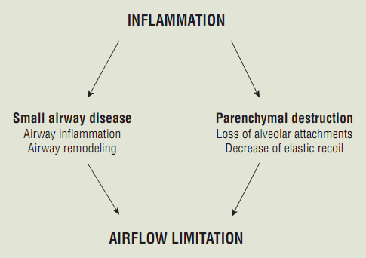

Slide 7
PATHOPHYSIOLOGY
Noxious Agent
Inflammation
Hyperinflation and Hypersecretion
Airflow Obstruction
Gas exchange abnormalities

Slide 8
1. Noxious particles and gas inhalation
Activation of neutrophils, macrophages, and CD8 + lymphocytes, Release tumor necrosis factor-α , interleukin-8, and leukotriene B
Inflammation
Increased number and size of goblet cells and mucus glands Smooth muscle& connective tissue thickening in airways
Scarring and fibrosis.

Slide 9
2.Oxidative stress
Increased oxidants
Damage various proteins and lipids Cell and tissue damage.
OXIDANTS Promote inflammation Inhibit antiprotease activity.
Increase protease-antiprotease imbalance

Slide 10
Proteases and antiproteases imbalance
Antiprotease a1-antitrypsin (AAT) is an antiprotease enzyme which inhibit the proteases (neutrophil elastase).
Neutrophil elastase is a potent elastolytic enzyme that attack elastin
which leads to tissue damage and loss of elasticity.
Elastin is a major component of alveolar walls.
Cigarette smoke activate and attract inflammatory cells into the lung, thereby promoting the release of proteases such as elastase.
Other proteases, including cathepsins and metalloproteinases.
A hereditary deficiency of AAT results in an increased risk for premature development of emphysema.

Slide 11
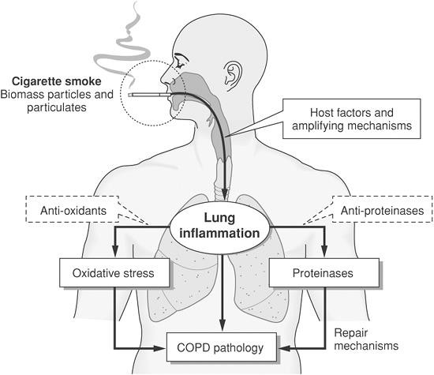

Slide 12
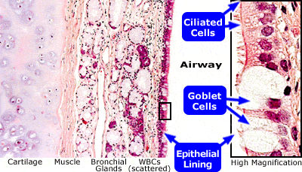
BRONCHIAL WALL

Slide 13
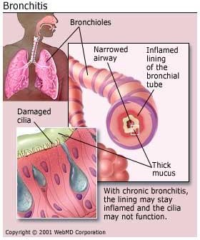
CHRONIC BRONCHITIS
Excess mucous secretions
Inflamated lung endothelium
Damaged cilia
Tissue destruction
Airway obstruction
Decreases gas exchange
Infections
Hypoxemia
Pulmonary hypertension
Polycythemia

Slide 14
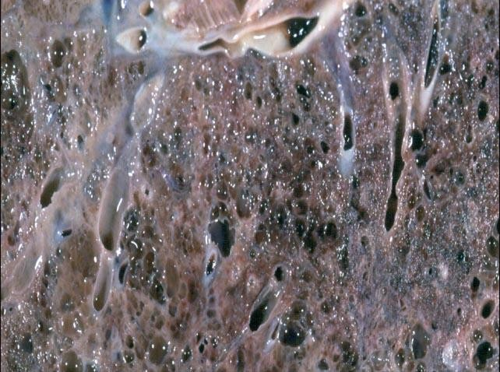
EMPHYSEMA
Destructive enlargement of air sacs
Dilation and destruction
Impaired gas exchange
Breakdown of elastin
Loss of elasticity
Lack of alpha1 anti trypsin
2 types CENTRILOBULAR:
Dilation & destruction of bornchioles, alveolar ducts, alveoli. In COPD PANACINAR:
Destruction of whole acinus ( airway ending). In alpha1 antitrypsin deficiency.

Slide 15
Centrilobular emphysema that primarily affects respiratory
bronchioles
Panlobular emphysema is seen in AAT deficiency and extends to the alveolar ducts and sacs.

Slide 16
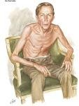
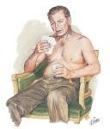
PINK PUFFERS
BLUE BLOATERS
EMPHYSEMA
CHRONIC BRONCHITIS

Slide 17
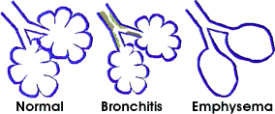
STRUCTURAL CHANGES IN ALVEOLI

Slide 18
RISK FACTORS
Host Factors
Genetic predisposition (alfa1-antitrypsin)
Airway hyper responsiveness
Impaired lung growth
Exposures
Environmental tobacco smoke
Occupational dusts and chemicals
Air pollution

Slide 19
AETIOLOGY
Smoking
Major cause of COPD and risk increases
pack years = Number of cigarettes per day x number of years smoked ÷ 20
Age
Increasing age results in ventilatory impairment
3. Gender
Women have greater airway reactivity and experience faster FEV1 and are at more risk than men.
declines in
4. Occupation
Coal and gold mining, cement & cotton industries, farming
and grain handling.

Slide 20
Aetiology …
Genetic factor
Deficiency of α₁ antitrypsin ( strongest risk factor)
Genetic disorders involving tissue necrosis factor,
Air pollution
Death rates are higher in urban areas than in rural areas
Indoor air pollution from burning fuel biomass ( In underdeveloped
areas)
Socio-economic status
More common in individuals of low socio-economic status
Airway- hyper responsiveness &allergies
Smokers show high IgE & eosnophils & airway hyper responsiveness

Slide 21
SYMPTOMS
Chronic cough
Dyspnea
Sputum production
Bluish discoloration of lips and nail beds
Increased resting respiratory rate
Shallow breathing
Pursed lips during expiration
Weight loss

Slide 22
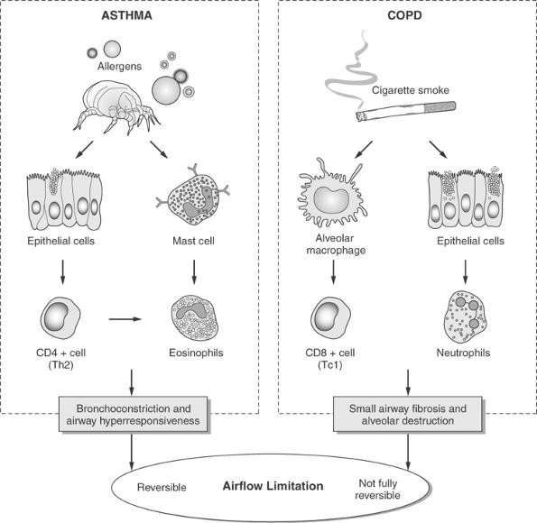

Slide 23
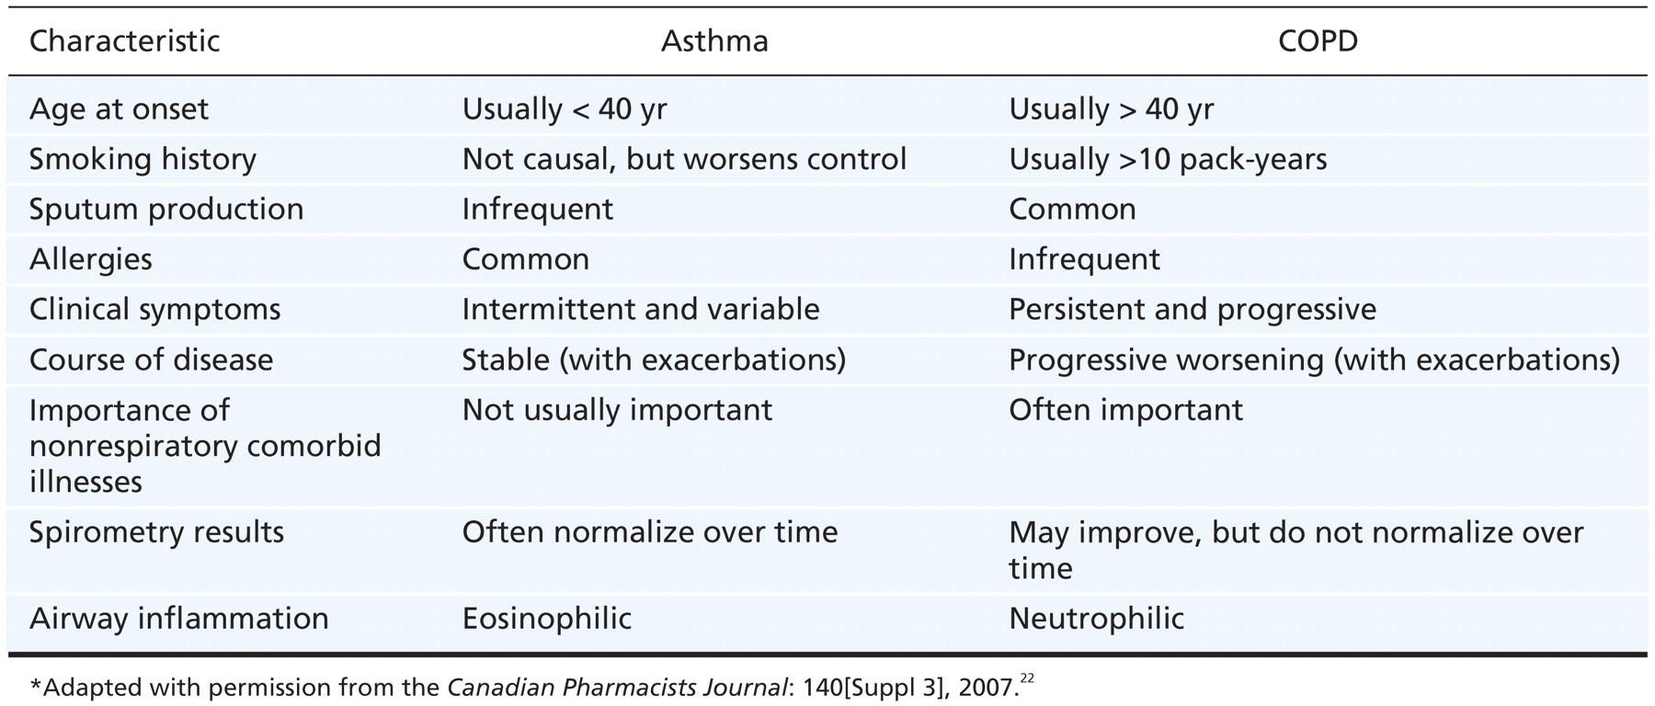

Slide 24
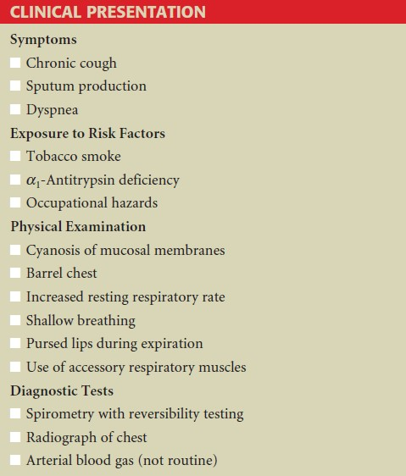

Slide 25
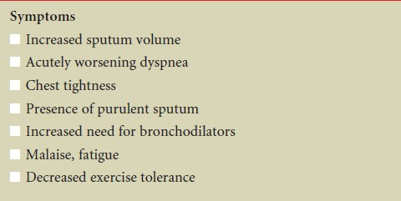
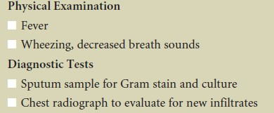

Slide 26
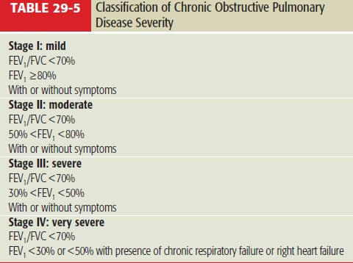

Slide 27
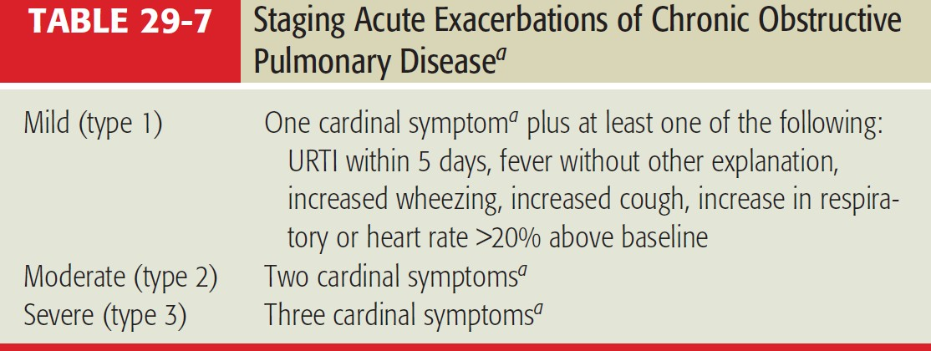

Slide 28
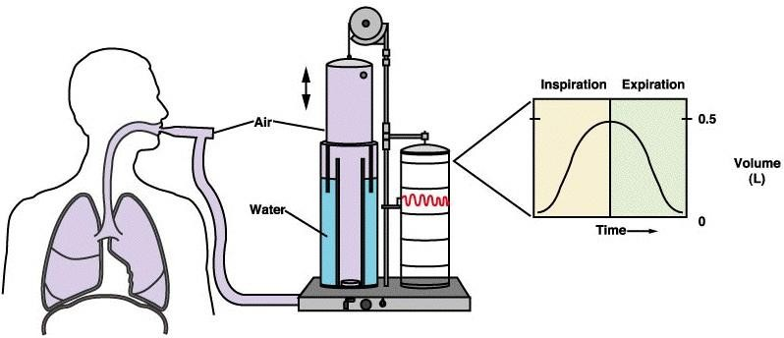
SPIROMETER

Slide 29
