Slide 1
PHARMACEUTICAL MICROBILOLOGY
Different methods used in isolation and identification of bacteria with emphasis to different staining techniques and biochemical reactions. Counting of bacteria -Total and Viable counting techniques.
17-09-2024
1

Slide 2
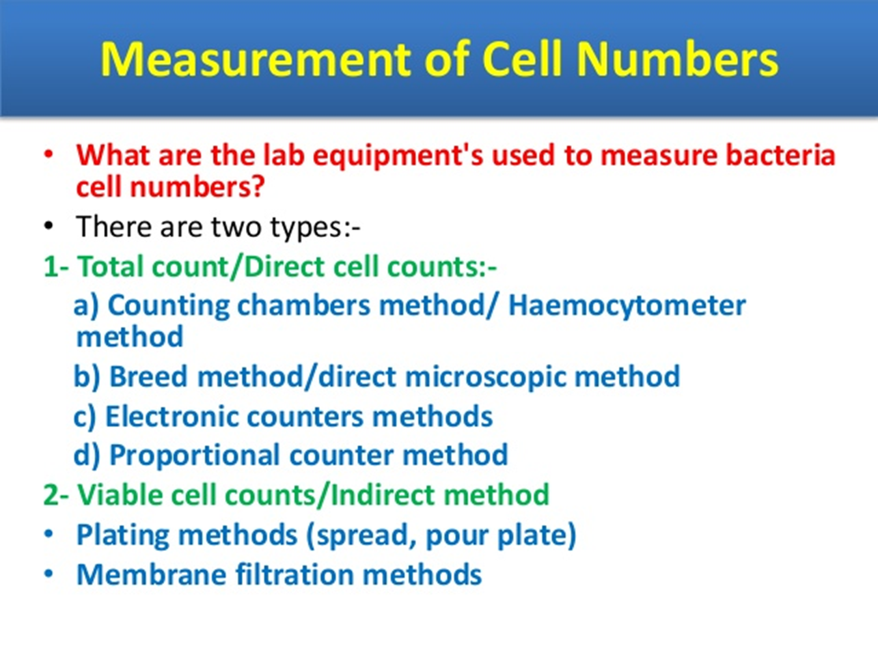

Slide 3
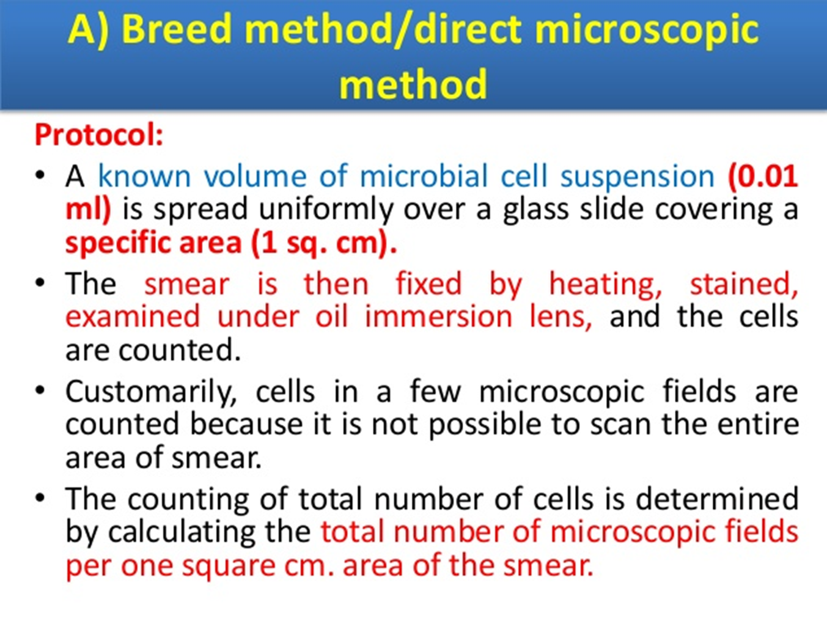

Slide 4
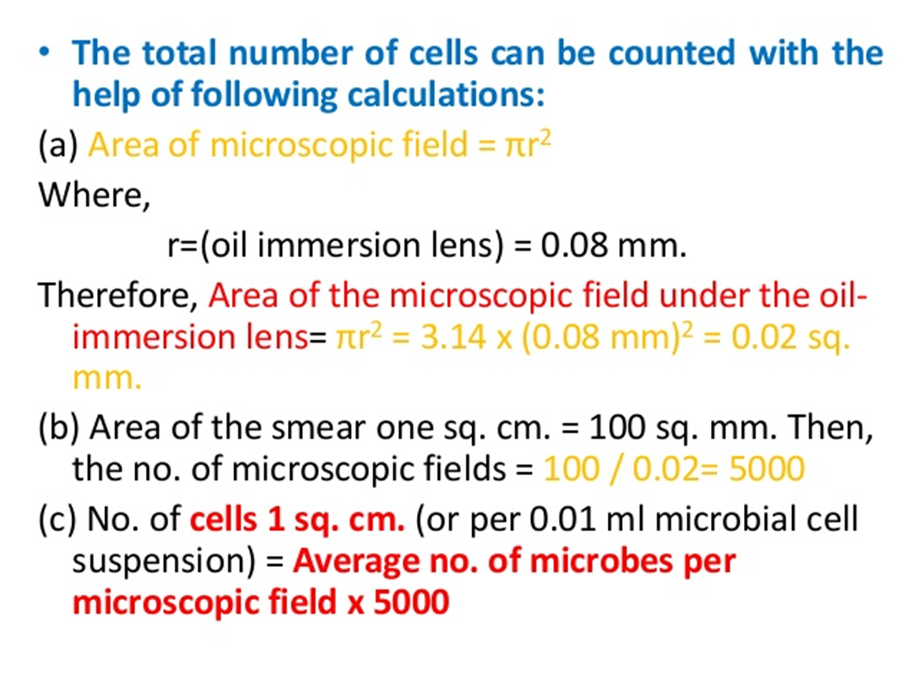

Slide 5
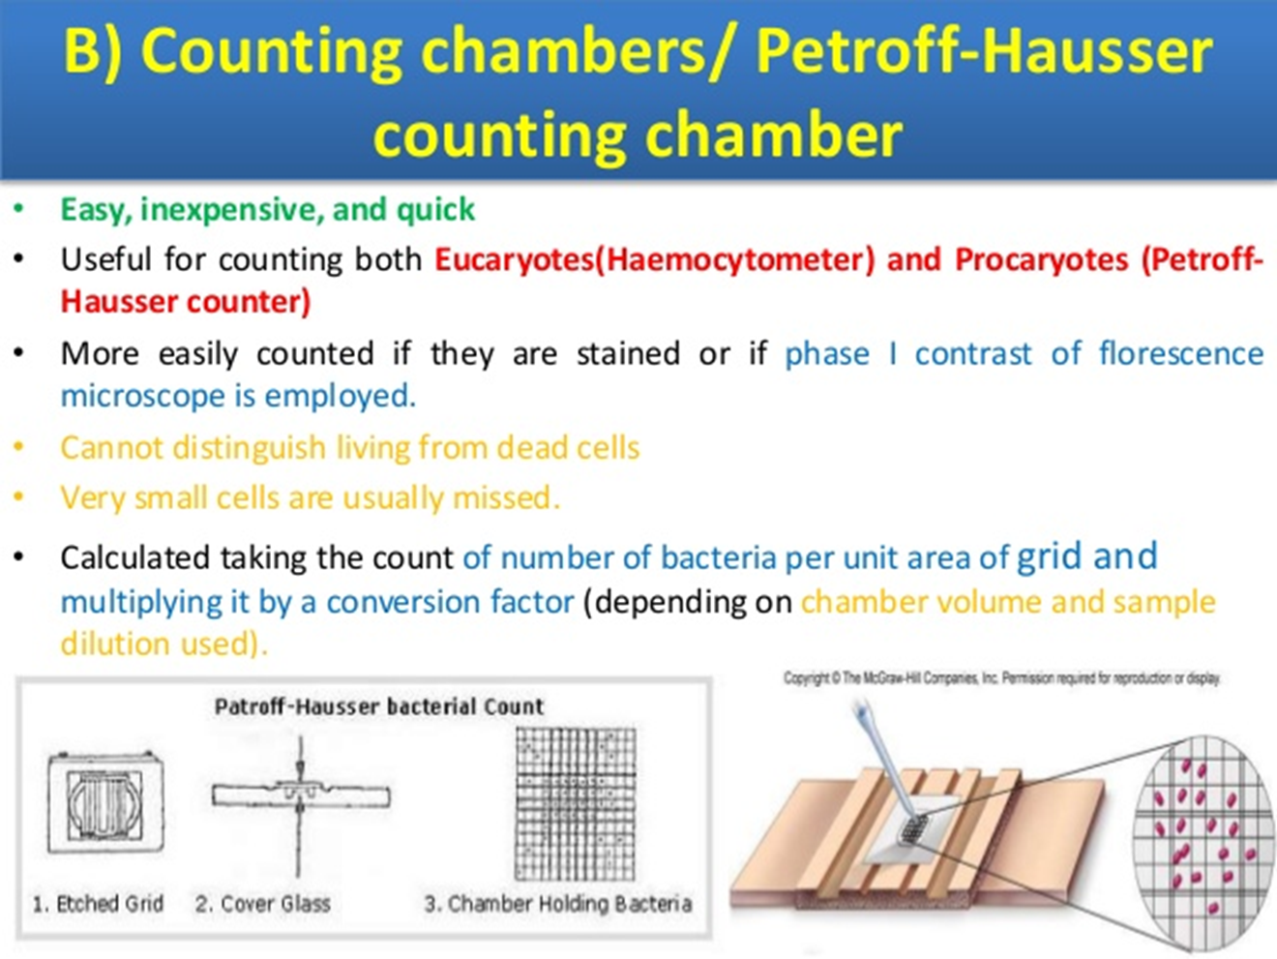

Slide 6
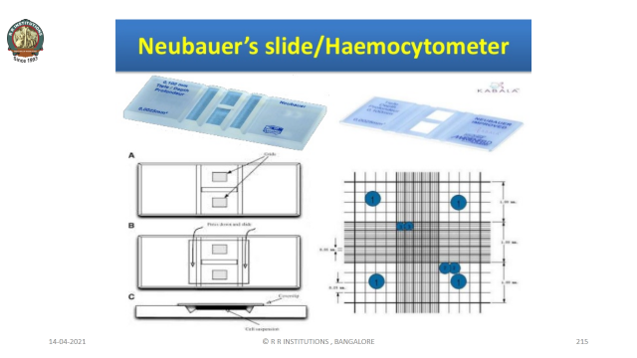

Slide 7
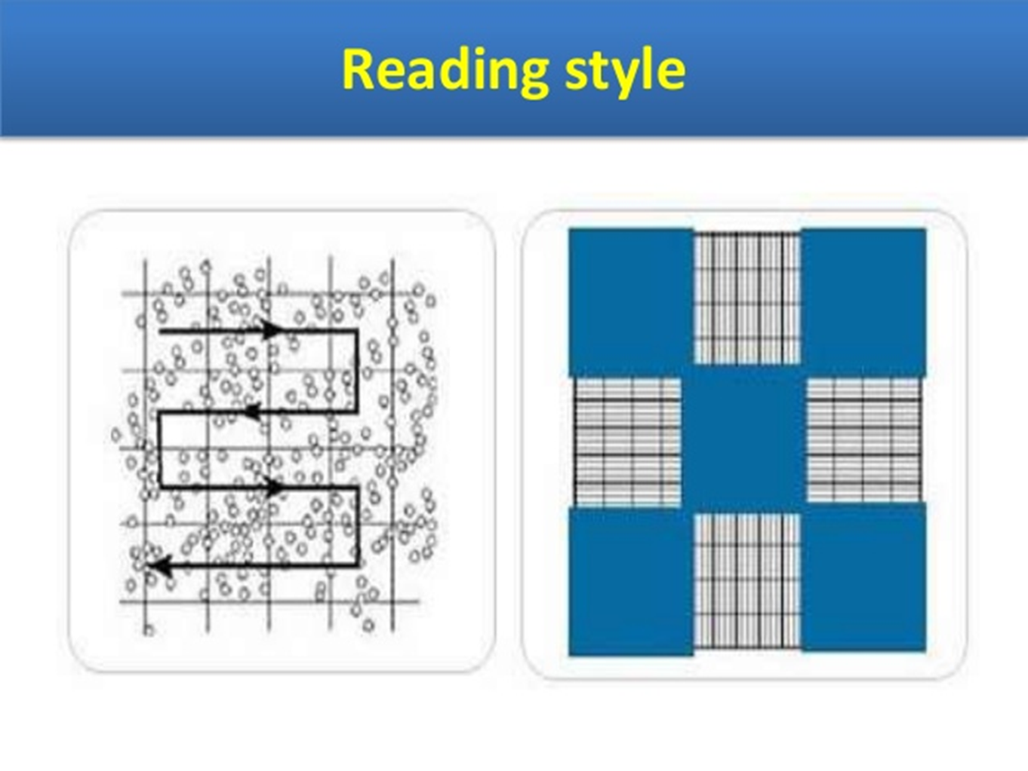

Slide 8
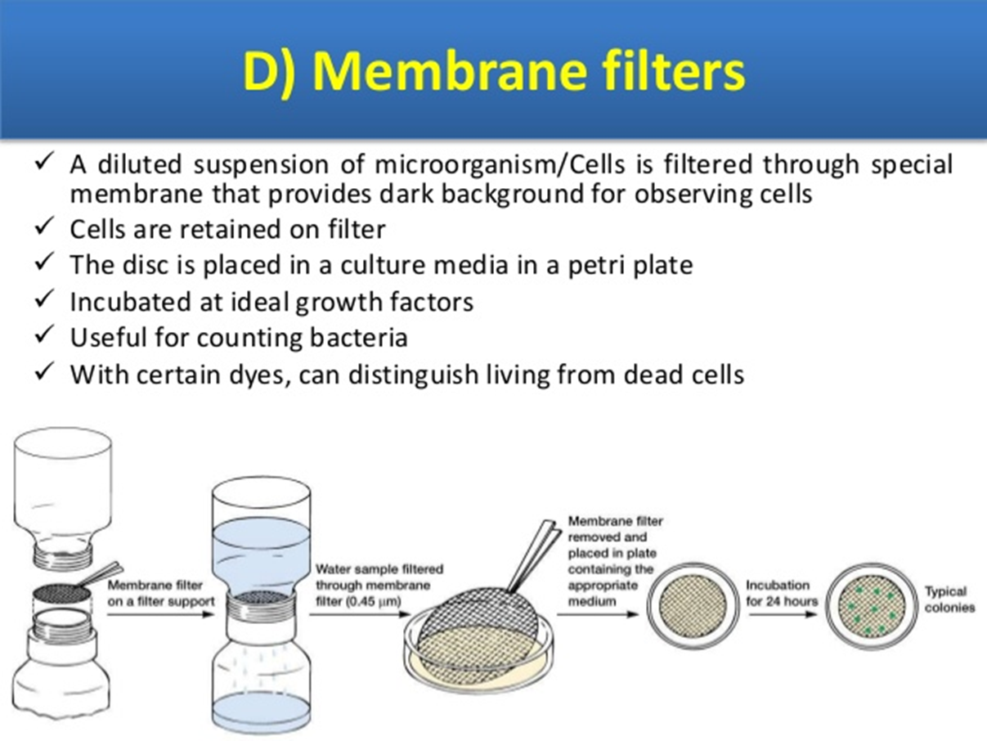

Slide 9
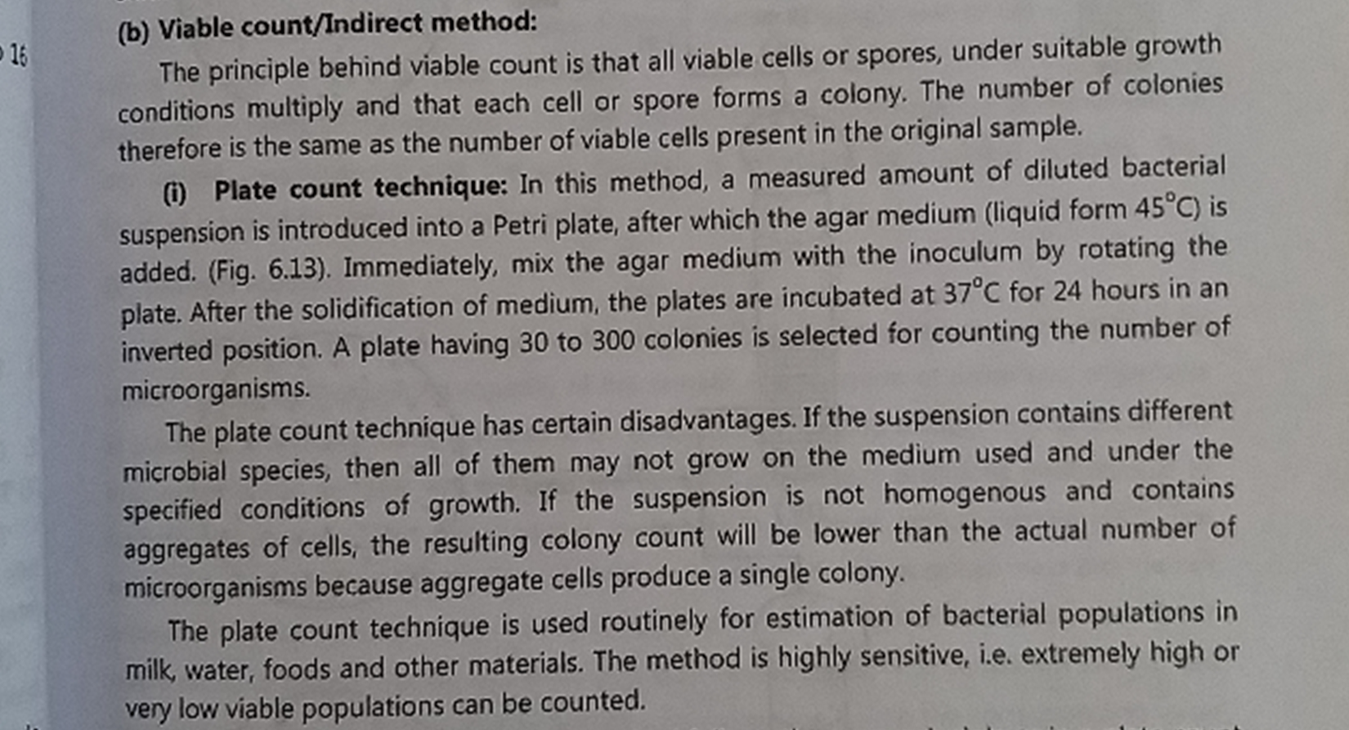

Slide 10
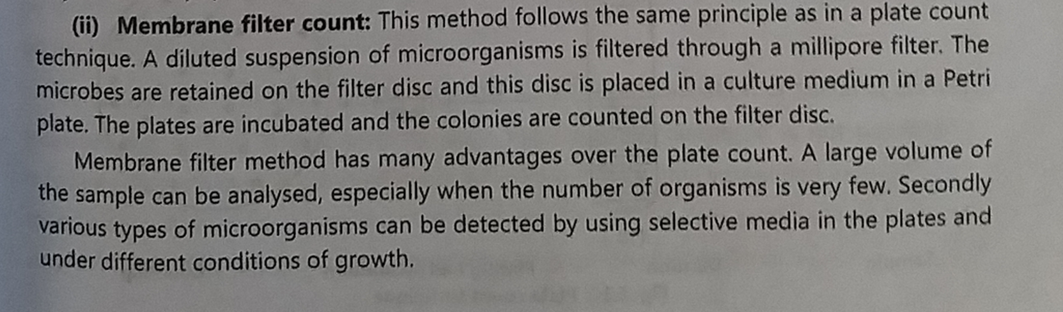

Slide 11
END OF THE UNIT

