Slide 1
Chronic renal failure

Slide 2
DEFINITION
CRF is the progressive, irreversible, deterioration of renal function. Usually resulting from long standing disease, it sometimes derives from acute renal failure that does not respond to treatment. ➢ CRF is characterized by anemia, nocturia, oedema, HTN, bone pain, neurological changes & disordered muscle function.
➢ The incidence of CRF with age & is greater in females & which may progress in ESRF (enf stage renal failure)

Slide 3
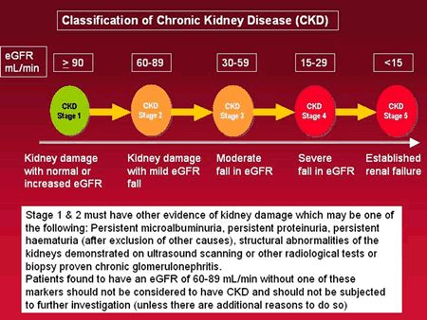

Slide 4
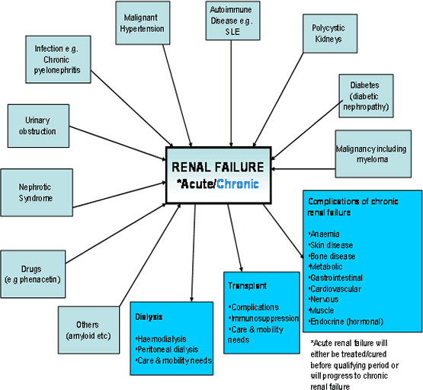
Etiology

Slide 5
Pathophysiology
Glomerular hyperfiltration & intra hypertension
When number of functioning nephrons is reduced due to renal disease the remaining nephrons compensate by enlarging or increasing their individual GFR, by escalating glomerular blood flow & intraglomerular capillary pressure, increased glomerular perfusion is attained .
This would result blood flow & pressure within glomeruli causes damage to remaining nephrons .
Glomerular injury also results from increased capillary permeability which allows proteins & other macromolecules to leak through capillaries into the renal tubules.
Microalbuminuria is one of the clinical manifestations of glomerular damage.
The abnormal solute load promotes the secretion of proinflamatory mediators & induce renal mesangila cells to deposit an extracellular glycoprotein matrix leading to renal fibrosis & sclerosis
Hyperglycemia ,systemic HTN & excessive diet protein are able to initiate or exacerbate hyperfiltration

Slide 6
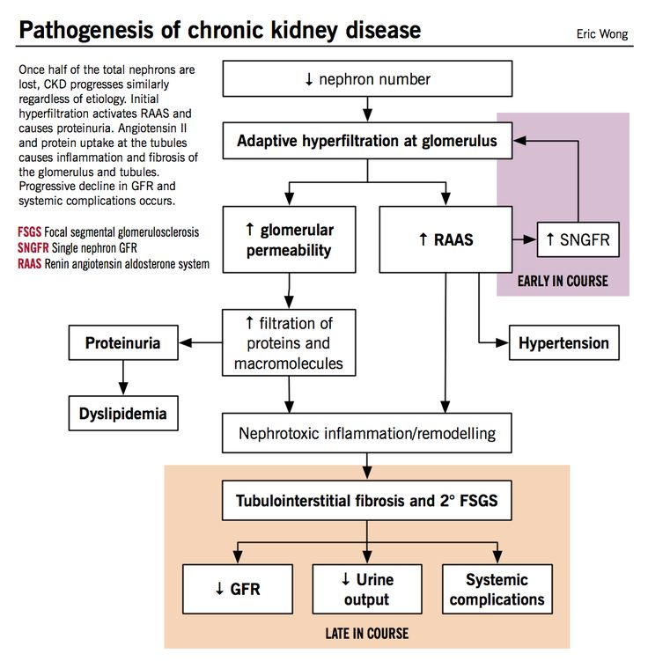

Slide 7
Protein intake:- A high protein diet has been found to increase RBF and GFR.
HTN:- Systemic HTN may be transmitted to the glomerulus which leads to CRF
Hyperlipidemia :- Renal mesangial cells possess LDL receptors and are capable of LDL uptake & oxidation. Oxidized LDL act as a direct toxin to mesangial cells that induces the production & release of inflammatory cytokinins & macrophage chemotactic factors which would finally result in glomerular scarring.
Diabetes

Slide 8
Prognosis
When the GFR has declined to about 20 mL/min, a continuing
deterioration in renal function to end stage renal disease is common
even when the initial cause of the kidney damage has been removed and appropriate treatment instigated. The mechanisms
for the decline in renal function include uncontrolled
hypertension, proteinuria and damage resulting from hyperfiltration
through the remaining intact nephrons. Serial GFR
measurements should be monitored in conjunction with the
patient's clinical condition to ensure the detection of the most
appropriate point at which to commence renal replacement
therapy. When a patient reaches an eGFR of 20 mL/min, plans
should be in place for choice of renal replacement modality,
transplantation or conservative management and where appropriate
ongoing management of anaemia and bone disease.

Slide 9
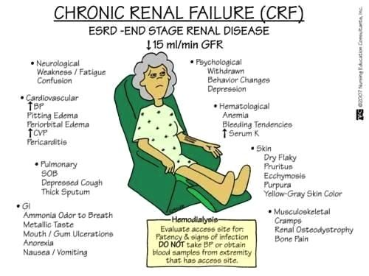
SIGNS & SYMPTOMS

Slide 10
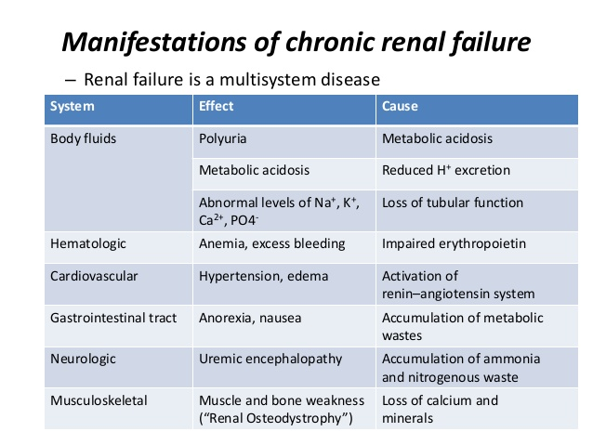

Slide 11
Clinical evaluation
Metabolic abnormalities
Neurological manifestations
Cardiovascular problems
GI manifestations
Respiratory problems
Integumentary findings
Musculoskeletal changes
Hematological disturbances
physical examination

Slide 12
Diagnostic test results
Creatinine clearance | Blood tests | Urinanalysis | Radiographic findings
May range from 0-90ml/min Reflecting renal impairment | Elevated BUN & S.creatinine conc Reduced arterial pH &bicarbonate conc Reduced S.Ca level Increased S.potassium & phosphate Reduction in S.Na level Normochromic (hematocrit 20-30%) | May reveal glycosuria, proteinuria, erythrocytes, leukocytes &casts Specific gravity fixed at 1.010 | Kidney, ureter, bladder, renal scan, renal arteriography, nephroromography These reveal small kindenys (less than 8cm length)

Slide 13
Treatment objectives
Improve patients comfort & prolong life
Treat systemic manifestations
Correct body chemistry abnormalities

Slide 14
Non-pharmacological treatment
a) Dietary measures-
*Potassium restricted to 40mEq/day
(hyperkalemia).
*Phosphorous -800-1000mg/day.
*CaCO3 =500-1000mg PO with each
meal.
*Mg- avoid Mg antacids, cathartics.
*Protein restiction
b) Lifestyle modification
c )Fluid restrictions:-1-3Lts

Slide 15
Pharmacological treatment
Treatment of edema
ACE inhibitors
Treatment of hypertension
ACE inhibitors
Ca channel
blockers
Treatment of hyperphoshatemia
Phosphate binders
Treatment of hypocalcaemia
Oral
Ca salts
Vit D
diuretics
Beta blockers

Slide 16
Treatment of other systemic manifestations of CKD
GI disturbances
anemia
Management of body chemistry abnormalities
Dialysis
peritoneal
hemo
Renal transplantation
Skin problems

Slide 17
DRUGS | MOA | DOSE | ADR | DI
Treatment | Of | Oedema
ACE inhibitors Captopril Enalapril | They act by inhibiting angiotensin converting enzymes. This prevents the conversion of angiotensin I to angiotensin II. | 12.5-25 mg BD/TD 5-20mg orally OD | Hypotensiontachycardia chest pain rash neutropenia Hyperkalemia angioedema. | *Alpha 1 blockers: -Hypotensive effect Increased. *Aspirin &NSAIDs:- decrease ACE efficacy or increase adverse renal effects *Insulin:- Risk of hypoglycemia increased
Diuretics 1. furosemide (Loop diuretics) 2. Metolazone (Thiazide diuretics) | Inhibit reabsorption of Na & Cl in the ascending loop & distal renal tubule, interfering with the Cl-binding co-transport system, thus causing increased excretion of water, NaCl, Mg, Ca & K+ | 20-80mg 6-8 hrs orally (max 600mg/day) 5-20mg OD orally | Muscle cramps Pruritis Nausea Diarrhoea Vertigo orthostatic Hypotension. | *Digoxin-Furosemide-induced hypokalemia may predispose to digoxin toxicity *Aminoglycoside-increase risk of ototoxicity *Antihypertensive agents- Hypotensive effect increased.

Slide 18
DRUGS | MOA | DOSE | ADR | DI
Treatment | Of | Hypertension
ACE inhibitors | Same as above | -- | -- | --
Dihydropyridine Ca-channel blocker Verapamil Diltiazem Nifedipine | They produce vasodilation by reducing Ca influx into vascular muscle cells producing a relaxation of coronary vascular smooth muscle cells | 80-480mg daily, child 10mg/kg 120mg-480mg 30-60mg OD (max of 120mg/day) | Headache Facial flushing Oedema Fatigue bradycardia | *Aspirin & verapamil:- may increase bleeding time monitor while using other antiplatelet or anticoagulants. *Beta-blockers may have increased dynamic interactions with verapamil Lithium neurotoxicity may result
Beta adrenergic blockers Metoprolol Atenolol | inhibitor of beta 1- adrenergic recep competitively blocks beta1 receptors with little or no effect on beta2 receptors. There by Cause vasodilation. | 1) 100-450 mg/day in 2-3 divided doses 2) 25-100mg/day twice daily | Bradycardia Hypotension Dizziness Diarrhoea Nausea Vomiting confusion. | *Alpha- blockers: Concurrent use of beta-blockers may increase risk of orthostasis *NSAIDs may increase anti HTN effects of betablocker
Other anti HTN agents

Slide 19
Treatment of hyperphosphatemia
Involves administration of phosphate binders such as AlOH or Ca carbonate

Slide 20
Treatment of Hypocalcemia
Treatment of osteodystrophy : The osteodystrophy of renal failure is due to 3 factors :
Hyperphosphataemia It is management depends upon restricting phosphate in dairy products, egg, cheese, chocolate, etc., Phosphate biding agents can be used to reduce its absorption orally .agents like Al ,Ca or Mg hydroxide . AlOH is used widely but it produces toxic effects due to poor clearance . Desferrioxamine is used to prevent Al toxicity(4-6g in 500ml of saline)
Vit D deficiency:-it may be treated with synthetic vit D analogues like alfacalcidol or calcitriol . S.Ca levels is to be monitored
Hyper parathyroidism:-
*The rise in plasma calcitrol &calcium levels that results from starting vitamin D therapy usually suppressess the production of parathyroid hormone.
*If vitamin D therapy does not correct parathyroid hormone levels then parathyroidectomy to remove part or most of the parathyroid glands may be needed.

Slide 21
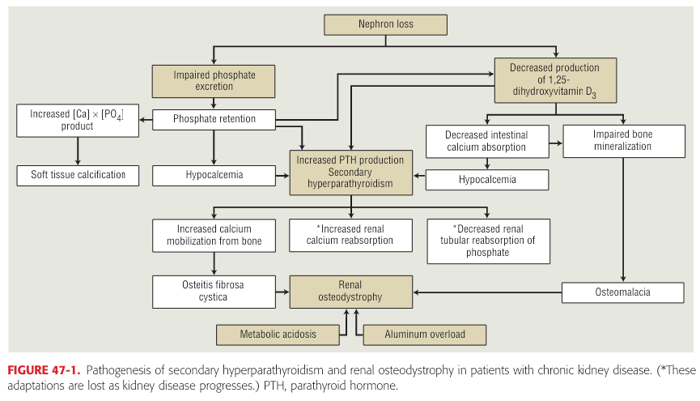

Slide 22
Treatment of other systemic manifestations of CKD
Treatment of anemia
Iron or folic acid supplements & erythropoietin .
Ex:-ferrous sulphate
Epoetin therapy i.e the introduction of
recombinant human erythropoietins
(epoetin alpha & beta), generally
engineered form of the hormone which
is safe & effective.
Treatment of GI disturbances
Antiemitics to control nausea& vomting
Docusate Na or methyl cellulose prevent constipation
Enemas to remove blood from GI

Slide 23
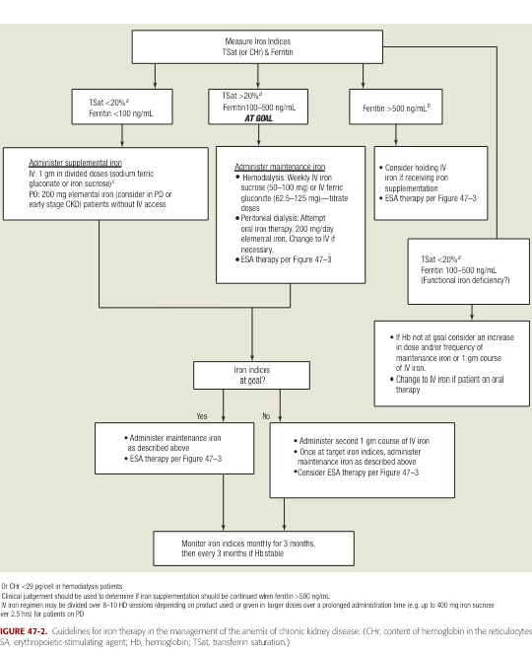

Slide 24
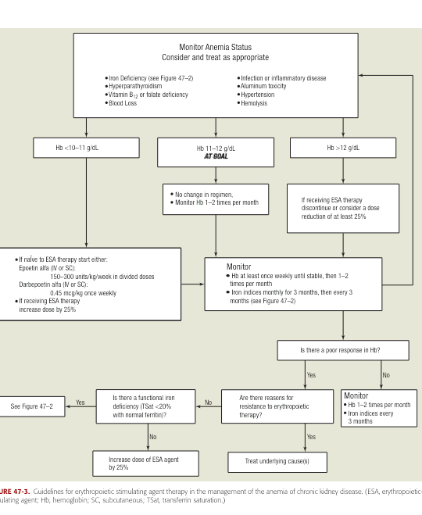

Slide 25
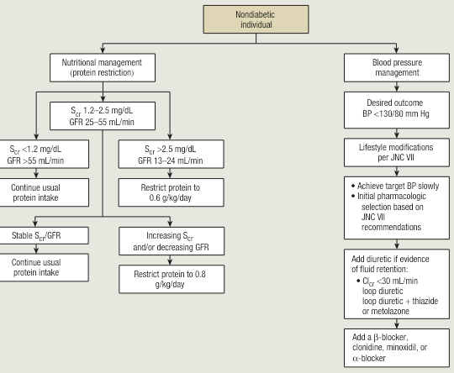
To prevent progression of disease in

Slide 26
Dialysis
When ckd progresses to end stage &no response to conservative measures long term dialysis is needed
Hemo dialysis:- it is preferred in acute hyperkalemia, hypercatabolism
Peritoneal dialysis:- it is preferred in bleeding disorders & CVS disorders

Slide 27
Renal transplantation
This is surgical procedure done for patients with end stage renal disease
Histocompatibility must be tested to mini the risk of rejection HLA type &blood type is tested to assess compatibility.
Renal transplant material may be obtained from a living or cadaver
Three types of graft rejection are:-
Hyperacute rejection results in graft loss within min or hrs
Acute rejection may occur 4-60 days after transplant
Chronic rejection occurs more than 60 days after transplant

Slide 28
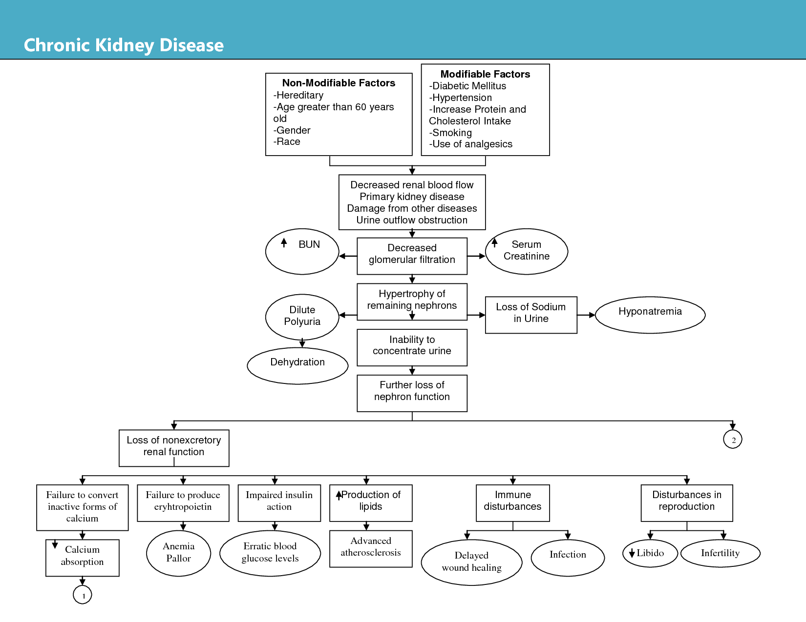
Complications

