Slide 1
SUBJECT NAME- PHARMACEUTICAL MICROBIOLOGY
UNIT NO & NAME-1 CULTIVATION OF BACTERIA
17-09-2024
1

Slide 2
TOPIC NAME – CULTIVATION AND GROWTH OF BACTERIA
Bacterial requires adequate nutrition, optimum pH, temperature and oxygen for growth and multiplication
Suitable artificial media containing sources of carbon, nitrogen, hydrogen, oxygen, phosphorous and other elements such as sodium, potassium, magnesium and iron in small amounts have been used for cultivation of micro-organisms in the laboratory
Bacteria can be classified depending on nutritional requirement i.e. sources of energy, electrons, carbon etc
Source of energy : Bacteria which derive their energy from sunlight are called phototrophs and those that obtained energy from chemical reactions are called chemotrophs (e.g. Escherichia coli)
Source of electron : All micro-organisms require a source of electrons for their metabolism. Bacteria which use reduce inorganic compounds as electron donors are called lithotrophs and some other species which use organic compounds as electron donors are called organotrophs. Among the phototropic bacteria, some species use inorganic compounds (H2S) as source of electron and are called photolithotrophs and other which use organic compounds such as fatty acids and alcohols as electron donors are called photo organotrophs .
17-09-2024
2

Slide 3
Source of carbon : Microorganism requires carbon for synthesizing cell components. However, some species use CO2 as the major source of carbon.
Nitrogen : Bacteria can use nitrogen from the atmosphere or from inorganic compounds such as nitrates, nitrites, ammonium salts or organic compounds such as amino acids
Sulphur : Many bacterial species use sulphur from organic sulphur compounds, inorganic sulphur compounds and elementary sulphur
Phosphorus : It usually supplied in the form of phosphate is an essential component of nucleotides, nucleic acids, phospholipids etc
Minerals salts : Bacteria requires salts, particularly the anions such as phosphate and sulphate and the cations as sodium, potassium, magnesium, iron and calcium
Growth factor or bacterial vitamins : some bacterial species require organic compounds in minute quantities for growth
Water : It is the major essential nutrients as it accounts for about 80 to90 % of the total weight of cells

Slide 4
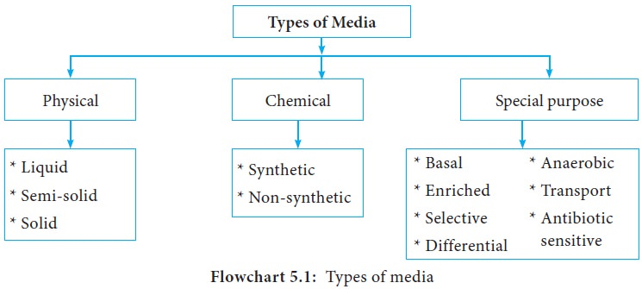
BACTERIOLOGICAL MEDIA
Media is artificially prepared mixture of various nutrients for the growth and multiplication of microorganisms
A wide variety of culture media is employed by microbiologist for isolation growth purification maintenance and identification of microorganisms

Slide 5
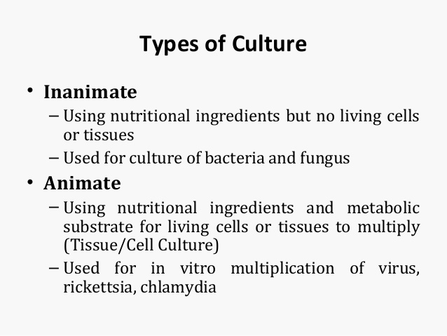
COMMON INGRIDIENTS OF MEDIA
Water
Peptone
Yeast extract
Meat extract
Agar

Slide 6
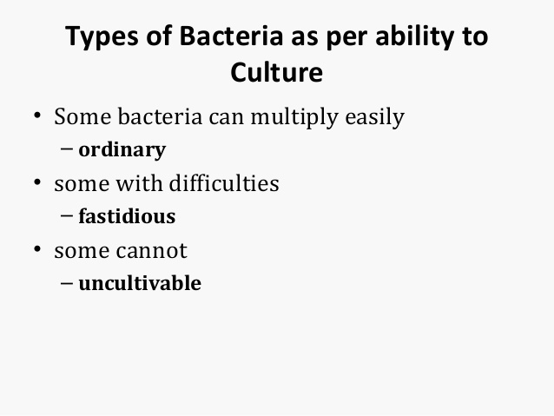

Slide 7
These are classified into six types: (1) Basal media, (2) Enriched media, (3) Selective media, (4) Indicator media, (5) Transport media, and (6) Storage media. 1. BASAL MEDIA. Basal media are those that may be used for growth (culture) of bacteria that do not need enrichment of the media.
Enriched media contain the nutrients required to support the growth of a wide variety of organisms, including some of the more fastidious ones. They are commonly used to harvest as many different types of microbes as are present in the specimen
Selective media are used to select for the growth of a particular “selected” microorganism. For example, if a certain microbe is resistant to a particular antibiotic (e.g., novobiocin), then that antibiotic can be added to the medium in order to. S. aureus is seen producing yellow colonies on mannitol salt agar

Slide 8
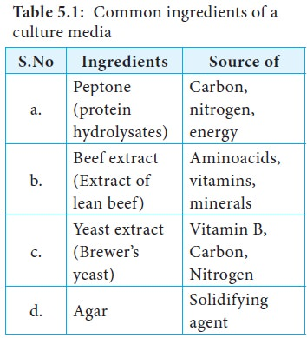

Slide 9
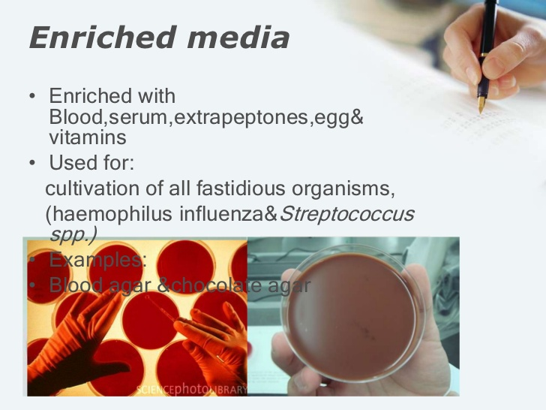

Slide 10
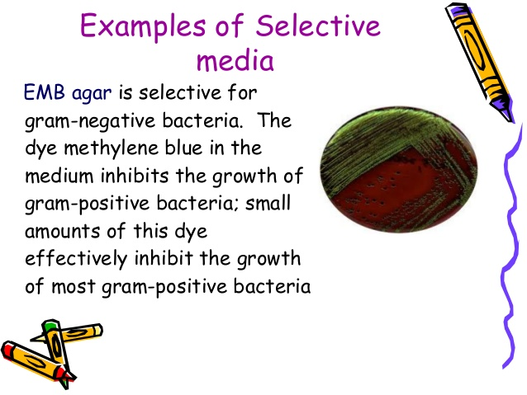

Slide 11
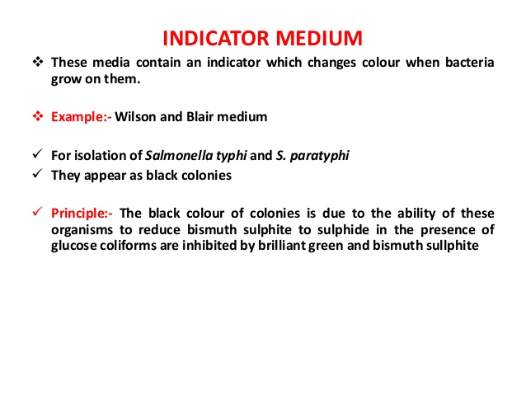

Slide 12
