Slide 1
PHARMACOGNOSY AND PHYTOCHEMISTRY
Macro, powder and microscopic study of Cassia
17-09-2024
1

Slide 2
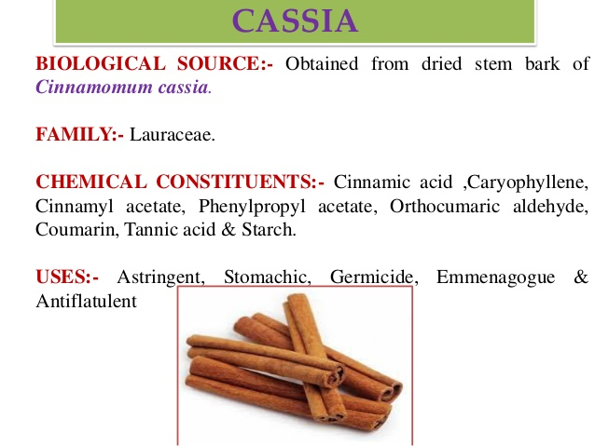
CASSIA
synonym
Chinese cinnamon, Cassia lignea, Bastard cinnamon, Cassia aromaticum, Canton cassia.
Biological Source
Cassia is the dried stem bark of Cinnamomum cassia Blume., belonging to family Lauraceae.
Geographical Source
It is Indigenous to China, Cochin and Assam. It is also cultivated in Ceylon, Japan, Sumatra, Java, Mexico, and America
17-09-2024
2

Slide 3
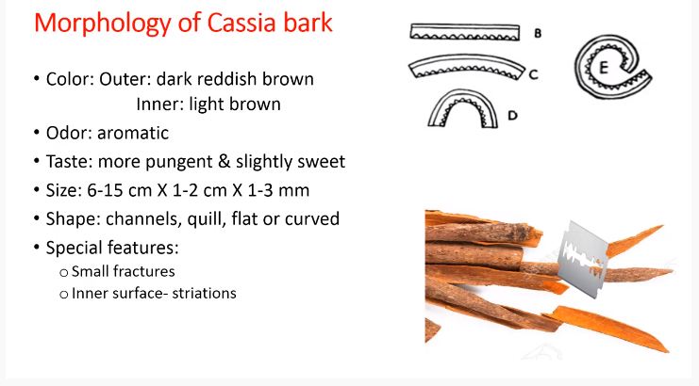
presence of volatile oil
The cultivated cassia long
And use cassia bark is small in nature
Macroscopical Character:
(i) Colour: Dirty brown (both side)
(ii) Odour: Characteristic, sweet, aromatic.
(iii) Taste: Slightly sweet, aromatic
(iv) Size: 5 to 40 x 12 to 18 x 1 to 3 mm.
(v) Shape: Single squill.
FRACRURE :- Short granular on outer part, occasional grayish patches of cork.
Perpendicular direction
Lower part – put Boling water , sudden red
17-09-2024
3

Slide 4
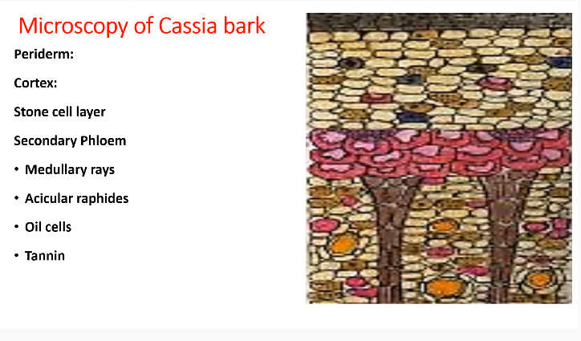
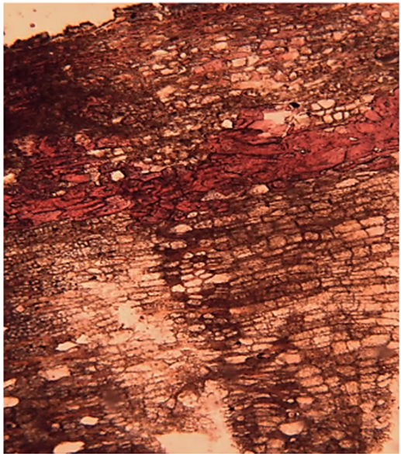
Outer most layer
Mint for storage – food material [ starge grain ,calcium oxalate reserve food material s]
Function – rigidity , flexibility ,and strength
protection
Needle like crystals – in this figure this absent
Transfer food material in perpendicular rays direction to cortex
17-09-2024
4

Slide 5
Microscopical characters:
Periderm:
a. Cork: It consists of several layers of radially arranged rows of thin walled cells with dark brown contents. The cork cells are impregnated with suberin.
b. Phellogen: It consists of 2-3 layers of thin walled rectangular cells without any cellular contents.
c. Phelloderm: 6 to 8 layers of thin walled rectangular cells without any cellular contents. Like cork, they are arranged at times in radial rows.
2. Cortex:
They consist of several layers of thin walled and tangentially elongated cells containing yellowish brown matter. Some of the cortical cells are filled with microsphenoidal crystals of calcium oxalate and the rest with minute starch grains.
3. Secondary phloem:
It consists of phloem parenchyma, phloem fibres and medullary rays.
4. Medullary rays:
Medullary rays transverse radially the phloem parenchyma; 1 to 3 cells wide, extend up to cortex, cells radially elongated and contain starch grains.
17-09-2024
5

Slide 6
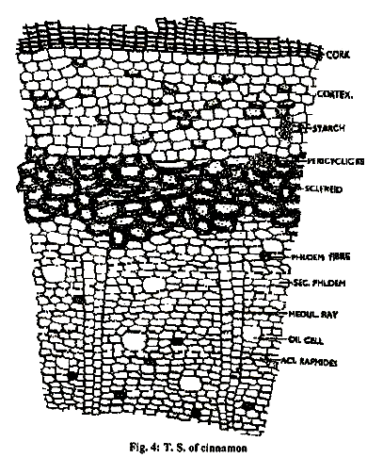
17-09-2024
6

Slide 7
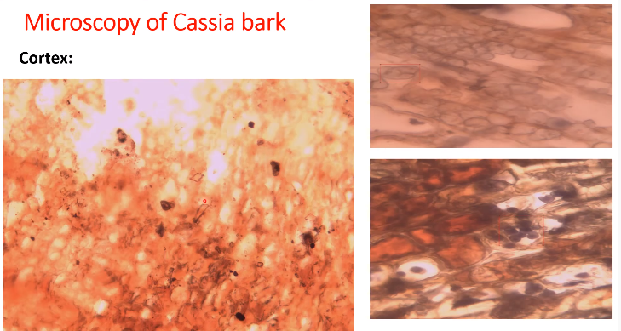
Apply Iodine
Starch grains
Prisms of calcium oxalate crystals
17-09-2024
7

Slide 8
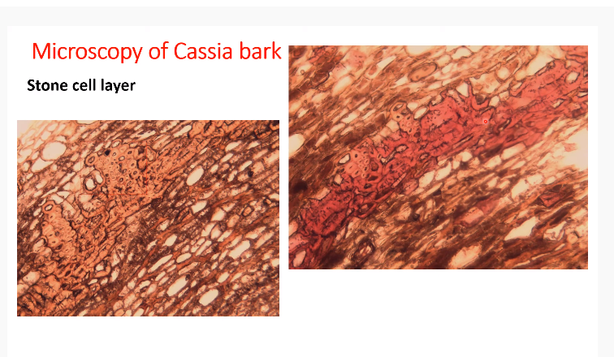
Phloems fibers
With ph. F HCl
Without phloroglucinol F HCl
17-09-2024
8

Slide 9
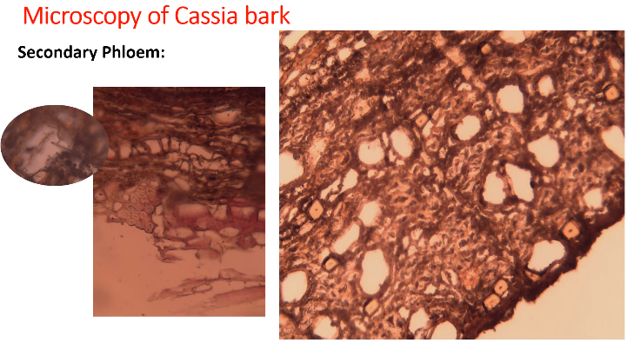
Medullary rays
Oil gland
Fibers
Acicular raphides - crystals needle shaped
17-09-2024
9

Slide 10
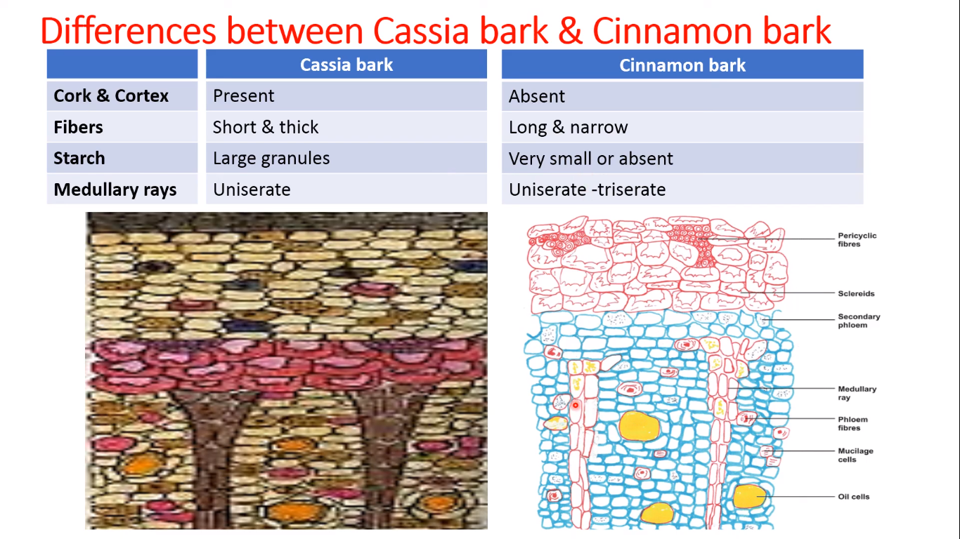
Three layer of medullary rays
Single ray
17-09-2024
10

Slide 11
Cassia –present
Cinnamon –cortex and periderm absent
17-09-2024
11

Slide 12
Difference between cassia bark and cinnamon bark
Topic | Cassia bark | Cinnamon bark
B.S | Cinnamomum cassia dried entire stem bark | Cinnamomum zeylanicum inner stem bark
Thickness | Thin | Thick
Shaped | Quill , channeled , curved | Compound quill , double quill , quill channeled , curved
Color | Blackish brown externally Reddish brown internally | Light brown red brown ext. Dark brown infernally

Slide 13
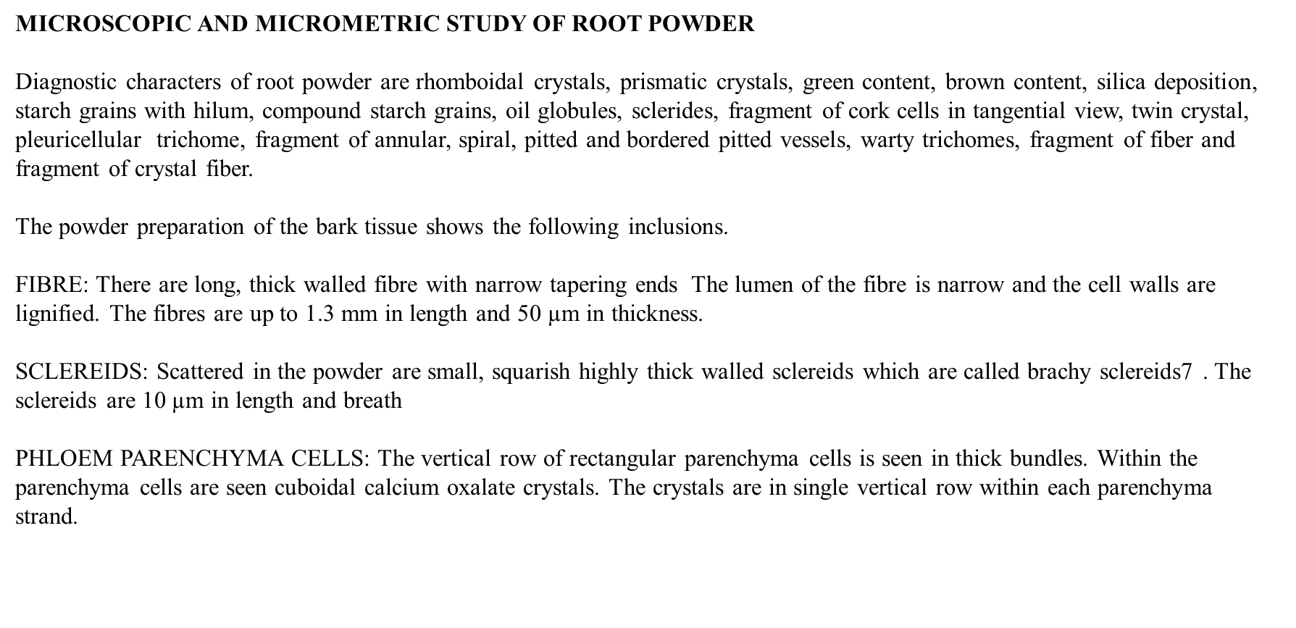

Slide 14
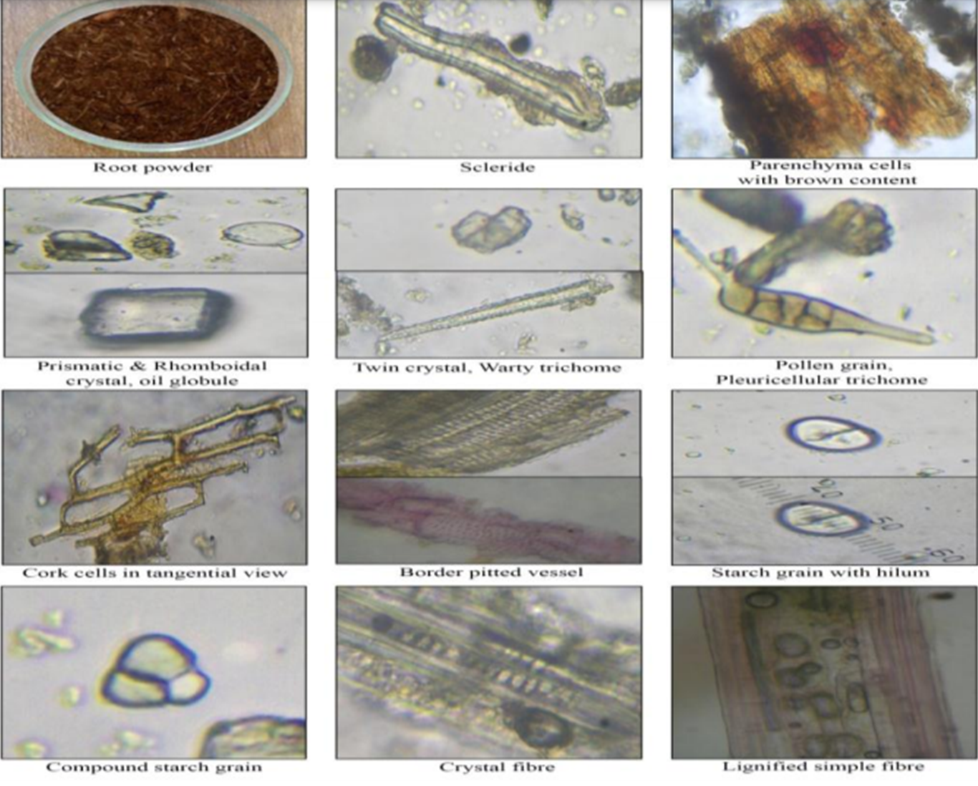

Slide 15
Fibers – lignified , tapering end length of 27 – 40 mm , narrow lumen
Starch grain – it is having hilum is present 10 – 20 micron in diameter
Cork cell – abundant in nature with the reddish brown matter
Trichrome – hairy like structure

Slide 16
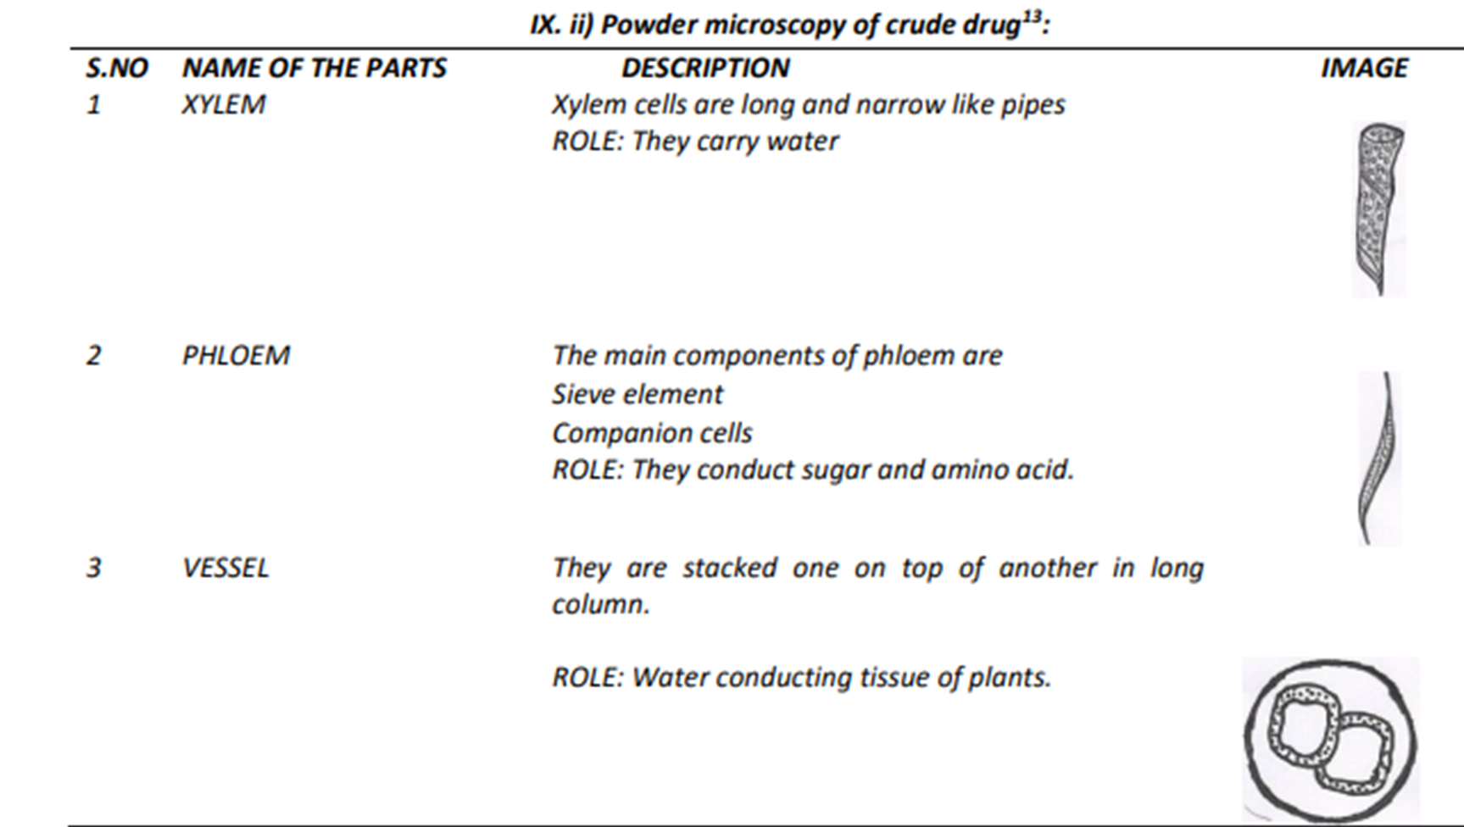
Very big pipe in nature
Preparation food , storage food materials

Slide 17
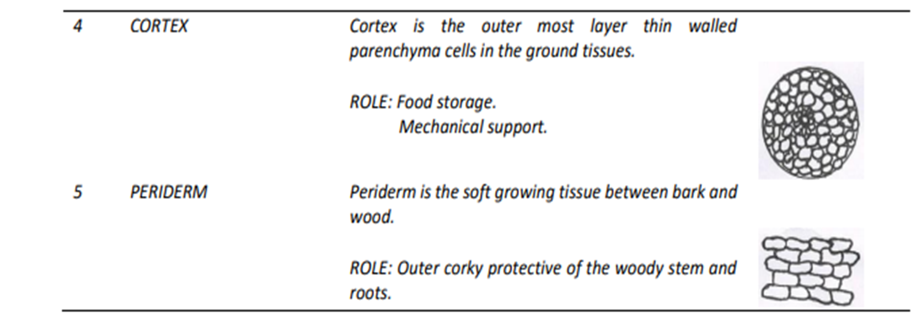

Slide 18
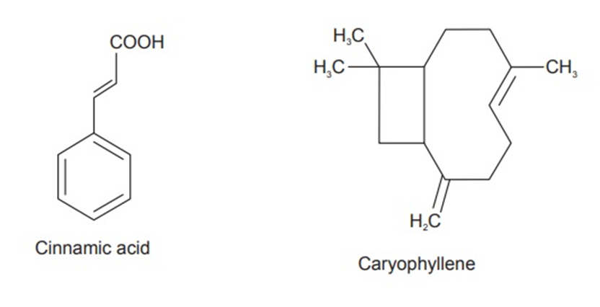
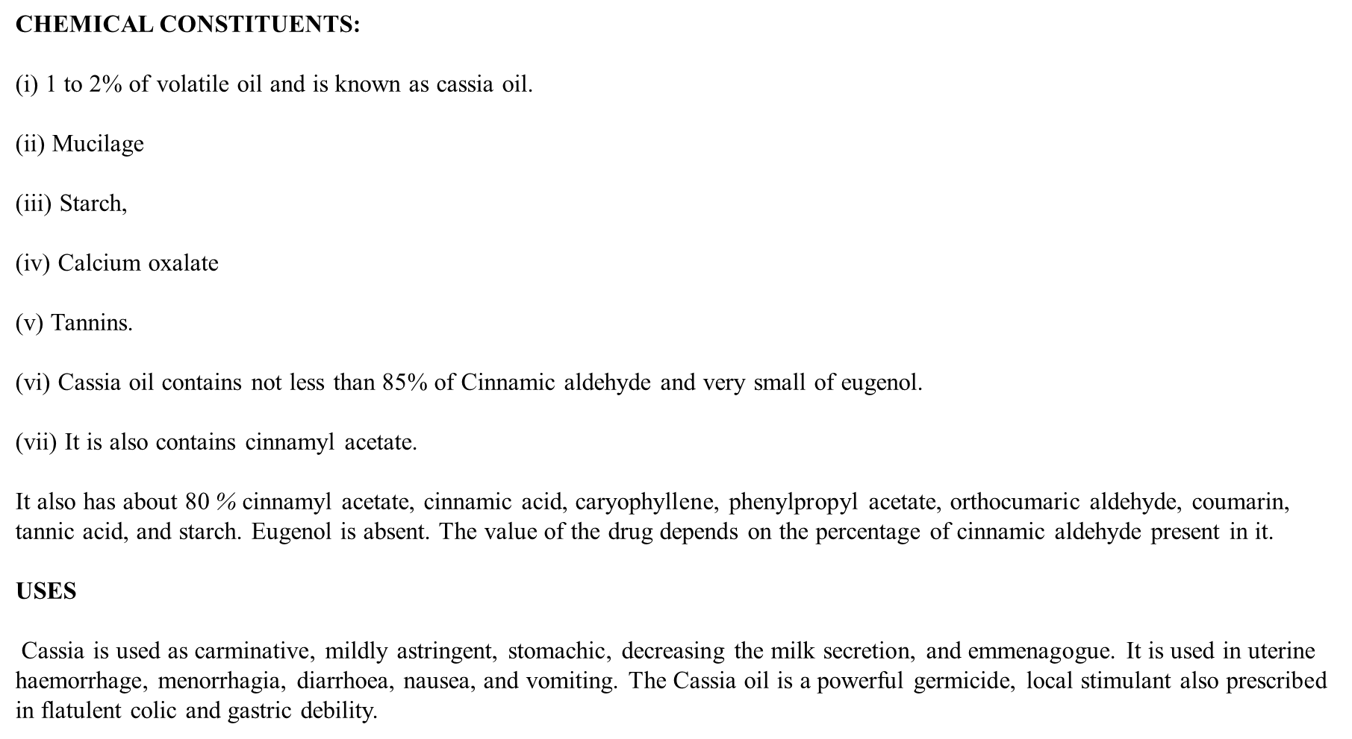
The value of drug function – responsible for odor , sweet test , flavour , germicide , plant metabolite
Cinnamic acid – role of the plant metabolite and presence of phenolic group
It is a acetate ester , it is responsible for fragrance and flavor
Odor
Crystalline substance presence of keto group

Slide 19
Carminative – excess of the gas
Germicide – to kill the germs

