Slide 1
BIOPHARMACEUTICS AND PHARMACOKINETICS
1. ABSORPTION OF DRUGS
14-09-2024
1

Slide 2
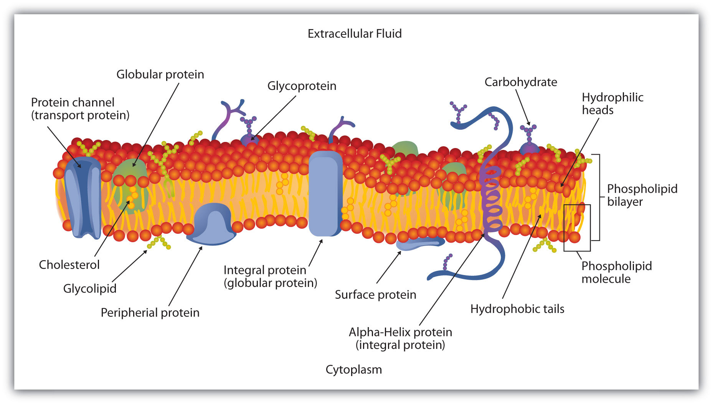
CELL MEMBRANE STRUCTURE
14-09-2024
2

Slide 3
A drug to be absorbed and distributed into organs and tissues and eliminated from the body, it must pass through one or more biological membranes/ barriers ar various locations. Such a movement of drug across membrane is called as drug transport
Definition: The cell membrane, also known as the plasma membrane, is a double layer of lipids and proteins that surrounds a cell. It separates the cytoplasm (the contents of the cell) from the external environment. It is a feature of all cells, both prokaryotic and eukaryotic.
The cell membrane (plasma membrane) is a thin semi-permeable membrane that surrounds the cytoplasm of a cell.
Its function is to protect the integrity of the interior of the cell by allowing certain substances into the cell while keeping other substances out.
Cell membrane consists of double layer of amphiphilic phospholipids molecules arranged in such away that their hydrocarbon chains are oriented inwards to form the hydrophobic or lipophilic phase and their polar heads oriented to form the outer and inner hydrophilic boundaries of the cellular membrane the face the surrounding aqueous environment
14-09-2024
3

Slide 4
Globular protein molecules are associated on either side of these hydrophilic boundaries . In shot the cell membrane is sandwich where a bimolecular layer of lipids is contained between two parallel monomolecular layers of proteins.
The hydrophobic core of the membrane is responsible for the relative impermeability of polar molecules.
Aqueous pores of 4 to 10 A in diameter are also present in the membrane , through which inorganic ions and small organic water soluble molecules like urea can pass.
In general bio membrane acts like a semi permeable barrier permitting rapid and limited passage of compounds while restricting that of others.
The cell membrane is primarily composed of a mix of proteins and lipids.
Depending on the membrane’s location and role in the body, lipids can make up anywhere from 20 to 80 percent of the membrane, with the remainder being proteins.
While lipids help to give membranes their flexibility, proteins monitor and maintain the cell's chemical climate and assist in the transfer of molecules across the membrane.
14-09-2024
4

Slide 5
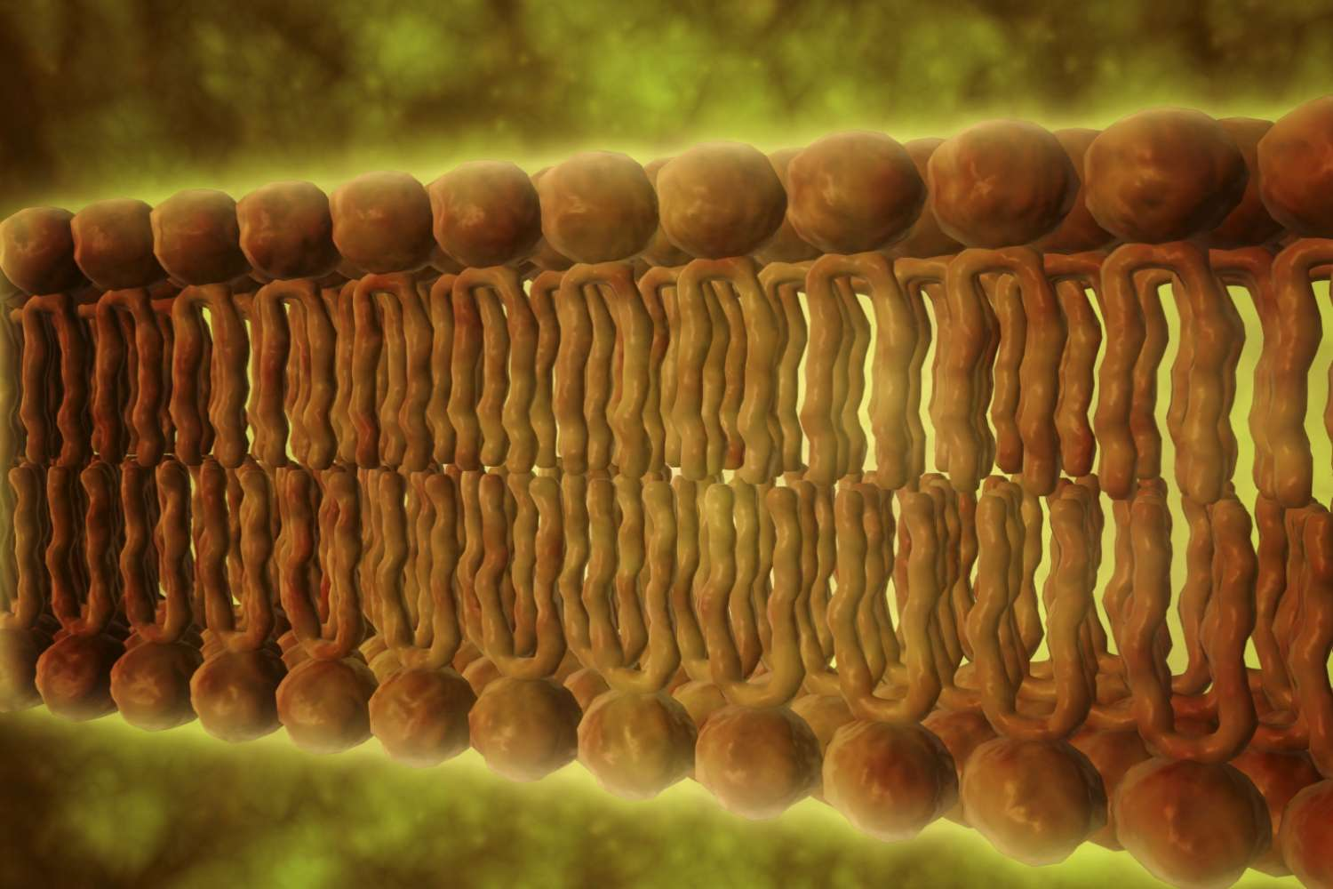
Cell Membrane Lipids
Phospholipids are a major component of cell membranes.
Phospholipids form a lipid bilayer in which their hydrophilic (attracted to water) head are as spontaneously arrange to face the aqueous intracellular fluid (ICF) and the extracellular fluid, while their hydrophobic (repelled by water) tail areas face away from the intracellular fluid (ICF) and extracellular fluid. The lipid bilayer is semi-permeable, allowing only certain molecules to diffuse across the membrane.
Cholesterol is another lipid component of animal cell membranes. Cholesterol molecules are selectively dispersed between membrane phospholipids. This helps to keep cell membranes from becoming stiff by preventing phospholipids from being too closely packed together. Cholesterol is not found in the membranes of plant cells.
Glycolipids are located on cell membrane surfaces and have a carbohydrate sugar chain attached to them. They help the cell to recognize other cells of the body.
14-09-2024
5

Slide 6
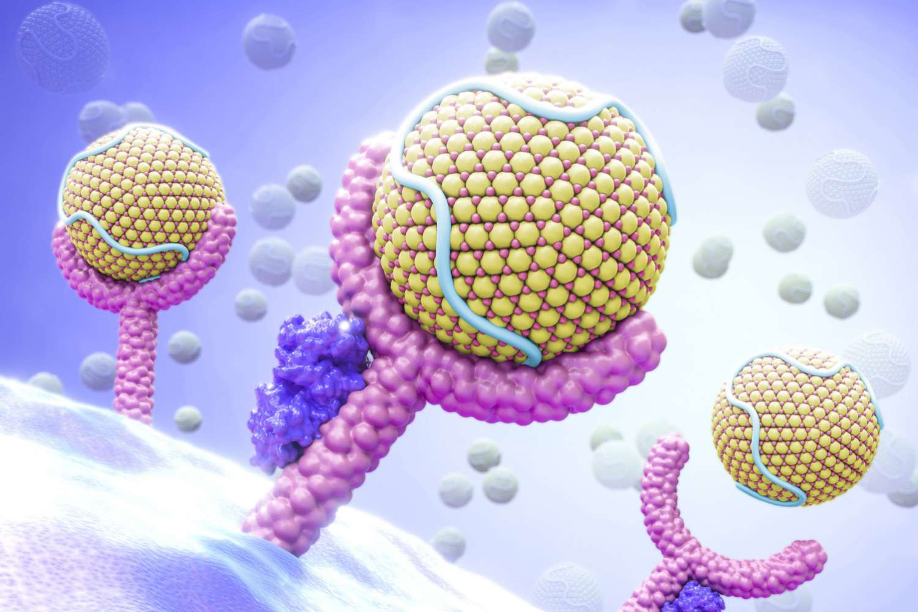
Cell Membrane Proteins
Contents of The cell membrane contains two types of associated proteins.
Peripheral membrane proteins are exterior to and connected to the membrane by interactions with other proteins.
Integral membrane proteins are inserted into the membrane and most pass through the membrane. Portions of these transmembrane proteins are exposed on both sides of the membrane.
Cell membrane proteins have a number of different functions.
1. Structural proteins help to give the cell support and shape.
2. Cell membrane receptor proteins help cells communicate with their external environment through the use of hormones, neurotransmitters, and other signaling molecules.
3. Transport proteins, such as globular proteins, transport molecules across cell membranes through facilitated diffusion.
4. Glycoproteins have a carbohydrate chain attached to them.
They are embedded in the cell membrane and help in cell to cell communications and molecule transport across the membrane.
14-09-2024
6

Slide 7
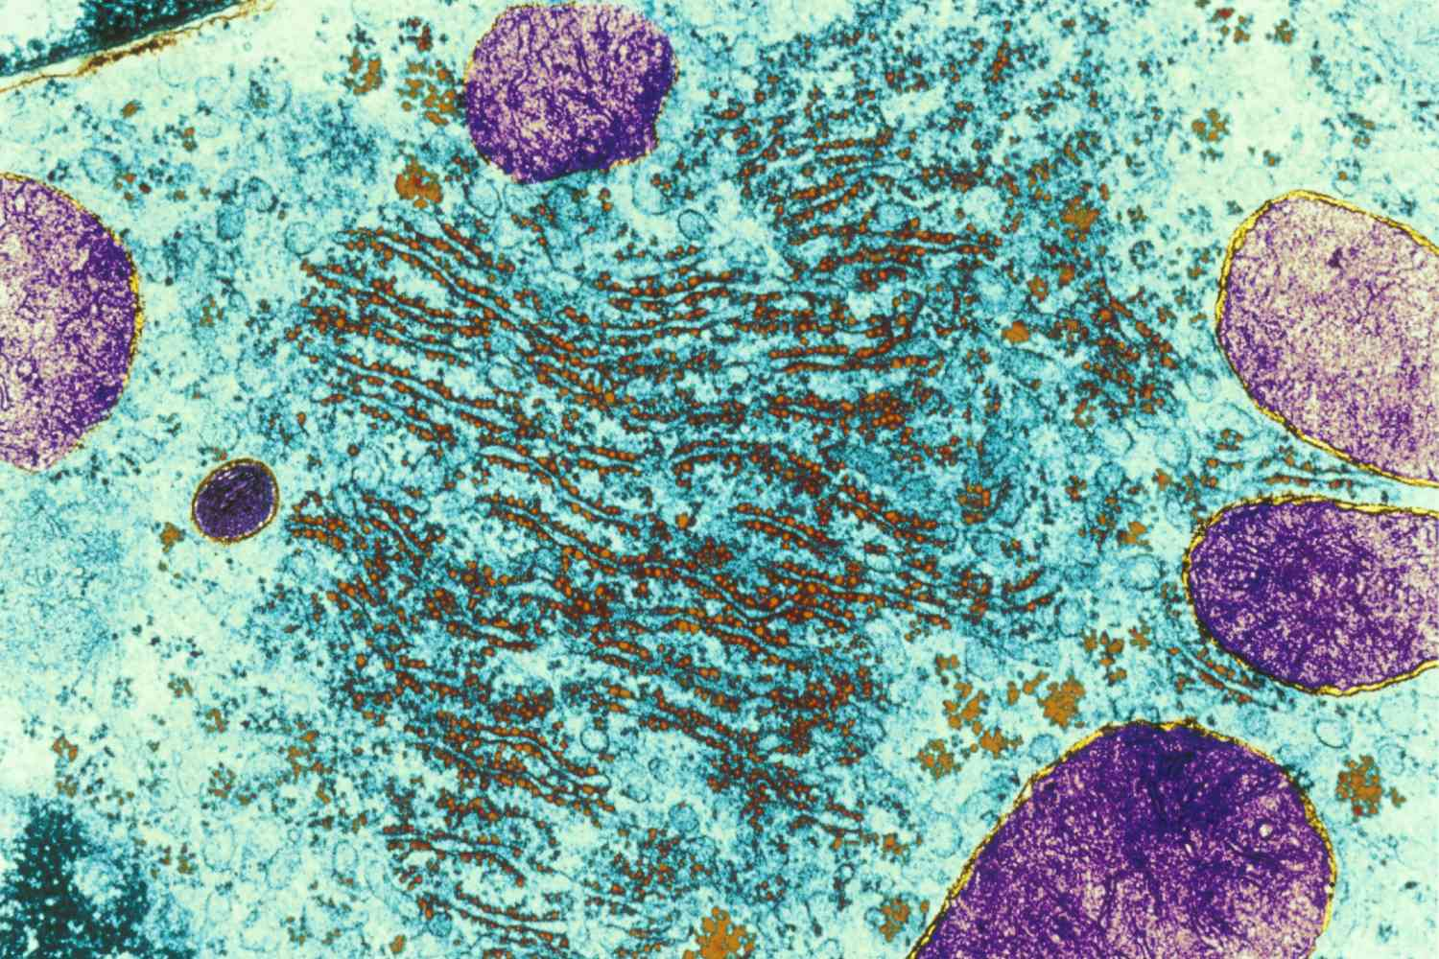
Organelle Membranes
Some cell organelles are also surrounded by protective membranes.
The nucleus, endoplasmic reticulum, vacuoles, lysosomes, and Golgi apparatus are examples of membrane-bound organelles.
Mitochondria and chloroplasts are bound by a double membrane.
The membranes of the different organelles vary in molecular composition and are well suited for the functions they perform.
Organelle membranes are important to several vital cell functions including protein synthesis, lipid production, and cellular respiration.
14-09-2024
7

Slide 8
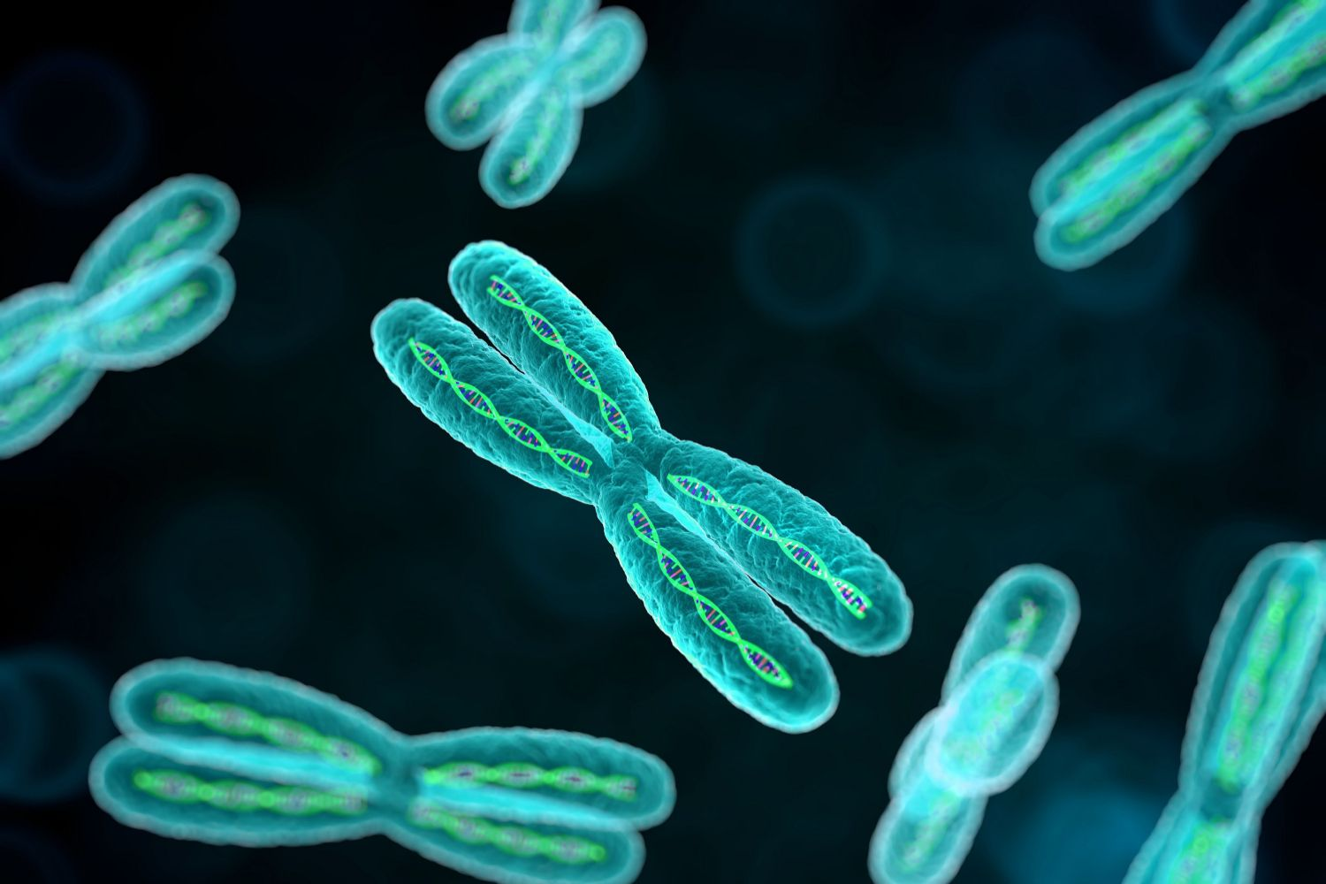
Eukaryotic Cell Structures
The cell membrane is only one component of a cell.
The following cell structures also be found in a typical animal eukaryotic cell:
Centrioles—help to organize the assembly of microtubules.
Chromosomes—house cellular DNA.
Cilia and Flagella—aid in cellular locomotion.
Endoplasmic Reticulum—synthesizes carbohydrates and lipids.
Golgi Apparatus—manufactures, stores and ships certain cellular products.
Lysosomes—digest cellular macromolecules.
Mitochondria—provide energy for the cell.
Nucleus—controls cell growth and reproduction.
Peroxisomes—detoxify alcohol, form bile acid, and use oxygen to break down fats.
Ribosomes—responsible for protein production via translation
14-09-2024
8

Slide 9
Function of the Cell Membrane
The cell membrane gives the cell its structure and regulates the materials that enter and leave the cell.
It is a selectively permeable barrier, meaning it allows some substances to cross, but not others.
Like a drawbridge intended to protect a castle and keep out enemies, the cell membrane only allows certain molecules to enter or exit.
Crossing the Membrane
Small molecules, such as oxygen, which cells need in order to carry out metabolic functions such as cellular respiration, and carbon dioxide, a byproduct of these functions, can easily enter and exit through the membrane.
Water can also freely cross the membrane, although it does so at a slower rate.
However, highly charged molecules, like ions, cannot directly pass through, nor can large macromolecules like carbohydrates or amino acids.
Instead, these molecules must pass through proteins that are embedded in the membrane.
In this way, the cell can control the rate of diffusion of these substances.
14-09-2024
9

Slide 10
Another way the cell membrane can bring molecules into the cytoplasm is through endocytosis.
The reverse process, where the cell delivers contents outside the membrane barrier, is called exocytosis.
Endocytosis includes phagocytosis (“cell eating”) and pinocytosis (“cell drinking”).
During these processes, the cell membrane forms a depression, surrounding the particle that it is engulfing.
It then “pinches off” to form a small sphere of membrane called a vesicle that contains the molecule and transports it to wherever it will be used in the cell.
Large molecules can be taken into the cell through the process of endocytosis.
Cells can also deliver substances across the cell membrane to the external environment through exocytosis, which is the opposite of endocytosis.
During exocytosis, vesicles form in the cytoplasm and move to the surface of the cell membrane.
Here, they merge with the membrane and release their contents to the outside of the cell.
Exocytosis removes the cell’s waste products, which are the parts of molecules that are not used by the cell, including old organelles.
14-09-2024
10

Slide 11
Signaling at the Cell Membrane
The cell membrane also plays an important role in cell signaling and communication.
The membrane contains several embedded proteins that can bind molecules found outside of the cell and pass on messages to the inside of the cell
Importantly, these receptor proteins on the cell membrane can bind to substances produced by other areas of the body, such as hormones.
When a molecule binds to its target receptor on the membrane, it initiates a signal transduction pathway inside the cell that transmits the signal to the appropriate molecules.
As a result of these often complex signaling pathways, the cell can perform the action specified by the signaling molecule, such as making or stopping the production of a certain protein.
14-09-2024
11

