Slide 1
HOSPITAL PHARMACY
CENTRAL STERILE SUPPLY SERVICES
16-09-2024
1

Slide 2
INTRODUCTION: The central sterile services department (CSSD), also called sterile processing department (SPD), central supply department (CSD),is an integrated place in hospitals and other health care facilities that performs sterilization and other actions on medical devices, equipment and consumables.
Each of these has equipments in place in order to perform specific functions towards sterilization of articles for immediate use in patient care.
Definition : The Central Sterile Supply Department (CSSD) is the service responsible for receiving, storing, processing, distributing and controlling the professional supplies and equipments(both sterile and non sterile) for all user unit of hospital for the care and safety of patient under strict quality control.
16-09-2024
2

Slide 3
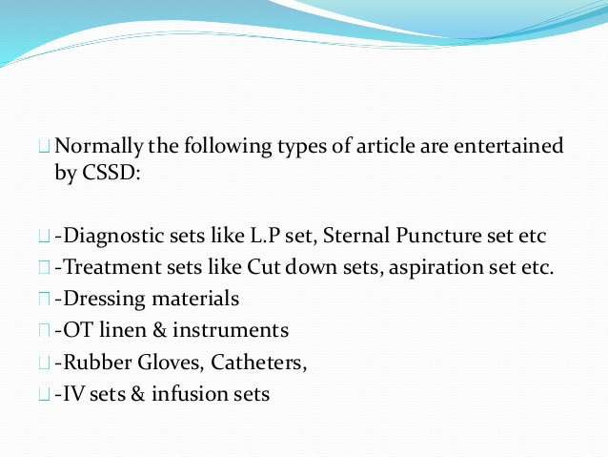
It is an important facility of hospital that supplies sterile instruments and materials for dressing and procedures carried out in ward and other departments of hospital.
CSSD has a great role in reducing Hospital Acquired Infection (HAI)
16-09-2024
3

Slide 4
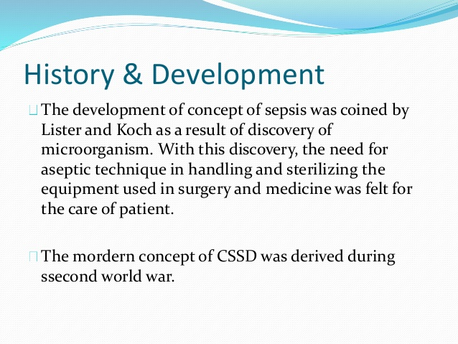
16-09-2024
4

Slide 5
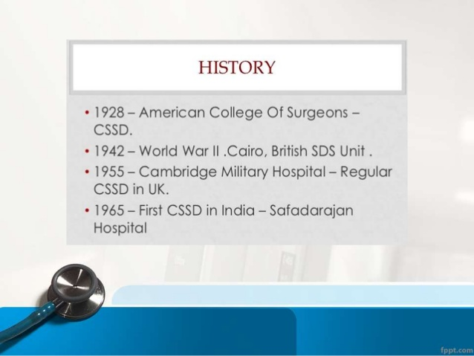
16-09-2024
5

Slide 6
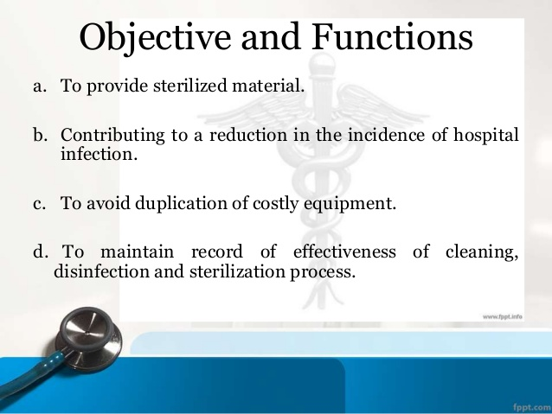
16-09-2024
6

Slide 7
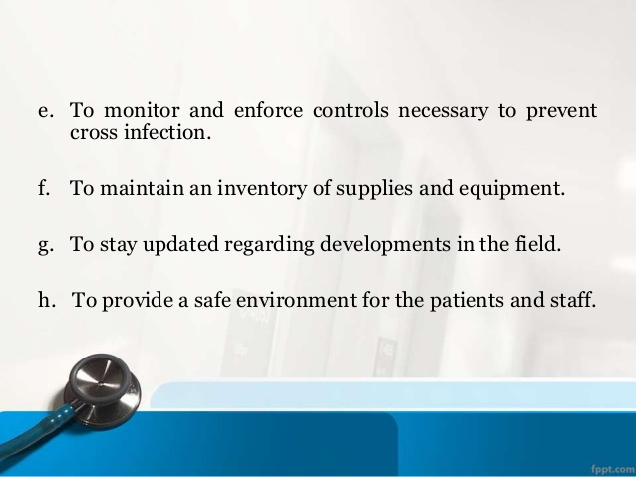
16-09-2024
7

Slide 8
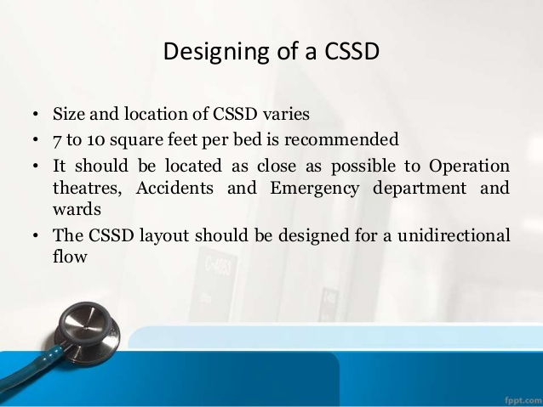
16-09-2024
8

Slide 9
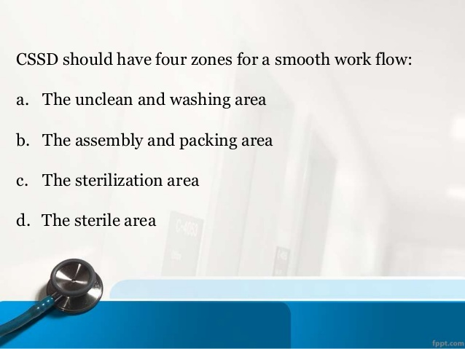
16-09-2024
9

Slide 10
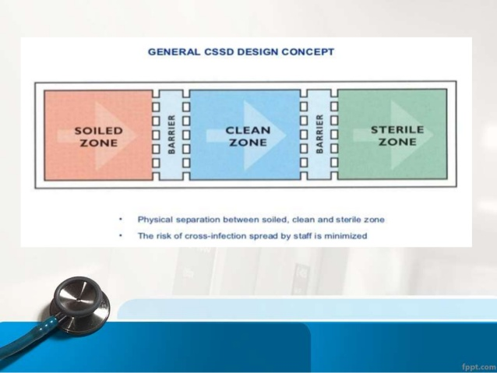
16-09-2024
10

Slide 11
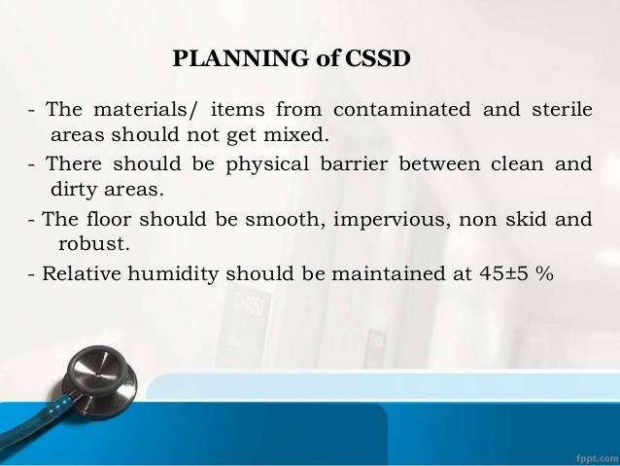
16-09-2024
11

Slide 12
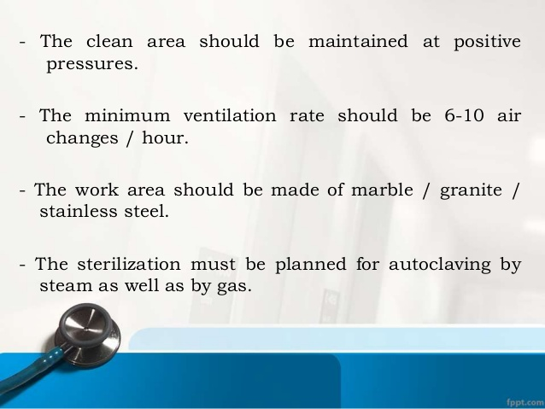
16-09-2024
12

Slide 13
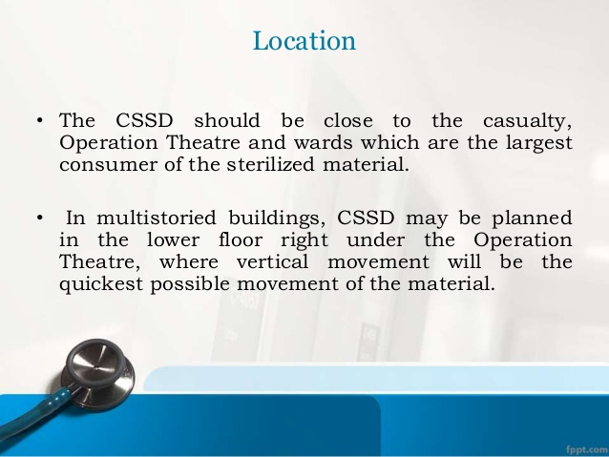
16-09-2024
13

Slide 14
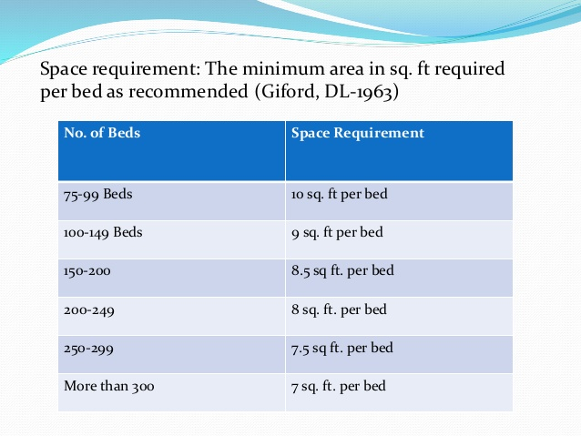
16-09-2024
14

Slide 15
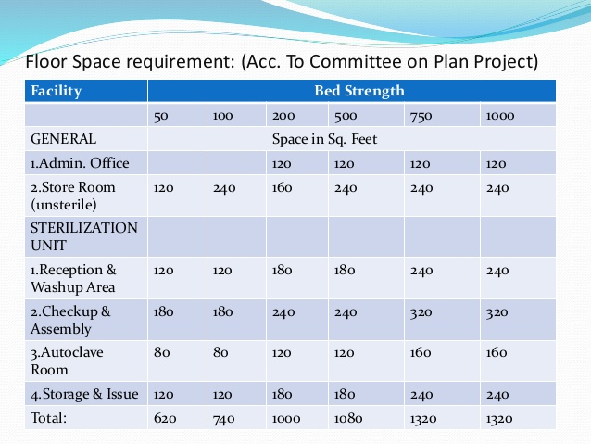
16-09-2024
15

Slide 16
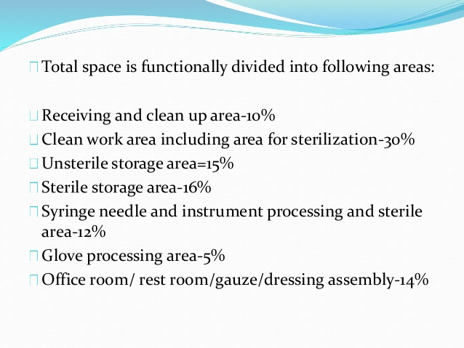
16-09-2024
16

Slide 17
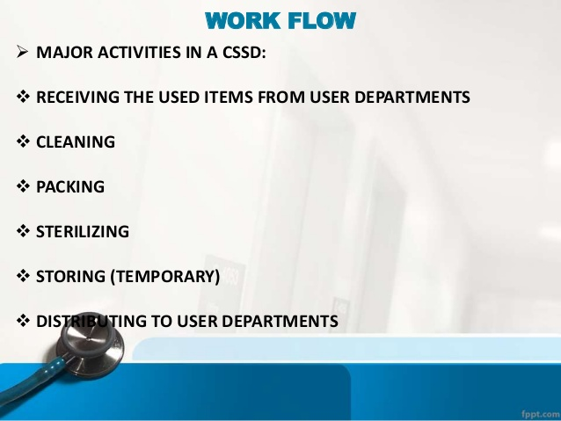
16-09-2024
17

Slide 18
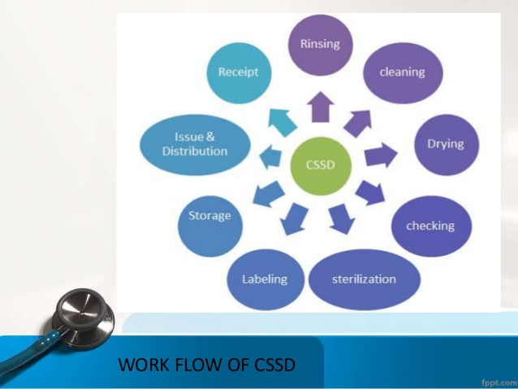
16-09-2024
18

Slide 19
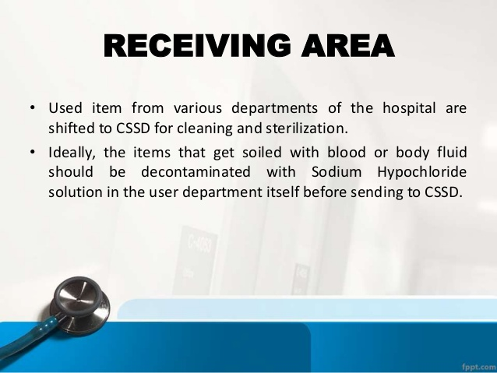
16-09-2024
19

Slide 20
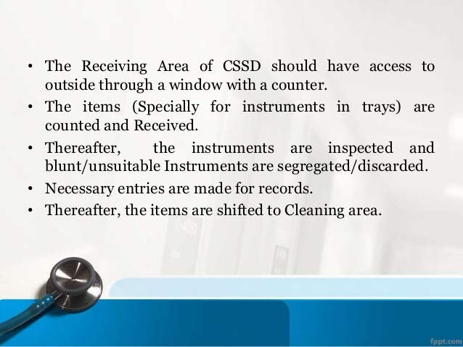
16-09-2024
20

Slide 21
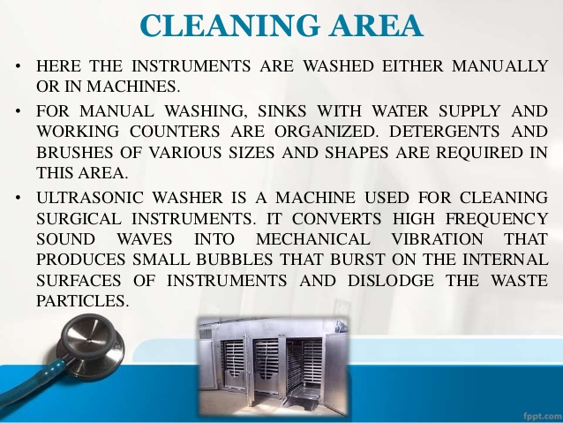
16-09-2024
21

Slide 22
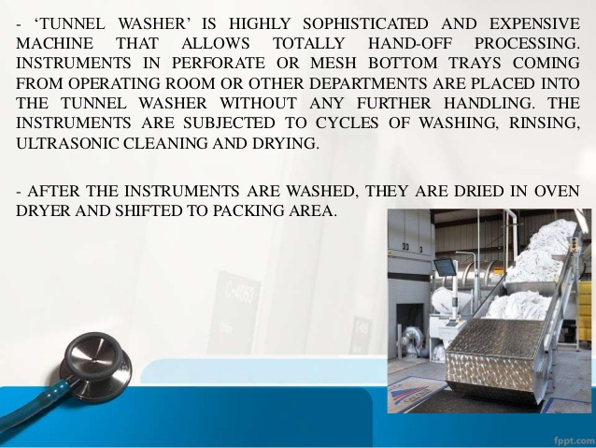
16-09-2024
22

Slide 23
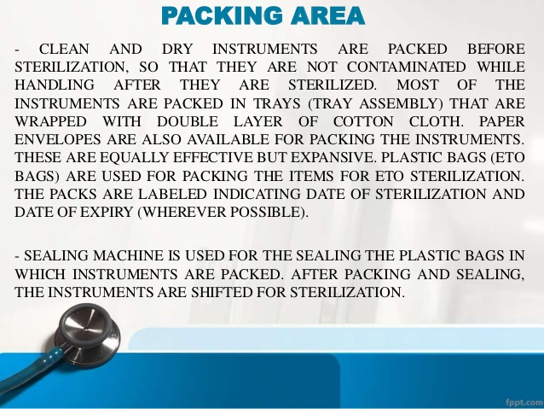
16-09-2024
23

Slide 24
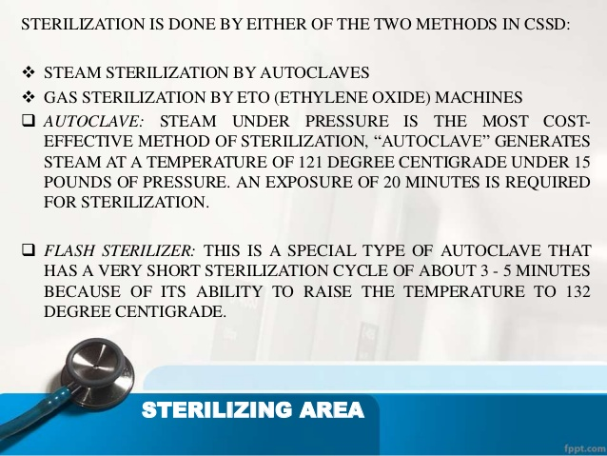
16-09-2024
24

Slide 25
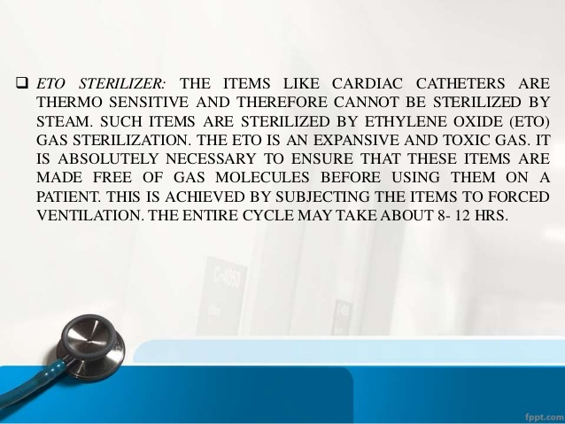
16-09-2024
25

Slide 26
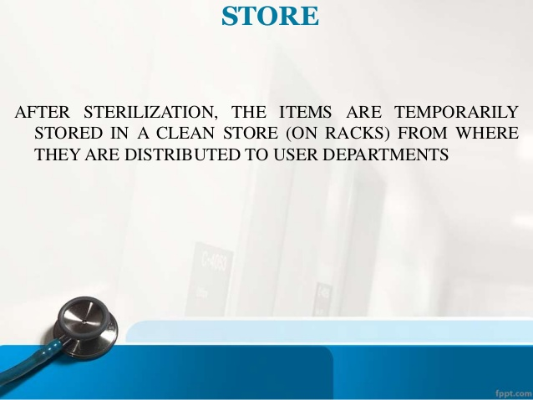
16-09-2024
26

Slide 27
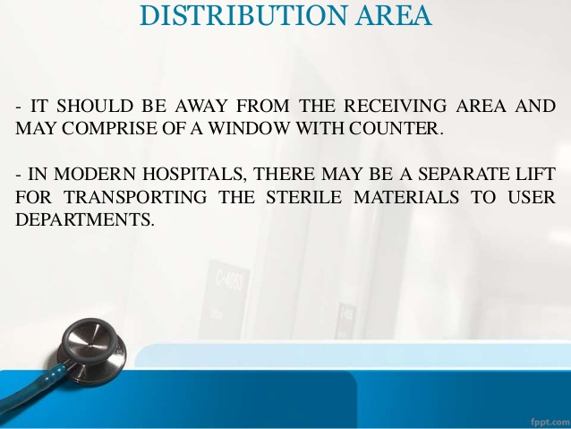
16-09-2024
27

Slide 28
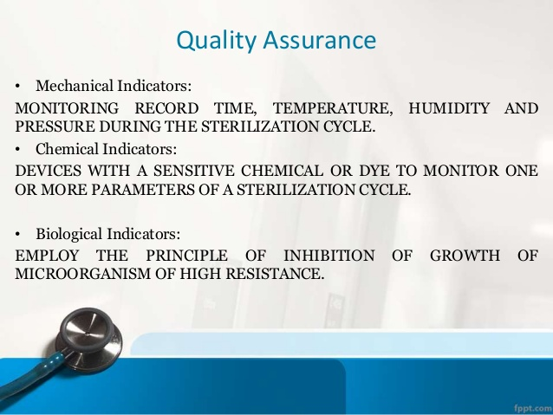
16-09-2024
28

Slide 29
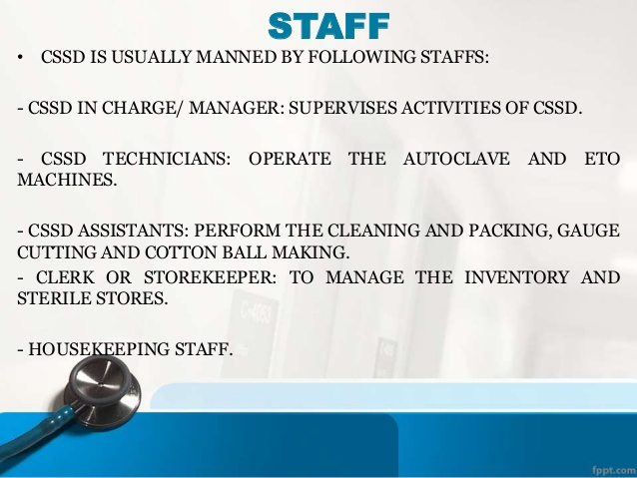
16-09-2024
29

Slide 30
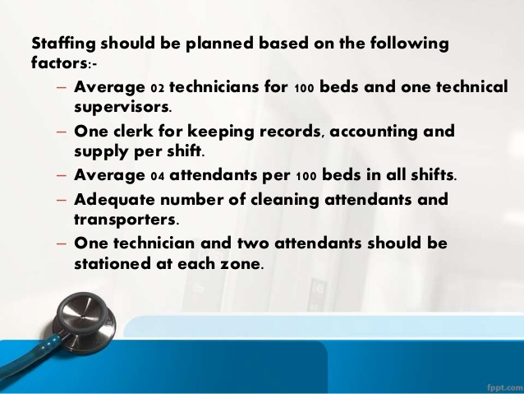
16-09-2024
30

Slide 31
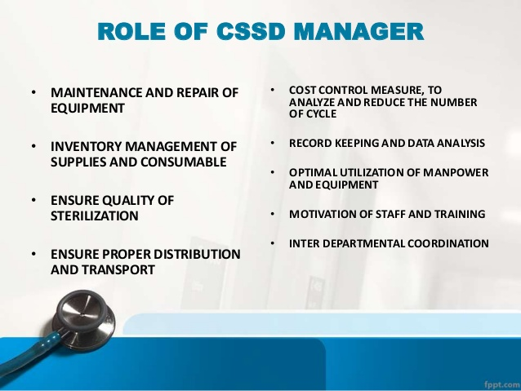
16-09-2024
31

Slide 32
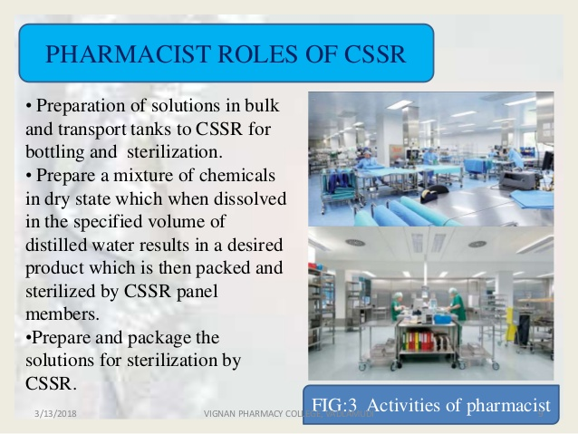
16-09-2024
32

Slide 33
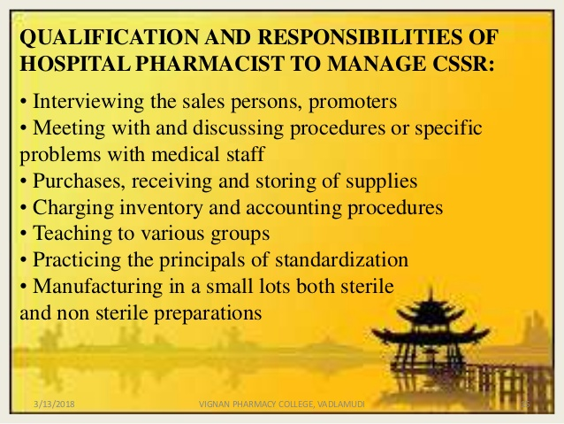
16-09-2024
33

