Slide 1
PHARMACEUTICAL MICROBIOLOGY
UNIT 3 - Nutritional requirements, growth and cultivation of bacteria and virus. Study of different important media required for the growth of aerobic and anaerobic bacteria & fungi. Differential media, enriched media and selective media, maintenance of lab cultures
08-09-2024
1

Slide 2
NUTRIENT REQUIREMENTS OF BACTERIA
Bacteria are prokaryotic organisms that do not contain chlorophyll.
They are unicellular and do not show true branching.
They differ from eukaryotes in not having a nuclear membrane, a nucleolus, and cell organelles like mitochondria, golgi apparatus and endoplasmic reticulum.
They have a single circular chromosome
Interestingly, the microbial cell represents an extremely complex entity, which is essentially comprised of approximately 70% of by its weight as water, and the remaining 30% by its weight as the solid components.
Besides, the two major gaseous constituents viz., oxygen (O2) and hydrogen (H2) themicrobial cell predominantly consists of four other major elements, namely : Carbon (C), nitrogen (N), sulphur (S), and phosphorus (P).
In fact, the six aforesaid constituents almost account for 95% of the ensuing cellular dry weight. The various other elements that also present but in relatively much lesser quantum are :
Na+, K+, Ca2+, Mg2+, Mn2+, Co2+, Zn2+, Cu2+, Fe3+ and Mo4+.
Based on these critical observations and findings one may infer that the microorganisms significantly require an exceptionally large number of elements for its adequate survival as well as growth (i.e., cultivation).
08-09-2024
2

Slide 3
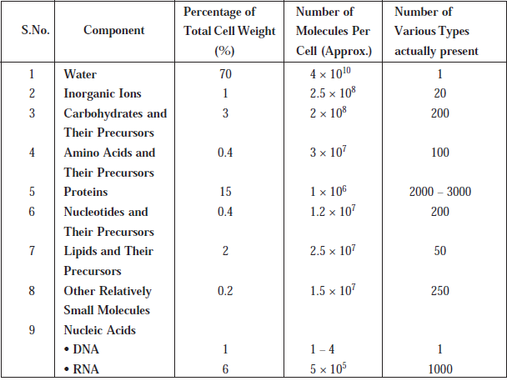
Chemical Composition of an E. coli Cell
08-09-2024
3

Slide 4
Bacteria can be classified nutritionally based on their energy requirements and on their ability to synthesize essential metabolites. Bacteria which derive energy from sunlight are called phototrophs.
Those that obtain energy from chemical reactions are called chemotrophs.
Bacteria that can synthesize all their organic compounds are called autotrophs.
They are able to use atmospheric carbon dioxide and nitrogen, capable of independent existence in water and soil. They are of no medical importance. Some bacteria are unable to synthesize their own metabolites.
They depend on preformed organic compounds. They are called heterotrophs. These bacteria are unable to grow with carbon dioxide as the sole source of carbon. Their nutritional requirements vary widely. Some may require only a single organic substance like glucose.
Others may need a large number of different compounds like amino acids, nucleotides, lipids, carbohydrates and coenzymes. Bacteria require a supply of inorganic salts. They require anions like phosphate and sulphate anions and cations like sodium, potassium, magnesium, iron and calcium.
Some ions like cobalt may be required in trace amounts. Some bacteria require certain organic compounds in minute quantities. These are called growth factors or bacterial vitamins. Growth factors are called essential when growth does not occur in their absence. Accessory growth factors are those which enhance growth without being absolutely necessary for it. In many cases, bacterial vitamins are same as vitamins necessary for nutrition of mammals, for example, B group vitamins – thiamine, riboflavin, pyridoxine, nicotinic acid, folic acid and vitamin B12
08-09-2024
4

Slide 5
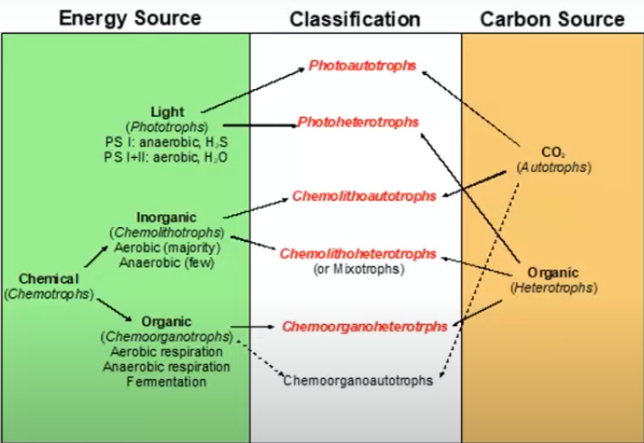
08-09-2024
5

Slide 6
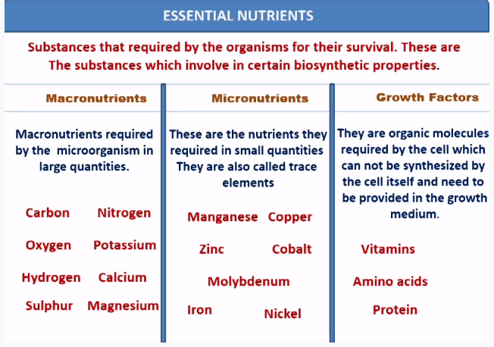
08-09-2024
6

Slide 7
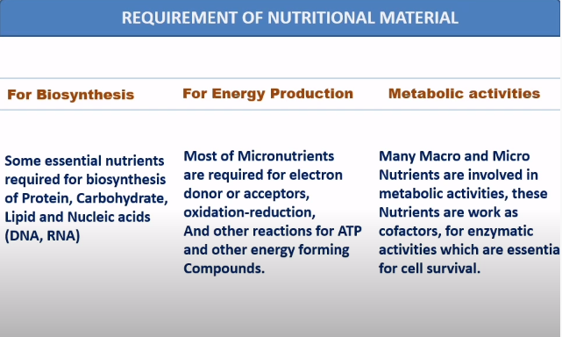
08-09-2024
7

Slide 8
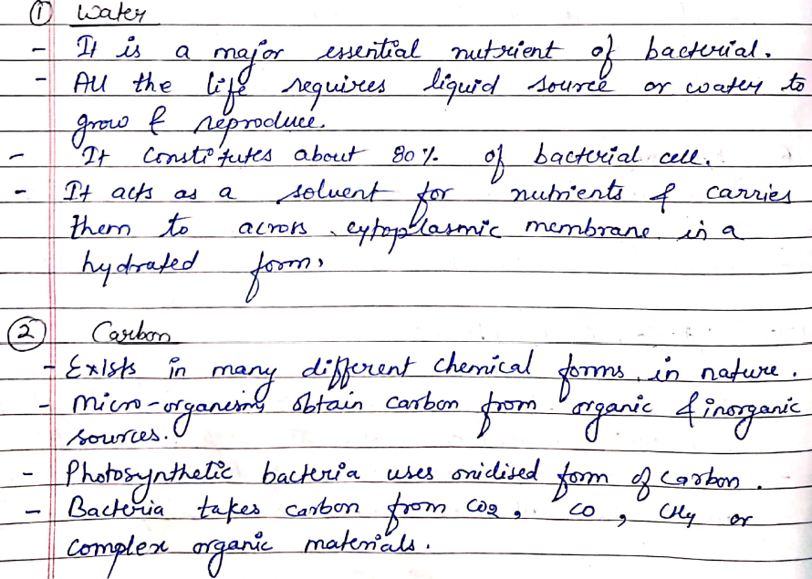
08-09-2024
8

Slide 9
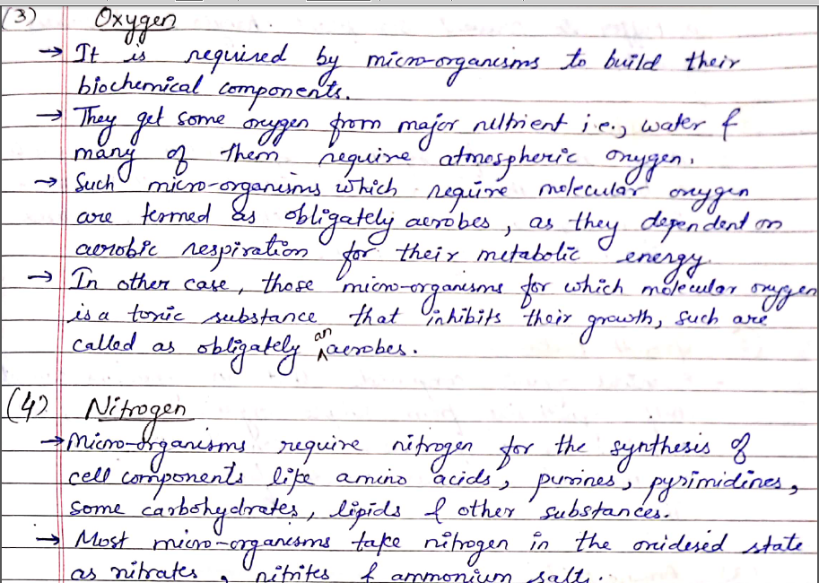
08-09-2024
9

Slide 10
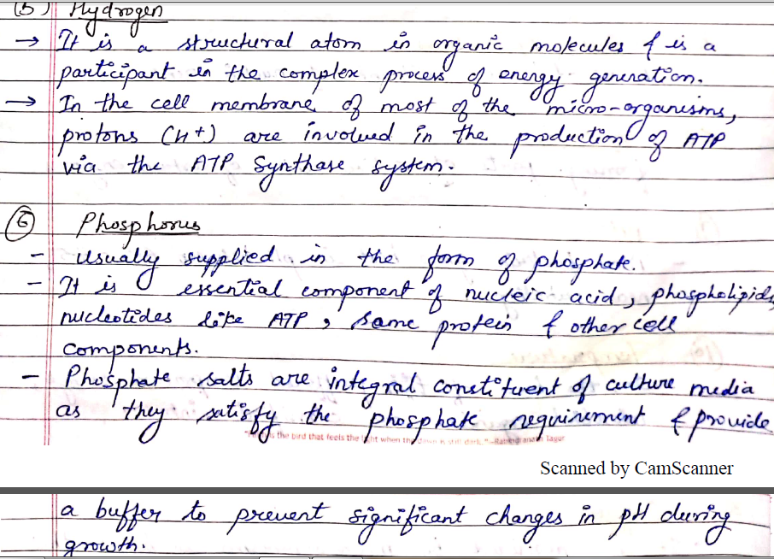
08-09-2024
10

Slide 11
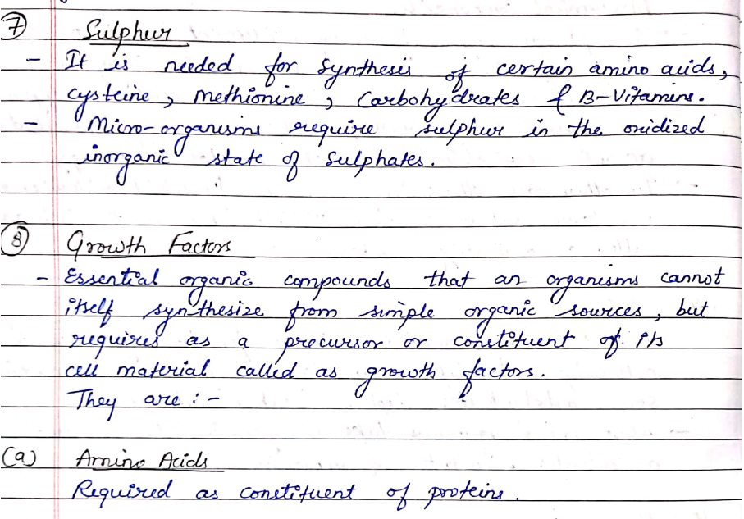
08-09-2024
11

Slide 12
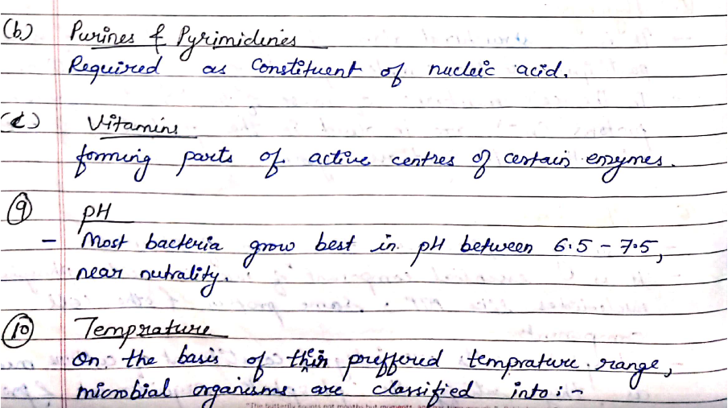
08-09-2024
12

Slide 13
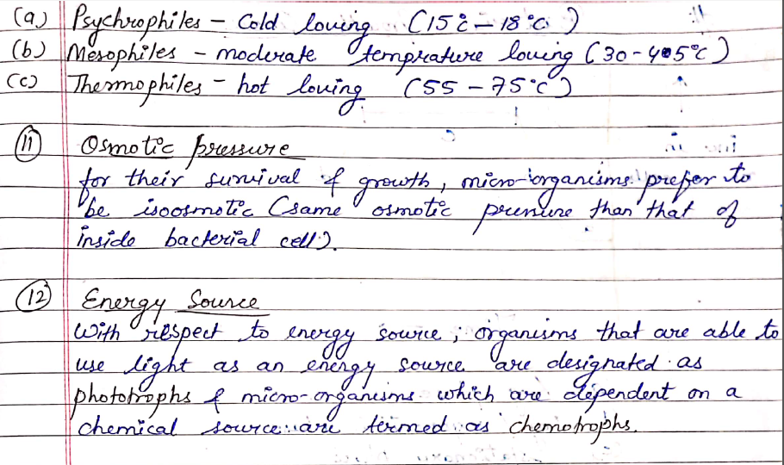
08-09-2024
13

Slide 14
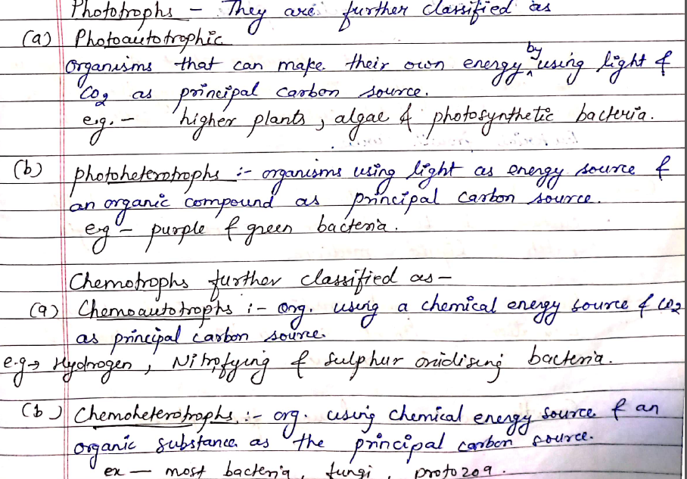
08-09-2024
14

Slide 15
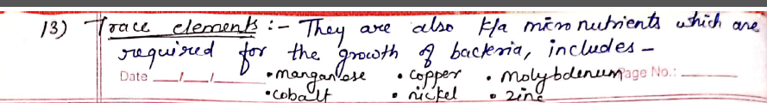
08-09-2024
15

Slide 16
CULTIVATION (GROWTH) OF BACTERIA
The cultivation (growth) of bacteria may be defined, as — ‘a systematic progressive increase in the cellular components’. Nevertheless, an appreciable enhancement in ‘mass’ exclusively may not always reflect the element of growth because bacteria at certain specific instances may accumulate enough mass without a corresponding increment in the actual cell number. In the latest scenario the terms ‘balanced growth’ has been introduced which essentially draws a line between the so called ‘orderly growth’ and the ‘disorderly growth’.
Importantly, one may describe the pattern of normal growth curve (or growth cycle) of microorganisms by having an assumption that a ‘single microorganism’ after being carefully inoculated into a sterilized flask of liquid culture medium aseptically which is incubated subsequently for its apparent desired growth in due course of time. At this point in time the very ‘seeded bacterium’ would have a tendency to undergo ‘binary fission’ thereby safely plunging into an era of rapid growth and development whereby the bacterial cells shall undergo ‘multiplication in an exponential manner’.
Thus, during the said span of rapid growth, if one takes into consideration the theoretical number of microorganisms that must be present at different intervals of time, and finally plot the data thus generated in the following two ways, namely :
(a) Logarithm of number of microorganisms, and
(b) Arithmetic number of microorganisms Vs time.
08-09-2024
16

Slide 17
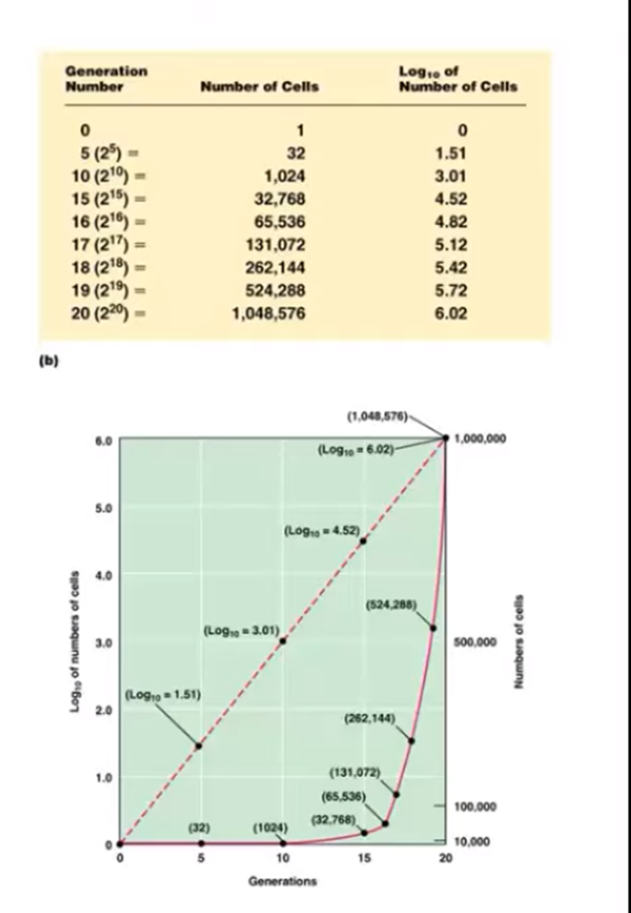
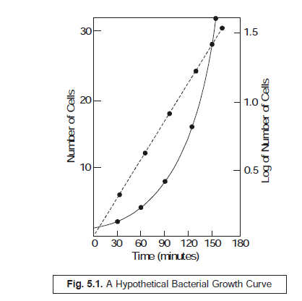
08-09-2024
17

Slide 18
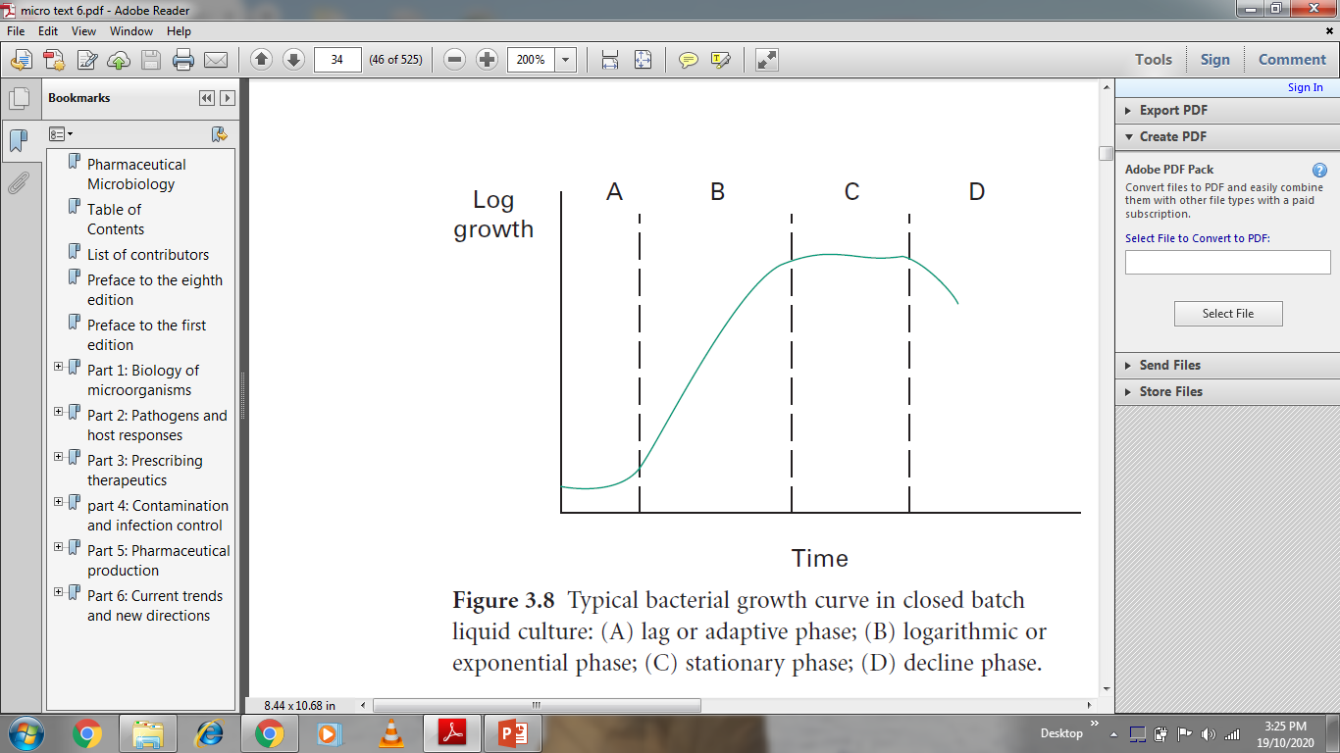
BACTERIAL GROWTH CURVE - write this diagram
08-09-2024
18

Slide 19
BACTERIAL GROWTH CURVE / CYCLE
In actual practice, however, when one carefully inoculates a fresh-sterilized culture medium with a stipulated number of cells, subsequently finds out the ensuing bacterial population intermittently
under the following two experimental parameters :
(a) during an incubation period of 24 hours, and
(b) plot the curve between logarithms of the number of available microbial cells Vs time (in minutes),
Curve A : Lag Phase ;
Curve B : Exponential Phase or Log (Logarithmic) Phase ;
Curve C : Stationary Phase ;
Curve D : Death (or Decline) Phase.
From figure one may distinctly observe the following salient features :
• Lag Phase — i.e., at initial stages there exist almost little growth of bacteria,
• Exponential (or Log) Phase — i.e., showing a rather rapid growth,
• Stationary Phase — i.e., depicting clearly a levelling off growth of microbes, and
• Death (or Decline) Phase — i.e., showing a clear cut decline in the viable population of
microorganisms.
08-09-2024
19

Slide 20
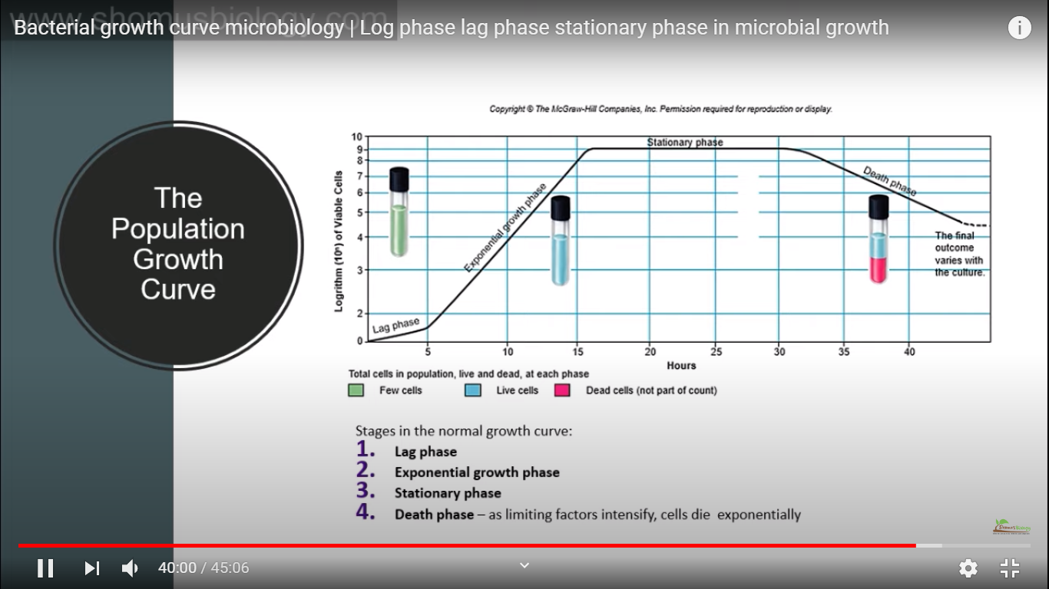
08-09-2024
20

Slide 21
LAG PHASE:
After a liquid culture broth is inoculated, the multiplication of bacteria does not start immediately. It takes some time to multiply.
The time between inoculation and beginning of multiplication is known as lag phase.
In this phase, the inoculated bacteria become acclimatized to the environment, switch on various enzymes, and adjust to the environmental temperature and atmospheric conditions.
During this phase, there is an increase in size of bacteria but no appreciable increase in number of bacterial cells. The cells are active metabolically.
The duration of the lag phase varies with the bacterial species, nature of culture medium, incubation temperature, etc.
It may vary from 1 hour to several days.
This initial phase is characterized by cellular activity but not growth. A small group of cells are placed in a nutrient rich medium that allows them to synthesize proteins and other molecules necessary for replication.
These cells increase in size, but no cell division occurs in the phase
08-09-2024
21

Slide 22
2. LOG PHASE
This phase is characterized by rapid exponential cell growth (i.e., 1 to 2 to 4 to 8 and so on).
The bacterial population doubles during every generation. They multiply at their maximum rate.
The bacterial cells are small and uniformly stained.
The microbes are sensitive to adverse conditions, such as antibiotics and other antimicrobial agents.
Growth rate is the greatest during the log phase.
The log phase is always brief, unless the rapidly dividing culture is maintained by constant addition of nutrients and frequent removal of waste products.
When plotted on logarithmic graph paper, the log phase appears as a steeply sloped straight line.
08-09-2024
22

Slide 23
3. STATIONARY PHASE:
After log phase, the bacterial growth almost stops completely due to lack of essential nutrients, lack of water oxygen, change in pH of the medium, etc. and accumulation of their own toxic metabolic wastes.
It is during this phase that the culture is at its greatest population density.
However, Death rate of bacteria exceeds the rate of replication of bacteria.
Endospores start forming during this stage.
Bacteria become Gram variable and show irregular staining.
Many bacteria start producing exotoxins.
Eventually, the population growth experienced in the log phase begins to decline as the available nutrients become depleted and waste products start to accumulate. Bacterial cell growth reaches a plateau, or stationary phase, where the number of dividing cells equal the number of dying cells. This results in no overall population growth. Under the less favorable conditions, competition for nutrients increases and the cells become less metabolically active. Spore forming bacteria produce endospores in this phase and pathogenic bacteria begin to generate substances (virulence factors) that help them survive harsh conditions and consequently cause disease.
08-09-2024
23

Slide 24
4. DECLINE PHASE:
During this phase, the bacterial population declines due to death of cells. The decline phase starts due to,
(a) accumulation of toxic products and autolytic enzymes (b) exhaustion of nutrients.
Involution forms are common in this stage. Some cells assume various shapes, becoming long, filamentous rods or branching or globular forms that are difficult to identify. Some develop without a cell wall and are referred to as protoplasts, spheroplasts, or L-phase variants (L-forms). When these involuted forms are inoculated into a fresh nutrient medium, they usually revert to the original shape of the healthy bacteria.
As nutrients become less available and waste products increase, the number of dying cells continues to rise.
In the death phase, the number of living cells decreases exponentially and population growth experiences a sharp decline. As dying cells lyse or break open, they spill their contents into the environment making these nutrients available to other bacteria.
This helps spore producing bacteria to survive long enough for spore production.
Spores are able to survive the harsh conditions of the death phase and become growing bacteria when placed in an environment that supports life.
08-09-2024
24

Slide 25
SIGNIFICANCE OF THE BACTERIAL GROWTH CURVE
The study of bacterial growth curves is important when aiming to utilize or inoculate known numbers of the bacterial isolate, for example to enhance plant growth, increase biodegradation of toxic organics, or produce antibiotics or other natural products at an industrial scale.
Knowledge of bacterial growth kinetics and bacterial numbers in a culture medium is important from both a research and commercial point of view.
Growth kinetics is also useful for assessing whether particular strains of bacteria are adapted to metabolize certain substrates, such as industrial waste or oil pollution.
Bacteria that are genetically engineered to clean up oil spills, for example, can be grown in the presence of complex hydrocarbons to ensure that their growth would not be repressed by the toxic effects of oil.( NOT VERY IMP)
Similarly, the slope and shape of growth curves produced from bacteria grown with mixtures of industrial waste products can inform scientists whether the bacteria can metabolize the particular substance, and how many potential energy sources for the bacteria can be found in the waste mixture.
08-09-2024
25

Slide 26
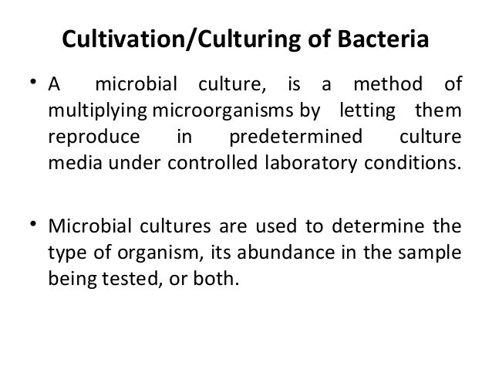
CULTIVATION OF BACTERIA
Although most bacteria are able to multiply in nature under a large variety of conditions, a detailed study of their activity is only possible by the examination of the growth characteristics in artificial media. In the majority of instances the nutritional needs
of the bacteria are not very specialized, but some parasitic members are very exacting in their requirements.
Even these, however, usually display considerable adaptability; on first isolation from the tissues some grow very poorly, but after several sub-cultures they gradually adapt themselves to the new conditions and growth occurs in a wider range of media.
08-09-2024
26

Slide 27
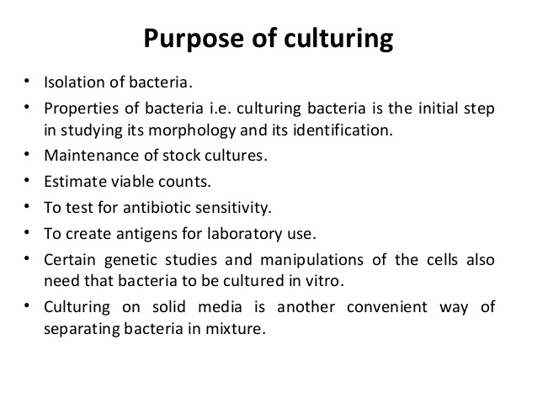
08-09-2024
27

Slide 28
Microbiological media, or bacterial culture media, is a growth medium used to grow bacteria. In other words, it contains everything bacteria need to grow outside the body and under laboratory conditions. Bacterial culture media is used when a specific bacterium must be grown in order to confirm the presence of an infection or study a specific bacterium further. There are thousands of different media used today.
Microbiological media can be classified under two primary categories; chemical or organic. A purely chemical media uses chemical medium to provide the needed nutrients to an organism. An organic media contains organic material that a certain bacterium may need to grow.
Furthermore, bacterial culture media can be used to grow a general variety of bacteria. On the other hand, selective media is used when only a certain type of bacteria is to be grown.
How does Microbiological Media work?
To rule out that a finished product such as a drug, medical device, tissue or implant is contaminated with microorganisms bacterial culture media is used. The media enables the microbiologist to identify and quantify any organism so that patient safety is assured.
Why is such Media Important?
It is through the use of a bacterial culture media that the presence of a bacterial infection is either confirmed or not. Although there are other ways of doing so, growing microbes is the most accurate method. In simple words, unless microbiological media existed, accurately confirming a disease would be incredibly difficult.
Whether it is the identification of bacteria for commercial use or for identifying and confirming infections, knowing basic information about microbial media is crucial to understanding it.
08-09-2024
28

Slide 29
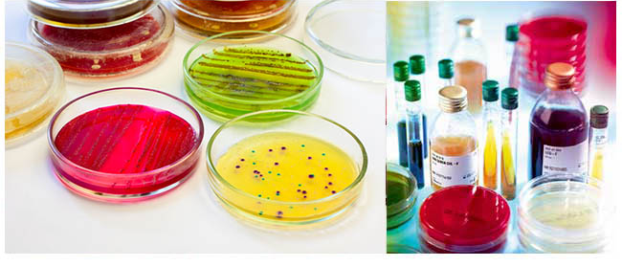
08-09-2024
29

Slide 30
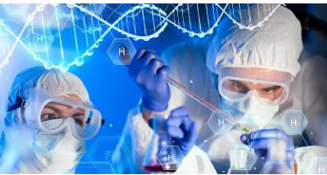
Cultivation of microorganisms depends on a number of important factors:
❖ Proper nutrients must be available.
❖ Oxygen or other gases must be available, as required.
❖ Moisture is necessary.
❖ The medium must have an appropriate pH.
❖ Proper temperature relations must prevail.
❖ The medium must be free of interfering bioburden.
❖ Contamination must be prevented
A satisfactory microbiological culture medium must contain available sources of:
• Carbon • Nitrogen • Inorganic phosphate and sulfur • Trace metals • Water • Vitamins
08-09-2024
30

Slide 31
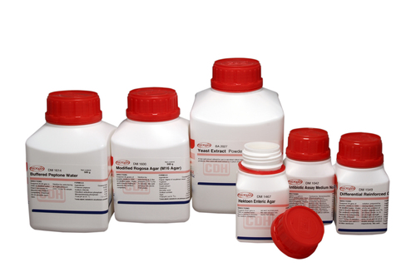
Common ingredients of media:
Water: essential for bacterial growth, use deionized or distilled water.
Peptone: from hydrolyzed animal or plant protein, it provides nitrogen and amino acid.
Meat extract: provides amino acid, vitamins, mineral salts (phosphate and sulphate).
Yeast extract: used to stimulate the growth of bacteria.
Mineral salts: traces of magnesium, potassium, iron and calcium which are essential for bacterial
enzyme activity.
Carbohydrates: to provide bacteria with energy and carbon source.
Agar: inert polysaccharide from sea weed or marine algae, it is solidifying agent with concentration of 1-2%, dissolves at 90-100 °C, solidify at 45 °C.
08-09-2024
31

Slide 32
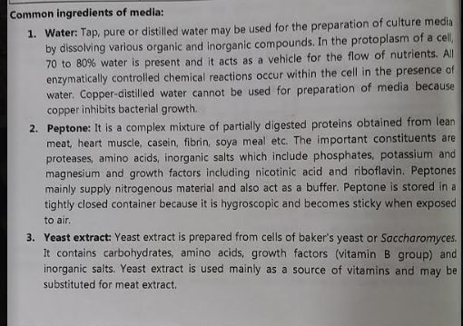
08-09-2024
32

Slide 33
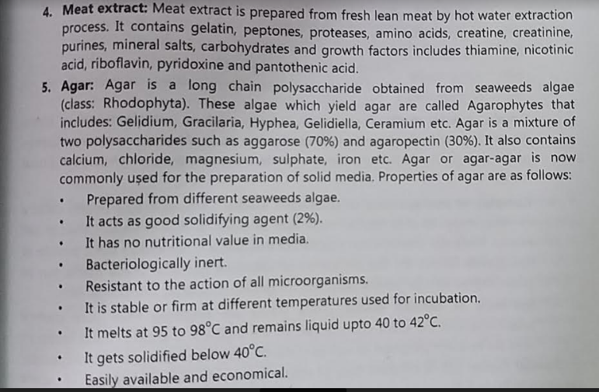
08-09-2024
33

Slide 34
NUTRIENT AGAR
It is a basic culture medium commonly used for the culture of non-fastidious microorganisms, and for quality control and checking purity prior to biochemical or serological testing.
Nutrient media can also be used for the cultivation of fastidious microorganism by enriching the medium with serum or blood
Nutrient Agar is an ideal medium for the demonstration and teaching purposes as it allows more prolonged survival of cultures at ambient temperature without the risk of overgrowth that might occur with more nutritious mediums.
This media has a relatively simple formula that has been retained and is still widely used in the microbiological examination of a variety of samples and is also recommended by standard methods.
Nutrient agar is a general-purpose media that is mostly used for routine culture or to ensure prolonged survival of microorganisms.
It is one of the most important and commonly used non-selective media for the routine cultivation of microorganisms.
Nutrient agar has been used for the cultivation and enumeration of many bacteria that are not particularly fastidious.
The media can be made suitable for the cultivation of other fastidious organisms by the addition of different biological fluids such as horse or sheep blood, serum, egg yolk, etc
08-09-2024
34

Slide 35
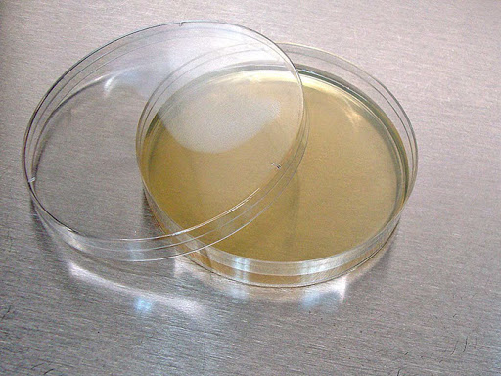
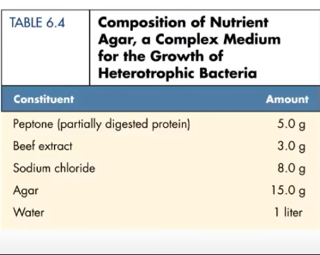
08-09-2024
35

Slide 36
CLASSIFICATION OF CULTURE MEDIA
Classification of bacterial culture media on the basis of consistency
Solid medium (b) Semi solid medium (c) Liquid (Broth medium).
2. Depending on oxygen requirement
Aerobic media (b) Anaerobic media.
3. Depending on chemical composition
Simple / basal media (b) Synthetic/defined media (c) Non synthetic or undefined or complex media.
4. Depending on functional type
Enriched media* (b) Enrichment media (c) Selective media* (d) Indicator media (e) Differential media*
(f) Transport media (g) Assay media (h) Storage media
08-09-2024
36

Slide 37
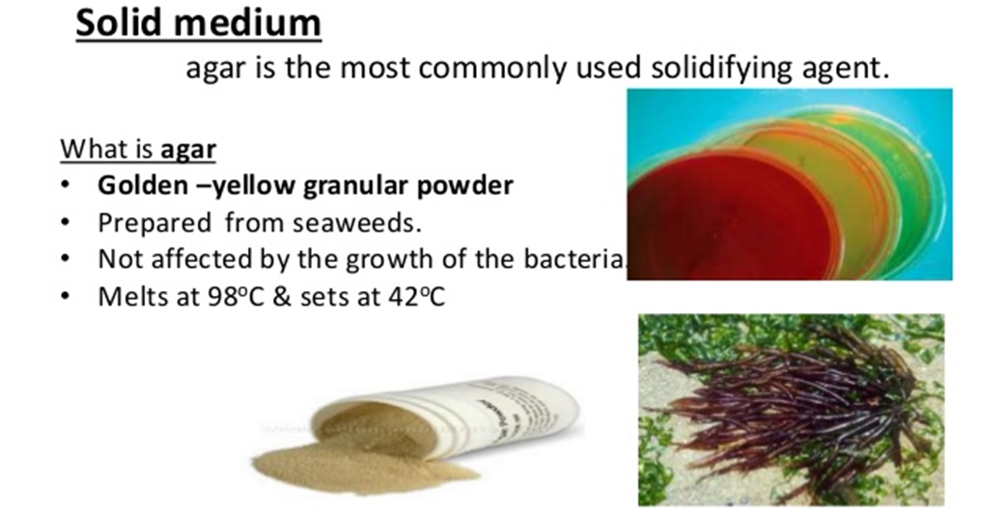
Classification of bacterial culture media on the basis of consistency
Solid medium
Solid medium contains agar at a concentration of 1.5-2.0% or some other, mostly inert solidifying agent. Solid medium has physical structure and allows bacteria to grow in physically informative or useful ways (e.g. as colonies or in streaks). Solid medium is useful for isolating bacteria or for determining the colony characteristics of the isolate.
08-09-2024
37

Slide 38
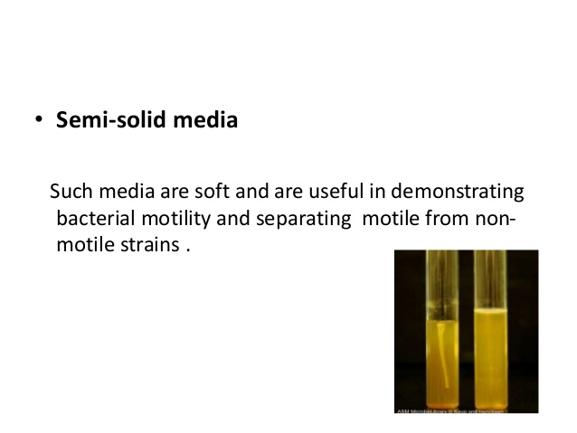
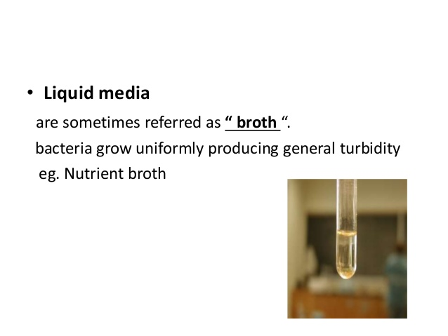
Semisolid medium
Semisolid medium is prepared with agar at concentrations of 0.5% or less. Semisolid medium has a soft custard-like consistency and is useful for the cultivation of microaerophilic bacteria or for the determination of bacterial motility.
Liquid (Broth) medium
These media contain specific amounts of nutrients but don’t have a trace of gelling agents such as gelatin or agar. Broth medium serves various purposes such as propagation of a large number of organisms, fermentation studies, and various other tests. e.g. sugar fermentation tests, MR-VR broth
08-09-2024
38

Slide 39
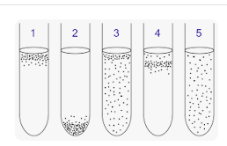
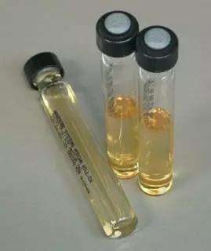
2. Classification on basis of oxygen requirement
Aerobic media :- Aerobic media are used to grow aerobes Eg:-Mannitol salt agar
Anaerobic media :Anaerobic media is used to grow anaerobic organisms Eg:-Robertson’s cooked meat agar
Anaerobic bacteria need special media for growth because they need low oxygen content, reduced oxidation-reduction potential and extra nutrients.
Media for anaerobes may have to be supplemented with nutrients like hemin and vitamin K. Such media may also have to be reduced by physical or chemical means. Boiling the medium serves to expel any dissolved oxygen. Addition of 1% glucose, 0.1% thioglycollate, 0.1% ascorbic acid, 0.05% cysteine, or red hot iron filings can render a medium reduced. Before using the medium must be boiled in a water bath to expel any dissolved oxygen and then sealed with sterile liquid paraffin.
08-09-2024
39

Slide 40
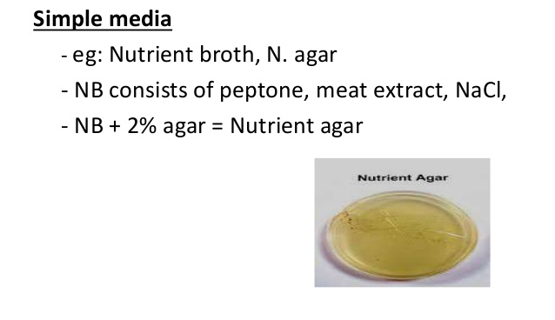
3. Depending on chemical composition
General-purpose media/ Basic media/ Simple media
Basal media are basically simple media that supports most non-fastidious bacteria. Peptone-water, nutrient broth, and nutrient agar (NA) are considered as basal medium. These media are generally used for the primary isolation of microorganisms.
08-09-2024
40

Slide 41
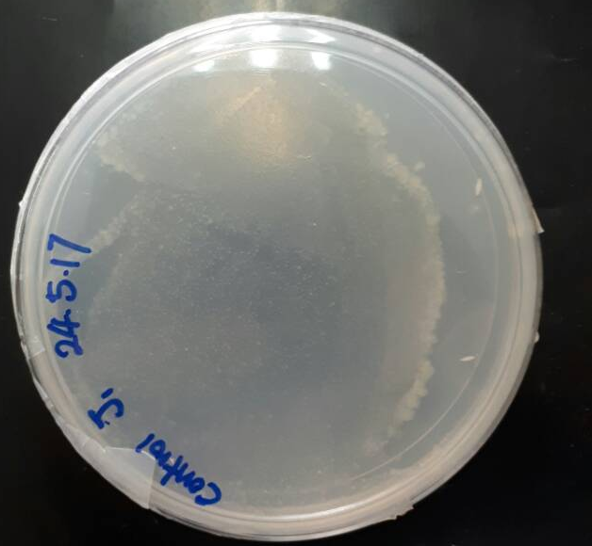
Synthetic or defined media
These media is prepared from pure chemical substances and the exact composition of the medium is fully documented
A medium in which all the chemical components are known
Used to cultivate photolithotrophs like cyanobacteria and photosynthetic protists and chemoorganoheterotrophs
CO2 in the form of sodium carbonate or bicarbonate serve as carbon source for photolithotrophs
Ammonium ion and nitrate serve as nitrogen source
Glucose serve as carbon source for chemoorganoheterotrophs
Used in research to know what the microbes are metabolizing
Eg:-Minimal media (Minimal media are those that contain the minimum nutrients possible for colony growth, generally without the presence of amino acids, and are often used by microbiologists and geneticists to grow "wild-type" microorganisms. Minimal media can also be used to select for or against recombinants or exconjugants.)
08-09-2024
41

Slide 42
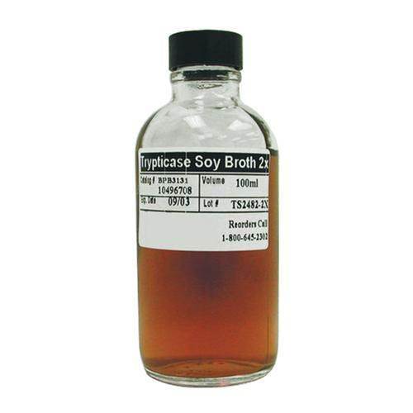
Non synthetic or undefined or complex media
Media that have some ingredients with unknown chemical composition
Needed when the nutritional requirement of a particular organism is unknown as a single a complex medium maybe sufficiently rich to completely meet the nutritional requirements
Used to culture fastidious bacteria
Blood, serum, meat extracts, milk, soybean digests, peptone etc. are added to the medium
Peptones are protein hydrolysates prepared by partial proteolytic digestion of meat, casein, soy meal, gelatin and other protein sources that serve as excellent sources of C, N and energy.
Example of complex medium – Nutrient broth, Tryptic soy broth.
BD Tryptic Soy Broth (Soybean-Casein Digest Medium) is a general purpose liquid enrichment medium used in qualitative procedures for the sterility test and for the enrichment and cultivation of aerobic microorganisms that are not excessively fastidious.
08-09-2024
42

Slide 43

4. Depending on functional type
A.ENRICHED MEDIA (ADDED GROWTH FACTORS):
Addition of extra nutrients in the form of blood, serum, egg yolk, etc, to basal medium makes enriched media. Enriched media are used to grow nutritionally exacting (fastidious) bacteria. Blood agar, chocolate agar, Loeffler’s serum slope, etc are few of the enriched media. Blood agar is prepared by adding 5-10% (by volume) blood to a blood agar base. Chocolate agar is also known as heated blood agar or lysed blood agar.
08-09-2024
43

Slide 44

08-09-2024
44

Slide 45
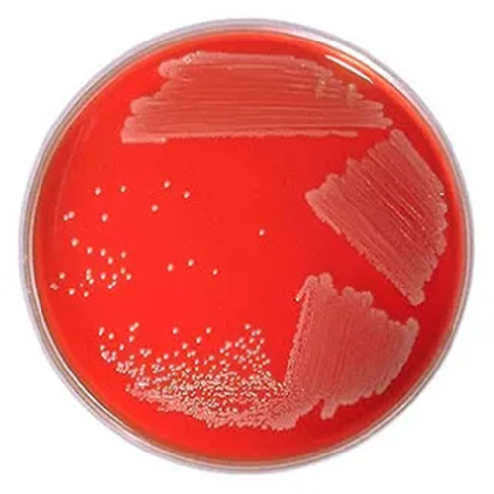
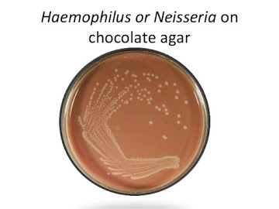
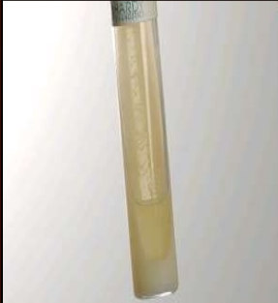
BLOOD AGAR CHOCOLATE AGAR LOEFFLER’S SERUM
08-09-2024
45

Slide 46
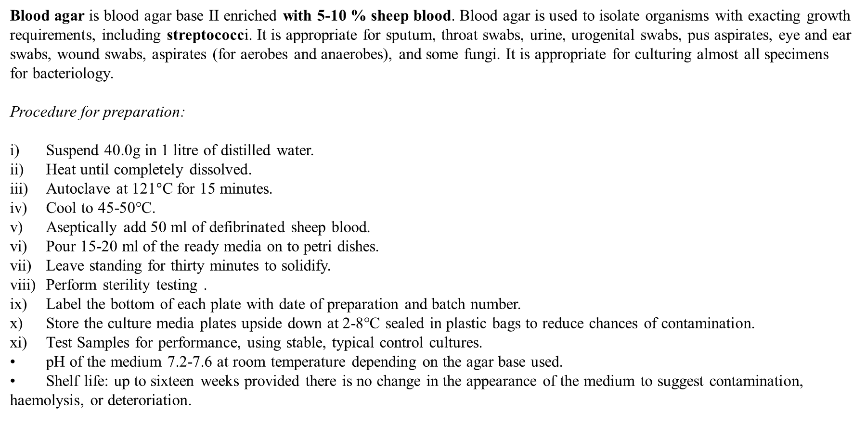
Blood agar is blood agar base II enriched with 5-10 % sheep blood. Blood agar is used to isolate organisms with exacting growth requirements, including streptococci. It is appropriate for sputum, throat swabs, urine, urogenital swabs, pus aspirates, eye and ear swabs, wound swabs, aspirates (for aerobes and anaerobes), and some fungi. It is appropriate for culturing almost all specimens for bacteriology.
Procedure for preparation:
i) Suspend 40.0g in 1 litre of distilled water.
ii) Heat until completely dissolved.
iii) Autoclave at 121$°$C for 15 minutes.
iv) Cool to 45-50°C.
v) Aseptically add 50 ml of defibrinated sheep blood.
vi) Pour 15-20 ml of the ready media on to petri dishes.
vii) Leave standing for thirty minutes to solidify.
viii) Perform sterility testing .
ix) Label the bottom of each plate with date of preparation and batch number.
x) Store the culture media plates upside down at 2-8°C sealed in plastic bags to reduce chances of contamination.
xi) Test Samples for performance, using stable, typical control cultures.
• pH of the medium 7.2-7.6 at room temperature depending on the agar base used.
• Shelf life: up to sixteen weeks provided there is no change in the appearance of the medium to suggest contamination, haemolysis, or deteroriation.
08-09-2024
46

Slide 47
Chocolate agar supplies the factors required for the proper growth of Haemophilus influenzae, the X and V factors.
It is also used to culture nutritionally demanding pathogens such Neisseria meningitidis and Streptococcus pneumoniae.
When Blood agar is heated, the red cells are lysed and the medium becomes brown in colour; it is referred to as chocolate agar. It is appropriate for isolating pathogenic bacteria in sputum, throat swabs, eye swabs, ear swabs, urogenital swabs, cerebrospinal fluid.
Procedure for preparation:
i) Prepare as described for Blood agar except after adding blood, heat the medium in a 70°C water bath until it becomes brown in colour. This takes about 10-15 minutes during which time the medium should be mixed gently several times.
ii) Allow the medium to cool to about 45°C, remix and dispense in sterile petri dishes as described for blood agar.
iii) Leave standing for thirty minutes to solidify.
iv) Perform sterility testing.
v) Label the bottom of each plate with date of preparation and batch number.
vi) Store the culture media plates upside down at 2-8°C sealed in plastic bags to reduce chances of contamination.
vii) Test Samples for performance, using stable, typical control cultures.
• pH of the medium 7.2-7.6 at room temperature depending on the agar base used.
• Shelf life: up to sixteen weeks provided there is no change in the appearance of the medium to suggest contamination or deteroriation.
Important: Care must be taken not to over heat or prolong the heating of the medium because this will cause it to become granular and unfit for use
08-09-2024
47

Slide 48
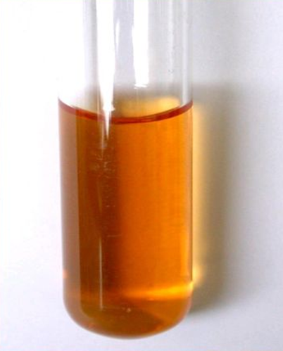
Loeffler Serum. Serum is used for enrichment. Diphtheria bacilli grow in this medium in 6 hours when the secondary bacteria do not grow. It is used for rapid diagnosis of diphtheria and to demonstrate volutin granules. It contains sheep, ox or horse serum.
B. Enrichment media
Basic principle is to control the nutrients and culture conditions in such a way that it suits mainly to a specific species y temperature, air supply, light, pH. When we assume low amount of potential pathogens being present in the specimen, they have to be enriched first, to multiply up the low number – e.g. serum bouillon, dextrose bouillon, chopped meat bouillon
Promotes the growth of a particular organism by providing it with the essential nutrients, and rarely contains inhibitory substances to prevent the growth of normal competitors.
Enrichment medium is used to increase the relative concentration of certain microorganisms in the culture prior to plating on solid selective medium. Unlike selective media, enrichment culture is typically used as a broth medium. Enrichment media are liquid media that also serves to inhibit commensals in the clinical specimen. Selenite F broth, tetrathionate broth, and alkaline peptone water (APW) are used to recover pathogens from fecal specimens.
Selenite F Broth is used to isolate – Selenite, Salmonella and Shegella
Alkaline peptone water is used to isolate – Vibrio cholera
Tetratiyonate broth – Inhibits coliform bacteria, Isolate salmonella thypi
08-09-2024
48

Slide 49
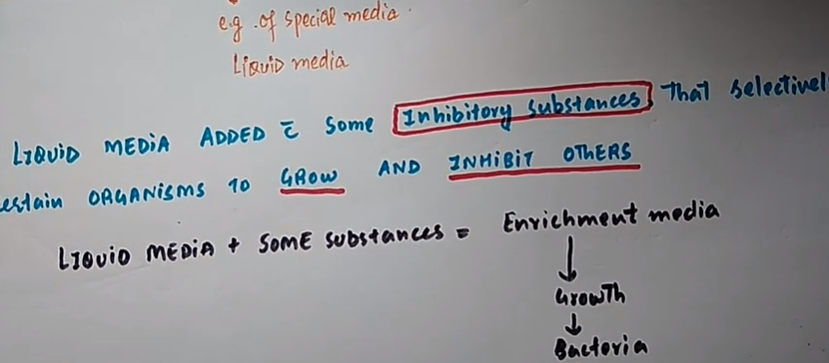
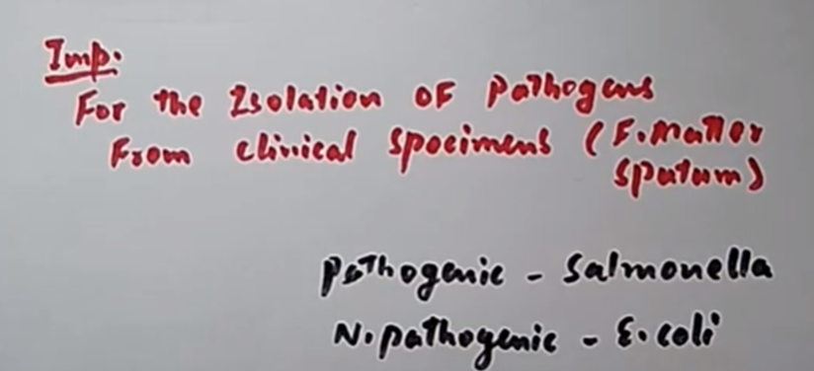
ENRICHMENT MEDIA
GROW INHIBIT
08-09-2024
49

Slide 50
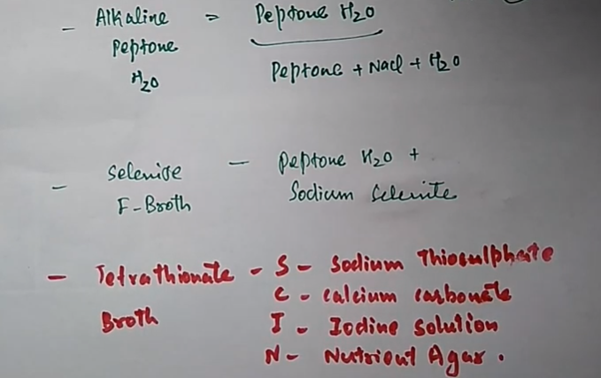
.
Composition of Substances
08-09-2024
50

Slide 51
EXTRA POINTS
Checking the pH of a culture medium
The pH of most culture media is near neutral. An exception is alkaline peptone water. The simplest way of testing the pH of a culture medium is to use narrow range pH papers or a pH meter.
A fluid medium can be tested by dipping a narrow range pH paper into a sample of the medium when it is at room temperature and comparing the colour of the paper against the pH colour chart provided. An agar medium can be tested by pouring a sample of the molten medium into a small beaker or petri dish and when it has solidified, laying a narrow range pH paper on its surface. The colour of the paper is then compared against the pH colour chart provided.
The pH of a dehydrated medium should not require adjustment providing it has been prepared correctly using pure water and clean equipment, and it has not been over-autoclaved.
The pH of other media should be adjusted as directed in the method of preparation. Minor adjustments should be carried out using 0.1mol/l (N/10) sodium hydroxide when the medium is too acidic, and 0.1 mol/l (N/10) hydrochloric acid when too alkaline.
When adjusting the pH of a large volume of medium it is best to measure the amount of acid that needs to be added to adjust 10 ml of the medium, and then calculate the amount required to adjust the remaining volume.
08-09-2024
51

Slide 52
How to dispense culture media
Media should be dispensed in a clean draught-free room. Most fluid media are dispensed into screw-capped bottles or tubes, and then sterilized by autoclaving. Sterile media must be dispensed into sterile petri dishes, tubes, or bottles using an aseptic technique.
Dispensing sterile media into petri dishes.
Lay out the sterile petri dishes on a level, clean (disinfected) bench surface.
Mix the medium gently by rotating the flask or bottle. Avoid forming air bubbles. Flame-sterilize the neck of the flask or bottle and pour 15-20 ml of medium into each dish (90-100 mm diameter). If air bubbles enter while pouring, rapidly flame the surface of the medium before gelling occurs. Rotate the dish on the surface of the bench to ensure an even layer of agar. Agar plates should be of an even depth (not less that 4 mm) and of a firm gel.
When the medium has gelled and cooled, stack the plates and seal them in plastic bags to prevent loss of moisture and reduce the risk of contamination. Do not leave the plates exposed to bright light especially sunlight.
Store at 2-8˚C.
08-09-2024
52

Slide 53
Sterility testing of Culture media
Sterility test routinely media to which blood or other substances have been added after autoclaving. For sterile media in screw-cap tubes or bottles, the simplest way to test for contamination is to incubate 5 % of the batch at 35-37˚C overnight.
Contamination by microorganisms capable of overnight growth will be shown by turbidity in a fluid medium and growth on or in a solid medium. Media in petri dishes are best examined for contamination immediately before use.
All media, even those that have been sterility tested at the time of preparation, should always be checked visually immediately before being inoculated for any change in appearance that could indicate contamination or deterioration.
08-09-2024
53

Slide 54
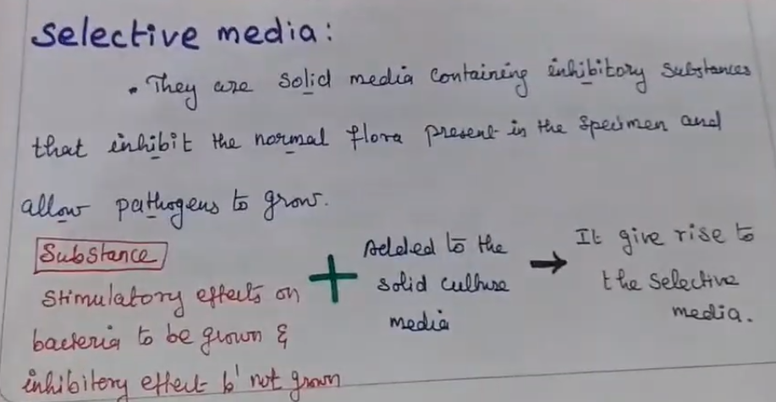
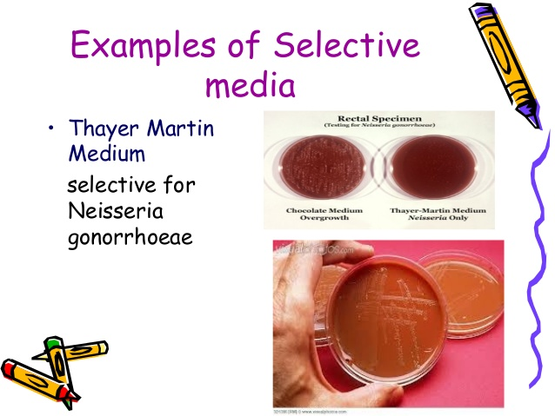
C. Selective medium
Principle: Differential growth suppression
Selective medium is designed to suppress the growth of some microorganisms while allowing the growth of others. Selective medium is agar-based (solid) medium so that individual colonies may be isolated.
A selective media is composed of specific ingredients to inhibit the growth of certain species of microbes in a mixed culture while allowing others to grow. Again, in order to fully grasp this definition, let's look at an example of a selective medium.
08-09-2024
54

Slide 55
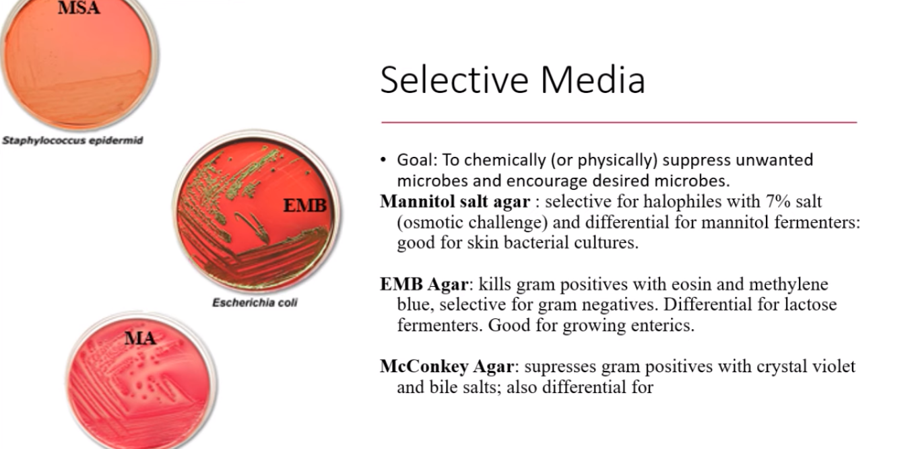
08-09-2024
55

Slide 56
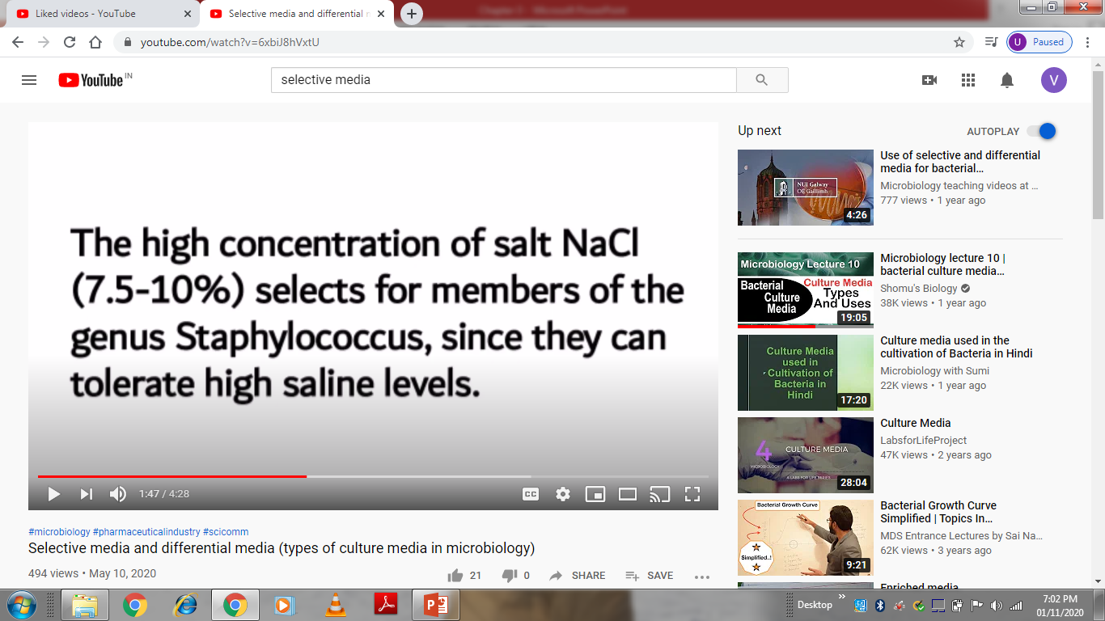
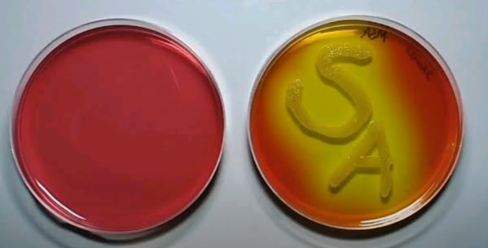
Manitol salt agar
Mannitol Salt Agar contains beef extract and proteose peptone, which makes it very nutritious as they provide essential growth factors and trace nutrients such as nitrogen, vitamins, minerals and amino acids essential for growth.
The medium contains 7.5% concentration of sodium chloride which results in the partial or complete inhibition of bacterial organisms other than staphylococci. Mannitol is the fermentable carbohydrate source, fermentation of which leads to acid production.
Staphylococcus aureus grows on this medium and ferments mannitol to produce yellow colonies. Most coagulase negative species of Staphylococci and Micrococci do not ferment mannitol and grow as small red colonies. The color of the colonies and the medium is due to the reactivity of phenol red (indicator) to the pH of the medium. Phenol red is red at pH 8.4 and phenol red is yellow at pH 6.8. Agar is the solidifying agent. In addition, 5% v/v Egg Yolk Emulsion can be added to a medium which enables the detection of lipase activity of staphylococci along with mannitol fermentation. The salt clears the egg yolk emulsion and lipase production is detected as yellow opaque zone around the colonies.
08-09-2024
56

Slide 57
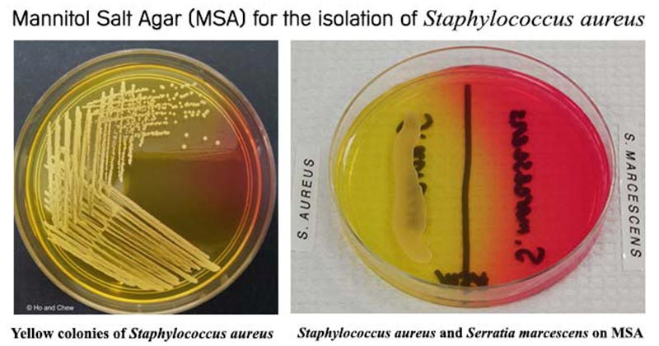
PROCEDURE OF MSA
Suspend 111 grams of Mannitol Salt Agar in 1000 ml of distilled water.
Boil to dissolve the medium completely.
Sterilize by autoclaving at 15 lbs. pressure (121°C) for 15 minutes.
If desired, sterile Egg Yolk Emulsion (E7899) can be added to a final concentration of 5% v/v after autoclaving.
Pour cooled Mannitol Salt Agar into sterile petri dishes and allow to cool to room temperature.
Organisms | Results
Staphylococcus aureus | Yellow colonies surrounded by yellow zone
Staphylococcus epidermidis | Pink or Red colonies
Micrococci | Red colonies
Escherichia coli | No growth
08-09-2024
57

Slide 58
(B) Macconkey agar
MacConkey agar was the first solid differential media to be formulated which was developed at 20th century by Alfred Theodore MacConkey. MacConkey Agar is the earliest selective and differential medium for cultivation of coliform organisms. It is used for the isolation and differentiation of non-fastidious gram-negative rods, particularly members of the family Enterobacteriaceae and the genus Pseudomonas.
Pancreatic digest of gelatin and peptones (meat and casein) provide the essential nutrients, vitamins and nitrogenous factors required for growth of microorganisms. Lactose monohydrate is the fermentable source of carbohydrate. The selective action of this medium is attributed to crystal violet and bile salts, which are inhibitory to most species of gram-positive bacteria. Sodium chloride maintains the osmotic balance in the medium.
Lactose fermenting strains grow as red or pink. The red colour is due to production of acid from lactose, absorption of neutral red and a subsequent colour change of the dye when the pH of medium falls below 6.8. Non-lactose fermenting bacteria such as Salmonella, Proteus, Pseudomonas aeruginosa and Shigella cannot utilize lactose, and will use peptone instead. This forms ammonia, which raises the pH of the agar, and leads to the formation of white or colorless colonies formed in the plate and the agar surrounding the bacteria remains relatively transparent. These colonies can also look golden to brown with dark centers.
Ingredients | Amount
Peptone (Pancreatic digest of gelatin) | 17 gm
Proteose peptone (meat and casein) | 3 gm
Lactose monohydrate | 10 gm
Bile salts | 1.5 gm
Sodium chloride | 5 gm
Neutral red | 0.03 gm
Crystal Violet | 0.001 gm
Agar | 13.5 gm
08-09-2024
58

Slide 59
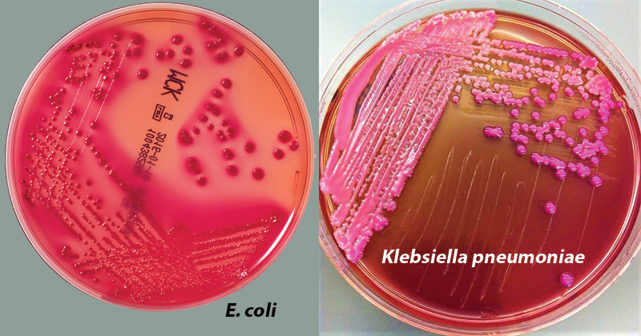
Organisms | Growth results
Escherichia coli | Pink to rose red colonies (may be surrounded by a zone of precipitated bile)
Enterobacter, Klebsiella | Mucoid, pink colonies
Proteus | Colorless colonies, swarming growth
Salmonella, Shigella | Colorless colonies, or sometime medium color: orange to amber
Pseudomonas | Irregular, colorless to pink colonies
08-09-2024
59

Slide 60
(C) Eosin Methylene Blue (EMB) Agar
Eosin Methylene Blue (EMB) agar is a differential microbiological medium, which slightly inhibits the growth of Gram-positive bacteria and provides a color indicator distinguishing between organisms that ferment lactose (e.g., E. coli) and those that do not (e.g., Salmonella, Shigella).The medium is important in medical laboratories to distinguish gram-negative pathogenic microbes in a short period of time.
EMB agar is characterized by the presence of a combination of the two dyes eosin and methylene blue in the ratio of 6:1. Gram-negative bacteria that ferment the lactose produce acid which lowers the pH. This encourages dye absorption by the colonies and turns the colonies dark purple as the acid acts upon the dyes. In addition, certain lactose-fermenting bacteria produce flat, dark colonies with a green metallic sheen. Other lactose fermenters produce larger, mucoid colonies, often purple only in their center.
In EMB agar, most of the strains of E. coli colonies have a characteristic green sheen. Rapid fermentation of lactose & production of strong acids, thus a rapid reduction in the pH of the EMB agar the critical factor in the formation of the green metallic sheen observed with E. coli, rapid fermentation of lactose and formation of strong acids.
Lactose non-fermenters, on the other hand, may increase the pH by deamination of proteins. This ensures that the dye is not absorbed. The colonies will be colorless.
Lactose non-fermenters are thus either colorless or light lavender.
Peptic digest of animal tissue serves as a source of carbon, nitrogen, and other essential growth nutrients.
Lactose and sucrose are the sources of energy by being fermentable carbohydrates.
Eosin-Y and methylene blue serve as differential indicators. Phosphate buffers the medium.
Ingredients | Gms/litre
Peptic digest of animal tissue | 10.000
Dipotassium phosphate | 2.000
Lactose | 5.000
Sucrose | 5.000
Eosin – Y | 0.400
Methylene blue | 0.065
Agar | 13.500
08-09-2024
60

Slide 61
Suspend 35.96 grams in 1000 ml distilled water.
Mix until the suspension is uniform. Heat to boiling to dissolve the medium completely.
Sterilize by autoclaving at 15 lbs pressure (121°C) for 15 minutes. AVOID OVERHEATING.
Cool to 45-50°C and shake the medium in order to oxidize the methylene blue (i.e. to restore its blue color) and to suspend the flocculent precipitate.
Pour into sterile Petri plates.
Allow plates to warm to room temperature.
The agar surface should be dry before inoculating.
Inoculate and streak the specimen as soon as possible after collection.
If the specimen to be cultured is on a swab, roll the swab over a small area of the agar surface and streak for isolation with a sterile loop.
Incubate plates aerobically at 35-37°C for 18-24 hours and protect from light.
Examine plates for colonial morphology. If negative after 24 hours, reincubate an additional 24 hours.
Organisms | Growth
Escherichia coli | Blue-black bulls eye; may have green metallic sheen
Pseudomonas aeruginosa | Colorless
Enterobacter aerogenes | Good growth; pink, without sheen
Klebsiella pneumoniae | Pink, mucoid colonies
Proteus mirabilis | Luxuriant growth; colorless colonies
Salmonella Typhimurium | Luxuriant growth; colorless colonies
08-09-2024
61

Slide 62
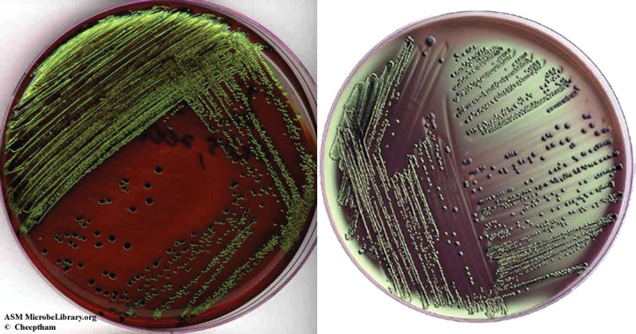
08-09-2024
62

Slide 63
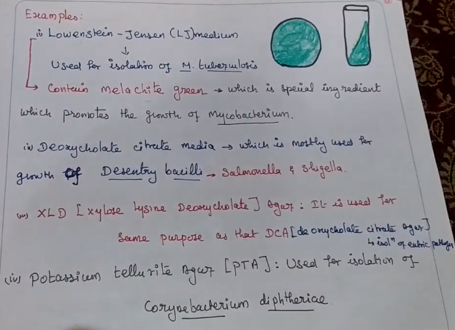
08-09-2024
63

Slide 64
Transport media
Clinical specimens must be transported to the laboratory immediately after collection to prevent overgrowth of contaminating organisms or commensals. This can be achieved by using transport media. Such media prevent drying (desiccation) of a specimen, maintain the pathogen to commensal ratio, and inhibit the overgrowth of unwanted bacteria. Some of these media (Stuart’s & Amie’s) are semi-solid in consistency. Addition of charcoal serves to neutralize inhibitory factors.
Cary Blair transport medium and Venkatraman Ramakrishnan (VR) medium are used to transport feces from suspected cholera patients.
Sach’s buffered glycerol saline is used to transport feces from patients suspected to be suffering from bacillary dysentery.
Pike’s medium is used to transport streptococci from throat specimens.
Assay media
These media are used for the assay of vitamins, amino acids, and antibiotics. E.g. antibiotic assay media are used for determining antibiotic potency by the microbiological assay technique.
Other types of medium include;
Media for enumeration of bacteria,
Media for characterization of bacteria,
Maintenance media etc.
08-09-2024
64

Slide 65

Differential/ indicator medium: differential appearance:
Certain media are designed in such a way that different bacteria can be recognized on the basis of their colony color. Various approaches include incorporation of dyes, metabolic substrates, etc, so that those bacteria that utilize them appear as differently colored colonies. Such media are called differential media or indicator media. Differential media allow the growth of more than one microorganism of interest but with morphologically distinguishable colonies.
STORAGE MEDIA. Media used for storing the bacteria for a long period of time. Examples: Egg saline medium, chalk cooked meat broth
.
08-09-2024
65

Slide 66
assay culture medium.
A microbiological assay culture medium is a device that consists primarily of liquid or solid biological materials intended for medical purposes to cultivate selected test microorganisms in order to measure by microbiological procedures the concentration in a patient's serum of certain substances, such as amino acids, antimicrobial agents, and vitamins. The concentration of these substances is measured by their ability to promote or inhibit the growth of the test organism in the innoculated medium. Test results aid in the diagnosis of disease resulting from either deficient or excessive amounts of these substances in a patient's serum. Tests results may also be used to monitor the effects of the administration of certain antimicrobial drugs.
08-09-2024
66

Slide 67
MAINTENANCE AND PRESERVATION OF LAB CULTURES AND PURE CULTURES
Once a microorganism has been isolated and grown in pure culture, it becomes necessary to maintain the viability and purity of the microorganism by keeping the pure culture free from contamination.
Normally in laboratories, the pure cultures are transferred periodically onto or into a fresh medium (subculturing) to allow continuous growth and viability of microorganisms. The transfer is always subject to aseptic conditions to avoid contamination.
To maintain pure culture for extended periods in a viable conditions, without any genetic change (Mutations) as well as avoiding its contamination is referred as Preservation. During preservation most important factor is to stop microbial growth or at least lower the growth rate.
Due to this toxic chemicals are not accumulated and hence viability of microorganism is not affected.
Application of Preservation
1. Academic Use
2. Research Purpose
3. Fermentation Industry
4. Biotechnological Field
08-09-2024
67

Slide 68
Techniques for the Preservation of microbes broadly divided into two
1. Methods where organisms are in Continuous metabolic active state
2. Methods where organisms are in Suspended metabolic state.
1. Continuous metabolic active state preservation technique: In this technique, organisms preserved on nutrient medium by repeated sub-culturing. In this technique, any organisms are stored by using general nutrient medium. Here repeated subculturing is required due to depletion or drying of nutrient medium. This technique includes preservation by following methods.
a. Periodic transfer to fresh media: Organisms grown in general media on slant, incubated for particular period at particular temperature depending on the characteristics of the selected organisms, then it is stored in refrigerator. These cultures can be stored for certain interval of time depending on the organism and its growth conditions. After that time interval, again these organisms transferred to new fresh medium and stored in refrigerator.
b. Overlaying culture with mineral oil: Organisms are grown on agar slant then they are covered with sterile mineral oil to a depth of 1 cm. above the tip of the surface. This method is simple; one can remove some organisms in aseptic condition with the help of
sterile wire loop and still preserving the initial culture. Some species preserved satisfactorily for 15 – 20 years by this method.
c. Storage in sterile soil: This method is widely used for preserving spore forming bacteria and fungi. In this method, organisms will remain in dormant stage in sterile soil. Soil sterilized then spore suspension added to it aseptically, this mixture dried at room
temperature and stored in refrigerator. Viability of organisms found around 70 – 80 years.
d. Saline suspension: Normal Saline used to provide proper osmotic pressure to organism’s
otherwise high salt concentration is inhibitory for organisms. Organisms kept in screw cap bottles in normal saline, stored at room temperature, wherever required transfer made on agar slats, and incubated
08-09-2024
68

Slide 69
2. Methods where organisms are in Suspended metabolic state: Organisms preserved in suspended metabolic state by either drying or storing at low temperature. Microbes are dried or kept at low temperature carefully so that their revival is possible.
Drying in vacuum: In this technique, organisms dried over chemical instead of air dry. Cells passed over CaCl2 in a vacuum and then stored in refrigerator. Organisms survive for longer period.
b. Lyophilization: Lyophilization is vacuum sublimation technique. Cells grown in nutritive media and then this culture distributed in small vials. These vials culture then immersed in a mixture of dry ice and alcohol at -78 °C. These vials immediately connected to a high- vacuum line, and when they are completely dried, each vial sealed under vacuum. This is most effective and widely
08-09-2024
69

Slide 70
Since repeated subculturing is time consuming, it becomes difficult to maintain a large number of pure cultures successfully for a long time. In addition, there is a risk of genetic changes as well as contamination. Therefore, it is now being replaced by some modern methods that do not need frequent subculturing. These methods include,
1. Periodic transfer to fresh media (Subculturing)
2. Oil overlay (Paraffin method)
3. Storage at low temperature
a. Refrigeration
b. Cryopreservation
4. Freez dying (Lyophilization)
5. Storage in sterile soil
6. Saline suspension
08-09-2024
70

Slide 71
Periodic transfer to fresh media (Subculturing)
Strains can be maintained by periodically preparing a fresh culture from the previous stock culture. The culture medium, the storage temperature, and the time interval at which the transfers are made vary with the species and must be ascertained beforehand. The temperature and the type of medium chosen should support a slow rather than a rapid rate of growth so that the time interval between transfers can be as long as possible. Many of the more common heterotrophs remain viable for several weeks or months on a medium like Nutrient Agar.
Advantages
1. It is a simple method, any special apparatus are not required.
2. Easy to recover the culture
Disadvantages:
1. Since repeated subculturing is time consuming, it becomes difficult to maintain a large number of pure cultures successfully for a long time.
2. Risk of contamination is more
3. Possibility of genetic changes due to the development of variants and mutants and changes in biochemical characteristics Therefore, it is now being replaced by some modern methods that do not need frequent subculturing.
08-09-2024
71

Slide 72
Oil overlay (Paraffin method)
The agar slants are inoculated and incubated until good growth appears. Many bacterial species can be preserved by covering the growth on the agar slants with sterile mineral oil. They are then covered with sterile mineral oil to a depth of 1 cm above the tip of slant surface. Oil must cover the slants completely. Oil reduces the loss of water and also slow down the exchange of gas within organism and surrounding. This is a simple and most economical method of preserving bacteria and fungi where they remain viable for several years at room temperature. The layer of paraffin prevents dehydration of the medium and by ensuring an aerobic condition, the microorganism remain in dormant state.
08-09-2024
72

Slide 73
Refrigeration
Pure cultures can be successfully stored at 0-4°C either in refrigerators or in cold-rooms.
This method is applied for short duration (2-3 weeks for bacteria and 3-4 months for fungi)
because the metabolic activities of the microorganisms are greatly slowed down but not stopped.
Thus their growth continues slowly, nutrients are utilized and waste products released in
medium. This results in, finally, the death of the microbes after sometime.
Cryopreservation
Cryopreservation (i.e., freezing in liquid nitrogen at -196°C or in the gas phase above the
liquid nitrogen at -150°C) helps survival of pure cultures for long storage times. In this method,
the microorganisms of culture are rapidly frozen in liquid nitrogen at -196°C in the presence of
stabilizing agents such as glycerol or Dimethyl Sulfoxide (DMSO) that prevent the cell damage
due to formation of ice crystals and promote cell survival. This liquid nitrogen method has been
successful with many species that cannot be preserved by lyophilization and most species can
remain viable under these conditions for 10 to 30 years without undergoing change in their
characteristics, however this method is expensive.
08-09-2024
73

Slide 74
Freeze dying (Lyophilization)
Freeze-drying is a process where water and other solvents are removed from a frozen product via sublimation. Sublimation occurs when a frozen liquid goes directly to a gaseous state without entering a liquid phase. It is recommended using slow rates of cooling, as this will result in the formation of vertical ice crystal structures, thus allowing for more efficient water sublimation from the frozen product. Freeze-dried products are hygroscopic and must be protected from moisture during storage. Under these conditions, the microbial cells are dehydrated and their metabolic activities are stopped; as a result, the microbes go into dormant state and retain viability for years. Lyophilized or freeze-dried pure cultures and then sealed and stored in the dark at 4°C in refrigerators. Freeze-drying method is the most frequently used
technique by culture collection centers. Many species of bacteria preserved by this method have remained viable and unchanged in their characteristics for more than 30 years.
Advantage of Lyophilization
1. Only minimal storage space is required; hundreds of lyophilized cultures can be stored in
a small area.
2. Small vials can be sent conveniently through the mail to other microbiology laboratories
when packaged in a special sealed mailing containers.
3. Lyophilized cultures can be revived by opening the vials, adding liquid medium, and
transferring the rehydrated culture to a suitable growth medium.
08-09-2024
74

Slide 75
Storage in sterile soil
This method is widely used for preserving spore forming bacteria and fungi. In this method, organisms will remain in dormant stage in sterile soil. Soil sterilized then spore suspension added to it aseptically, this mixture dried at room temperature and stored in refrigerator. Viability of organisms found around 70 – 80 years.
Saline suspension
Sodium chloride in high concentration is frequently an inhibitor of bacterial growth. Bacteria are suspended in 1% salt solution (sublethal concentration in screw cap tubes to prevent evaporation). The tubes are stored at room temperature. Whenever needed the transfer is made on agar slant.
CULTIVATION OF AEROBIC BACTERIA
Main Principle: Provide Oxygen
Atmospheric condition is generally satisfactory for culture of aerobes or facultative anaerobes but for the growth of many aerobes, it is necessary to provide extensive aeration. Forced aeration of cultures is therefore frequently desirable and can be achieved either by vigorously shaking the flask or tube on a shaker or by bubbling sterilized air into the medium. When aerobic organisms are to be grown in large quantities, it is advantageous to increase the exposure of the medium to the atmosphere. This can be accomplished by dispensing the medium in shallow layers or by providing aeration by constantly shaking the inoculated liquid cultures.
08-09-2024
75

Slide 76





Slide 77


ROUX BOTTLE
FERNBACK FLASK

Slide 78
B. Cultivation of Anaerobic Bacteria
Main Principle: reduce the O2 content of culture medium and remove any oxygen already present inside the system or in the medium .
Oxygen is ubiquitous in the air so special methods are needed to culture anaerobic microorganisms. A number of procedure are available for reducing the O2 content of cultures; some simple but suitable mainly for less sensitive organisms, others more complex but necessary for growth of strict anaerobes.
Bottles or tubes filled completely to the top with culture medium and provided with tightly fitting stopper. Suitable for organisms not too sensitive to small amounts of oxygen.
Addition of a reducing agent that reacts with oxygen and reduces it to water e.g., Thioglycolate in thioglycolate broth. After thioglycolate reacts with oxygen throughout the tube, oxygen can penetrate only near the top of the tube where the medium contacts air.
Obligate aerobes grow only at the top of such tubes.
Facultative organisms grow throughout the tube but best near the top.
Microaerophiles grow near the top but not right at the top.
Anaerobes grow only near the bottom of the tube, where oxygen cannot penetrate.
08-09-2024
78

Slide 79

08-09-2024
79

Slide 80

Pre-reduced media
During preparation, the culture medium is boiled for several minutes to drive off most of the dissolved oxygen. A reducing agent e.g., cysteine, is added to further lower the oxygen content. Oxygen free N2 is bubbled through the medium to keep it anaerobic. The medium is then dispensed into tubes which are being flushed with oxygen – free nitrogen, stoppered tightly, and sterilized by autoclaving. Such tubes are continuously flushed with oxygen free CO2 by means of a cannula, restoppered, and incubated.’
08-09-2024
80

Slide 81

Anaerobic Chamber – GAS PAK METHOD
This refers to a plastic anaerobic glove box that contains an atmosphere of H2, CO2, and N2. Culture media are placed within the chamber by means of an air lock which can be evacuated and refilled with N2. Any oxygen in the media is slowly removed by reaction with hydrogren, forming water; this reaction is aided by a palladium catalyst. After being rendered oxygen free, the media are inoculated within the chamber (by means of the glove ports) and incubated (also within the chamber).
08-09-2024
© R R INSTITUTIONS , BANGALORE
81

Slide 82

Anaerobic Jar: GasPak system
Anaerobic jar is a heavy- walled jar with a gas tight seal within which tubes, plates, or other containers to be incubated are placed along with H2 and CO2 generating system (GasPak system) . After the jar is sealed oxygen present in the atmosphere inside jar and dissolved in the culture medium, is gradually used up through reaction with the hydrogen in the presence of catalyst. The air in the jar is replaced with a mixture of H2 and CO2, thus leading to anoxic conditions.
08-09-2024
82

Slide 83

CULTIVATION OF VIRUS

Slide 84

.
08-09-2024
84

Slide 85

.
08-09-2024
85

Slide 86

.
08-09-2024
86

Slide 87

.
08-09-2024
87

Slide 88

.
08-09-2024
88

Slide 89

.
08-09-2024
89

Slide 90

.
08-09-2024
90

Slide 91

.
08-09-2024
91

Slide 92

.
08-09-2024
92

Slide 93




.
08-09-2024
93

Slide 94


.
08-09-2024
94

Slide 95


.
08-09-2024
95

Slide 96


.
08-09-2024
96

Slide 97



.
08-09-2024
97

Slide 98


.
08-09-2024
98

Slide 99
END OF THE UNIT
08-09-2024
99

