Slide 1
PHARMACEUTICAL MICROBILOLOGY
Different methods used in isolation and identification of bacteria with emphasis to different staining techniques and biochemical reactions. Counting of bacteria -Total and Viable counting techniques.
17-09-2024
1

Slide 2
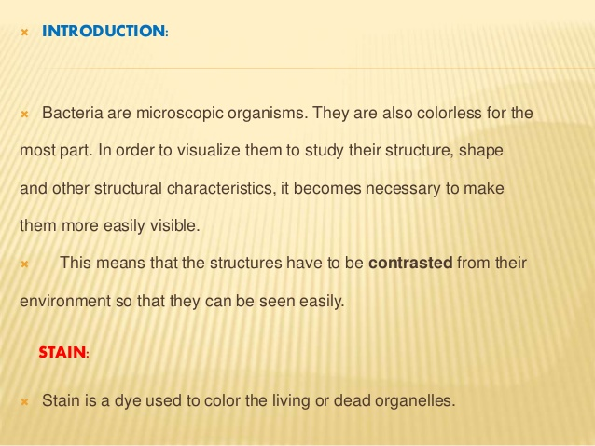
17-09-2024
2

Slide 3
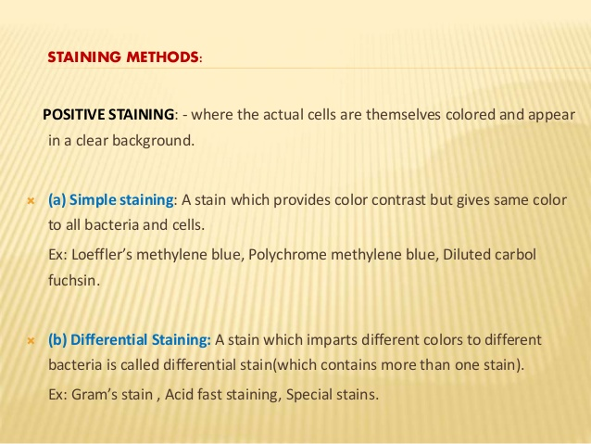
17-09-2024
3

Slide 4
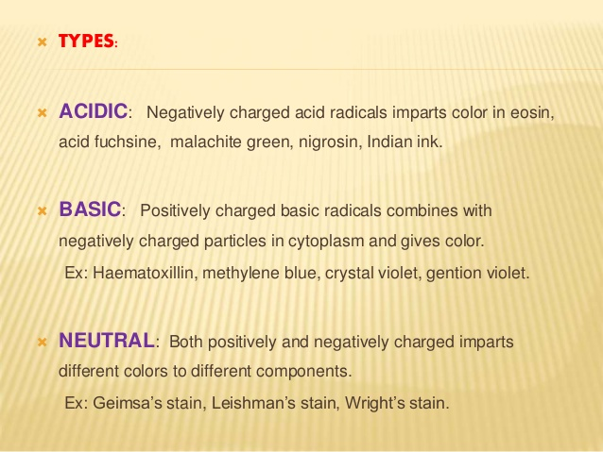
17-09-2024
4

Slide 5
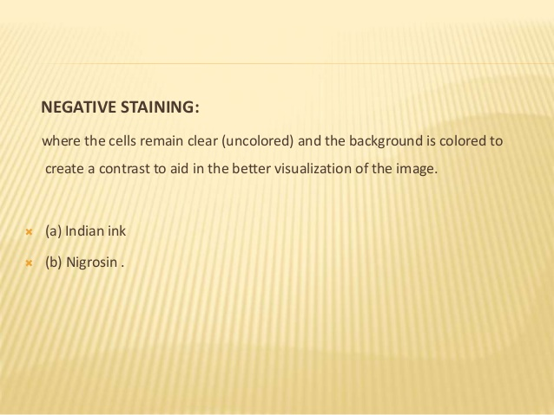
17-09-2024
5

Slide 6
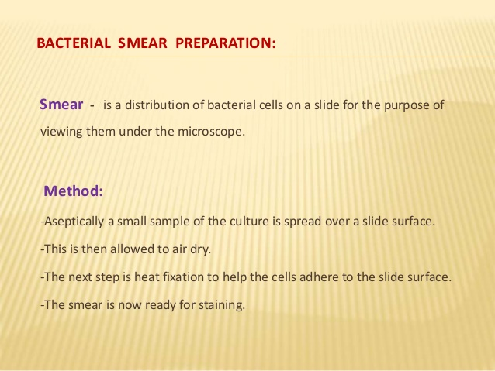
17-09-2024
6

Slide 7
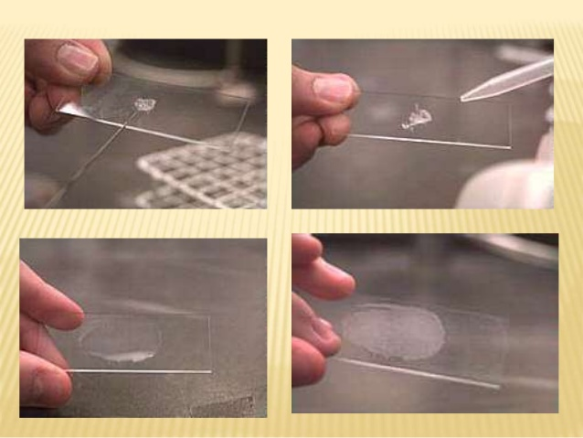
17-09-2024
7

Slide 8
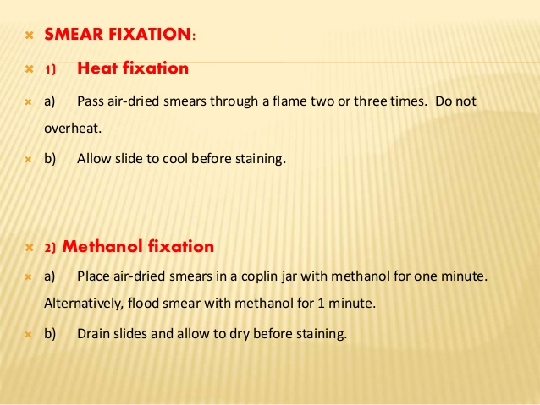
17-09-2024
8

Slide 9
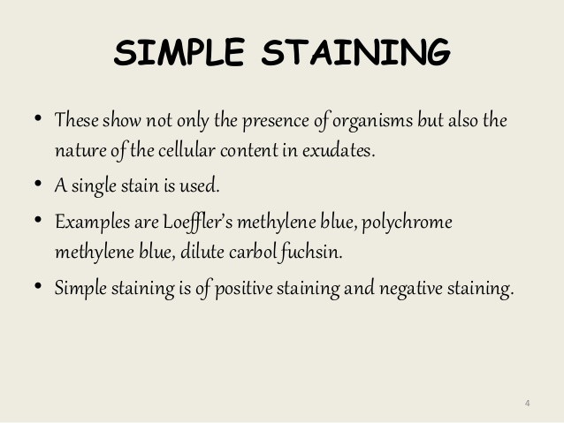
17-09-2024
9

Slide 10
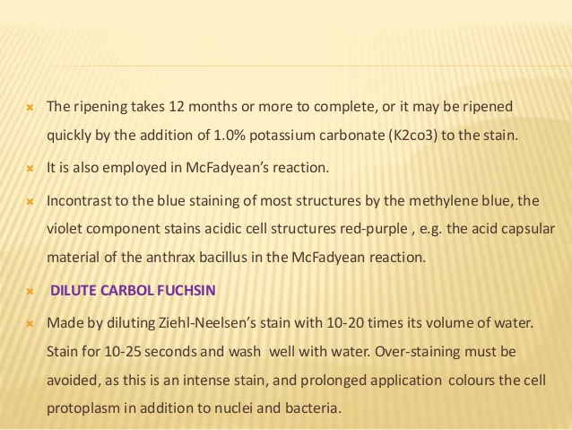
17-09-2024
10

Slide 11
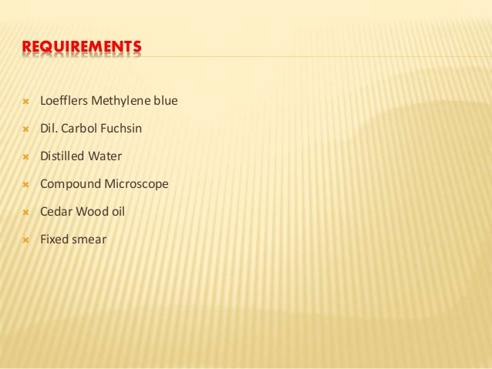
17-09-2024
11

Slide 12
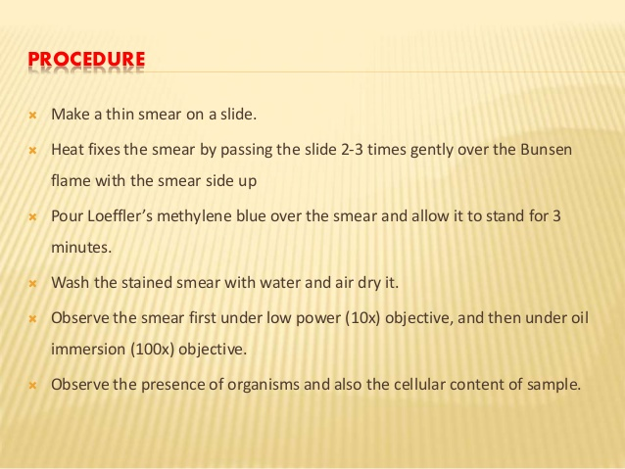
17-09-2024
12

Slide 13
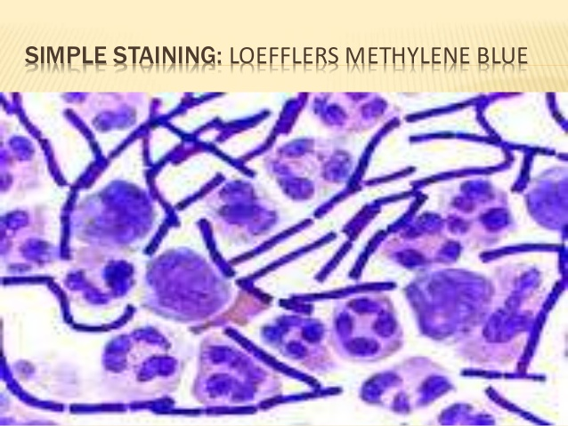
17-09-2024
13

Slide 14
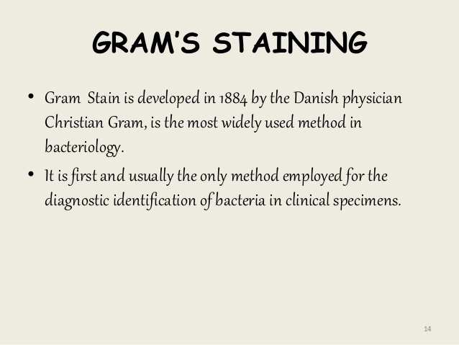
17-09-2024
14

Slide 15
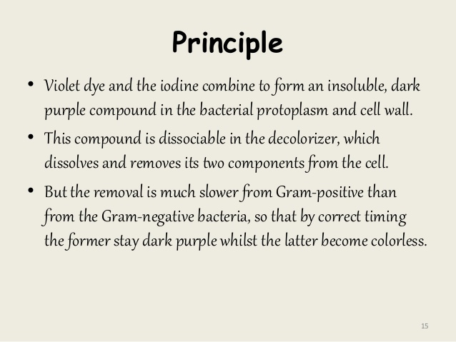
17-09-2024
15

Slide 16
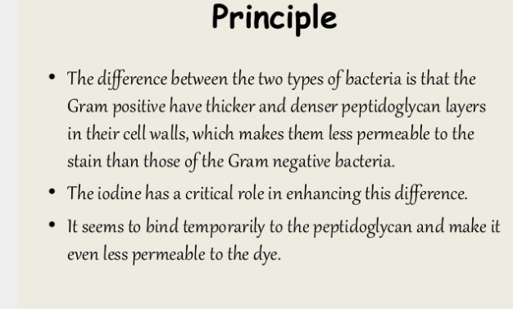
17-09-2024
16

Slide 17
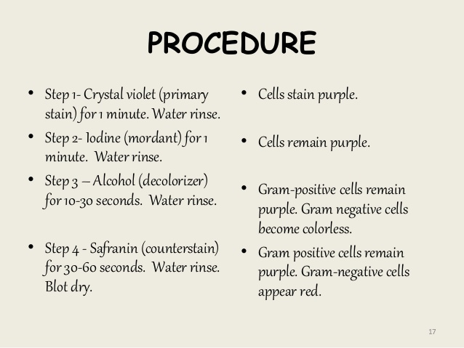
17-09-2024
17

Slide 18
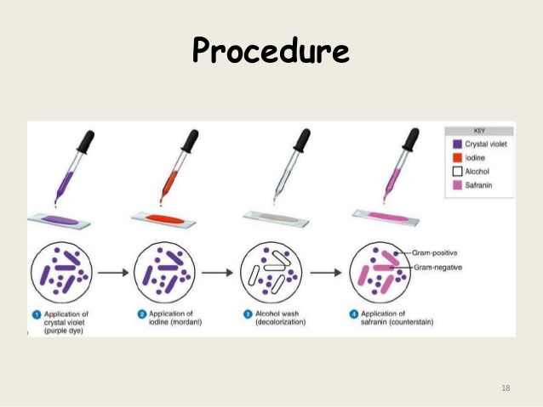
17-09-2024
18

Slide 19
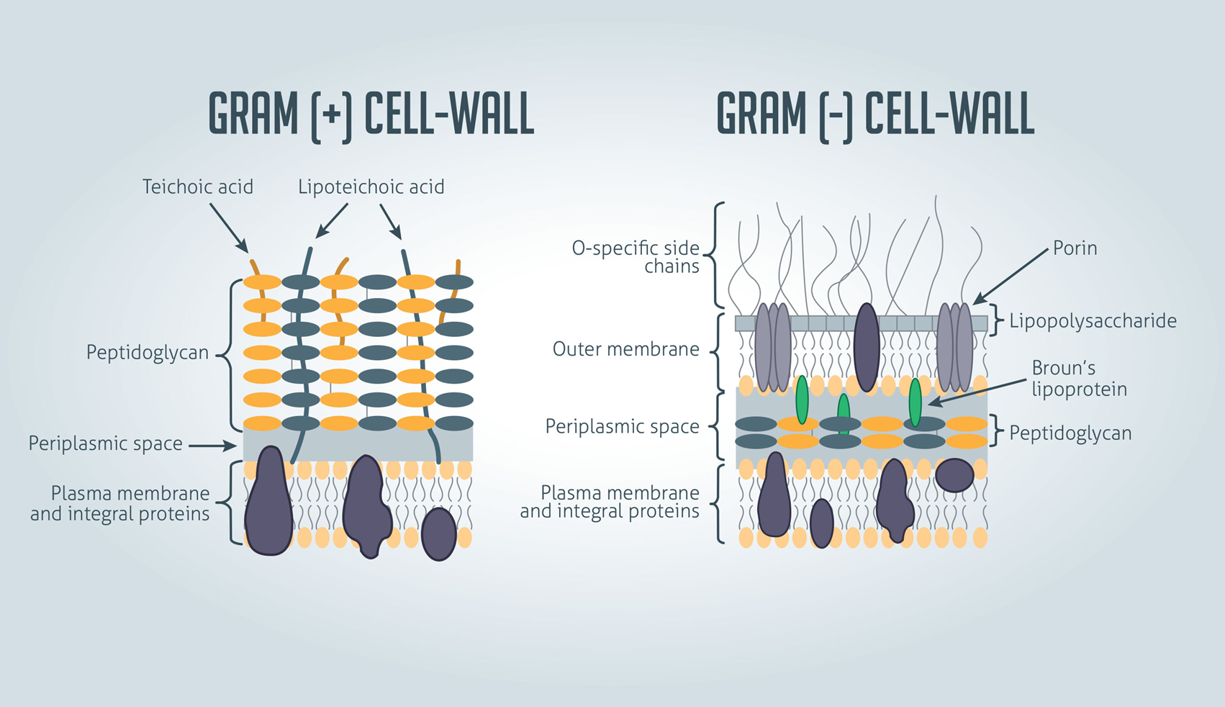
17-09-2024
19

Slide 20
Gram-Positive and Gram-Negative Bacteria
The various characteristic features of Gram-positive and Gram-negative bacteria shall be discussed at length in this particular section.
FOR GRAM-NEGATIVE BACTERIA. There are two distinct layers that have been duly recognized in
the cell envelopes of Gram-negative bacteria, namely :
(a) An uniform inner layer approximately 2–3 mm wide, and
(b) A thicker outer layer nearly 8–10 nm wide.
Importantly, the peptidoglycan is prominently confined to the inner layer ; whereas, the outer layer (membrane) essentially comprises of proteins, lipoproteins, and lipopolysaccharides. The principal chemical differences that predominently occur between the cell walls of GRAM-POSITIVE BACTERIA and the inner rigid wall layer and outer wall layer(s) of Gram-negative bacteria have been duly summarized in Table Principal Chemical Differences Existing Between Cell Walls of Gram-positive and Gram-negative Bacteria
.
CHEMICAL ENTITIES | GRAM POSTIVE | G R A M NEGATIVE
 |  | INNER RIGID WALL LAYER | OUTER WALL LAYERS(S)
Lipoprotein | - | + or - | -
Lipopolysaccharide | - | - | -
Peptidoglycen | + | + | -
Polysaccharide | + | - | -
Protein | + or - | - | +
Teichoic acid | + | - | -
17-09-2024
20

Slide 21
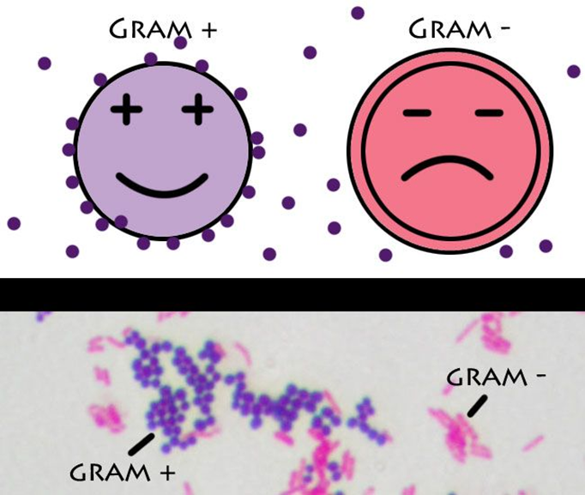
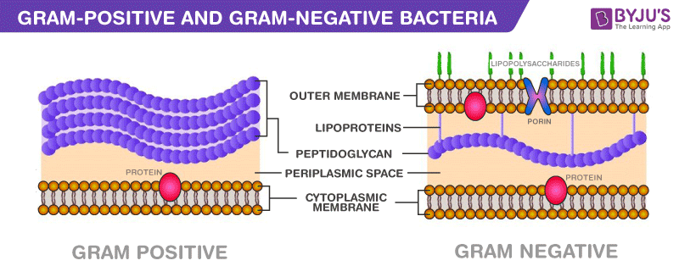

Slide 22
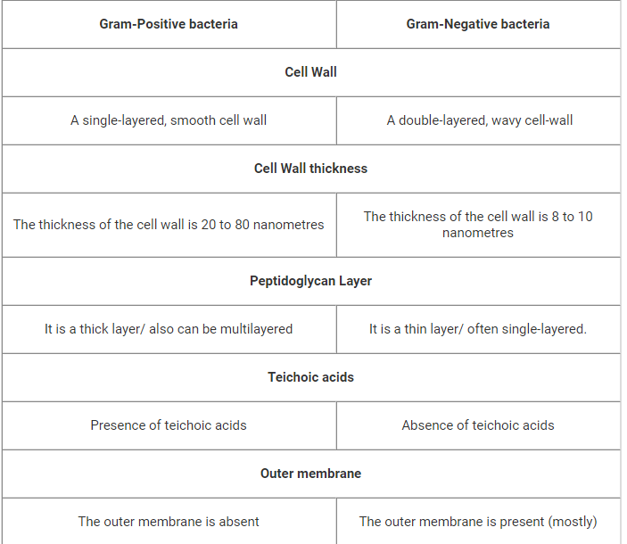
DIFFERNCE BETWEEN GRAM POSITIVE AND GRAM NEGATIVE BACTERIA
.
17-09-2024
22

Slide 23
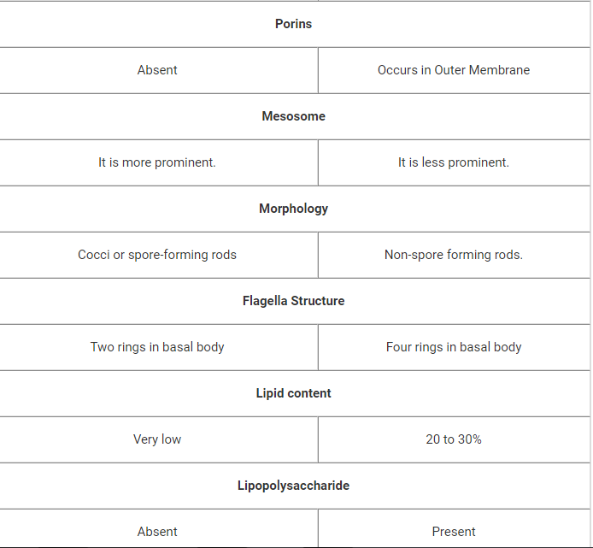
.
17-09-2024
23

Slide 24
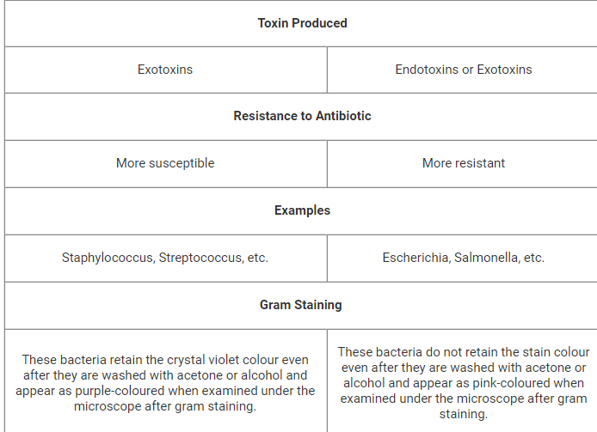
.
17-09-2024
24

Slide 25
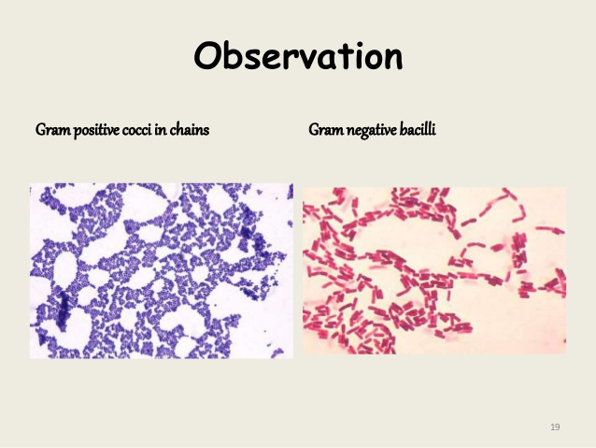
17-09-2024
25

Slide 26
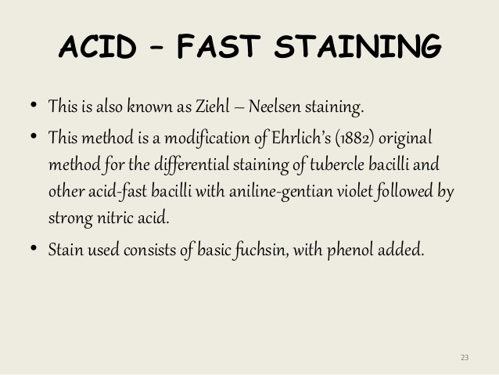
17-09-2024
26

Slide 27
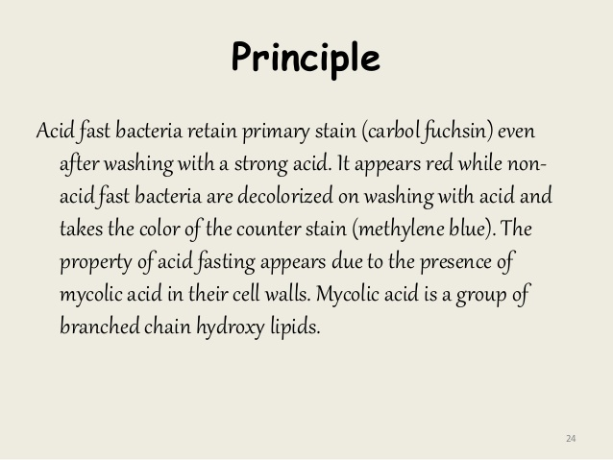
17-09-2024
27

Slide 28
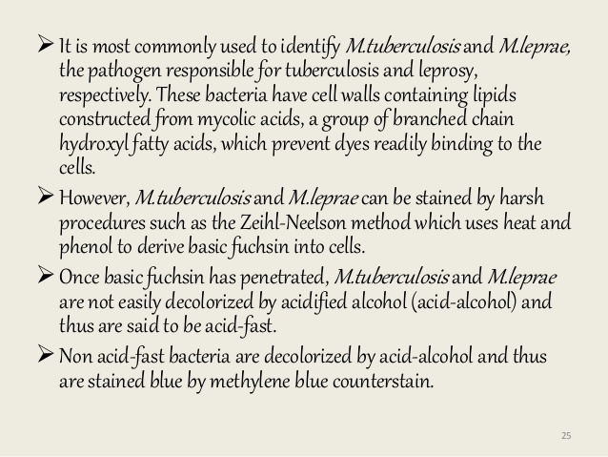
17-09-2024
28

Slide 29
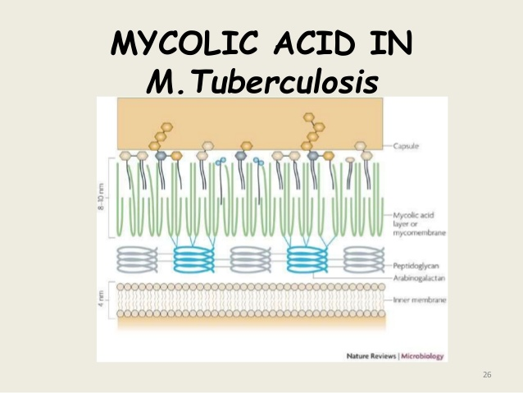
17-09-2024
29

Slide 30
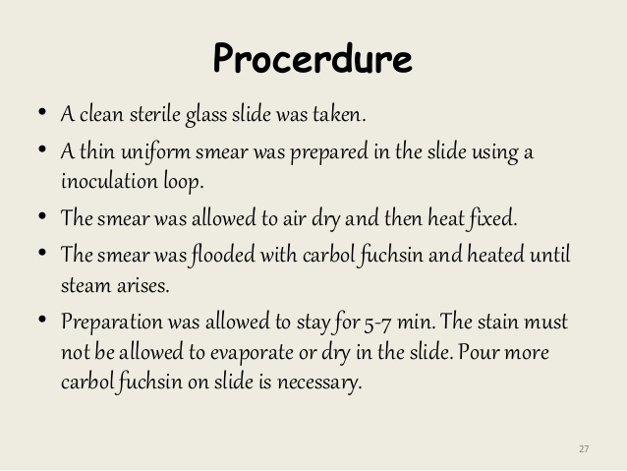
17-09-2024
30

Slide 31
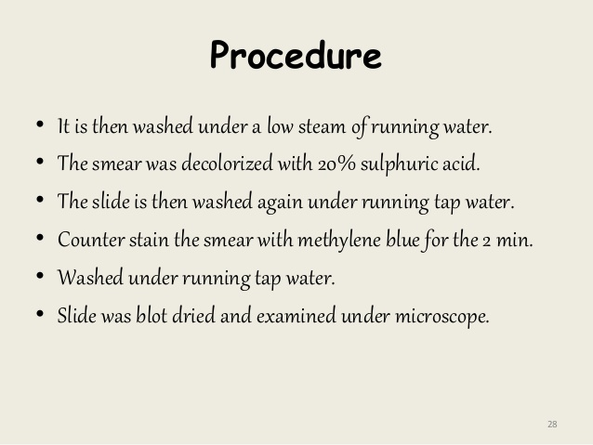
17-09-2024
31

Slide 32
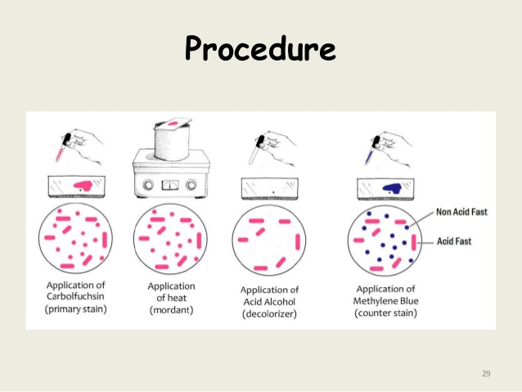
17-09-2024
32

Slide 33
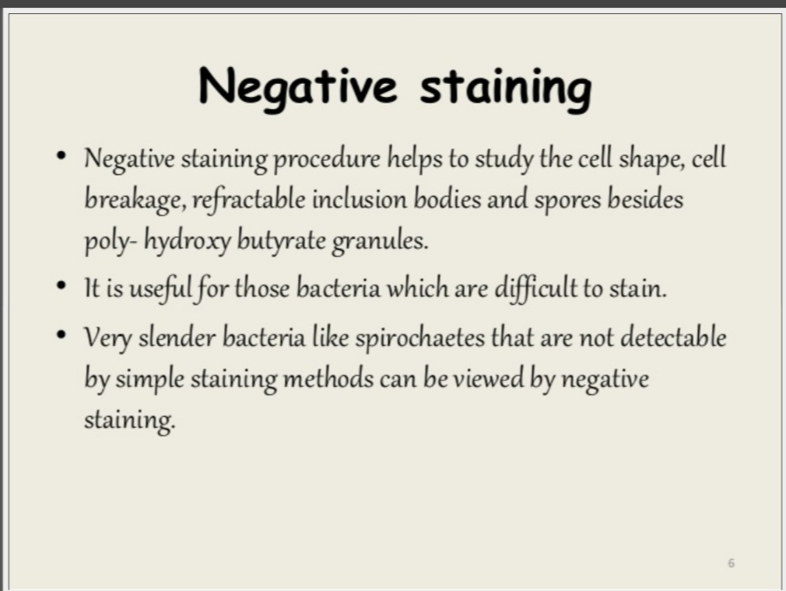

Slide 34
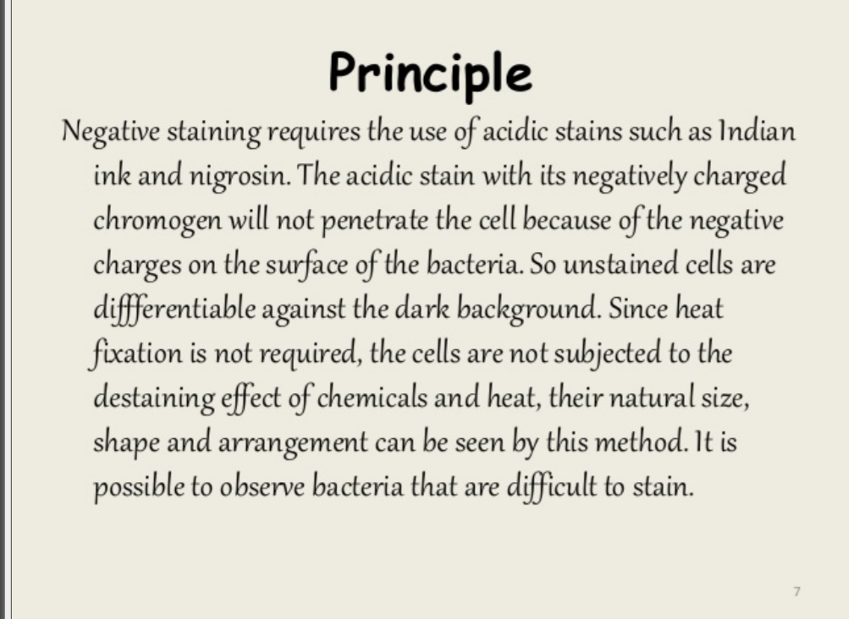

Slide 35
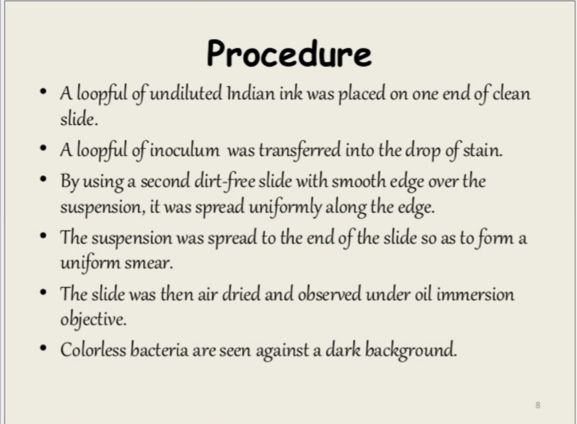

Slide 36
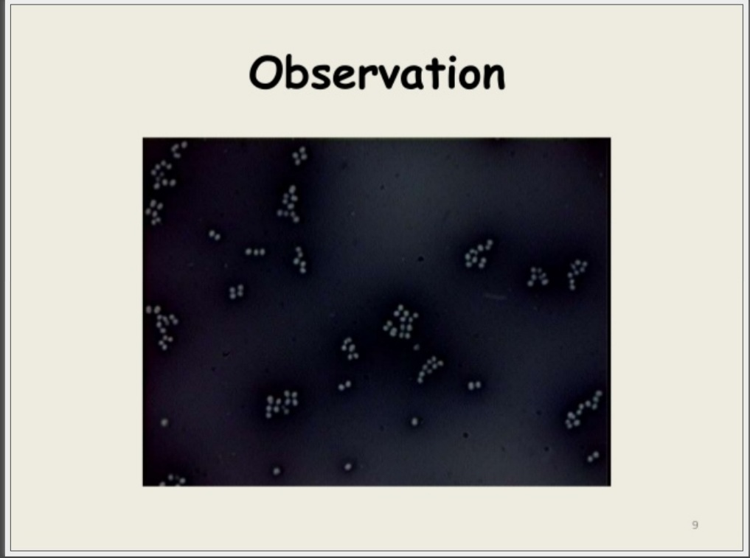

Slide 37
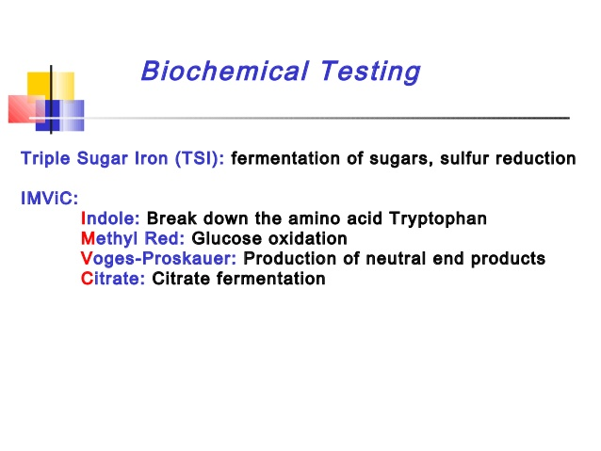
17-09-2024
37

Slide 38
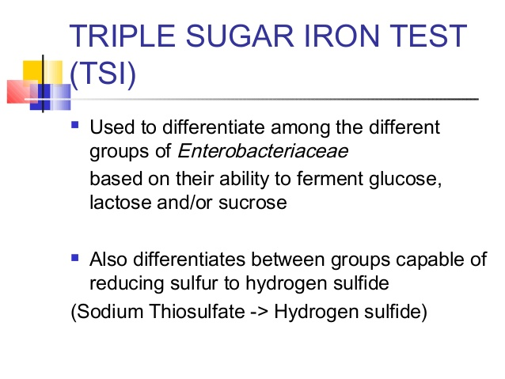
17-09-2024
38

Slide 39
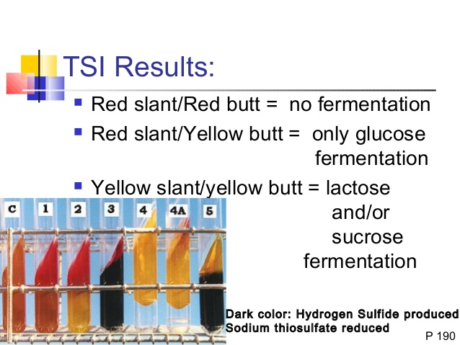
17-09-2024
39

Slide 40
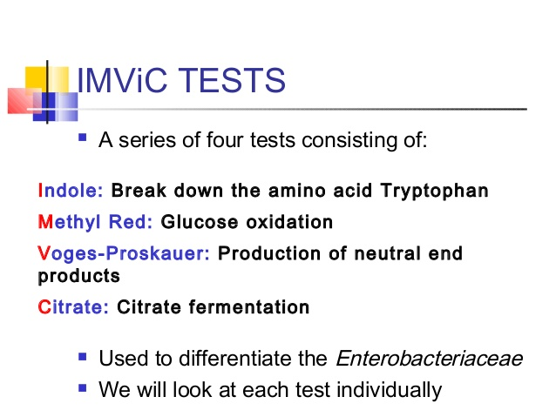
17-09-2024
40

Slide 41
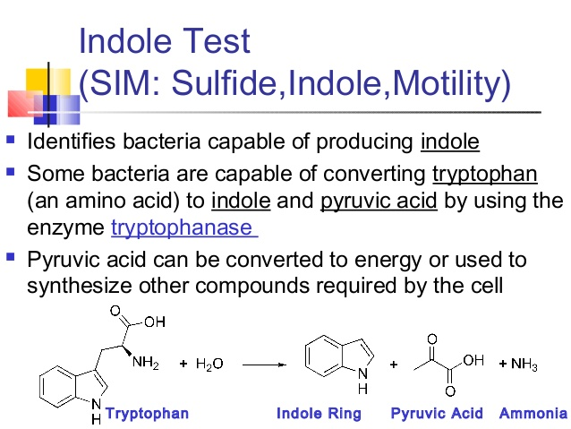
17-09-2024
41

Slide 42
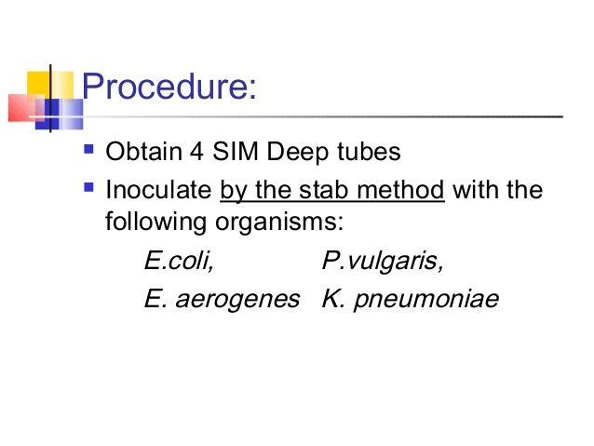
17-09-2024
42

Slide 43
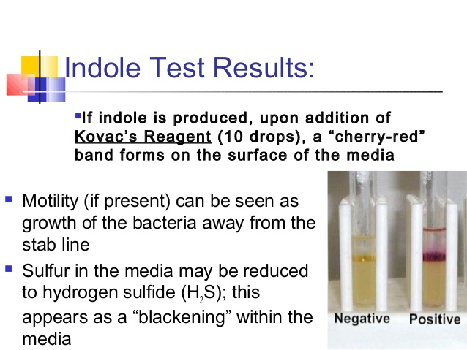
17-09-2024
43

Slide 44
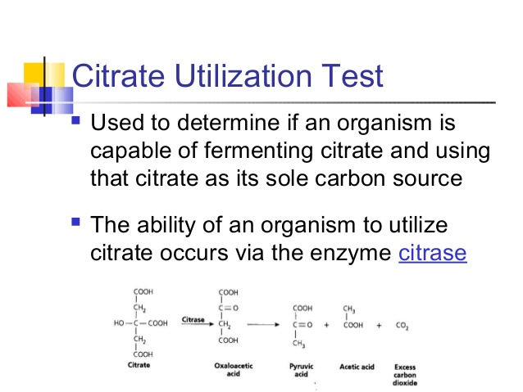
17-09-2024
44

Slide 45
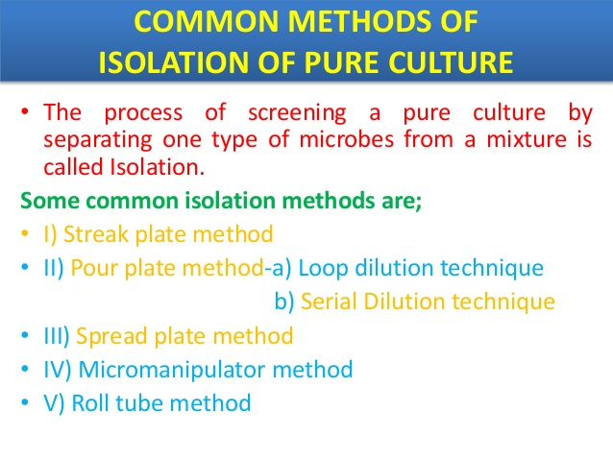

Slide 46
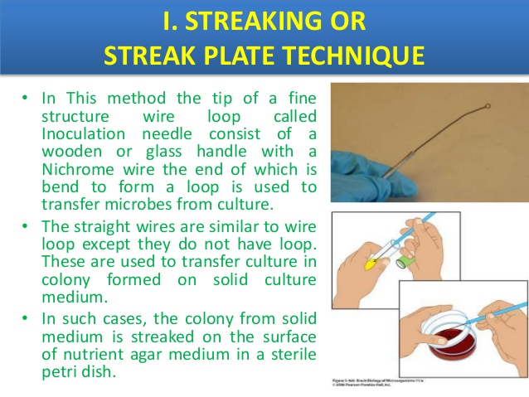

Slide 47
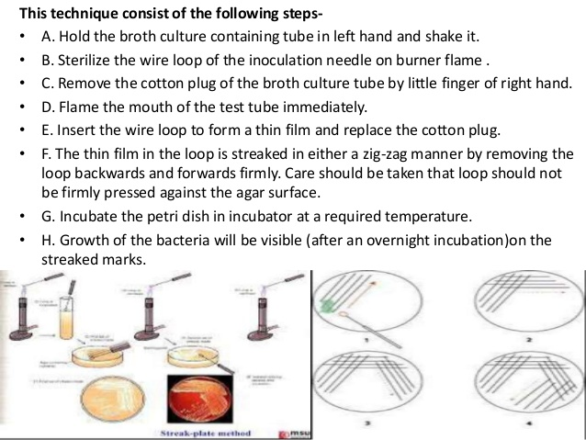

Slide 48
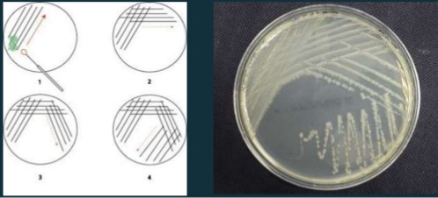

Slide 49
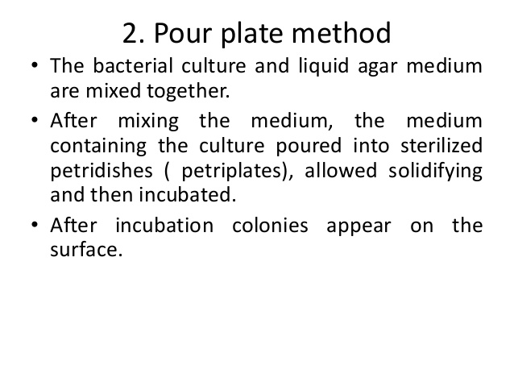

Slide 50
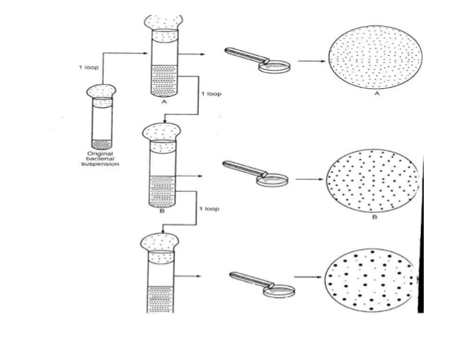

Slide 51
Loop dilution method
The pour technique , also sometimes called the loop dilution method , involves the successive transfer of bacteria from the original culture to a series of tubes of liquified agar . Basically , a loopful of your original culture is transferred to a tube of liquified agar and mixed .

Slide 52
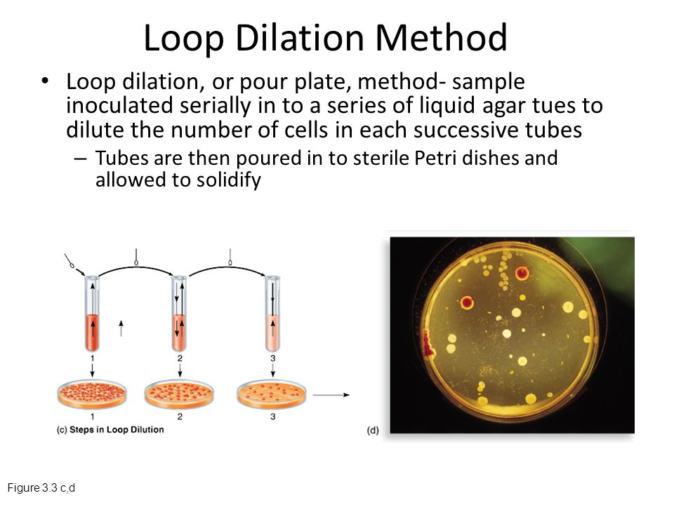

Slide 53
Serial dilution
Serial dilatation involves the process of taking a sample and diluting it through a series of standard volumes of sterile dilutant , which can either be distilled water or 0.9 % saline . Then a small measured volume of each dilution is used to make a series of pour or spread plates .

Slide 54


Slide 55


Slide 56


Slide 57


Slide 58


Slide 59


Slide 60
END OF THE UNIT

