Slide 1
PHARMACEUTICAL MICROBILOGY
UNIT 5- Detailed study of different methods of sterilization including their merits
and demerits. Sterilization methods for all pharmaceutical products.
Detailed study of sterility testing of different pharmaceutical preparations .
Brief information on Validation.
UNIT 6 - Disinfectants- Study of disinfectants, antiseptics, fungicidal and virucidal
agents factors affecting their activation and mechanism of action.
Evaluation of bactericidal, bacteristatic, , virucidal activities, evaluation of
preservatives in pharmaceutical preparations.
17-09-2024
1

Slide 2
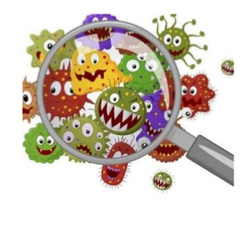
STRERILIZATION
Sterilization is complete killing, or removal, of all living organisms from a particular location or material. It can be accomplished by incineration, nondestructive heat treatment, certain gases, exposure to ionizing radiation, some liquid chemicals, and filtration.
Disinfection is the destruction of pathogenic microorganisms by processes that fail to meet the criteria for sterilization. Pasteurization is a form of disinfection, but the term is most commonly applied to the use of liquid chemical agents known as disinfectants, which usually have some degree of selectivity. Bacterial spores, organisms with waxy coats (eg, mycobacteria), and some viruses may show considerable resistance to the common disinfectants. Antiseptics are disinfectant agents that can be used on body surfaces such as the skin or vaginal tract to reduce the numbers of microbiota and pathogenic contaminants. They have lower toxicity than disinfectants used environmentally, but are usually less active in killing vegetative organisms.
17-09-2024
2

Slide 3
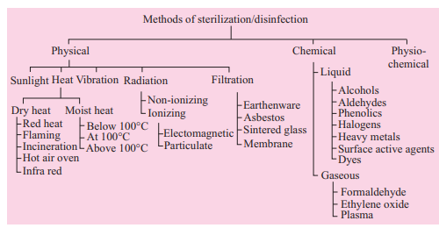
17-09-2024
3

Slide 4
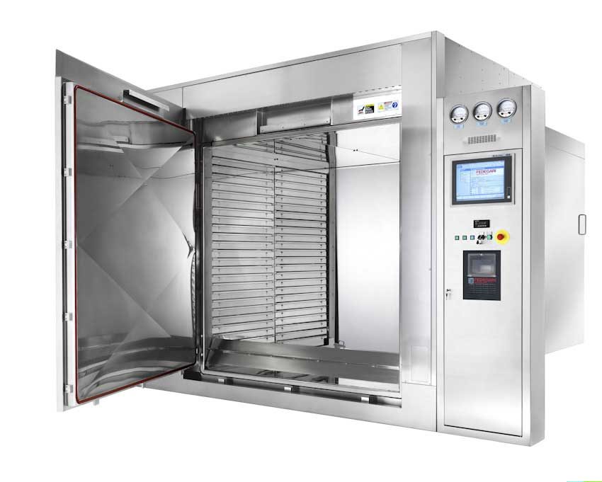
DRY HEAT STERILIZATION
Heat sterilization is the most widely used and reliable method of sterilization,
involving destruction of enzymes and other essential cell constituents. The
process is more effective in hydrated state where under conditions of high
humidity, hydrolysis and denaturation occur, thus lower heat input is required.
Under dry state, oxidative changes take place, and higher heat input is required.
This method of sterilization can be applied only to the thermostable products,
but it can be used for moisture-sensitive materials for which dry heat (160-
180°C) sterilization, and for moisture-resistant materials for which moist heat
(121-134°C) sterilization is used
Dry Heat Sterilization: Examples of Dry heat sterilization are:
1. Incineration
2. Red heat
3. Flaming
4. Hot air oven
It employs higher temperatures in the range of 160-180°C and requires exposures time up to 2 hours, depending upon the temperature employed. The benefit of dry heat includes good penetrability and non-corrosive nature which
makes it applicable for sterilizing glass-wares and metal surgical instruments. It is also used for sterilizing non-aqueous thermo-stable liquids and thermostable powders. Dry heat destroys bacterial endotoxins (or pyrogens) which are difficult to eliminate by other means and this property makes it applicable for sterilizing glass bottles which are to be filled aseptically
17-09-2024
4

Slide 5
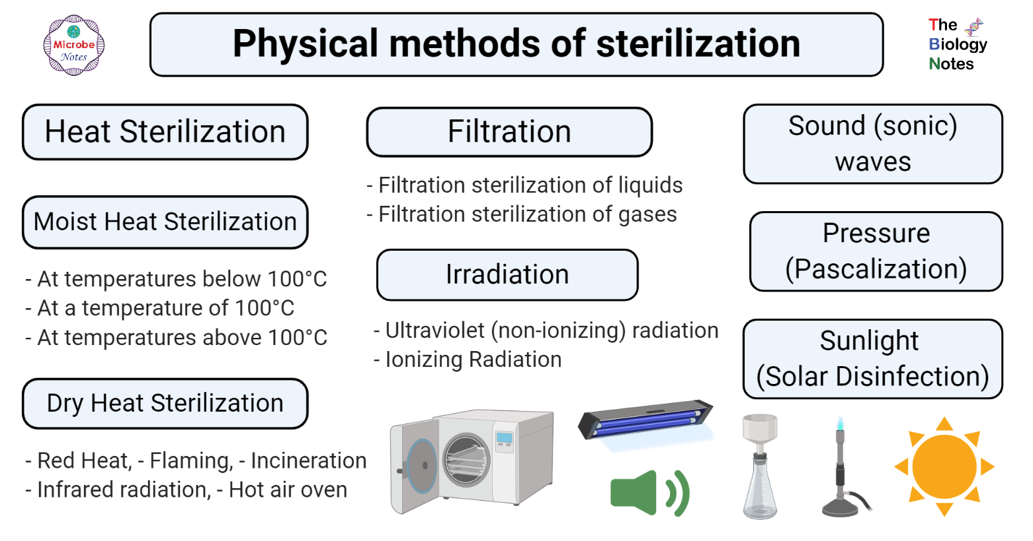
17-09-2024
5

Slide 6
Hot-air oven:- Dry heat sterilization is usually carried out in a hot air oven, which consists of the following:
(i) An insulated chamber surrounded by an outer case containing electric heaters.
(ii) A fan
(iii) Shelves
(iv) Thermocouples
(v) Temperature sensor
(vi) Door locking controls.
Operation
(i) Articles to be sterilized are first wrapped or enclosed in containers of cardboard, paper or aluminium.
(ii) Then, the materials are arranged to ensure uninterrupted air flow.
(iii) Oven may be pre-heated for materials with poor heat conductivity.
(iv) The temperature is allowed to fall to 40°C, prior to removal of sterilized
material.
TEMPERATURE AND TIME RELATIONSHIP FOR HOT AIR OVEN
TEMPERATURE ( IN DEGREE ) | TIME ( IN MIN)
170 | 60
160 | 120
150 | 150
140 | 180
17-09-2024
6

Slide 7
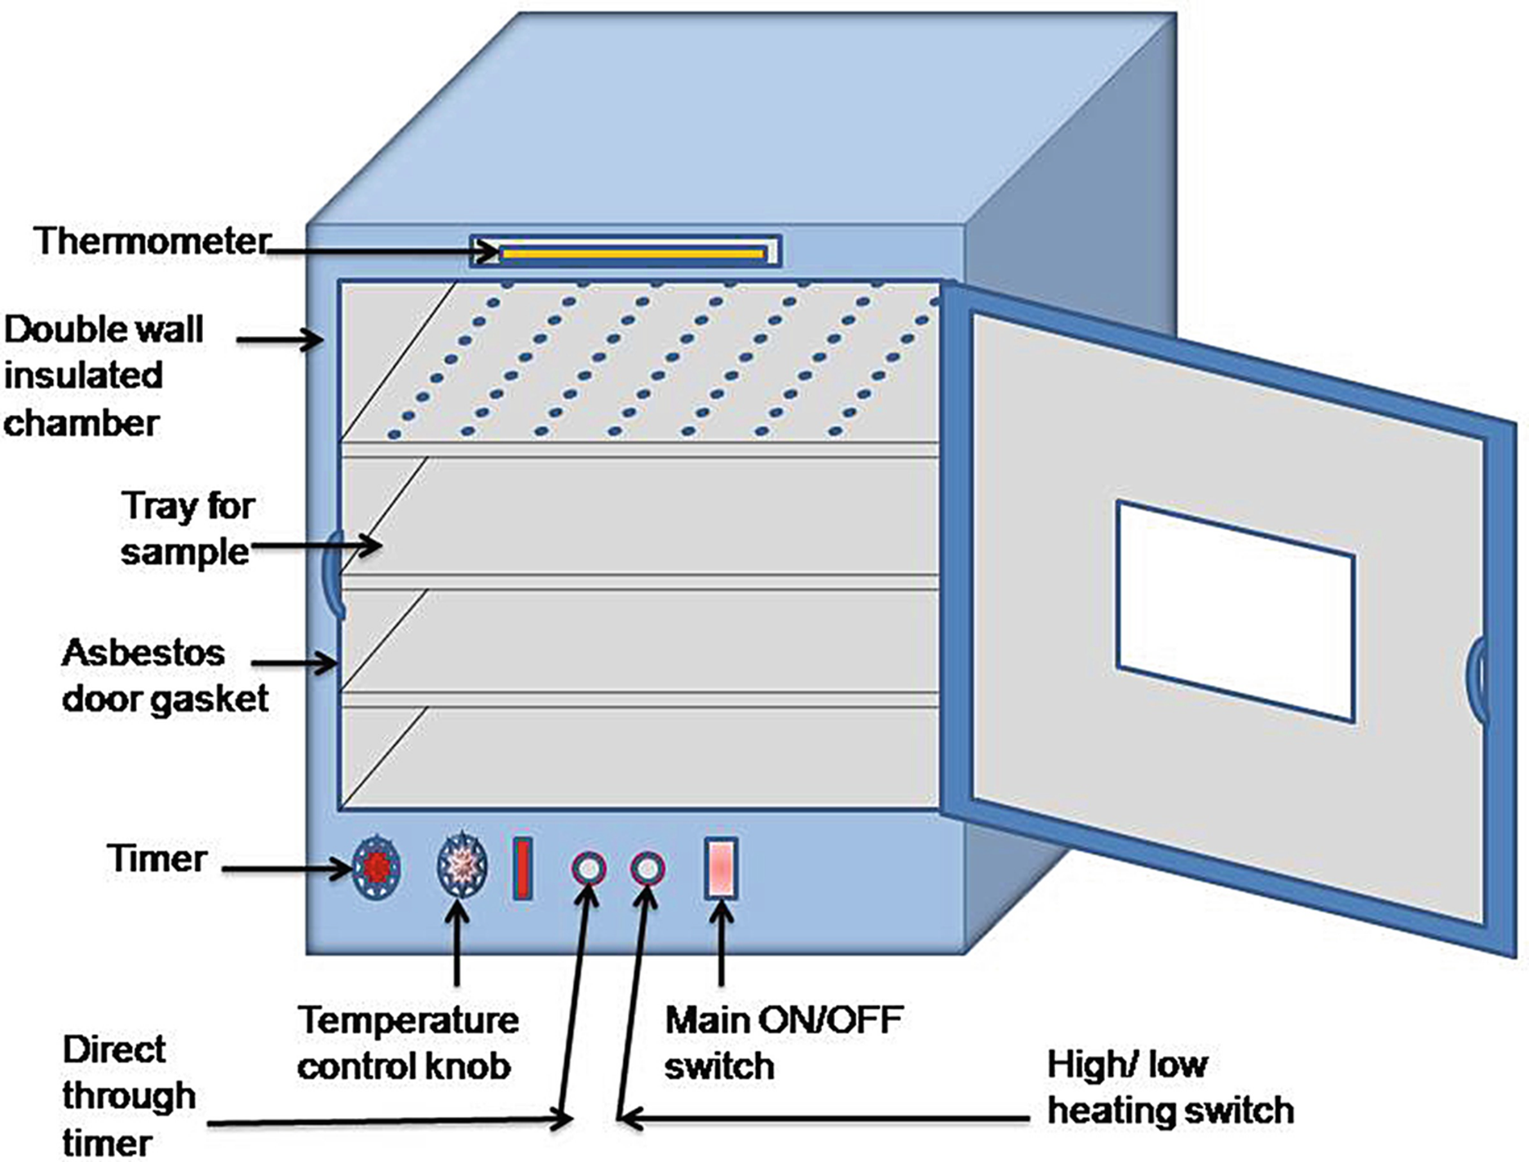
17-09-2024
7

Slide 8
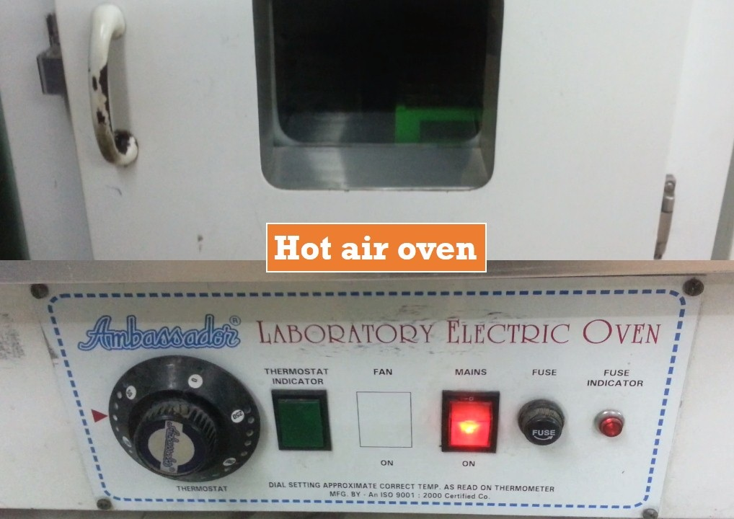
17-09-2024
8

Slide 9
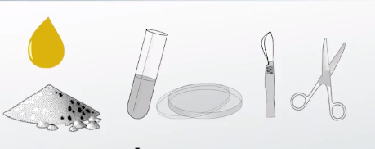
Sterilization by dry heat is performed by conduction. The temperature is consumed by the surface of the objects, then moves towards the core of the object, coating by coating. The whole object will ultimately attain the temperature needed for sterilization to take place.
Dry heat causes most of the injury by oxidizing particles. The primary cell components are damaged and the organism dies. The temperature is kept for about an hour to eliminate the most ambitious of the resistant spores.
A hot air oven is a type of dry heat sterilization. Dry heat sterilization is used on equipment that cannot be wet and on material that will not melt, catch fire, or change form when exposed to high temperatures. Moist heat sterilization uses water to boil items or steam them to sterilize and doesn't take as long as dry heat sterilization. Examples of items that aren't sterilized in a hot air oven are surgical dressings, rubber items, or plastic material.
Items that are sterilized in a hot air oven include:
Glassware (like petri dishes, flasks, pipettes, and test tubes)
Powders (like starch, zinc oxide, and sulfadiazine)
Materials that contain oils
Metal equipment (like scalpels, scissors, and blades).
Hot air ovens use extremely high temperatures over several hours to destroy microorganisms and bacterial spores. The ovens use conduction to sterilize items by heating the outside surfaces of the item, which then absorbs the heat and moves it towards the center of the item. The commonly-used temperatures and time that hot air ovens need to sterilize materials is 170 degrees Celsius for 30 minutes, 160 degrees Celsius for 60 minutes, and 150 degrees Celsius for 150 minutes.
17-09-2024
9

Slide 10
Advantages
Do not require water and there is not much pressure build up within the oven making safer to work.
Smaller than autoclave but can still be as effective.
Higher temperature can be reached compared to other means.
This treatment kills the bacterial endotoxin, not all treatments can do this.
Effective method of sterilization of heat stable articles only method of sterilizing oils and powders.
Protective of sharps or instruments with a cutting edge (fewer problems with dulling of cutting edges).
It does not leave any chemical residue.
It is nontoxic and does not harm the environment.
Disadvantage
Some organisms like prion may not be killed or inactivated.
Plastic wares or heat sensitive materials can’t be sterilized.
Glasses may become smoky due to high sterilization temperatures: Temperature holding period is at 160°C for 1 hour, 170°C 30 minutes where as at 180°C 20 minutes.
Dry heat penetrates materials slowly and unevenly and thus time consuming method because of slow rate of heat penetration and microbial killing.
It requires a continuous source of electricity.
17-09-2024
10

Slide 11
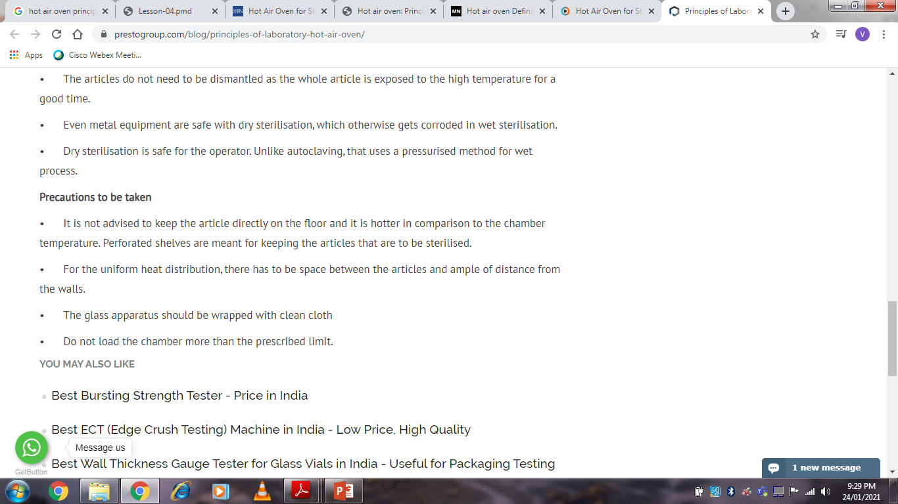
17-09-2024
11

Slide 12
MOIST HEAT STERILIZATION
Moist heat may be used in three forms to achieve microbial inactivation
1. Dry saturated steam – Autoclaving
2. Boiling water/ steam at atmospheric pressure
3. Hot water below boiling point.
Moist heat sterilization involves the use of steam in the range of 121-134°C. Steam under pressure is used to generate high temperature needed for sterilization. Saturated steam acts as an effective sterilizing agent. Steam for sterilization can be either wet saturated steam (containing entrained water droplets) or dry saturated steam (no entrained water droplets).
Moist heat destroys microorganisms by the irreversible coagulation and denaturation of enzymes and structural proteins. In support of this fact, it has been found that the presence of moisture significantly affects the coagulation temperature of proteins and the temperature at which microorganisms are destroyed.
Pasteurization, heat-treatment process that destroys pathogenic microorganisms in certain foods and beverages. It is named for the French scientist Louis Pasteur, who in the 1860s demonstrated that abnormal fermentation of wine and beer could be prevented by heating the beverages to about 57° C (135° F) for a few minutes
17-09-2024
12

Slide 13
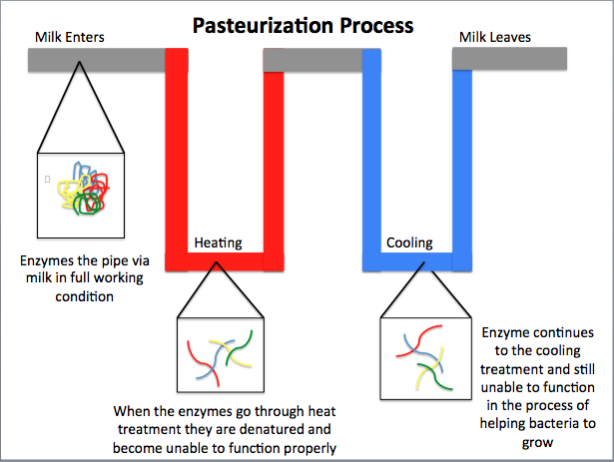
17-09-2024
13

Slide 14
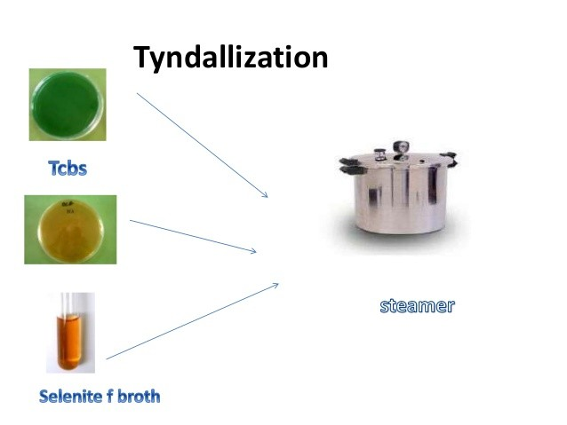
Tyndallization is a process dating from the nineteenth century for sterilizing substances, usually food, named after its inventor, scientist John Tyndall, that can be used to kill heat-resistant endospores. Although considered old-fashioned, it is still occasionally used. A simple and effective sterilizing method commonly used today is autoclaving: heating the substance being sterilized to 121 °C for 15 minutes in a pressured system.
If autoclaving is not possible because of lack of equipment, or the need to sterilize something that will not withstand the higher temperature, unpressurized heating for a prolonged period at a temperature of up to 100 °C, the boiling point of water, may be used.
The heat will kill the bacterial cells; however, bacterial spores capable of later germinating into bacterial cells may survive. Tyndallization can be used to destroy the spores. Tyndallization essentially consists of heating the substance to boiling point (or just a little below boiling point) and holding it there for 15 minutes, three days in succession
17-09-2024
14

Slide 15
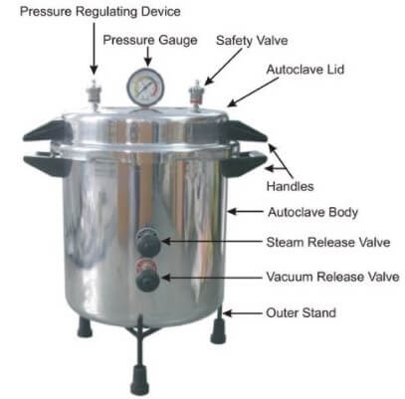
AUTOCLAVE
An autoclave is a machine that provides a physical method of sterilization by killing bacteria, viruses, and even spores present in the material put inside of the vessel using steam under pressure.
Autoclave sterilizes the materials by heating them up to a particular temperature for a specific period of time.
The autoclave is also called a steam sterilizer that is commonly used in healthcare facilities and industries for various purposes.
The autoclave is considered a more effective method of sterilization as it is based on moist heat sterilization.
17-09-2024
15

Slide 16
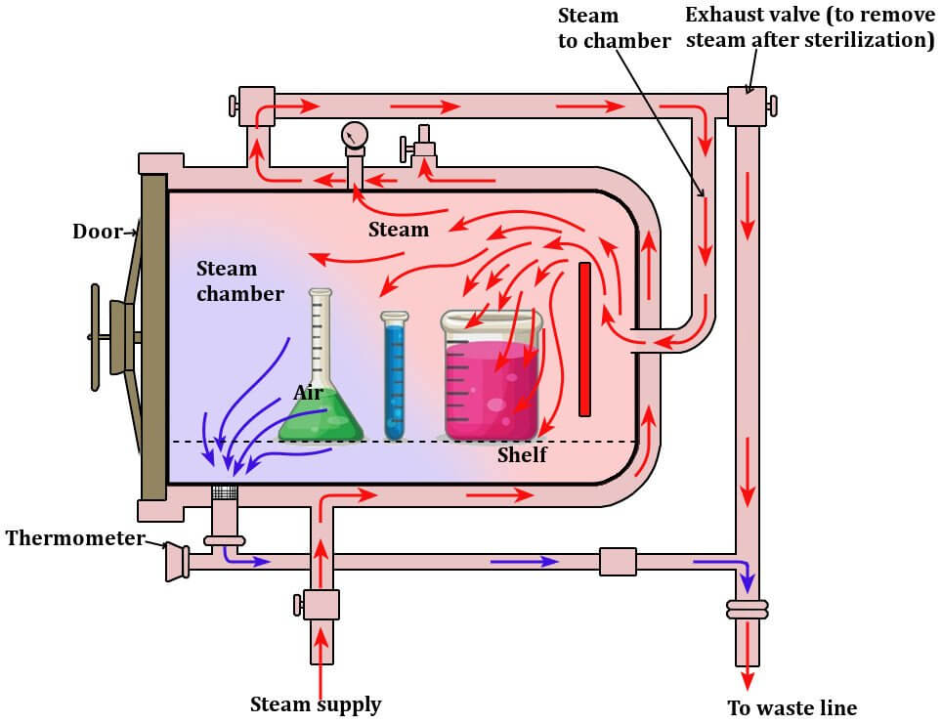
17-09-2024
16

Slide 17
The autoclave works on the principle of moist heat sterilization where steam under pressure is used to sterilize the material present inside the chamber.
The high pressure increases the boiling point of water and thus helps achieve a higher temperature for sterilization.
Water usually boils at 100°C under normal atmospheric pressure (760 mm of Hg); however, the boiling point of water increases if the pressure is to be increased.
Similarly, the high pressure also facilitates the rapid penetration of heat into deeper parts of the material, and moisture present in the steam causes the coagulation of proteins causing an irreversible loss of function and activity of microbes.
This principle is employed in an autoclave where the water boils at 121°C at the pressure of 15 psi or 775 mm of Hg.
When this steam comes in contact on the surface, it kills the microbes by giving off latent heat.
The condensed liquid ensures the moist killing of the microbes.
Once the sterilization phase is completed (which depends on the level of contamination of material inside), the pressure is released from the inside of the chamber through the whistle.
The pressure inside the chamber is then restored back tot eh ambient pressure while the components inside remain hot for some time.
17-09-2024
17

Slide 18
In general, an autoclave is run at a temperature of 121° C for at least 30 minutes by using saturated steam under at least 15 psi of pressure. The following are the steps to be followed while running an autoclave:
Before beginning to use the autoclave, it should be checked for any items left from the previous cycle.
A sufficient amount of water is then put inside the chamber.
Now, the materials to be sterilized are placed inside the chamber.
The lid is then closed, and the screws are tightened to ensure an airtight condition, and the electric heater is switched on.
The safety valves are adjusted to maintain the required pressure in the chamber.
Once the water inside the chamber boils, the air-water mixture is allowed to escape through the discharge tube to let all the air inside to be displaced. The complete displacement can be ensured once the water bubbles cease to come out from the pipe.
The drainage pipe is then closed, and the steam inside is allowed to reach the desired levels (15 lbs in most cases).
Once the pressure is reached, the whistle blows to remove excess pressure from the chamber.
After the whistle, the autoclave is run for a holding period, which is 15 minutes in most cases.
Now, the electric heater is switched off, and the autoclave is allowed to cool until the pressure gauge indicates the pressure inside has lowered down to that of the atmospheric pressure.
The discharge pipe is then opened to allow the entry of air from the outside into the autoclave.
Finally, the lid is opened, and the sterilized materials are taken out of the chamber.
17-09-2024
18

Slide 19
Autoclaves are important devices to ensure the sterilization of materials containing water as they cannot be sterilized by dry heat sterilization. Besides, autoclaves are used for various other purposes.
They are used to decontaminate specific biological waste and sterilize media, instruments, and labware.
Regulated medical waste that might contain bacteria, viruses, and other biological materials are recommended to be inactivated by autoclaving before disposal.
In medical labs, autoclaves are used to sterilize medical equipment, glassware, surgical equipment, and medical wastes.
Similarly, autoclaves are used for the sterilization of culture media, autoclavable containers, plastic tubes, and pipette tips.
Aqueous solutions in glass containers usually reach thermal equilibrium within 10 minutes for volumes up to 100 mL and 20
minutes for volumes up to 1000 mL.
Porous loads, such as surgical dressings and related products, should be processed in an apparatus that ensures steam
penetration.
Most dressings are adequately sterilized by maintaining them at a temperature of 134 - 138 °C for 5 minutes. In certain cases, glass, porcelain, or metal articles are sterilized at 121 - 124 °C for 20 minutes.
Fats and oils may be sterilized at 121 °C for 2 hours but, whenever possible, should be sterilized by dry heat.
In certain cases (e.g. thermolabile substances), sterilization may be carried out at temperatures below 121 °C, provided that the
chosen combination of time and temperature has been validated. Lower temperatures offer a different level of sterilization; if this
is evaluated in combination with the known microbial burden of the material before sterilization, the lower temperatures may be
satisfactory. Specific conditions of temperature and time for certain preparations are stated in individual monographs.
The bioindicator strain proposed for validation of this sterilization process is: spores of Bacillus stearothermophilus (e.g. ATCC
7953 or CIP 52.81) for which the D-value (i.e. 90% reduction of the microbial population) is 1.5-2 minutes at 121 °C, using about
106 spores per indicator.
17-09-2024
19

Slide 20
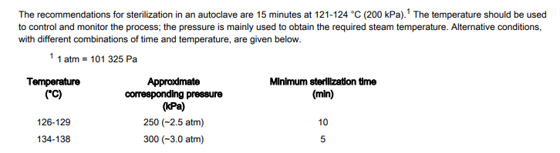
17-09-2024
20

Slide 21
Advantages of Steam Sterilization Method
Nontoxic to patient, staff, environment
Cycle easy to control and monitor
Rapidly microbicidal
Least affected by organic/inorganic soils among sterilization processes listed
Rapid cycle time
Penetrates medical packing, device lumens.
Disadvantages of Steam Sterilization Method
Deleterious for heat-sensitive instruments
Microsurgical instruments damaged by repeated exposure
May leave instruments wet, causing them to rust
Potential for burns
17-09-2024
21

Slide 22
RADIATION STERILIZATION
Many types of radiation are used for sterilization like electromagnetic radiation (e.g. gamma rays and UV light), particulate radiation (e.g. accelerated electrons).
The major target for these radiation is microbial DNA. Gamma rays and electrons cause ionization and free radical production while UV light causes excitation.
Radiation sterilization with high energy gamma rays or accelerated electrons has proven to be a useful method for the industrial sterilization of heat sensitive products. But some undesirable changes occur in irradiated products, an
example is aqueous solution where radiolysis of water occurs.
Radiation sterilization is generally applied to articles in the dry state; including surgical instruments, sutures, prostheses, unit dose ointments, plastic syringes. and dry pharmaceutical products. UV light, with its much lower energy, and poor
penetrability finds uses in the sterilization of air, for surface sterilization of aseptic work areas, for treatment of manufacturing grade water, but is not suitable for sterilization of pharmaceutical dosage forms.
Gamma ray Sterilizer: Gamma rays for sterilization are usually derived from cobalt-60 source, the isotope is held as pellets packed in metal rods, each rod carefully arranged within the source and containing 20 KCi of activity. This source is housed within a reinforced concrete building with 2 m thick walls. Articles being sterilized are passed through the irradiation chamber on a conveyor belt and move around the raised source. Ultraviolet Irradiation: The optimum wavelength for UV sterilization is 260 nm. A mercury lamp giving peak emission at 254 nm is the suitable source of UV light in this region
17-09-2024
22

Slide 23

Ultraviolet Irradiation: The optimum wavelength for UV sterilization is 260 nm. A mercury lamp giving peak emission at 254 nm is the suitable source of UV light in this region.
Radiation kills germs that can cause disease and neutralizes other harmful organisms. Sterilization with ionizing radiation inactivates microorganisms very efficiently and, when used for product wrapping, ensures that healthcare products are safe and can be relied upon.
There are 2 general types of radiation used for sterilization, ionizing radiation and non-ionizing radiation. Ionizing radiation is the use of short wavelength, high-intensity radiation to destroy microorganisms. This radiation can come in the form of gamma or X-rays that react with DNA resulting in a damaged cell. Non-ionizing radiation uses longer wavelength and lower energy. As a result, non-ionizing radiation loses the ability to penetrate substances, and can only be used for sterilizing surfaces. The most common form of non-ionizing radiation is ultraviolet light, which is used in a variety of manners throughout industry.
One industrial application of non-ionizing radiation is the breakdown of ozone (O3). By adding ozone to water, bacteria are unable to sustain life. Unfortunately, ozone also destroys process media. Therefore ozone must be broken down so water can be used for its designated purpose. Since ozone is very sensitive to ultraviolet light, pass the water stream under UV bulbs. This breaks the oxygen-oxygen bonds and results in safe process water. Here is a simple representation of the system.
17-09-2024
23

Slide 24
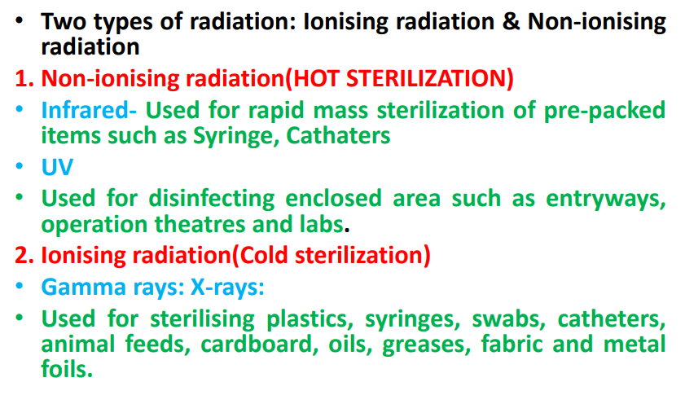
17-09-2024
24

Slide 25
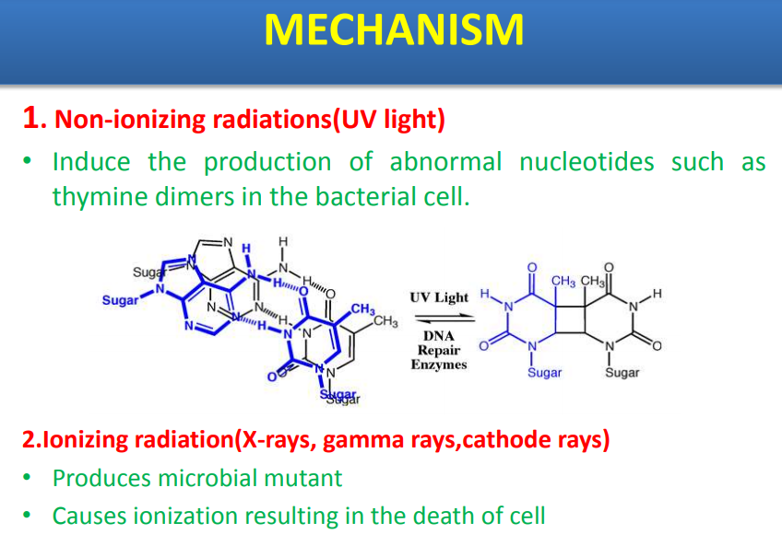
17-09-2024
25

Slide 26
Advantages:
No degradation of media during sterilization, thus it can be used for thermally labile media
Leaves no chemical residue
Administration of precise dosage and uniform dosage distribution
Immediate availability of the media after sterilization.
Disadvantages:
This method is a more costly alternative to heat sterilization
Requires highly specialized equipment.
FILTRATION STERILIZATION
Filtration is the preferred method of sterilizing heat sensitive liquid and gases without exposure to denaturing heat. Rather than destroying contaminating microorganisms, it simply removes them. It is the method of choice for sterilizing antibiotic solutions, toxic chemicals, radioisotopes, vaccines, and carbohydrates, which are all heat-sensitive.
Filtration Sterilization
The liquid or gas is passed through a filter, a device with pores too small for the passage of microorganisms, but large enough to allow the passage of the liquid or gas. These filters are made of different materials;
17-09-2024
26

Slide 27
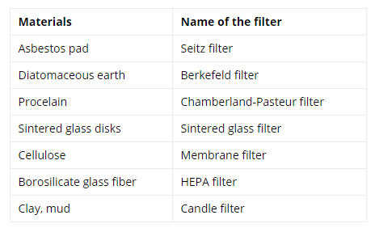
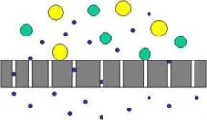
17-09-2024
27

Slide 28
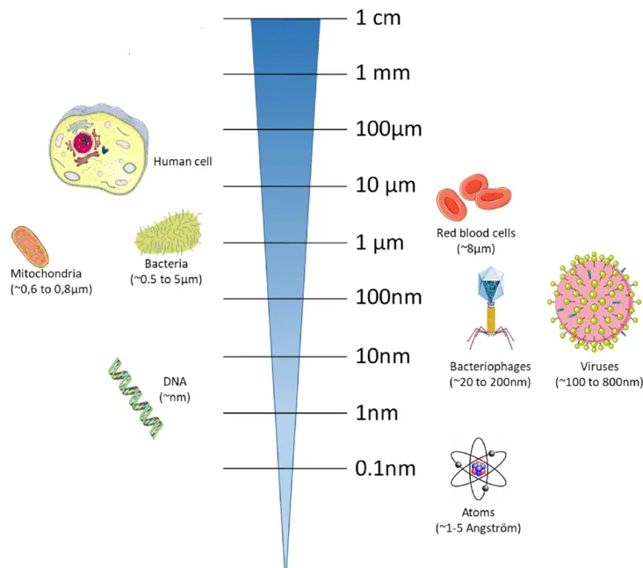
17-09-2024
28

Slide 29
The selection of filters for sterilization must account for the size range of the contaminants to be excluded. The most commonly used filter is composed of nitrocellulose and has a pore size of 0.22μm. The size of the bacteria ranges from 0.3 to 0.5 μm whereas the size of the viruses ranges from 20 nm to 0.36 μm. Thus a filter of 0.22μm retains all bacteria and spores but not all viruses.
Working Mechanism of Filtration Sterilization
Filters work by physically trapping particles larger than the pore size and by retaining somewhat smaller particles via electrostatic attraction of the particles to the filters. Besides porosity, other factors also influence the efficiency of filtration, they are:
electric charge of the filter
electric charge carried by the organisms
nature of the fluid being filtered.
Filtration of liquids is accomplished either by pulling the solution through a cellulose acetate or cellulose nitrate membrane with a vacuum (i.e, by applying negative pressure in the filter paper) or by forcing the solution through filter paper by imposing positive pressure above the fluid.
Filtration of air is accomplished using high-efficiency particulate air (HEPA) filters designed to remove organisms larger than 0.3 μm from isolation rooms, operating rooms, and biological safety cabinets.
17-09-2024
29

Slide 30
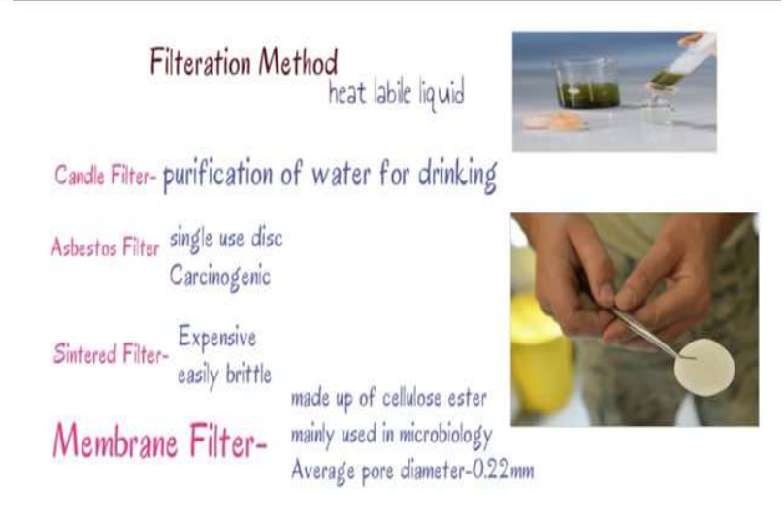
17-09-2024
30

Slide 31
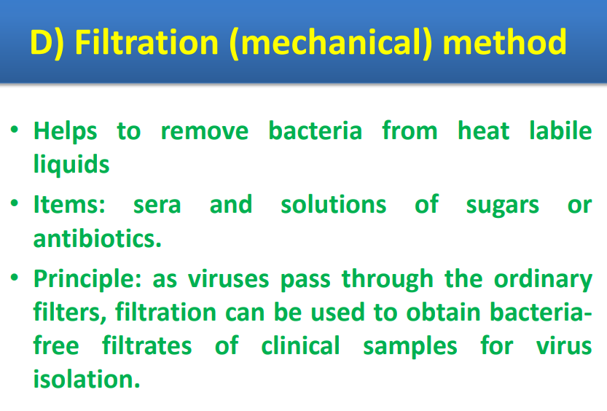
17-09-2024
31

Slide 32
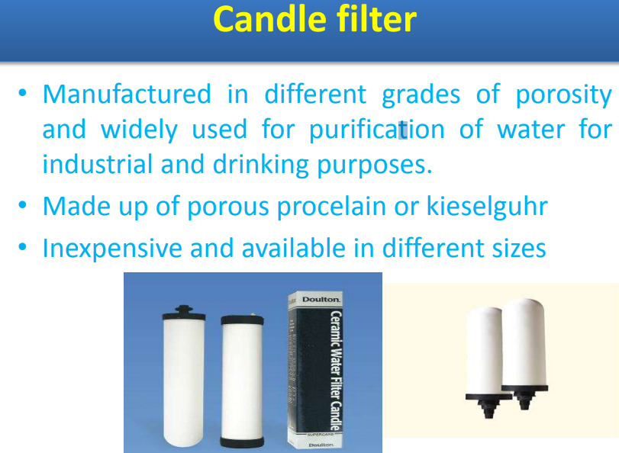
17-09-2024
32

Slide 33
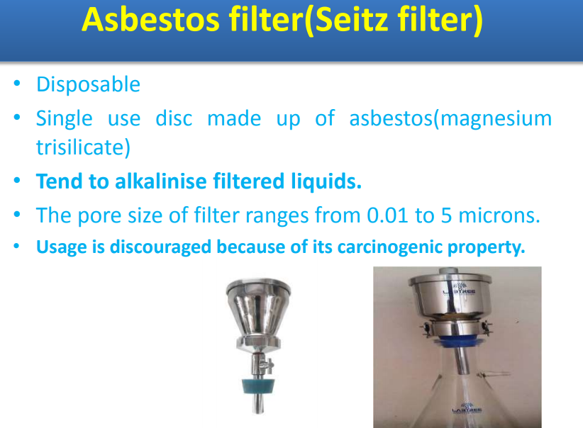
17-09-2024
33

Slide 34
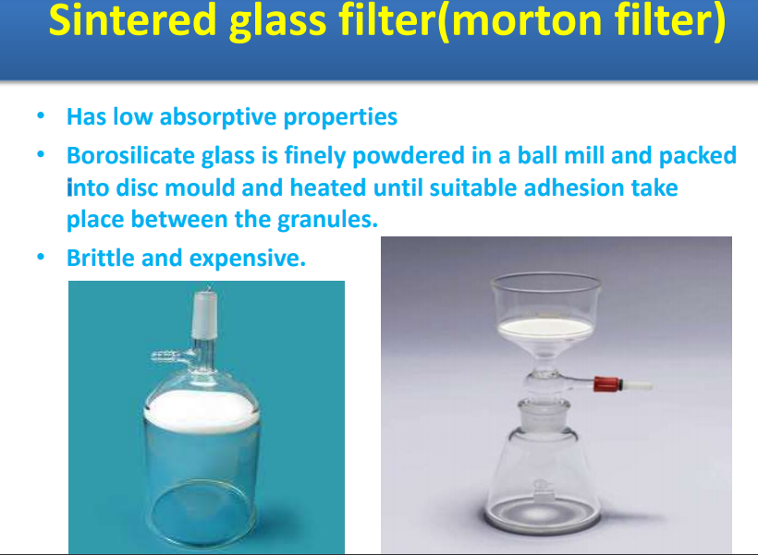
17-09-2024
34

Slide 35
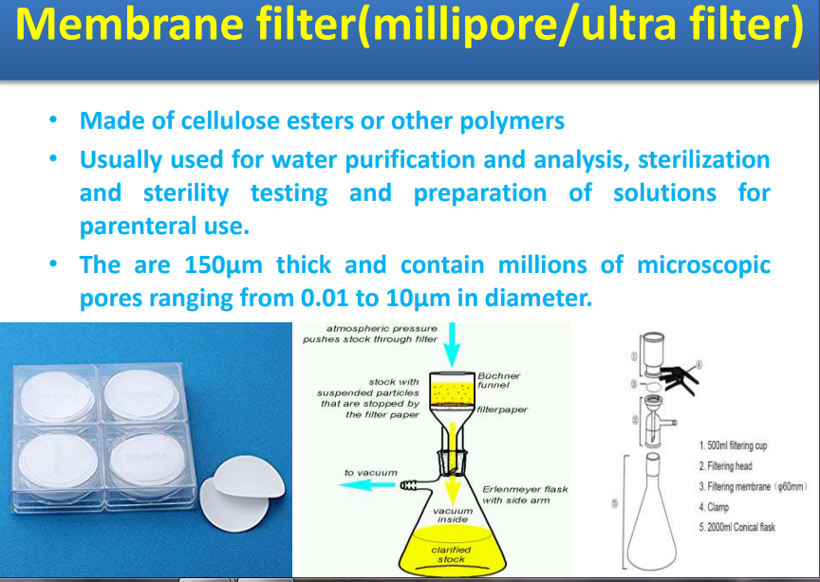
17-09-2024
35

Slide 36
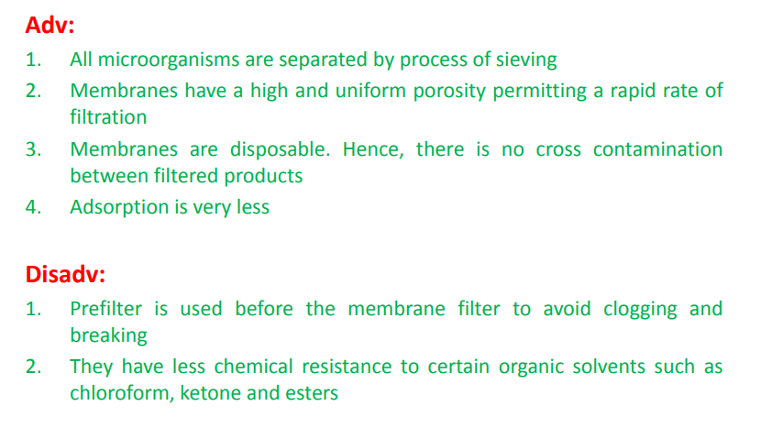
17-09-2024
36

Slide 37
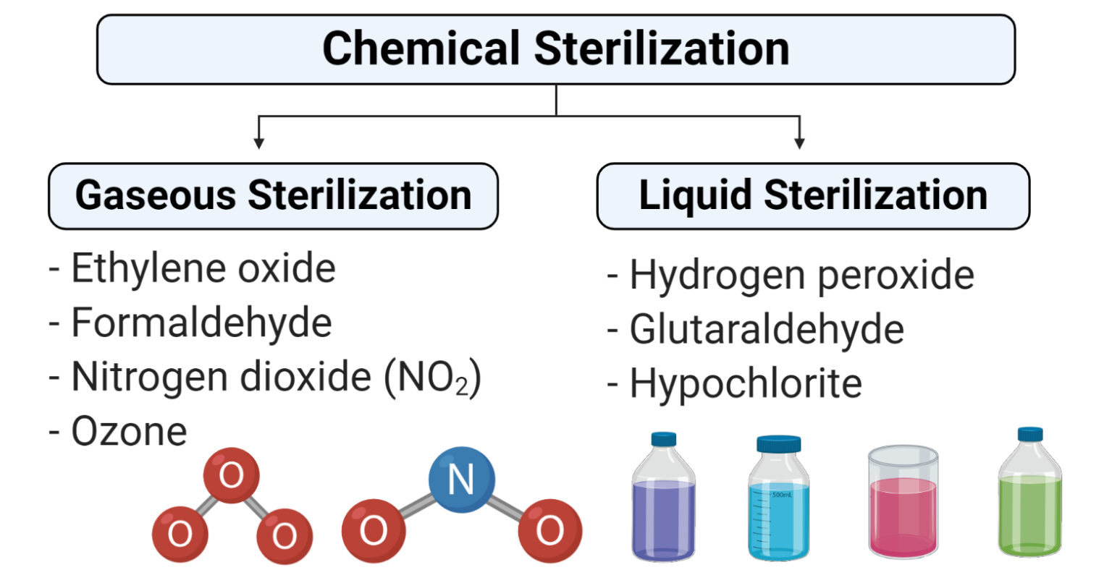
17-09-2024
37

Slide 38
Gaseous Sterilization
Gaseous sterilization involves the process of exposing equipment or devices to different gases in a closed heated or pressurized chamber.
Gaseous sterilization is a more effective technique as gases can pass through a tiny orifice and provide more effective results.
Besides, gases are commonly used along with heat treatment which also facilitates the functioning of the gases.
However, there is an issue of release of some toxic gases during the process which needs to be removed regularly from the system.
The mechanism of action is different for different types of gases.
Some of the common gases used for gaseous sterilization are explained below:
Ethylene oxide
Ethylene oxide (EO) gas is a common gas used for chemical treatment applied to sterilize, pasteurize, or disinfect different types of equipment and surfaces because of its wide range of compatibility with different materials.
EO treatment often replaces other sterilization techniques like heat, radiation, and even chemicals in cases where the objects are sensitive to these techniques.
This method is a widespread method used for almost 70% of all sterilizations and around 50% for disposable medical devices.
The mechanism of antimicrobial action of this gas is assumed to be through the alkylation of sulphydryl, amino, hydroxyl, and carboxyl groups on proteins and imino groups of nucleic acids.
EO treatment is usually conducted at the temperature range of 30-60°C for several hours which aids in the activity of the gas.
The efficacy of the gas depends on the concentration of gas available for each article which is greatly assisted by the good penetrating nature of the gas, which diffuses readily into many packaging materials including rubber, plastics, fabric, and paper.
Ethylene oxide kills all known microorganisms, such as bacteria (including spores), viruses, and fungi (including yeasts and molds), and is compatible with almost all materials even when repeatedly applied.
17-09-2024
38

Slide 39
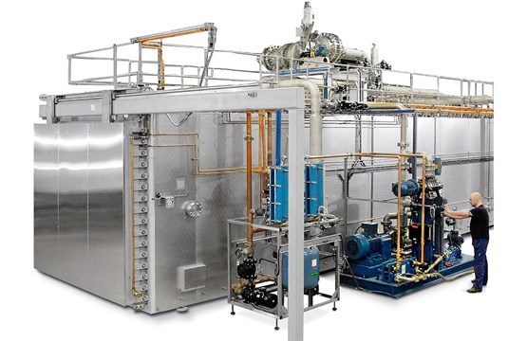
This process, however, is not without drawbacks as the level of gas in the sterilizer goes on decreasing due to absorption, and the treated articles need to undergo a process of desorption to remove the toxic residual wastes.
Organisms are more resistant to ethylene oxide treatment in a dried state, as are those protected from the gas by inclusion in crystalline or dried organic deposits.
17-09-2024
39

Slide 40
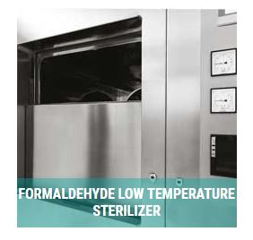
ii. Formaldehyde
Formaldehyde is another important highly reactive gas which is used for sterilization.
This gas is obtained by heating formalin (37%w/v) to a temperature of 70-80°C.
It possesses broad-spectrum biocidal activity and has found application in the sterilization of reusable surgical instruments, specific medical, diagnostic and electrical equipment, and the surface sterilization of powders.
Formaldehyde doesn’t have the same penetrating power of ethylene oxide but works on the same principle of modification of protein and nucleic acid.
As a result of the low penetrating power, its use is often limited to paper and cotton fabrics.
Formaldehyde can generally be detected by smell at concentrations lower than those permitted in the atmosphere and thus can be detected during leakage or other such accidents
17-09-2024
40

Slide 41
iii. Nitrogen dioxide (NO2)
Nitrogen dioxide is a rapid and effective sterilant that can be used for the removal of common bacteria, fungi, and even spores.
NO2 has a low boiling point (20°C) which allows a high vapor pressure at standard temperature.
This property of NO2 enables the use of the gas at standard temperature and pressure.
The biocidal action of this gas involves the degradation of DNA by the nitration of phosphate backbone, which results in lethal effects on the exposed organism as it absorbs NO2.
An advantage of this gas is that no condensation of the gas occurs on the surface of the devices because of the low level of gas used and the high vapor pressure. This avoids the need for direct aeration after the process of sterilization.
CHEMICAL METHODS OF DISINFECTION
Disinfectants are those chemicals that destroy pathogenic bacteria from inanimate surfaces. Some chemicals when used at apropriate concentration for appropriate duration can be used for sterilization and are called sterilant liquids. Those
chemicals that can be safely applied over skin and mucus membranes are called antiseptics.
17-09-2024
41

Slide 42
An ideal antiseptic or disinfectant should have following properties:
1. Should have wide spectrum of activity
2. Should be able to destroy microbes within practical period of time
3. Should be active in the presence of organic matter
4. Should make effective contact and be wettable
5. Should be active in any pH
6. Should be stable
7. Should have long shelf life
8. Should be speedy
9. Should have high penetrating power
10. Should be non-toxic, non-allergenic, non-irritative or non-corrosive
11. Should not have bad odour
12. Should not leave non-volatile residue or stain
13. Efficacy should not be lost on reasonable dilution
14. Should not be expensive and must be available easily
Such an ideal disinfectant is not yet available. The level of disinfection achieved depends on contact time, temperature, type and concentration of the active ingredient, the presence of organic matter, the type and quantum of microbial
load. The chemical disinfectants at working concentrations rapidly lose their strength on standing.
17-09-2024
42

Slide 43
Classification of disinfectants:
1. Based on consistency
(a) Liquid (E.g., Alcohols, Phenols)
(b) Gaseous (Formaldehyde vapour)
2. Based on spectrum of activity
(a) High level
(b) Intermediate level
(c) Low level
3. Based on mechanism of action
(a) Action on membrane (E.g., Alcohol, detergent)
(b) Denaturation of cellular proteins (E.g., Alcohol, Phenol)
(c) Oxidation of essential sulphydryl groups of enzymes (E.g., H2O2,
Halogens)
(d) Alkylation of amino-, carboxyl- and hydroxyl group (E.g.,
Formaldehyde)
(e) Damage to nucleic acids (Formaldehyde)
17-09-2024
43

Slide 44
Alcohols
Mode of action: Alcohols dehydrate cells, disrupt membranes and cause coagulation of protein.
Examples: Ethyl alcohol, isopropyl alcohol and methyl alcohol
Application: A 70% aqueous solution is more effective at killing microbes than
absolute alcohols. 70% ethyl alcohol (spirit) is used as antiseptic on skin.
Isopropyl alcohol is preferred to ethanol. It can also be used to disinfect surfaces.
It is used to disinfect clinical thermometers. Methyl alcohol kills fungal spores, hence is useful in disinfecting inoculation hoods.
Disadvantages: Skin irritant, volatile (evaporates rapidly), inflammable.
Disadvantages: Vapors are irritating (must be neutralized by ammonia), has poor penetration, leaves non-volatile residue, activity is reduced in the presenceof protein. Gluteraldehyde requires alkaline pH and only those articles that are wettable can be sterilized.
Phenol
Mode of action: Act by disruption of membranes, precipitation of proteins and
inactivation of enzymes.
Examples: 5% phenol, 1-5% Cresol, 5% Lysol (a saponified cresol),
hexachlorophene, chlorhexidine, chloroxylenol (Dettol)
17-09-2024
44

Slide 45
Applications: Joseph Lister used it to prevent infection of surgical wounds. Phenols are coal-tar derivatives. They act as disinfectants at high concentration and as antiseptics at low concentrations. They are bactericidal, fungicidal, mycobactericidal but are inactive against spores and most viruses. They are not readily inactivated by organic matter. The corrosive phenolics are used for
disinfection of ward floors, in discarding jars in laboratories and disinfection of bedpans. Chlorhexidine can be used in an isopropanol solution for skin disinfection, or as an aqueous solution for wound irrigation. It is often used as
an antiseptic hand wash. 20% Chlorhexidine gluconate solution is used for preoperative hand and skin preparation and for general skin disinfection.
Chlorhexidine gluconate is also mixed with quaternary ammonium compounds such as cetrimide to get stronger and broader antimicrobial effects (eg. Savlon). Chloroxylenols are less irritant and can be used for topical purposes and are more
effective against gram positive bacteria than gram negative bacteria.
Hexachlorophene is chlorinated diphenyl and is much less irritant. It has marked effect over gram positive bacteria but poor effect over gram negative bacteria, mycobacteria, fungi and viruses. Triclosan is an organic phenyl ether with good
activity against gram positive bacteria and effective to some extent against many gram negative bacteria including Pseudomonas. It also has fair activity on fungi and viruses.
Disadvantages: It is toxic, corrosive and skin irritant. Chlorhexidine is inactivated by anionic soaps. Chloroxylenol is inactivated by hard water.
17-09-2024
45

Slide 46
Formaldehyde
Formaldehyde is used as a disinfectant and sterilant in both its liquid and gaseous states. Liquid formaldehyde will be considered briefly in this section, and the gaseous form is reviewed elsewhere 570. Formaldehyde is sold and used principally as a water-based solution called formalin, which is 37% formaldehyde by weight. The aqueous solution is a bactericide, tuberculocide, fungicide, virucide and sporicide.
Mode of Action.
Formaldehyde inactivates microorganisms by alkylating the amino and sulfhydral groups of proteins and ring nitrogen atoms of purine bases ..
Microbicidal Activity
.
Varying concentrations of aqueous formaldehyde solutions destroy a wide range of microorganisms. Inactivation of poliovirus in 10 minutes required an 8% concentration of formalin, but all other viruses tested were inactivated with 2% formalin 72. Four percent formaldehyde is a tuberculocidal agent, inactivating 104 M. tuberculosis in 2 minutes 82, and 2.5% formaldehyde inactivated about 107 Salmonella Typhi in 10 minutes in the presence of organic matter 572. The sporicidal action of formaldehyde was slower than that of glutaraldehyde in comparative tests with 4% aqueous formaldehyde and 2% glutaraldehyde against the spores of B. anthracis 82. The formaldehyde solution required 2 hours of contact to achieve an inactivation factor of 104, whereas glutaraldehyde required only 15 minutes.
17-09-2024
46

Slide 47
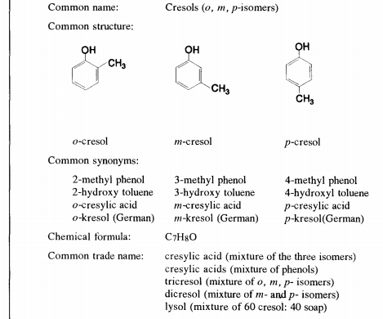
Uses.
Although formaldehyde-alcohol is a chemical sterilant and formaldehyde is a high-level disinfectant, the health-care uses of formaldehyde are limited by its irritating fumes and its pungent odor even at very low levels (<1 ppm). For these reasons and others—such as its role as a suspected human carcinogen linked to nasal cancer and lung cancer 578, this germicide is excluded from Table 1. When it is used, , direct exposure to employees generally is limited; however, excessive exposures to formaldehyde have been documented for employees of renal transplant units.
PHENOL
17-09-2024
47

Slide 48
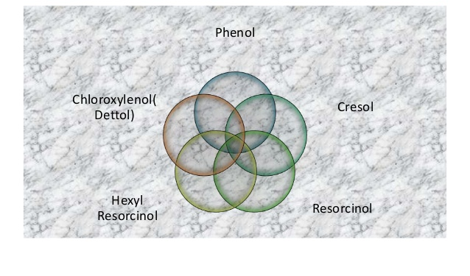
17-09-2024
48

Slide 49
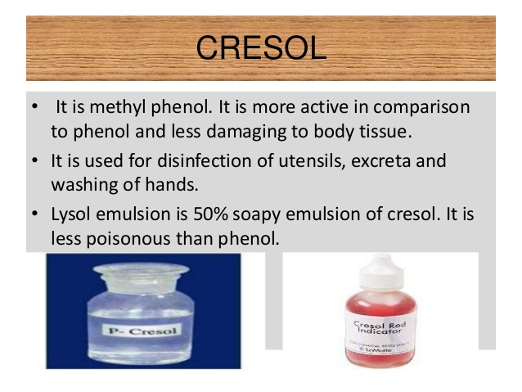
When cresol isomers are used directly as the active ingredient in bactericides or disinfectants, it appears as if much of the evidence for the mechanism of action for such phenolic germicides indicates that their effect is due to physical damage of bacterial cell membranes .
17-09-2024
49

Slide 50
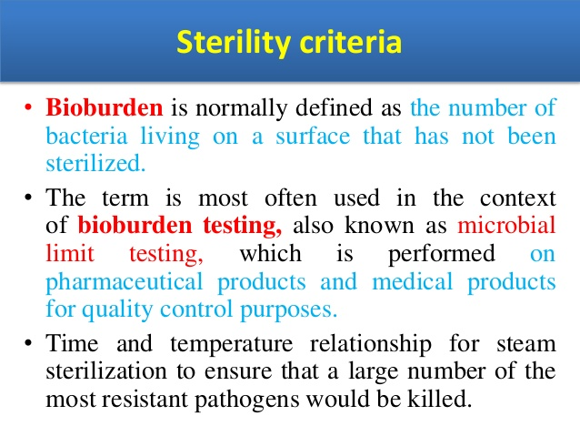
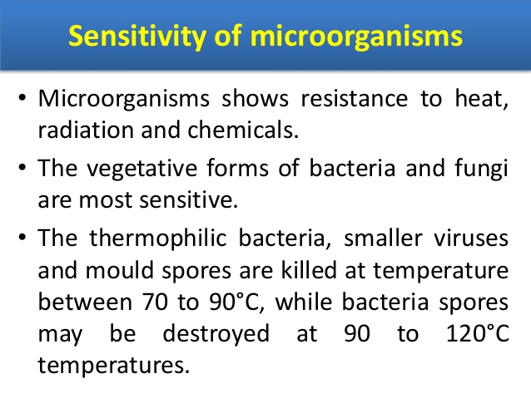
EVALUATION OF THE EFFICIENCY OF STERILIZATION METHODS.

Slide 51
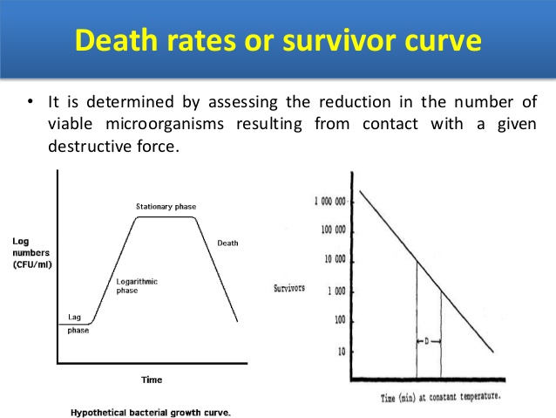

Slide 52
EVALUATION OF THE EFFICIENCY OF STERILIZATION METHODS.
Evaluation of the effectiveness of the chemical agents used for sterilization:
a. The phenol coefficient
By taking phenol as a standard disinfectant, the activity of other disinfectants is measured and compared with the activity of phenol. Any disinfectant which has phenol coefficient equals to 1 is having same acclivity as that of phenol, while having phenol coefficient less than 1.0, the activity of that disinfectant is said to be lesser than that of phenol and vice-versa.
For the determination of the phenol coefficient, two organisms, namely, Staphylococcus aureus and Salmonella typhi are used. In two culture samples, phenol and disinfectant are mixed separately and the activity can be measured after a certain time for phenol and the disinfectant used against the organisms. Phenol coefficient can be similar or different for different microorganism.
It can be understood by the example of Lysol. Lysol shoes no growth at 10 minutes when used as 1:450 dilution, while phenol shows no growth at 10 minutes when used as 1:90 dilutions. Therefore, the phenol coefficient for Lysol is 5, that means, Lysol is 5 times more effective than phenol
17-09-2024
52

Slide 53
b. Filter paper method
In this method, a small disk of filter paper is soaked into the disinfectant and then placed on the agar plate cultured with test microorganism. A zone of inhibition is visible after some time. Disinfectant having a wider zone of inhibition is said to be more active for that test sample. The activity of disinfectant can differ with the test microorganism.
c. Use dilution test
In this, the broth culture of the test microorganism is coated over the stainless steel cylinder and is allowed to dry. These cylinders are then dipped in the test tubes filled with broth and having different dilutions of the disinfectant. The effectiveness of the disinfectant can be measured by the greatest dilution at which the growth of microorganism is inhibited.
17-09-2024
53

Slide 54
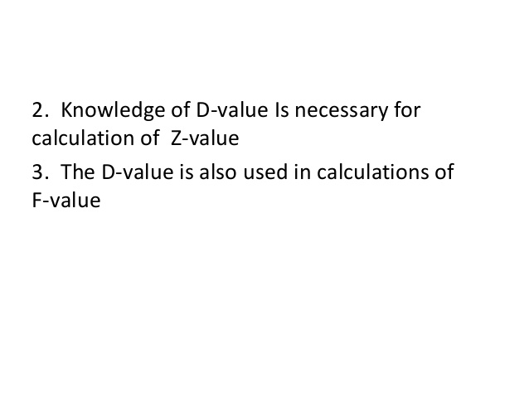
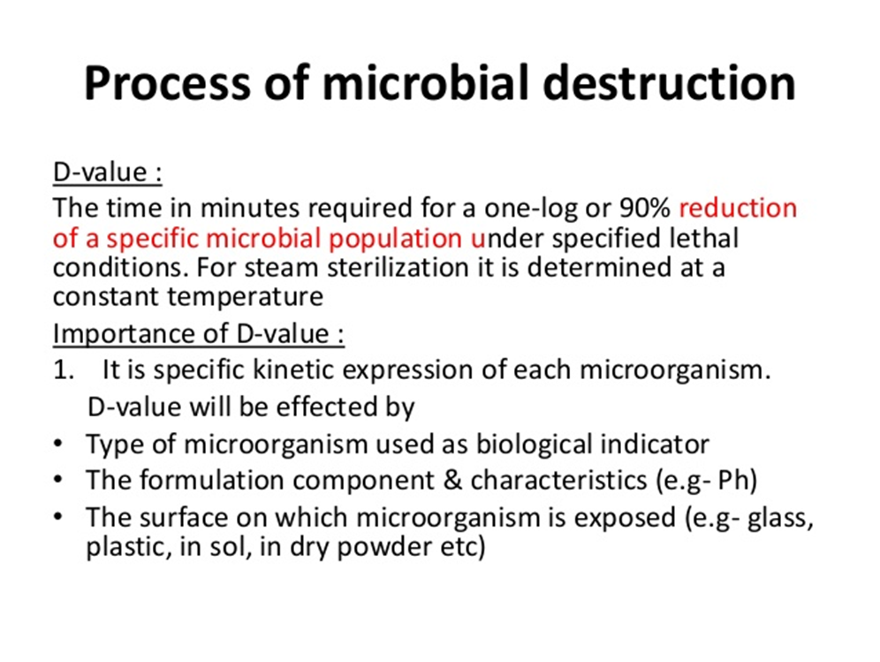
17-09-2024
54

Slide 55
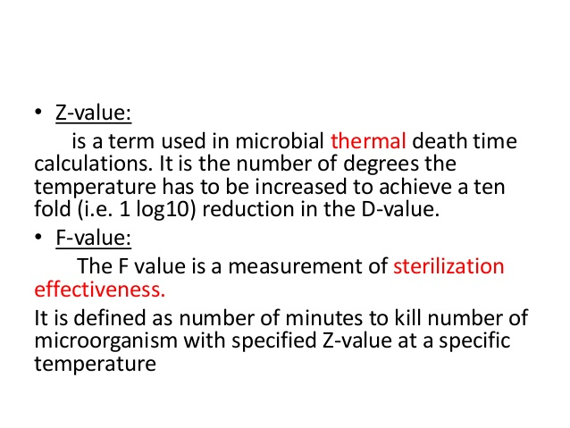
17-09-2024
55

Slide 56
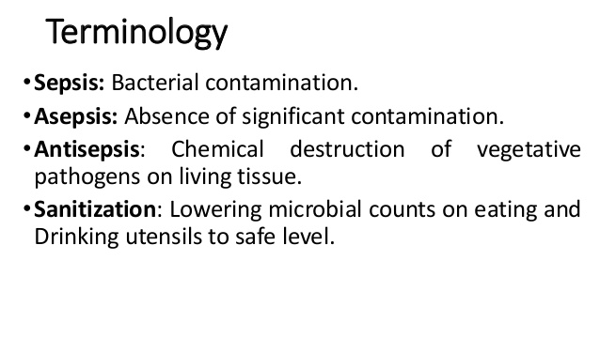
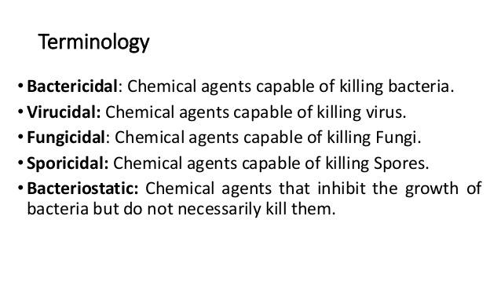
FACTORS AFFECTING DISINFECTION
.
17-09-2024
56

Slide 57
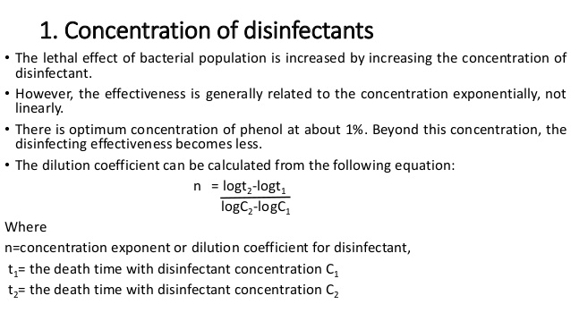
.
17-09-2024
57

Slide 58
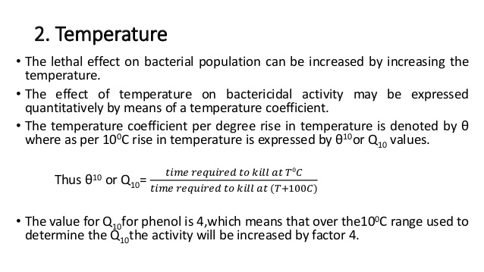
.
17-09-2024
58

Slide 59
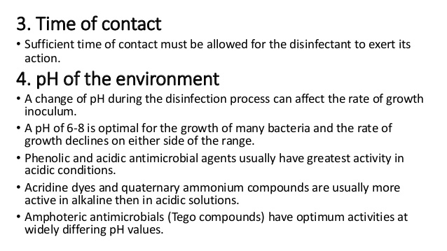
.
17-09-2024
59

Slide 60
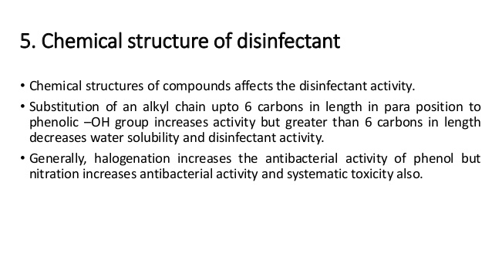
.
17-09-2024
60

Slide 61
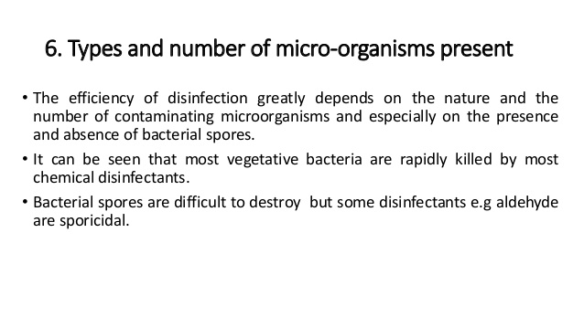
.
17-09-2024
61

Slide 62
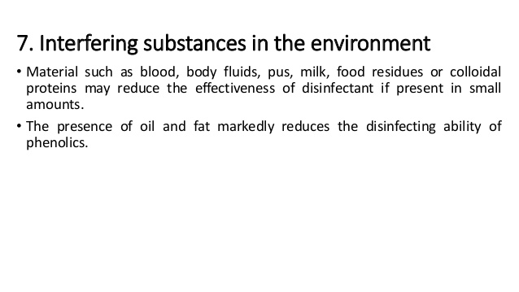
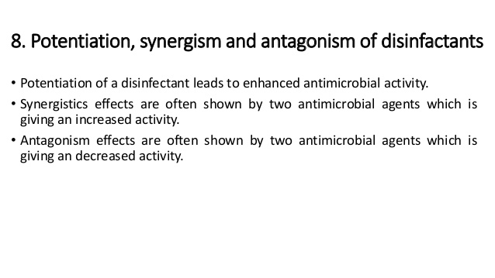
.
17-09-2024
62

Slide 63
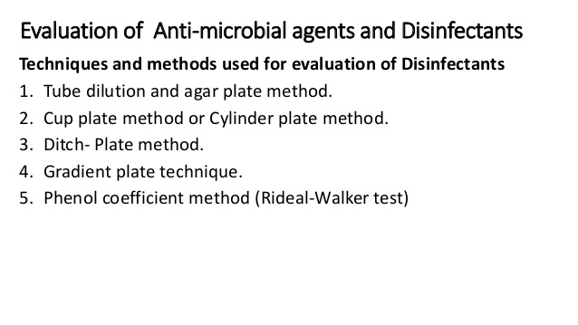
.
17-09-2024
63

Slide 64
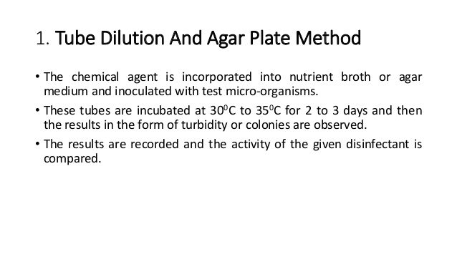
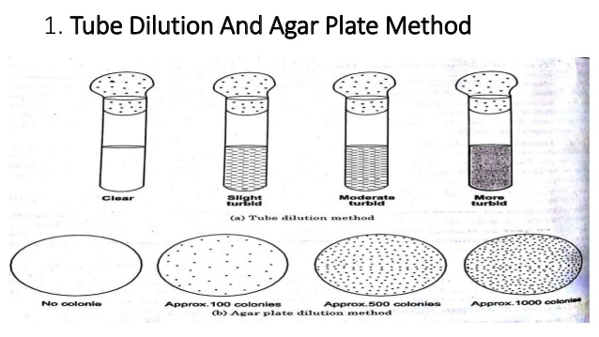
.
17-09-2024
64

Slide 65
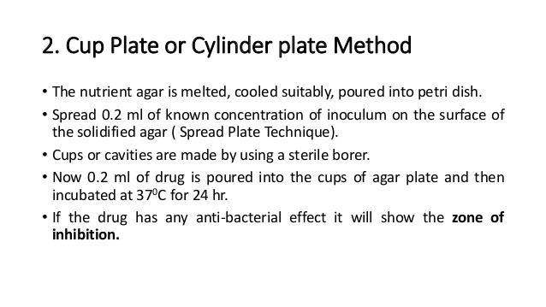

.
17-09-2024
65

Slide 66

.
17-09-2024
66

Slide 67

.
17-09-2024
67

Slide 68

.
17-09-2024
68

Slide 69

.
17-09-2024
69

Slide 70

.
17-09-2024
70

Slide 71

.
17-09-2024
71

Slide 72

.
17-09-2024
72

Slide 73

.
17-09-2024
73

Slide 74

.
17-09-2024
74

Slide 75
.
17-09-2024
75

Slide 76

.
17-09-2024
76

Slide 77

.
17-09-2024
77

Slide 78

.
17-09-2024
78

Slide 79

.
17-09-2024
79

Slide 80

.
17-09-2024
80

Slide 81

.
17-09-2024
81

Slide 82

.
17-09-2024
82

Slide 83

.
17-09-2024
83

Slide 84

.
17-09-2024
84

Slide 85

.
17-09-2024
85

Slide 86

.
17-09-2024
86

Slide 87

.
17-09-2024
87

Slide 88

.
17-09-2024
88

Slide 89

.
17-09-2024
89

Slide 90

.
17-09-2024
90

Slide 91

.
17-09-2024
91

Slide 92

.
17-09-2024
92

Slide 93

.
17-09-2024
93

Slide 94

.
17-09-2024
94

Slide 95

.
17-09-2024
95

Slide 96

.
17-09-2024
96

Slide 97

.
17-09-2024
97

Slide 98

.
17-09-2024
98

Slide 99

.
17-09-2024
99

Slide 100
END OF THE UNIT

