Slide 1
PHARMACOGNOSY AND PHYTOCHEMISTRY
CHEMICAL TEST FOR LIPIDS
17-09-2024
1

Slide 2
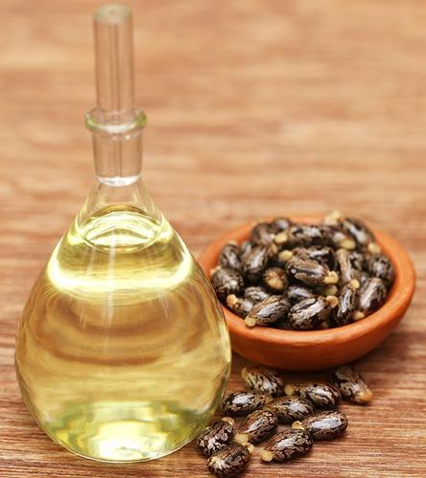
CHEMICAL TEST FOR CASTOR OIL
Preliminary observation:
Colour: Pale yellowish (or ) almost colourless, transparent viscous liquid
Odour- Slight and characteristic
Taste- Bland, acrid, and nauseating
Solubility- Soluble in alcohol, miscible with chloroform, solvent ether, glacial acetic acid and petroleum ether(40 -60° C)
17-09-2024
2

Slide 3
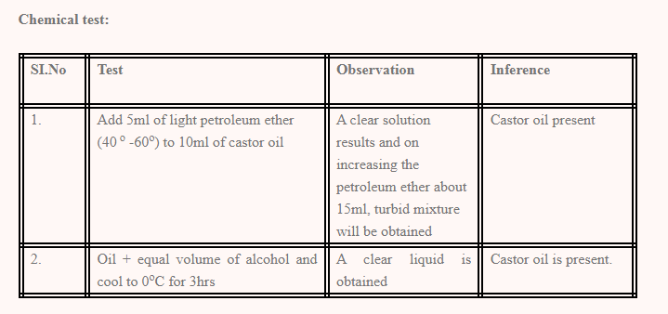
Oil + equal volume of alcohol Clear Liquid is obtained Clear liquid is obtained
Cool at 0 degree after 3 hours
17-09-2024
3

Slide 4
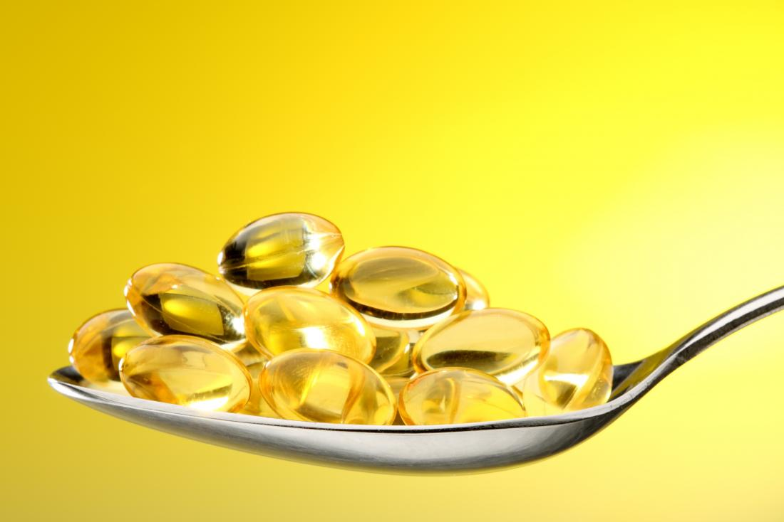
CHEMICAL TEST FOR SHARK- LIVER OIL
Preliminary observations:
Colour: Pale yellow to brownish yellow oil
Odour: Characteristic fishy but not acrid
Taste: Bland or fishy
Solubility: Miscible with solvent ether, chloroform and with light petroleum (60 ο -80ο), slightly soluble in alcohol.
17-09-2024
4

Slide 5
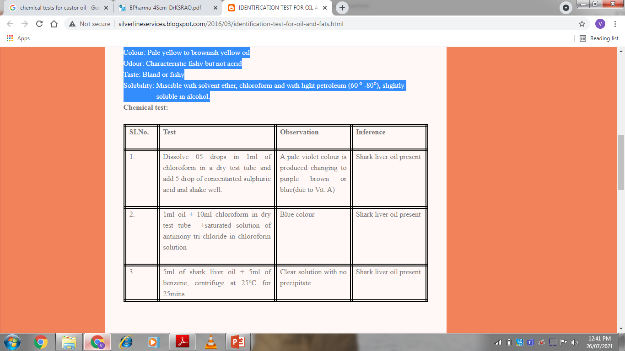
17-09-2024
5

Slide 6
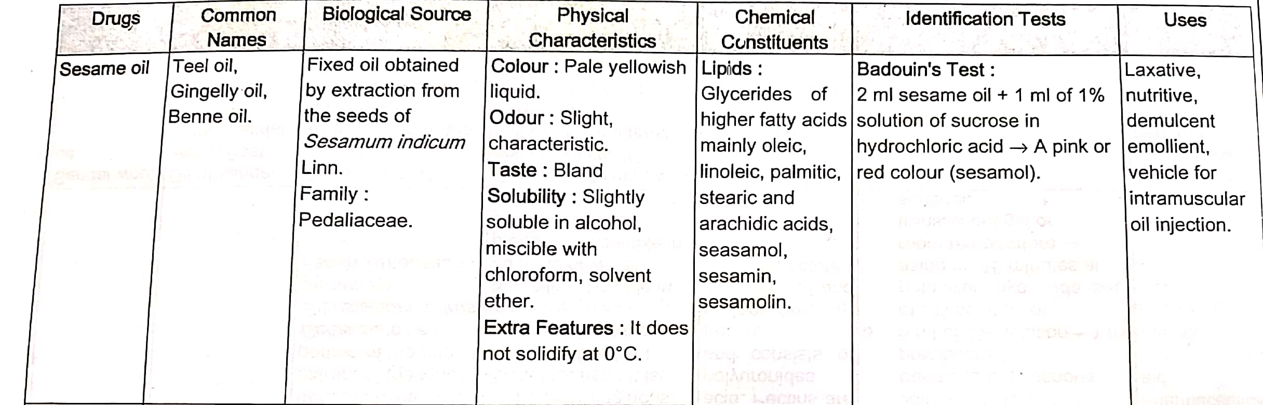
CHEMICAL TEST FOR SESAME OIL
17-09-2024
6

Slide 7
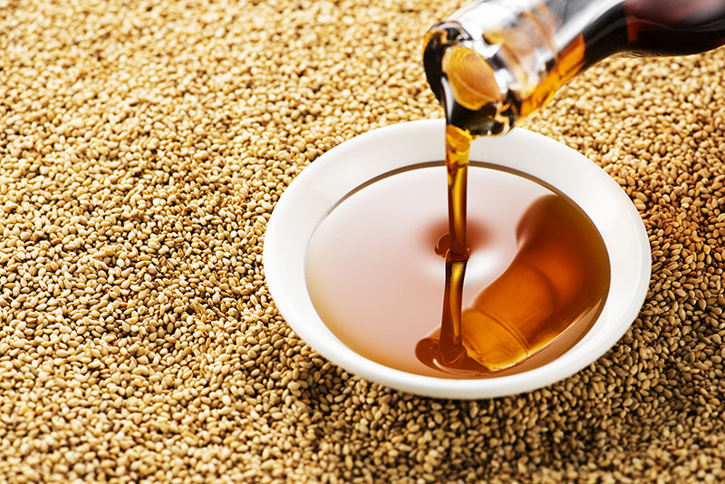
17-09-2024
7

Slide 8
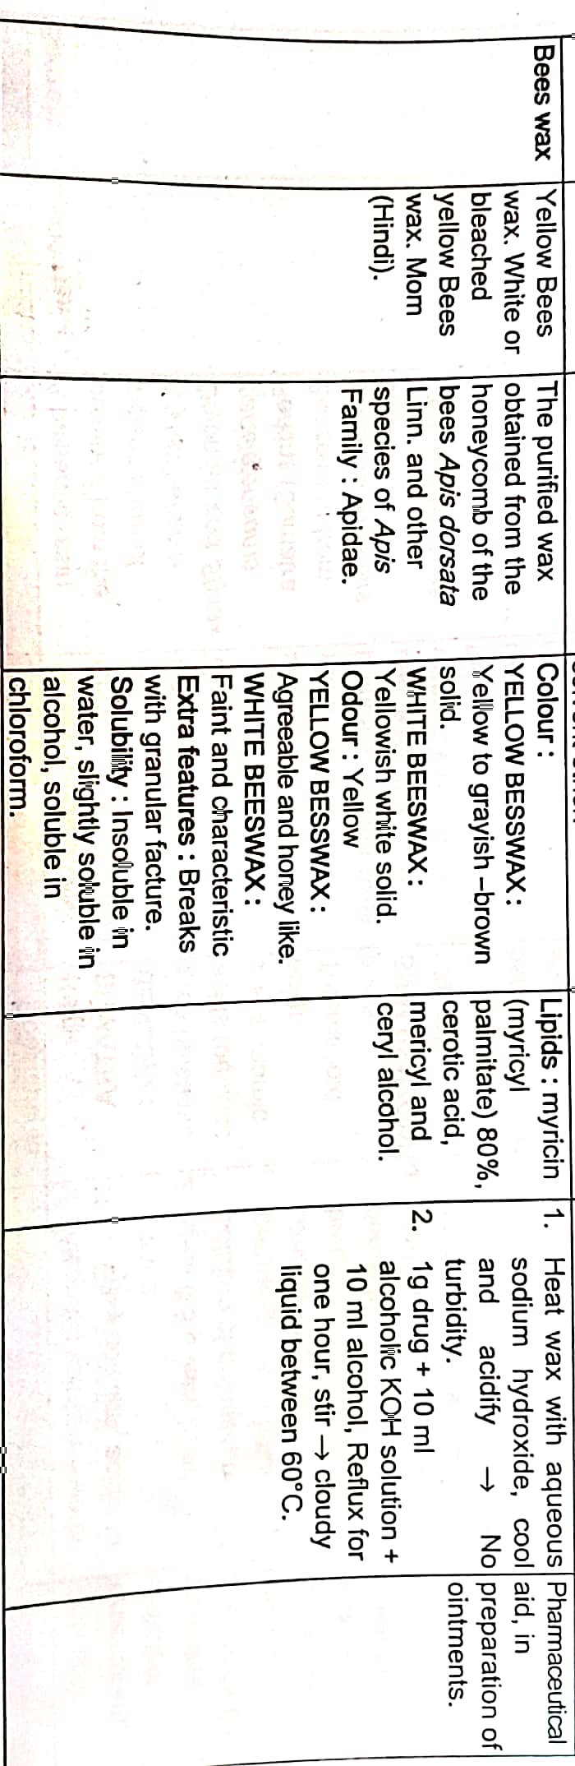
CHEMICAL TEST FOR BEES WAX
17-09-2024
8

Slide 9
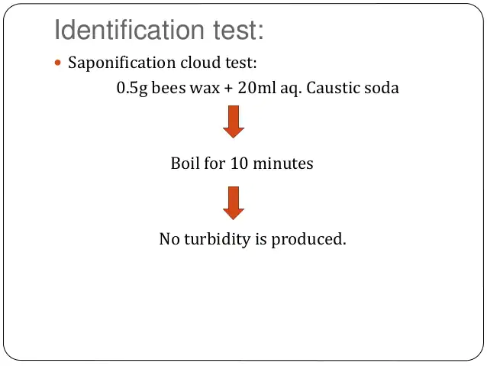
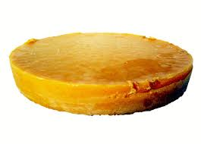
17-09-2024
9

