Slide 1
Chronic Kidney Disease

Slide 2
Chronic kidney disease is characterized by a progressive deterioration in kidney function ultimately leading to irreversible structural damage to existing nephrons.
Progressive loss of function occurring over several months to years, and is characterized by the gradual replacement of normal kidney architecture with interstitial fibrosis.

Slide 3
Stages of CKD
From National Kidney Foundation. K/DOQI clinical practice guidelines for chronic kidney disease
Stage 1
2
3
4
5
Damage
Kidney damage with normal GFR
GFR ml/min/1.73m²
> /=90
Kidney damage with mild decrease in GFR Moderate decrease in GFR
Severe decrease in GFR Kidney failure
60–89
30–59
15–29
<15

Slide 4
Etiology Susceptibility factors Advanced age
Reduced kidney mass & low birth weight Family history
Systemic inflammation Dyslipidemia
Initiation factors
Diabetes mellitus (44%),
Hypertension (27%),
Chronic glomerulonephritis (8%)

Slide 5
Progression factors Glycemia Hypertension Proteinuria
smoking obesity

Slide 6
Pathophysiology
The key elements of this pathway are:
Loss of nephron mass
Glomerular capillary hypertension
Proteinuria
Glomerular Hyperfiltration and Intraglomerular Hypertension Exposure to initiation factor
Loss of nephron mass

Slide 7
Progressive loss of nephron function
Adaptive changes in remaining nephrons to increase single nephron eGFR
Prolonged elevation of glomerular capillary pressure and increased glomerular plasma flow
Intraglomerular hypertension
Glomerular injury
Impairs the size-selective function of the glomerular permeability
Barrier

Slide 8
Proteinuria
Direct cellular damage
(Albumin, transferrin, complement factors, immunoglobulins, cytokines, and angiotensin II are toxic to kidney tubular cells.)
Secretion of proinflammatory mediators
Renal fibrosis and Scarring (sclerosis) Sclerosis may involve entire nephron

Slide 9
DM associated CKD
Hyperglycemia leads to a nonenzymatic reaction between sugar and protein.
Formation of advanced glycation end products (AGEs)
Complexes accumulation
AGEs cause expansion of the mesangium, damage to the glomerular
basement membrane, cytokine release.
Glomerulosclerosis

Slide 10
Hypertension associated CKD
Intraglomerular hypertension and hyperfiltration
Arteriosclerosis (Nephron loss through ischemic mechanisms)
Dyslipidemia associated CKD
Oxidation and deposition of lipoproteins in the glomerulus and the mesangial cells
Synthesis of inflammatory cytokines, vasoactive substances, and macrophage chemotactic factors.
Glomerular scarring.

Slide 11
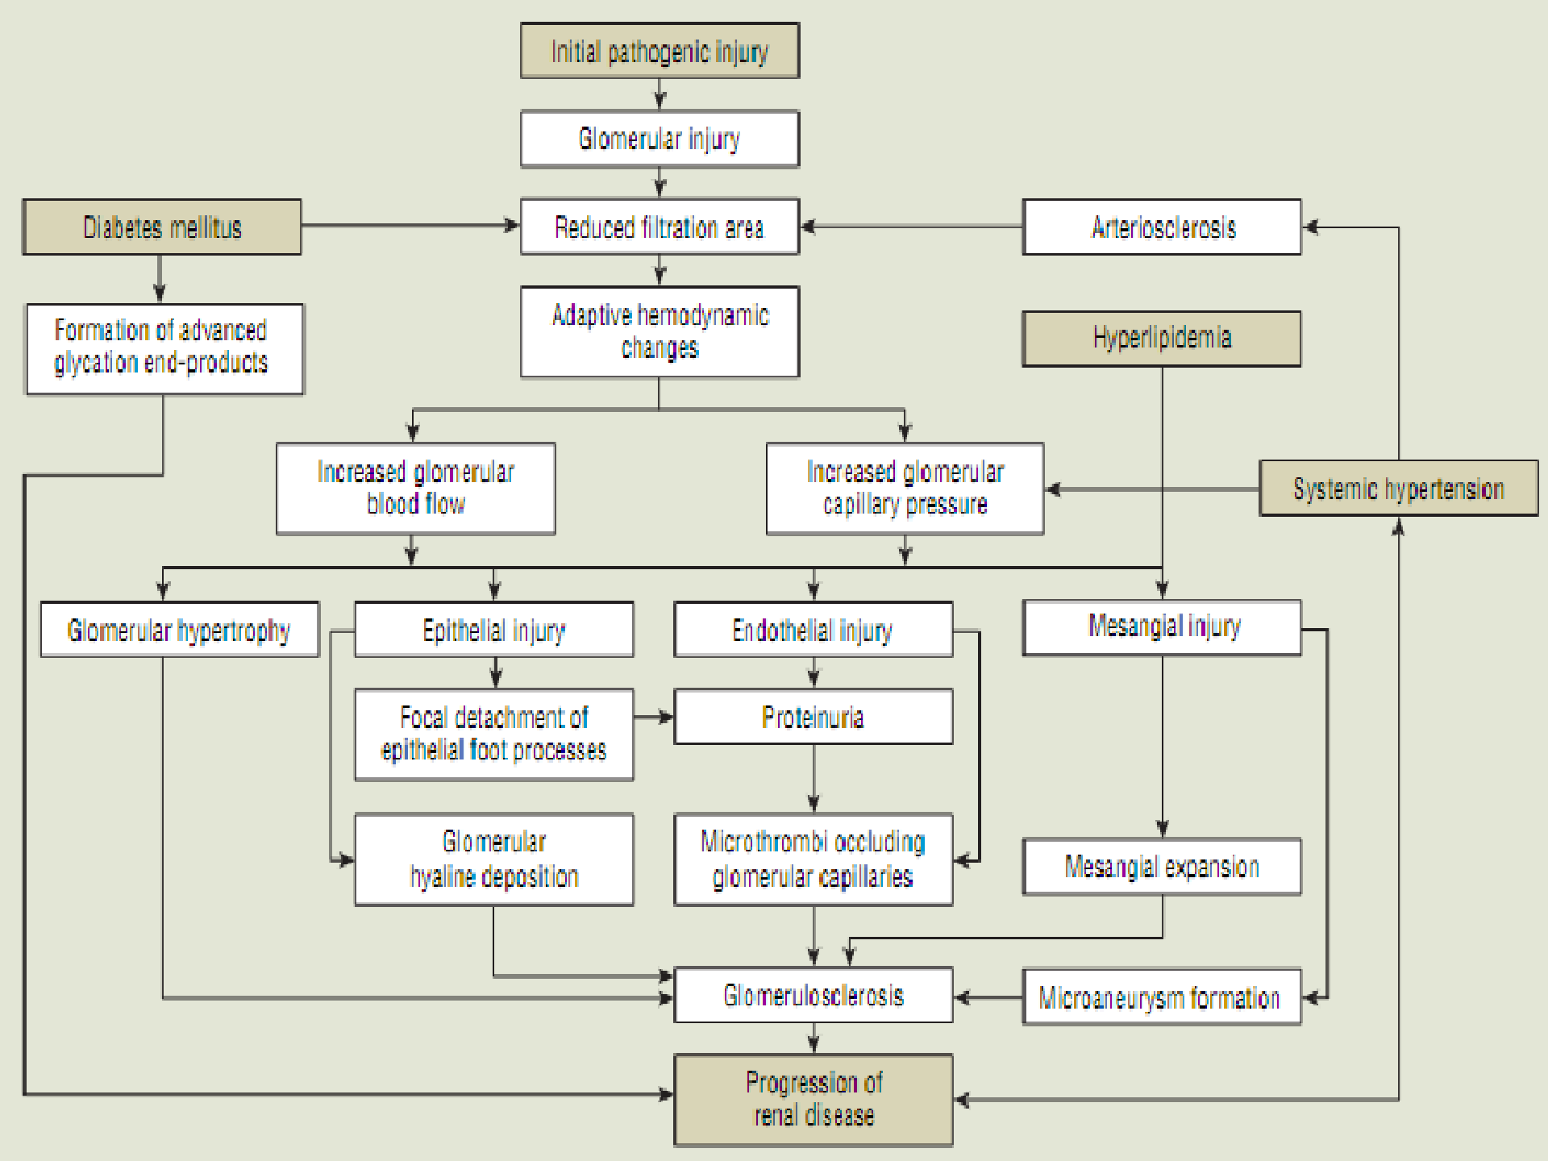

Slide 12
Clinical presentation
Symptoms
Symptoms are generally absent in stages 1 and 2.
Minimum during stages 3 and 4
General symptoms associated with stages 1 to 4 include
Edema
Shortness of breath
Palpitations
Cramping
Muscle pain
Depression
Anxiety
Fatigue
Sexual dysfunction.

Slide 13
Consequences of CKD

Slide 14
Anemia
Kidneys secrete 90% of erythropoietin, which is necessary for erythropoiesis
CKD erythropoietin deficiency Anemia
Anemia prevalence begins with stage 3.
Shortened life cycle of red blood cells in uremia

Slide 15


Cardiovascular disease
Patients with CKD tend to have many risk factors for CVD
Every 1 mg per dL decrease in hemoglobin, a 6% increase in the risk of LVH
LVD – Fluid overload, shunting of blood through AV fistula for dialysis and anemia
Hypertension- Volume overload, Peripheral vascular resistance, Renal vasodilator prostaglandins, RAAS activity
Dysregulation of calcium and phosphorous (An increase in serum phosphorous levels has been shown to stimulate vascular calcification)
Pericarditis – uremic state or dialysis

Slide 16
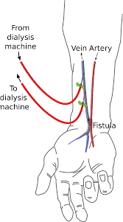

Slide 17


Disorders of calcium and phosphorus homeostasis
Hyperphosphatemia serum calcium by physiochemical interaction and complexation.
Serum calcium triggers the parathyroid gland to synthesize and secrete more parathyroid hormone (PTH).
PTH in turn causes an increase in osteoclast activity in the bone, breaking down bone to release calcium and restore serum levels.

Slide 18
In kidney, the inactive vit D (25 OH vit D3) active vit D (1,25 OH vit D3) or calcitriol in the presence of enzyme 1 α- hydroxylase.
Active vitamin D (1,25-dihydroxyvitamin D or calcitriol )promotes increased intestinal absorption of calcium and has supression effect on PTH production.
Calcitriol - PTH levels Osteodystrophy (high bone or low bone turnover OD)
•
Calcitriol also works directly on the parathyroid gland to suppress PTH production.

Slide 19
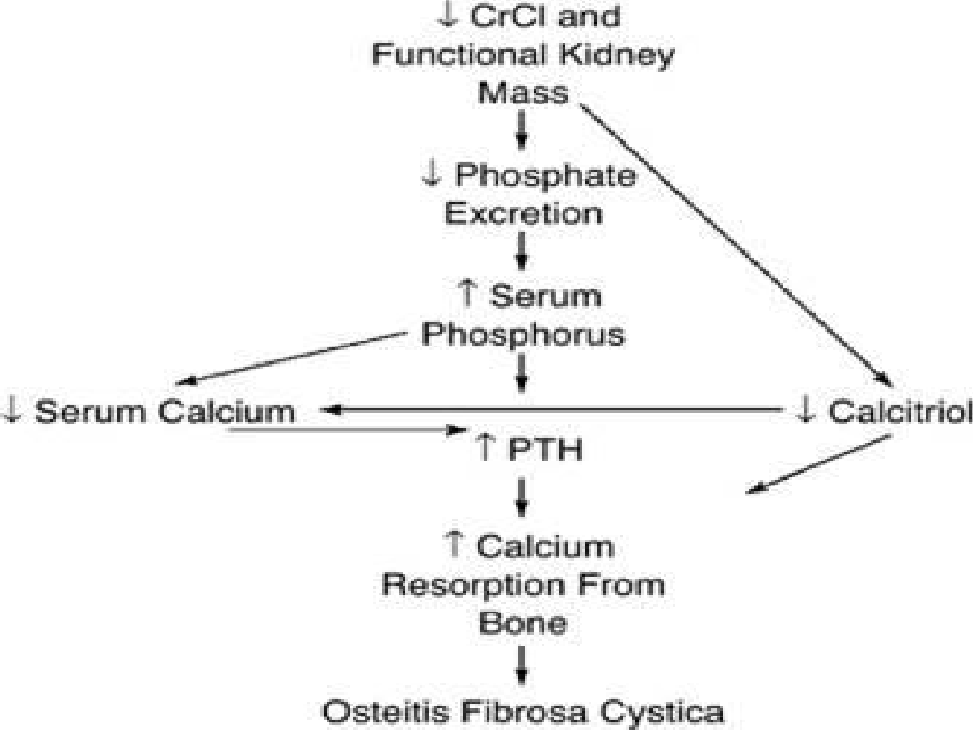
OSTEOMALACIA and ADYNAMIC OD

Slide 20
Sodium and Water
Normal renal function guarantees that the tubular reabsorption of filtered sodium and water is adjusted so that urinary excretion matches net intake
Renal disease disrupt this glomerulotubular balance such that dietary intake of sodium exceeds its urinary excretion, leading to sodium retention and attendant extracellular fluid volume (ECFV) expansion

Slide 21
Potassium Homeostasis
90% to 95% of the daily potassium (dietary load)excreted by kidneys.
5% to 10% is excreted through the gut
In patients with CKD, distal tubular potassium secretion the GFR is less than 20 mL/min per 1.73 m ²
until
End up with hyperkalemia

Slide 22
Magnesium homeostasis
The primary route of magnesium excretion is renal.
Mild, asymptomatic elevations in serum magnesium may occur in patients with advanced CKD

Slide 23
Uremic Bleeding
uremia is the accumulation of substances in the blood, One such compound is guanidinosuccinic acid, a byproduct of ammonia detoxification.
Increase in nitric oxide,
Decrease platelet function
(By interfering with the interaction of fibrinogen and the platelet GP IIb/IIIa receptor)

Slide 24
Gastrointestinal Disorders
Anorexia, nausea, and vomiting are common in patients with uremia, along with a metallic taste in the mouth that further depresses the appetite.
A possible cause of nausea and vomiting is the decomposition of urea by intestinal flora, resulting in a high concentration of ammonia.
PTH increases gastric acid secretion and contributes to gastrointestinal problems

Slide 25
Disorders of Neural Function
Neuropathy is caused by atrophy and demyelination of nerve fibers, possibly caused by uremic toxins.
Peripheral and central nervous system function affected
Restless legs syndrome (creeping, prickling, and itching sensations that are more intense at rest) is a manifestation of peripheral nerve involvement
uremic encephalopathy is a manifestation of central nervous system
These often are followed by an inability to fix attention, loss of recent memory, and perceptual errors in identifying persons and objects ,Delirium , coma & seizures

Slide 26
Altered Immune Function
All aspects of inflammation and immune function may be affected adversely by the high levels of urea and metabolic wastes
Disorders of Skin Integrity
Skin dryness is caused by a reduction in size of sweat glands and the diminished activity of oil glands
Pruritus is common from the high serum phosphate levels and the development of phosphate crystals.

Slide 27
In the advanced stages of untreated renal failure, urea crystals may precipitate on the skin
The fingernails may become thin and brittle, with a dark band just behind the leading edge of the nail, followed by a white band called Terry’s nails.

Slide 28
Sexual Dysfunction
Cause is multifactorial high levels of uremic toxins, neuropathy, altered endocrine function, psychological factors, and medications
Impaired sexual function in women is manifested by abnormal levels of progesterone, luteinizing hormone, and prolactin.
Impaired sexual function in men is due to derangements of the pituitary and gonadal hormones, such as decreases in testosterone levels and increases in prolactin and luteinizing hormone levels, are common and cause erectile difficulties and decreased spermatocyte counts.

Slide 29
METABOLIC ACIDOSIS
The kidneys normally regulate blood pH by eliminating hydrogen ions produced in metabolic processes and regenerating bicarbonate.
This is achieved through hydrogen ion secretion, sodium and bicarbonate reabsorption, and the production of ammonia
With a decline in renal function, these mechanisms become impaired, and metabolic acidosis results.

Slide 30
