Slide 1
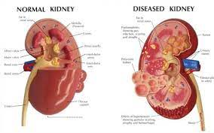
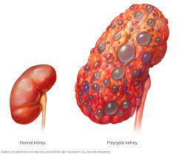
Chronic Renal Failure
Renal System Disease
By Animesh Das

Slide 2
Definition
It is an infection disease of kidney leading to renal failure also called as CKD . It is a condition involving the kidneys filter waste and excess fluid from the blood .
Affected organ – kidneys

Slide 3
Type / Classification
Kidney stones. Kidney stones are another common kidney problem.
Glomerulonephritis. Glomerulonephritis is an inflammation of the glomeruli.
Polycystic kidney disease.
Urinary tract infections

Slide 4
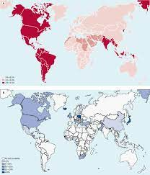
Epidemiology
The global estimated prevalence of CKD is 13.4%
kidney disease (ESKD) needing renal replacement therapy is estimated between 4.902 and 7.083 million
CKD zone – UK , America , India , Russia .

Slide 5
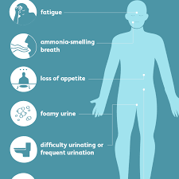
Sings and Symptoms
weight loss and poor appetite.
swollen ankles, feet or hands – as a result of water retention (oedema)
shortness of breath.
tiredness.
blood in your pee (urine)
an increased need to pee – particularly at night.
difficulty sleeping (insomnia)
itchy skin

Slide 6
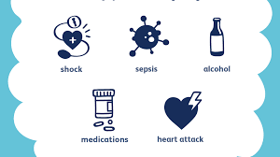
Risk factor
Diabetes.
High blood pressure.
Heart (cardiovascular) disease.
Smoking.
Obesity.
Being Black, Native American or Asian American.
Family history of kidney disease.
Abnormal kidney structure

Slide 7
Stages of Chronic Renal Failure
There are 4 stage involved in this disease --
Reduce Renal reserve
Renal insufficiency
Renal failure
End Stage Renal disease

Slide 8

Pathophysiology
Due to etiological factors
Decreased GFR
Hypertrophy of remaining nephrons
In ability to concentrate urine

Slide 9
Pathophysiology
Further loss of nephron Function
Loss of non excretory and excretory function

Slide 10
Management
Diagnosis
Treatment

Slide 11
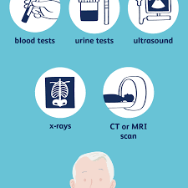
Diagnosis
history and clinical physical examination
blood test
Urea test
Metabolic acidosis
KUB radiography

Slide 12
Treatment
Category | Drug Name
Diuretics | Furosemide , torsemide
Loop | Lasix , Demadex

Slide 13
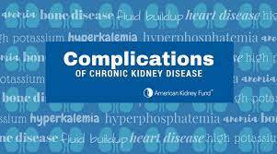
Complication
anemia,
bone disease,
heart disease,
high potassium,
high calcium
fluid buildup

Slide 14
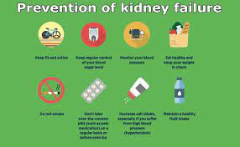
Prevention
Adhering to a low fat , low Salt intake
Controlling blood pressure
Regular exercise
Avoid the onset of diabetes
Avoid smoking
Regular annual check up .

Slide 15
Thank
you

