Slide 1
PHARMACOGNOSY & PHYTOPHARMACEUTICALS
Macro, powder and microscopic study of Cinchona.
17-09-2024
1

Slide 2
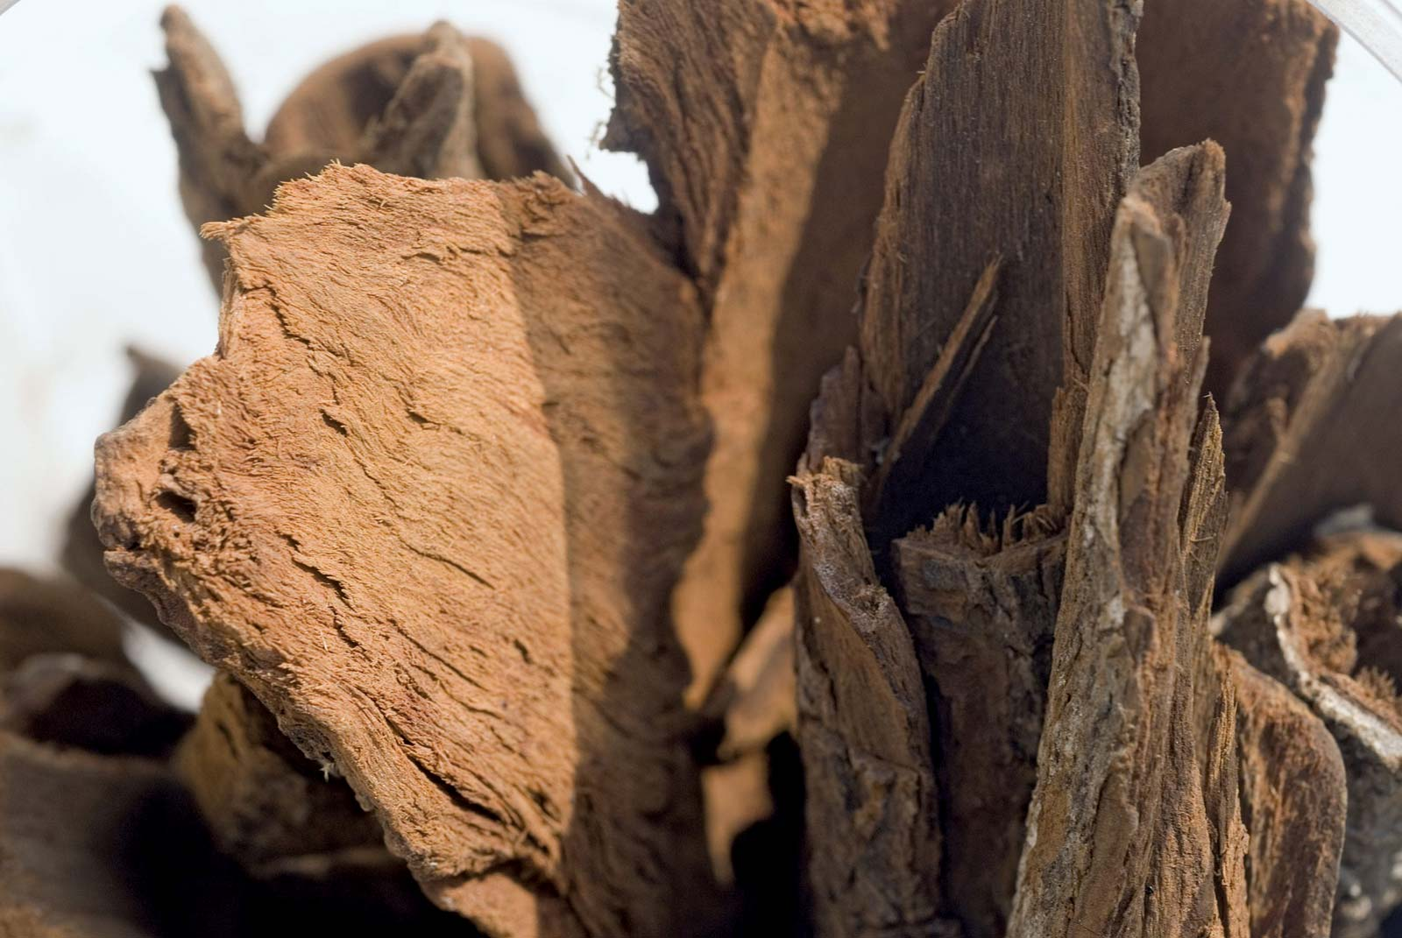
CINCHONA
Synonyms :- Cortex Cinchonae, Countess, Peruvian or Jesuit’s bark, Cinchona
Biological Source :- Cinchona is the dried bark of the stem or of the root of Cinchona calisaya Wedd., Cinchona ledgeriana Moens., Cinchona officinalis Linn., and Cinchona succirubra Pavon., or hybrids of any of the first two species with any of the last two species, belonging to family Rubiaceae.
Geographical Source :- Tropical valleys of the Andes. Bolivia and Southern Peru. Cinchona is a native of South America, occurring wild there. At present, it is mainly cultivated in Indonesia (Java), Zaire, India, Guatemala, Bolivia, Ceylon etc.
17-09-2024
2

Slide 3
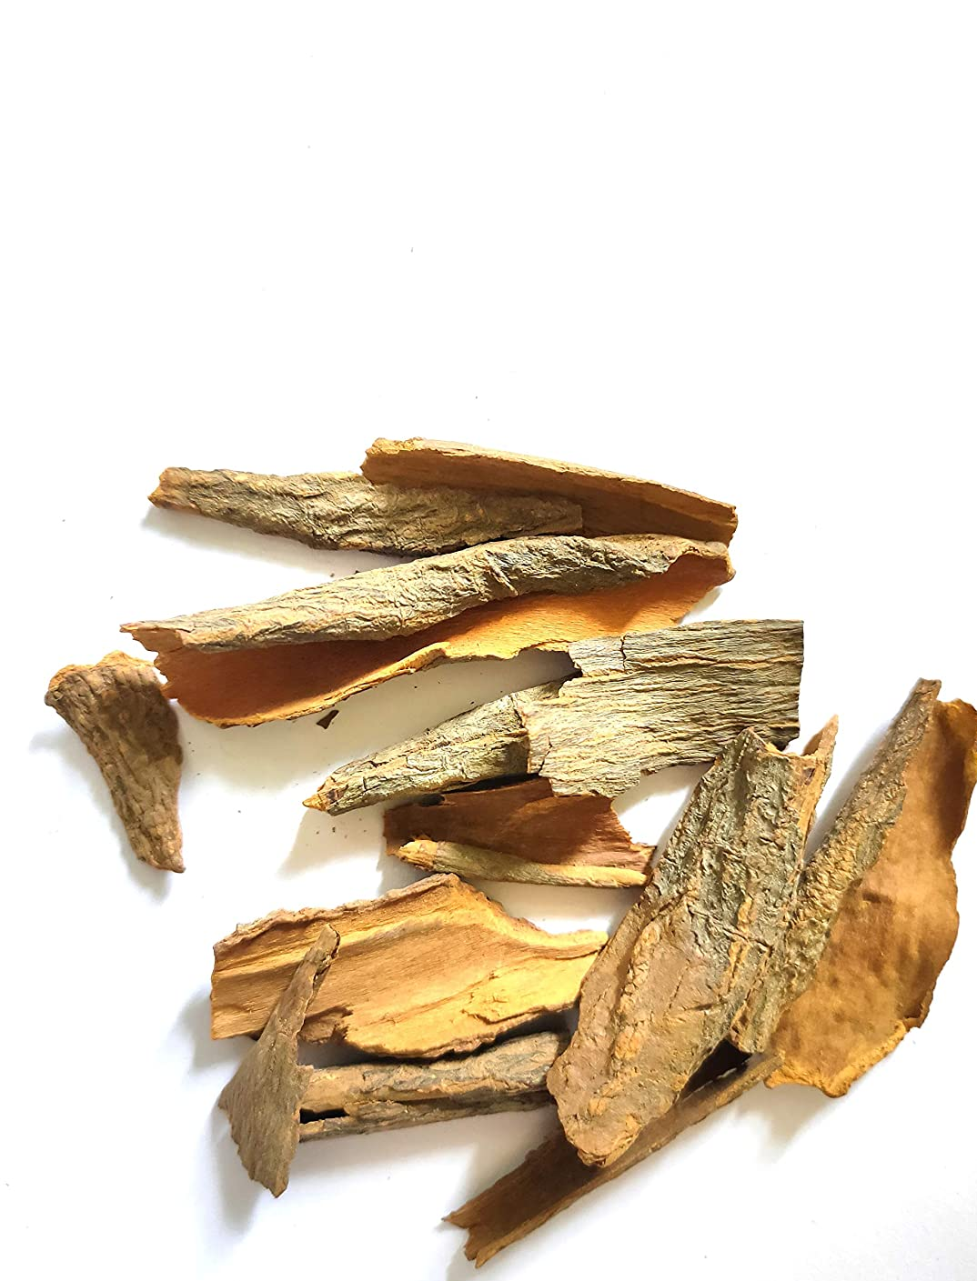
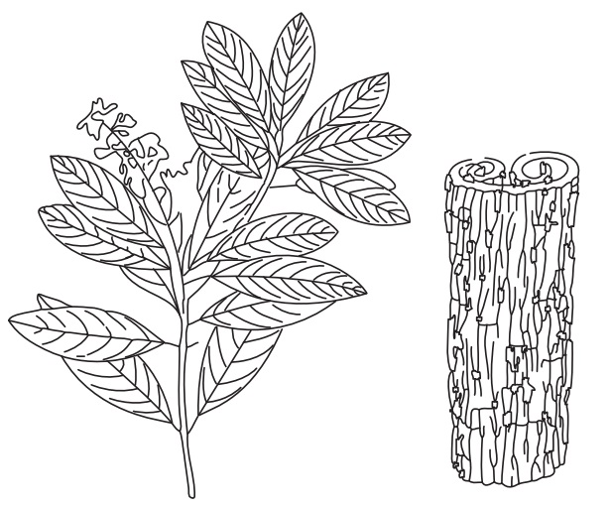
Morphology : Organoleptic characters:
Colour: Brown or reddish brown
Odour: slight and characteristics
Taste: Intensely bitter and slightly astringent
Shape: quill, double quill, curved
Fracture: short in outer surface and fibrous in inner part
17-09-2024
Twig and bark of Cinchona ledgeriana
3

Slide 4
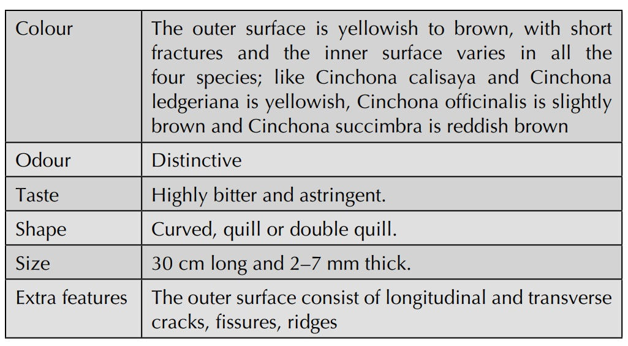
17-09-2024
4

Slide 5
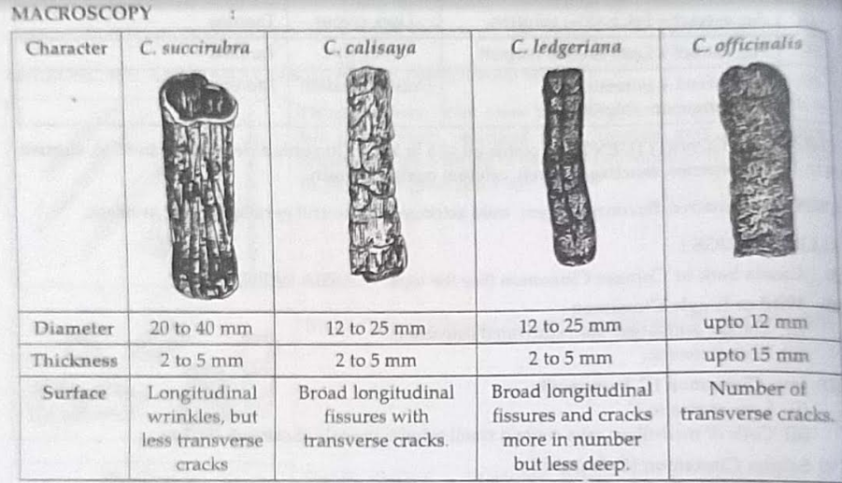
17-09-2024
5

Slide 6
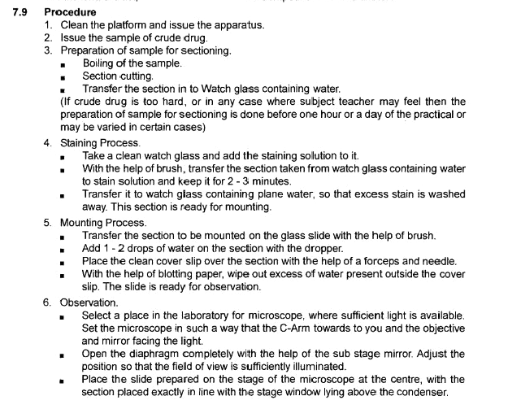
17-09-2024
6

Slide 7
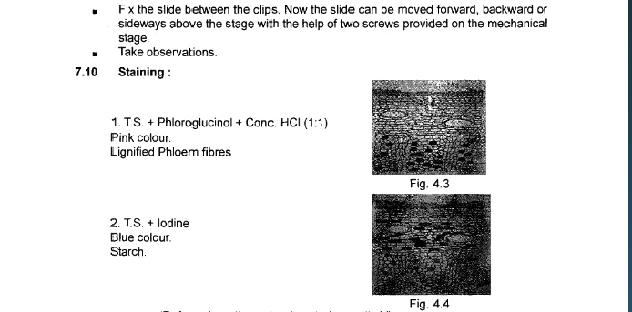
17-09-2024
7

Slide 8
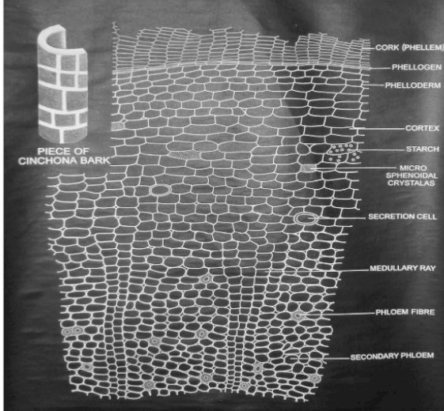
TRANSVERSE SECTION
17-09-2024
8

Slide 9
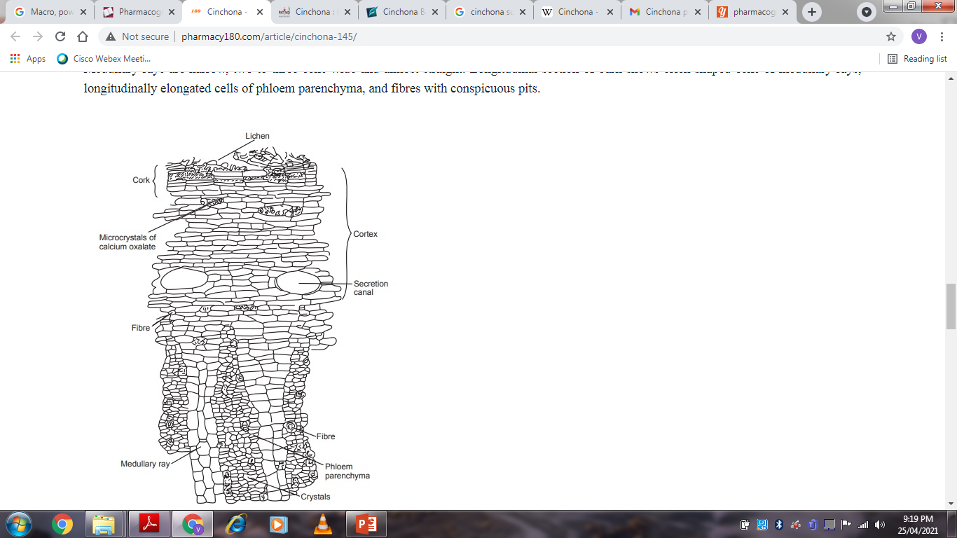
Transverse section of bark shows cork composed of uniformly arranged several layers of thin-walled cells, containing amorphous reddish-brown matter.
Cork is a redion of cortex, composed of tangentially elongated parenchymatous cells with red-brown and thin walls, containing small starch grains.
Idioblasts, containing micro-crystals of calcium oxalate (2–6 μ long), and secretion cells are scattered in the cortex.
Phloem consists of compressed and collapsed sieve tubes, phloem parenchyma similar to cortex, and irregularly arranged, large spindle-shaped lignified fibres.
Medullary rays are narrow, two to three cells wide and almost straight.
Longitudinal section of bark shows brick-shaped cells of medullary rays, longitudinally elongated cells of phloem parenchyma, and fibres with conspicuous pits.
17-09-2024
9

Slide 10
Chemical Constituents
More than 30 alkaloids have been reported in cinchona.
The chiefly identified alkaloids are quinidine, quinine, cinchonine and cinchonidine.
These constituents are the stereoisomers of each other like quinine is stereoisomer of quinidine and cinchonine is stereoisomer of cinchonidine.
The other constituents available are quiniarnine, cinchotine, hydroquinine, hydrocinchonidine, cinchotannic acid, etc. Quinine and quinidine has a methoxy group in it but cinchonine and cinchonidine do not have a methoxy group.
Other than these it also consist of bitter glycoside, starch grains, calcium oxalate crystals and crystalline acid like quinic acid.
Uses
It is mainly employed as antimalarial drug, but it is also used as analgesic, antipyretic, protoplasmic, bitter stomachic and tonic. Quinidine is cardiac depressant and Cinchonidine is used in rheumatism and neuralgia.
17-09-2024
10

Slide 11
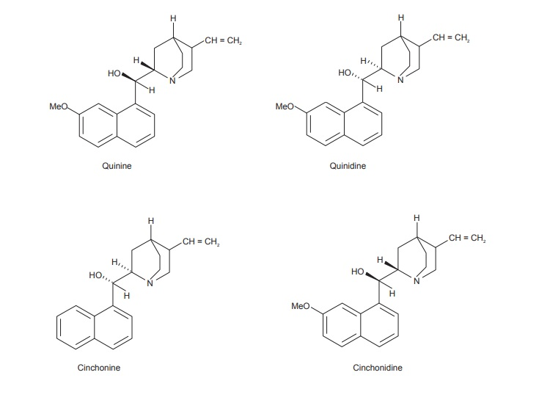
17-09-2024
11

Slide 12
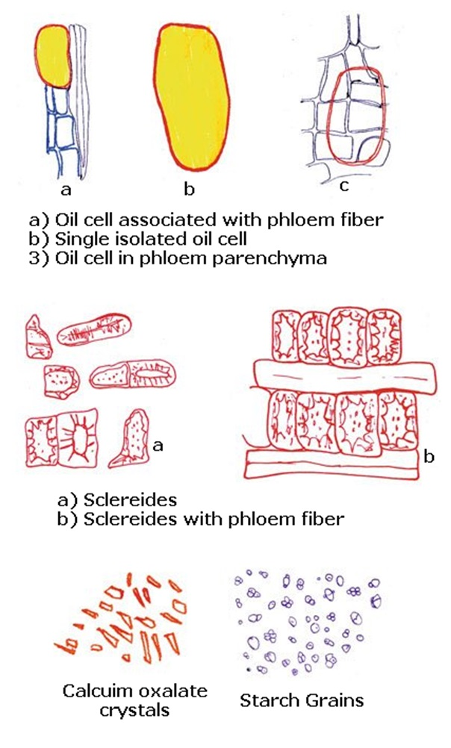
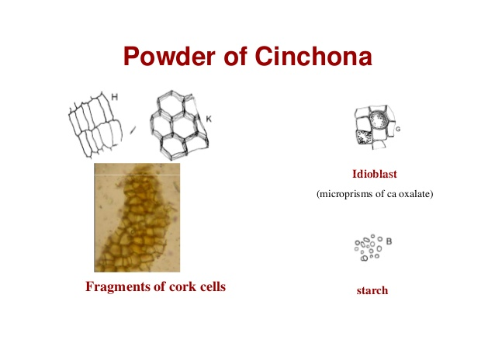
POWDER MICROSCOPY
17-09-2024
12

Slide 13
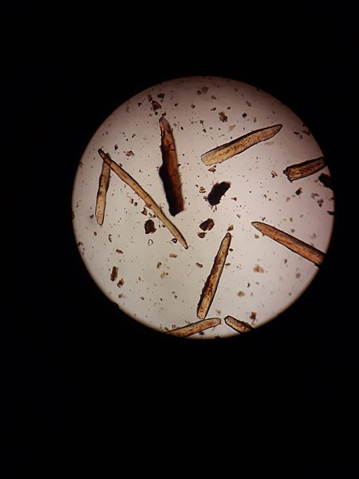
Reddish brown, showing fragments of:
1.cork cells thin walled suberized with brown content.
2. Phloem fibre, long, fusiform, thick wall, lignified with narrow lumen, pointed apex and showing funnel-shaped pits.
3.parenchyma with starch granules.
4.Idioblasts contain microprisms of calcium oxalate.
17-09-2024
13

Slide 14
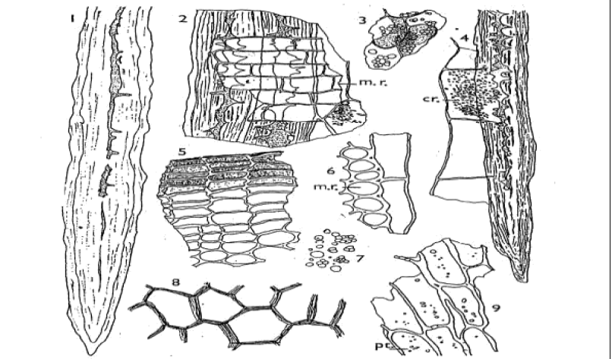
17-09-2024
14

Slide 15
CINNAMON
Biological source:- Obtained from dried inner bark of the tree Cinnamomum zeylanicum. It consists of the dried inner bark of the shoots of coppiced trees of Cinnamomum zeylanicum Nees (Cinnamomum verum J. S. Presl.)
Family:-Lauraceae
Geographical source :- Cinnamon, the evergreen tree of tropical area, is considered to be native of Sri Lanka and Malabar Coast of India. It is also found in Jamaica and Brazil. However, most of the world requirements are met by Sri Lanka and hence true cinnamon is known as Sri Lanka cinnamon.
Synonyms: Cinnamon bark, Kalmi-dalchini; Ceylon cinnamon.
Cinnamon is obtained in the form of quills (single or double) with longitudinal striations.
Externally cinnamon bark is yellowish brown while the inner surface is more darker. The length of cinnamon quills is variable whereas the diameter of quills is around 6-10 mm. Good quality cinnamon is usually not more than 0.5 mm in thickness, aromatic odor and fragrant
17-09-2024
15

Slide 16
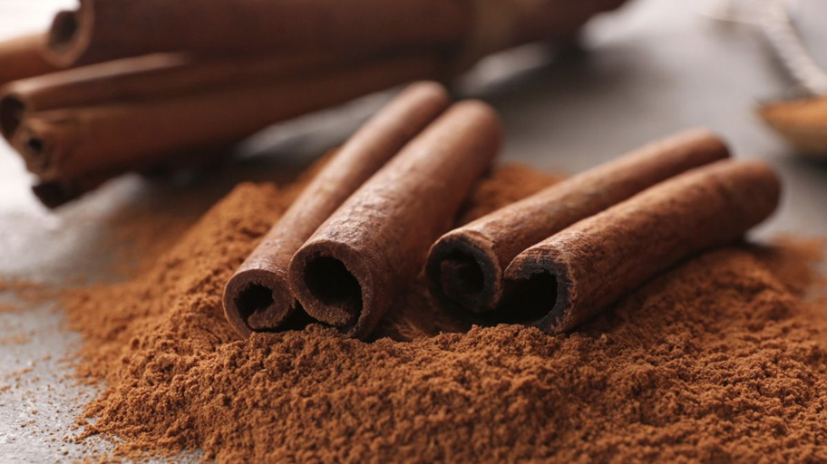
Macroscopical Character:
(i) Colour: The outer surface is dull yellowish-brown, while the inner surface is dark yellowish-brown.
(ii) Odour: Fragrant.
(iii) Shape: Compound squill.
(iv) Size: About 1 meter in length and 1 cm in diameter. The thickness of the bark is approximately 0.5 mm.
(v) Taste: Aromatic and sweet followed by warm sensation.
(vi) Fracture: Splintery
(vii) The outer surface of the bark is marked by wavy longitudinal striations with small holes of scars left by the branches. The inner surface also shows the longitudinal striations. Bark is free of cork.
17-09-2024
16

Slide 17
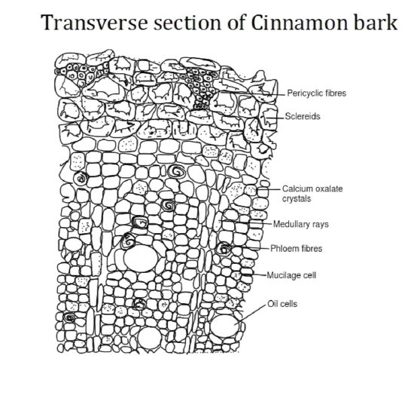
17-09-2024
17

Slide 18
The cork consists of several layers of thin-walled flat cells occurring in rows and filled with reddish-brown content.
The cortex is made of brown thin walled parenchyma containing small starch grains with occasional idioblast filled with micro crystals of calcium oxalate. Near the inner margin of the cortex are large oval secretion canals at intervals.
The phloem which forms the greater bulk of the bark is traverses longitudinally by 1-3 seriate medullary rays. The sieve tubes are usually collapsed with the small companion cell and phloem parenchyma, some of which are idioblast with micro prismatic crystals of calcium oxalate. The phloem fibers are very diagnostic and are large fusiform thick-walled lignified with striated walls and funnel-shaped pits. The fibers occur singly or in small radial groups of two to four cells. Sclereids are absent.
The root bark is similar to the stem bark but is mainly composed of phloem. The fibers are similar to those of the stem but are generally forked. There are occasional thickwalled striated pitted sclereids. Secretion tubes are absent.
17-09-2024
18

Slide 19
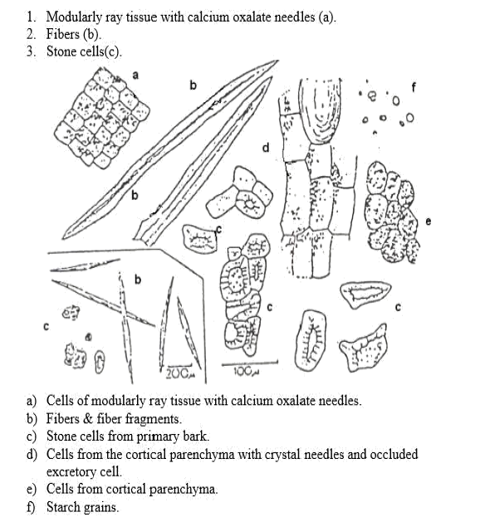
POWDER MICROSCOPY
17-09-2024
19

Slide 20
Since cinnamon is a bark, there should be no microscopic epidermis and cork in the transverse section. However, residual patches of cork cells may be observed.
2) The outer layer of the bark is made up of pericycle fibres 1000-2500 μm long with lignified walls having pit canals.
3) Presence of starch grains (both compound and simple) is visible under the microscope, sized around 10μm and can be found in the phloem. It is difficult to distinguish the primary phloem, however, the secondary phloem contains phloem parenchyma with the oil and mucilage cells which produce the volatile oil constituents of the plant.
4) There are also phloem fibres and medullary rays.
5) Acicular (radiating needle like) calcium oxalate crystals can be found about 5-8μm in size.
6) The phloem parenchyma contains tannins. Presence of medullary rays in the secondary phloem is prominent which are uni- or biseriate near the cambium but become broader towards the periphery.
7) There is also presence of sclereid layers of cells along the pericyclefibres.
17-09-2024
20

Slide 21
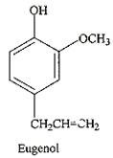
Chemical Constituents:
(i) About 0.5 to 1.0% of volatile oil,
(ii) 1.2% of tannins (phlobatannins),
(iii) Mucilage
(iv) Calcium oxalate
(v) Starch
(vi) Sweet substance known as mannitol.
(vii) Cinnamon oil contains 60-70% of cinnamaldehyde, 5-10% eugenol, and benzaldehyde, cuminaldehyde and other terpenes like phellandrene, pinene, cymene, Caryophyllene, etc
17-09-2024
21

Slide 22
Uses:
Carminative,
Stomachic
Mild astringent
Flavouring agent
Aromatic
6. Used as a spice and condiment
7. Preparation of candy, dentrifies and perfumes.
8. Oil is powerful germicide
17-09-2024
22

Slide 23
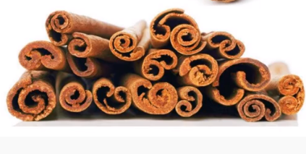
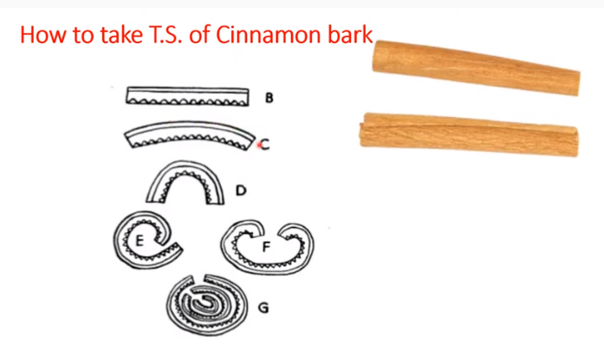
17-09-2024
23

Slide 24
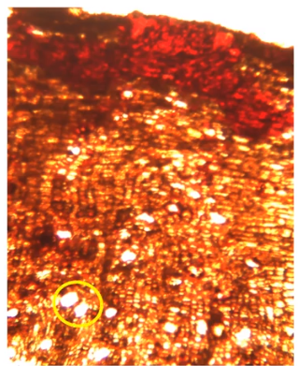
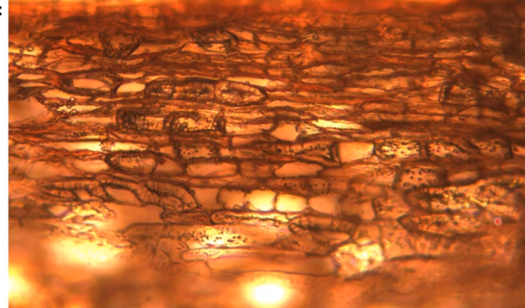
17-09-2024
24

Slide 25
