Slide 1
CLINICAL PHARMACY
INTRODUCTION TO CLINICAL PHARMACY
15-09-2024
1

Slide 2
DEFINITION OF CLINICAL PHARMACY
Clinical pharmacy is the branch of Pharmacy where pharmacists provide patient care that optimizes the use of medication and promotes health, wellness, and disease prevention.
The American College of Clinical Pharmacy (ACCP) defines clinical pharmacy as an area of pharmacy concerned with the science and practice of rational medication use.

Slide 3
CLINICAL PHARMACIST
Clinical pharmacist is the expert in therapeutic use of medication therapy, evaluation and recommendation of drugs to the patient and other health care professionals.
It comprises of functions necessary to discharge a particular set of social responsibilities related to therapeutic drug use in the following major categories.

Slide 4
FUNCTIONS
1. Prescribing drugs
2. Dispensing and administering drugs
3. Documenting professional services
4. Direct patient involvement
5. Reviewing drug use
6. Education
7. Consolation (comfort the patients)

Slide 5
AIM OF CLINICAL PHARMACY
The aim of clinical pharmacy is to ensure the patient‘s maximum well being and to play a meaningful role in the safe and rational use of drugs. The main roles of clinical pharmacy are:
1. To assist the physician in doing a better job of prescribing and monitoring drug therapy for the patient.
2. To assist medical and paramedical staff and documenting medication indications correctly.
3. To maximize the patients’ compliance in drug use process.

Slide 6
SCOPE OF CLINICAL PHARMACY
Clinical pharmacy services are of considerable importance in all the hospitals because; Clinical Pharmacy can serve as a guide to the physician for the safe and rational use of drugs.
A clinical pharmacist can help to achieve economic hospital by planning safe drug policies, for suggesting means of reductions of waste, by preventing misuse of drugs and in the preparation of budget by forecasting future means of hospital based upon their drug utilization process.

Slide 7
SCOPE
The scope of clinical pharmacy is of utmost appreciation in the following areas:
1. Drug information
2. Drug utilization
3. Drug distribution
4. Drug selection
5. Drug evaluation
6. Pharmacy education and teaching.

Slide 8
QUALITIES OF CLINICAL PHARMACIST
The clinical pharmacist should have the following qualities.
1. Good communication skills
2. Clinical skills (pharmaceutical care)
3. Professional relationship
4. Empathy (ability to understand another)
5. Monitoring drug therapy

Slide 9
ROLE OF CLINICAL PHARMACIST IN HEALTH CARE TEAM
The Clinical Pharmacist has the following roles.
1. Taking medication history of the patient
2. Drug interactions
3. Selection of drug therapy
4. Drug monitoring
5. Adverse drug reactions
6. Management of drug policies
7. Research and development programme
8. Drug information

Slide 10
DUTIES OF CLINICAL PHARMACIST
The daily routine duties of Clinical Pharmacist are,
1. Assisting pharmacokinetic consultations with necessary follow up.
2. Monitoring drug therapy schedule.
3. Taking rounds with health care team
4. Teaching pharmacy students
5. Patient counseling
6. Review of hospital rules or law
7. Preparation of drug monograph (dose, formulations, label, active ingredients) to be reviewed by pharmacy and the therapeutic community of hospital.
In this manner, clinical pharmacy is totally patient oriented and deals with rationale of drug therapy.

Slide 11
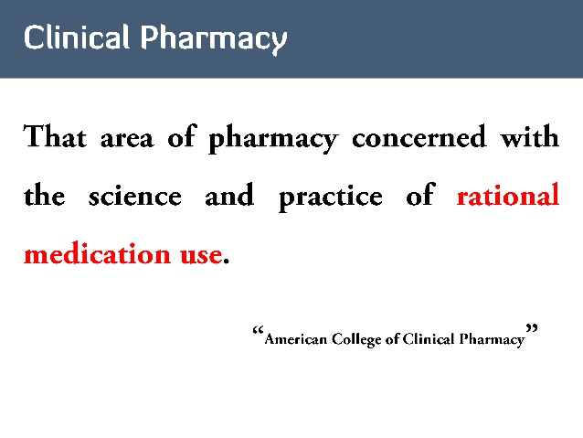

Slide 12
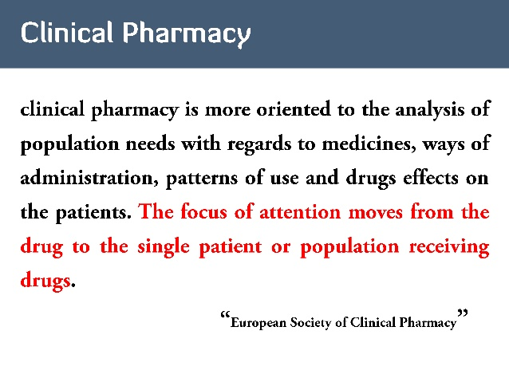

Slide 13
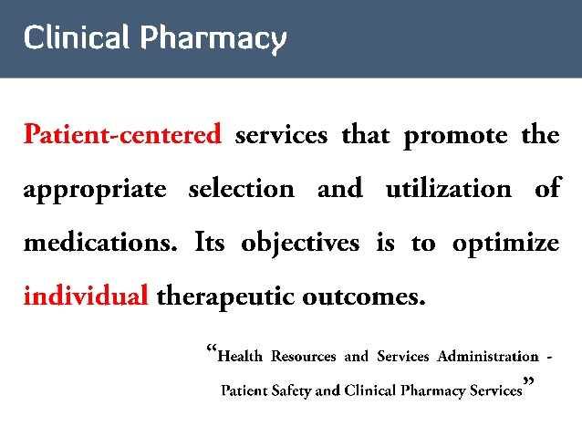

Slide 14
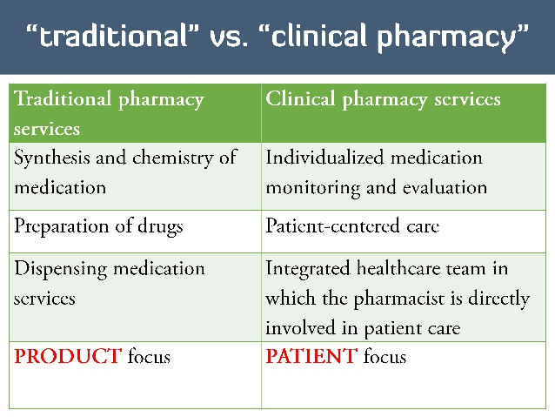

Slide 15
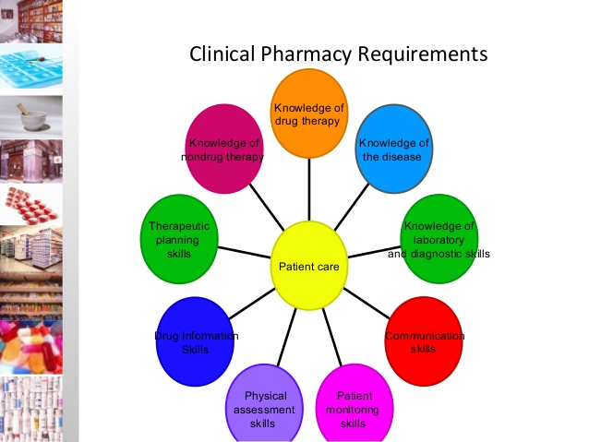

Slide 16
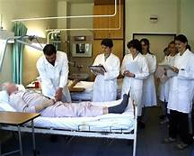

Slide 17


Slide 18


Slide 19
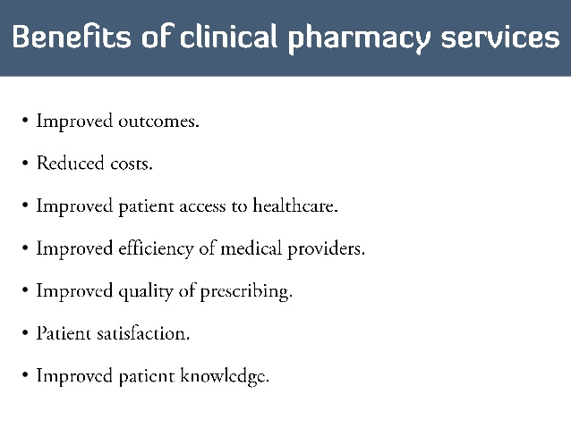

Slide 20
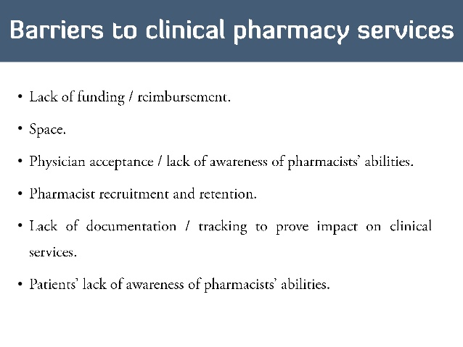

Slide 21
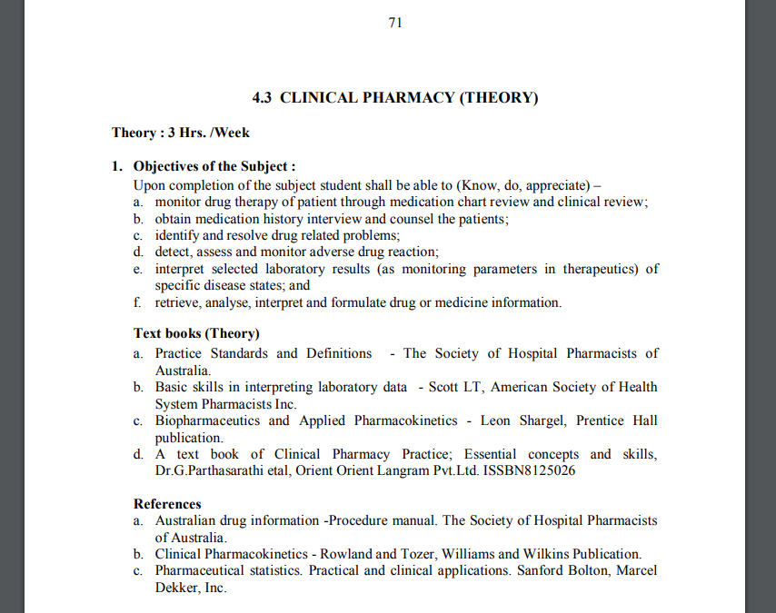

Slide 22
