Slide 1
BIOPHARMACEUTICS AND PHARMACOKINETICS
4: EXCRETION OF DRUGS
14-09-2024
1

Slide 2
CONCEPT OF CLEARANCE :
In pharmacology, clearance is a pharmacokinetic measurement of the volume of plasma from which a substance is completely removed per unit time. Usually, clearance is measured in L/h or mL/min.
The quantity reflects the rate of drug elimination divided by plasma concentration.
Excretion, on the other hand, is a measurement of the amount of a substance removed from the body per unit time (e.g., mg/min, μg/min, etc.).
While clearance and excretion of a substance are related, they are not the same thing.
The concept of clearance was described by Thomas Addis, a graduate of the University of Edinburgh Medical School .
Substances in the body can be cleared by various organs, including the kidneys, liver, lungs, etc.
14-09-2024
2

Slide 3
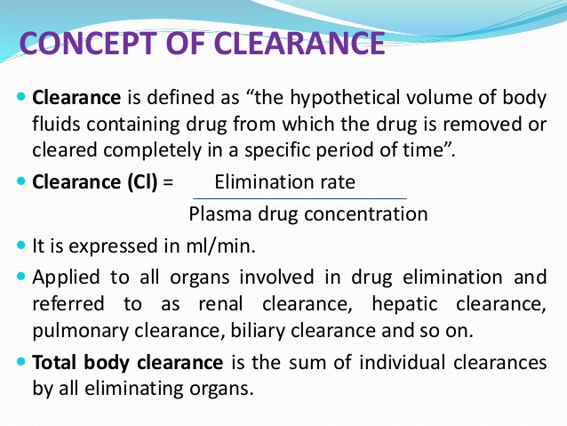
14-09-2024
3

Slide 4

14-09-2024
4

Slide 5
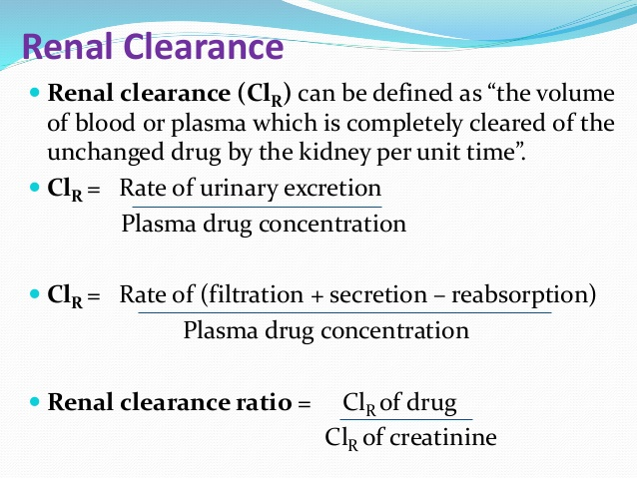
14-09-2024
5

Slide 6
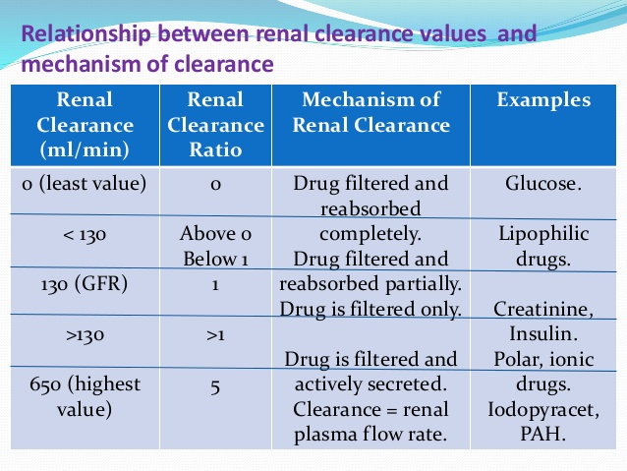
14-09-2024
6

Slide 7
DETERMINATION OF CLEARANCE :
One method of quantitatively describing the renal excretion of drugs is by means of the renal clearance value for the drug.
Renal clearance can be used to investigate the mechanism of drug excretion:
A- If the drug is filtered but not secreted or reabsorbed the renal clearance will be about 120 ml/min in normal subjects.
B- If the renal clearance is less than 120 ml/min then we can assume that at least two processes are in operation, glomerular filtration and tubular re-absorption.
C- If the renal clearance is greater than 120 ml/min then tubular secretion must be contributing to the elimination process.
14-09-2024
7

Slide 8
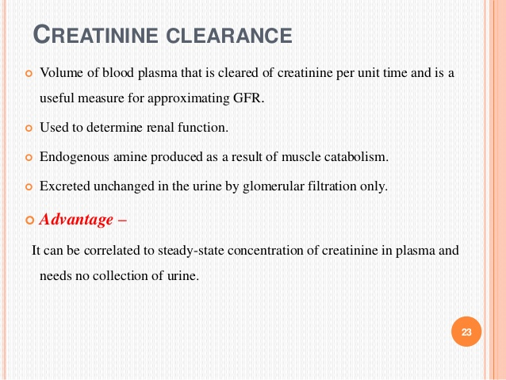
14-09-2024
8

Slide 9
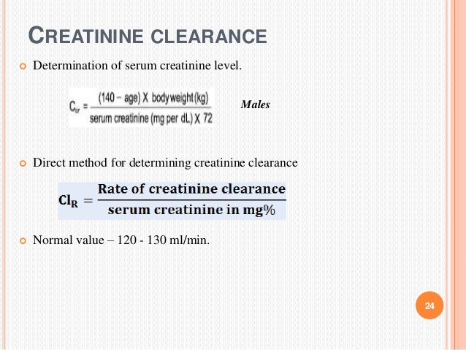
14-09-2024
9

Slide 10
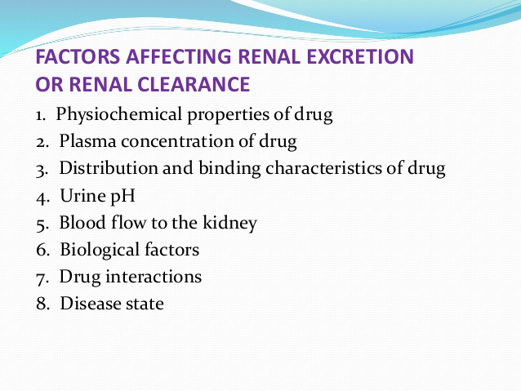
14-09-2024
10

Slide 11
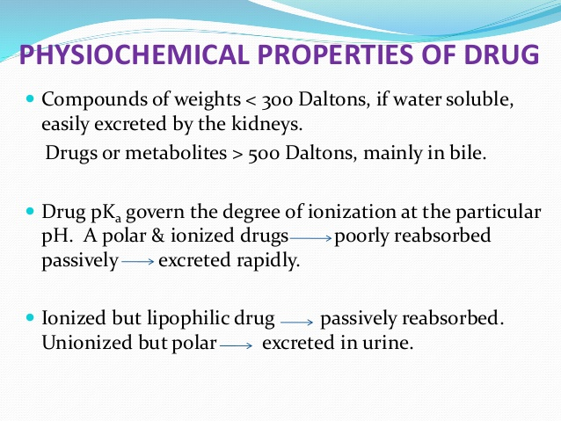
14-09-2024
11

Slide 12
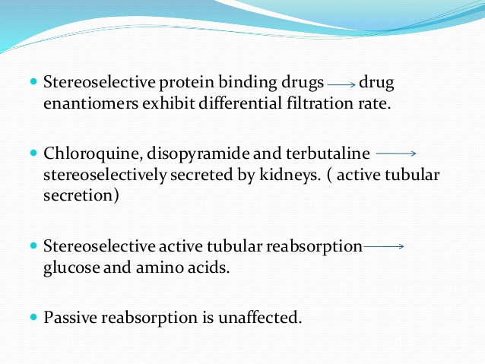
14-09-2024
12

Slide 13
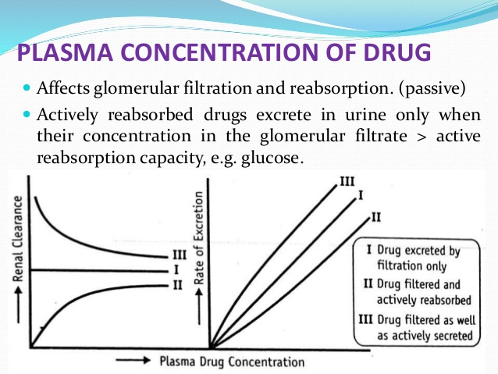
14-09-2024
13

Slide 14
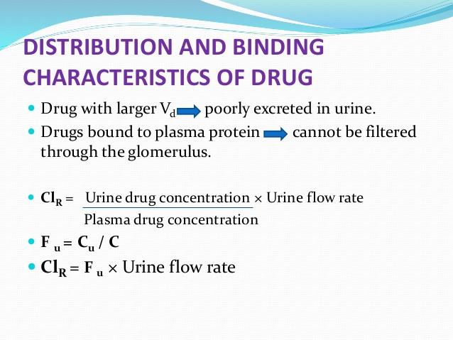
14-09-2024
14

Slide 15
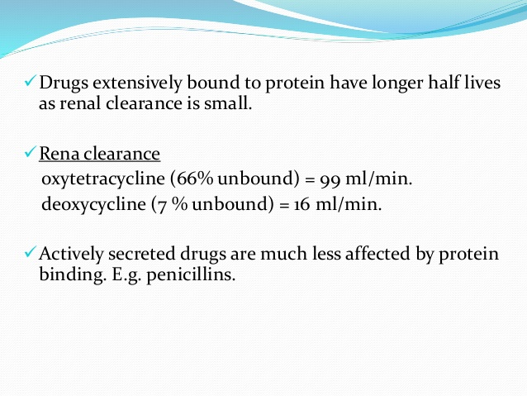
14-09-2024
15

Slide 16
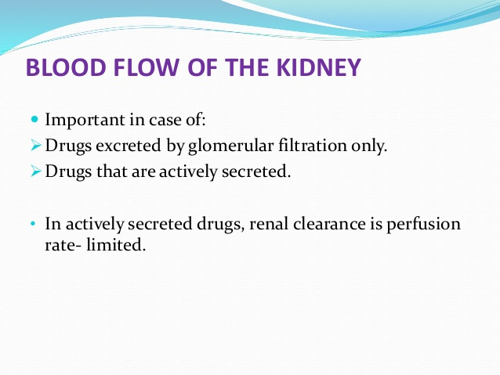
14-09-2024
16

Slide 17
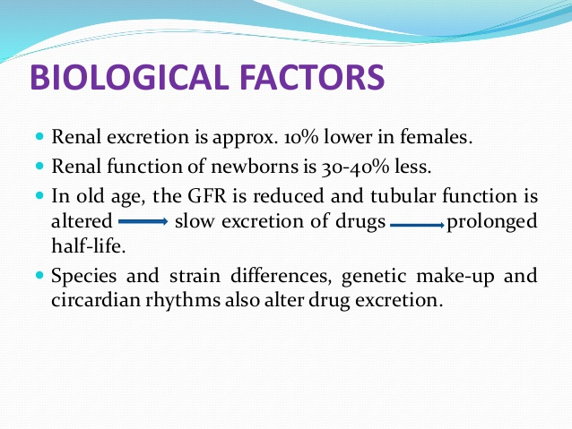
14-09-2024
17

Slide 18
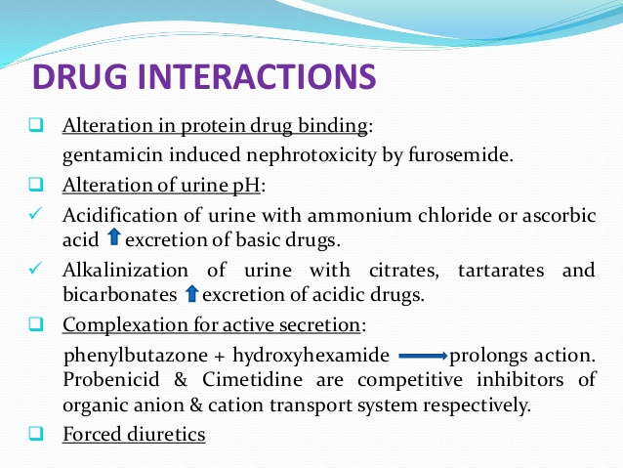
14-09-2024
18

Slide 19
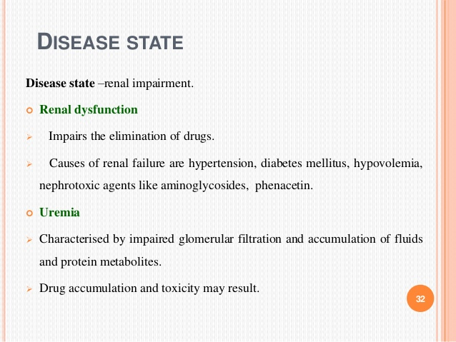
14-09-2024
19

