Slide 1
SUBJECT NAME –PHARMACEUTICAL MICROBIOLOGY
UNIT NO & NAME – 8 DIAGNOSTIC TEST
17-09-2024
1

Slide 2
TOPIC NAME – DIAGNOSTIC TESTS
Schick s test is defined a test for susceptibility to diphtheria by cutaneous injection of a diluted diphtheria toxin that causes an area of reddening and induration
a serological test for susceptibility to diphtheria by cutaneous injection of a diluted diphtheria toxin that causes an area of reddening and induration in susceptible individuals
PROCEDURE
The test is a simple procedure. A small amount (0.1 ml) of diluted (1/50 MLD) diphtheria toxin is injected intradermally into one arm of the person and a heat inactivated toxin on the other as a control. If a person does not have enough antibodies to fight it off, the skin around the injection will become red and swollen, indicating a positive result. This swelling disappears after a few days. If the person has an immunity, then little or no swelling and redness will occur, indicating a negative result.
Results can be interpreted as:
Positive: when the test results in a wheal of 5–10 mm diameter, reaching its peak in 4–7 days. The control arm shows no reaction. This indicates that the subject lacks antibodies against the toxin and hence is susceptible to the disease.
Pseudo-positive: when there is only a red-colored inflammation (erythema) and it disappears within 4 days. This happens on both the arms since the subject is immune but hypersensitive to the toxin
17-09-2024
2

Slide 3

Negative reaction: Indicates that the person is immune.
Combined reaction: Initial picture is like that of the pseudo-reaction but the erythema fades off after 4 days only in the control arm. It progresses on the test arm to a typical positive. The subject is interpreted to be both susceptible and hypersensitive.
The test was created when immunizing agents were scarce and not very safe; however, as newer and safer toxoids became available, susceptibility tests were no longer required

Slide 4
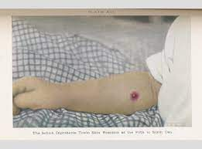

Slide 5
The enzyme-linked immunosorbent assay (ELISA) is an immunological assay commonly used to measure antibodies, antigens, proteins and glycoproteins in biological samples. Some examples include: diagnosis of HIV infection, pregnancy tests, and measurement of cytokines or soluble receptors in cell supernatant or serum
ELISA is used in both experimental and diagnostic virology. It is a highly sensitive assay that can detect proteins at the picomolar to nanomolar range (10⁻¹² to 10⁻⁹ moles per liter). It is the mainstay for the diagnosis of infections by many different viruses, including HIV-1, HTLV-1, adenovirus, and cytomegalovirus.
Advantages. High sensitivity and specificity: it is common for ELISAs to detect antigens at the picogram level in a very specific manner due to the use of antibodies. High throughput: commercial ELISA kits are normally available in a 96-well plate format. But the assay can be easily adapted to 384-well plates.
The most simple form of an ELISA, antigens from the sample to be tested are attached to a surface. Then, a matching antibody is applied over the surface so it can bind the antigen. This antibody is linked to an enzyme and then any unbound antibodies are removed.

Slide 6
ELISA
A buffered solution of the antigen to be tested for is added to each well (usually 96-well plates) of a microtiter plate, where it is given time to adhere to the plastic through charge interactions.
A solution of nonreacting protein, such as bovine serum albumin or casein, is added to each well in order to cover any plastic surface in the well which remains uncoated by the antigen.
The primary antibody with an attached (conjugated) enzyme is added, which binds specifically to the test antigen coating the well.
A substrate for this enzyme is then added. Often, this substrate changes colour upon reaction with the enzyme.
The higher the concentration of the primary antibody present in the serum, the stronger the colour change. Often, a spectrometer is used to give quantitative values for colour strength.

Slide 7
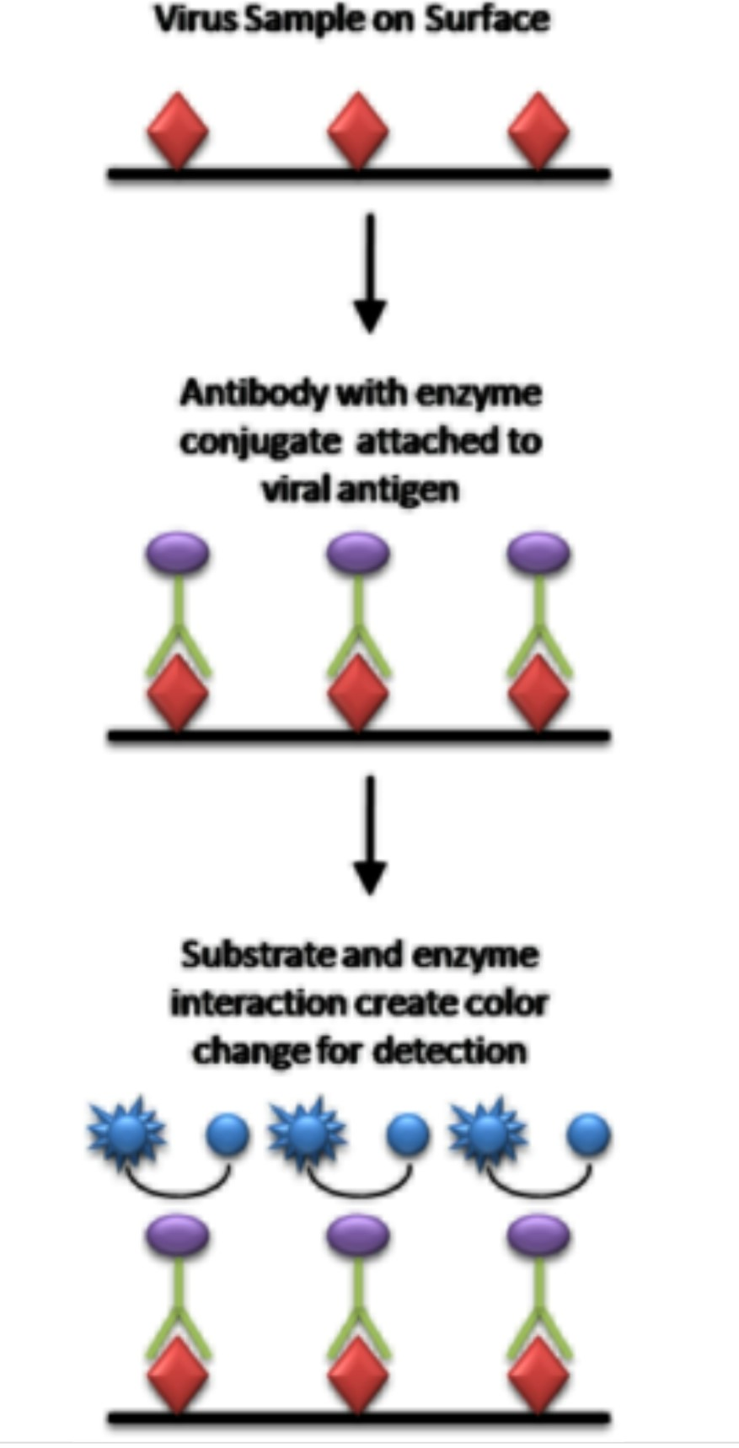
ELISA

Slide 8
western blot
The western blot is routinely used for verification of protein production after cloning. It is also used in medical diagnostics, e.g., in the HIV test The confirmatory HIV test employs a western blot to detect anti-HIV antibody in a human serum sample.
The western blot (sometimes called the protein immunoblot), or western blotting, is a widely used analytical technique in molecular biology and immunogenetics to detect specific proteins in a sample of tissue homogenate or extract.
In brief, the sample undergoes protein denaturation, followed by gel electrophoresis. A synthetic or animal-derived antibody (known as the primary antibody) is created that recognises and binds to a specific target protein. The electrophoresis membrane is washed in a solution containing the primary antibody, before excess antibody is washed off. A secondary antibody is added which recognises and binds to the primary antibody. The secondary antibody is visualised through various methods such as staining, immunofluorescence, and radioactivity, allowing indirect detection of the specific target protein.

Slide 9
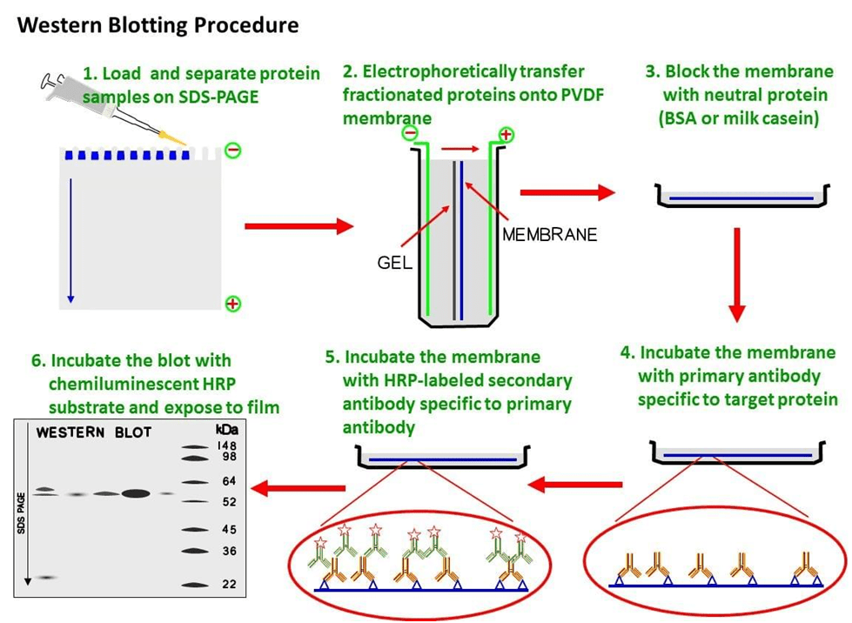
western blot

Slide 10

Southern blot
A Southern blot is a method used in molecular biology for detection of a specific DNA sequence in DNA samples. Southern blotting combines transfer of electrophoresis-separated DNA fragments to a filter membrane and subsequent fragment detection by probe hybridization.
The method is named after the British biologist Edwin Southern, who first published it in 1975
Restriction endonucleases are used to cut high-molecular-weight DNA strands into smaller fragments.
The DNA fragments are then electrophoresed on an agarose gel to separate them by size.
If some of the DNA fragments are larger than 15 kb, then prior to blotting, the gel may be treated with an acid, such as dilute HCl. This depurinates the DNA fragments, breaking the DNA into smaller pieces, thereby allowing more efficient transfer from the gel to membrane.
If alkaline transfer methods are used, the DNA gel is placed into an alkaline solution (typically containing sodium hydroxide) to denature the double-stranded DNA. The denaturation in an alkaline environment may improve binding of the negatively charged thymine residues of DNA to a positively charged amino groups of membrane, separating it into single DNA strands for later hybridization to the probe and destroys any residual RNA that may still be present in the DNA. The choice of alkaline over neutral transfer methods, however

Slide 11
Southern blot
A sheet of nitrocellulose (or, alternatively, nylon) membrane is placed on top of (or below, depending on the direction of the transfer) the gel. Pressure is applied evenly to the gel (either using suction, or by placing a stack of paper towels and a weight on top of the membrane and gel), to ensure good and even contact between gel and membrane. If transferring by suction, 20X SSC buffer is used to ensure a seal and prevent drying of the gel. Buffer transfer by capillary action from a region of high water potential to a region of low water potential (usually filter paper and paper tissues) is then used to move the DNA from the gel onto the membrane; ion exchange interactions bind the DNA to the membrane due to the negative charge of the DNA and positive charge of the membrane.
The membrane is then baked in a vacuum or regular oven at 80 °C for 2 hours (standard conditions; nitrocellulose or nylon membrane) or exposed to ultraviolet radiation (nylon membrane) to permanently attach the transferred DNA to the membrane.
The membrane is then exposed to a hybridization probe—a single DNA fragment with a specific sequence whose presence in the target DNA is to be determined. The probe DNA is labelled so that it can be detected, usually by incorporating radioactivity or tagging the molecule with a fluorescent or chromogenic dye. In some cases, the hybridization probe may be made from RNA, rather than DNA. To ensure the specificity of the binding of the probe to the sample DNA, most common hybridization methods use salmon or herring sperm DNA for blocking of the membrane surface and target DNA, deionized formamide, and detergents such as SDS to reduce non-specific binding of the probe.
After hybridization, excess probe is washed from the membrane (typically using SSC buffer), and the pattern of hybridization is visualized on X-ray film by autoradiography in the case of a radioactive or fluorescent probe, or by development of colour on the membrane if a chromogenic detection method is used.

Slide 12
