Slide 1
DEEP VEIN THROMBOSIS

Slide 2
Definition : A DVT is a thrombus composed of cellular material (red & white blood cells, platelets) bound together with fibrin strands.
Venous thromboembolism (VTE) : results from clot formation in the venous circulation and is manifested as DVT and PE (pulmonary embolism)
A PE is a thrombus that arises from the systemic circulation and lodges in the pulmonary artery or one of its branches, causing complete or partial obstruction of pulmonary blood flow.

Slide 3
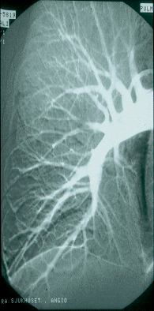
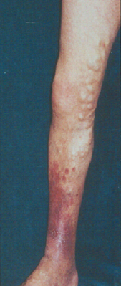
VENOUS THROMBOEMBOLISM
DVT
PE
Deep vein
insufficiency
Pulmonary
hypertension
Death
Post-thrombotic
syndrome
Chronic PE
Ulcus cruris

Slide 4
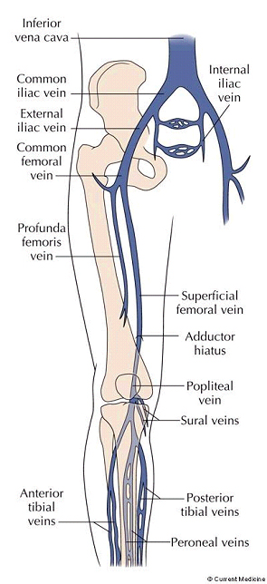
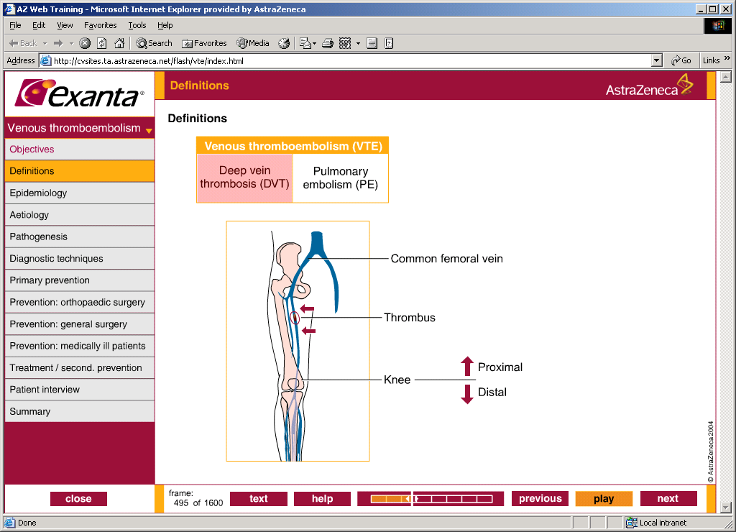
Deep vein thrombosis
Common femoral vein
Thrombus
Proximal
Knee
Distal
Veins of the leg

Slide 5
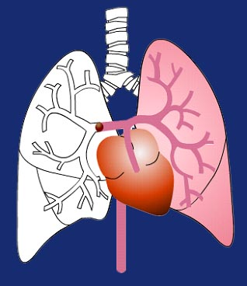
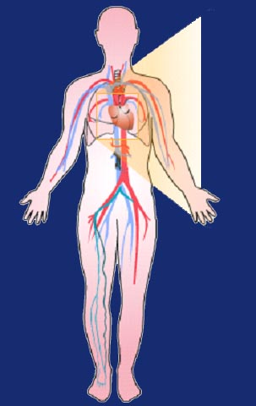
Pulmonary embolism
Embolus
Dyspnea, syncope, hypotension,
cyanosis

Slide 6
AETIOLOGY
Rapid blood flow has an inhibitory effect on thrombus formation, but a slow rate of flow reduces the clearance and dilution of activated clotting factors in the zone of injury and slows the influx of regulatory substances.
Stasis of blood tips the delicate balance of procoagulation and anticoagulation in favor of thrombogenesis.

Slide 7
The rate of blood flow in the venous circulation, particularly in the deep veins of the lower extremities, is relatively slow.
Damage to the venous valves and prolonged periods of immobility result in venous stasis.
Vessel obstruction, either from external compression or a thrombus, also promotes clot propagation.
Greater-than-normal blood viscosity, seen in myeloproliferative disorders like polycythemia vera.

Slide 8
Although less common, inherited deficiencies of the natural anticoagulants protein C, protein S, and antithrombin place patients at a high lifetime risk for VTE.
Conversely, excessively high concentrations of factors VIII, IX, and XI also increase the risk of VTE.
Activated protein C resistance is the most common genetic disorder of hypercoagulability.
IDIOPATHIC DVT : mutation of factor
V leiden and the prothrombin G20210Amutation

Slide 9
Acquired disorders of hypercoagulability may result from MALIGNANCY (cancer), the presence of ANTIPHOSPHOLIPID ANTIBODIES, and ESTROGEN USE.

Slide 10
RISK FACTORS FOR VENOUS THROMBOEMBOLISM
HISTORY OF VTE Strongest known risk factor of DVT and PE
AGE Risk doubles with each decade after age 50 y
VENOUS STASIS : Major medical illness (e.g., CHF, status post-MI)
Major surgery (e.g., general anesthesia >30 minutes)
Paralysis (e.g., status post-stroke, spinal cord injury) Polycythemia vera
Obesity
Varicose veins
VASCULAR INJURY : Major orthopedic surgery (e.g., knee and hip replacement)
Trauma (especially fractures of the pelvis, hip, or leg)
Indwelling venous catheters

Slide 11
HYPERCOAGULABLE STATES :
Malignancy, diagnosed or occult
Activated protein C resistance/factor V Leiden
Prothrombin (G20210A) gene mutation
Protein C deficiency
Protein S deficiency
Antithrombin deficiency
Factor VIII excess (>90th percentile)
Factor XI excess (>90th percentile)
Antiphospholipid antibodies
Dysfibrinogenemia
Hyperhomocysteinemia
Plasminogen activator inhibitor-1 excess
Inflammatory bowel disease
Nephrotic syndrome
Pregnancy/postpartum

Slide 12
DRUG THERAPY :
Estrogen-containing contraception
Estrogen replacement therapy
Selective estrogen receptor modulators
Heparin-induced thrombocytopenia

Slide 13
CLASSIFICATION OF LEVEL OF VTE RISK
Low risk
Moderate risk
High risk
Highest risk
Minor surgery in patients <40
years with no additional risk
factors
Surgery in
patients 40-60
years with no
additional risk factors
Minor surgery
in patients with additional risk factors
Surgery in
patients >60
years, or age 40-60 with additional
risk factors (prior VTE, cancer, molecular hyper-coagulability)
Surgery in
patients with multiple risk factors (age >40, cancer, prior VTE)
Hip or knee arthroplasty, hip fracture surgery
Major trauma, spinal cord injury
Geerts WH et al. Chest 2004;126:338S–400S

Slide 14
THROMBOEMBOLIC RISK CATEGORIES
Frequency of
calf DVT (%)
Frequency of
proximal DVT (%)
Frequency of
fatal PE (%)
Category
Highest risk 40-80 10-20 0.2-5
High risk 20-40 4-8 0.4-1.0
Moderate risk 10-20 2-4 0.1-0.4
Low risk 2 0.4 <0.01

Slide 15
THROMBOPHILIA AND RISK OF RECURRENCE
Risk importance
Risk
Antithrombin deficiency
Homozygous factor VLeiden
Combined defects
Antiphospholipid antibodies (LA/ACA)
Protein C deficiency
Protein S deficiency
Heterozygous factor VLeiden
Heterozygous prothrombin gene mutation

Slide 16
PATHOGENESIS
With vascular injury, a dynamic series of reactions involving a complex interplay of thrombogenic and antithrombotic stimuli result in the local formation of a hemostatic plug that seals the vessel wall and prevents further blood loss.
A disruption of this delicate system of checks and balances may lead to inappropriate clot formation within the blood vessel that subsequently obstructs blood flow or embolizes to a distant vascular bed.

Slide 17
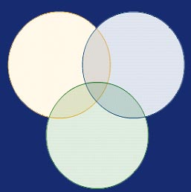
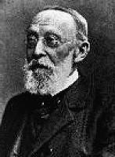
PATHOGENESIS OF VTE
VIRCHOW´S TRIAD
Stasis
Injury to the vessel wall
Hypercoagulability
Rudolf Virchow

Slide 18
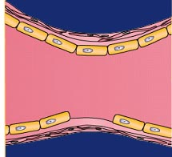
PATHOGENESIS OF VTE
VIRCHOW´S TRIAD
Stasis
Injury to the vessel wall
Damage to the vessel wall can be produced by direct trauma such as major hip or knee surgery, stab wounds or insertion of venous catheters, by direct invasion from cancer cells, or as a consequence of age. Support structures in vessel walls deteriorate with age, leading to weakness and a predisposition to damage from distension.
Hypercoagulability

Slide 19
PATHOGENESIS OF VTE
VIRCHOW´S TRIAD
Injury to the
vessel wall
Stasis
Stasis describes the slowing or even cessation of blood flow. This commonly occurs in veins as a result of immobility or paralysis and can lead to concentration and subsequent activation of coagulation factors. Stasis can also cause the vessel walls to become distended, resulting in endothelial damage.
Hypercoagulability

Slide 20
PATHOGENESIS OF VTE
VIRCHOW´S TRIAD
Stasis
Injury to the vessel wall
Hypercoagulability
The term hypercoagulability means an increased propensity to clot. Hypercoagulability can occur as a result of a genetic defect, stasis, malignancy or hormone changes such as during pregnancy, during administration of oral contraceptives or hormone replacement therapy.

Slide 21
Vascular injury can expose the subendothelium. Platelets readily adhere to the subendothelium, using glycoprotein Ib receptors found on their surfaces and facilitated by von Willebrand factor.
This causes platelets to become activated, releasing a number of procoagulant substances into the local circulation that stimulate platelets to expose glycoprotein IIb/IIIa receptors. These receptors allow the platelets to adhere to one another, resulting in platelet aggregation.

Slide 22
INITIATION OF BLOOD COAGULATION
Extrinsic Pathway
Intrinsic Pathway
Tissue trauma
Leakage of Tissue Factor
Blood trauma/ contact with collagen
Activation of factor XII, IX, VIII
Ca⁺², factor VII
X Xa
X Xa
Ca⁺²
Ca⁺²
Prothrombin activator
Ca⁺²
Prothrombin Thrombin
(factor II)
Prothrombin Thrombin
(factor II)
Activation of certain factors (VII, II, X and protein C and S) is essential for coagulation. This activation requires vit K (reduced form)

Slide 23
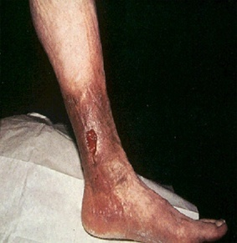
POST-THROMBOTIC SYNDROME
  Pain
  Oedema
  Discoloration
  Varices
  Ulceration
Symptoms of post-thrombotic syndrome – long “lag-phase” (years)

Slide 24
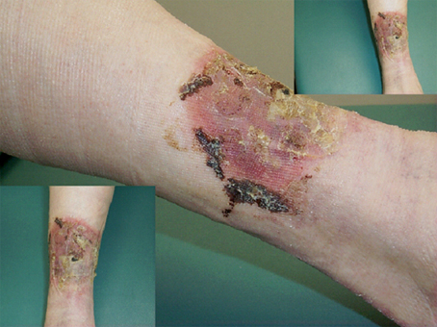
Post-thrombotic syndrome

Slide 25
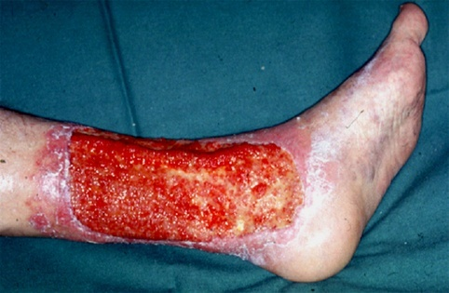
Ulcus cruris venosum

Slide 26
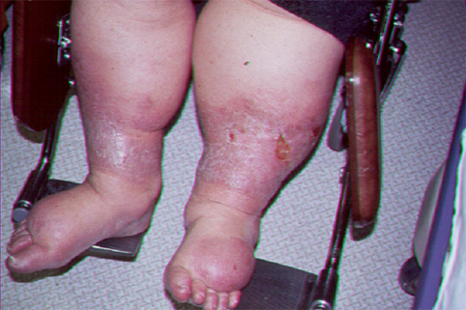
Severe stasis and ulceration

Slide 27
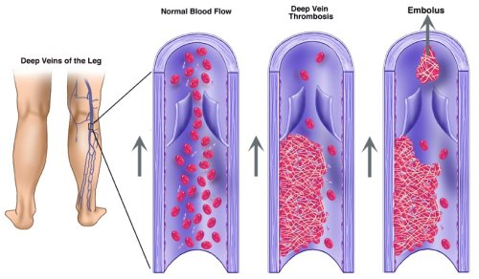

Slide 28
Clinical Presentation of Deep Vein Thrombosis
General :
Venous thromboembolism most commonly develops in patients with identifiable risk factors during or following a hospitalization. Many, perhaps the majority, of patients have asymptomatic disease. Patients may die suddenly of pulmonary embolism.
Symptoms :
The patient may complain of leg swelling, pain, or warmth. Symptoms are nonspecific and objective testing must be performed to establish the diagnosis.

Slide 29
Signs
The patient’s superficial veins may be dilated and a “palpable cord” may be felt in the affected leg.
The patient may experience pain in back of the knee when the examiner dorsiflexes the foot of the affected leg (known as Homans sign).
Laboratory tests
Serum concentrations of D-dimer, a byproduct of thrombin generation, is usually elevated.
The patient may have an elevated erythrocyte sedimentation rate and white blood cell count.

Slide 30
Diagnostic tests
Duplex ultrasonography is the most commonly used test to diagnosis deep vein thrombosis. It is a noninvasive test that can measure the rate and direction of blood flow and visualize clot formation in proximal veins of the legs. It cannot reliably detect small blood clots in distal veins. Coupled with a careful clinical assessment, it can rule in or out the diagnosis in the majority of cases.
Venography (also known as phlebography) is the gold standard for the diagnosis of deep vein thrombosis. However, it is an invasive test that involves injection of radiopaque contrast dye into a foot vein. It is expensive and can cause anaphylaxis and nephrotoxicity.

Slide 31
TREATMENT
Unfractionated heparin – 5000 units every 8-12 hrs
Low molecular weight heparins
Ardeparin
Dalteparin – 200 IU S.C every 24hrs
Enoxaparin – 1mg/kg s.c every 12 hrs
Nadroparin
Tinzaparin – 175 Units/kg s.c every 24 hrs
Heparinoid
Danaparoid – 750 units s.c bd

Slide 32
Anti–factor Xa inhibitors
Fondaparinux – 5mg/day s.c
Idraparinux
Direct thrombin inhibitors
Argatroban – 2µg/kg/min continuous infusion
used in heparin induced thrombocytopenia
Bivalirudin – 1mg/kg IV bolus, then 2.5 mg/kg/hr IV infusion
Alternative to heparin
Desirudin
Lepirudin – 0.4mg/kg IV bolus, then 0.15 mg/kg/hr infusion
Vitamin K antagonists
Warfarin - initial dose is 5mg/day
maintenance dose: 2.5mg/day

Slide 33
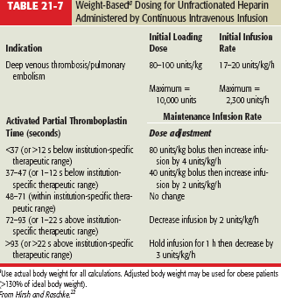

Slide 34
ADVERSE EFFECTS:
Direct thrombin inhibitors:
allergic reactions like skin rash, itching or hives, swelling of the face, lips, or tongue
back or stomach pain
black, tarry stools
blood in urine
coughing up blood
difficulty breathing
dizziness or fainting spells
heavy menstrual bleeding
nosebleeds
unusual bruising or bleeding
Heparins:
Thrombocytopenia
elevated aminitransferases level
Hyperkalemia
Alopecia
Osteoporosis

Slide 35
Warfarin:
Osteoporosis
Purple toe syndrome

Slide 36
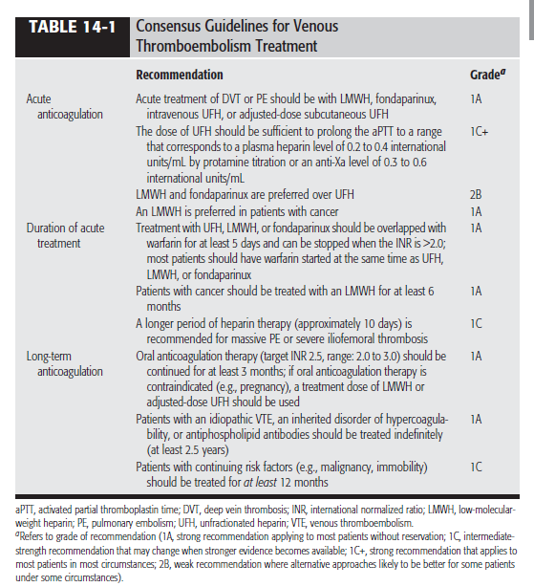

Slide 37
THANK YOU

