Slide 1
PHARMACOGNOSY & PHYTOPHARMACEUTICALS
Macro, powder and microscopic study of Datura
17-09-2024
1

Slide 2
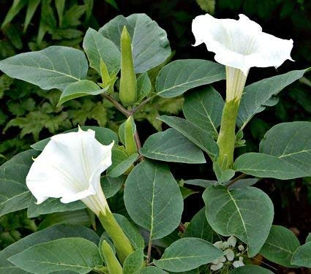
DATURA
Botanical source: It consists of dried leaves and flowering tops of Datura metal Linn. And Datura metal var. fastuosa.
Family: Solanaceae
Geographical Source : It is found in India, England and other tropical and sub-tropical countries.
Synonym: Angel’s Trumpet.
Alkaloids
Annual production of flowers
17-09-2024
2

Slide 3
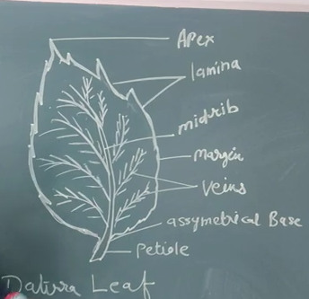
17-09-2024
3

Slide 4
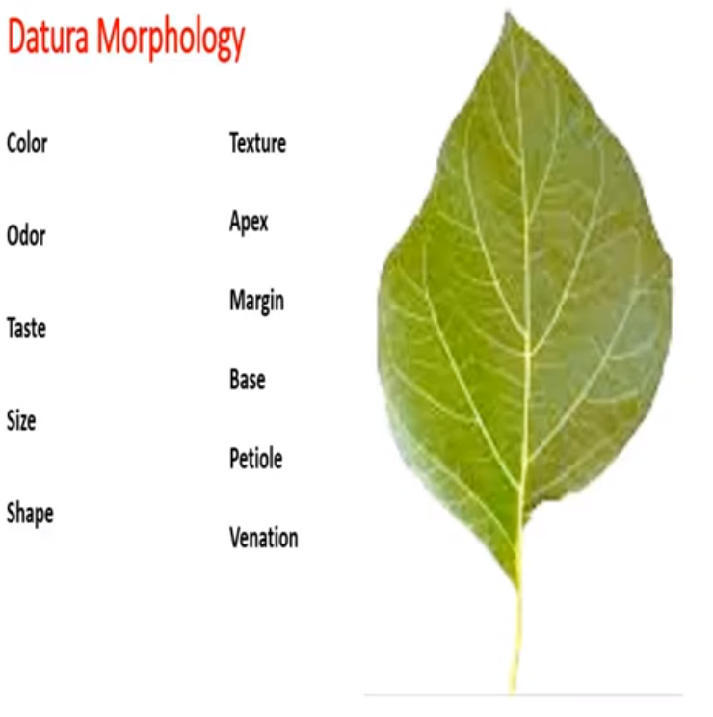
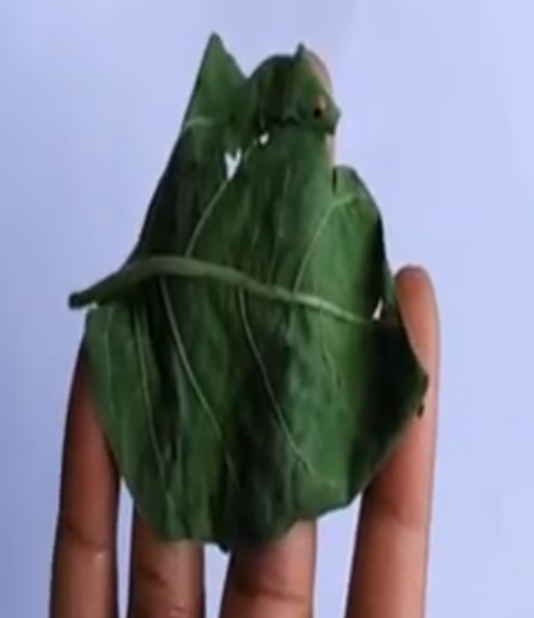
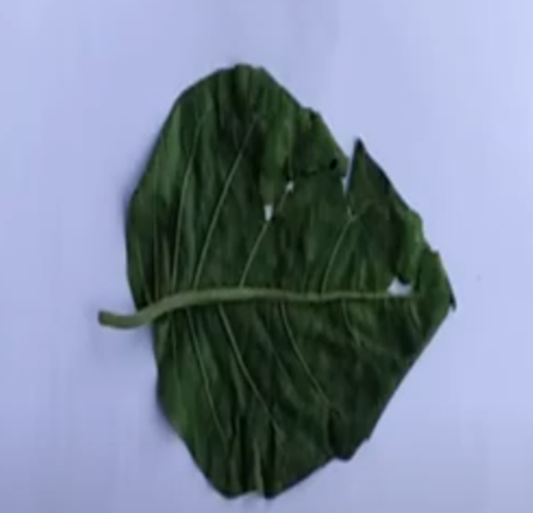
Tip of the leaf – acute in nature
Dorsal sur face
2. ventral surface
Lenth and width of the leaf are same – aspect ratio , OVATE in shape
Vein reticulate
Crush the leaf – chateristic odors
The part of the leaf towards sun
The opposite part of the leaf towards sun and it is facing the land
Light green
Bitter and sweet presence of alakaloids
Green
Rough – presence of trichomes [ hairy ]
Base – asymmetrical
Periphery – sinate in nature [ rough ] cyaniod in shape [due to the presence like waves]
Stalk of the leaf
17-09-2024
4

Slide 5
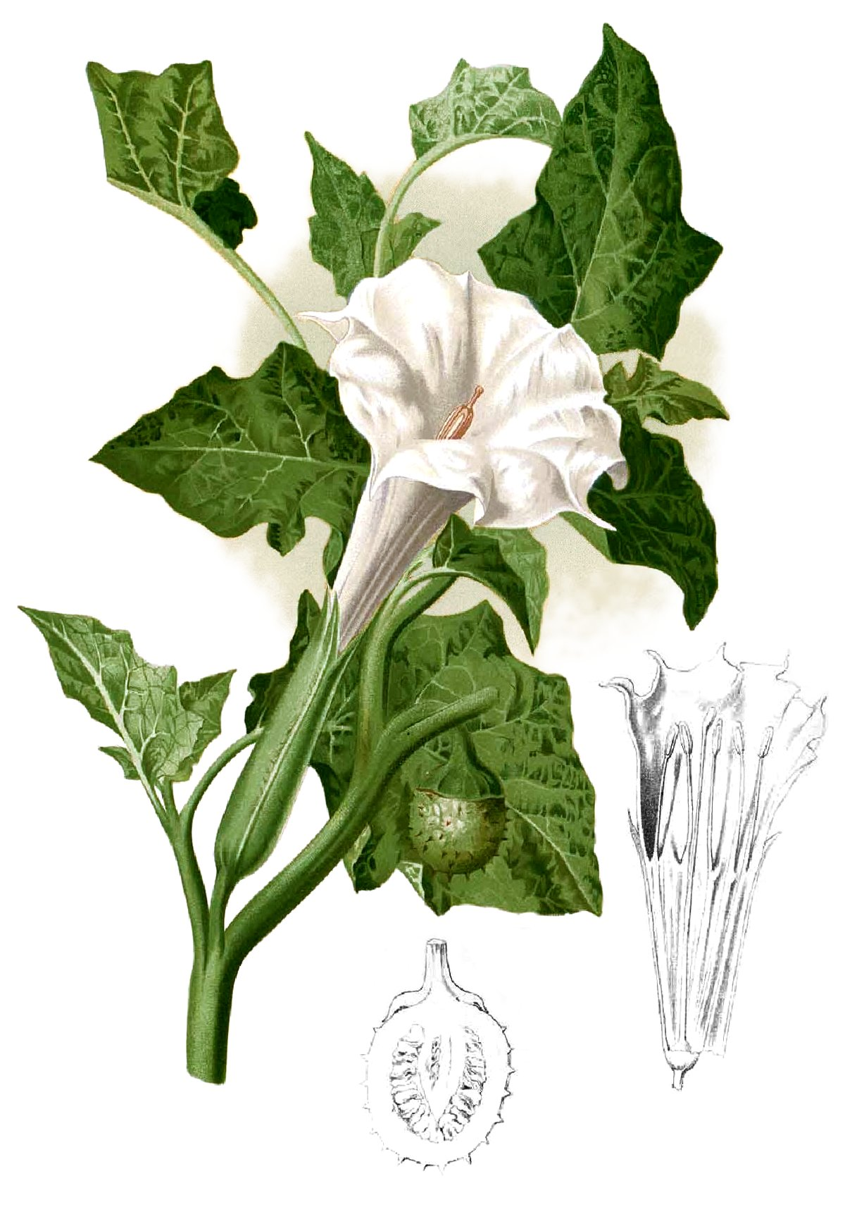
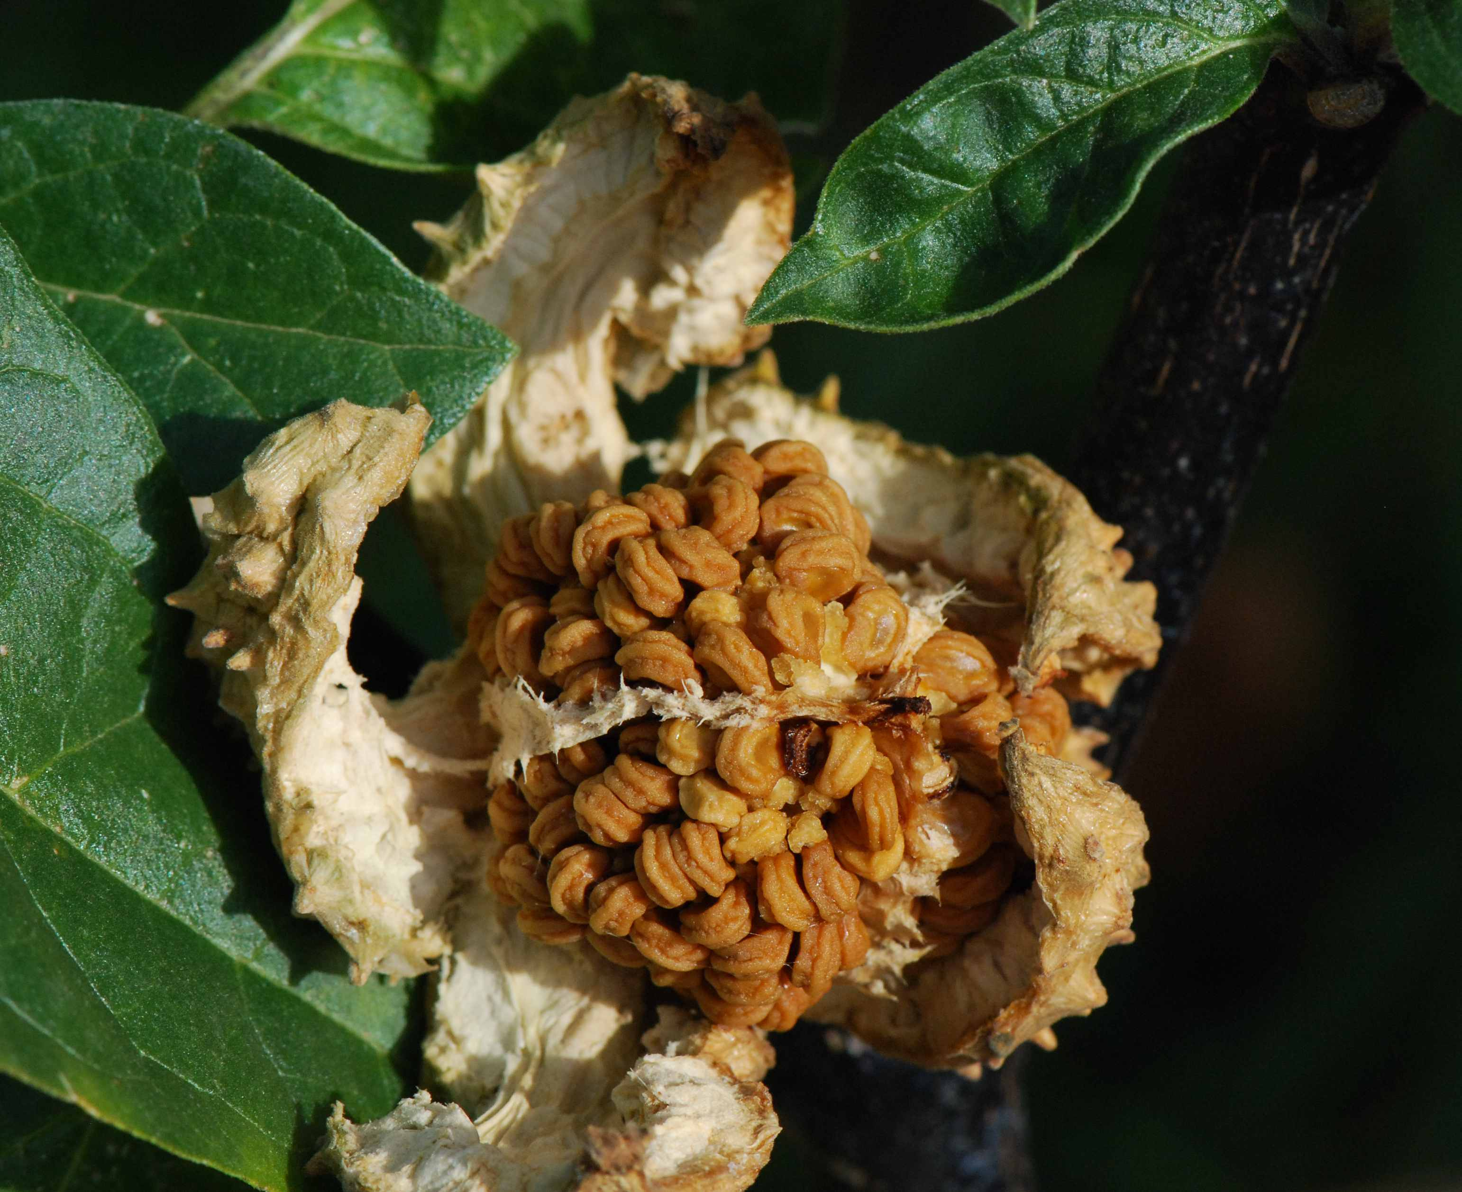
MACROSCOPICAL CHARATERISTICS
A. DATURA METAL
Leaves:-
(i) Sub glabrous spreading herb with cylindrical stem.
(ii) Shape single triangular ovate.
(iii) Base unequal
(iv) Margin toothed
Flower:
(i) Solitary, funnel shaped large and tubular, 7.5 to 9 cm length.
(ii) Corolla 15 to 18 cm length, 10-12.5 cm across at the mouth
Fruit:
Sub-globose capsule covered with short and blunt spines, 2.5 to 3.2 cm diameter nodding or sub erect.
17-09-2024
5

Slide 6
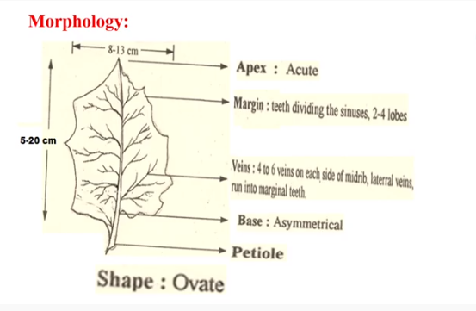
17-09-2024
6

Slide 7
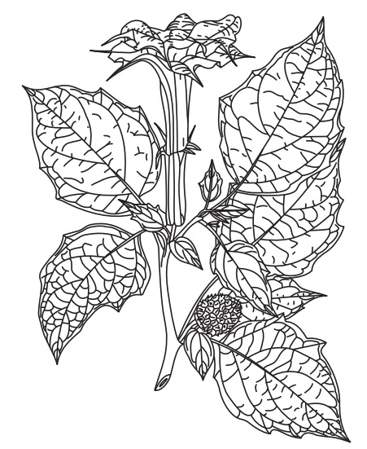
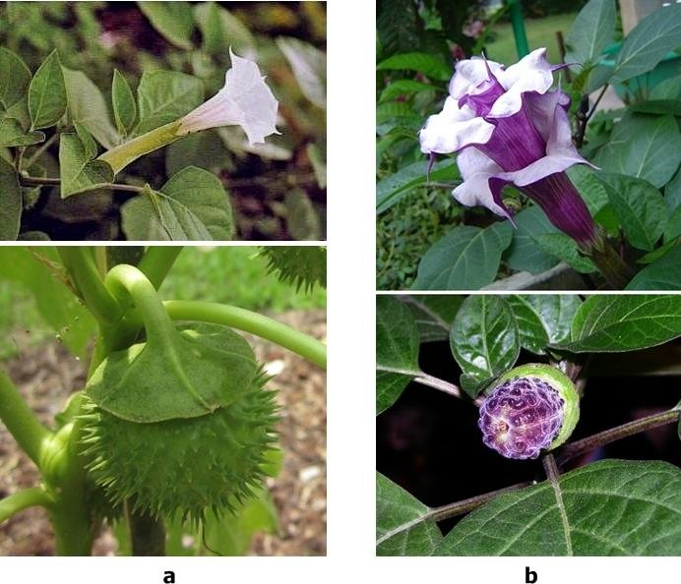
B. Datura metel var. fastuosa
It is known in commerce as black datura. The leaves are ovate and more or less angular, the flowers being mostly purplish, sometimes white. Corolla is double or triple. Outer corolla has five teeth and inner Corolla has six to ten teeth.
17-09-2024
7

Slide 8
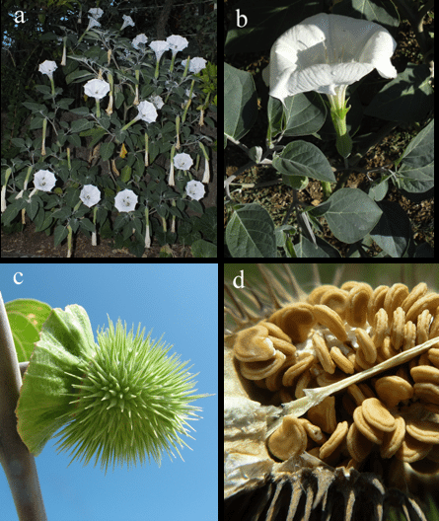
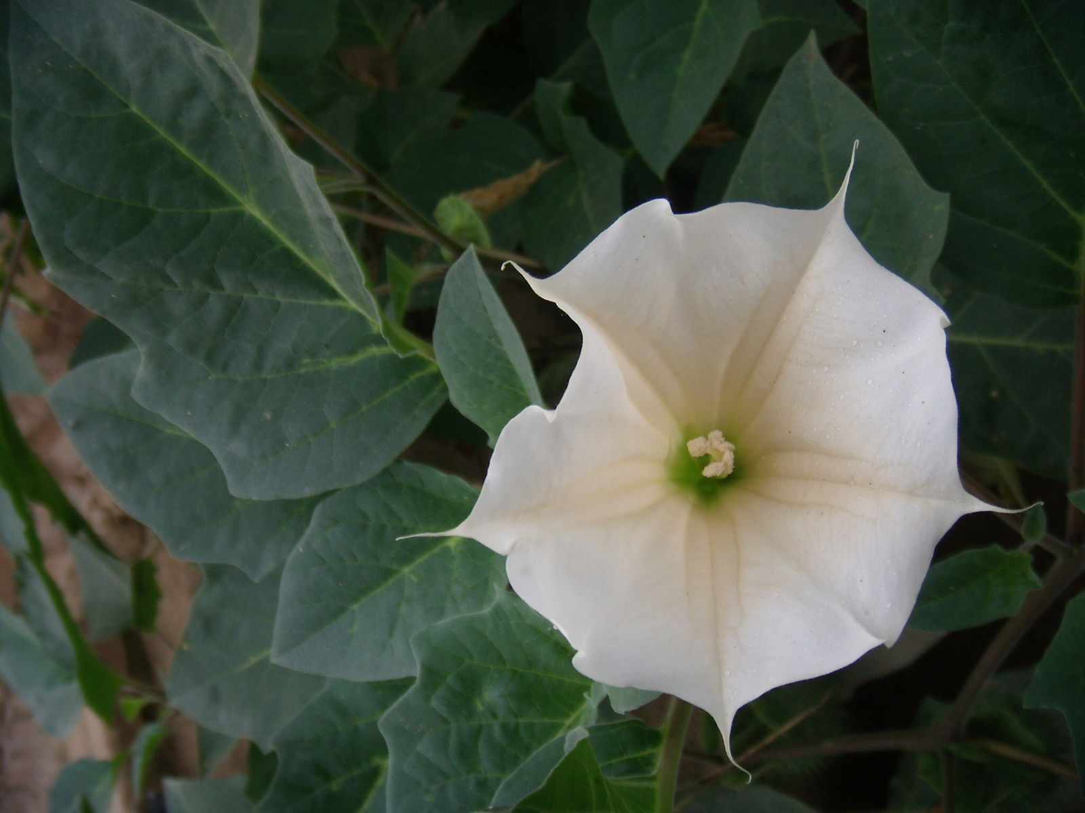
C. DATURA INNOXIA:
It also resembles D. metal but can be distinguished by the presence of dense pubescence, ovate leaves with cordate base, 10 toothed corolla and long weak spines on the capsular fruit.
17-09-2024
8

Slide 9
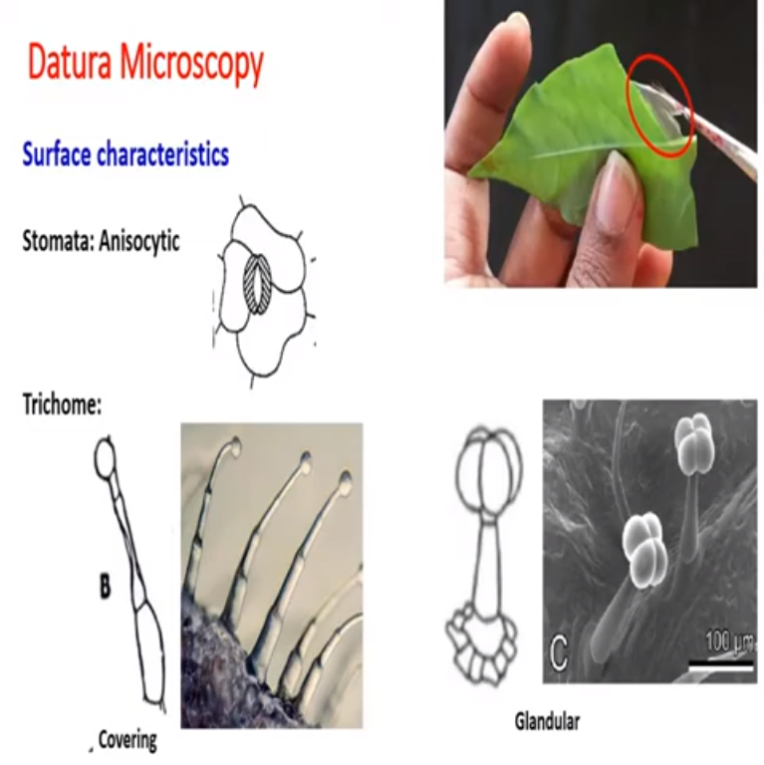
Stoma
Transparent layer contains epidermis function of epidermis in the leaf [ protect from dust , moisture and pesticide ] – epidermal cell
Subsidary cells
Unequal distribution of cell stomata
Guard cell protect to epidermis to moisture
Guard cell
Unicellular stalk 4 – 6 cell
contain – multicellular stalk
Unequal distribution of cells guard cell so it is allied as
ANI – unequal
CYTIC – cells
Trichome
Multicell are present
17-09-2024
Balget
9

Slide 10
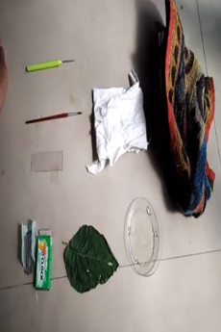
Anisocytic
A – not equal
Cytic – cell
Requirement
Pen brash
Covering glass
Filter paper
Watch glass
Bled
Datura [ ventricle surface ]
17-09-2024
10

Slide 11
Unisocytic stomata and its function
2. Difference between covering and glandular trichome
Slide number 9 Is very important

Slide 12
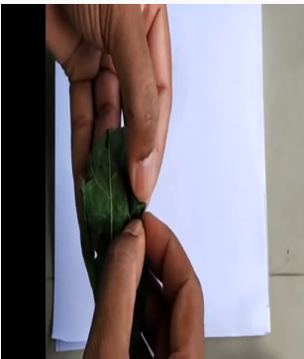
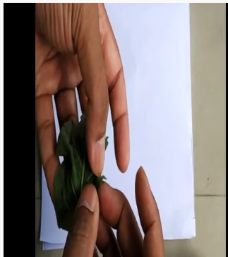
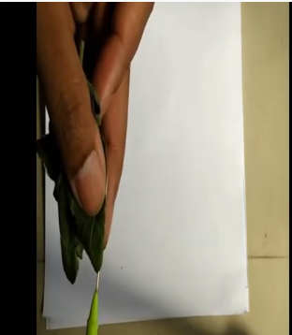
Hold a the margin of the ventral surface
Pull small surface slowly towards the periphery
And also taking thin train section at apex because the number of trichomes are more in apex region
17-09-2024
12

Slide 13
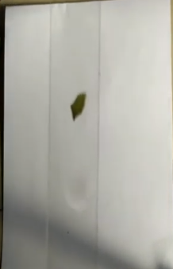
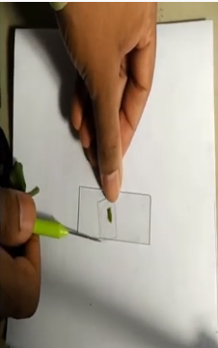
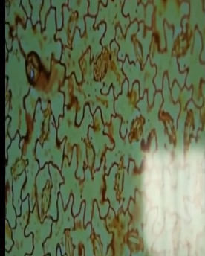
We have took thin section of the leaf
Choral hydrate + F . Hcl + before covering slide add few crops of gyl
Trichrome , epidermis and spongy parenchyma
17-09-2024
13

Slide 14
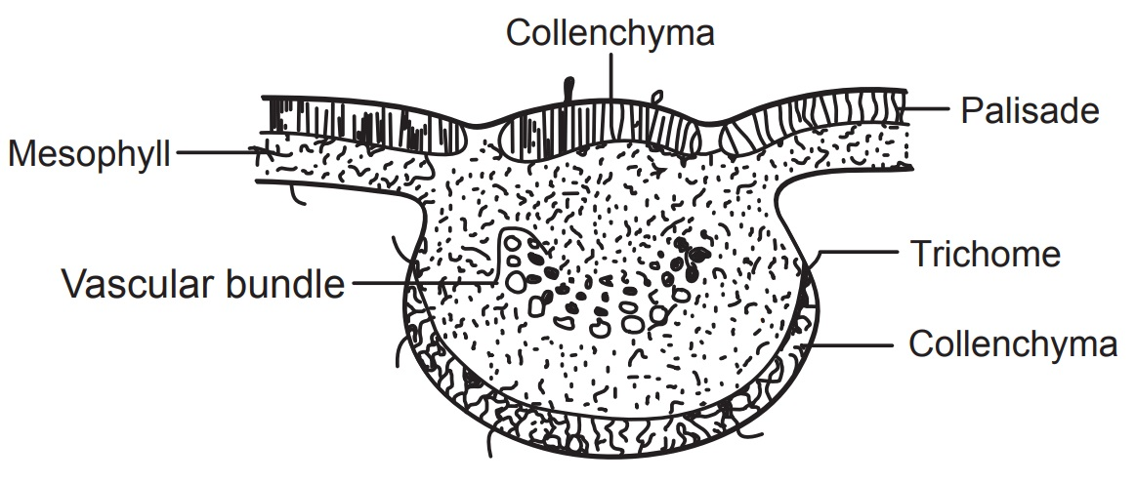
T.S. (schematic) diagram of datura leaf
17-09-2024
14

Slide 15
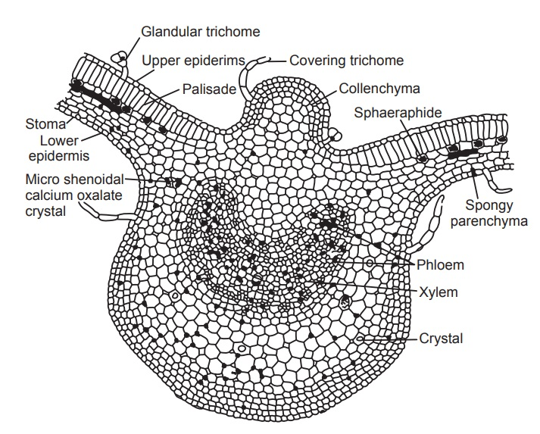
Transverse section of datura leaf
Epidermis . Upper epidermis , lower layer , the epidermis is dived into 3 layers
Cuticle layer – protection to the leaf
Trichome – covering and glandular [ hairy like projection ]
Stomata – anisocytic
2. Mesophile – crystal layer
Palisade cell – used in the photosynthesis production
3. Vascular bundles
Xylem – water
Phloem – food and minerals
17-09-2024
15

Slide 16
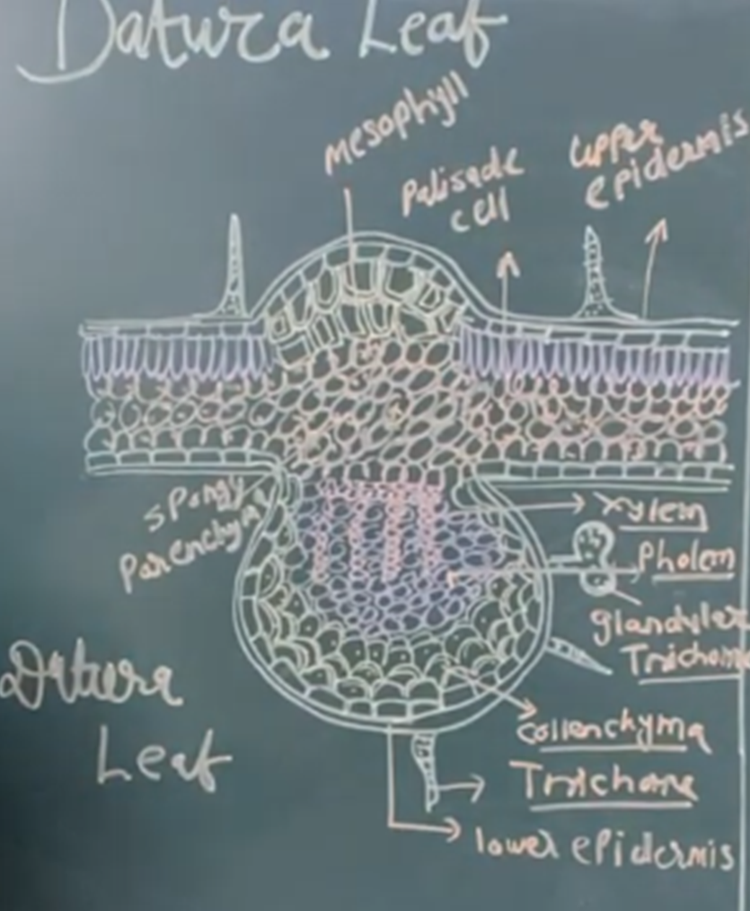
Datura

Slide 17
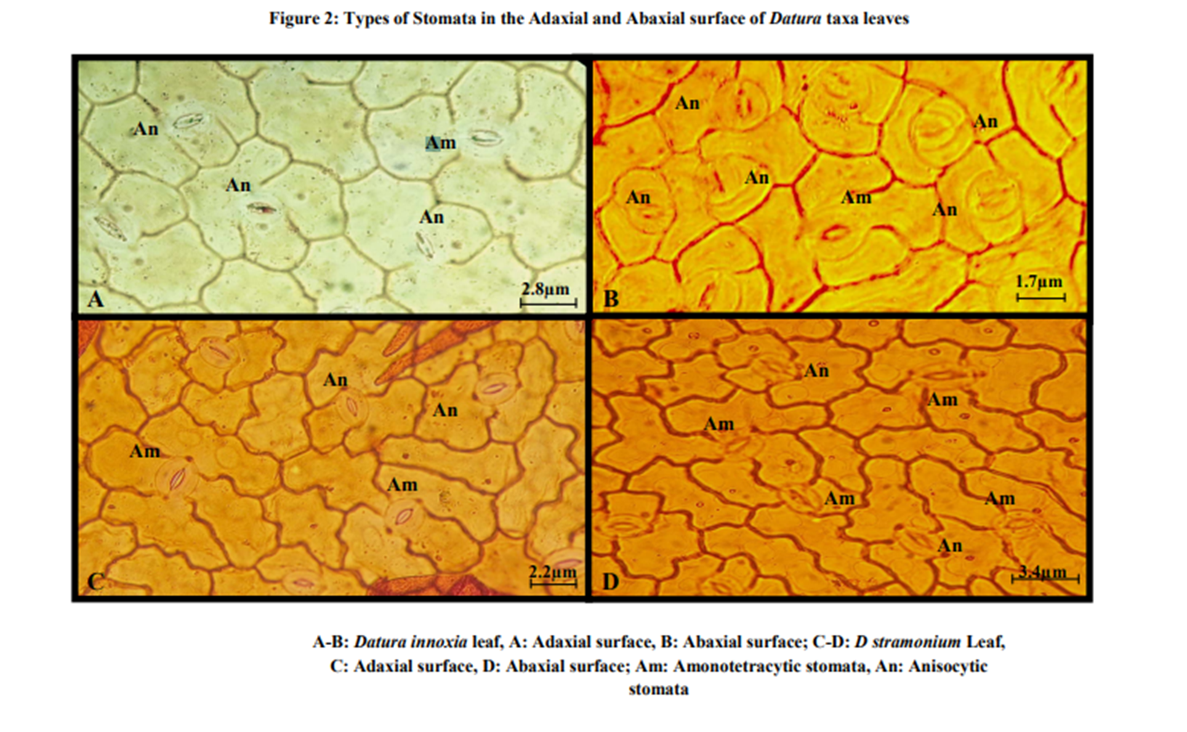

Slide 18
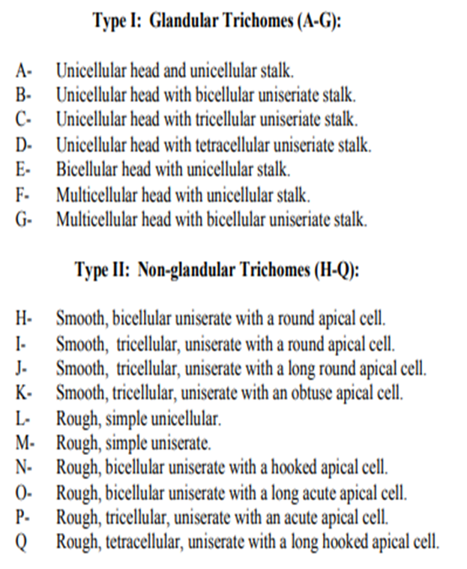
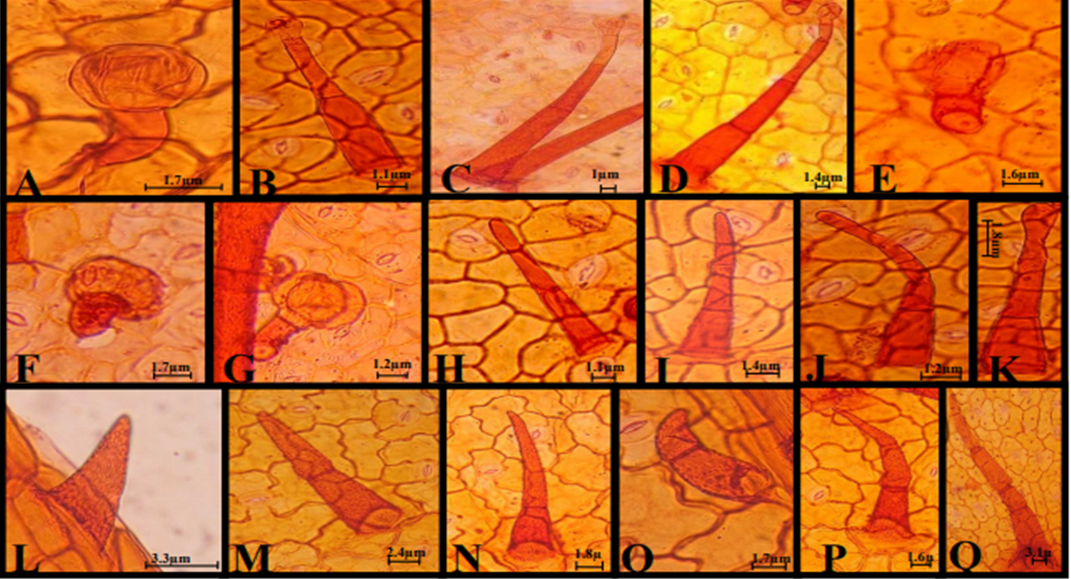

Slide 19
MICROSCOPICAL CHARACTERS:
Lamina:
Upper epidermis:
They are single layered, cells rectangular with cuticularized outer walls. Trichomes, both covering and glandular are seen. Covering trichomes are uniseriate, multicellular, warty and blunt at the apex. Glandular trichomes are made up to a stalk of one cell and a 2 to 4 celled glandular head.
Mesophyll:
It is differentiated into palisade and spongy parenchyma.
Palisade:
It is a single layered, compact and cells radially elongated
Spongy parenchyma:
They are many layered, loosely arranged with intercellular spaces. Sphaeraphides, microsphenoidal crystals and vascular strands are found in the upper layers of spongy parenchyma.
17-09-2024
19

Slide 20
Lower epidermis: It is identical to upper epidermis. Stomata and numerous trichomes are seen on the lower epidermis.
Midrib: The epidermis layers of lamina are continuous in the midrib region also. Strips of collenchymas appear below the upper and above the lower epidermis. This is followed by cortical parenchyma containing prisms of calcium oxalate and microsphenoidal crystals. Embedded in the central region of the cortical parenchyma is a bicollateral bundle.
POWDER MICROSCOPY
Powdered stramonium leaf is greyish green with faint odour and bitter taste. The powder shows the following diagnostic characters:
A. FRAGMENTS OF LAMINA:
In surface view, abundant fragments of lamina show thin-walled cells (with sinuous outline) of upper epidermis with palisade cells below which are irregular in size and are packed loosely. Cells of the lower epidermis show wavy walls and
slight thickening at the corners. The lower epidermis has numerous anisocytic stomata.
17-09-2024
20

Slide 21
B. TRICHOMES:
Both covering and glandular trichomes are found abundantly on the upper and lower epidermises. Covering trichomes are uniseriate, three to fi ve celled with conspicuously warty walls. These are conical, wide at base and tapering at the
apex. Glandular trichomes have short stalk and oval head composed of three to seven thin-walled cells.
C. CALCIUM OXALATE CRYSTALS:
Cluster crystals of calcium oxalate occur in spongy mesophyll. Crystals are absent from the cells adjacent to the veins. Occasionally prisms of calcium oxalate also occur.
D. PARENCHYMA:
It is centrally placed in the midrib region and composed of longitudinally elongated cells with slightly thick walls. Prisms or microsphenoidal crystals of calcium oxalate or cluster crystals of calcium oxalate are seen.
E. FRAGMENTS OF THE LAMINA IN SECTIONAL VIEW:
Fragments of the lamina in sectional view show the tabular epidermal cells with a smooth cuticle. The remaining part of mesophyll is composed of the single layer of palisade cells with the underlying crystal layer and the irregular cells.
F. POLLEN GRAINS:
The occasional fairly large subspherical pollen grains with three pores and an irregularly warted exine are seen.

Slide 22
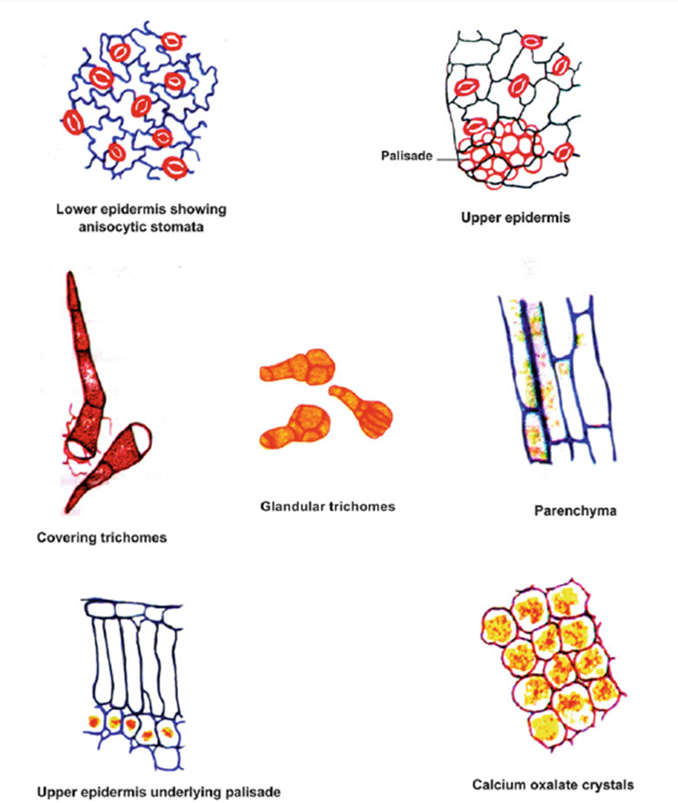

Slide 23
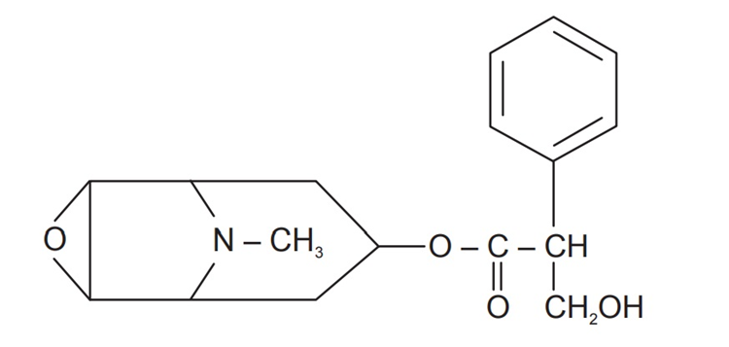
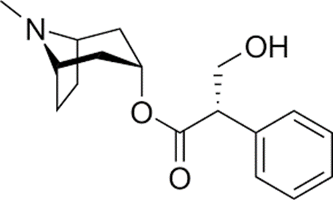
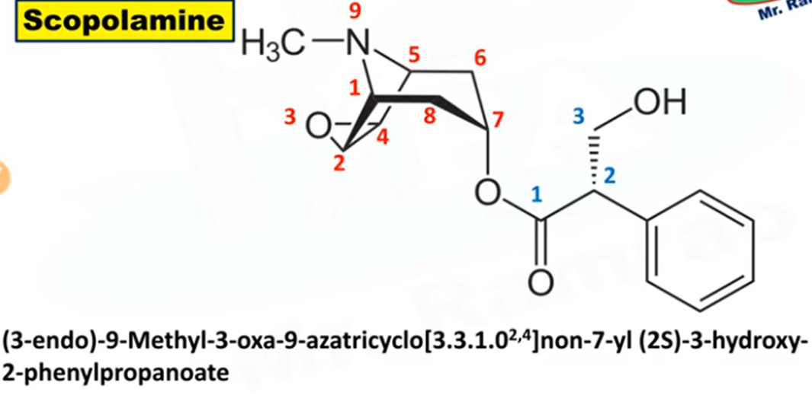
CHEMICAL CONSTITUENTS:
1. Tropane alkaloids-
a. Hyoscyamine:
b. Scopolamine (hyoscine)
2. Fastudine and fastunine,
3. Fastusic acid, alantoin.
4. Ascorbic acid, etc. scopolamine

Slide 24
USES:
1. Mydriatic (dilation of the pupil).
2. Antispasmodic (a drug that counteracts a sudden, violent, involuntary muscular contraction)
3. Antimuscarinic effect (acts peripherally to produce parasympathetic inhibition).
4. Antisialagogue (a drug that arrest the flow of excess of saliva)
5. Cerebral sedative (reduce excitement)
Principle – atropine [ to reduce the section ] –eye [ decreased lachrymal tears secretion ]
In dental surgy – dental –[ decreased the saliva secretion ]
Joints [ inflammation ] – increase heat production

Slide 25
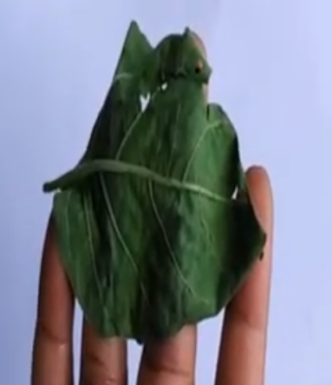
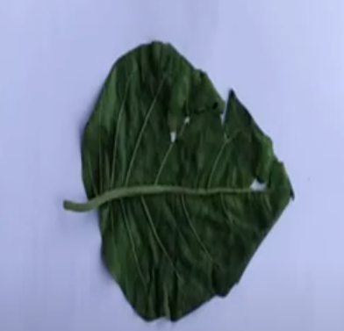
17-09-2024
25

Slide 26
3 – endo and 8 – methyl , 8 azabicyclo [ 3,2,1] . Oct -3-YL- 3 hydroxy -2-phenylpropanate
Tropen alkaloids
Ascrobic acid
17-09-2024
26

