Slide 1

Depression

Slide 2
Introduction
Depression is a common and often chronic disorder that may manifest at anytime in one’s life.
Depression is more than just sadness. People with depression may experience a lack of interest and pleasure in daily activities, significant weight loss or gain, insomnia or excessive sleeping, lack of energy, inability to concentrate, feelings of worthlessness or excessive guilt and recurrent thoughts of death or suicide.

Slide 3
DSM-IV-TR Diagnostic criteria for major depression include a minimum of five symptoms persisting for at least two weeks.
One of these symptoms must be either depressed mood or anhedonia.
Suicidal ideation should be assessed in all patients.

Slide 4
Other 7 symptoms include
1. Change in appetite
2. Change in sleep
3. Low energy
4. Poor concentration (or difficulty making decisions)
5. Feelings of worthlessness or inappropriate guilt
6. Psychomotor agitation or retardation
7. Recurrent thoughts of suicide

Slide 5
Etiopathogenesis
Biogenic amine hypothesis: Decreased brain levels of the neurotransmitters norepinephrine, serotonin (5-HT), and dopamine may cause depression.
Postsynaptic changes in receptor sensitivity: Studies have demonstrated that desensitization or downregulation of norepinephrine or 5-HT1A receptors may relate to onset of antidepressant effects.

Slide 6
Dysregulation hypothesis: This theory emphasizes a failure of homeostatic regulation of neurotransmitter systems, rather than absolute increases or decreases in their activities

Slide 7
Dysregulation hypothesis
(a) An impairment in the regulatory or homeostatic mechanisms,
(b) An erratic basal output of neurotransmitters,
(c) A disruption in normal periodicities (circadian rhythm),
(d) A less selective response to environmental stimuli,
(e) Perturbation of the system resulting in a delayed return to baseline, and
(f ) Restoration to efficient regulation through the use of pharmacologic agents.

Slide 8
5-HT/norepinephrine link hypothesis: This theory suggests that 5-HT and norepinephrine activities are linked, and that both the serotonergic and noradrenergic systems are involved in the antidepressant response
The role of dopamine: Several studies suggest that increased dopamine activity in the mesolimbic pathway contributes to antidepressant activity.
DA transmission is decreased in depression

Slide 9
Brain-derived neurotrophic factor (BDNF) is a growth factor protein that regulates the differentiation and survival of neurons.
A disruption of brain derived neurotrophic factor expression in the hippocampus may be associated with depression.

Slide 10
Permissive hypothesis- Low concentrations of serotonin or norepinephrine in the CNS precipitated depressive symptoms, whereas low levels of serotonin and increased activity of norepinephrine resulted in manic symptoms.

Slide 11
Major depression have a neuroendocrine abnormality, including hypersecretion of cortisol
There is a disruption somewhere in the normal negative feedback system that controls cortisol levels
Blunted or exaggerated thyroid-stimulating hormone response and there is an indirect association between mood disorders and thyroid homeostasis

Slide 12
The hypothalamic-pituitary-adrenal (HPA) axis may also influence the manifestation of depression, with a relative hyperactivity of this system commonly reported in depressed individuals.
Inability of the brain to suppress the hypothalamic–pituitary–adrenal (HPA) axis

Slide 13
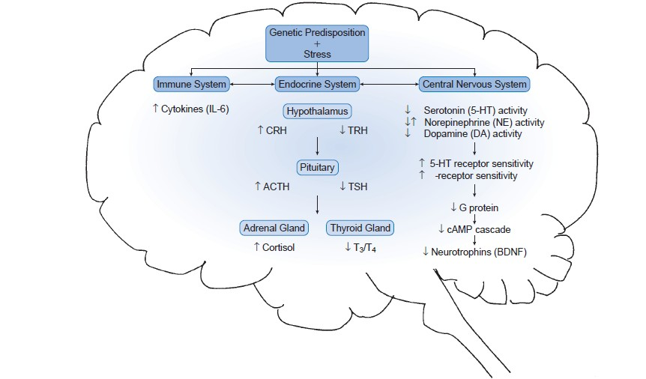

Slide 14
CLINICAL PRESENTATION
Emotional symptoms: diminished ability to experience pleasure, loss of interest in usual activities, sadness, pessimism, crying, hopelessness, anxiety (present in ~90% of depressed outpatients), guilt, and psychotic features (eg, auditory hallucinations and delusions).
Physical symptoms: fatigue, pain (especially headache), sleep disturbance, decreased or increased appetite, loss of sexual interest, and gastrointestinal (GI) and cardiovascular complaints (especially palpitations).

Slide 15
Intellectual or cognitive symptoms: decreased ability to concentrate or slowed thinking, poor memory for recent events, confusion, and indecisiveness.
Psychomotor disturbances: psychomotor retardation (slowed physical movements, thought processes, and speech) or psychomotor agitation.

Slide 16



