Slide 1



Slide 2
Introduction
DM is a group of metabolic disorders characterized by
hyperglycemia.
It is associated with abnormalities in carbohydrate, fat, and protein metabolism and results in chronic complications including microvascular, macrovascular, and neuropathic disorders.

Slide 3
Microvascular complications include neuropathy (nerve damage), nephropathy (kidney disease) and vision disorders (eg retinopathy, glaucoma, cataract and corneal disease).
Macrovascular complications include heart disease, stroke and peripheral vascular disease (which can lead to ulcers, gangrene and amputation).

Slide 4
CLASSIFICATION OF DIABETES
Type 1 Diabetes
Type 2 Diabetes
Gestational Diabetes Mellitus
Type 1 Diabetes
This form of diabetes results from autoimmune destruction of the β cells of the pancreas.
This form of diabetes usually occurs in children and adolescents, it can occur at any age.

Slide 5
Type 2 Diabetes
This form of diabetes is characterized by insulin resistance impaired insulin secretion, and increased glucose production.
Gestational Diabetes Mellitus
GDM is defined as glucose intolerance that is first recognized during pregnancy.

Slide 6
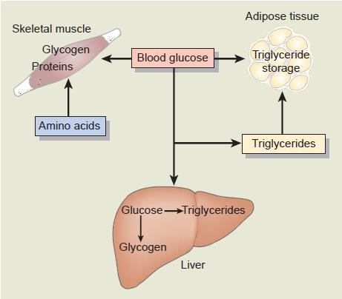

Slide 7
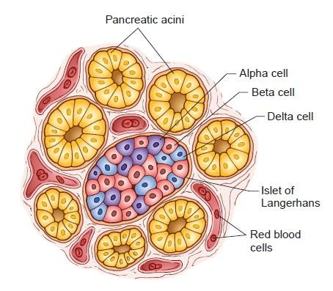
Islets of Langerhans

Slide 8
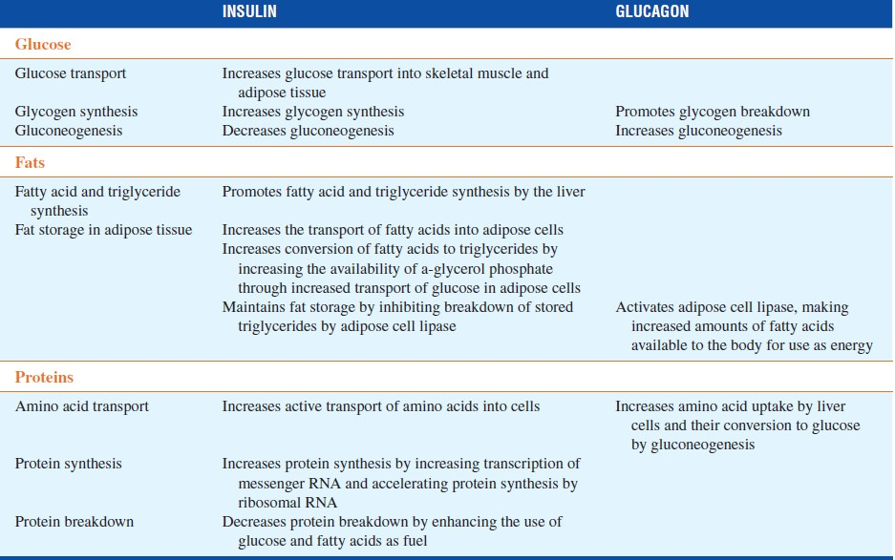

Slide 9
INSULIN
In the fasting state 75% of total body glucose disposal takes place in non–insulin-dependent tissues: the brain and splanchnic tissues
The remaining 25% of glucose metabolism takes place in muscle, which is dependent on insulin.
In the fed state, carbohydrate ingestion increases the plasma glucose concentration and stimulates insulin release from the pancreatic β cells.

Slide 10




INSULIN
In children and adolescents, insulin is needed for normal growth and development
Insulin is the only hormone known to have a direct effect in lowering blood glucose levels.

Slide 11
INSULIN
The actions of insulin are threefold:
it promotes glucose uptake by target cells and provides for glucose storage as glycogen,
it prevents fat , glycogen breakdown (glycogenolysis),
it inhibits gluconeogenesis and increases protein synthesis

Slide 12
Other functions of insulin
Insulin acts to promote fat storage by increasing the transport of glucose into fat cells.
It also facilitates triglyceride synthesis from glucose in fat cells
Inhibits the intracellular breakdown of stored triglycerides and reduction in the plasma free fatty acid (FFA) level..
Inhibits protein breakdown

Slide 13
Pathogenesis
Type I DM
Triggered by environmental factors, such as viruses or toxins, in genetically susceptible individuals.
This form of diabetes is associated closely with histocompatibility antigens (human leukocyte antigen [HLA]-DR3 or HLA-DR4) and the presence of circulating antibodies

Slide 14
The autoimmune process is mediated by macrophages and T lymphocytes with circulating autoantibodies to various β-cell antigens.
The most commonly detected antibody associated with type 1 DM is the islet cell antibody.
Other more readily measured circulating antibodies include insulin autoantibodies.

Slide 15
Four main steps in type 1 DM
A long preclinical period marked by the presence of immune markers when β-cell destruction is thought to occur;
Hyperglycemia when 80% to 90% of β cells are destroyed;
Transient remission (Honeymoon phase)
Established disease with associated risks for complications and death

Slide 16
Type II DM
Type 2 diabetic individuals are characterized by
(1) Defects in insulin secretion; and
(2) Insulin resistance involving muscle, liver, and the adipocyte.

Slide 17
Impaired Insulin Secretion
Decreased postprandial insulin secretion is caused by both impaired pancreatic β-cell function
Reduced stimulus for insulin secretion from incretin hormones.
The two hormones are, glucagon-like peptide-1 (GLP-1) and glucose-dependent insulin-releasing peptide (GIP).
Incretin harmones effect is blunted

Slide 18
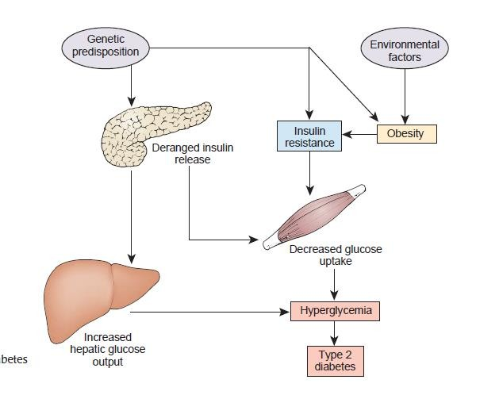

Slide 19
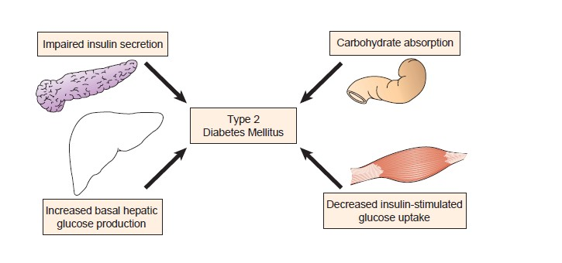

Slide 20
Insulin Resistance
Insulin resistance (IR) is a condition in which the cells of the body become resistant to the effects of insulin
or
Insulin resistance is a state in which a given concentration of insulin produces a less-than-expected biological effect

Slide 21
Causes of IR
Metabolic syndrome
Obesity
Pregnancy
Infection or severe illness
Stress
Steroid use

Slide 22
Cellular Mechanisms of Insulin Resistance
Obesity and Insulin Resistance
Weight gain leads to insulin resistance.
The increase in insulin resistance with weight gain is directly related to the amount of visceral adipose tissue (fat cells located within the abdominal cavity)
This fat tissue has been shown to have a higher rate of lipolysis than subcutaneous fat, resulting in an increase in FFA production.

Slide 23

These fatty acids stimulate the production of
Very low-density lipoproteins and
Decrease insulin sensitivity in peripheral tissues.
VAT also produces a number of cytokines that cause insulin resistance.
Elevated plasma FFA levels, as well as increased triglyceride/fatty acyl coenzyme A (CoA) content in muscle, liver, and β cells, lead to the development of muscle/hepatic insulin resistance and impaired insulin secretion.

Slide 24
Adiponectin is secreted by adipose tissue and circulates in the blood.
It has been shown that decreased levels of adiponectin coincide with insulin resistance in patients with obesity and type 2 diabetes.

Slide 25
The Metabolic Syndrome
The association of insulin resistance with a clustering of cardiovascular risk factors including hyperinsulinemia, hypertension, abdominal obesity, dyslipidemia, and coagulation abnormalities has been referred to by a variety of names including “the insulin resistance syndrome,” “the metabolic
syndrome,” “the dysmetabolic syndrome,” and Syndrome X

Slide 26
Sites of Insulin Resistance
Liver
Following glucose ingestion, insulin is secreted which suppresses glucagon secretion and reduces hepatic glucose output
Type 2 diabetic patients fail to suppress glucagon in response to
a meal and can even have a paradoxical rise in glucagon levels.
Thus, hepatic insulin resistance and hyperglucagonemia result in continued production of glucose by the liver

Slide 27
Peripheral (Muscle)
Muscle is the major site of glucose disposal
Insulin resistance decrease muscle glucose uptake
The primary site of insulin resistance in type 2 diabetic subjects resides in muscle
Peripheral (Adipocyte)
Insulin is a potent inhibitor of lipolysis, and holds the release of FFAs from the adipocyte by inhibiting the hormone- sensitive lipase enzyme.

Slide 28
Risk factors for type II DM
Family history of diabetes
Physical inactivity
History of PCOS,
Clinical conditions associated with insulin resistance (e.g., severe obesity
Hypertension (≥140/90 mmHg or on antihypertensive therapy)
Dyslipidemia
HDL-C <35 mg/dL (0.90 mmol/L)
Triglyceride >250 mg/dL (2.82 mmol/L)
Cardiovascular disease

Slide 29

Symptoms Type I
Polyuria, polydipsia, polyphagia, and weight loss, diabetic ketoacidosis, Hyperglycemic Hyperosmolar State.
Type II
Lethargy, Polyuria, Nocturia, and Polydipsia

Slide 30
Acute Complications of DM
Diabetic Ketoacidosis
Hyperglycemic Hyperosmolar State
Chronic Complications of DM
Microvascular
Macrovascular
Others
  Gastrointestinal (gastroparesis, diarrhea)
  Genitourinary (uropathy/sexual dysfunction)
  Dermatologic
  Infectious
  Cataracts
  Glaucoma

Slide 31
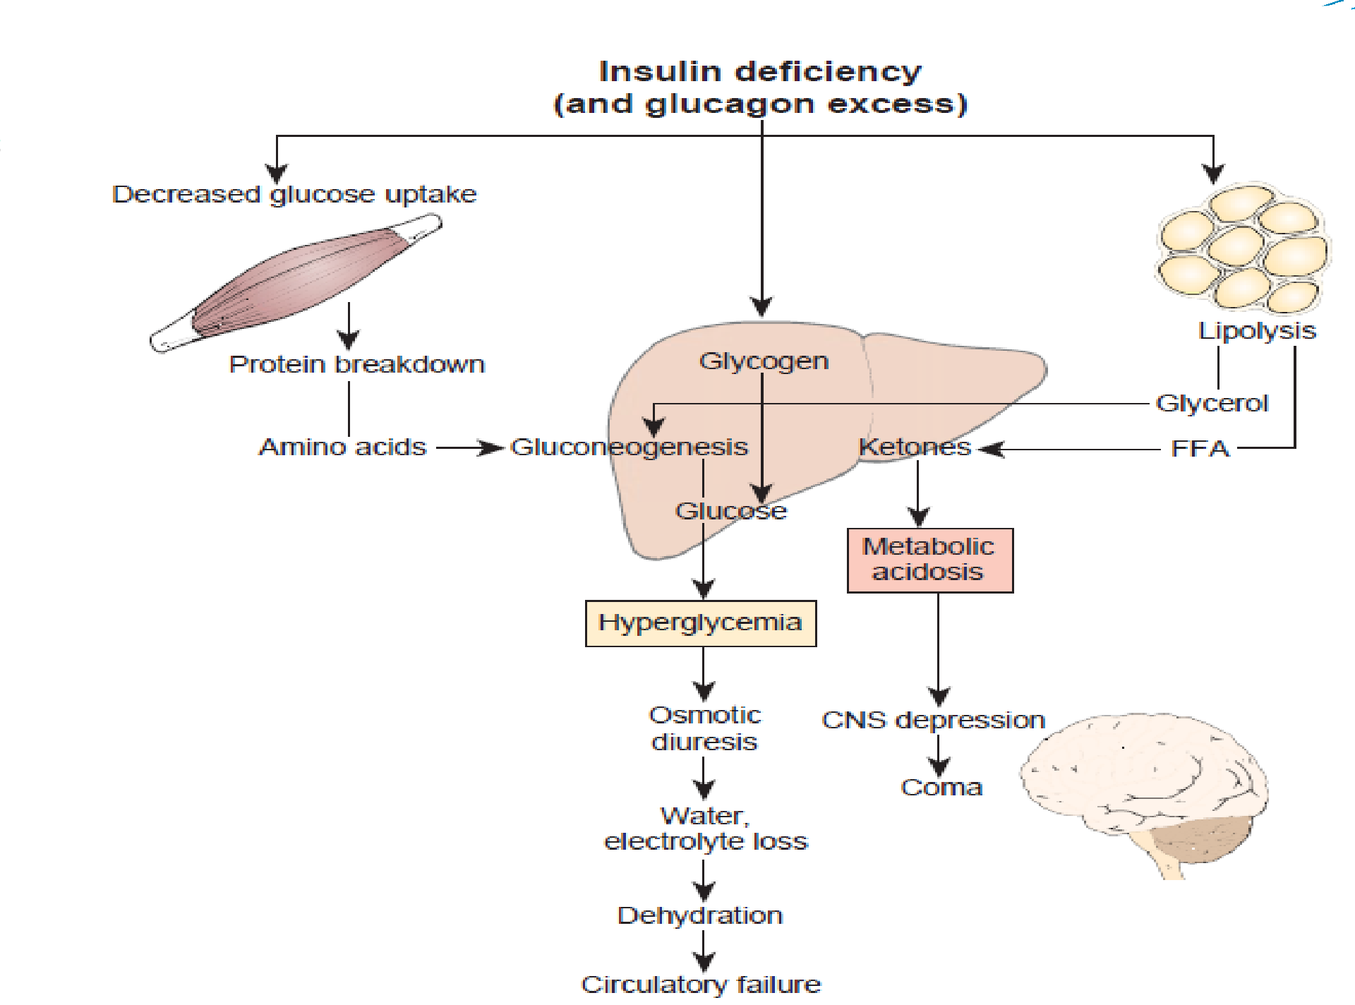


Slide 32

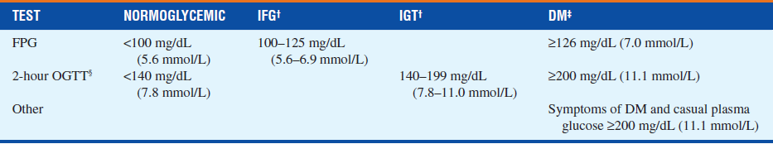
Plasma glucose values

Slide 33
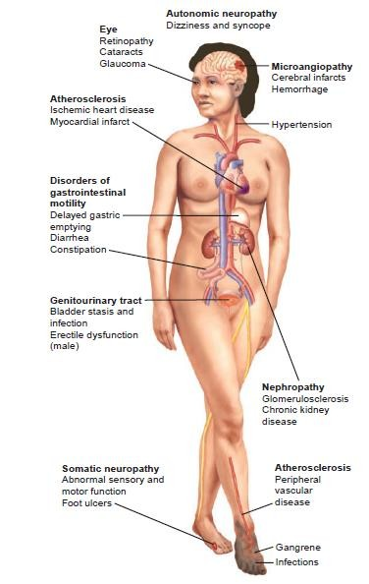

Slide 34
Diagnosis
Fasting plasma glucose (FPG) Normal
FPG <100 mg/dL (5.6 mmol/L) Impaired fasting glucose (IFG)
100–125 mg/dL (5.6–6.9 mmol/L) Diabetes mellitus
FPG =126 mg/dL (7.0 mmol/L)
2-Hour postload plasma glucose (oral glucose tolerance test) Normal
Postload glucose <140 mg/dL (7.8 mmol/L) Impaired glucose tolerance (IGT)
2-hour postload glucose 140–199 mg/dL (7.8–11.1 mmol/L) Diabetes mellitus
2-hour postload glucose =200 mg/dL (11.1 mmol/L)

Slide 35
According to ADA, diagnosis of diabetes can be made when one of the following is present
Classic signs and symptoms of diabetes (polyuria, polydipsia, ketonuria, and unexplained weight loss) combined with a
random plasma glucose ≥200 mg/dL.
FPG ≥126 mg/dL.
After a standard oral glucose challenge (75 g glucose for an adult or 1.75 g/kg for a child)
  Venous plasma glucose concentration is ≥200 mg/dL at 2 hours and >200 mg/dl or at least one other time during the test (0.5, 1, 1.5 hours).

Slide 36
Thank you

