Slide 1
HOSPITAL PHARMACY
DISTRIBUTION OF NARCOTIC AND OTHER CONTROLLED SUBSTANCES
16-09-2024
1

Slide 2
Controlled substances:
“Controlled substances are drugs that have some potential for abuse or dependence. ”
These prevent unauthorized use of analgesics, anesthetics, steroids
Law of controlled substances:
•The drug law 1976, in schedule B has the list of such drugs.
•1997 is the drug law currently used nowadays and have not changed.
Categorized into 5 schedules:
✓Schedule 1 e.g marijuana : High potential for abuse and has no accepted medical use in treatement.
✓Schedule 2 e.g cocaine : High potentials for abuse but accepted for medical use.
✓Schedule 3-5 e.g steroids, valium, opium etc: Less as compare to above potentials for abuse, accepted for medical treatment and has less physical dependence and psychological dependence
16-09-2024
2

Slide 3
Policies & procedures for ordering of controlled substances:
•Preparation of orders: Ink or indelible pencil sign and typing.
•Doctor’s orders for administration of controlled drugs:
Ward stock orders must written on Doctor order sheet or patient chart & if it is not in ward stock a complete priscription is written on hospital prescription blank and a complete name signature is done by the Doctor.
•Pro Re Nata orders: Must be discouraged except under special circumstances.
•Telephone orders: Doctor may give the orders, in necessity nurse may also take and orders are written on Doctor order sheet by nurse by Doctor name and initials,
Doctor must sign by his name or initials within 24 hours.
16-09-2024
3

Slide 4
•Verbal orders:
A doctor may give a verbal order in emergency cases and the nurse may write order on order sheet and later on Doctor may sign within 24 hours.
•Ordering non ward stock controlled drugs from pharmacy: It is also covered by Doctor sign if more is needed then Doctor may sign again.
•Ordering ward stock controlled substances from pharmacy:
✓The ward stock form is completed by placing a check mark opposite the name, and strength.
✓Before issuing new controlled substances, previous supply is to be accounted.( 24 hr record, record losses and errors)
✓When ever dose or drug is lost or wasted on ward, nurse in charge must prepare a special report on form to cover incidence so report is prepared in duplicate and sent it to pharmacy (request for new supply of drugs).
✓Orignal is filled in pharmacy and duplicate is sent to nursing office.
16-09-2024
4

Slide 5
Prescribing:
•Prescription for personal use: Physician may not prescribe any drug for his personal use.
•No refilling:
•Prescribing controlled drugs to outpatients: yes, it can be prescribed and route of administration and frequency info is added.
Dispensing of controlled substances:
•Dispensing of ward supply to patients for home use: No
•Dispensing to employees: No
•Dispensing of controlled drugs for home use during pharmacy off- hours: yes can be given from ward stock.
16-09-2024
5

Slide 6
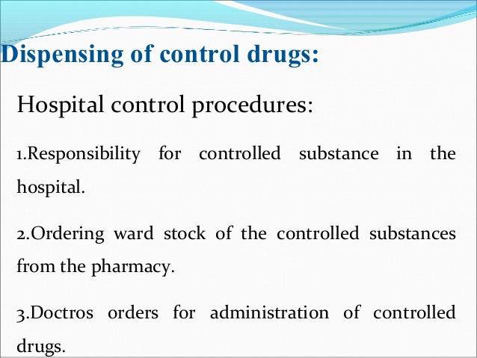
16-09-2024
6

Slide 7
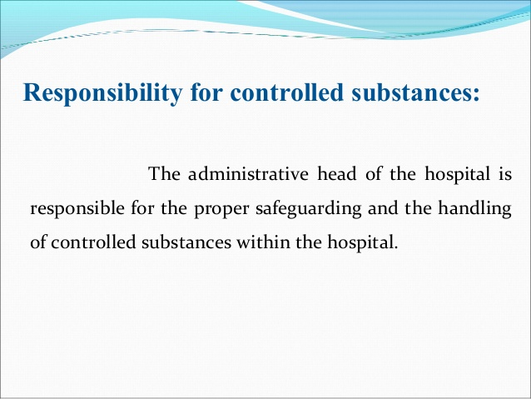
16-09-2024
7

Slide 8
Role and responsibility of Administration:
Administration execute responsibilities for drug control by formulating proper policies regarding: ✓Ordering
✓Dispensing
✓Prescription
✓Documentation of controlled drugs
•Controlled drugs form to be used by head nurse to order drugs from pharmacy.
•A daily basis administration form of controlled drugs to have 24 hours administration record, this form is also used as review of errors (form record).
•Monthly controlled drugs serves as a monthly dispensing record for each nursing unit
16-09-2024
8

Slide 9
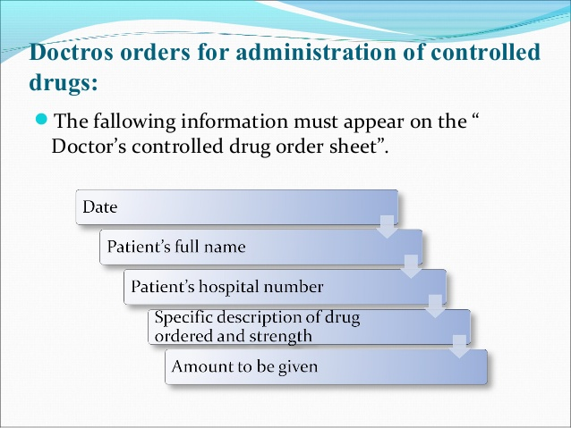
16-09-2024
9

Slide 10
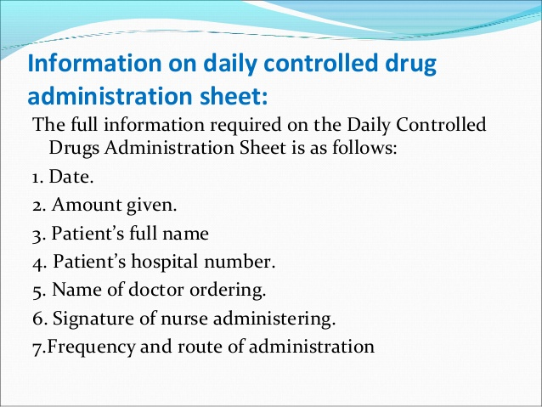
16-09-2024
10

Slide 11
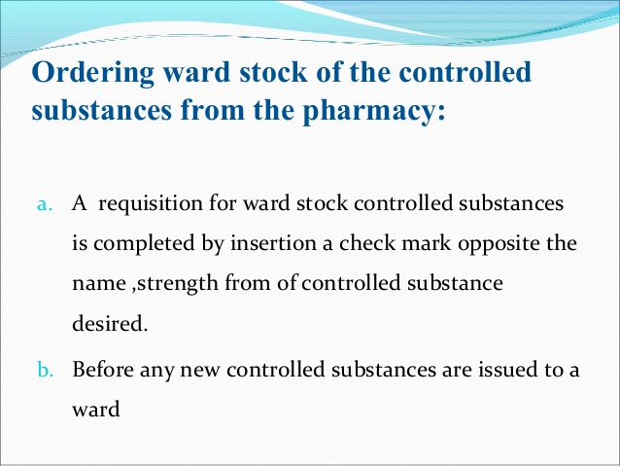
16-09-2024
11

Slide 12
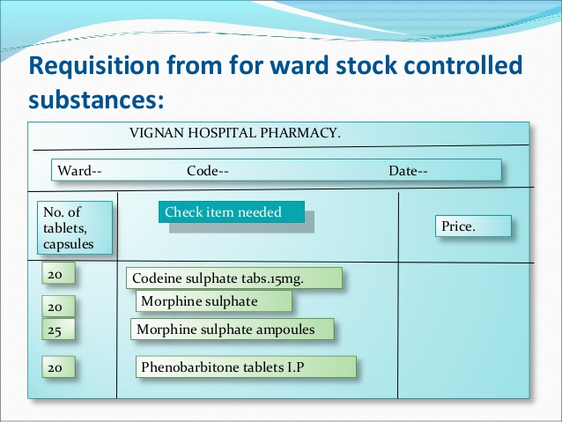
16-09-2024
12

Slide 13
Why they are not used as other medications (in terms of safety):
•It may cause levels of addiction.
•They have maximum adverse effects and very harmful then other drugs.
•Once a person is addicted to it its very difficult to come back to normal condition and may need rehabilitation centre.
Control and Security:
•Provide effective controls to guard against theft, prevent illegal drug use, and protect public from harm.
16-09-2024
13

Slide 14
•Administered By Nurse:
•The nurse should use Proper number of tablets /ampules
Record the number used
Dose given
•Controlled drugs administration sheet:
Date
Amount given
Patient's full name
Patient's hospital number
Number of tablets administered
Filling out invetory column
16-09-2024
14

Slide 15
Procedure in case of wastage:
Aliquot part of drug solution: It should be expelled into sink.
Dose refusal by patient or Dose cancellation by doctor: In such cases drug prepared should be expelled into sink.
Accidental destruction: In this case the incident and reasons are to be recorded on a specified form.
Delivery To Nursing Stations
Reliable person must be assigned for this purpose.
Due to Maintenance of adequate record illegal use can be Immediately detected
If happen so appropriate measures are necessary for Recovery
16-09-2024
15

Slide 16
Roles and Responsibilities of Pharmacy Department:
Various systems include:
Controlled drug loss report
Drug Delivery system for nursing stations
Protocol for drug abuse and diversion
Documentation
16-09-2024
16

Slide 17
Documentation : is useful in
Maintaining proper control
Periodic audits
Basis for appropriate measures
•Records of the receipt and return of controlled drugs to the pharmacist for disposal must be maintained.
It is considered good practice for records of the return of controlled drugs to be signed by the pharmacist receiving them for destruction
16-09-2024
17

Slide 18
Use Of Controlled Drugs In Research:
Notification to Pharmacy and Therapeutics Committee
No one can conduct research without authorization of Pharmacy & theraputics committe
Documentation –Maintaining records
Name and address
Maintenance of inventory accounting for Each controlled substance,
Dispensing records
Disposal records
Quality control purposes
Maintaining receipts
16-09-2024
18

Slide 19
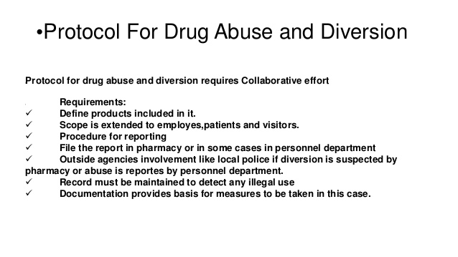
16-09-2024
19

Slide 20
Charges To Patients :
Charge of each dose received: Charge for each dose administered to patient
Flat charge to cover all controlled drugs: this is done by charging a flat charge to cover all controlled drugs
Charges in per diem charge : Sometimes cost is added in per day expenditures.
Without specific charge: no specific charge is made to patients .In some these are available at no charge.
Split charging: There is no charge for routinely used drugs but those obtained on special order are charged.
16-09-2024
20

Slide 21
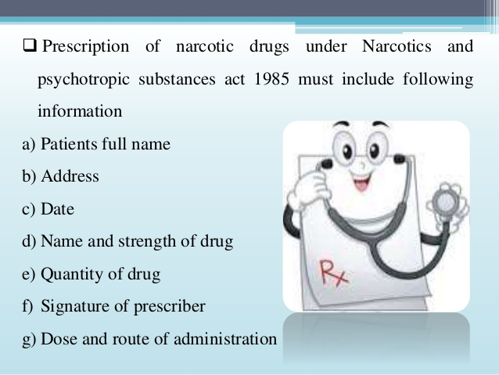
16-09-2024
21

Slide 22
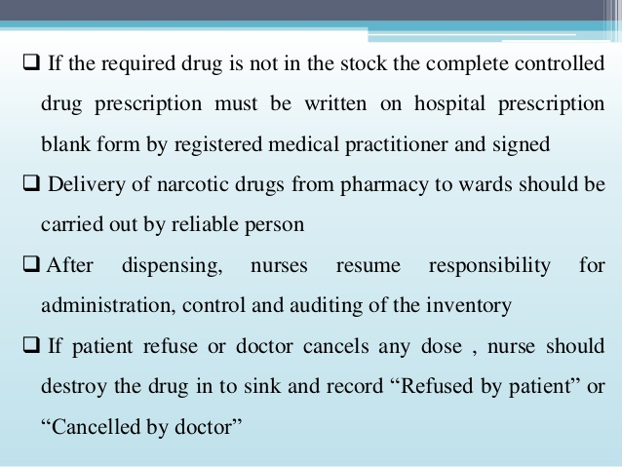
16-09-2024
22

Slide 23
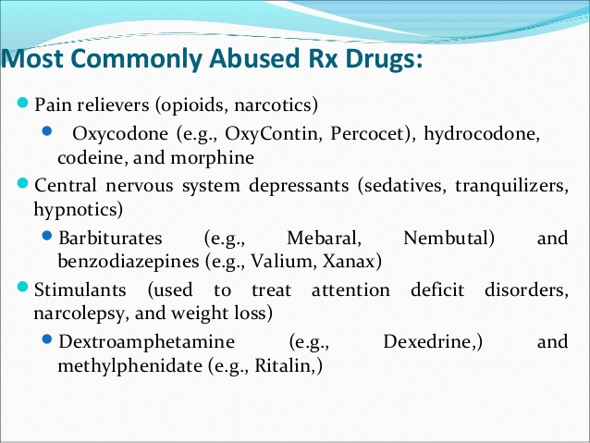
16-09-2024
23

