Slide 1
BIOPHARMACEUTICS AND PHARMACOKINETICS
1: DISTRIBUTION OF DRUGS
14-09-2024
1

Slide 2
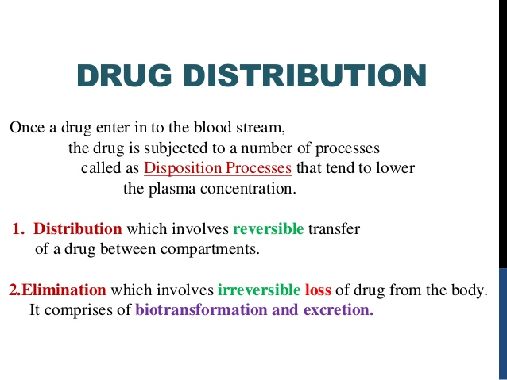
14-09-2024
2

Slide 3
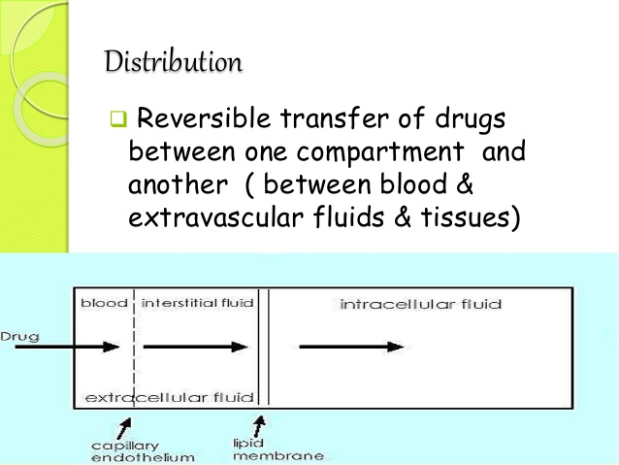
14-09-2024
3

Slide 4
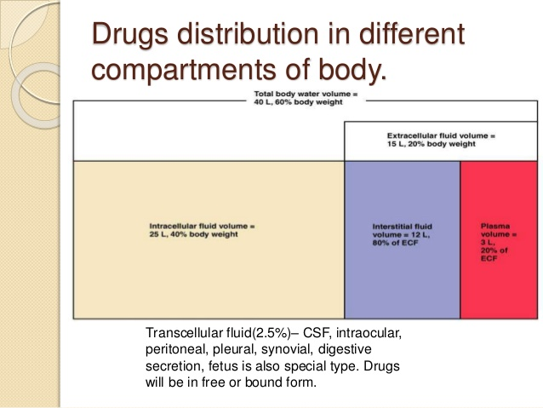
14-09-2024
4

Slide 5
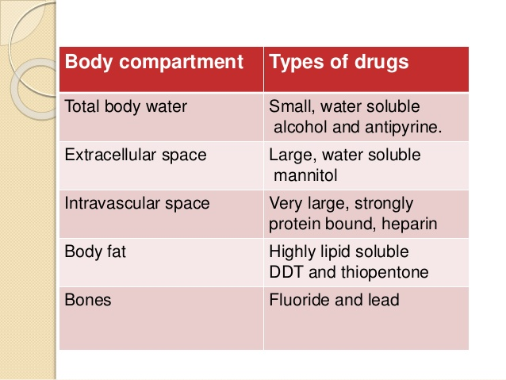
14-09-2024
5

Slide 6
Distribution is predominantly a passive process :
The driving force is the concentration gradient between the blood and extravascular tissues
Process occurs by the diffusion of free drug until equilibrium is established
As the pharmacological action of a drug depends upon its concentration at the site of action distribution plays a significant role in the onset, intensity, and duration of action.
Distribution of a drug is not uniform throughout the body because different tissues receive the drug from plasma at different rates and to different extents.
14-09-2024
6

Slide 7
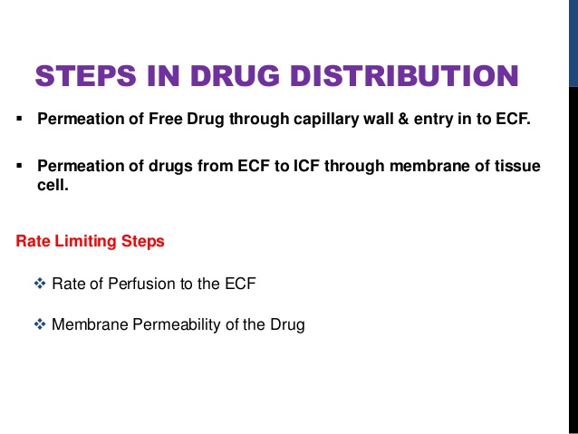
14-09-2024
7

Slide 8
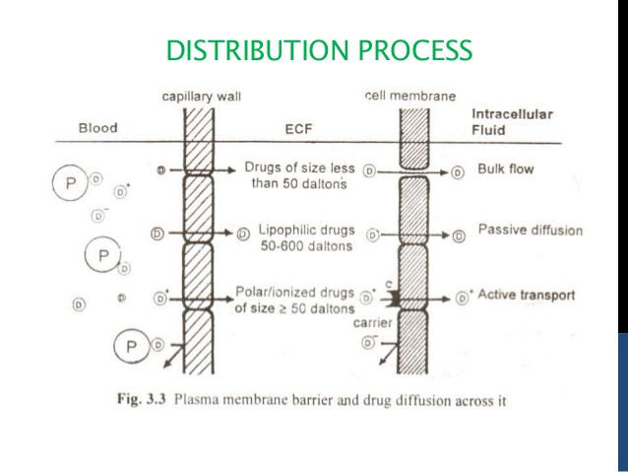
14-09-2024
8

Slide 9
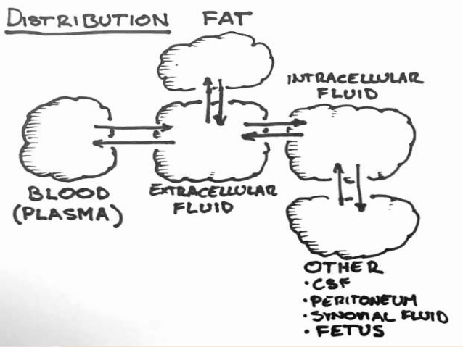
14-09-2024
9

Slide 10
Distribution determines the transport of drugs to their site of action, to other sites, and to the organs of metabolism and excretion is NOT UNIFORM; because the rate of delivery and potential amount of drug distributed into tissues depends on following,
Lipid solubility
Penetrate - capillary endothelium.
Diffuse across the cell membrane
Ionization at physiological PH
Binding to plasma proteins
Cardiac output,
Regional blood flow,
Difference in perfusion rates due to Capillary permeability and tissue volume.
Well-perfused organs (liver, kidney, brain) : initially receive most of the drug
Lesser perfused organs (muscle, skin, and fat) : delivery is slower.
14-09-2024
10

Slide 11
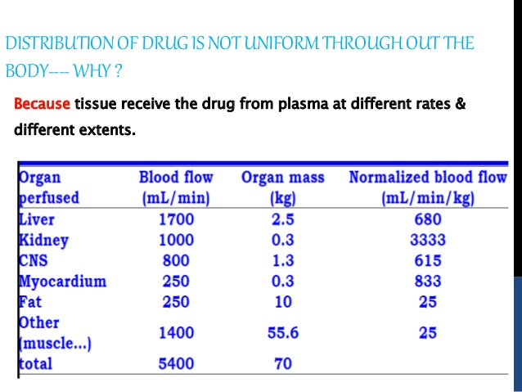
14-09-2024
11

Slide 12
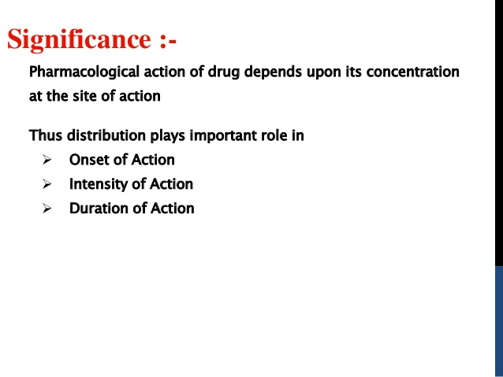
14-09-2024
12

Slide 13
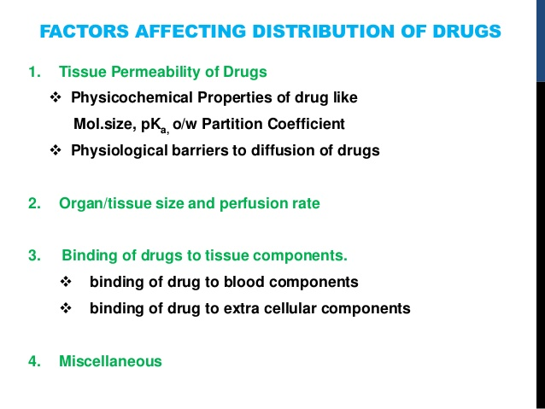
14-09-2024
13

Slide 14
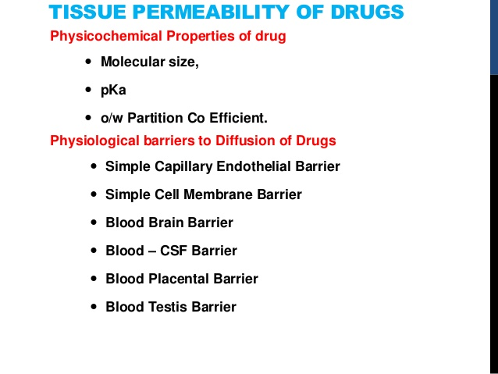
14-09-2024
14

