Slide 1
Clinical Pharmacy
Drug Use Evaluation (DUE)
6/1/2021
1

Slide 2


Drug Use Evaluation (DUE)
Drug use evaluation is an ongoing, authorized improvement process, which is designed to:
Review drug use and or prescribing patterns Provide feedback of results to clinicians and
Develop criteria and standards Promote appropriate drug use
and systematic quality
other relevant groups
6/1/2021

Slide 3
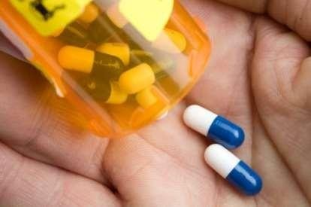

TYPES OF DUE
Quantitative DUE
studies
Qualitative DUE studies
6/1/2021

Slide 4

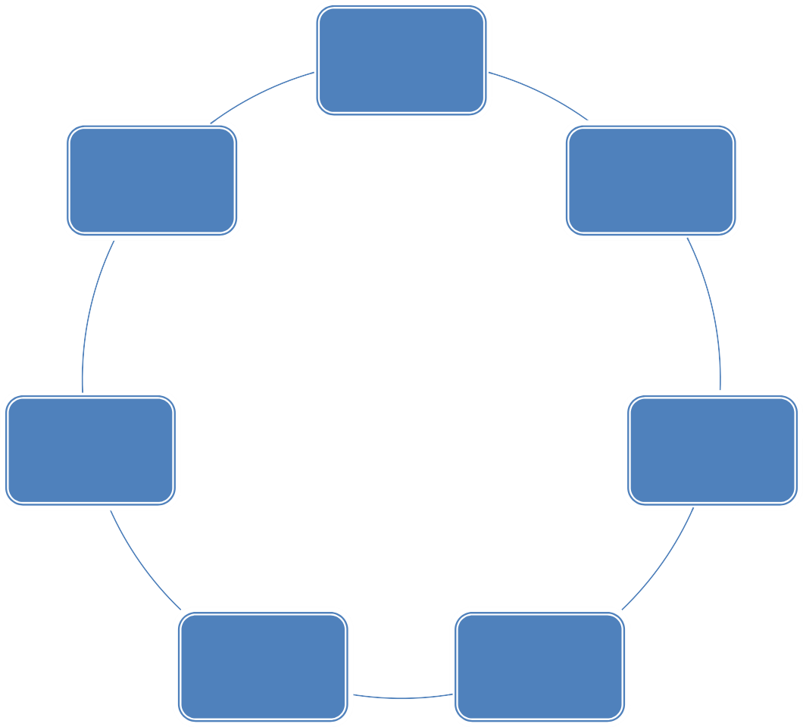
planning
Feedback
of results
Data
collection
Re- evaluation
Evaluation
Feed back of results
Intervention
6/1/2021

Slide 5


STEP 1:Identify drugs or therapeutic areas of practice for possible inclusion in the program
STEP2:Design of study
STEP3:Define criteria and standards STEP4: Design the data collection form STEP6:Evaluate results
STEP5:Data collection
6/1/2021

Slide 6

STEP6: Evaluateresults
STEP7: Provide feedback of results
STEP 8: Develop and implement interventions
STEP9: Reevaluate to determine if drug use has improved STEP10: Reassess and revise the DUE program
STEP11 : Feedbackresults
6/1/2021

Slide 7
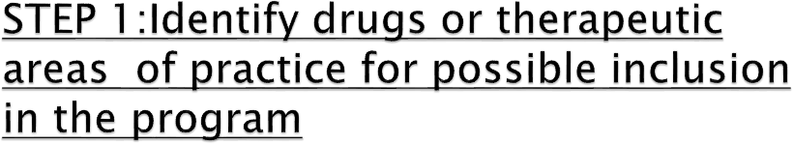

Common targets for DUE includes:
Commonly prescribed drugs
Drugs associated with potentially significant drug Expensive drugs
New drugs
Drugs with narrow therapeutic index
Drugs that frequently cause serious ADR Drugs used in high risk patient
interactions
6/1/2021

Slide 8
DUE studies may also be described as
prospective,
concurrent or retrospective
ADVANTAGE: The prescribers and others are unaware of data collection
DISADVANTAGE: patient do not gain immediate benefit.
6/1/2021

Slide 9

After the DUE target has been selected ,it is important to conduct a comprehensive literature review.
Criteria
Standards

Slide 10

Patient demographics Prescriber details
6/1/2021

Slide 11
COMMON ASPECTSOF DRUG USESTUDIED IN DUEs
Disease severity
Indication for drug use Contraindications
Side/adverse effects Dosing information
Dr ug- dr ug and drug-food Monitoring of drug therapy
Cost of therapy
interactions
6/1/2021

Slide 12
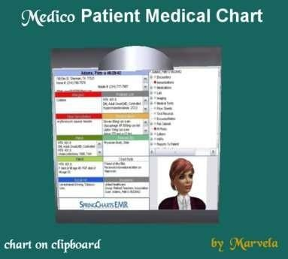
SOURCES OF DATA FOR DUEs IN HOSPITALS
Clinical data
Patient treatment charts
Patient admission records Departmental audits Pathology records
Microbiological data
Demographic data Administrative data
6/1/2021

Slide 13
HOSPITAL NAME
Drug Use Evaluation of renal function monitoring during aminoglycoside therepy Patient Data Collection Form
Nam e:………………… Date
of Adm ission:
……/……/2014
Age:…………………………….
male/Female
InpatientNo:………………………..
Weigt(Kg):………………………
Previous history of renal
impairment?
Date of Discharge:
…./……/2014
Consultant
………………………………
Details of aminoglycoside therapy
YES/ No
Indication(circle):
Reason for
ceasing(circle): Infection
resolved Toxicity
UTI/Pneumonia/Septicemia/Endocarditis
Other(please specify)
Other(please specify)
Date
Drug(circle)
ceased
Gentam ycin Tobramycin
Am ikacin
Dose(mg)
Route
Frequency(circle)
Date started
…/…../14
IV IM
qd bd tds
Other
…./…./14
Date … /… /14
…./…./14
…./…./14
…./…./14
Serum
Creatinine
Comments:…………………………………………………………………………………………………………………………………. Data collector’s
signature:………………………………………………………………………………………………………….
13

Slide 14











Data collectors should be chosen carefully, and should be familiar with how information is arranged in the patient’s case notes.
The data obtained should be collected using spreadsheets
,databases and word processing.
available resources such as
CHALAPATHI INSTITUTE OF PHARMCEUTICAL SCIENCES
14

Slide 15

The reports should be a well –presented and well –reasoned document,with no grammatical or typographical errors
Educational
Operational
CHALAPATHI INSTITUTE OF PHARMCEUTICAL SCIENCES
15

Slide 16

The reevaluation is done three to twelve months after the introduction of the intervention.
The questions addressed should include:
Did the program address important aspects of care? Were the criteria developed appropriate?
Were drug use problems identified?
CHALAPATHI INSTITUTE OF PHARMCEUTICAL SCIENCES
16

Slide 17

Program development, supervision
and coordination
Education of hospital Promotion of the goals objectives
staff
and
Development /review of audit criteria,
Development of data collection instrument
CHALAPATHI INSTITUTE OF PHARMCEUTICAL SCIENCES
17

Slide 18

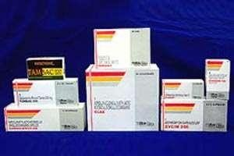
STEP1:Identify target drug or therapeutic area of practice
STEP2 :Design of study-A concurrent STEP3:Defining criteria and standards STEP4:Design data collection form STEP5:Data collection
STEP 6:Evaluation
Criteria 1:38 patients (60.3%)
Criteria 2: 12 of 38 patients(31.5%)
Criteria 3:4 of 6 patients (66.6%)
observational study
CHALAPATHI INSTITUTE OF PHARMCEUTICAL SCIENCES
18

Slide 19
STEP7:Feedback results
STEP8:Development and implement interventions STEP9:Reevaluate after intervention Criteria 1:47 of 60
patients(78.3%)
Criteria 2:18 of 47 patients(38.2%) Criteria 3: 8 of 12 patients (66.5%)
STEP10:Reassess and revise DUE program
STEP11:Feedback results
CHALAPATHI INSTITUTE OF PHARMCEUTICAL SCIENCES
19

Slide 20

Thank you
6/1/2021
20

