Slide 1
HOSPITAL PHARMACY
DRUG DISTRIBUTION SYSTEMS
16-09-2024
1

Slide 2
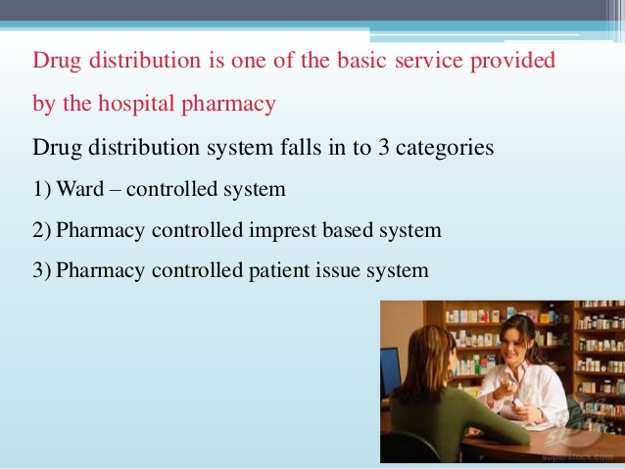
Drug distribution in hospital pharmacy
16-09-2024
2

Slide 3
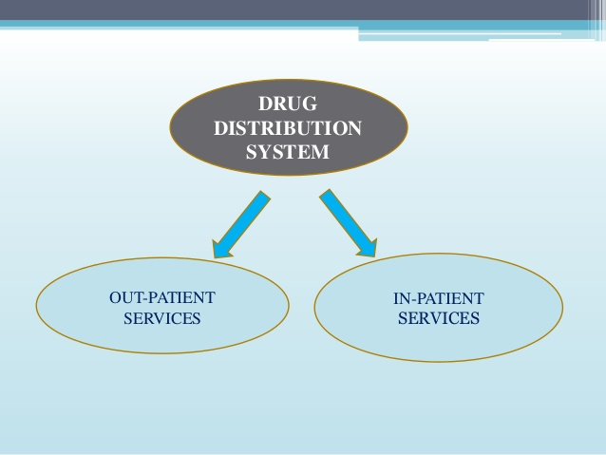
16-09-2024
3

Slide 4
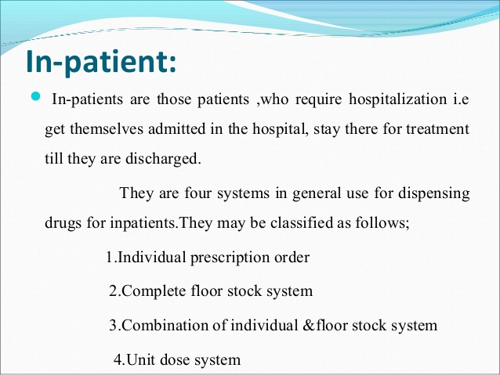
16-09-2024
4

Slide 5
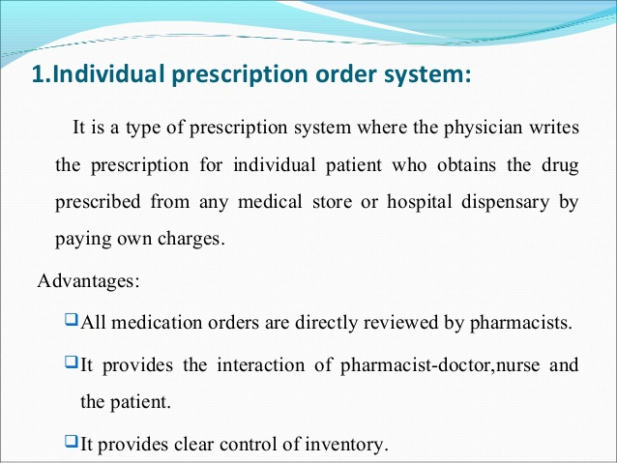
DISADVANTAGES:
➢ There may be possible delay in obtaining the required medications for administration to the patient
➢ Increase in the cost to the patient
16-09-2024
5

Slide 6
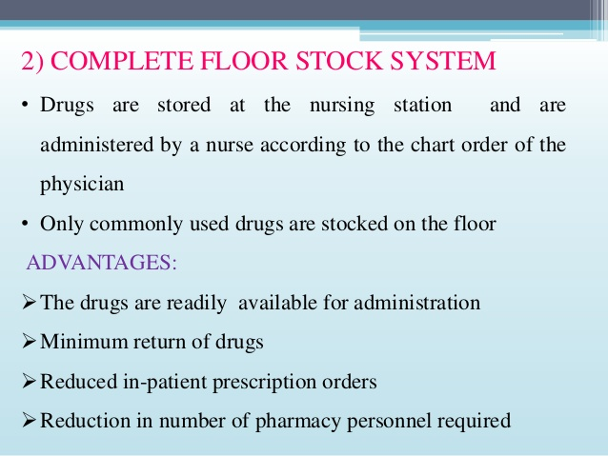
16-09-2024
6

Slide 7
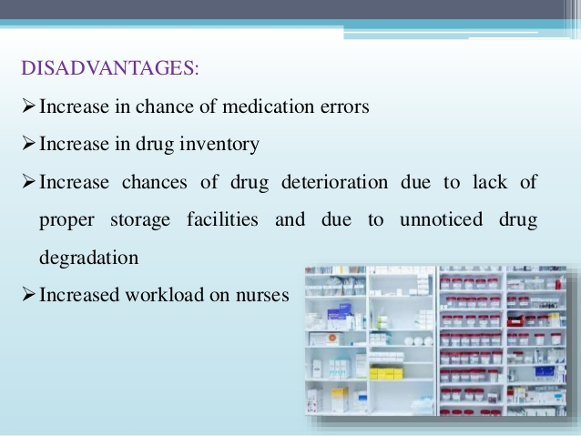
16-09-2024
7

Slide 8
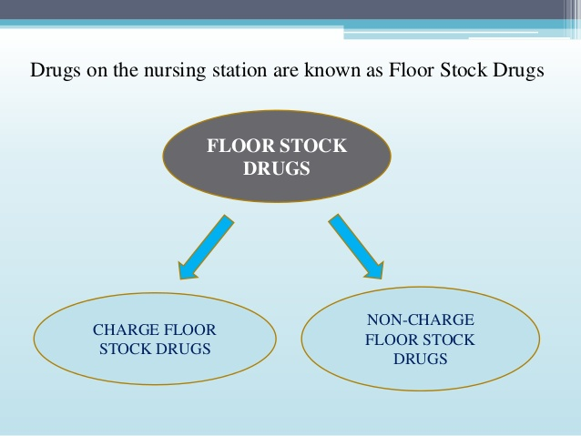
16-09-2024
8

Slide 9
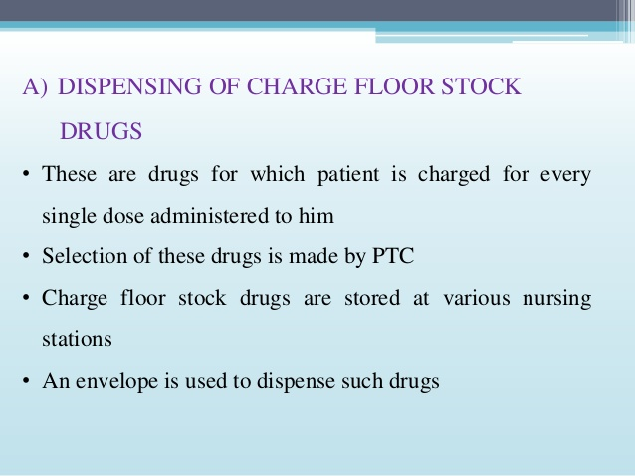
16-09-2024
9

Slide 10
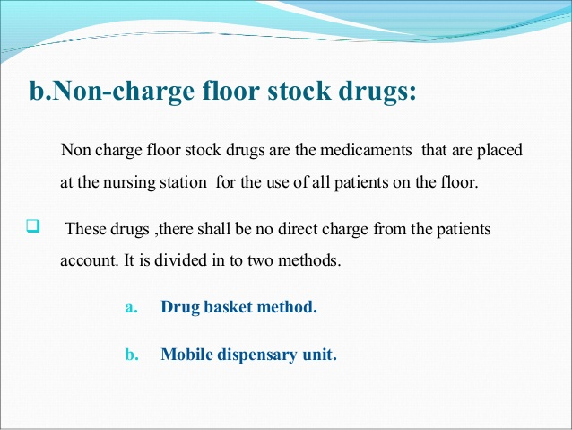
16-09-2024
10

Slide 11
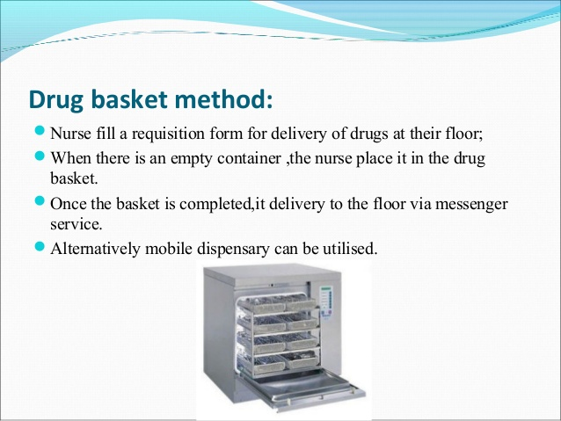
16-09-2024
11

Slide 12
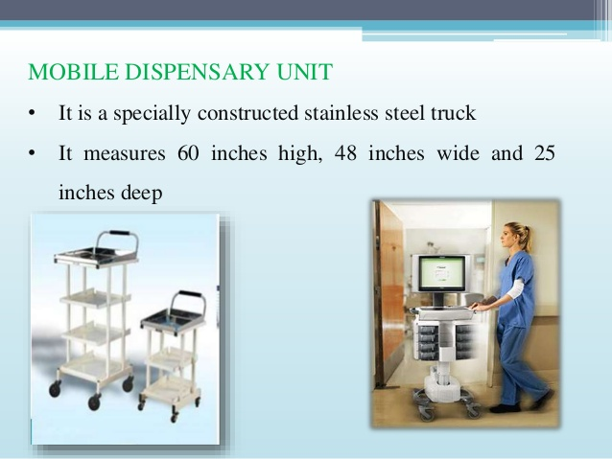
16-09-2024
12

Slide 13
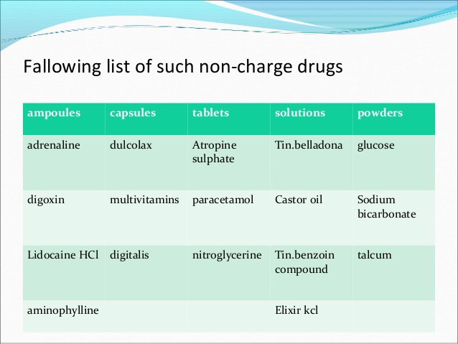
16-09-2024
13

Slide 14
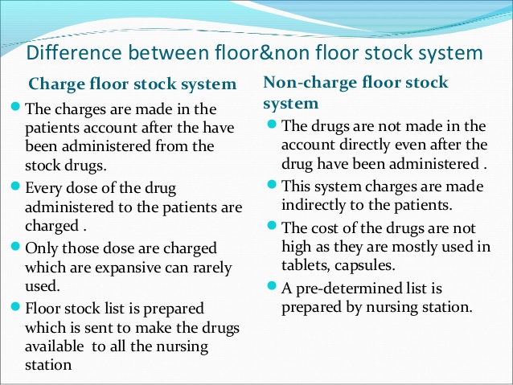
16-09-2024
14

Slide 15
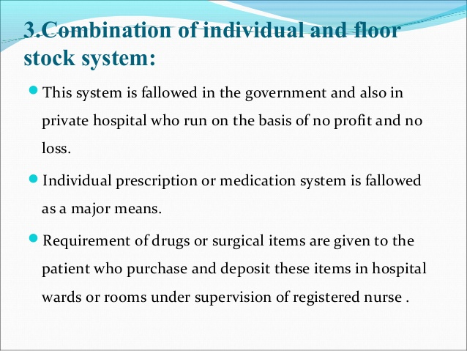
16-09-2024
15

Slide 16
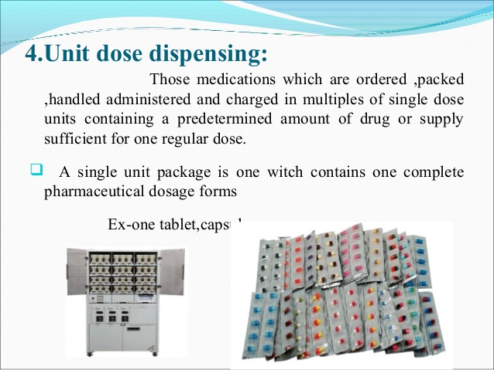
16-09-2024
16

Slide 17
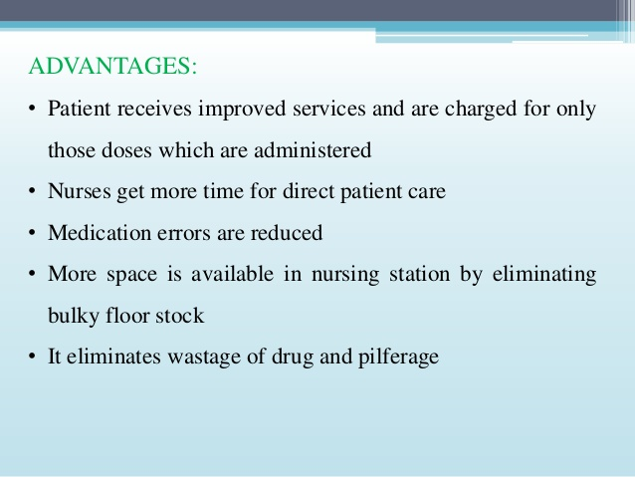
16-09-2024
17

Slide 18
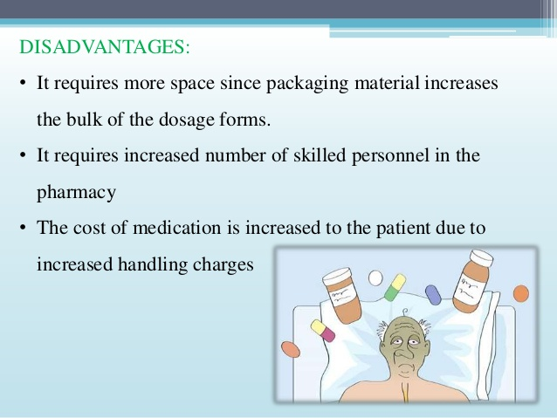
16-09-2024
18

Slide 19
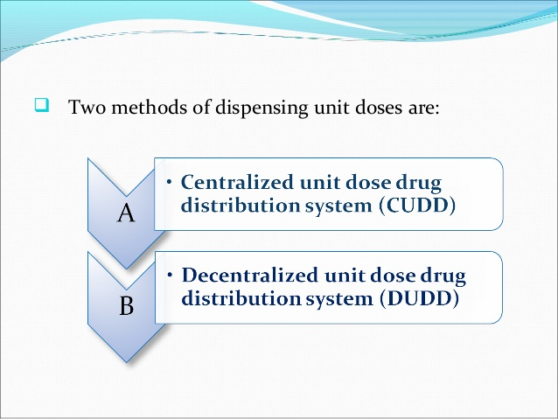
16-09-2024
19

Slide 20
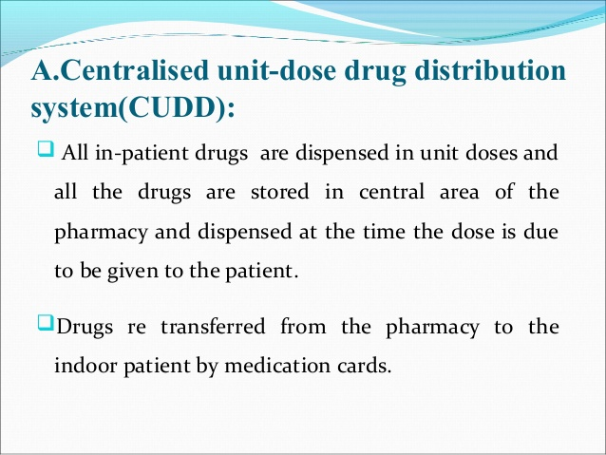
16-09-2024
20

Slide 21
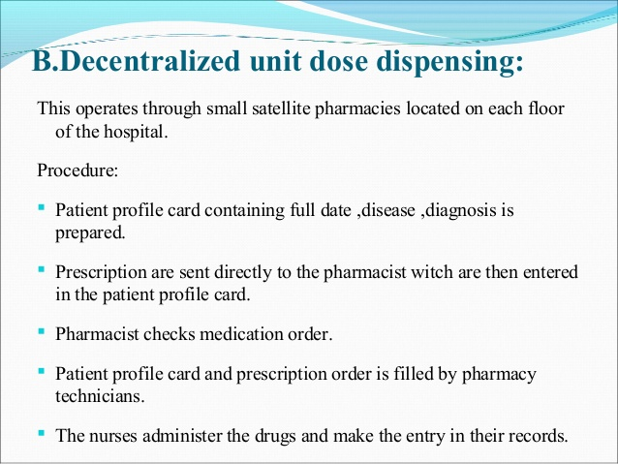
16-09-2024
21

Slide 22
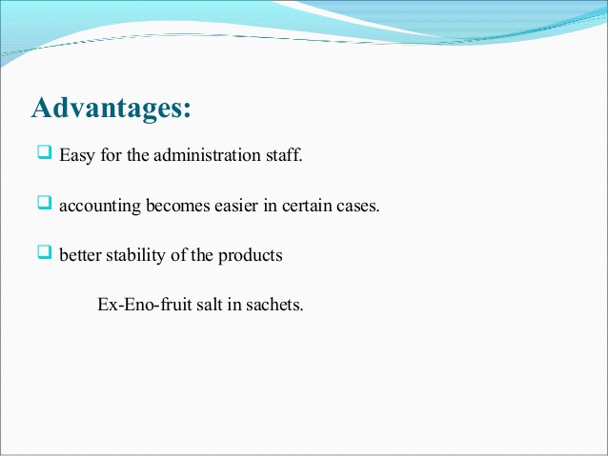
16-09-2024
22

Slide 23
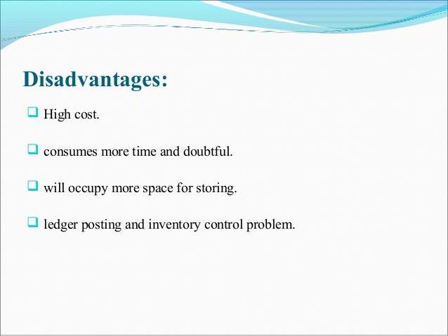
16-09-2024
23

Slide 24
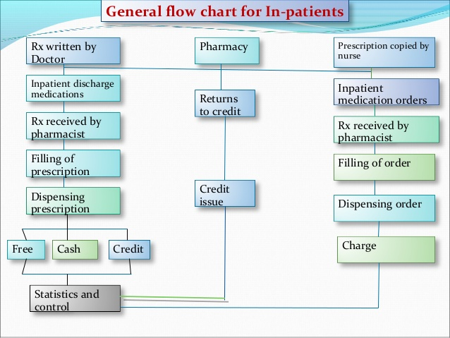
16-09-2024
24

Slide 25
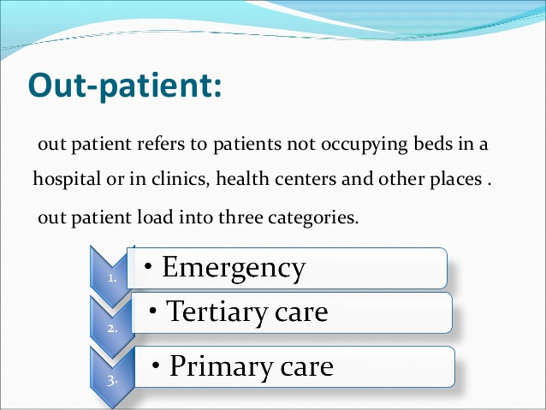
16-09-2024
25

Slide 26
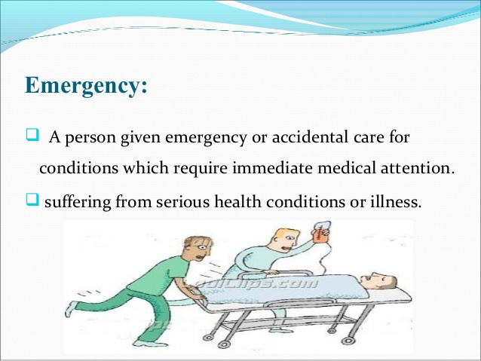
16-09-2024
26

Slide 27
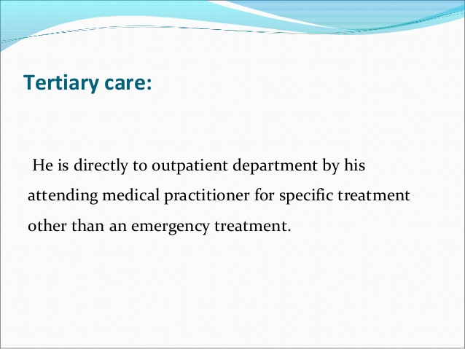
16-09-2024
27

Slide 28
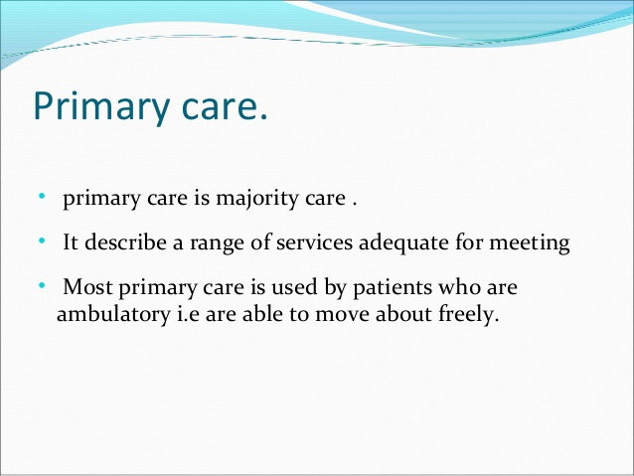
16-09-2024
28

Slide 29
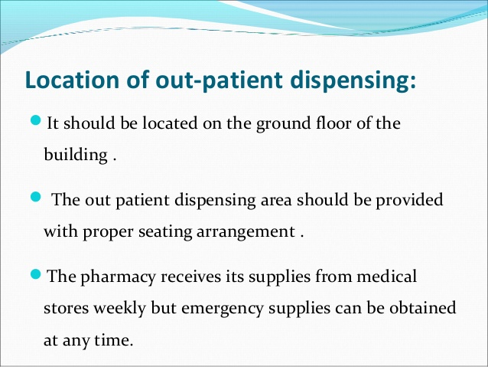
16-09-2024
29

Slide 30
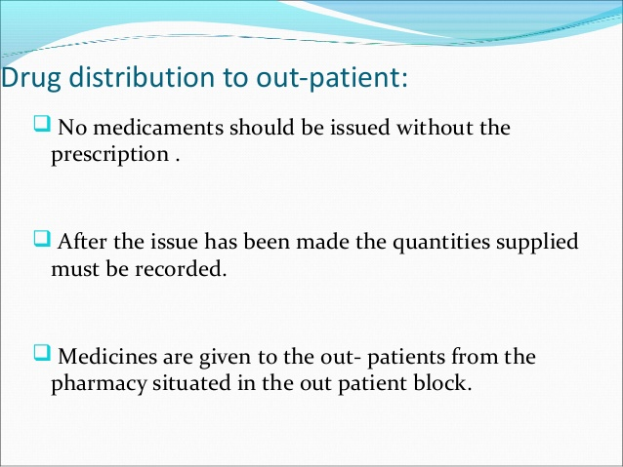
16-09-2024
30

Slide 31
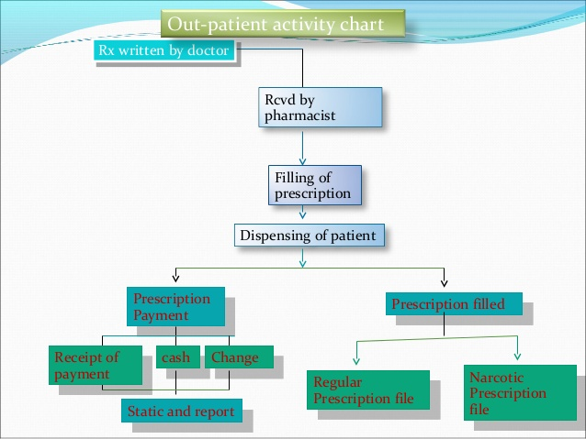
16-09-2024
31

Slide 32
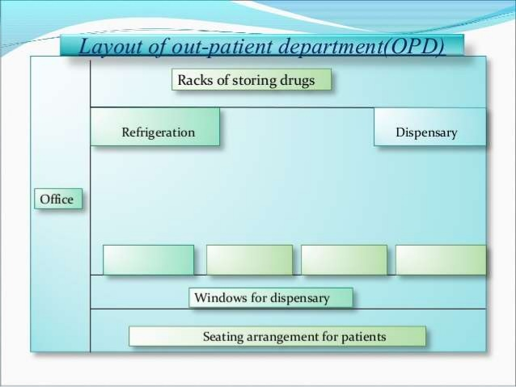
16-09-2024
32

