Slide 1
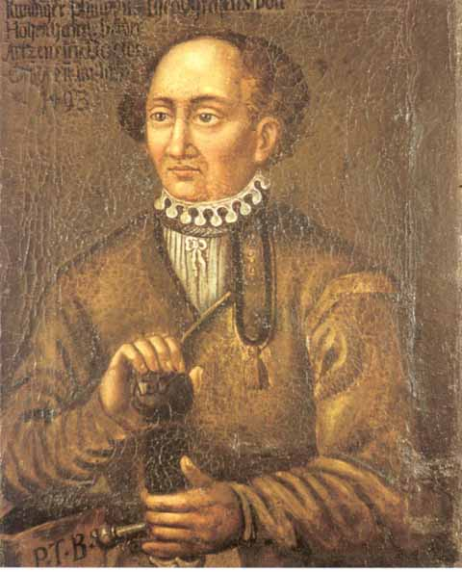
Drug-induced nephrotoxicity
“All drugs known to humans are poisons, only the amount or dose determine the effects.”

Slide 2
DRUG INDUCED RENAL FAILURE
Drug induced kidney disease is a relatively common complication of several diagnostic and therapeutic agents.
Clinical manifestations include
Acid-base abnormalities
Electrolyte imbalance
Proteinuria
Pyuria
Hematuria
INTRODUCTION

Slide 3
DIN is often reversible on discontinuation of the causative agent ; but may also lead to acute or end-stage renal failure.

Slide 4
EPIDEMIOLOGY
DIN accounts for nearly 7%of all drug toxicity.
It forms 18% to 27% of all cases of acute renal failure (ARF).
The -in-hospital drug use contributes to 35% of all cases of acute tubular necrosis (ATN).
NSAID nephrotoxiciy is common and well defined.
1-5% NSAID users are developing nephrotoxicity.
In U.S; 5 lakhs people out of the 25 lakhs developing DIN.

Slide 5
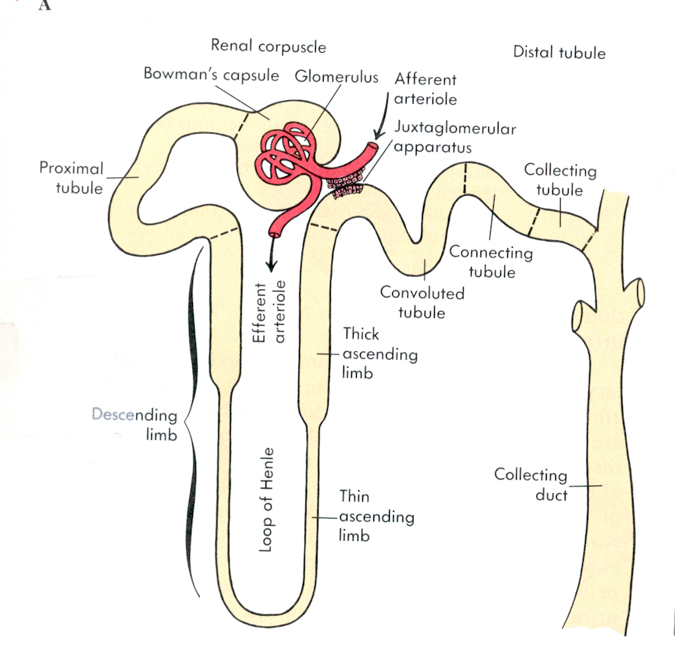
Basic Renal Physiology
nephron
the functional unit of the kidney
capable of forming urine
has two major components:
  glomerulus
  tubule:
    proximal
    loop of Henle
    distal
    collecting

Slide 6
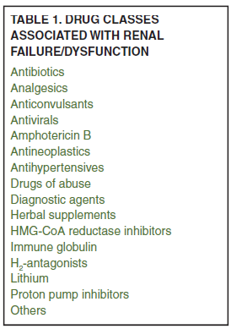
DRUGS CAUSING DIN

Slide 7
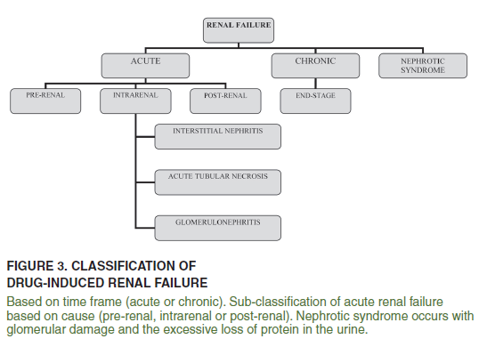

Slide 8
PATHOPHYSIOLOGY
DIN have two main pathophysiological mechanisms.
Immune mediated
Non-immune mediated

Slide 9
IMMUNE MEDIATED DIN
Kidney is highly susceptible because of its large vascular surface area for exposure to circulating immune mediators.
Immune mediated DIN occurs due to :
Alteration in the intrinsic immune function of the glomerular mesangial cells.
Alteration in the renal cytokine activation.

Slide 10
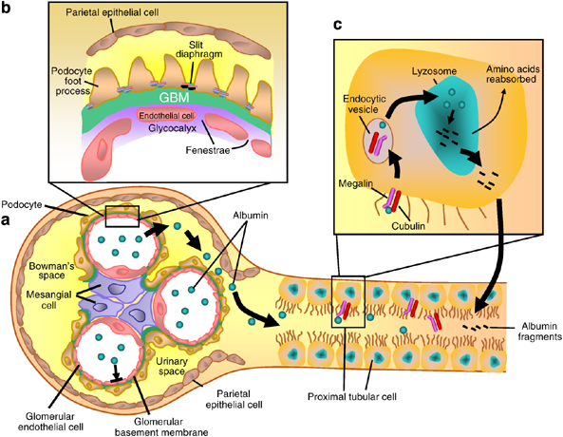

Slide 11
NON-IMMUNE MEDIATED DIN
Alteration in the renal blood flow.
Alteration in the tubular transport process,
Alteration in the intra renal drug metabolism.
Alteration in the urine concentraton and acidification abilities,

Slide 12
TYPES OF DRUD INDUCED NEPHROTOXICITY
Tubular epithelial cell damage.
Tubulointerstitial disease.
Hemodynamically mediated renal-failure.
Renal vasculitis , thrombosis and cholesterol emboli.
Obstructive nephropathy.
Glomerular disease.
Pseudo-renal failure.

Slide 13
TUBULAR EPITHELIAL CELL DAMAGE
Acute tubular necrosis
Aminoglycoides
Radiographic contrast media
Cisplatin
Amphotericin B
Osmotic nephrosis
Mannitol
Dextran
I.V immunoglobulin

Slide 14
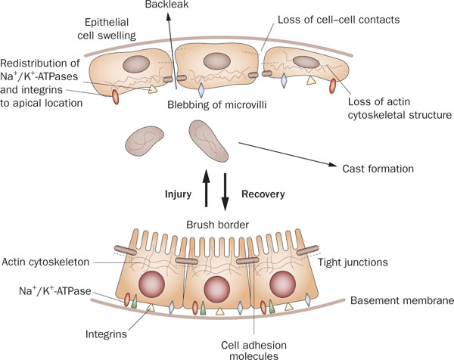
PATHOGENESIS OF ATN

Slide 15
1. Tubular cells injury/necrosis :
Proximal tubular cells and distal tubules are involved.
Concentrating urine and reabsorbing the ions.
Expose to high concentration of toxins
Toxins cause impairing mitochondrial function and increasing the oxidative stress, interfering with tubular transports, , or free radical formation.
Swollen cells are filled with abundant lysosomal vacoules.

Slide 16
ACUTE TUBULAR NECROSIS
DRUGS
Aminoglycoside antibiotics
Amphotericin B
Cisplatin
Anaesthetic drugs
Calcineurin inhibitors
Mannitol
Radio-contrast media

Slide 17
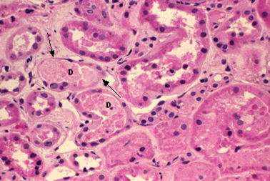
Acute Tubular Necrosis
Acute tubular necrosis showing focal loss of tubular epithelial cells (arrows) and partial occlusion of tubular lumens by cellular debris (D) (H&E stain).

Slide 18
DESCRIPTION
Patient with toxic acute tubular necrosis present with acute renal failure that be oliguric and require dialysis.
Tubular injury is often accompanied by increased fractional excretion of Na.
Majority of the cases of acute tubular necrosis will recover following discontinuation of the drug and institution of the supportive measure.

Slide 19
AMINOGLYCOSIDE INDUCED ATN
Aminoglycoside nephrotoxicity involves disruption of membrane structure and function and alteration of the membrane permeability; which leads to the inhibition of the lysosomal phospholipase ; lysosomal rupture and cytoplasmic release of lysosomal acid hydrolase.
Cisplatin indused ATN is thought to involve oxygen free radical formation ; reduction in renal perfusion and disruption of DNA and RNA synthesize.

Slide 20
AMINOGLYCOSIDE(CONTINEUS…)
RISK FACTORS :
Combination therapy with other nephrotoxic drug.
Total cumulative dose through levels>2mg/ L
Repeated course of antibiotic therapy or prolonged therapy>10 days.
Dehydration.

Slide 21
MANAGEMENT:
Reversible if discontinuing the drug.
Adequate hydration
Monitor the levels of the drug.

Slide 22
AMPHOTERICIN B INDUCED ATN
MECHANISM : Mechanism of Amphotericin induced ATN are vasoconstriction and modification of cell membrane integrity and permeability.
INCIDENCE : ~80% when cumulative dose reaches 2g.
PATHOGENESIS: Direct tubular epithelial cell damage ; it binds to cell wall resulting in increased tubular permeability and necrosis.

Slide 23
AMPHOTERICIN INDUCED ATN
CLINICAL PRESENTATION
Increases serum creatinine level
Increased BUN
Decreased Mg and K(Urinary wasting).
Polyuria
RISK FACTORS
Combination therapy with other nephrotoxic drugs.
Total cumulative dose : total dose>0.5mg/kg/day

Slide 24
Dehydration
MANAGEMENT
Reversible if discontinuing the drug.
Hydration with 1L NS daily

Slide 25
Radio-contrast nephropathy
Mild renal dysfunction may complicate up to 10% of angiographic procedures . Radio-contrast nephropathy is manifested by non oliguric ARF, typically occurring 1-5 days after the procedure. Intra- renal vasoconstriction, mediated largely by endothelial and tubular cell toxicity (with ATN) are important in the pathogenesis . The ARF is fully reversible.

Slide 26
RISK FACTORS FOR RADIO-CONTRAST NEPHROPATHY
High contrast load
Hypovolaemia
Myeloma , Hyperuricaemia
Age
High iodine content of contrast
Diabetes
Hypercalcaemia
Pre-existing CRF

Slide 27
Contrast-induced ARF
CLINICAL FEATURES
Onset - 24 to 48 hrs after exposure
Duration - 5 to 7 days
Non-oliguric (majority)
Dialysis - rarely needed
Urinary sediment - variable
Low fractional excretion of Na

Slide 28
Contrast-induced ARF
PROPHYLACTIC STRATEGIES
Use I.V. contrast only when necessary
Hydration
Minimize contrast volume
Low-osmolar (nonionic) contrast media
N-acetylcysteine, fenoldopam

Slide 29
INTERVENTION TO PREVENT CONTRAST NEPHROPATHY
Which is the most proven preventive strategy?s
NS --1-2 ml/kg/hr ; starting 12 hours pre and continued 12 hours post procedure.
NaHCO3—150 mEq/L ; infused at 3mL/kg/hr pre and then 1mL/kg/hour for 6 hours post procedure.
N-acetyl cysteine 600mg PO- B.I.D-four doses on day prior to and on day after administration of contrast.

Slide 30
OSMOTIC NEPHROSIS
high doses of mannitol, immunoglobulins, dextrans and starches are nephrotoxic
Direct effect on glomerular filtration
or the uptake of these large molecules by pinocytosis into the proximal tubule
: The renal failure began from 1 to 10 days after therapy

Slide 31
TUBULO INTERSTITIAL DISEASE
Acute allergic interstitial nephritis
Penicillin, Ciprofloxacin
Furosemide ,NSAIDs
Chronic interstitial nephritis
Cyclosporine,Lithium,
Papillary necrosis
Phenacetin,Aspirin,and Caffeine analgesic

Slide 32
DRUG INDUCED ACUTE INTERSTITIAL NEPHRITIS
DRUGS
B-lactams
Sulpha drugs
Quinolones
Anticonvulsants
H2 blockers
NSAID
Allopurinol
Rifampin
Diuretics

Slide 33
ACUTE INTERSTITIAL NEPHRITIS
PATHOGENESIS
AIN is caused by beta-lactem and sulpha based antibiotics is mediated by cell mediated immunity except in case of methicillin induced AIN; where humoral immunity plays the role.
AIN caused by beta-lactem and sulpha drugs is usually begins 2 weeks after drug exposure but may occur sooner if patient has been previously sensitized to the same agent.
But NSAID causes AIN only after 1 year treatment.

Slide 34
PATHOGENESIS OF ACUTE INTERSTITIAL NEPHRITIS
Interstitial inflammation
Edema
Tubulitis
Interstitial granulomas are commonly seen in AIN & may represent the predominant injury (known as granulomatous interstitial nephritis)

Slide 35
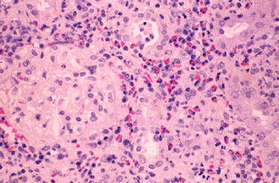
Acute Interstitial Nephritis
Drug-induced allergic interstitial nephritis (H&E stain). Note the diffuse interstitial infiltrate, many red-staining eosinophils, and sparing of the glomerulus (on the left).

Slide 36
ACUTE INTERSTITIAL NEPHRITIS
CLINICAL FEATURES
AIN caused by beta-lactams and sulpha based antibiotics is characterized by systemic signs of hypersensitivity reaction.
Fever
Esinophilia
Skin rash
Where as NSAID induced AIN does not manifest these systemic signs of hypersensitivity.

Slide 37
NSAIDs INDUCED AIN
Selective cyclooxygenase (COX-2) inhibitors cause similar renal dysfunction.
COX-2 exists as a constitutive enzyme in the thick part of the ascending limb of loop of Henle and in the renal medulla.
COX-2 causes natriuresis and diuresis
Inhibition of COX-2 by selective COX-2 inhibitors, such as celecoxib and rofecoxib causes renal dysfunction.
particularly in patients who are volume-depleted or haemodynamically unstable.

Slide 38
NSAID
Loss of PGI₂ induced inhibition of LTB₄ mediated
endothelial adhesion and activation of neutrophils
Loss of PGE₂ and PGI₂ mediated inhibition
of acid secretion and cytoprotective effect
↑ Leukocyte-Endothelial
Interactions
Capillary
Obstruction
Proteases +
Oxygen Radicals
Ischemic
Cell Injury
Endo/Epithelial
Cell Injury
Mucosal Ulceration

Slide 39
slno |  | AIN | ATN
1 | Onset | 1st exposure>10-14 days 2nd exposture>3-5 days. | earky:7-10 days
2 | Clinical features | Fever Rash Esinophilia>75% | Uraemic syndrome

Slide 40
3 | Urine analysis | WBC cast Eosinophilia Haematuria Mild proteinuria oliguria

Slide 41
OBSTRUCTIVE NEPHROPATHY
Intra tubular obstruction
Acyclovir
Sulfadiazine
Extra-renal obstruction
Tricyclic antidepressants
Indinavir
Nephrolithiasis
Triamterene
Indinavir

Slide 42
OBSTRUCTIVE NEPHROPATHY
RHABDOMYOLYSIS
Intravascular precipitation of myoglobulin.
Reddish brown urine.
Statin : Simvastatin , Atorvastatin – risk increased with Cyp-3A4 inhibitors.
PREVENTIOIN
Hold statin while on Clarithromycin or Erythromycin
therapy.
Use Pravastatin, Rosuvastatin ; which is not metabolized by Cyp-3A4.

Slide 43
OBSTRUCTIVE NEPHROPATHY
CLINICAL FEATURES
Pain
Haematuria
Urinary tract infection
Significant rise in the serum creatinine
Oliguria or anuria

Slide 44
RENAL VASCULITIS,THROMBOSIS AND CHOLESTEROL EMBOLI
Vasculitis and thrombosis
Hydralazine
Allopurinol
Gemcitabine
Mytomycin C
Cholesterol emboli
Warfarin
Thrombolytic agents

Slide 45
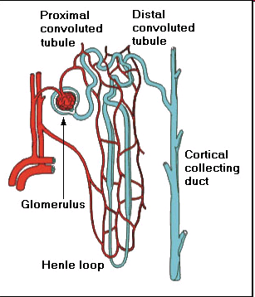
NEPHROTIC SYNDROME
NSAIDS, PENICILLAMINE
CAPTOPRIL
HEROIN/COCAINE
METALS (Au, Hg)
ATN(P): ACUTE TUBULAR NECROSIS AMINOGLYCOSIDES, ANTINEOPLASTICS, GLYCOLS, RADIOCONTRAST AGENTS
ATN(D): ACUTE TUBULAR NECROSIS AMPHOTERICIN, CISPLATIN, GLYCOLS
CORTEX
VASCULITIS AMPHETAMINES, NSAIDS, PENICILLINS,SULFONAMIDES
-----------------------------------------------------------
ACUTE PRE-RENAL FAILURE AMPHOTERICIN, ANTIHYPERTENSIVES, DIURETICS, DOXORUBICIN, NSAIDS, CYCLOSPORIN-A
INNER MEDULLA
------------------------------------------------------------
OUTER MEDULLA
OBSTRUCTION
ACYCLOVIR, ANTICHOLINERGICS, BROMOCRIPTINE, ERGOT ALKALOIDS, FLUOROQUINOLONE, MTX
ACUTE INTERSTITIAL NEPHRITIS
ALLOPURINOL, RIFAMPIN, VANCOMYCIN, NSAIDS
CHRONIC INTERSTITIAL NEPHRITIS ANALGESIC COMBINATIONS, CHINESE HERBS, CYCLOSPORINE, METALS (PB, Cd, Li, Ge), METHYL-CCNU

Slide 46
Example of specific renal protective strategies
Exposure | Strategy
Aminoglycoside antibiotics | Once – daily dosing Monitoring of drug levels Avoiding in CKD and pts at risks. Maintain trough levels < 1mcg /ml.
Tumor lysis (uric acid) | Allopurinol Rasburicase IV hydration/urine alkalisation
Amphotericin B | Use lipid formulation Saline hydration pre and post administration Avoid high or rapid dose or prolonged duration
Ethylene glycol ingestion | Ethanol/fomepizole hemodialysis
Rhabdomyolysis | IV hydration/urine alkalinization ± mannitol
Methotrexate | IV hydration/urine alkalinization
Acyclovir | IV hydration

Slide 47
Strategy | Exposure
Avoid long-term use, More than one drug Avoid in old age Monitor cumulative consumptions and avoid it Avoid combination wit RAS blockers | Acetaminophen Aspirin, NSAIDs
Fluid correction before drugs initiation Monitoring S.creatinine | RAS inhibitors
Discontinue or reduce dose Hydration Oral route Establish high urine flow | Acyclovir Methotrexate Sulfa ATB Triamterene
Monitoring drug levels Lowering the doses ± CCB | Calcineurin inhibitors

