Slide 1

CLINICAL PHARMACY
DRUG THERAPY MONITORING AND
PHARMACEUTICAL CARE
1

Slide 2
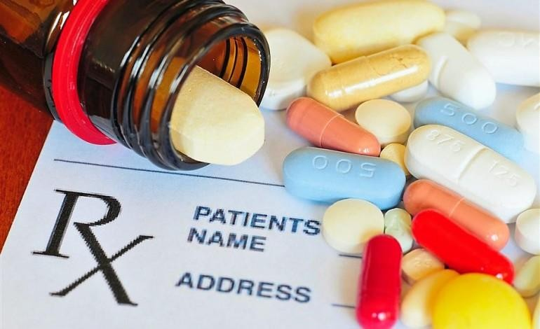
DRUG THERAPY MONITORING
One of the fundamental activity of of the clinical pharmacist
working in hospital.
Individualisation of patient drug therapy
Rational usage of drugs
2

Slide 3
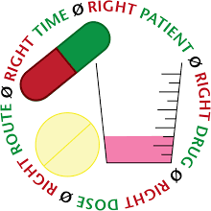
Appropriate drug
Appropriate patient Appropriate dose Appropriate route Appropriate frequency Appropriate duration
3

Slide 4
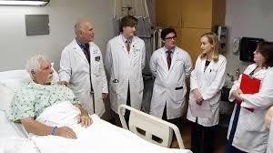
A reliable and responsive drug therapy monitoring service
depends on team work between nurses, doctors, pharmacist, scientist and technical staff. The clinical pharmacist should provide advice to medical staff on the
appropriate use of drugs and assist them in obtaining better therapeutic results
© R R INSTITUTIONS , BANGALORE
4

Slide 5

GOALS
To optimise the drug therapy and patient outcomes by implementing a strategy involving fallowing components.
Collation and interpretation of patient specific information.
Identification of desired therapeutic outcomes.
Review of drug therapy. Formulation and interpretation of monitoring
strategy.
Review of outcomes.
Modification of patient monitoring if required.
© R R INSTITUTIONS , BANGALORE
5

Slide 6

COMPONENTS OF DRUG THERAPY MONITORING
Medication order review
Clinical review
Pharmacist intervention
© R R INSTITUTIONS , BANGALORE
6

Slide 7
MEDICATION ORDER REVIEW
It is a fundamental responsibility of a pharmacist to ensure the
appropriateness of medication orders.
It serves as starting point for other clinical pharmacy activities ( medication counselling, TDM, DI, and ADR).
Organizing information according to medical problems
helps breakdown a complex situation into its individual parts
© R R INSTITUTIONS , BANGALORE
7

Slide 8

GOAL
To optimise the patients drug therapy.
To prevent or minimise drug related problems/medication errors
© R R INSTITUTIONS , BANGALORE
8

Slide 9
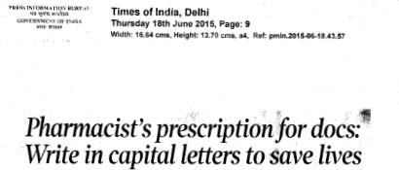
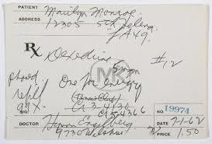


Ensuring that the medication order is comprehensible and unambiguous, that
appropriate terminology is used and that drug name are not abbreviated.
Annotate the chart to provide clarification as required.
9

Slide 10


Detecting orders for medication to which the patient may be
hypersensitive/intolerant
© R R INSTITUTIONS , BANGALORE
10

Slide 11
Ensuring that medication order is appropriate with respect to
The patient’s previous medication order.
Patient’s specific considerations e.g disease state, pregnancy.
Drug dose and dosage schedule, especially with respect to age, renal
function, liver function.
Route, dosage form and method of administration.
© R R INSTITUTIONS , BANGALORE
11

Slide 12
incompatibilities
Checking complete drug profile for medication duplication, interactions or
Ensuring that administration times are appropriate e.g. with respect to food , other drugs and procedures
  Checking the medication administration record to ensure that all ordered
have been administered
  Ensuring that the drug administration order clearly indicates the time at
which drug administration is to commence.
© R R INSTITUTIONS , BANGALORE
12

Slide 13


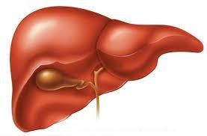

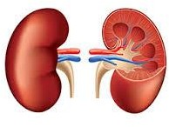
Special considerations should be given especially in short course therapy as
in antibiotics and analgesics.
© R R INSTITUTIONS , BANGALORE
13

Slide 14

Ensuring that the order is cancelled in all sections of medication administration record when the drug therapy is intended to cease.
  If appropriate follow up of any non-formulary drug orders, recommending a
formulary equivalent if required.
© R R INSTITUTIONS , BANGALORE
14

Slide 15

Ensuring appropriate therapy monitoring is implemented.
Ensuring that all necessary medication is ordered.
E.g. premedication, prophylaxis.
Reviewing medication for cost effectiveness
15

Slide 16
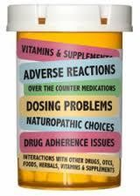
Identification of drug related problems.
Untreated indication.
Inappropriate drug selection.
Sub therapeutic dose.
Adverse drug reaction.
Failure to receive drug.
Drug interactions.
Drug use without indication.
Over dosage.
© R R INSTITUTIONS , BANGALORE
16

Slide 17

MEDICATION CHART ENDORSEMENT
Another important goal of treatment chart review is to minimise the risk of medication errors that might occur at the level of prescribing and / or drug administration.
A medication error is any preventable error that may lead to inappropriate
medication use or patient harm.
To prevent potential morbidity and mortality associated with these errors, pharmacists should systematically review the medication chart and write annotations on the chart where the medication orders are unclear
© R R INSTITUTIONS , BANGALORE
17

Slide 18
NATIONAL INPATIENT MEDICATION CHART
The National Inpatient Medication Chart (NIMC) is a suite of nationally standard medication charts, both paper and electronic, that present and communicate information consistently between healthcare professionals providing care to patients on the intended use of medicines for an individual patient.
Reduces the risk of prescribing, dispensing and administration error by health professionals through standardized presentation of information on the intended use of medicines
© R R INSTITUTIONS , BANGALORE
18

Slide 19
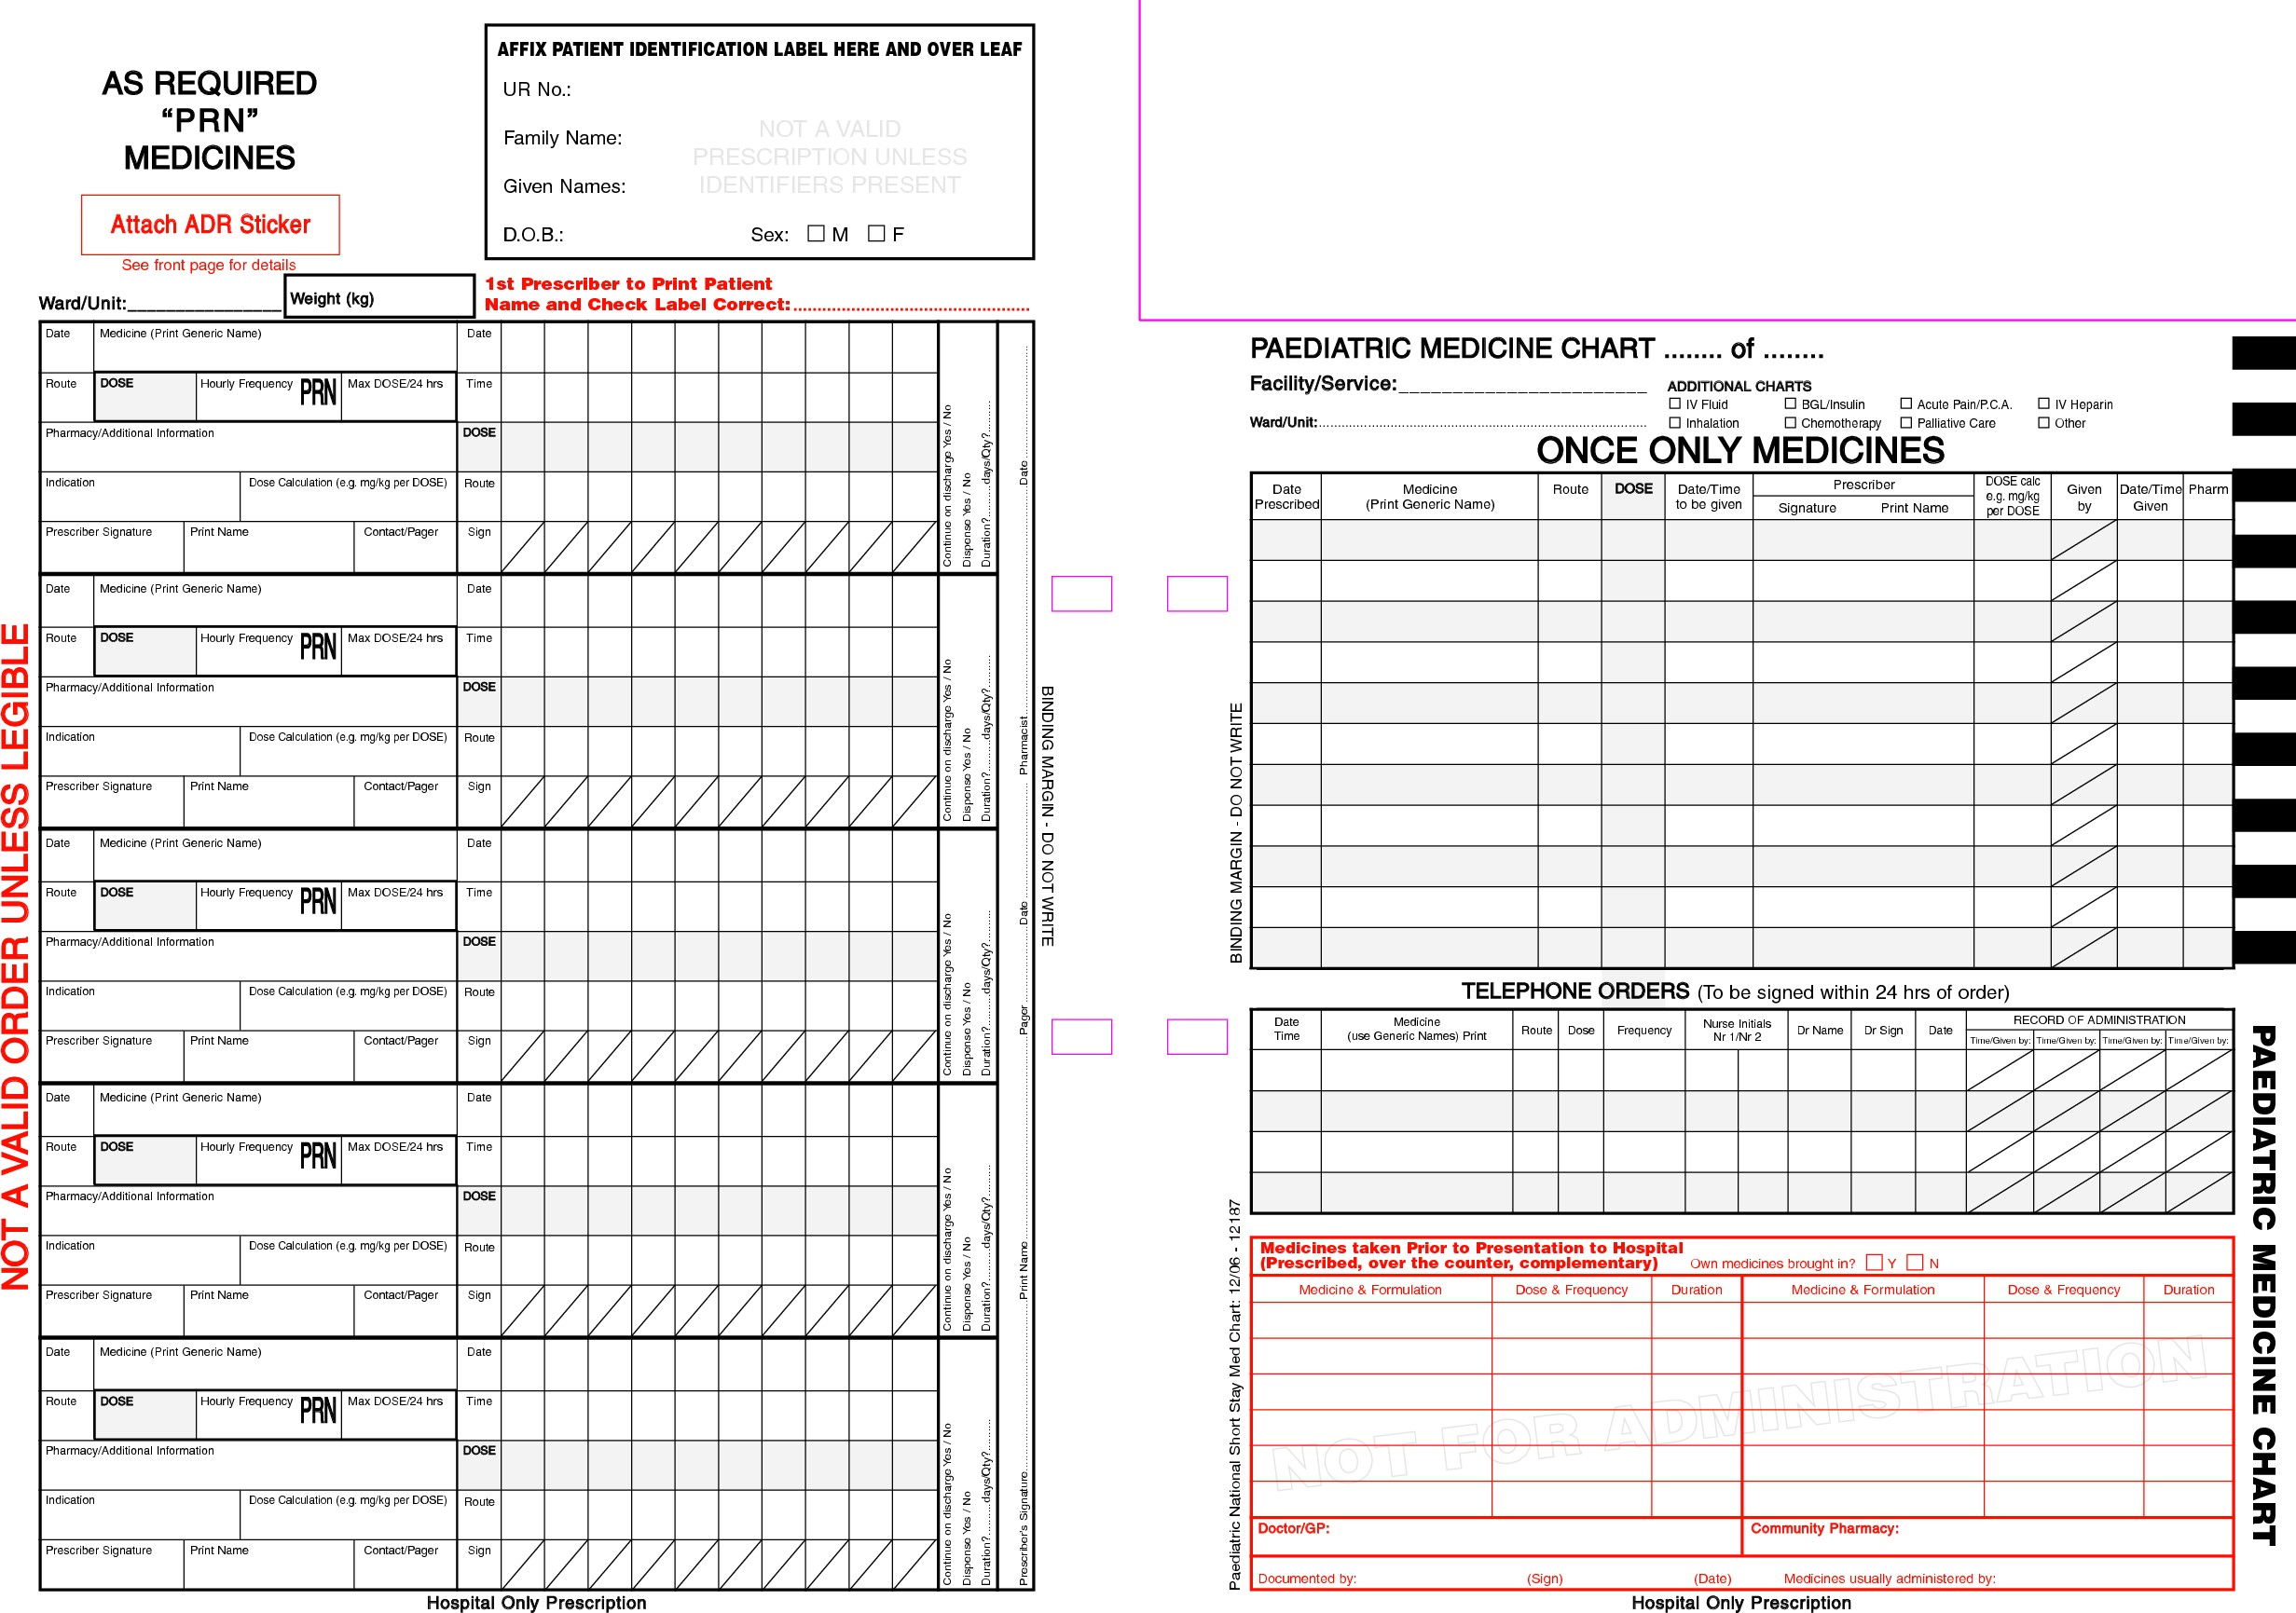
.
14-06-2021
© R R INSTITUTIONS , BANGALORE
19

Slide 20
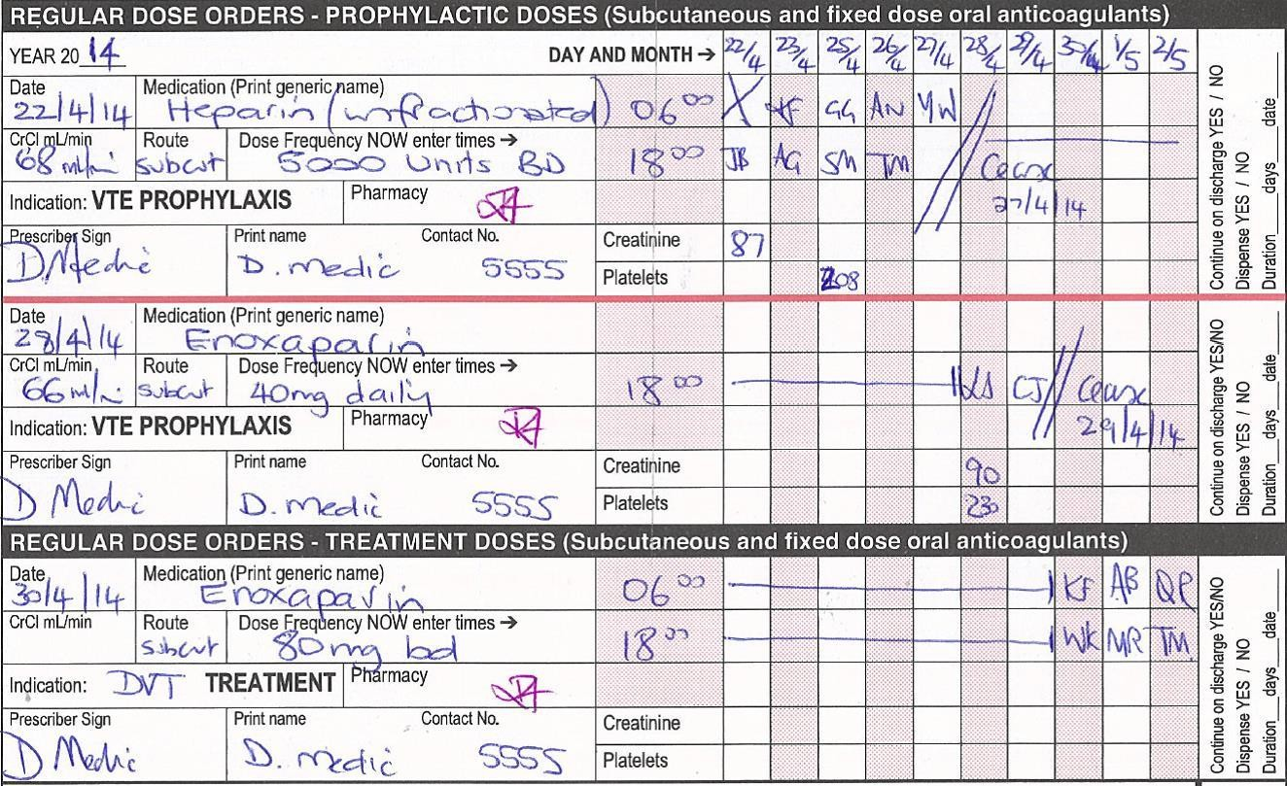
14-06-2021
© R R INSTITUTIONS , BANGALORE
20

Slide 21

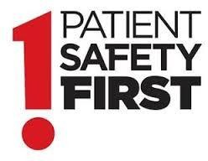
CLINICAL REVIEW
.
Clinical review is one of the integral components of medication review and should preferably be performed on a daily basis.
It is the review of the patients’ progress for the purpose of assessing the therapeutic outcome. The therapeutic goal for the specific disease should be clearly identified before the review.
© R R INSTITUTIONS , BANGALORE

Slide 22
GOALS:
The primary aims of the clinical review are to:
Assess the response to drug treatment.
Evaluate the safety of the treatment regimen.
Assess the progress of the disease and the need for any change in therapy.
Assess the need for monitoring, if any.
Assess the convenience of therapy(to improve compliance).
© R R INSTITUTIONS , BANGALORE

Slide 23
PROCEDURE:
Collection of patient specific data should be undertaken routinely.
The data collected should be clinically relevant, and documented
in the pharmacy patient profile.
Results of biochemical, haematological, microbiological,
radiological and other investigations should be reviewed.
Information elicited from the patient should also be considered.
© R R INSTITUTIONS , BANGALORE

Slide 24

Information obtained must be interpreted and evaluated with
reference to
Clinical features
Pathological condition
Indication for investigation
Patient medication history
Planned outcomes of therapy
© R R INSTITUTIONS , BANGALORE

Slide 25
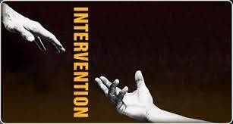
PHARMACIST INTERVENTION
Any action taken by the pharmacist that directly results in a change in management or therapy.
Intervention by pharmacist to assist prescribing can be Active --- Use of therapeutic guidelines
Passive --- Drug information service
Reactive
--- Seeking amendment of those that are unclear
inadequate or inappropriate
© R R INSTITUTIONS , BANGALORE

Slide 26

Interventions can also be classified in accordance with categories of drug related
problems.
  Documentation of each and every intervention is very important
That document should include the fallowing details Patient details
Date, ward and pharmacist Drugs involved
Description about the intervention
Details of response to intervention
© R R INSTITUTIONS , BANGALORE

Slide 27



Factors determining the success of intervention
Effective Communication skills
Appropriateness of the intervention
Way of approach
© R R INSTITUTIONS , BANGALORE

Slide 28

© R R INSTITUTIONS , BANGALORE

Slide 29
PHARMACEUTICAL CARE:
The responsible provision of drug therapy for the purpose of
achieving definite therapeutic outcomes that improve the patients quality of life.
Pharmaceutical care involves the process through which a pharmacist cooperates with a patient and other professional in designing , implementation, and monitoring a therapeutic plan that will produce specific therapeutic outcomes for the patient

Slide 30
OUTCOMES OF PHARMACEUTICAL CARE:
Cure of a disease
Elimination or reduction of patients symptomology
Arresting or slowing of a disease process
Preventing a disease or symptoms

Slide 31
MAJOR FUNCTIONS OF PHARMACEUTICAL CARE
Identifying potential and actual drug related problems
Resolving actual drug related problems
Preventing potential drug related problems

Slide 32
SKILLS REQUIRED FOR THE CLINICAL PHARMACIST FOR A BETTER PHARMACEUTICAL CARE
He must possess knowledge and skill in pharmaceutics and
clinical pharmacology
He must be able to mobilize the drug distribution system by which
drug use decisions are implemented
He must be able to develop relationship with the patients and other
health care professionals needed to provide pharmaceutical care
He must be available in the society /community for patient in time
He should have commitment to quality improvement and
assessment procedure

Slide 33
PROCESS OF PHARMACEUTICALCARE
Establish pharmacist‐patient relationship
Collect data
Interpret data
Identify drug related problems
Determine priority of drug related problems
Determine desired outcomes(clinical or therapeutic)
Develop therapeutic plan
Develop monitoring plan
Implement and follow up pharmaceutical care plan
© R R INSTITUTIONS , BANGALORE

Slide 34
COLLECTION OF PATIENTS DATA
The pharmacist must collect and generate subjective and objective information
regarding
The patients general health and activity status
Past medical history medication history
Social history
Diet, exercise
Education
History of present illness and
Economic status
Sources of information may not necessarily the patient medication records.
© R R INSTITUTIONS , BANGALORE

Slide 35
ELEMENTS OF PATIENT INFORMATION DATA
Demographics
Age, sex, race,
Height‐weight
Current problems
Signs and symptoms
Past medical history
Allergies and intolerance
Pregnancy and lactation status
Social habits
Economic conditions
Relevant lab data
© R R INSTITUTIONS , BANGALORE

Slide 36
IDENTIFICATION OF PROBLEMS
The data collected can be used to identify actual or potential drug‐related problems. Since the main focus of pharmaceutical care is patient.
Since the pharmacist attends the patient, it follows that the a pharmacist only can tackle , all drug related problems.
© R R INSTITUTIONS , BANGALORE

Slide 37
DRUG RELATED MORBIDITY:
DRM(drug related morbidity) is a phenomenon of therapeutic malfunction .
It is a failure of a therapeutic agents oragents together to produce intended therapeutic outcome.
The concept of DRM includes both treatment failure and production of a new
medical problem , like ADR or toxic
drug effect. If DRM is not recognized in time it may lead to drug related mortality which is ultimate disaster
© R R INSTITUTIONS , BANGALORE

Slide 38
SOME EXAMPLES OF DRUG RELATED PROBLEMS:
*New or additional drug required
*Wrong drug
*Too little of the right drug
*Too much of the right drug
*Adverse drug reaction
*Drug not taken appropriately
*Medication not indicated
© R R INSTITUTIONS , BANGALORE

Slide 39
ESTABLISHING OUTCOME GOALS:
Drug therapy can produce a range of positive clinical outcomes it may also result in negative outcomes resulting in disease morbidity and even in extreme case mortality. Clearly the
potential clinical outcomes are related to the disease being treated and the efficacy of the available drug treatments should be established.
© R R INSTITUTIONS , BANGALORE

Slide 40
EVALUATING TREATMENT ALTERNATIVES BY MONITORING AND
MODIFYING THERAPEUTIC PLAN
While evaluating treatment alternatives or therapeutic options the following factors have to be considered such as
Efficacy and safety
Availability
Cost of treatment and
Suitability of the treatment to the patient .
Efficacy and safety must be considered when evaluating the risk benefit ratio of a
particular treatment. The risk –benefit ratio will depend upon many factors.

Slide 41
FACTORS DETERMINING RISK BENEFIT RATIO
Seriousness of disease
Consequences of not treating the disease
The efficacy of the drug.
ADRs associated with the drug therapy
Efficacy of alternative drug or non‐drug therapy
Side effect profile of alternative drugs.
The pharmacists role especially clinical pharmacists role is increasingly becoming more evident in evaluating therapeutic options, modifying and monitoring therapeutic plan.

Slide 42
INDIVIDUALISATION OF DRUG REGIMEN:
PATIENT FACTORS
Diagnosis
Treatment goals
Physiological and pathological factors
Past medical history, past medicines received
Contraindication
Allergies and adverse effects
Patient compliance
Patients cooperation and convenience
Special consideration

Slide 43
DRUG FACTORS
Efficacy
Adverse effects
Prevalence and ability to minimize ADRs
Ability to monitor for efficacy and avoid ADR
Drug‐drug interactions
Pharmacokinetics and pharmacodynamics
Dosage form
Route and method of administration
Cost to the patient
Government or insurance company payments, presentation of bills in
their formats.

Slide 44
MONITORING OUTCOME:
The pharmacist regularly reviews subjective and objective monitoring parameters in order to determine if satisfactory progress is being made toward achieving desired outcomes as outlined in the drug therapy plan.
The pharmacist reviews ongoing progress in achieving desired outcomes with the patient and provides a report to the patient's other healthcare providers as appropriate

Slide 45
The pharmacist updates the patient's medical and/or pharmacy record with information concerning patient progress, noting the subjective and objective information which has been considered, his/her assessment of the patient's current progress, the patient's assessment of his/her current progress, and any modifications that are being made to the plan. Communications with other healthcare providers should also be noted.

Slide 46


