Slide 1

PHARMACOTHERAPEUTICS-III
EVIDENCE BASED MEDICINE

Slide 2
What is evidence-based medicine?
“Evidence-based medicine is the integration of best research evidence with clinical expertise and patient values”
- David Sackett
“Explicit, judicious, and conscientious use of current best evidence from medical care research to make decisions about the medical care of individuals”

Slide 3
EBM - What is it?
Clinical Expertise
Research
Evidence
Patient
Preferences

Slide 4
Evidence-based health-care practice
The integration of:
  individual clinical expertise
  best available external clinical evidence from systematic research

Slide 5
I - Individual clinical expertise
Skills
Judgement
  which individual health care workers acquire through
  clinical experience and clinical practice

Slide 6
II - Best available clinical evidence
Clinically relevant research derived from:
  basic medical sciences and
  patient-centred clinical research into the safety and efficacy of therapeutic interventions.
  Systematic Reviews

Slide 7
Why is EBM important?
New types of evidence are being generated which can create changes in the way patients are treated.
How much is actually being applied to patient care?
Although evidence is needed on a daily basis, usually
physicians don’t get it.
  lack of time
  out-of-date textbooks
  the disorganization of the up-to-date journals

Slide 8


Importance of EBM for practicing
clinicians?
TIME AVAILABLE TO READ:
Less than
1 Hour per Week
TIME NEEDED TO KEEP CURRENT ON GENERAL MEDICINE:
19 Articles per DAY
365 Days per Year
Source: Davidoff F, Haynes B, Sackett D, Smith R. BMJ. 1995;310:1085-1086.
Evidence Based Medicine
21

Slide 9
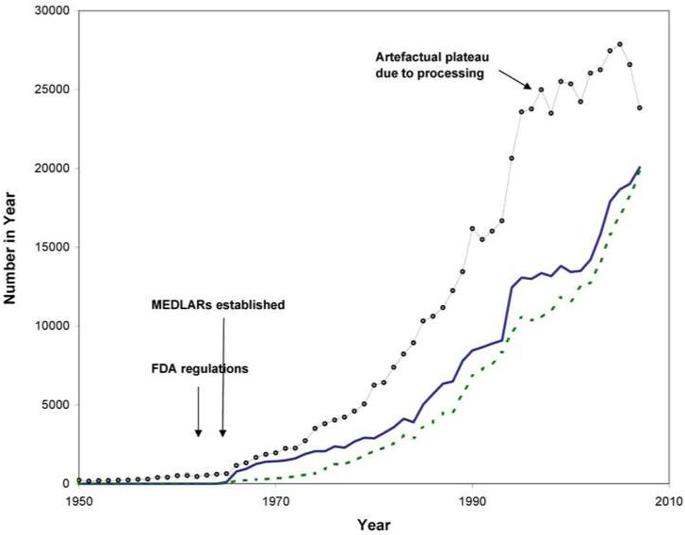

Evidence increasing so rapidly we need better skills to keep up- to-date more efficiently than previous generations of clinicians

Slide 10


Why do we need to use evidence efficiently?
5,000?
per day
2500000
Articles Per Year
r a
Ye
r
e p
s
e
l
c
ti
r A
l
a
c
i d
Me
2000000
1500000
2,000
per day
1000000
75 per
500000
day
0
Biomedical
MEDLINE
Trials
Diagnostic?

Slide 11
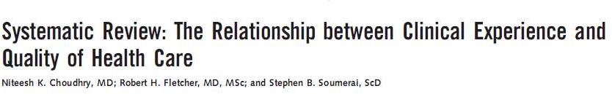
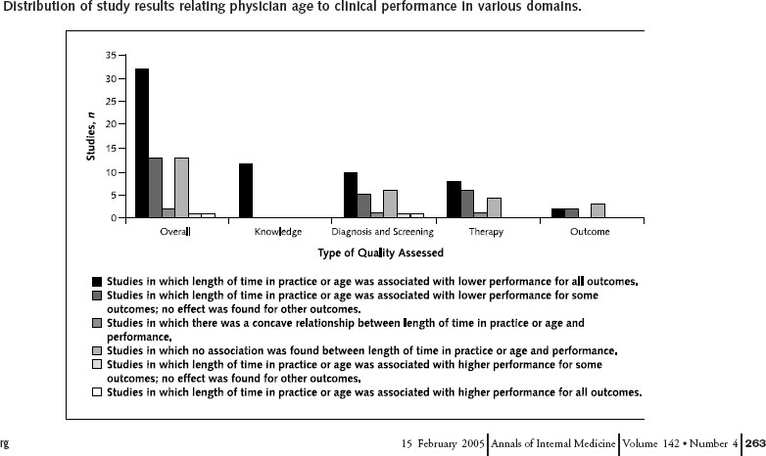
Gets worse with “duration in practice”

Slide 12
EVOLUTION OF EBM
Pre EBM: Passive diffusion (“publish it and they will come”)
Early EBM: Pull diffusion (“teach them to read it and they will come”)
Current EBM: Push diffusion (“read it for them and send it to them”)
Future EBM: Prompt diffusion (“read it for them, connect it to their individual patients”)

Slide 13
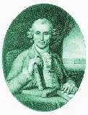
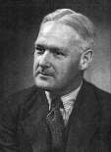
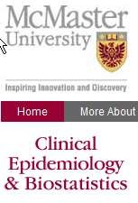
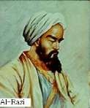
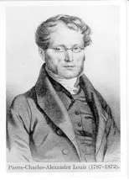
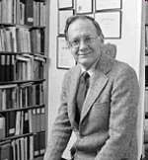

Some milestones in the history of EBM
James Lind
publishes review & clinical trial in Treatise on Scurvy
1780
Bradford-Hill
publishes Principles of
Medical Statistics &
MRC trial of streptomycin
1937/48
900 AD
1840
1967
1970’s
Al-Rhazi
For I once saved one group by it, while I intentionally neglected another group.
By doing that, I wished to reach a conclusion .
Alvan Feinstein
publishes his book
Clinical Judgement
Pierre Louis Develops his “numerical method” and changes blood letting practice in France

Slide 14
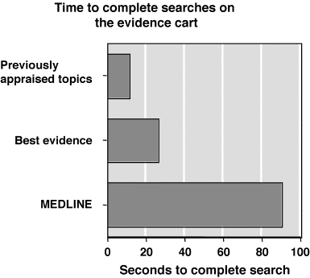
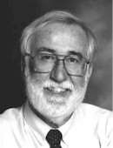
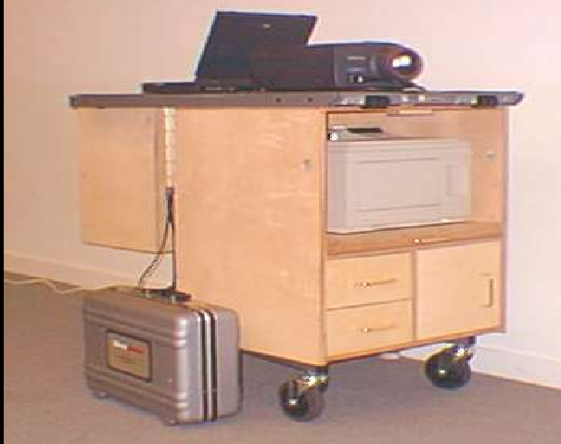
An EBM Approach to Education
Evidence cart on ward rounds - 1995
Looked up 2-3 questions per patient
Took 15-90 seconds to find
Change about 1/3 decision
David Sackett

Slide 15
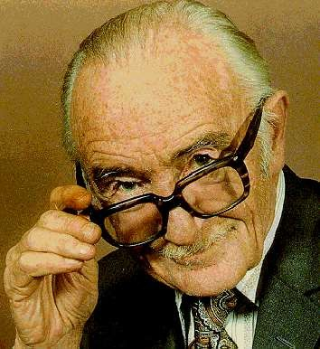
Prof Archibald Cochrane, CBE (1909 - 1988)
The Cochrane Collaboration is named in honor of Archie Cochrane, a British researcher.
In 1979 he wrote, "It is surely a great criticism of our profession that we have not organized a critical summary, by specialty or subspecialty, adapted periodically, of all relevant randomized controlled trials”

Slide 16
Why the sudden interest in EBM?
Increasing realization among clinicians that years of experience unaccompanied by updating of knowledge can result in decline of clinical performance.
The need for valid information about diagnosis, therapy, prognosis, and prevention in this era of consumer activism

Slide 17
The common man has access to the very same medical literature as the clinicians through numerous sources
Limited time available to the clinician for acquiring information is a major impediment for updating the knowledge from traditional sources

Slide 18
Assumptions of evidence-based practices
Not all evidence is equivalent
There is a hierarchy of study design
External evidence can inform but can never replace individual clinical expertise (Sackett et al., 1996)
Starting from the best external evidence and work from there.
Values always influence decisions

Slide 19
Decision making in clinical practice using evidence
Decision-making is the cognitive process resulting in the selection of a course of action among several alternative possibilities

Slide 20
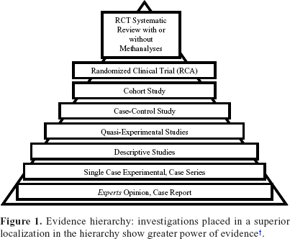
The Evidence Pyramid

Slide 21
Identifying the Best Study
Type of Question | Suggested best type of Study
Therapy | RCT>cohort > case control > case series
Diagnosis | Prospective, blind comparison to a gold standard
Etiology/Harm | RCT > cohort > case control > case series
Prognosis | Cohort study > case control > case series
Prevention | RCT>cohort study > case control > case series
Clinical Exam | Prospective, blind comparison to gold standard
Cost | Economic analysis

Slide 22
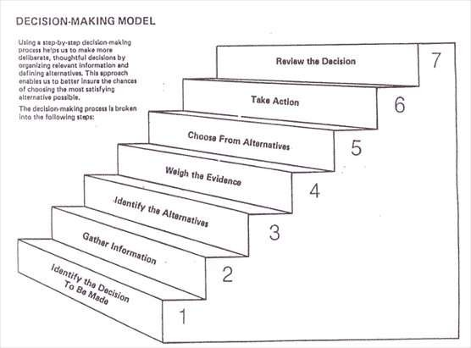

Slide 23


Slide 24

So in clinical practice
Treatment options
Disease

Slide 25

Medical
Laparoscopic
laparotomy
Ectopic pregnancy

Slide 26
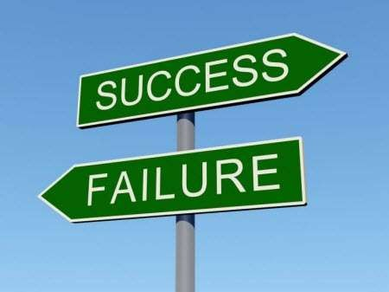
Outcome – the only thing that matters

Slide 27


What EBM additionally provides is
Opportunity for change Opportunity for better treatment

Slide 28


How evidence affects clinicians
Will the patient recover or not??
Will they sue me??
What about my reputation ??
Happy !!!
I am the best !!!

Slide 29
Think 100 times before refuting an old time tested method of treatment
Classic example is vaginal hysterectomy for benign diseases
“Give me 2 retractors, 2 scissors , 2 clamps, one tissue holding forceps and one needle holder, I will do a vaginal hysterectomy in any setup”
Surgeon

Slide 30
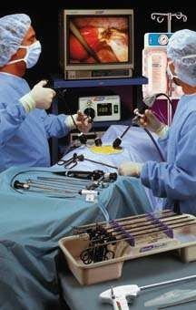
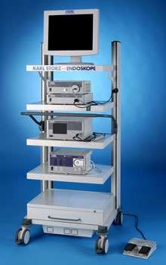
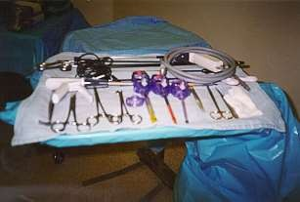
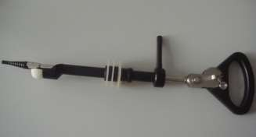
Laparoscopic hysterectomy setup

Slide 31
New developments ( unnecessary) in minimally invasive surgery
Studies sponsored by pharma companies
Use of meshes in different clinical conditions
Mesh Erosion in bladder or bowel, infection or rejection of mesh, vaginal pain or painful intercourse, groin infection/abscess, extrusion , obstruction , voiding dysfunction and erosion.

Slide 32
The Five-Step Approach to Practicing EBM
Step 1- Framing a Proper, Pertinent, Focused and Answerable Question
Step 2 - Searching the Literature
Step 3 - Critical Appraisal of the Literature
Step 4 –Integrating the Evidence with Clinical Expertise and Patient Values
Step 5- – Evaluating the process
50

Slide 33
EBM Method
Assess
your patient
Ask clinical questions
Acquire the best evidence
Appraise
the evidence
Apply
evidence to patient care
23 January 2015
Evidence Based Medicine
51

Slide 34
Answerable questions
EFFECTIVENESS
A description of the populations
P
An identified
intervention
I
An explicit comparison
C
Relevant outcomes
O

Slide 35
Ask Clinical Questions
Components of Clinical Questions
Patient/ Population
Intervention/ Exposure
Comparison
Outcome
In patients with acute MI
In women with suspected oronary disease
In post- menopausal women
compared to
placebo
compared to exercise ECG
compared to no
HRT
does early treat-
decrease cardio-
ment with a statin
vascular mortality?
what is the accuracy of exercise ECHO
for diagnosing significant CAD?
increase the
risk of
breast cancer?
c
does hormone replacement therapy

Slide 36
Step-1
Clinical Scenario :
12 years old only male child
admitted to ICU
history of accidental ingestion of OP compound 4 hours back
On admission the patient was comatose but hemodynamically stable

Slide 37
The anaesthesiologist used his past experience, knowledge, skill & expertise and treated the patient with an infusion of atropine
Inspite of that patient developed respiratory paralysis in the next 2 hours
The clinician used his expertise puts him on mechanical ventilation

Slide 38
Now, the consultant understands the gap in his knowledge & he identifies the same.
The consultant wanted to administer Inj Pralidoxime.
But he was not sure of the dosage and the mode of administration (a single bolus dose or an infusion).

Slide 39
‘P’ — Patient Problem: How would I describe a group
of patients similar to mine?
In this clinical situation it is a male pediatric patient (12 years) who has developed organophosphorous poisoning following its ingestion.
‘ I ’ — Intervention strategy: Which main intervention,
prognostic factor or exposure am I considering?
Here the intervention is the therapy with Pralidoxime in optimum dosage.

Slide 40
‘C’ — Comparison: What is the main alternative to compare with the intervention?
In his patient the clinical dilemma pertains to the dosage and mode of administration of Pralidoxime (low dose infusion vs. single large bolus dose)
‘O’ — (Outcome): - What can I hope to accomplish?
Recovery from OP poisoning and decrease in morbidity & mortality

Slide 41
Step-2 Literature Search
‘Traditional’ print resources like textbooks or journals
‘Browse’ online electronic databases

Slide 42
Step 3 - Critical Appraisal of the Literature
Screening for internal validity and relevance
Determining the intent of the article
Evaluating the validity based on its intent

Slide 43
The article that was tracked down is Prospective randomized placebo controlled clinical trial of Pralidoxime in two similar groups of patients. (Control group-low dose and study group-high dose)
Block randomization was used
The investigators were not blinded

Slide 44
The intent of the article is to evaluate two treatment regimes of PAM in the management of OP poisoning
The next thing to determine is the strength of the outcome. How large was the treatment effect?
Low dose group fared better than high dose group

Slide 45
PAM is a very expensive imported drug requiring considerable amount off foreign exchange and there are difficulties in procuring it.
It is imperative for the clinician to find a cost- effective
and yet effective treatment.
Patient’s father, being a primary school teacher, cannot afford the exuberant cost of the drug.
The out come of this research study is very much relevant and beneficial in solving the clinical dilemma

Slide 46
Step 4 –Integrating the Evidence with Clinical Expertise and Patient Values
The best documented critically appraised research evidence is already with the clinician
Take into consideration the patient values for example:
The patient is a precious, lone male child of the parents.
The economical/financial status of the parents does not permit expensive therapies
No contraindications for the drug to be administrated
Low dose regime requiring 1/16 of the high dose has better effect

Slide 47
Step 5 – Evaluating the Process
Was he able to formulate a focused question?
Was he able to devise a precise search strategy for locating the evidence?
Did he use the most appropriate resource?
Were more pertinent resources like practice guidelines available to him?
Did the ‘evidence’ work in his patient?
The clinician should document the outcomes of the application of the evidence and based on his experiences
Those of his colleagues should be able develop management protocols

Slide 48
What are the benefits of adopting EBM?
Minimize the errors in patient care
Reduces the cost of treatment to the patient
Optimizes the quality of patient care
Skills learnt in practicing EBM are the very same ones needed for being a lifelong, self-directed learner
Habit of accessing literature on a daily basis is the best guarantor of ensuring advancement of knowledge and keeping abreast of scientific progress

Slide 49
EBM Misconceptions
FALLACY
FACT
EBM is useless when there is no good evidence
EBM means appropriately using the best available evidence to care for patients
Clinical judgment must be used in deciding how to apply the evidence
EBM is algorithms that ignore clinical judgment/expertise
EBM is just numbers
and statistics
EBM is not numbers in a vacuum – the evidence must be individualized to each patient
67

Slide 50
Who benefits?
Practitioners
current knowledge to assist with
decision making
Researchers
reduced duplication identify research gaps
Community
recipients of evidence-based interventions
Funders
identify research gaps/priorities
Policy maker
current knowledge to assist with policy formulation

Slide 51
Evidence-based Public Health
“The development, implementation, and evaluation of effective programs and policies in public health through application of principles of scientific reasoning, including systematic uses of data and information systems, and appropriate use of behavioral science theory and program planning models”
Source: Brownson, R.C. et al, Evidence-based public health, Oxford University Press, 2003.

Slide 52
Clinical vs. Public health interventions
Public health
Populations and communities
Combinations of strategies
Processes as well as outcomes
Involve community members in design and evaluation
Qualitative and quantitative
Health promotion theories
and beliefs
Clinical
Individuals
Single interventions
Outcomes only (generally)
Often limited consumer input
Quantitative approaches to research and evaluation

Slide 53
Challenges - The research-practice gap
Research Evidence
Practice
Diffusion
/Adoption Information overload
Application to other populations
Lack of consideration of local community groups, agencies and governments role and needs Cultural factors
Economic factors Social factors

Slide 54
Challenges: The research-policy gap
Research Evidence
Policy making
Service level
National policy level

Slide 55
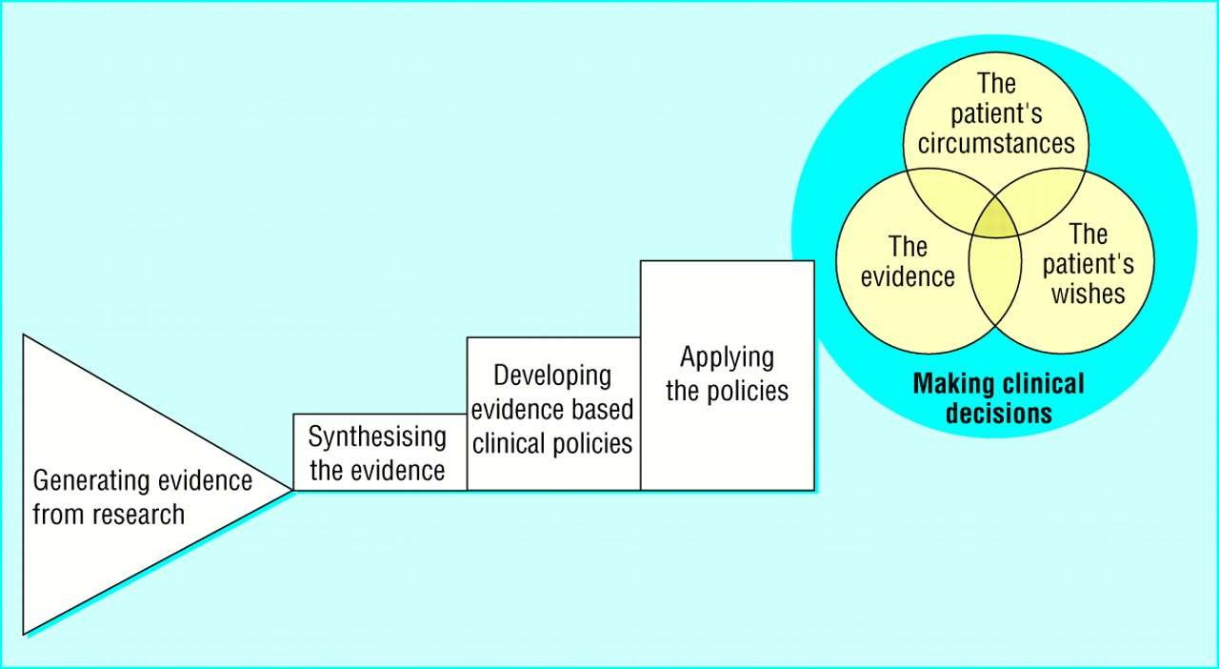

Slide 56
Develop statement of the issue
Disseminate widely
Or Discontinue Program/Policy
Tools: meta-
analysis, risk assessment, expert panel
Determine what is known through scientific literature
Evaluate the program or Policy
Tools: rates,
risks, Surveillance data
Quantify the issue
Implement
Re- tool
Develop Program or policy options
Develop an action plan

Slide 57
Conclusion
Medicine is not an exact science, but a science of probability
The challenge to physicians is to provide up to-date medical care
The ultimate goal for clinicians should be to help patients live long, functional, satisfying, and pain and symptom free life
By adopting the principles of Evidence Based Medicine, it will be possible to maximize the benefits of scientific research for patient care

Slide 58
Medical educators and medical colleges have the singular responsibility of indoctrinating the principles of EBM as a concept, a philosophy,a religion necessary for being efficient, compassionate, caring, and responsible clinician among the future physicians during their formative years of training.

Slide 59
References
Evidence-based Medicine Workbook-Finding and applying the better research , Paul Glasziou, Chris Del Mar and Janet Salisbury
Sackett, D. L., Straus, S. E., Richardson, W. S., Rosenberg,W., Haynes, R. B.: Evidence- Based Medicine – How to Practice and Teach EBM 2nd Ed., Churchill. Livingstone, 2000.
Sackett DL, Rosenberg WMC, Gray JA, Haynes RB Richardson WS. Evidence based medicine: What it is and what it isn’t Br. Med J 1996;312:71-72.
Evidence Based Medicine And Its Impact On Medical Education Dr. H. B. Rajashekhar1 Dr. B. S. Kodkany2 Dr. Vijaya A. Naik3 Dr. P. F. Kotur4 Dr. Shivaprasad S. Goudar5:Indian J. Anaesth. 2002; 46 (2) : 96-103
Guyatt GH, Evidence–based Medicine. Ann Intern Med. 1991;114(ACPJ Club. Suppl 2): A-16

Slide 60


