Slide 1
PHARMACOTHERAPEUTICS-III
MANAGEMENT OF EPILEPSY

Slide 2
TREATMENT:
Early control of epileptic seizures is important because it allows normalization of patients lives and prevents acute physical harm and long-term morbidity associated with recurrent seizures. In addition, early control of tonic-clonic seizures is associated with a reduced likelihood of seizure recurrence. Early control of epileptic seizures also correlates with successful discontinuation of AED treatment after long-term seizure control

Slide 3
NON PHARMACOLOGIC TREATMENT OF EPILEPSY
Alternatives or adjuncts to pharmacotherapy may be helpful in some patients. Surgery is an extremely useful form of treatment in selected patients. Depending on the epilepsy syndrome and procedure performed, up to 90% of patients treated surgically may improve or become seizure free.
Dietary modification may be used for patients who cannot tolerate AED or to treat seizures that are not completely responsive to AED. In most circumstances, dietary modification consists of a ketogenic diet. This low-carbohydrate, high-fat diet results in persistent ketosis, which is believed to play a major role in the therapeutic effect.

Slide 4
The vagus nerve stimulator (VNS) is approved for treatment of intractable partial seizures. This device uses electrodes attached around the left branch of the vagus nerve.
The electrodes are attached to a programmable stimulator that delivers stimuli on a regular cycling basis; patients can also use “on demand” stimulation at the onset of seizures by placing a magnet next to the subcutaneously implanted stimulator.
Approximately 30% to 40% of patients who are so treated have a positive response (50% reduction in seizures). The primary side effect of this device is hoarseness during stimulation; infrequently, this is accompanied by left vocal cord paralysis.

Slide 5
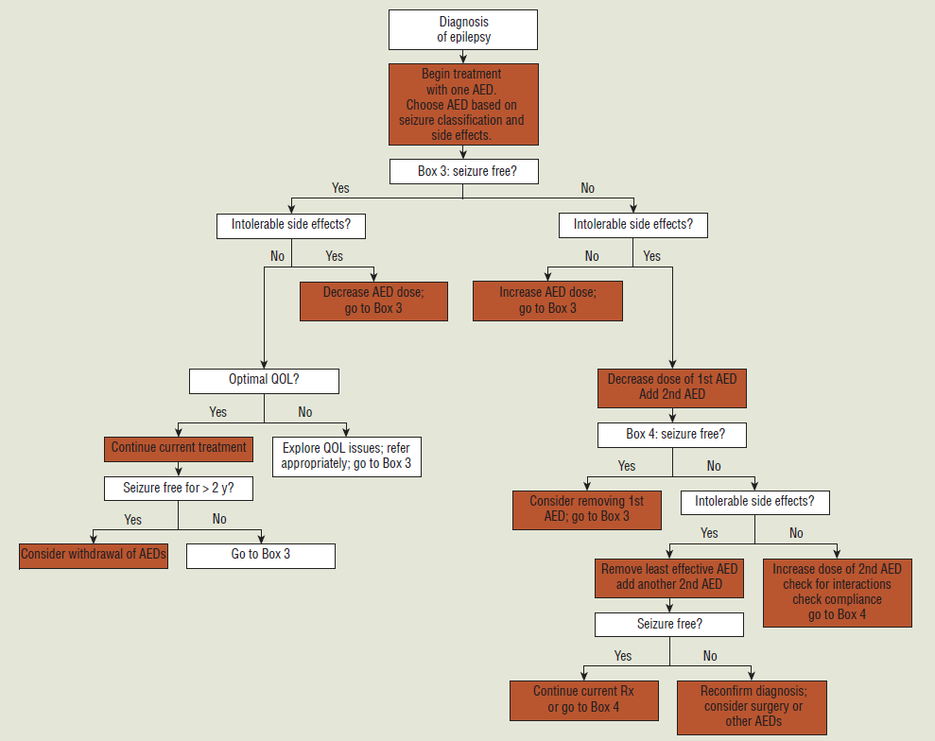
TREATMENT ALGORITHM FOR EPILEPSY

Slide 6
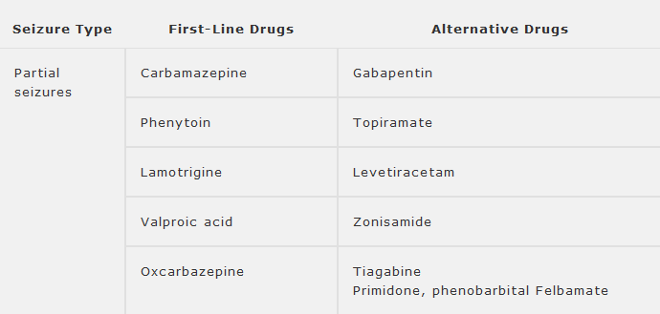

Slide 7
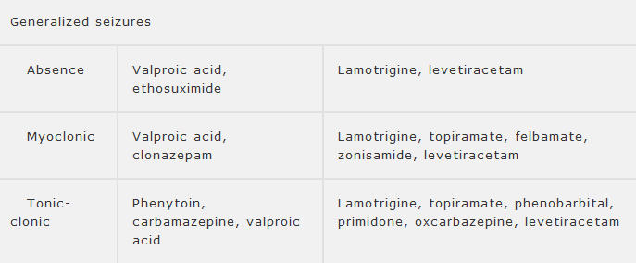

Slide 8
ANTIEPILEPTIC DRUG THERAPY
Pharmacotherapy is the mainstay of treatment for epilepsy. Therefore, patient education regarding medications and consultation among health care professionals regarding the optimal use of AED are essential to quality patient care.
Optimal AED therapy completely controls seizures in 60% to 95% of patients. Optimization of drug therapy depends on several factors; with the choice of appropriate AED, individualization of dosing, and adherence being the most important.

Slide 9
CARBAMAZEPINE
Mechanism of Action
The exact mechanism by which carbamazepine suppresses seizure spread is through inhibition of voltage gated sodium channels. In addition, interaction with voltage-gated calcium and potassium channels can also contribute to its activity.
Adverse Effects
Neurosensory side effects (e.g., diplopia, blurred vision, nystagmus, ataxia, unsteadiness, dizziness, and headache). Leukopenia is the most common hematologic side effect.

Slide 10
Drug Interactions
Carbamazepine may interact with other drugs by inducing their metabolism.
Dosage :
Initial dose : 400mg/day
Maximum daily dose : 400-2400mg

Slide 11
ETHOSUXIMIDE
Ethosuximide's proposed mechanisms of action include inhibition of NADPH-linked aldehyde reductase, inhibition of sodium-potassium ATPase, a decrease in non-inactivating Na⁺currents, blocking of Ca²⁺-dependent K⁺channels, and inhibition of T-type Ca²⁺ channel currents.
It is a first-line treatment for absence seizures;
There is some evidence for nonlinear metabolism at higher doses. Metabolites are believed to be inactive.

Slide 12
A loading dose is not required. Titration over 1 to 2 weeks to maintenance doses of 20 mg/kg/day (divided into two doses) usually results in serum concentrations of 50 mcg/mL.
Initial dose is 500mg/day and maximum daily dose is 500-2000mg

Slide 13
FELBAMATE
Felbamate appears to act as a glycine receptor antagonist.
It is approved for treating atonic seizures in patients with Lennox-Gastaut syndrome, and is effective for partial seizures as well.
Because of the reports of aplastic anemia (1 in 3000 patients) and hepatitis (1 in 10,000 patients), it is now recommended only for patients refractory to other AEDs. Risk factors for aplastic anemia may be a history of cytopenia, AED allergy or toxicity, viral infection, and/or immunologic problems.
It is recommended that the dose of phenytoin, carbamazepine, and valproic acid be decreased by about 30% when felbamate is added. Interactions with warfarin have also been reported.
If felbamate is used as monotherapy, the dose is initiated at 1200 mg/day (15 mg/kg in children) and then is increased by 600 mg every 2 weeks up to a maximum dose of 3600 mg/day (45 mg/kg in children).

Slide 14
GABAPENTIN
Gabapentin may modulate specific voltage-sensitive Ca²⁺ channels and elevates human brain GABA levels. It is a second-line agent for patients with partial seizures who have failed initial treatment. It may also have a role in patients with less severe seizure disorders, such as new-onset partial epilepsy, especially in elderly patients.
Bioavailability decreases with increasing doses. It is eliminated exclusively renally, and dosage adjustment is necessary in patients with impaired renal function.
Common side effects are fatigue, sleepiness, dizziness, and ataxia.
Dosing is initiated at 300 mg at bedtime and increased to 300 mg twice daily on the second day and 300 mg three times daily on the third day.

Slide 15
LAMOTRIGINE
Lamotrigine blocks neuronal sodium channels, produces dose-dependent inhibition of high-voltage activation Ca²⁺ currents, and blocks release of excitatory amino acid neurotransmitters.
It is useful as both adjunctive therapy and monotherapy in adults with partial epilepsy. It may also be useful in patients with primary generalized seizure types such as absence.
Initial dose is 25-50mg/day and maximum daily dose is 300-500mg.
The most frequent side effects are diplopia, drowsiness, ataxia, and headache. Rashes are usually mild to moderate, but Stevens-Johnson reaction has also occurred. The incidence of rash appears to be increased in patients who are also receiving valproic acid and who have rapid dosage titration.

Slide 16
PHENOBARBITAL AND PRIMIDONE
Phenobarbital decrease postsynaptic excitation, possibly through GABA mechanisms.
Phenobarbital is the drug of choice for neonatal seizures, but in other situations it is reserved for patients who have failed other AEDs.
Phenobarbital is a potent enzyme inducer.
The amount of phenobarbital excreted renally can be increased by giving diuretics and urinary alkalinizers.
The most common side effects are fatigue, drowsiness, and depression. Phenobarbital impairs cognitive performance.
Ethanol increases phenobarbital metabolism, but valproic acid, cimetidine, phenytoin, felbamate, and chloramphenicol inhibit its metabolism.
Phenobarbital can usually be dosed once daily, initial dose is 1-3mg/kg and bedtime dosing may minimize daytime sedation.

Slide 17
PHENYTOIN
Phenytoin alters ion fluxes, thus altering depolarization, repolarisation, and membrane stability.
Phenytoin is a first-line AED for generalized seizures (except absence) and for partial seizures.
Absorption is affected by particle size, and the brand should not be changed without careful monitoring. Food may slow absorption. Fosphenytoin can safely be administered intravenously and intramuscularly.
Phenytoin is metabolized in the liver mainly by CYP2C9 enzyme.
In nonacute situations, phenytoin may be initiated in adults at oral doses of 5 mg/kg/day and titrated upward. Subsequent dosage adjustments should be done cautiously because of nonlinearity in elimination. Most adult patients can be maintained on a single daily dose, but children often require more frequent administration.

Slide 18
Common but usually transient side effects are lethargy, incoordination, blurred vision, higher cortical dysfunction, and drowsiness. At concentrations greater than 50 mcg/mL, phenytoin can exacerbate seizures. Chronic side effects include gingival hyperplasia, impaired cognition, hirsutism, vitamin D deficiency, osteomalacia, folic acid deficiency, carbohydrate intolerance, hypothyroidism, and peripheral neuropathy.
Phenytoin is prone to many drug interactions . If protein-binding interactions are suspected, free rather than total phenytoin concentrations are a better therapeutic guide.
Phenytoin decreases folic acid absorption, but folic acid replacement enhances phenytoin clearance and can result in loss of efficacy. Phenytoin tablets and suspension contain phenytoin acid, while the capsules and parenteral solution are phenytoin sodium, which is 92% phenytoin.

Slide 19
TIAGABINE
Tiagabine is a specific inhibitor of GABA reuptake into glial cells and other neurons.
It is considered second-line therapy for patients with partial seizures who have failed initial therapy.
The most frequently reported side effect is dizziness. Other side effects are asthenia, nervousness, tremor, and diarrhea. These side effects are usually transient.
It is oxidized by CYP3A4 enzymes, and enzyme inducers increase its clearance.
The minimal effective adult dose level is considered to be 30 mg/day. The initial dose is 4 mg/day, and this may be increased up to 56 mg/day in intervals of 4 to 8 mg/day added each week. The dosage typically employed is 32 to 56 mg daily.

Slide 20
TOPIRAMATE
Topiramate affects voltage-dependent sodium channels, GABA receptors, and antagonism of 4-amino-3-hydroxy-5-methyl-4-isoxazole-4-propionic acid (AMPA) subtype glutamate receptors.
It is a second-line AED for patients with partial seizures who have failed initial therapy.
Approximately 50% of the dose is excreted renally, and tubular reabsorption may be prominently involved.

Slide 21
Starting doses are 12.5 to 50 mg/day, increasing by 12.5 to 50 mg/day every week or two. The minimally effective dose is approximately 200 mg/day.
The most common side effects are ataxia, impaired concentration, confusion, dizziness, fatigue, paresthesias, and somnolence. Nephrolithiasis occurs in 1.5% of patients. It has also been associated with acute narrow-angle glaucoma, oligohydrosis, and metabolic acidosis.
Enzyme inducers may decrease topiramate serum levels.

Slide 22
VALPROIC ACID
Valproic acid may increase synthesis or inhibit degradation of GABA. It may also potentiate postsynaptic GABA responses, have a direct membrane-stabilizing effect, and affect potassium channels.
The free fraction may increase as the total concentration increases, and free concentrations may be a better monitoring parameter than total concentrations, especially at higher concentrations or in patients with hypoalbuminemia. Protein binding is decreased in patients with head trauma.
It is first-line therapy for primary generalized seizures, such as absence, myoclonic, and atonic seizures, and is approved for adjunctive and monotherapy treatment of partial seizures. It can also be useful in mixed seizure disorders.

Slide 23
Side effects are usually mild and include gastrointestinal (GI) complaints, weight gain, drowsiness, ataxia, and tremor. GI complaints may be minimized with the enteric-coated formulation or by giving with food. Thrombocytopenia is common but is responsive to a decrease in dose. Other hematologic toxicities include leukopenia with transient neutropenia, transient erythroblastopenia, and bone marrow changes.
Polycystic ovary syndrome and menstrual irregularities have also been reported with valproic acid therapy.
Although carnitine administration may partially ameliorate hyperammonemia, it is expensive, and there are only limited data to support routine supplemental use in patients taking valproic acid.

Slide 24
Valproic acid is an enzyme inhibitor that increases serum concentrations of concurrently administered phenobarbital and may increase concentrations of carbamazepine 10,11-epoxide without affecting concentrations of the parent drug. It also inhibits the metabolism of lamotrigine.
Initial dose is 15mg/kg(500-1000mg) and maximum daily dose is 60mg/kg (3000-5000mg)

Slide 25
ZONISAMIDE
Zonisamide is a broad-spectrum sulfonamide AED that blocks voltage-sensitive sodium channels by reducing voltage-dependent T-type Ca²⁺ channels; it also facilitates dopaminergic and serotonergic neurotransmission, weakly inhibits carbonic anhydrase, and blocks K⁺ evoked glutamate release.
It is approved as adjunctive therapy with partial seizures, but it is potentially effective in a variety of partial and primary generalized seizure types.
Zonisamide is 40% protein bound and has a half-life of 63 to 69 hours. It is metabolized by CYP3A4, and about 30% is excreted unchanged.

Slide 26
The most common side effects include somnolence, dizziness, anorexia, headache, nausea, and irritability. Symptomatic kidney stones may occur in 2.6% of patients. Hypersensitivity reactions may occur in 0.02% of patients, and history of allergy to sulfonamides is a contraindication. Monitoring of renal function may be advisable in some patients.
Enzyme inducers may reduce the half-life of zonisamide to 27 to 36 hours.
The initial dose in adults is 100 mg/day, and daily doses are increased by 100 mg every 2 weeks until a response is seen. The dosage range in adults 100 to 600 mg/day.

Slide 27
STATUS EPILEPTICUS
A condition when consciousness does not return between seizures for more than 30 min. This state may be life-threatening with the development of pyrexia, deepening coma and circullatory collapse. Death occurs in 5-10%.
Status epilepticus may occur with frontal lobe lesions (incl. strokes), following head injury, on reducing drug therapy, with alcohol withdrawal, drug intoxication, metabolic disturbances or pregnancy.
Treatment: AEDs intravenously, general anesthesia with propofol or thipentone should be commenced immediately.

Slide 28
REFERENCES :
Joseph.T.Dipiro,Robert.L.Talbert ,Gary.C.Yee , L.Michael Posey Pharmacotherapy A Physiological Approach , 7th ed, 2008 ;pg:935-952.
Koda-kimble Mary Anne, Applied therapeutics The clinical use of drugs,9th ed,2009;pg:54p2-54p19.

