Slide 1
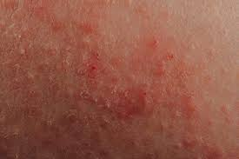
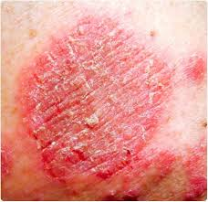
Eczema
Dermatology
By Animesh Das

Slide 2
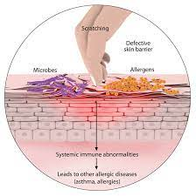
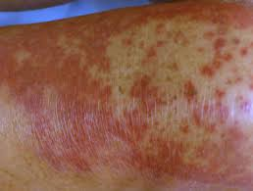
Definition
It is an inflammation of skin caused by a combination of immune system activation genetics , environmental triggers and stress . Atopic dermatitis usually develops in early childhood and is more common in people .
Causative organism -- Staphylococcus aureus

Slide 3
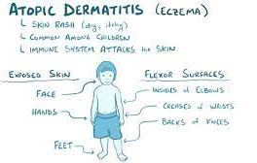
Etiology
anxiety
Temperature changes
decreased humidity
contact with irritants
allergens
Microbial agent

Slide 4
Type / Classifications
There are 4 types --
contact Dermatitis
Atopic dermatitis
Seborrheic dermatitis
Napkin dermatitis

Slide 5
Irritants
water
skin cleansers
plants
Animal products
Acids and alkalis
industrial clearance agent
oils and organic solvents

Slide 6
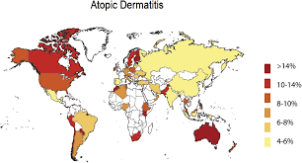
Epidemiology
About 20 percent of children and up to 3 percent of the adult population have some form of eczema .
People of all skin colors, races and ethnicities can be affected by eczema .
Eczema zone – China ,USA , UK etc.

Slide 7
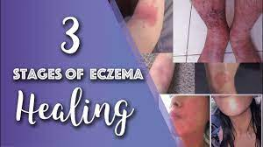
Stages
There are the three stages --
Acute
Sub acute
Chronic

Slide 8
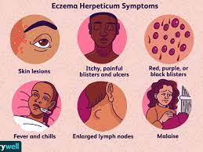
Sings and symptoms
Dry skin.
Itchy skin.
Red rashes.
Bumps on the skin.
Scaly, leathery patches of skin.
Crusting skin.
Swelling

Slide 9
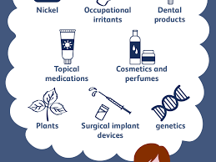
Risk factor
Living in a developed country, a city, or a cold climate.
Being born to a mother who is older
Being born into a higher social class or to parents with higher education.
Being born by Cesarean section.
Being exposed to secondhand smoke

Slide 10
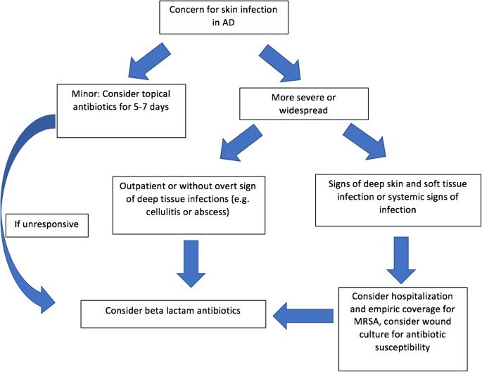
Pathophysiology

Slide 11
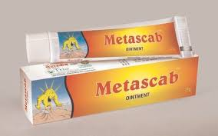

Management
Diagnosis
Treatment

Slide 12
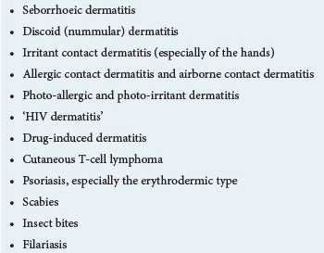
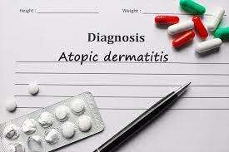
Diagnosis

Slide 13
Treatment
Category | Drug Name
Anti fungal agent | Clotrimazole
Antibiotics | flucloxacillin
Oral retinoid | Retinoids
Immune modulators | Pimecrolimus
Corticosteroid | hydrocortisone
Immunosuppressant | ciclosporin
Itch relief | OTC hydrocortisone

Slide 14
Investigations
Patch testing
phototactic testing
prick testing

Slide 15
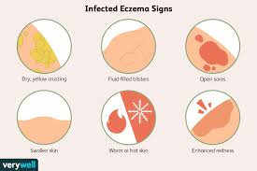
Complications
Asthma and hay fever. Eczema sometimes precedes these conditions.
Chronic itchy, scaly skin.
Skin infections.
Irritant hand dermatitis.
Allergic contact dermatitis.
Sleep problems

Slide 16
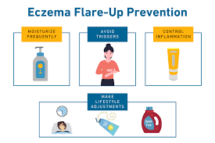
Prevention
Moisturize your skin often.
Avoid sudden changes in temperature or humidity.
Try not to sweat or get too hot.
Manage stress, and take time for yourself to relax.
Avoid scratchy materials such as wool.
Don't use harsh soaps, detergents, or solvents

Slide 17
Thank
you

