Slide 1
PHARMACOGNOSY & PHYTOPHARMACEUTICALS
Macro, powder and microscopic study of Ephedra
.
17-09-2024
1

Slide 2
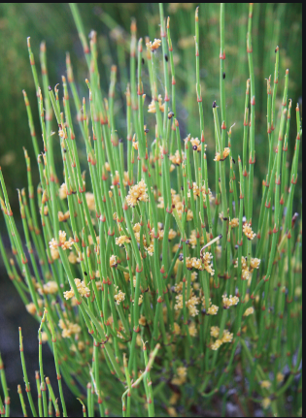
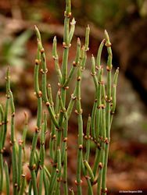
EPHEDRA
Synonyms :-Ma Huang.
Biological Source :-Ephedra consists of the dried aerial parts of Ephedra gerardiana Wall, Ephedra sinica Stapf, Ephedra equisetina Bunge, Ephedra nebrodensis Tineo and other Ephedra species,
Geographical Source :- It is mainly found in China, India, Nepal, Turkey, Pakistan and Bhutan.
17-09-2024
2

Slide 3
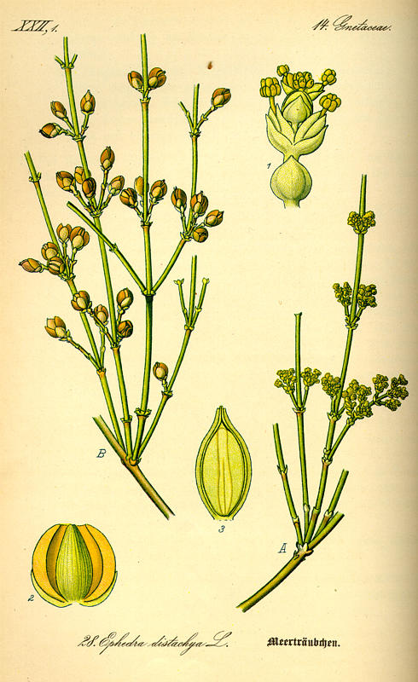
MACROSCOPICAL CHARATERISTICS
This shrub can grow up to 60 cm high.
• It is an evergreen shrub like plant and it has 50 species.
• The body of this plant is saprophytic and represent xerophytic character.
• Mostly they are woody shrubs ,few are lianas and some are small tree.
• This plant is differentiated into 3 parts : root, stem and leaves.
• They spread by the use of rhizomes.
• Their stems are green and photosynthetic.
• Leaves are opposite in arrangement and whorled.
• The shape of leaves are scale like and they are fuse into a sheath at the base which sheds soon after development.
17-09-2024
3

Slide 4
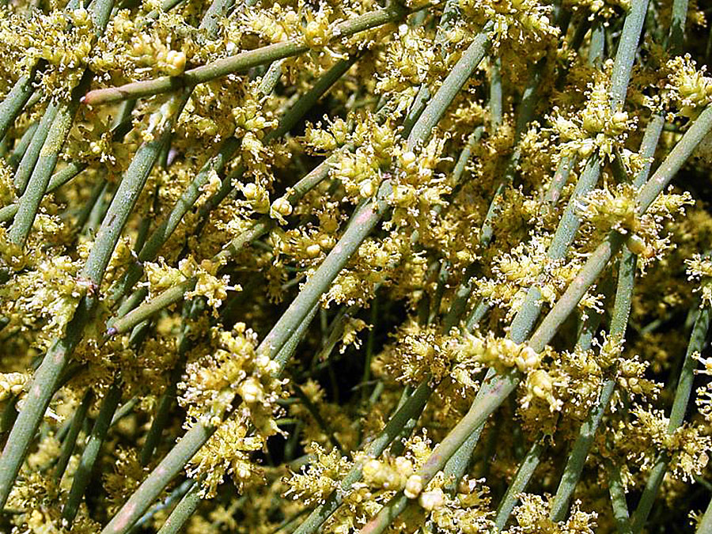
• They have no resin canals.
• Plants are dioecious having the pollen strobili in whorls of 1-10,in which each have a series of decussate bracts.
• The pollens of this plant are furrowed.
• They also have female strobili in whorls with bracts which fuse around a single ovule.
• The colour of the seeds are yellow to dark brown which are generally 1-2 per strobilus.
• The branches of this plant are slender, more or less broken aerial stems which are woody in nature and branched only at the base.
• Stems contain numerous, fine and longitudinal ridges.
• Leaves are small and connate at the base.
• The stems of Ephedra sinica staf species. are about 30 cm long and ashy grayish – green in colour and slightly rough
• The diameter of node is about 1-2 mm and diameter of internode is 3-6 cm
17-09-2024
4

Slide 5
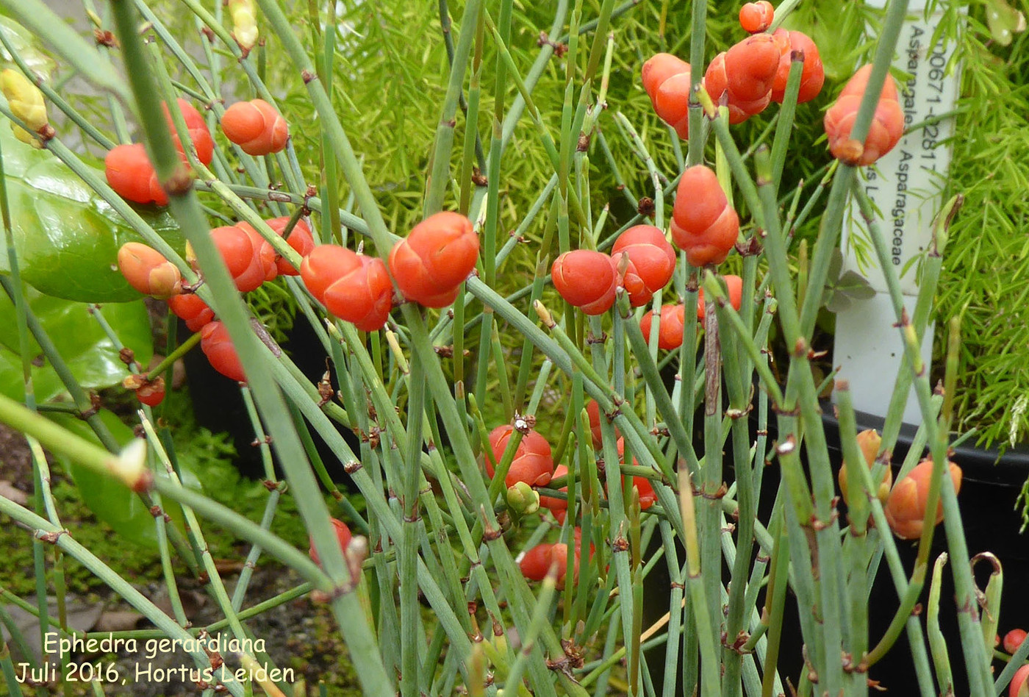
Characteristics
Ephedra gerardiana: It consists of cylindrical woody stem that is grey or greenish in colour. Nodes, internodes, scaly leaves and terminal buds are present in the stems. The distance between the internodes is 3–4 cm and the nodes bare the scaly leaves. They are bitter in taste. The plant has stamens and pistils on separate flowers; staminate flowers in catkins and a membraneous perianth, pistillate flowers terminal on axillary stalks, within a two-leaved involucre. Fruit has two carpels with a single seed in each and is a succulent cone, branches slender and erect, small leaves, scale-like, articulated and joined at the base into a sheath.
17-09-2024
5

Slide 6
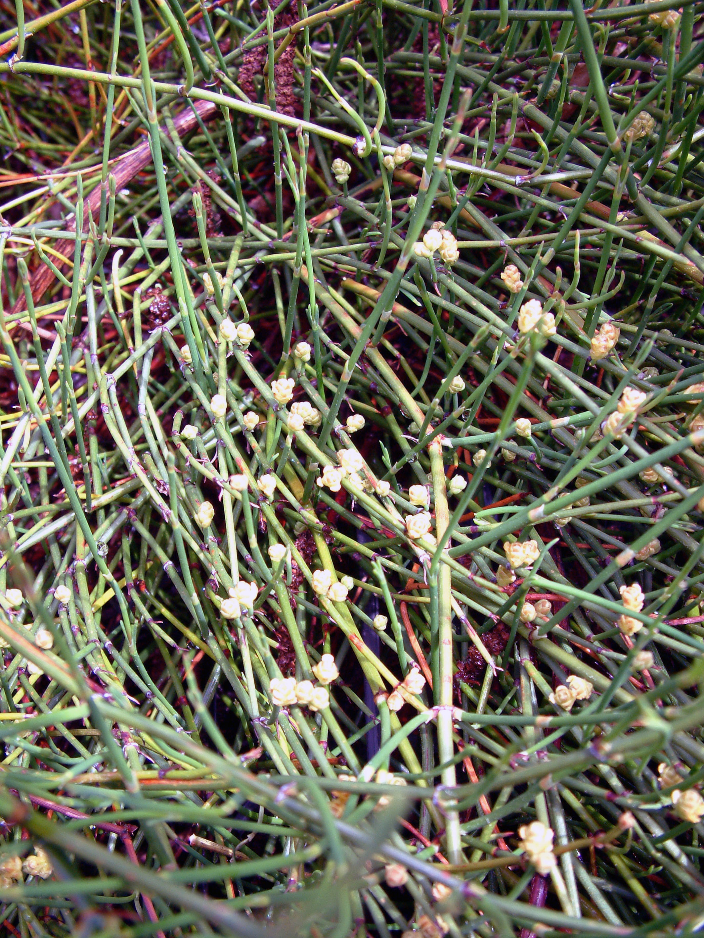
Ephedra sinica: Thickness of the stem is 4–7 mm branches are 1–2 mm. Length up to 30 cm of branches and 3–6 cm of internodes. The main stem is brown in colour. Leaves are 2–4 mm long, opposite, decussate and subulate. Leaf, base is reddish-brown, apex acute and recurved and lamina white in colour. A pair of sheathing leaves present at the nodes, encircling the stem and fused at the base,
17-09-2024
6

Slide 7
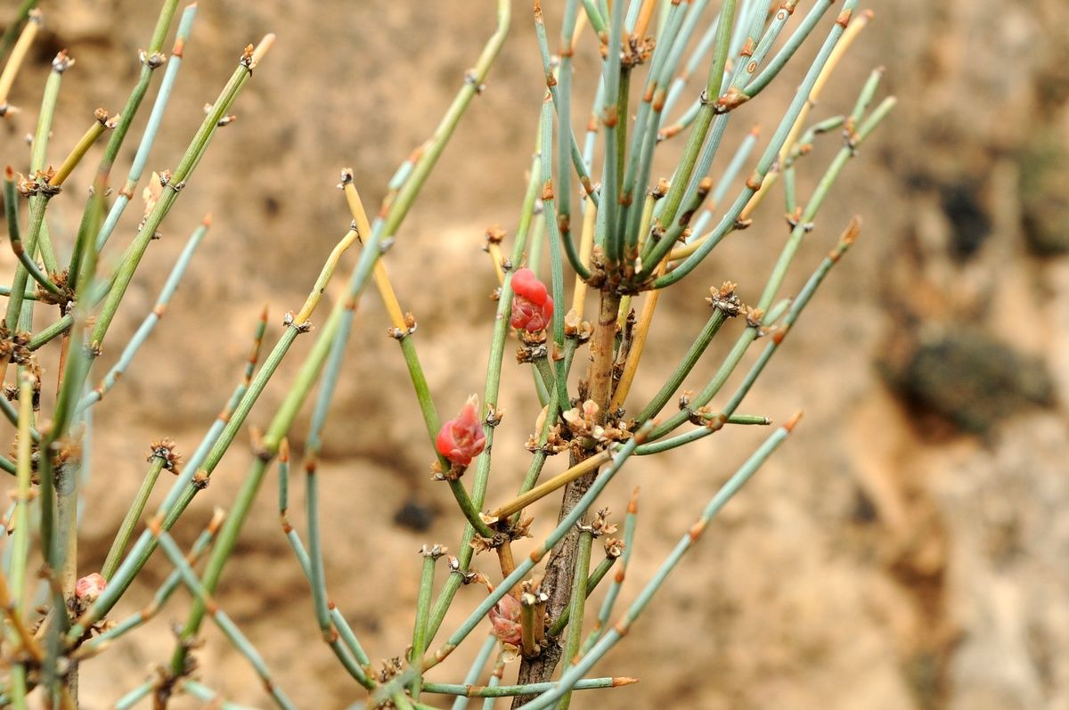
Ephedra equisetina: Stems are woodier and more branched 1.5–2 mm. Length 25–200 cm of branches and 1–2.5 cm ointernodes, outer surface is grey to pale green and smooth.
17-09-2024
7

Slide 8
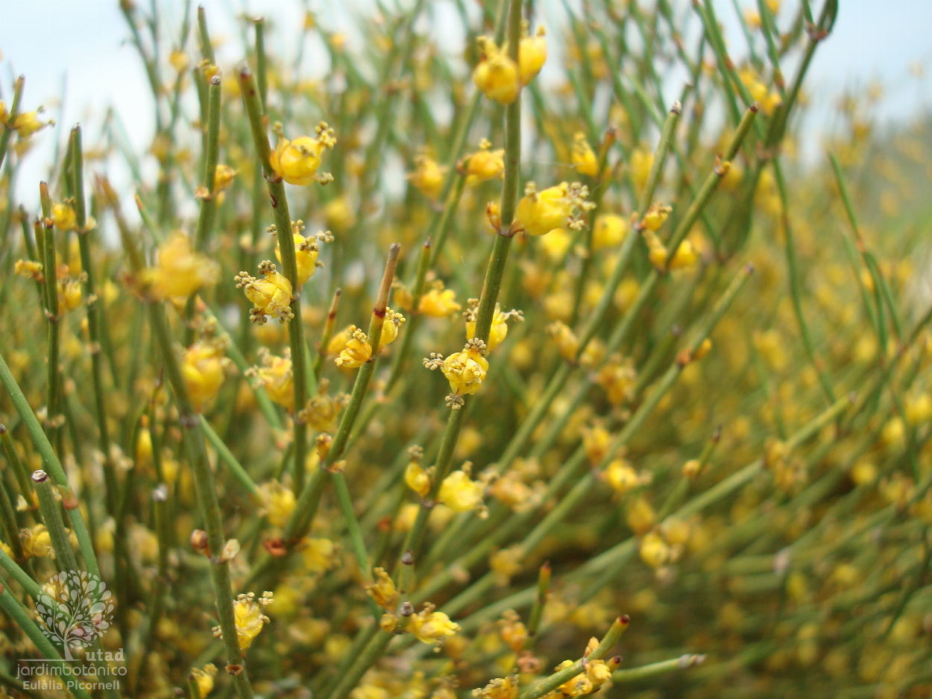
Ephedra nebrodensis: The stems are 15–35 cm in length; 1–2 mm thick, cylindrical, greenish-yellow in colour, nodes are brownish and distinct and fractured surface is fibrous in the cortex but pith contains brownish powdery mass. The leaves are brownish to whitish-brown in colour, scaly, connate, opposite and decussate, acute, agreeable and slightly aromatic odour and taste is astringent and bitter.
17-09-2024
8

Slide 9
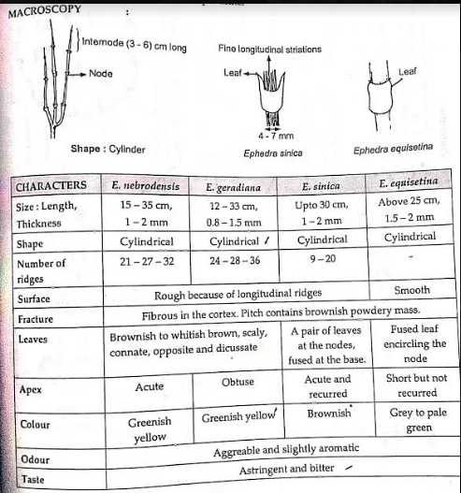
17-09-2024
9

Slide 10
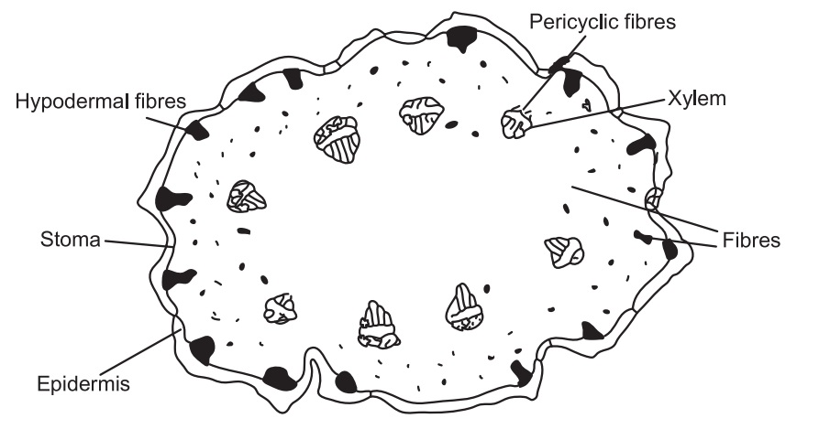
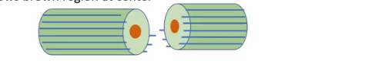

TRANSVERSE SECTION
TS of the stem shows epidermis, composed of thick-walled, quadrangular cells, covered by thick cuticle. Sunken stomata are present between many vertical ridges. Papillae are present in the ridges. Below the ridges, groups of nonlignified hypodermal fibres (nine to twenty per group) are present. Cortex is composed of chlorenchyma with outer zone of radially elongated cells and inner zone of spongy parenchyma. Cortex also contains few isolated fibres or groups of fibres (two to six per group), which are lignified. Pericycle is composed of groups of lignified fibres outside the phloem region. Vascular bundles are 6–10 in number, radially arranged in the cortex and composed of phloem and xylem. Pith is large with rounded cells, containing dark brown mucilaginous substance in pigment cells.
17-09-2024
10

Slide 11
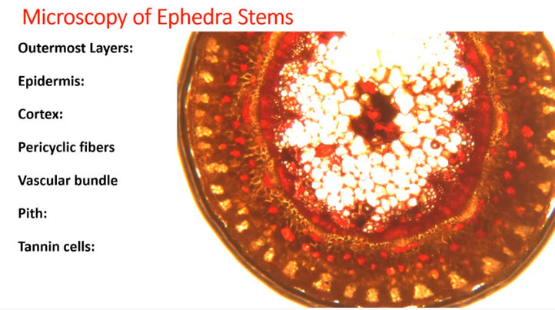
17-09-2024
11

Slide 12
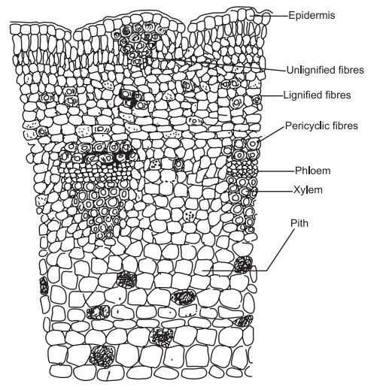
T.S of stem shows outer epidermis is made up of single layer
of rectangular thin walled cells. The cortex consists of outer two layered chlorenchyma and middle 2 to 3 layered collenchyma cells and inner 3 to 4 cells deep rotund to oval parenchyma cells, some of the parenchyma cells contain druses of calcium oxalate crystals.
Pericyclic fibres in groups occur as a ring, external to the phloem.
Vascular bundles are closely arranged forming a continuous ring.
Pith is made up of thin walled parenchyma cells, most of the cells are filled with starch grains. Mucilage cells are present in the cortex and pith. Most of the cells are filled with starch grains. During its early secondary growth cork cells are 3 to 4 layered and are made up of rectangular tangentially elongated cells arranged in a row.
Secondary cortex contains 2 to 3 rows of fibre groups. Secondary phloem is narrow.
The secondary xylem arranged as a ring and the vessels are rotund in outline and occur solitary or in radial rows of 2 to 3.
17-09-2024
12

