Slide 1

Epilepsy

Slide 2
Epilepsy is a disorder characterized by spontaneously recurring seizures.
A seizure results from an excessive discharge of cortical neurons and is characterized by changes in electrical activity as measured by the electroencephalogram (EEG).
Epilepsy is defined by the occurrence of at least two unprovoked seizures with or without convulsions (i.e., violent, involuntary contraction[s] of the voluntary muscles) separated by at least 24 hours.

Slide 3
Seizures can arise from a focal area of the brain (focal or partial seizures) or arise diffusely from both brain hemispheres (primary generalized seizures).

Slide 4
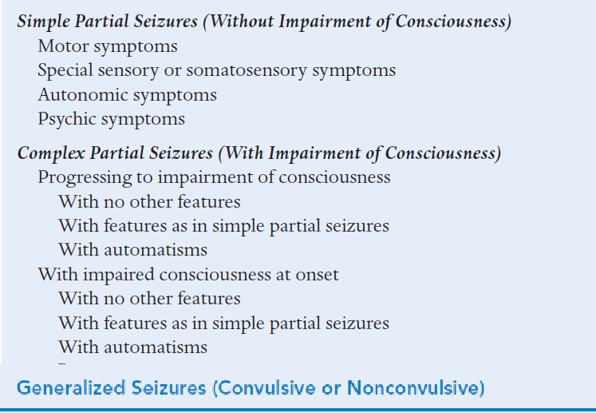
Classification of Epileptic Seizures
Partial Seizure (Focal)

Slide 5
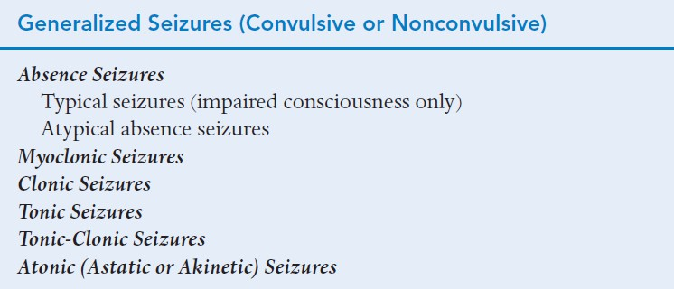

Slide 7
Generalized tonic-clonic seizures are common.
The patient loses consciousness and falls at the onset.
Simultaneously, tonic muscle spasms begin and may be accompanied by a cry that results from air being forced through the larynx.
➢
Bilateral, repetitive clonic movements follow.
After the clonic phase, patients return to consciousness but remain lethargic and may be confused for varying periods of time (postictal state).
Urinary incontinence and tongue biting is common

Slide 8
Generalized absence seizures are manifested by a sudden onset, interruption of ongoing activities, a blank stare, and possibly a brief upward rotation of the eyes.
They generally occur in young children through adolescence. It is important to differentiate absence seizures from CP seizures

Slide 9
Brief shock-like muscular contractions of the face, trunk, and extremities are known as myoclonic jerks. They can be isolated events or rapidly repetitive
A sudden loss of muscle tone is known as an atonic seizure, which may present as a head drop, the dropping of a limb, or a slumping to the ground. These patients often wear protective head ware to prevent trauma.

Slide 10
Simple partial (focal motor or sensory) seizures are localized in a single cerebral hemisphere or portion of a hemisphere.
Consciousness is not impaired during these events.
Various motor, sensory, or psychic manifestations may occur depending on the area of the brain that is affected.
➢
A single part of the body may twitch, or the patient may experience only an unusual sensory experience.

Slide 11
Complex partial seizures result from the spread of focal discharges to involve a larger area.
Consciousness is impaired and patients may exhibit complex but inappropriate behavior(automatisms) such as lip smacking, picking at clothing, or aimless wandering.
A period of brief lethargy or confusion is common

Slide 12
PATHOPHYSIOLOGY
Seizures result from excessive excitation or from disordered inhibition of neurons
Initially, a small number of neurons fire abnormally.
Normal membrane conductances and inhibitory synaptic currents then break down, and excitability spreads locally (focal seizure) or more widely (generalized seizure).

Slide 13
PATHOPHYSIOLOGY
Mechanisms that may contribute to synchronous hyperexcitability include
(1) alterations in the distribution, number, type, and biophysical properties of ion channels in the neuronal membranes
(2) Biochemical modifications of receptors,
(3) Modulation of second messaging systems and gene expression,

Slide 14
PATHOPHYSIOLOGY
Mechanisms that may contribute to synchronous hyperexcitability include
4) changes in extracellular ion concentrations,
(5) alterations in neurotransmitter uptake and metabolism in glial cells,
(6) modification in the ratio and function of inhibitory circuits, and
(7) local imbalances between the main neurotransmitters glutamate (excitatory) and γ-aminobutyric acid (GABA) (inhibitory) and neuromodulators (eg, acetylcholine, norepinephrine, and serotonin)

Slide 15
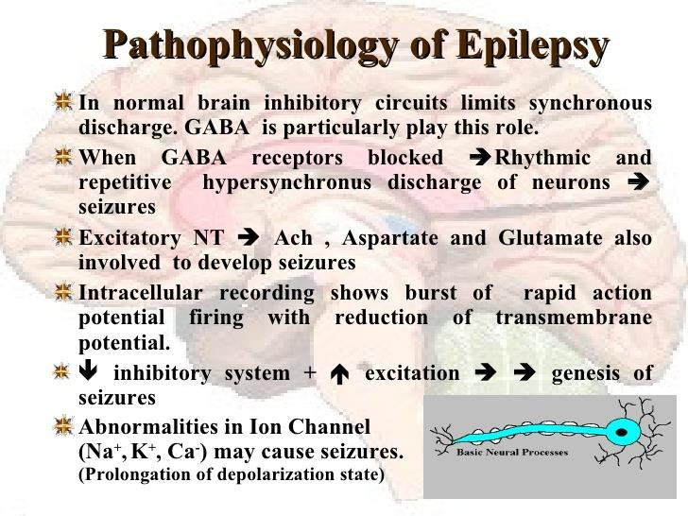

Slide 16
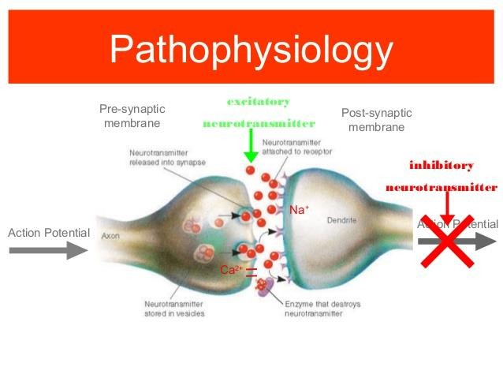

Slide 17
Symptoms
Symptoms of a specific seizure will depend on seizure type.
CP seizures can include somatosensory or focal motor features
CP seizures are associated with altered consciousness
Absence seizures can be almost non detectable with only very brief (seconds) periods of
altered consciousness
GTC seizures are major convulsive episodes and are always associated with a loss of consciousness

