Slide 1
BIOPHARMACEUTICS AND PHARMACOKINETICS
4: EXCRETION OF DRUGS
14-09-2024
1

Slide 2
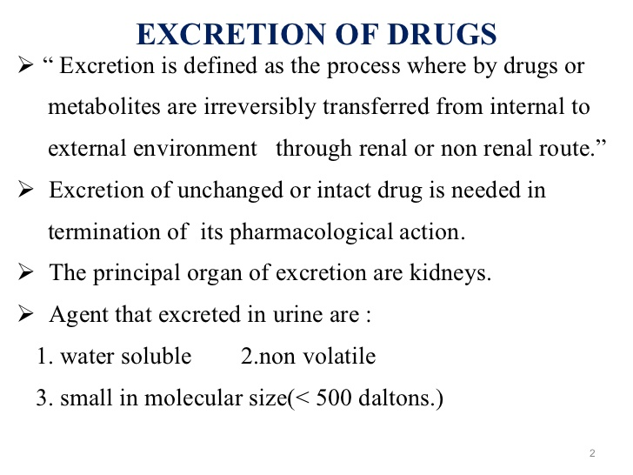
14-09-2024
2

Slide 3
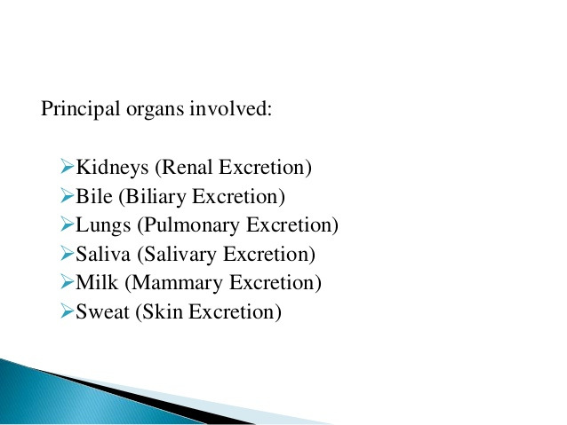
14-09-2024
3

Slide 4
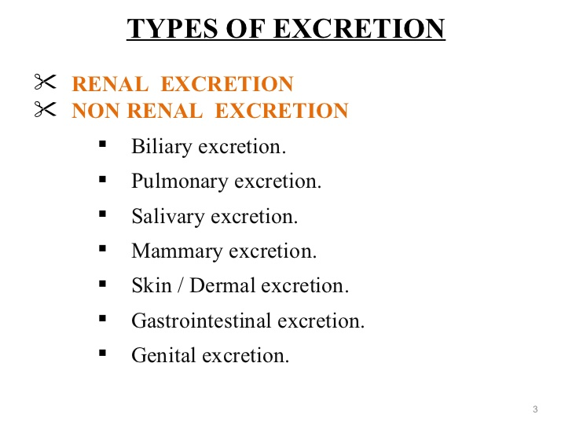
14-09-2024
4

Slide 5
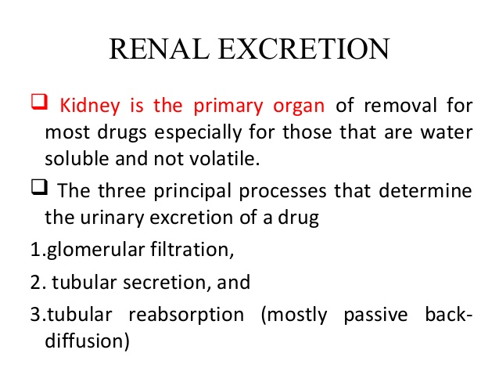
14-09-2024
5

Slide 6
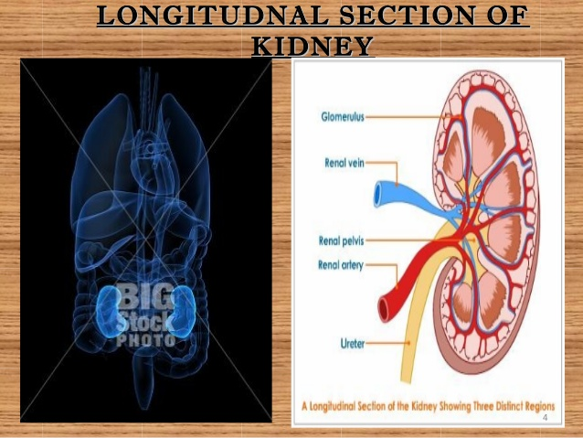
14-09-2024
6

Slide 7
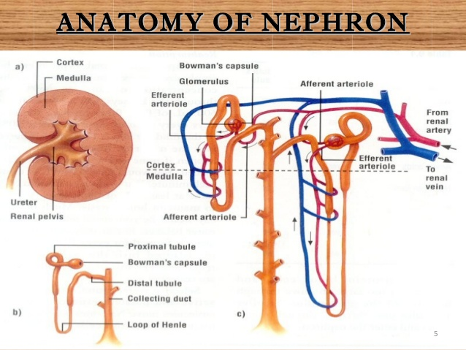
14-09-2024
7

Slide 8
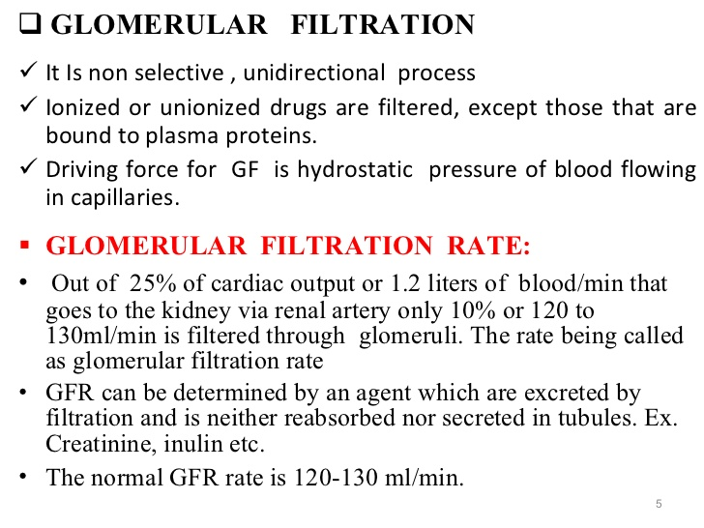
14-09-2024
8

Slide 9
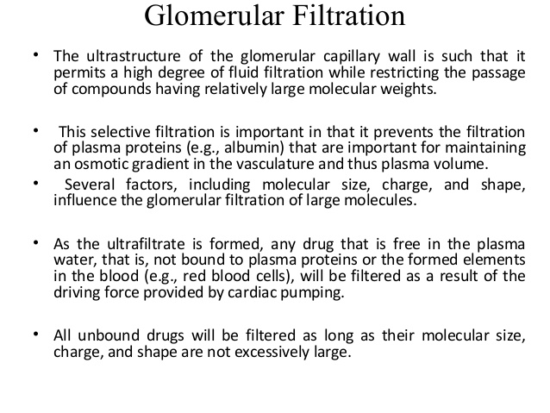
14-09-2024
9

Slide 10
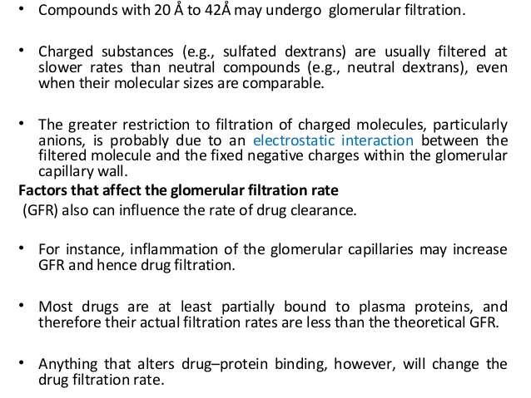
14-09-2024
10

Slide 11
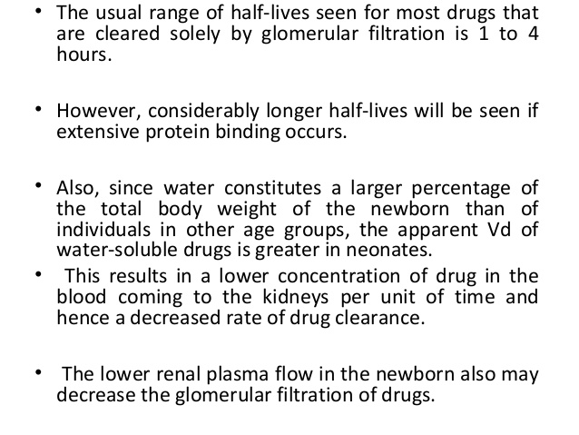
14-09-2024
11

Slide 12
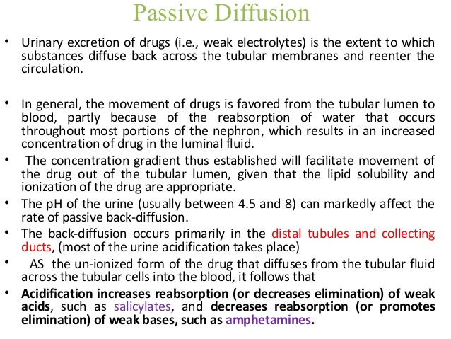
14-09-2024
12

Slide 13
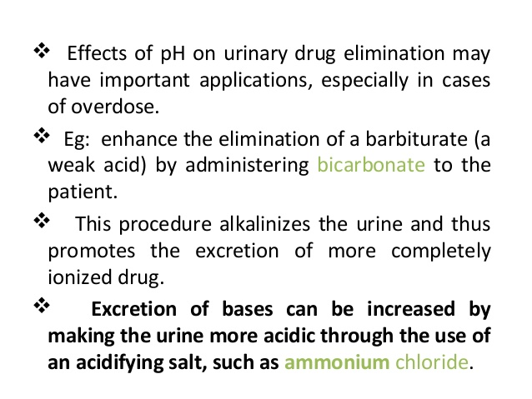
14-09-2024
13

Slide 14
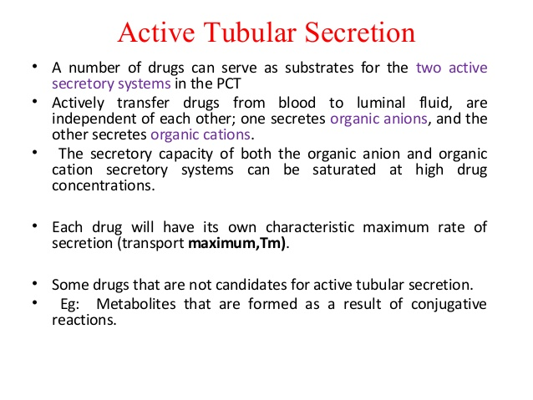
14-09-2024
14

Slide 15
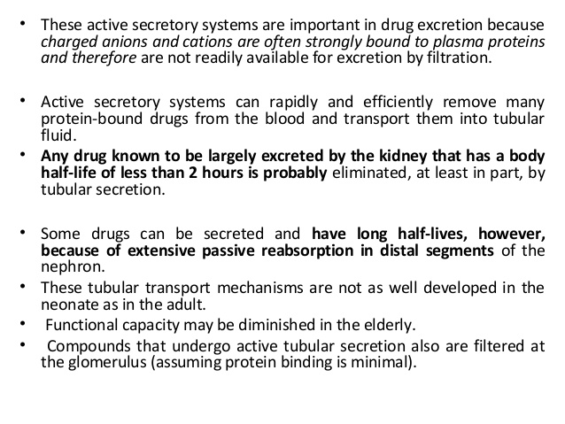
14-09-2024
15

Slide 16
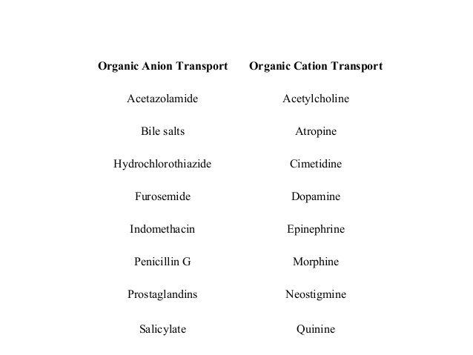
14-09-2024
16

Slide 17
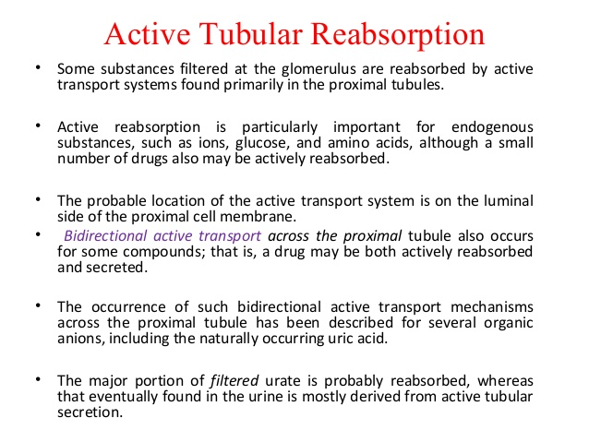
14-09-2024
17

Slide 18
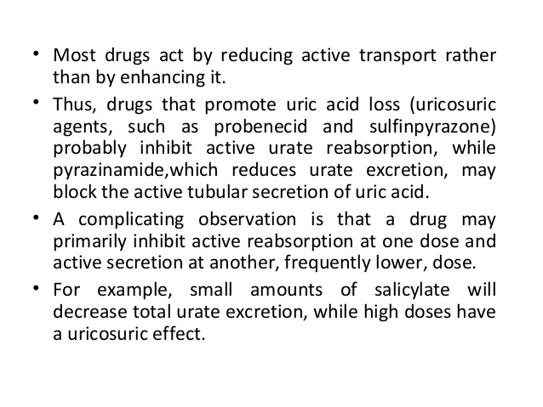
14-09-2024
18

Slide 19
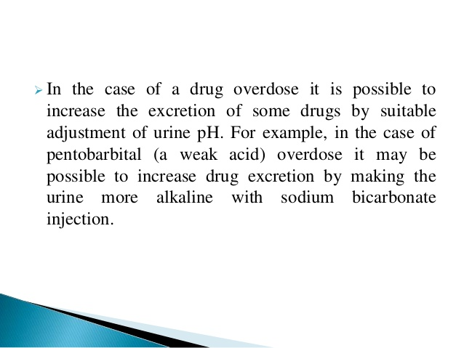
14-09-2024
19

Slide 20
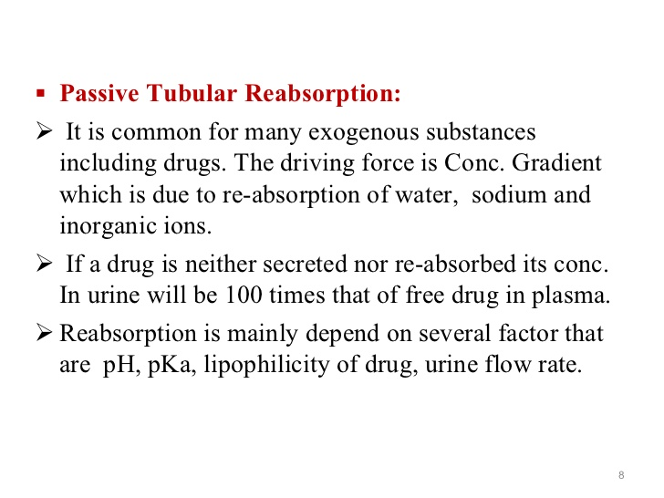
14-09-2024
20

Slide 21
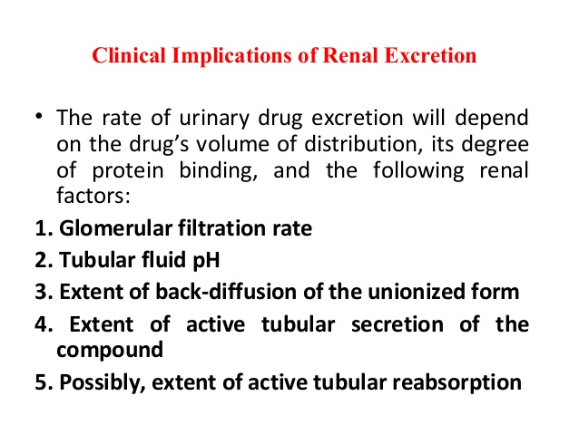
14-09-2024
21

Slide 22
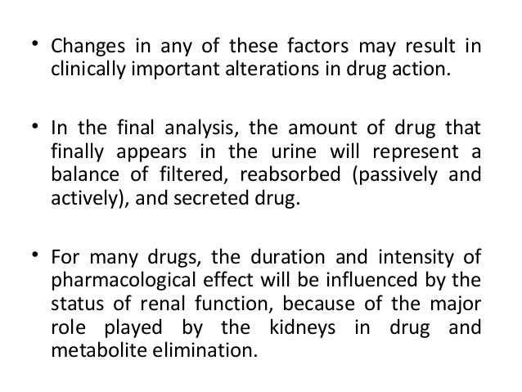
14-09-2024
22

