Slide 1
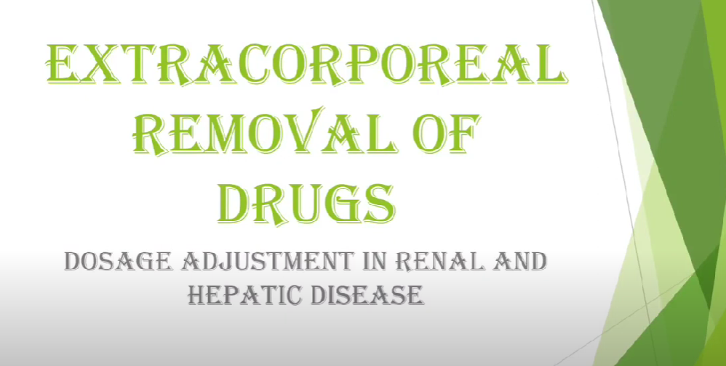

Slide 2
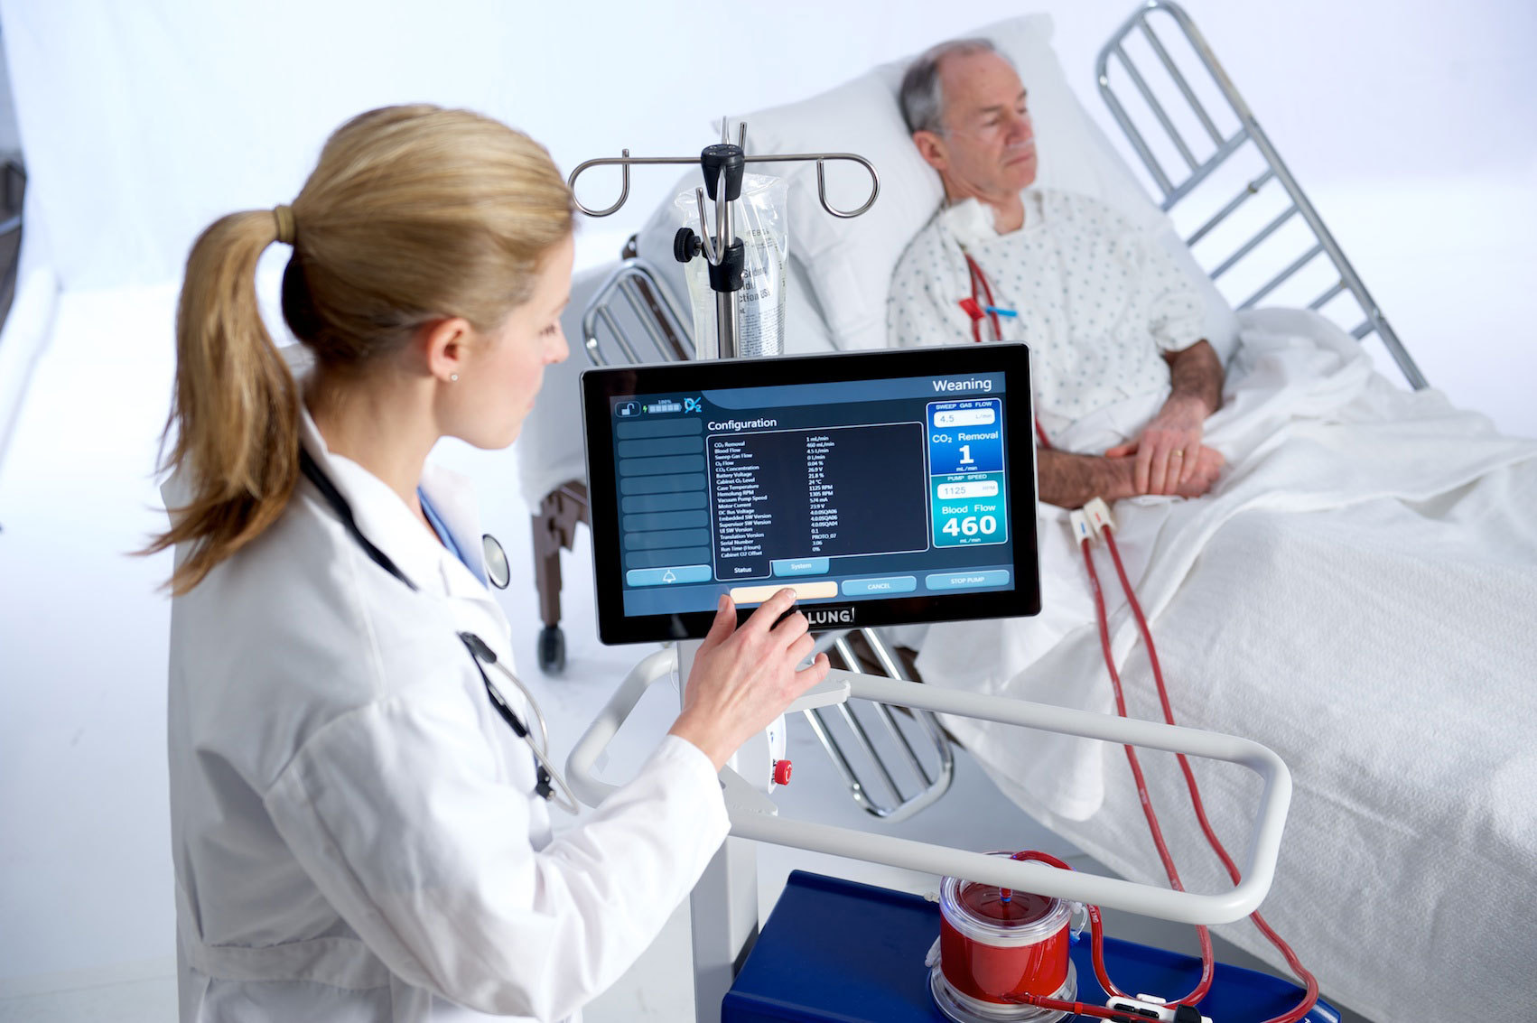
Extracorporeal removal of drug is a system in which undesirable drug and metabolites removed from the body without disturbing the fluid and electrolyte balance in the patient.
Extracorporeal therapy is a medical procedure which is performed outside the body.
Methods available for drug removal:-
•Hemodialysis
•Peritoneal dialysis
•Hemofiltration
•Hemodiafiltration
•Hemoperfusion

Slide 3
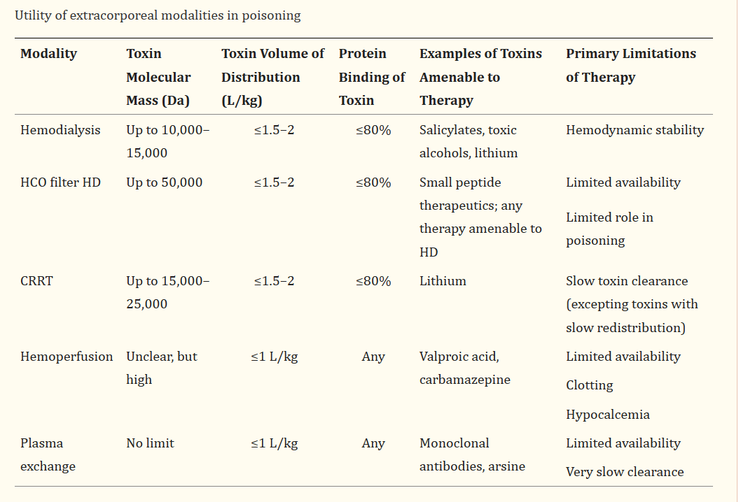

Slide 4
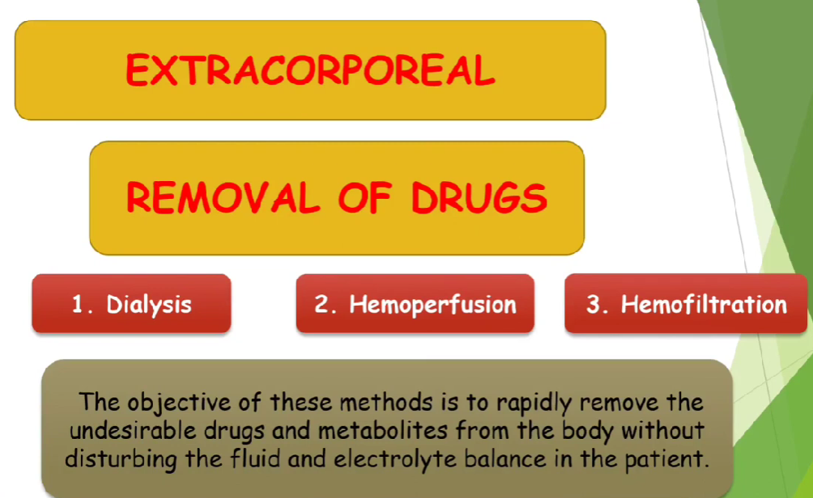

Slide 5
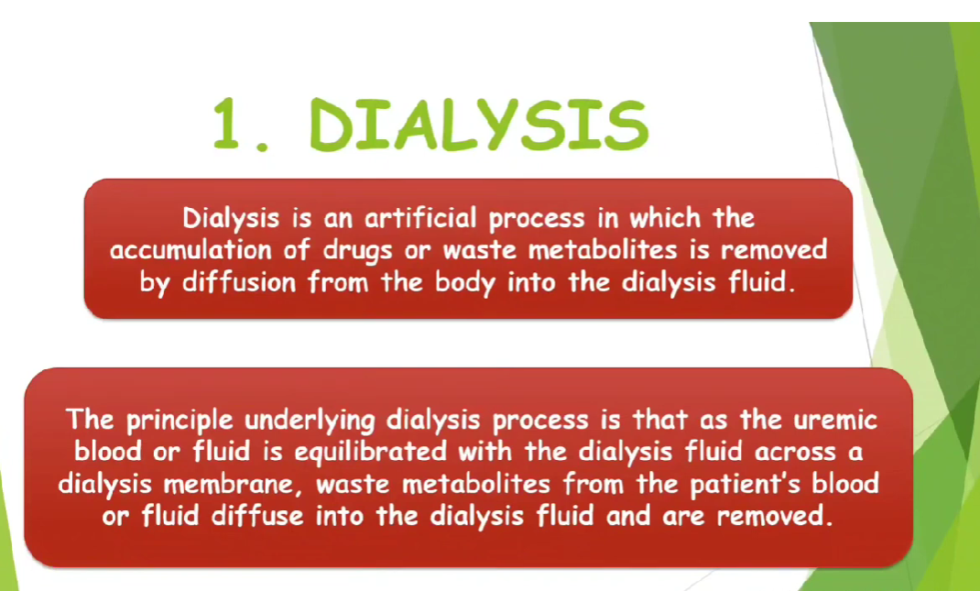

Slide 6
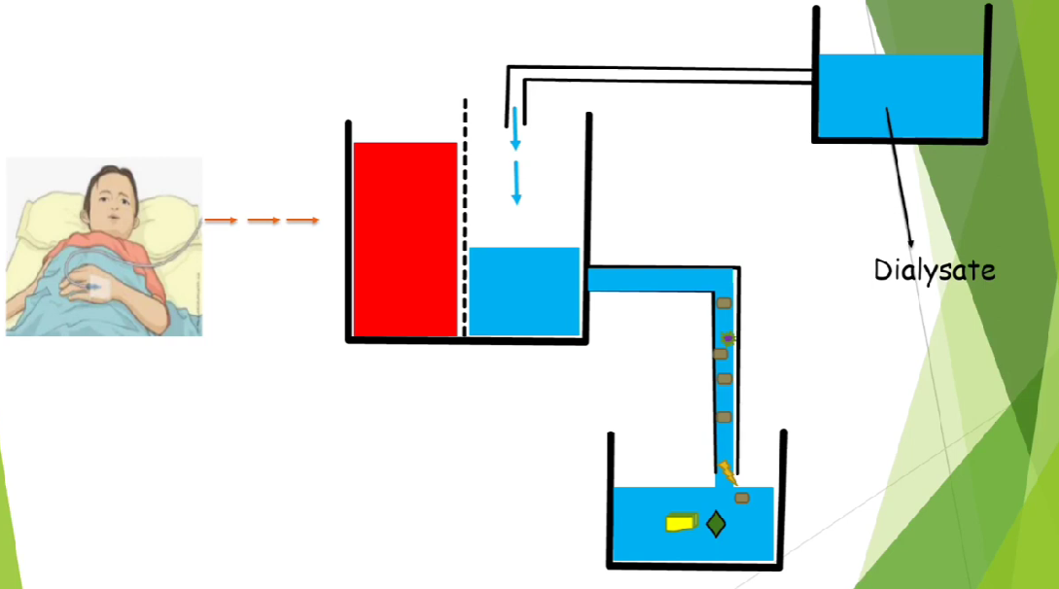

Slide 7
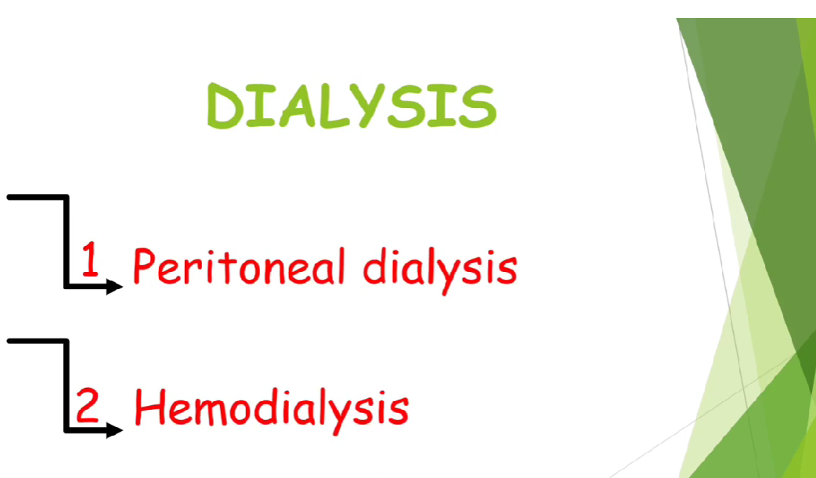

Slide 8
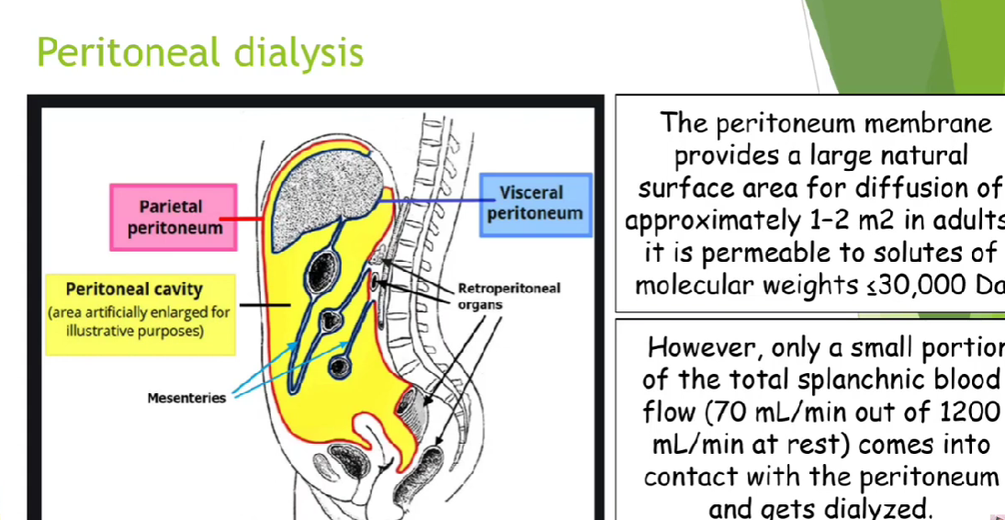

Slide 9
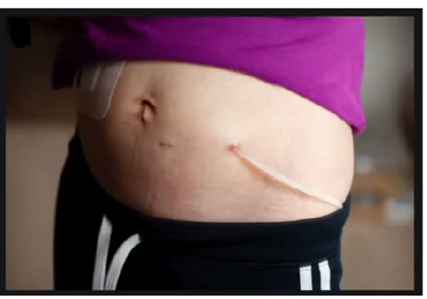

Slide 10
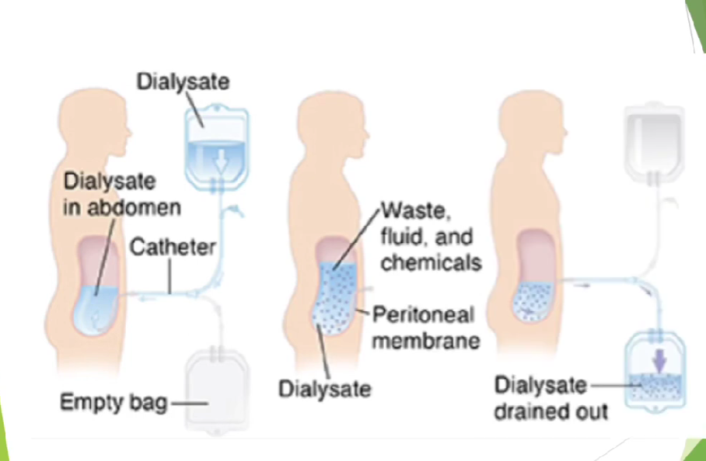

Slide 11
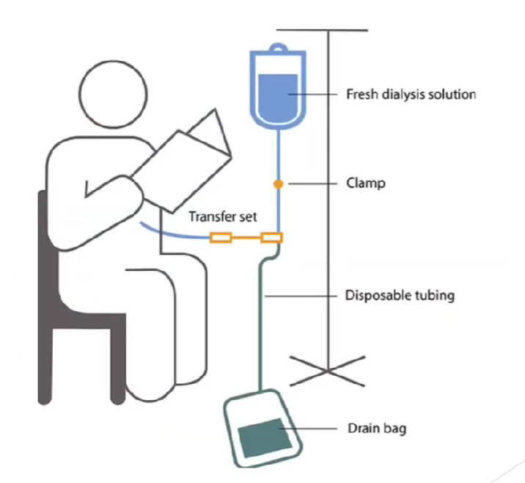

Slide 12
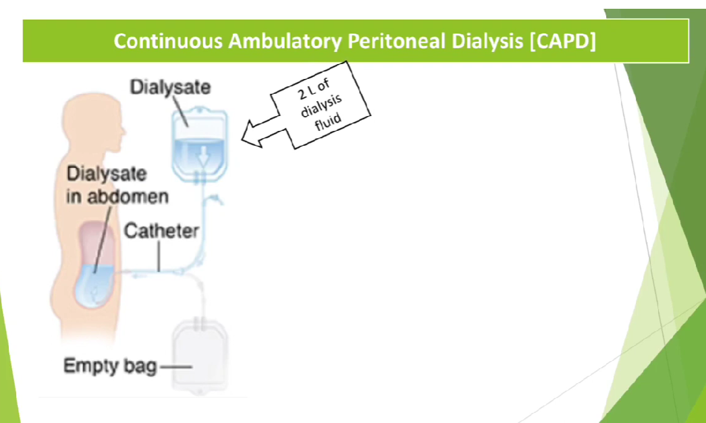

Slide 13
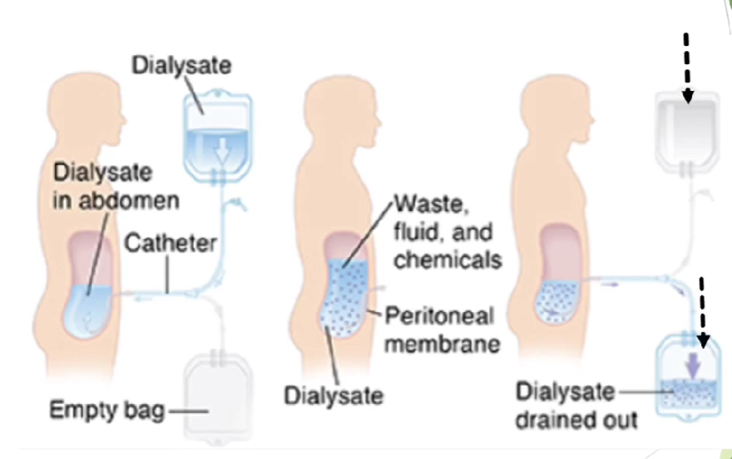

Slide 14
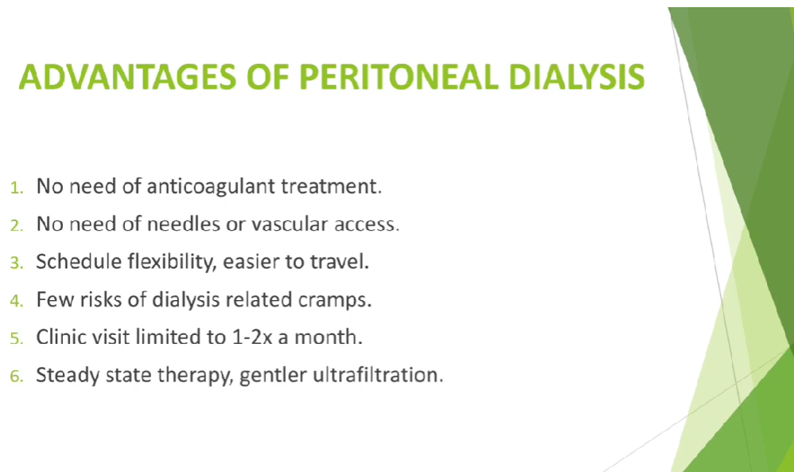

Slide 15
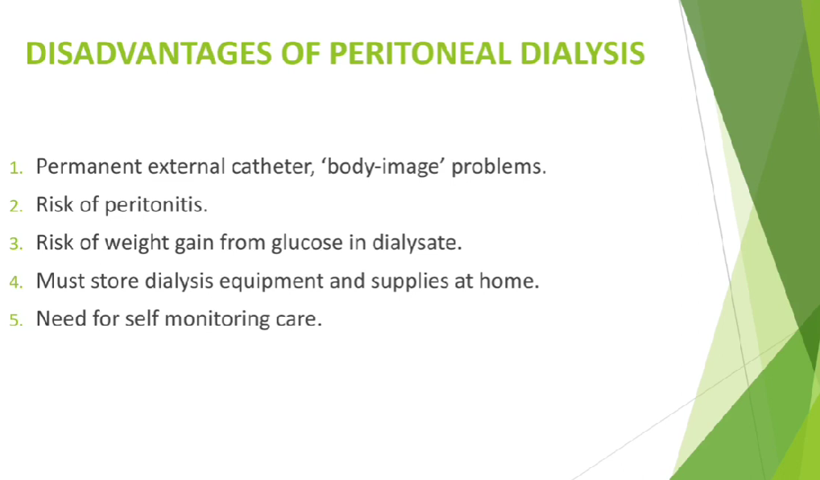

Slide 16
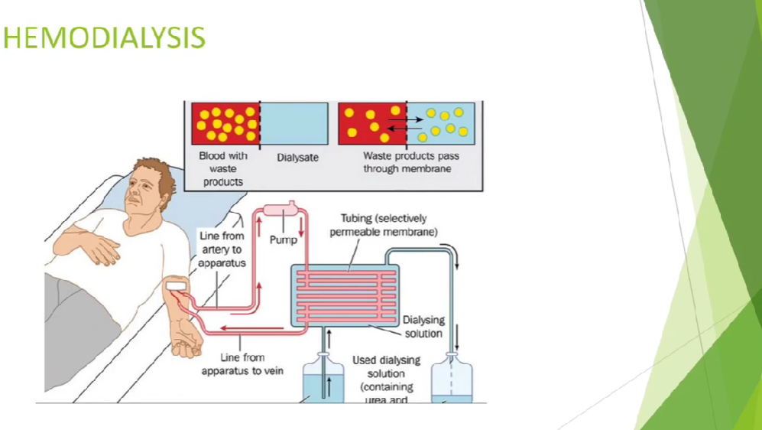

Slide 17
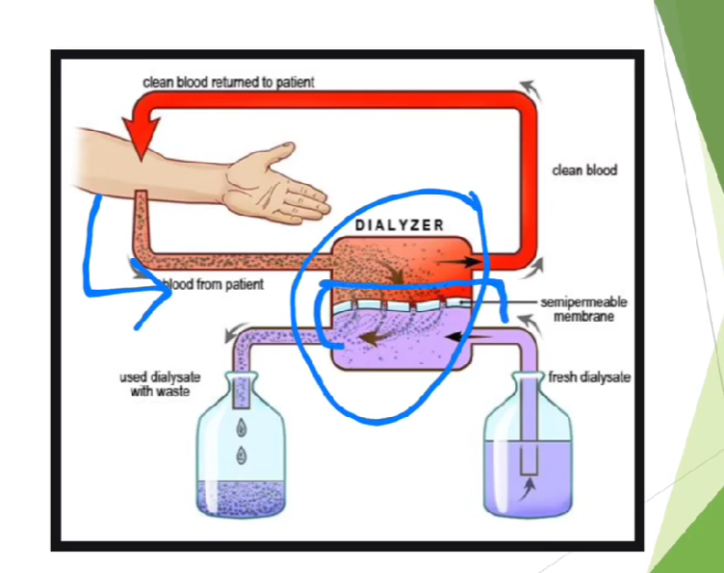

Slide 18
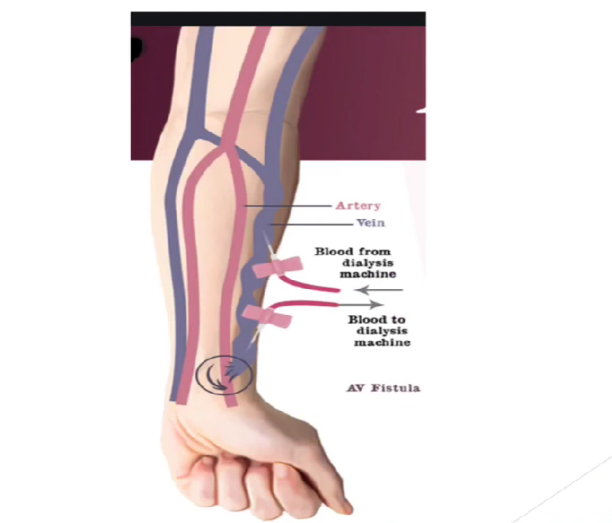

Slide 19
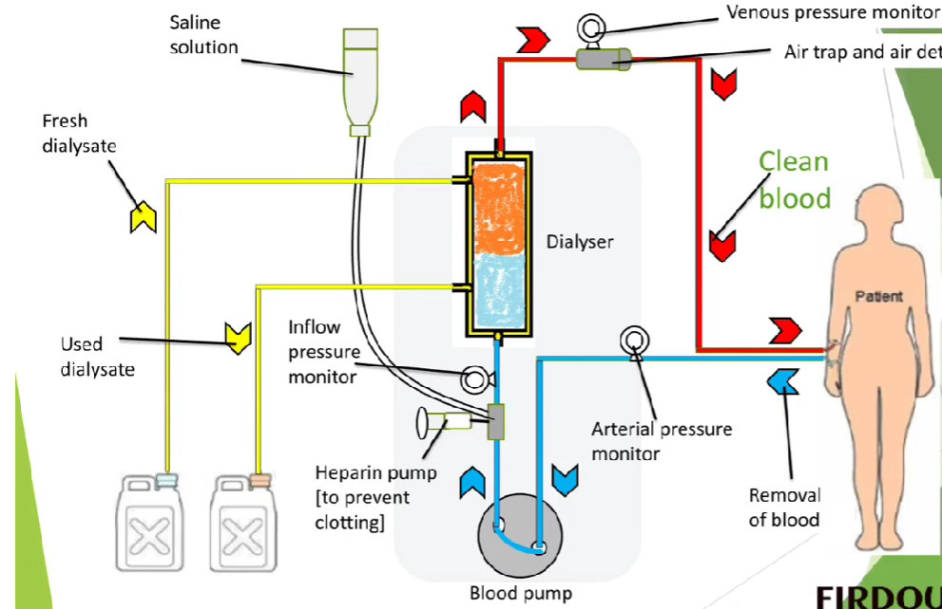

Slide 20
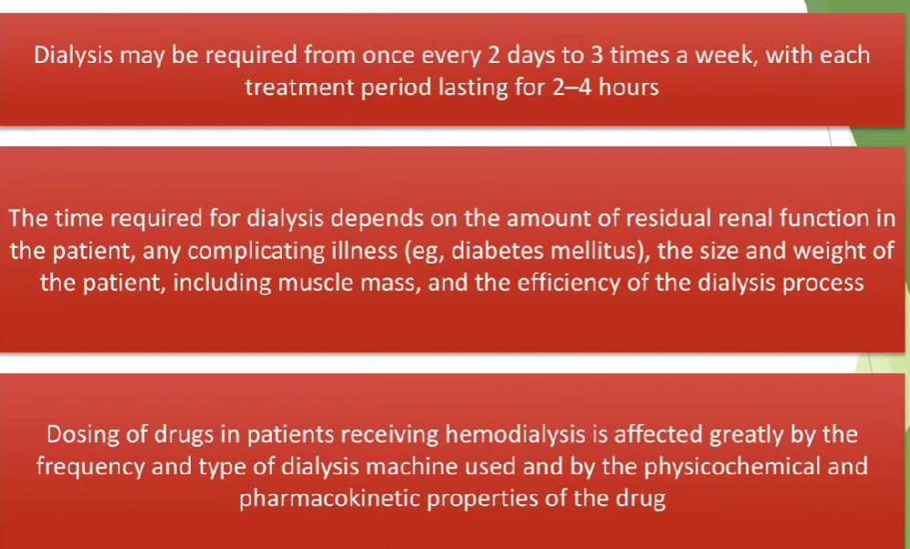

Slide 21
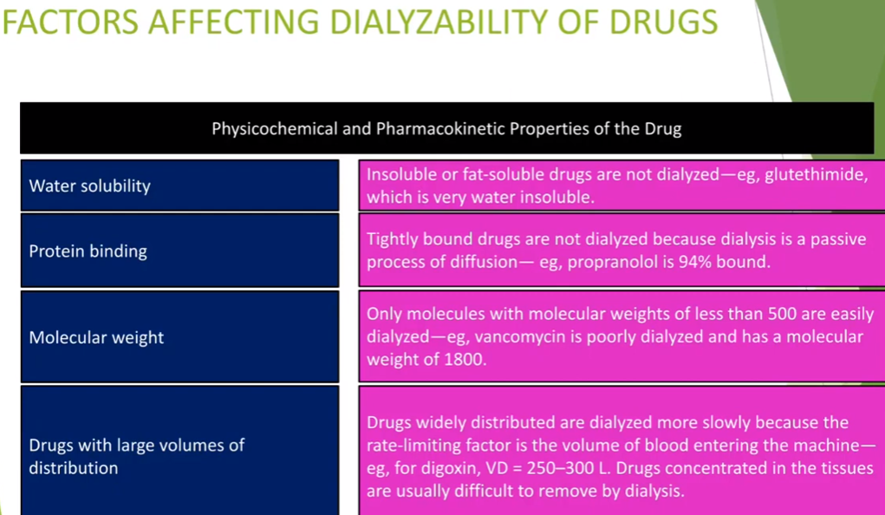

Slide 22
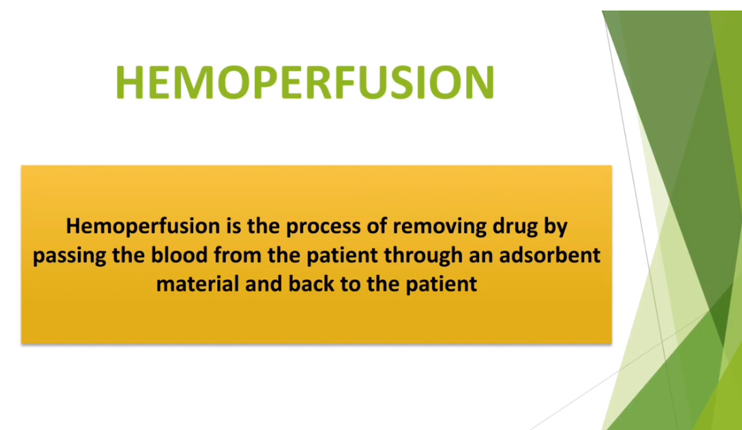
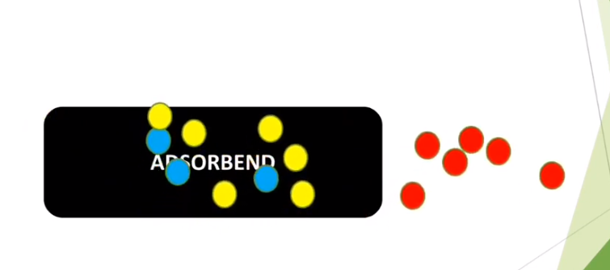

Slide 23
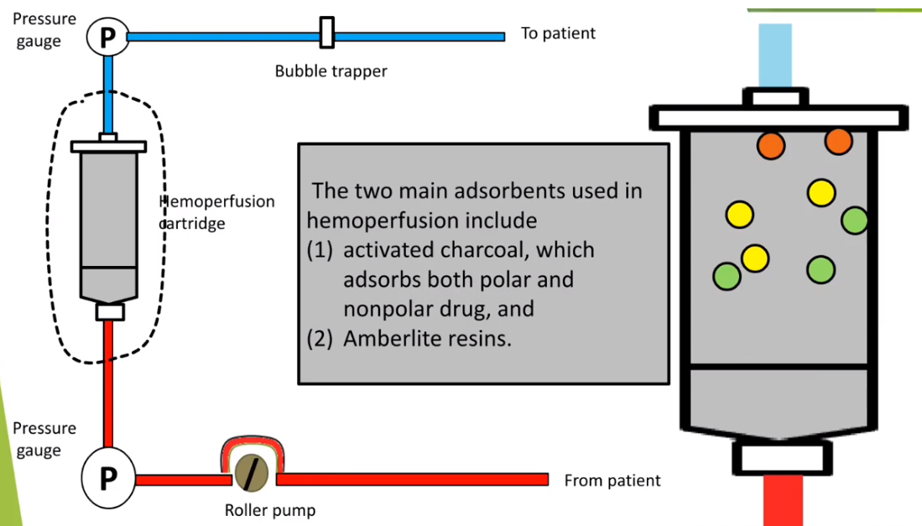

Slide 24
Mechanisms of haemoperfusion
Haemoperfusion is defined as "the extracorporeal procedure in which the anticoagulated patient’s blood passes through a volume of adsorbent material"
Adsorption is the deposition of molecules on the surface of a medium, rather than within it (which would be aBsorption).
The adsoprtion medium needs to have several favourable properies:
High selectivity/ affinity for noxious solutes
Rapid adsorption
High capacity for adsorption (i.e. large surface area)
Modern sorbents have a surface area of around 1000m2 per gram of sorbent
Chemical and thermal stability, including low water solubility
Good structural integrity (i.e. non-crumbly)
Good biocompatibility (to prevent inflammatory response or anaphylaxis)
Practical administration of haemoperfusion
Relevant features to make note of :
A normal CRRT machine can be used
Blood flow rate is about 250-300ml/min
Anticoagulation requirements are similar to normal CRRT
A session usually lasts about 4 hours
At the end of the 4 hours the cartidge is depleted and must be discarded

Slide 25
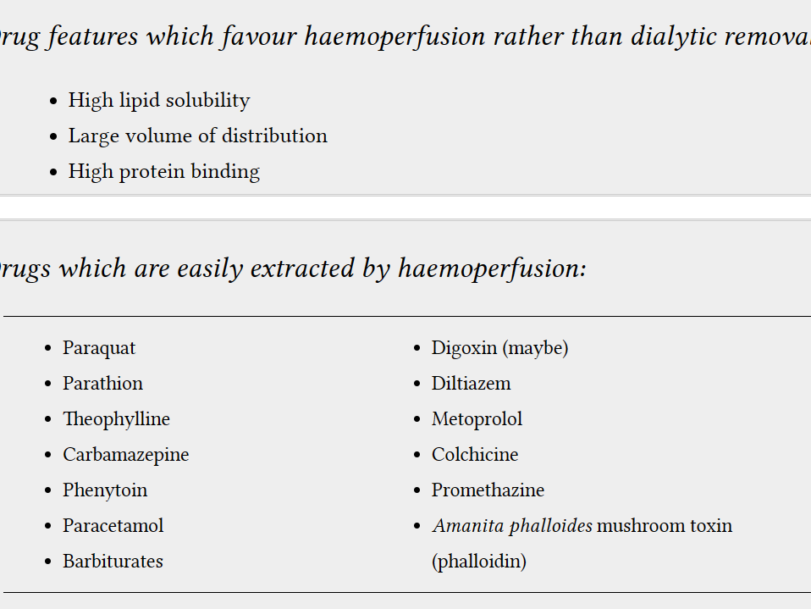

Slide 26
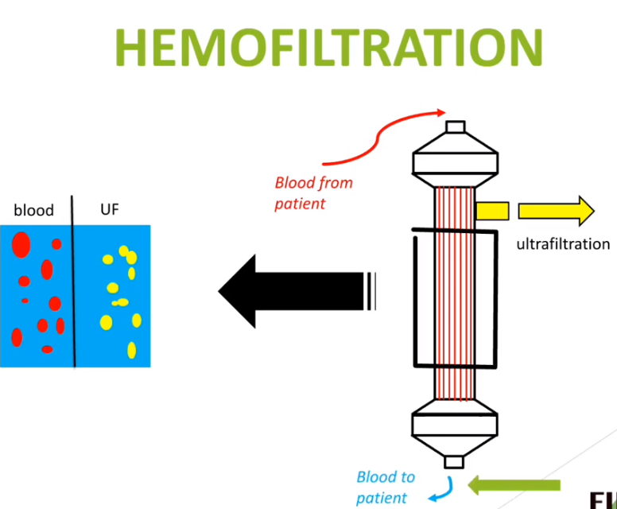
What are the side effects of hemoperfusion.
The commonly reported adverse reactions are thrombocytopenia, leukopenia, hypocalcemia, hypophosphatemia, hypoglycemia, and a decrease in fibrinogen.

Slide 27
