Slide 1
BIOPHARMACEUTICS AND PHARMACOKINETICS
2: DISTRIBUTION OF DRUGS: Protein binding of drugs
14-09-2024
1

Slide 2
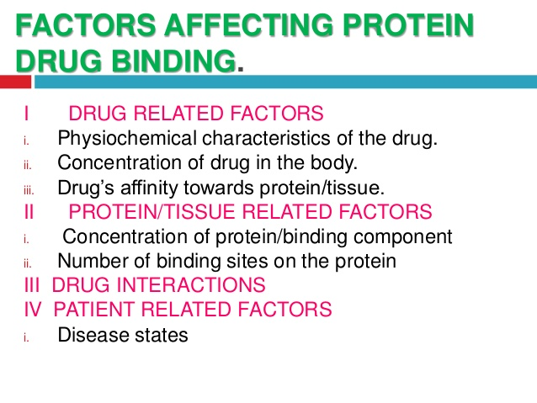
14-09-2024
2

Slide 3
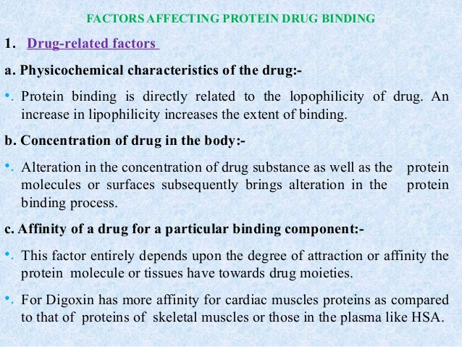
14-09-2024
3

Slide 4
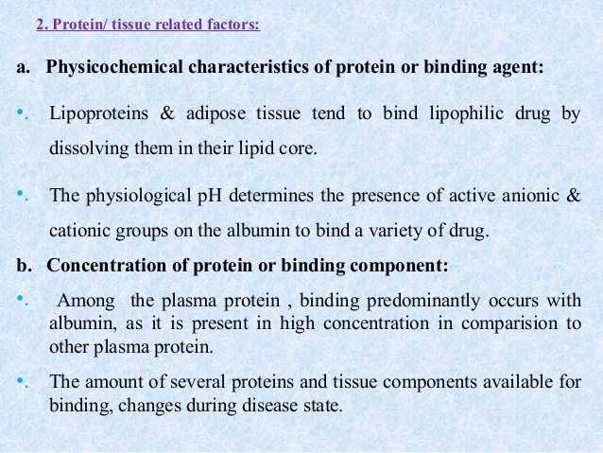
14-09-2024
4

Slide 5
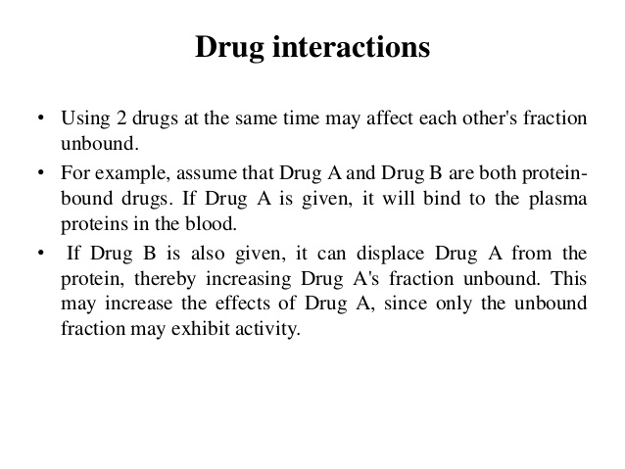
c) Number of binding sites on the binding agent:-
Albumin has a large no. of binding sites as compared to other proteins and is a high capacity binding component. AAG having low conc. & low molecular size therefore it has limited binding capacity.
14-09-2024
5

Slide 6
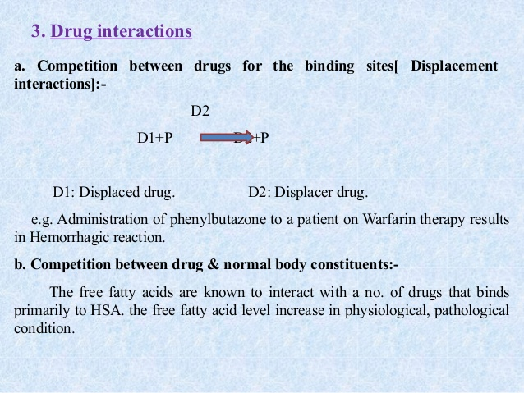
14-09-2024
6

Slide 7
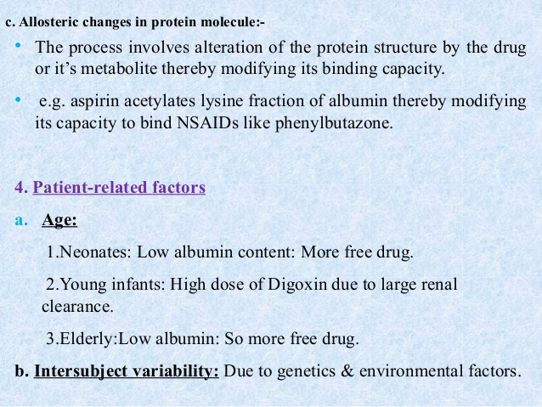
14-09-2024
7

Slide 8
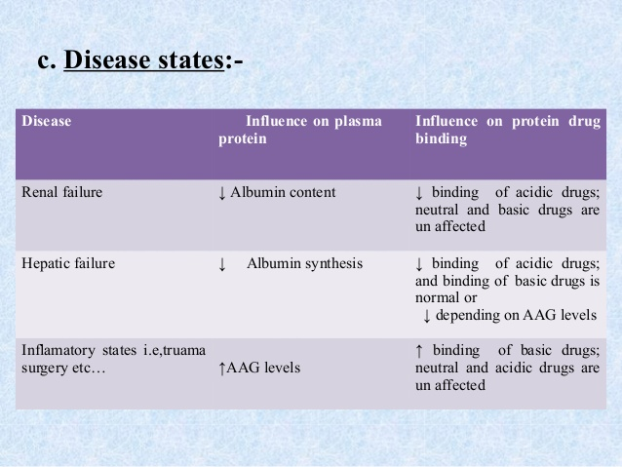
14-09-2024
8

Slide 9
significances of protein binding
14-09-2024
9

Slide 10
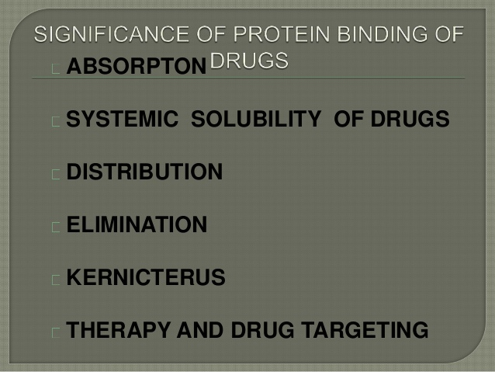
14-09-2024
10

Slide 11
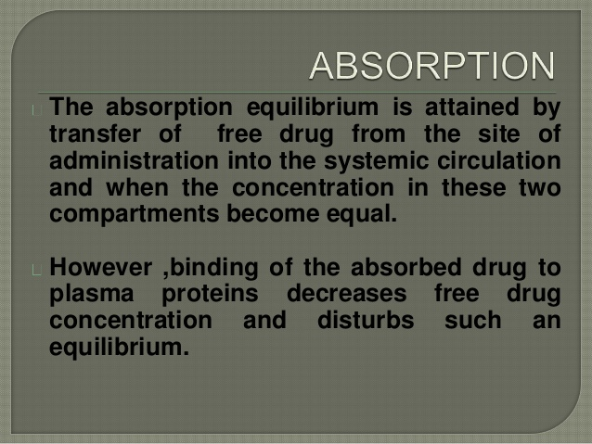
14-09-2024
11

Slide 12
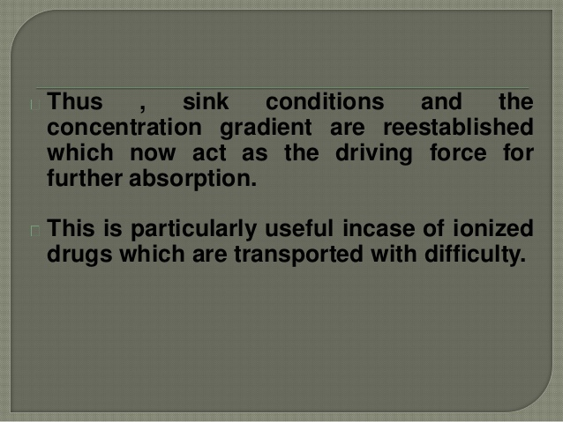
14-09-2024
12

Slide 13
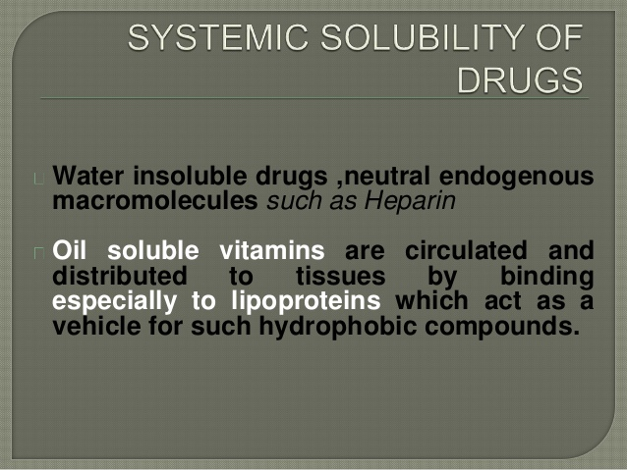
14-09-2024
13

Slide 14
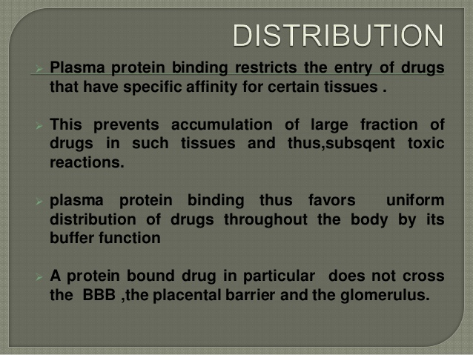
14-09-2024
14

Slide 15
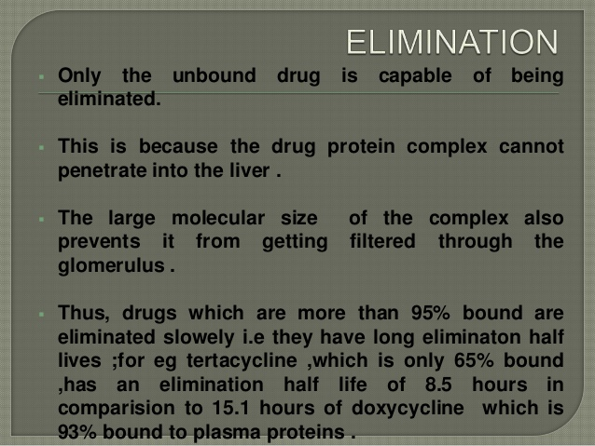
14-09-2024
15

Slide 16
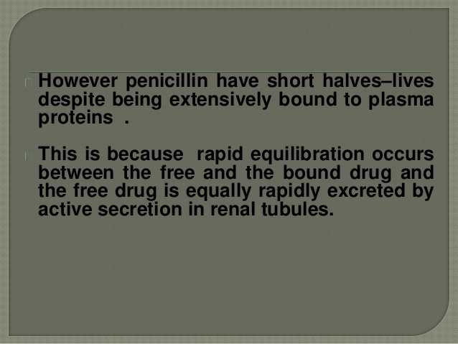
14-09-2024
16

Slide 17
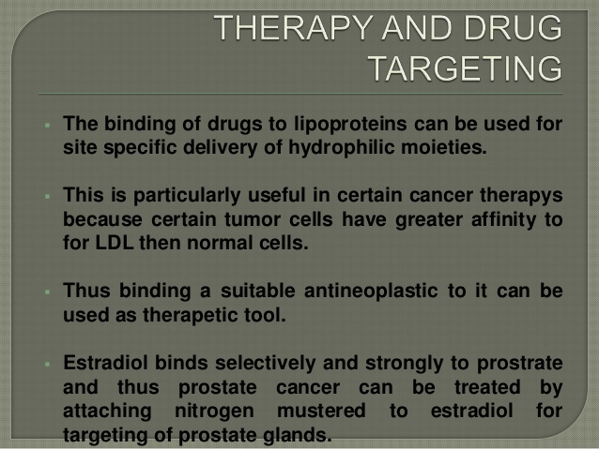
14-09-2024
17

Slide 18
Kinetics of protein binding
14-09-2024
18

Slide 19
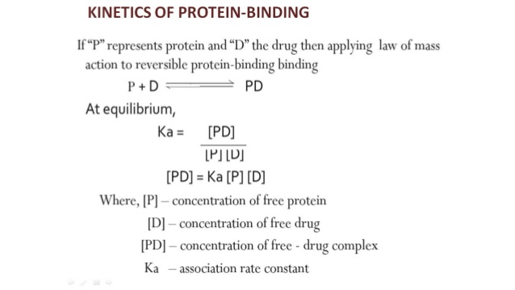
14-09-2024
19

Slide 20
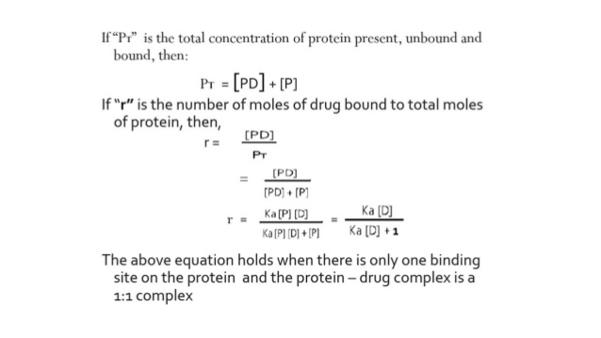
14-09-2024
20

Slide 21
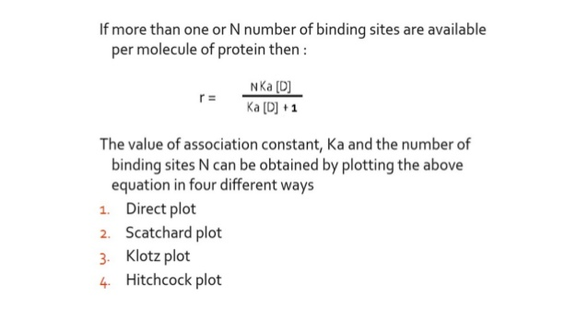
14-09-2024
21

Slide 22
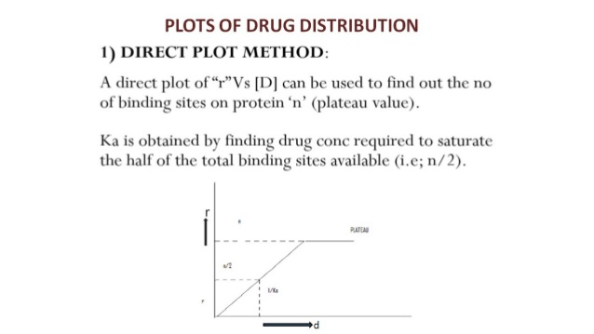
14-09-2024
22

Slide 23
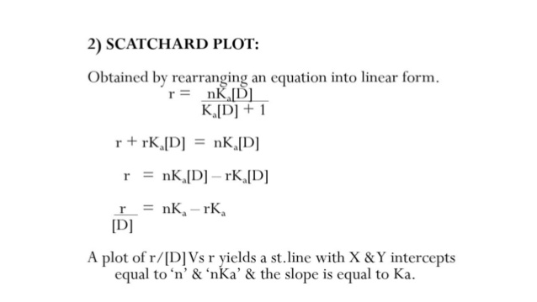
14-09-2024
23

Slide 24
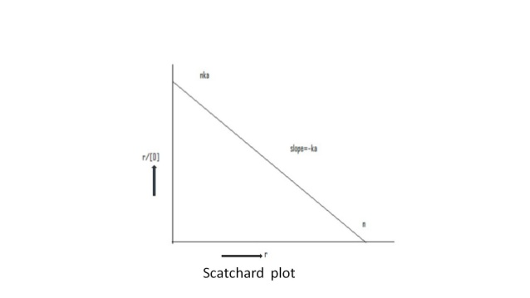
14-09-2024
24

Slide 25
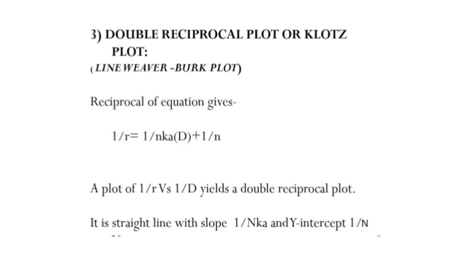
14-09-2024
25

Slide 26
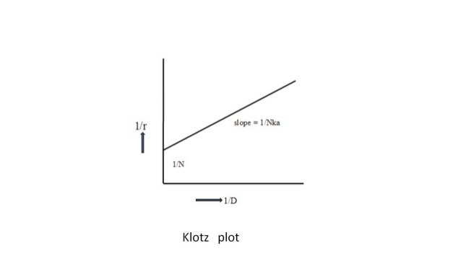
14-09-2024
26

Slide 27
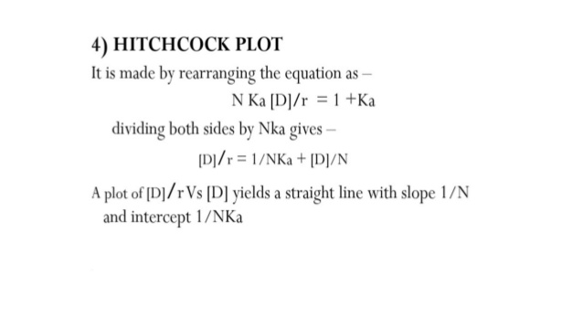
14-09-2024
27

Slide 28
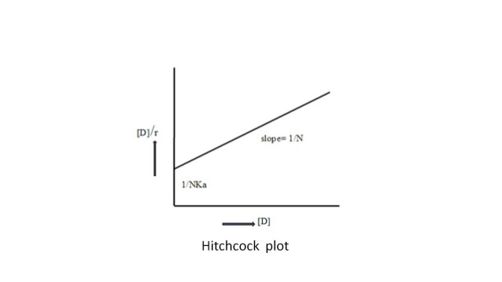
14-09-2024
28

