Slide 1
BIOPHARMACEUTICS AND PHARMACOKINETICS
1: METABOLISM OF DRUGS
14-09-2024
1

Slide 2
FACTORS AFFECTING BIOTRANSFORMATION OF DRUGS:
Physicochemical properties of drug
Molecular size &shape.
pKa
Acidity / Basicity
Lipophilicity
Steric & electronic characteristics
2. Chemical factors
a. Induction of drug metabolizing enzymes
b. Inhibition of drug metabolizing enzymes
c. Environmental chemicals
14-09-2024
2

Slide 3
3. Biological factors
Age
Sex
Diet
Species differences
Strain differences
Altered physiologic factors :
i. Pregnancy
ii. Hormonal imbalance
iii. Disease status
e. Temporal factors
i. Circadium rhythm
14-09-2024
3

Slide 4
Physiochemical Properties Of The Drug:
Molecular size and shape, pKa , acidity/basicity. Lipophilicity and stearic and electronic characteristics of a drug influence its interaction with the active sites of enzymes and the biotransformation processes.
2. Chemical factors:
Enzyme induction :
The phenomenon of Increased drug metabolizing ability of the enzymes by several drugs and chemicals is called as enzyme induction and the agents which bring about such effectare enzyme inducers, 2 categories :
Phenobarbital type
Polycyclic hydrocarbon type
Self induction or auto induction: Some drugs such as carbamazepine, meprobamate , rifampicin, cyclophosphamide, etc. stimulate their own metabolism & is known as auto induction.
14-09-2024
4

Slide 5
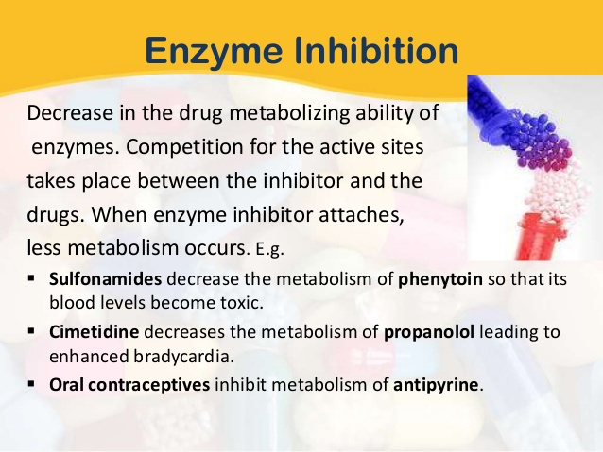
14-09-2024
5

Slide 6
3) . Environmental factors:
Several environmental agents influence the drug metabolizing ability of enzymes.
Halogenated pesticides such as DDT & polycyclic aromatic hydrocarbons contained in cigarette smoke have enzyme induction effect.
Organophosphate insecticides & heavy metals such as mercury, tin, nickel, cobalt & arsenic have enzyme inhibition effect.
Temperature, pressure, altitude , atmosphere etc. may influence drug metabolism
In hot and humid climate biotransformation is decreased and vice versa.
At high altitude decreased biotransformation occurs due to decreased oxygen leading to decreased oxidation of drugs.
14-09-2024
6

Slide 7
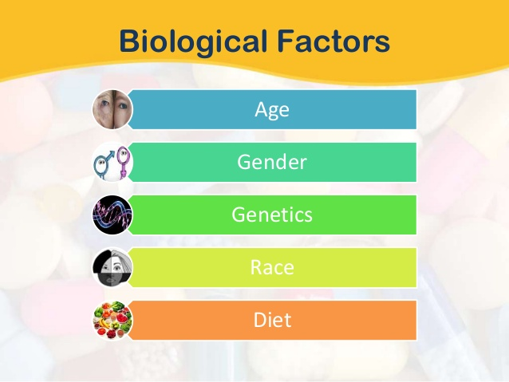
14-09-2024
7

Slide 8
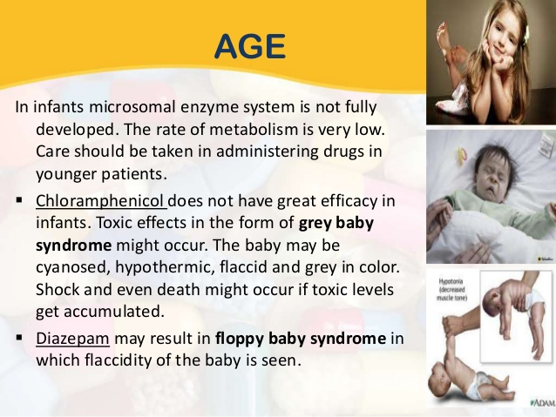
14-09-2024
8

Slide 9
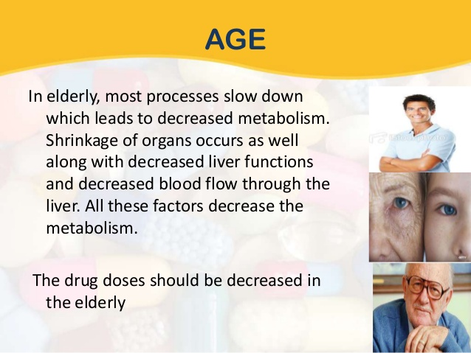
14-09-2024
9

Slide 10
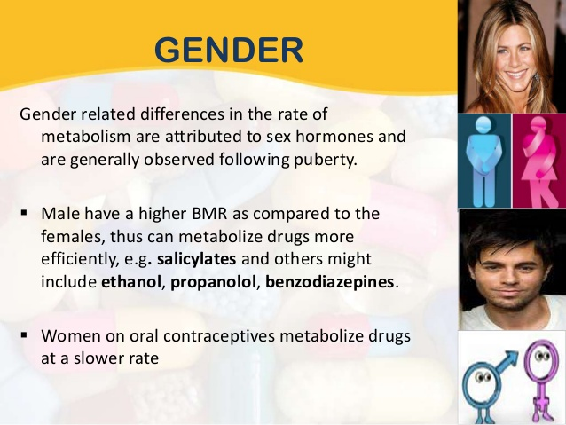
14-09-2024
10

Slide 11
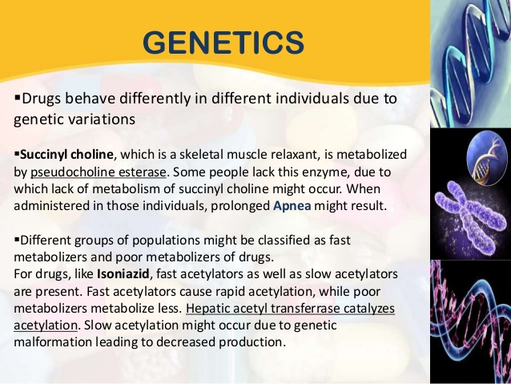
14-09-2024
11

Slide 12
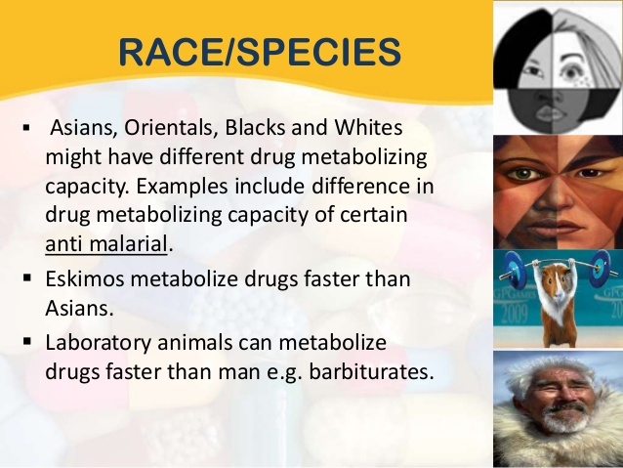
14-09-2024
12

Slide 13
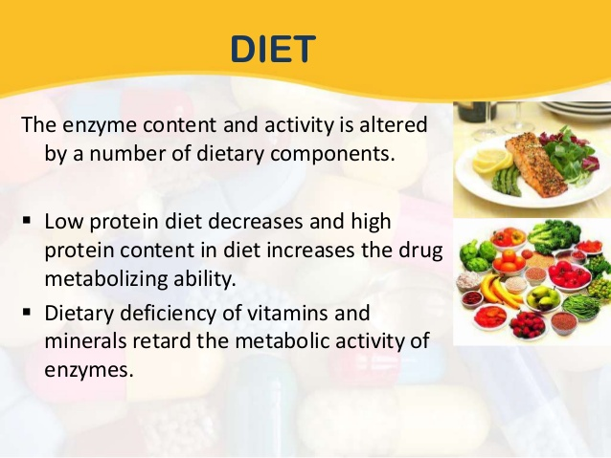
14-09-2024
13

Slide 14
SPECIES DIFFERENCES :
Qualitative & quantitative variation in the enzyme and their activity have been observed.
Drugs are metabolized in man more slowly than in laboratory animal with the exception of cat.
Barbiturates metabolism shows great differences in species.
Ex: Hexabarbitone rapidly metabolized in mouse(1/2life 19min.) whereas slow in man (1/2life 360min.)
Amphetamine metabolized by oxidative deamination in men while in rat by aromatic oxidation
STRAIN DIFFERENCES:
Enzyme influencing metabolic reactions are under the genetic control.
Differences in drug metabolizing ability between different species are related to genetics, so differences observed between the strains of the same animal species.
Differences observed in the metabolism of a drug among different races is called as Ethnic variations.
14-09-2024
14

Slide 15
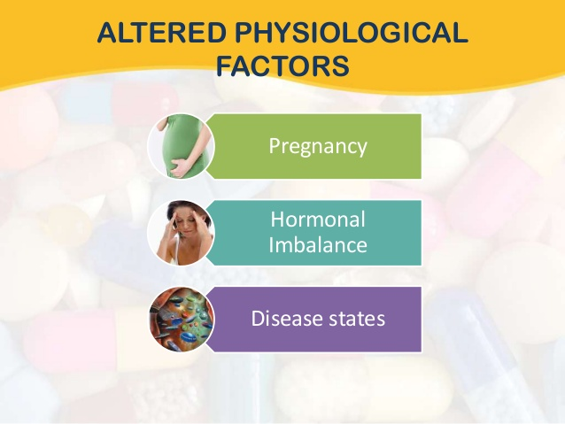
14-09-2024
15

Slide 16
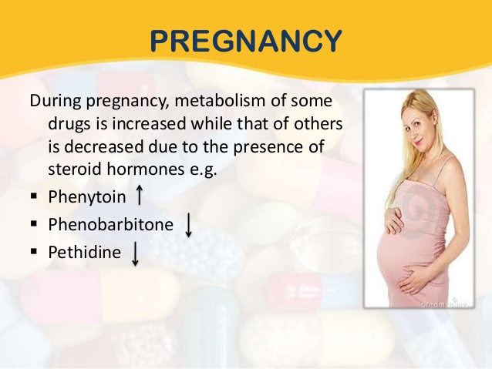
14-09-2024
16

Slide 17
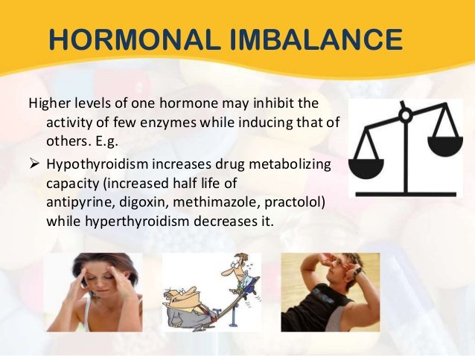
14-09-2024
17

Slide 18
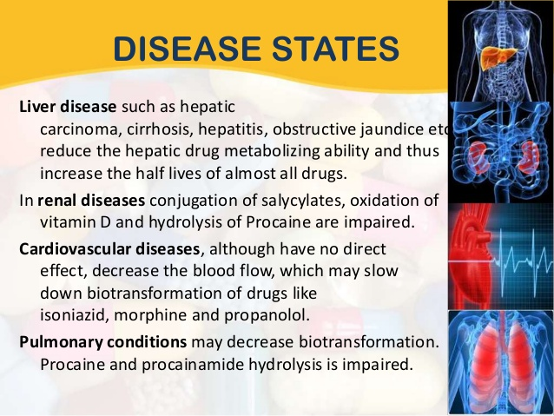
14-09-2024
18

Slide 19
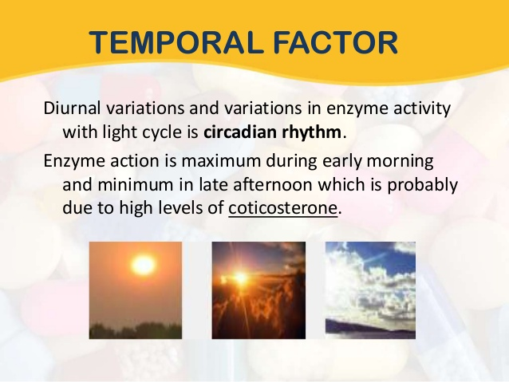
14-09-2024
19

