Slide 1
Clinical Pharmacy
Fluid and Electrolyte balance
1

Slide 2
Introduction
To achieve homeostasis, the body maintains strict control of water and electrolyte distribution and of acid-base balance.
This control is a function of the complex inter play of cellular membrane forces, specific organ activities and systemic and local hormone actions.
2

Slide 3
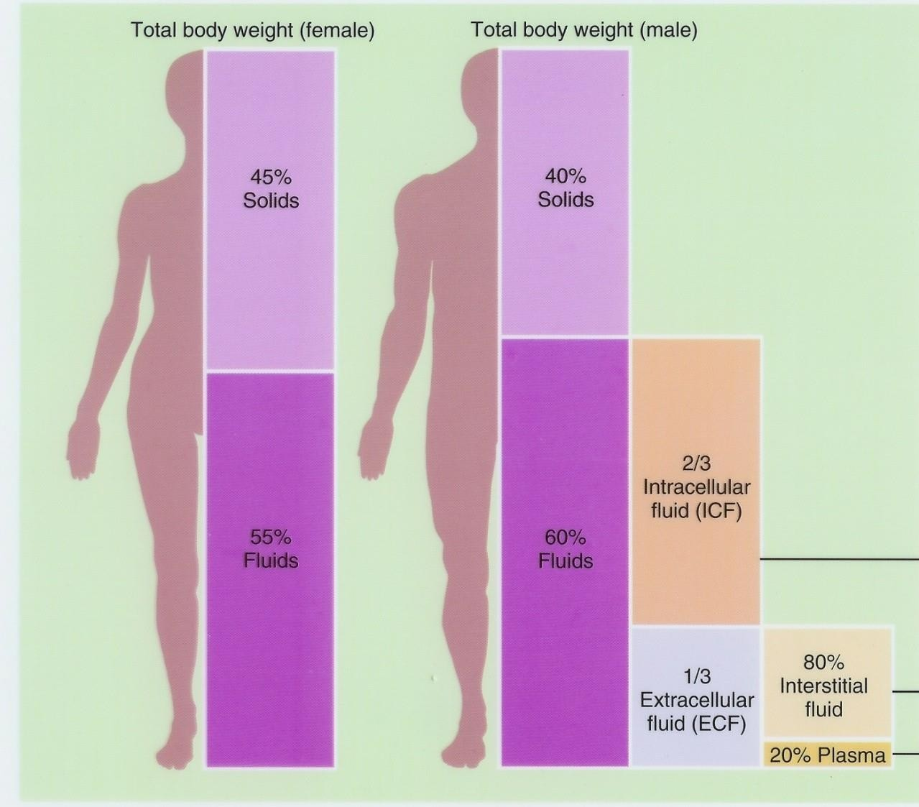
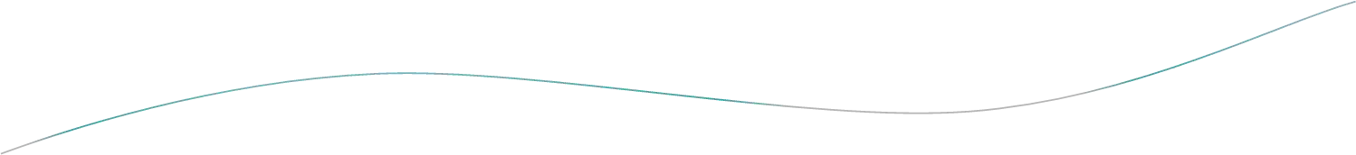
Total body water (TBW)
3
5

Slide 4
Water constitutes an average 50 to 70% of the total body weight.
Young males | - | 60% | of total body weight
Older males – |  | 52%
Young females – |  | 50% | of total body weight
Older females – |  | 47%
Variation of ±15% in both groups is normal.
Obese have 25 to 30% less body water than lean people.
Infants 75 to 80%
gradual physiological loss of body water.
65% at one year of age.

Slide 5

Sources of Body Fluids
Preformed water represents about 2,300 ml/day of daily intake.
Metabolic water is produced through the catabolic breakdown of nutrients occurring during cellular respiration. This amounts to about200 ml/d.
Combining preformed and metabolic water gives us total daily intake of 2,500 ml.

Slide 6
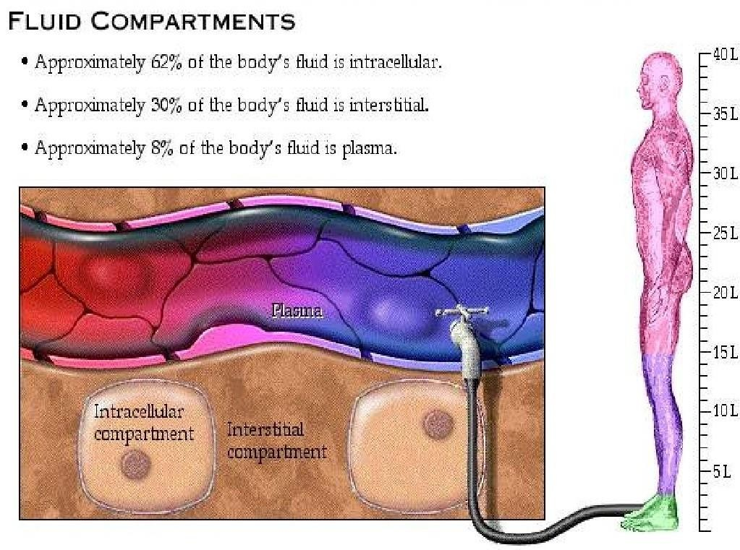
:

Slide 7
Functions
All chemical reactions occur in liquid medium.
It is crucial in regulating chemical and bioelectrical distributions within cells.
Transports substances such as hormones and nutrients.
O₂ transport from lungs to body cells.
CO₂ transport in the opposite direction.
Dilutes toxic substances and waste products and transports them to the kidneys and the liver.
  Distributes heat around the body.

Slide 8
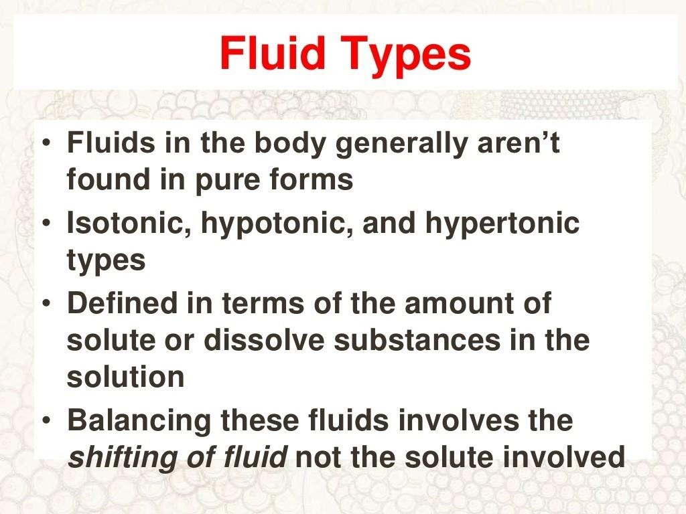

Slide 9
Composition of Body Fluids
Nonelectrolytes include most organic molecules, do not dissociate in water, and carry no net electrical charge.
Electrolytes dissociate in water to ions, and include inorganic salts, acids and bases, and some proteins.
The major cation in extracellular fluids is sodium, and the major anion is chloride; in intracellular fluid the major cation is potassium, and the major anion
is phosphate.
Electrolytes are the most abundant solutes in body fluids, but proteins and some nonelectrolytes account for 60-–97% of dissolved solutes.
8/17/2023 © R R INSTITUTIONS , BANGALORE
International Federation of Anti-Leprosy Associations (ILEP)

Slide 10
Principles of Body Water Distribution
Body control systems regulate ingestion and excretion:
- constant total body water
- constant total body osmolarity
Homeostatic mechanisms respond to changes in ECF.
No receptors directly monitor fluid or electrolyte balance.
- Respond to changes in plasma volume or osmotic concentrations

Slide 11
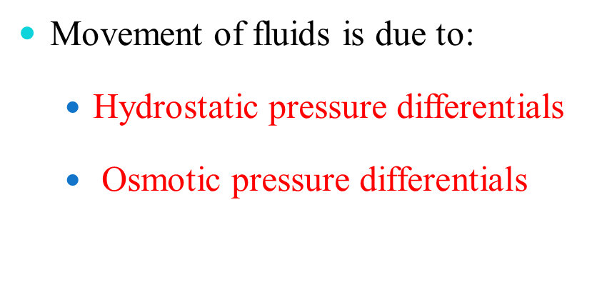
Fluid Movements

Slide 12

Movement of BODYFLUIDS
Diffusion Osmosis
Active Transport Filtration

Slide 13




















Osmosis
Fluid
Low Solute Concentration, High Fluid Concentration
High Solution Concentration, Low Fluid
Concentration
13

Slide 14




















Diffusion
Fluid
Solutes
High Solute Concentration
Low Solute Concentration
14

Slide 15
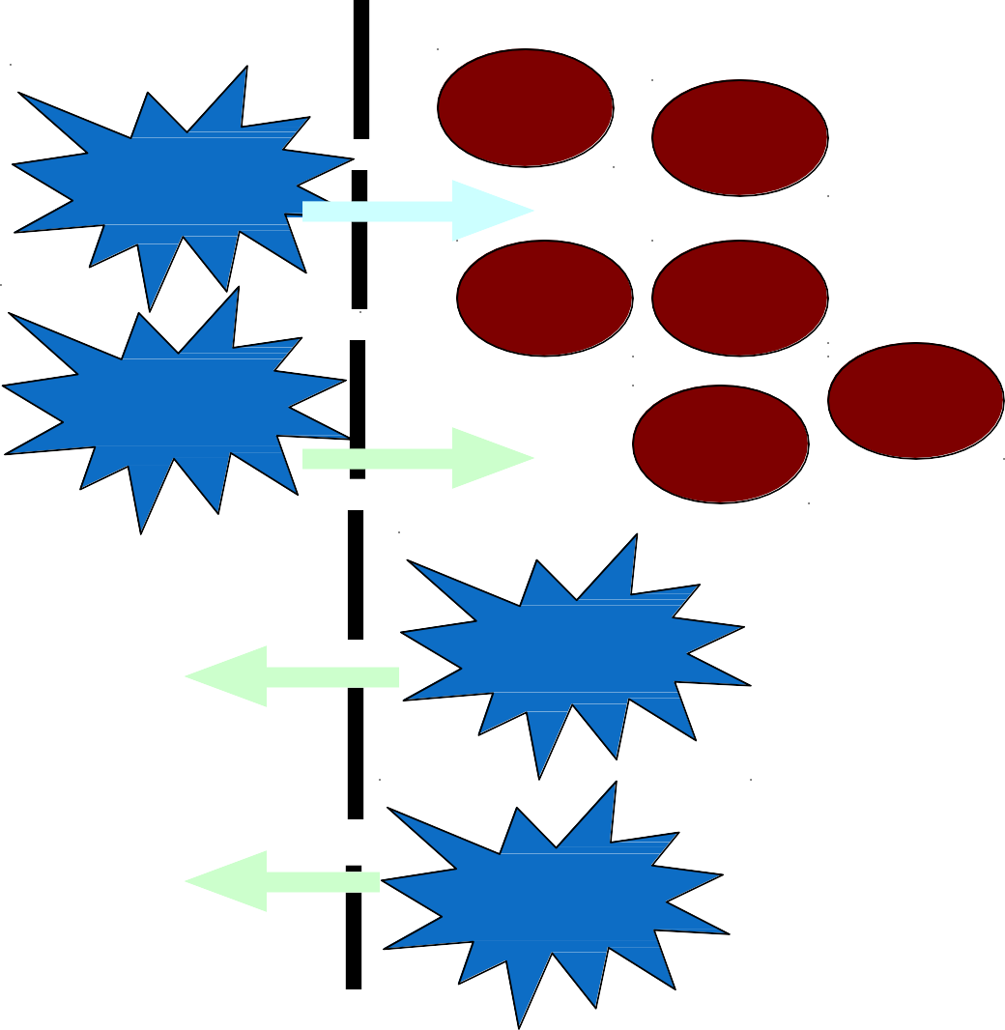
Active transport
Na +
Na +
Na + _{Na + Na +}
ATP
Na + Na + ^{Na +} _{Na}
Na +
Na +
Na +
Na +
+
Na +
Na +
Na +
ATP
Na +
Na +
Na +
Na +
K
+
K
+
K
K
+ K
+ K
+
K
+
K
+ K
ATP
K +
K
+ K
+
K
K +
K
+
ATP
K +
K +
₊₊ ++ ++
INTRACELLULAR
EXTRACELLULAR
FLUID
FLUID
15

Slide 16
Filtration
Filtration is the transport of water and dissolved
materials through a membrane from an area of higher pressure
to an area of lower pressure

Slide 17

Fluid Movement Among Compartments
Compartmental exchange is regulated by
osmotic and hydrostatic pressures.
Net leakage of fluid from the blood is picked up by lymphatic vessels and returned to the bloodstream.
Exchanges between interstitial and intracellular fluids are complex due to the selective permeability of the cellular membranes.
Two-way water flow is substantial.
Ion fluxes are restricted and move
selectively by active transport. Nutrients, respiratory gases, and wastes move unidirectionally.
Plasma is the only fluid that circulates throughout the body and links external and internal environments.
Osmolalities of all body fluids are equal; changes in solute concentrations are quickly followed by osmotic changes.

Slide 18

Water —
Two liters of water per day are generally sufficient for adults.
Most of this minimum intake is usually derived from the water content of food and the water of oxidation, therefore.
it has been estimated that only 500ml of water needs be imbibed given normal diet and no increased losses.
These sources of water are markedly reduced in patients who are not eating and so must be replaced by maintenance fluids.

Slide 19
water requirements increase with:
fever, sweating, burns, tachypnea, surgical drains, polyuria,
or ongoing significant gastrointestinal losses.

Slide 20
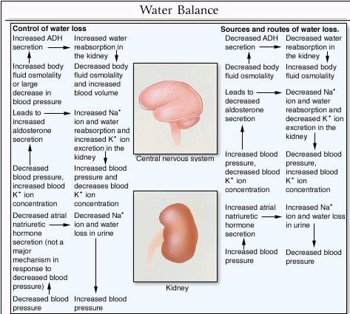

Slide 21
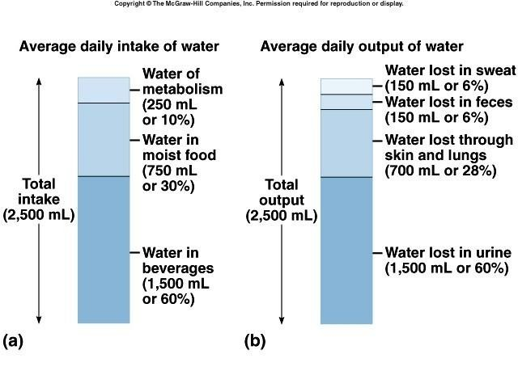
Fluid Balance

Slide 22

Fluid Balance
The body tries to maintain homeostasis of fluids and electrolytes by regulating:
Volumes
Solute charge and osmotic load

Slide 23

Fluid balance
Normally, there is a balance achieved between our total daily intake and output of water.
Total fluid intake is modified by the induction of the sensation of thirst.
This is produced by a reaction of cells in Hypothalamus to the increased osmotic pressure of the blood passing through this region.
Another stimulus of thirst would be the degree of dryness of the oral mucosa.

Slide 24
Regulation of body water
Any of the following:
Decreased amount of water in body
Increased amount of Na+ in the body
Increased blood osmolality
Decreased circulating blood volume
Results in:
Stimulation of osmoreceptors in hypothalamus
Release of ADH from the posterior pituitary
Increased thirst

Slide 25
Regulation of Water Intake
The thirst mechanism is triggered by a decrease in plasma osmolarity, which results in a dry mouth and excites the hypothalamic thirst center. Thirst is quenched as the mucosa of the mouth is moistened, and continues
with distention of the stomach and intestines, resulting in inhibition of the
hypothalamic thirst center.

Slide 26
Regulation of Water Output
Drinking is necessary since there is obligatory water loss due to the insensible water losses.
Beyond obligatory water losses, solute concentration and volume of urine depend on fluid intake.

Slide 27
Influence of ADH
.
The amount of water reabsorbed in the renal collecting ducts is proportional to ADH release.
When ADH levels are low, most water in the collecting ducts is not reabsorbed, resulting in large quantities of dilute urine.
When ADH levels are high, filtered water is reabsorbed, resulting in a lower volume of concentrated urine.
ADH secretion is promoted or inhibited by the hypothalamus in response to changes in solute concentration of extracellular fluid, large changes in blood volume or pressure, or vascular baroreceptors

Slide 28


Problems of Fluid Balance
Deficient fluid volume Hypovolemia Dehydration
Excess fluid volume
Hypervolemia
Water intoxication Electrolyte imbalance
Deficit or excess of one or more electrolytes
Acid-base imbalance

Slide 29


Factors Affecting Fluid Balance
Lifestyle factors Nutrition Exercise Stress
Physiological factors Cardiovascular Respiratory Gastrointestinal Renal Integumentary Trauma
Developmental factors Infants and children
Adolescents and middle-aged adults Older adults
Clinical factors Surgery Chemotherapy Medications
Gastrointestinal intubation Intravenous therapy
8/17/2023
© R R INSTITUTIONS , BANGALORE

Slide 30


Slide 31
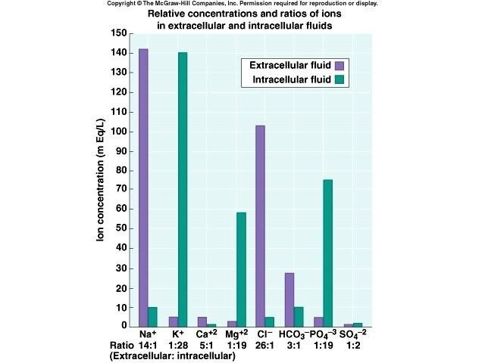
Electrolytes

Slide 32
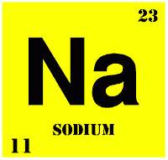
Electrolyte balance
Na⁺ Predominant extracellular cation
136 -145 mEq / L
Pairs with Cl⁻ , HCO ⁻ to neutralize charge
3
Most important ion in water balance
Important in nerve and muscle function
Reabsorption in renal tubule regulated by:
Aldosterone Renin/angiotensin Atrial Natriuretic Peptide (ANP

Slide 33
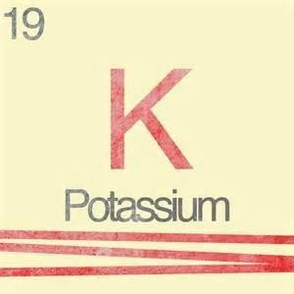
Electrolyte balance
_{K} +
Major intracellular cation 150- 160 mEq/ L
Regulates resting membrane potential Regulates fluid, ion balance inside cell
•
•
•
Regulation in kidney through:
•
•
Aldosterone Insulin

Slide 34
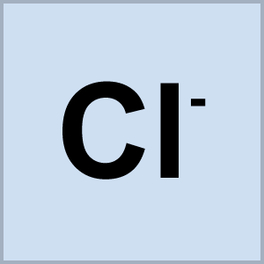
Electrolyte balance
Cl ˉ (Chloride)
Major extracellular anion
105 mEq/ L Regulates tonicity
Reabsorbed in the kidney with sodium
•
Regulation in kidney through:
•
•
Reabsorption with sodium
Reciprocal relationship with bicarbonate

Slide 35
SODIUM HOMEOSTASIS
Normal dietary intake is 6-15g/day.
Sodium is excreted in urine, stool, and sweat.
Urinary losses are tightly regulated by renal mechanisms.

Slide 36
Sodium abnormalities
Hypernatremia:
Defined as a serum sodium concentration that exceeds
150mEq/L.
Always accompanied by hyperosmolarity.

Slide 37
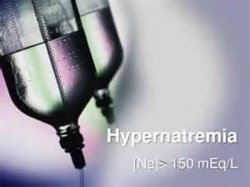
Etiology
Excessive salt intake
Excessive water loss Reduced salt excretion Reduced water intake
Administration of loop diuretics Gastrointestinal losses

Slide 38
Treatment:
Restore circulating volume with isotonic saline solution After intravascular vol. correction hypernatremia is corrected using free water.

Slide 39

Hyponatremia
Serum sodium concentration less than 135mEq/L .
Renal losses caused by diuretic excess, osmotic diuresis, salt- wasting nephropathy, adrenal insufficiency, proximal renal tubular acidosis, metabolic alkalosis, and pseudohypoaldosteronism result in a urine sodium concentration greater than 20 mEq/L
Extrarenal losses caused by vomiting, diarrhea, sweat, and third spacing result in a urine sodium concentration less than 20 mEq/L

Slide 40
Etiology
Excessive water intake
Impaired renal water excretion Loss of renal diluting capacity

Slide 41
Treatment of Hyponatremia
Correct serum Na by 1mEq/L/hr
Use 3% saline in severe hyponatremia. Goal is serum Na 130.

Slide 42
Hypochloremia
Most commonly from gastric losses
Often presents as a contraction alkalosis with paradoxical aciduria (Na+ retained and H+ wasted in the kidney)
Treatment : resuscitation with normal saline.

Slide 43
Hyperchloremia
Most commonly from over-resuscitation with normal saline.
Often presents as a hyperchloremic acidemia with
paradoxical alkaluria.
Rx: stop normal saline and replace with hypotonic crystalloid.

Slide 44
Hypokalemia
Serum K⁺< 3.5 mEq /L

Slide 45
Causes of Hypokalemia
Decreased intake of K⁺ Increased K⁺ loss
Chronic diuretics
Severe vomiting/diarrhea
Acid/base imbalance Trauma and stress Increased aldosterone
Redistribution between ICF and ECF

Slide 46
Hyperkalemia
Serum K+ > 5.5 mEq / L

Slide 47

Hyperkalemia
Management
10% Calcium Gluconate or Calcium Chloride Insulin (0.1U/kg/hr) and IV Glucose
Lasix 1mg/kg (if renal function is normal)

Slide 48
Hypokalemia:
Serum potassium level<3.5mEq/L
Etiology:
GI losses from vomiting, diarrhea, or fistula and use of diuretics

Slide 49
Treatment:
Correction of the underlying condition
K should be given orally unless severe(<2.5mEq/L), patient is symptomatic or the enteral route is contraindicated
Oral K supplements (60-80mEq/L) coupled with normal diet is sufficient. ECG monitoring along with frequent assessment of serum K level is reqiured

Slide 50
Calcium homeostasis
Body contains approx. 1400gm of calcium
Reduction in calcium level leads to increases calcium reabsorption from the bone.
It increases calcium reabsorption and stimulates the formation of the active metabolite of vit. D that increases gut reabsorption of elemental calcium and facilitates the action on the bone.

Slide 51
Calcium abnormalities
Hypercalcemia:
Ionized calcium conc. > 5.3mg/dL

Slide 52
Etiology: Hyperparathyroidism Cancer
Paget's disease
Pheochromacytoma Hyperthyroidism Thiazide diuretics

Slide 53
Treatment:
Severe hypercalcemia-
Initial supportive therapy includes furosamide to increase calcium excretion.
Calcitonin reduces bone resorption and has an immediate effect and lasts for 48 hrs. prolongation can be done by using corticosteroids

Slide 54
Hypocalcemia:
Ionized calcium conc. < 4.4mg/dL

Slide 55
Etiology:
Parathyroid or thyroid surgery Severe pancreatitis Magnesium deficiency Massive blood transfusion

Slide 56
Asymptomatic
Calcium supplementation is not required Symptomatic
IV calcium therapy- initially 100mg elemental calcium
over a period of 5-10mins.susequently, a calcium infusion of 0.5- 2mg/kg/hr is given.

