Slide 1
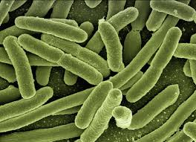
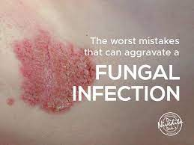
Fungal Infection
Infection Disease
By Animesh Das

Slide 2
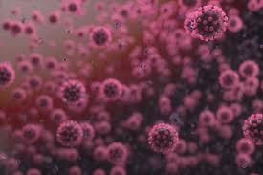
Definition
It is the disease caused by fungus , also called as mycosis . A fungus that indicates the tissue can cause a disease that confined to skin , spread into tissue bones and organs on affects the whole body .
Causative agent – Candida yeasts

Slide 3
Type / Classification
Type of fungi --
Endemic Fungi
Opportunistic Fungi
Type of fungal infection --
Superficial fungal infection [ skin , hair , nails ]
Deep fungal infection [ tissue , vital organ , immune ]

Slide 4
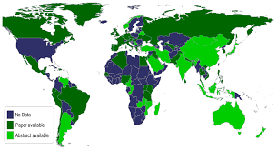
Epidemiology
4th most common cause of nosocomial blood stream infection accounting for 9 percentage cause in whole world .
most often parts of the host endogenous flora .
fungal zone – India , Pakistan , Saudi Arabia , Africa , United sates .

Slide 5
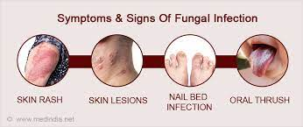
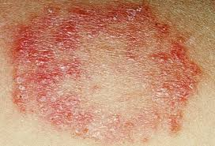
Sings and symptoms
Irritation.
Scaly skin.
Redness.
Itching.
Swelling.
Blisters

Slide 6
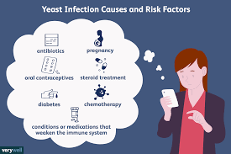
Risk factor
Colonization
Broad-spectrum antibiotics
Indwelling central catheter
Total parenteral nutrition
Immunosuppression
Burns
General measure of severity of illness

Slide 7
Mode of transmission
Incubation period --time between becoming infected and developing symptoms .
Spread

Slide 8
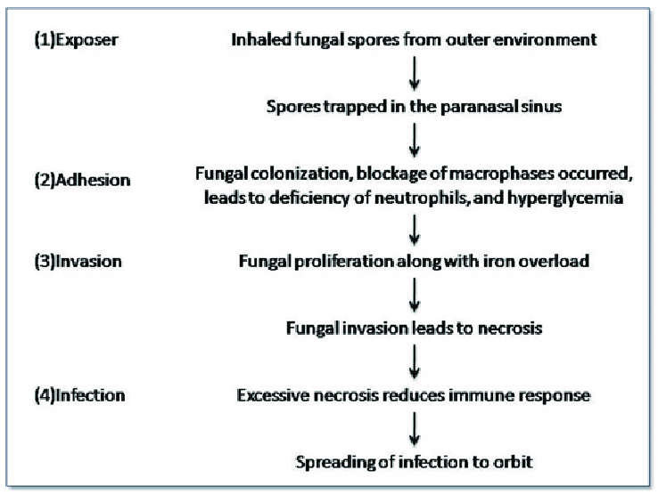
Pathogenesis

Slide 9
Management
Diagnosis
Treatment

Slide 10
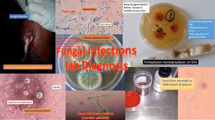
Diagnosis
ELISA .
Blood culture test .
Direct microscopy gram stanning.
Serological test for detection of capsular antigen.
in CSF latex test for diction of antigen .

Slide 11
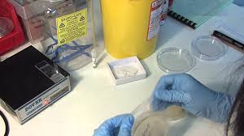
Investigation
Microscopic examination
Cultures
Wood’s light examination

Slide 12
Treatment
Category | Drug Name
Morpholine | Amorolfine
Antifungal | Amphotericin
Imidazole | Clotrimazole , Econazole , Ketoconazole
Triazoles | Fluconazole , Itraconazole
Azoles | Luliconazole

Slide 13
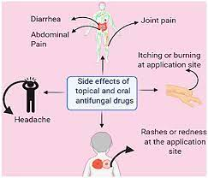
Side Effect of Antifungal medicine
Itching or Burring
Redness
Feeling sick
Tummy [ Abdominal pain ]
Diarrhoea
A rash

Slide 14
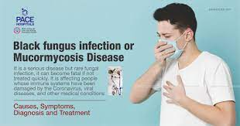
Complication
Abscess formation
Endocarditis
Meningitis
Nephritis
Organ failure
Transplant Rejection .

Slide 15
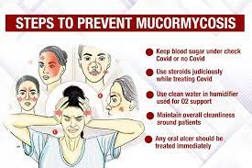
Prevention
keep your skin clean and dry , particularly the folds of your skin .
Washy your hand often epically after touching animals or other things .
Avoid using other people towels and other personal care products .
Wear shoes in locker rooms , community showers and swimming pools .

Slide 16
Thank
you

