Slide 1
PHARMACOTHERAPEUTICS-III
UNIT NO- 01 GASTROINTESTINAL SYSTEM
23-07-2020
1

Slide 2
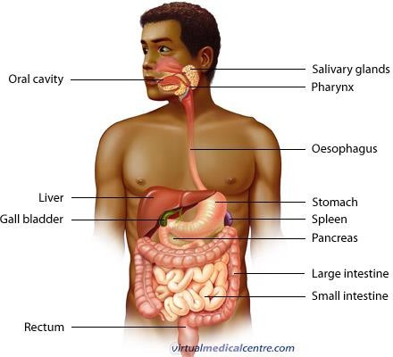
TOPIC NAME – GASTROINTESTINAL SYSTEM
The gastrointestinal tract (GIT) consists of a hollow muscular tube starting from the oral cavity, where food enters the mouth, continuing through the pharynx, oesophagus, stomach and intestines to the rectum and anus, where food is expelled.
23-07-2020
2

Slide 3
GASTROINTESTINAL SYSTEM- ITRODUCTION
The primary purpose of the gastrointestinal tract is to break food down into nutrients, which can be absorbed into the body to provide energy.
First food must be ingested into the mouth to be mechanically processed and moistened.
Secondly, digestion occurs mainly in the stomach and small intestine where proteins, fats and carbohydrates are chemically broken down into their basic building blocks.
Smaller molecules are then absorbed across the epithelium of the small intestine and subsequently enter the circulation.
The large intestine plays a key role in reabsorbing excess water.
Finally, undigested material and secreted waste products are excreted from the body via defecation (passing of faeces).

Slide 4
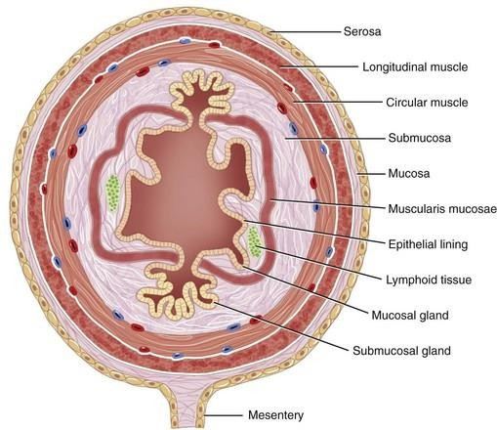
BASIC STRUCTURE:

Slide 5
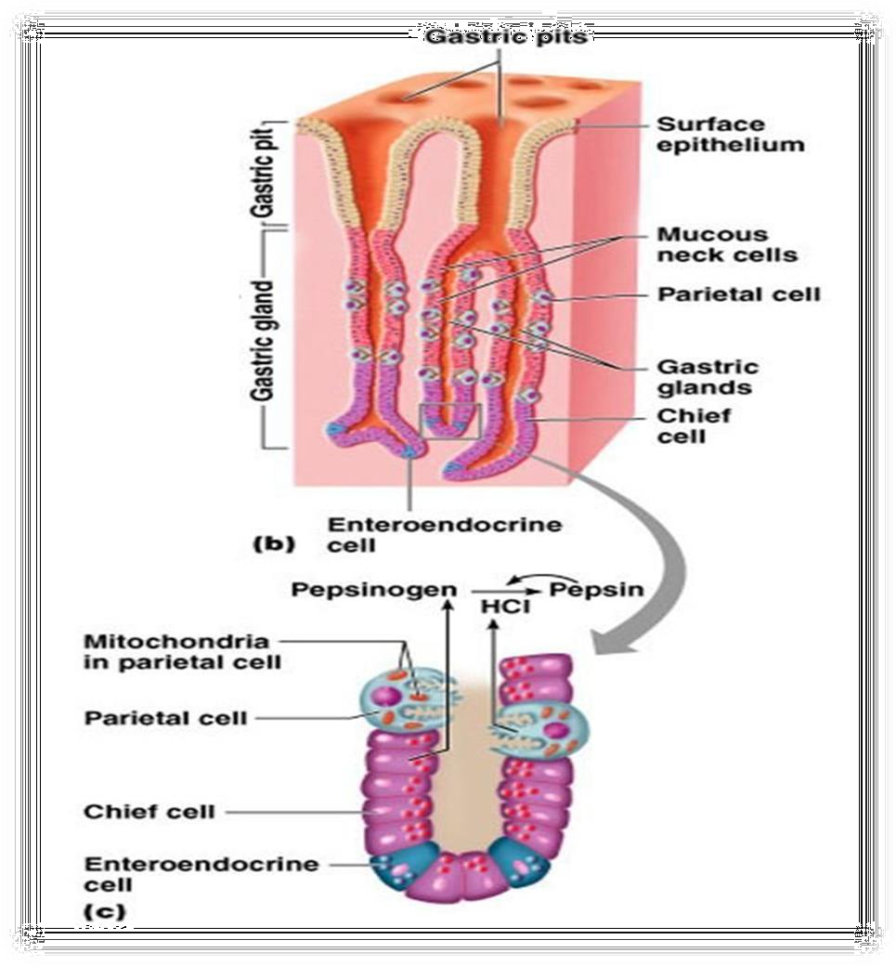
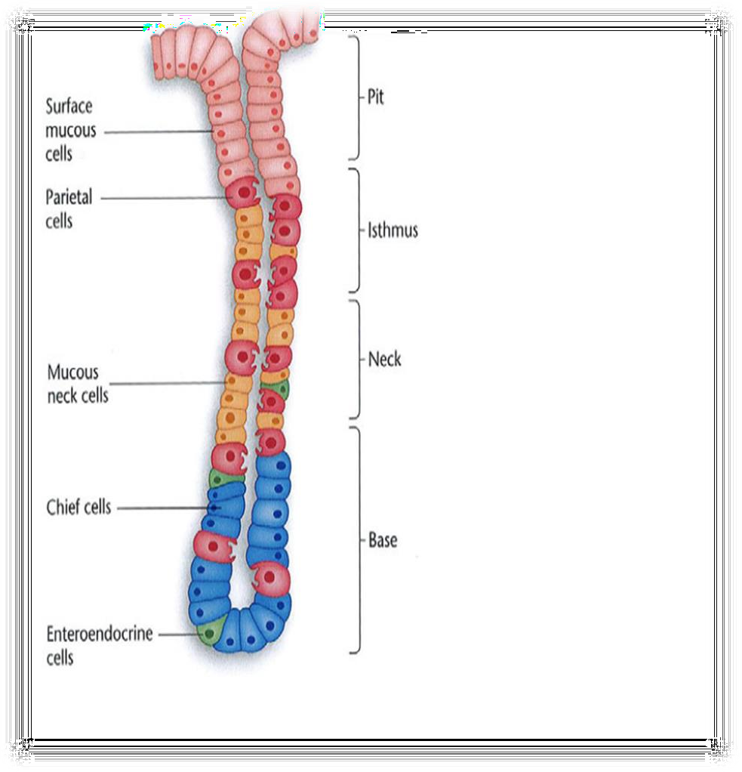
PHYSIOLOGY OF ACID PRODUCTION

Slide 6
PEPTIC ULCER DISEASE
Peptic Ulcer is a lesion in the lining (mucosa) of the digestive tract, typically in the stomach or duodenum, caused by the digestive action of pepsin and stomach acid. Lesion may subsequently occur into the lamina propria and submucosa to cause bleeding. – Most of peptic ulcer occur either in the duodenum, or in the stomach – Ulcer may also occur in the lower esophagus due to refluxing of gastric content – Rarely in certain areas of the small intestine

Slide 7
EPIDEMIOLOGY
Peptic ulcers are common and it has been estimated that up to 10%of the population has an ulcer and annual incidence of symptomatic peptic ulcer about 0.3%
Duodenal ulcers are four times as common as gastric ulcers and occur mainly in the duodenal cap.
Gastric ulcers occurs mostly in the lesser curvature of the stomach. These are benign, some time develop as a tumors (5%).
Gastric malignancy is common in Japan, Finland and Iceland than other world countries (because of environmental and diet factors)

Slide 8
ETIOLOGY/ RISK FACTORS
Lifestyle
Smoking
Acidic drinks
Medications
H. Pylori infection
90% have this bacterium
Passed from person to person (fecal-oral route or oral-oral route)
Age
Duodenal 30-40
Gastric over 50
Gender
Duodenal: are increasing in older women
Genetic factors
More likely if family member has Hx
Other factors: stress can worsen but not the cause

Slide 9
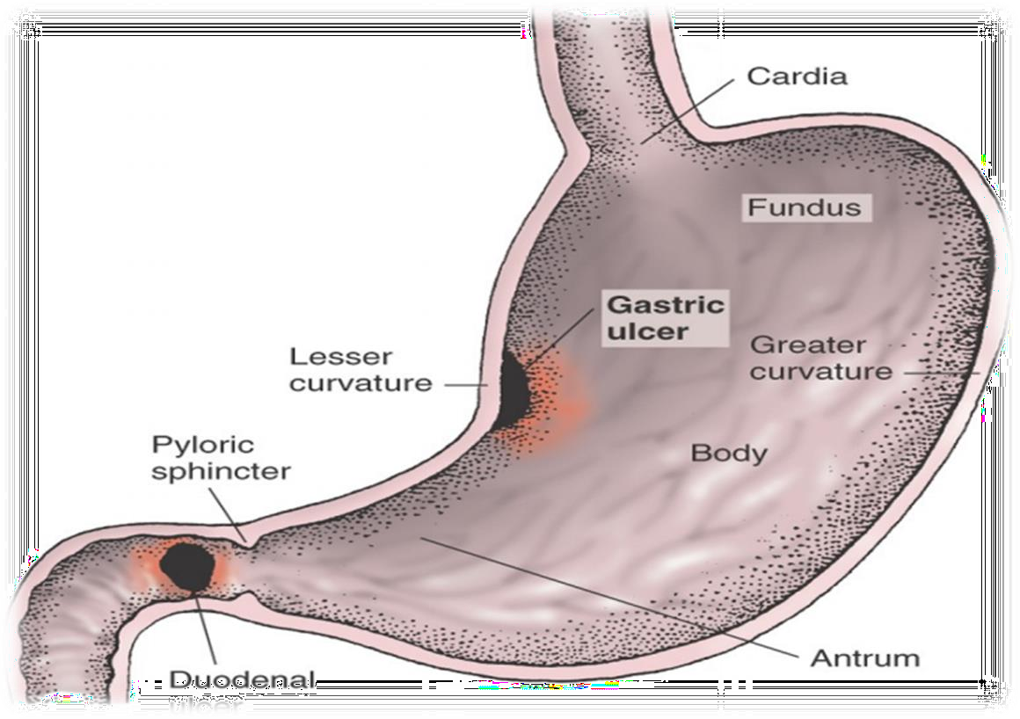
TYPES
GASTRIC ULCER
DUODENAL ULCER

Slide 10
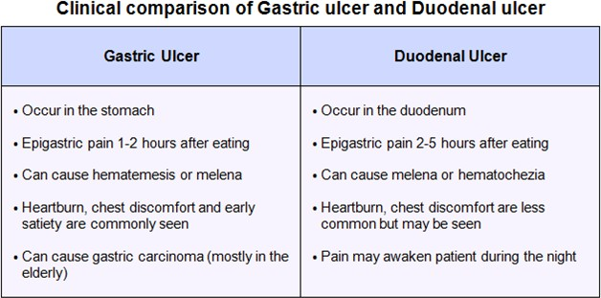
10

Slide 11
CLINICAL PRESENTATIONS:
Abdominal discomfort usually occurs in epigastric area (upper middle part of the abdomen) radiating to the back described as:
dull gnawing ache comes and goes for several days
pain may increase when the stomach is empty at night or half to three hours after meal.
Pain is relieved by eating & antacid medication.
Weight change
Fatigue
Bloating
Chest pain
Burping
Nausea and Anorexia (common with gastric ulcer)
Vomiting (relieves episodes of severe pain due to evacuation of gastric acid content).
Less common symptoms:
Constipation and 5% of the patients with chronic duodenal ulcers has predominantly colonic symptoms.
Heartburn and eructation are also commonly associated with ulcer activity

Slide 12
PATHOPHYSIOLOGY
H. PYLORI BACTERIUM (HELICOBACTER PYLORI)
Bacteria lives in the stomach and they feed on gastric surfactant.
The H. pylori bacteria excretes the enzyme urease, which converts urea into ammonia and bicarbonate.
The release of ammonia ‘neutralize’ the acidic environment in the stomach, which explains the difficulty in destroying the
H. pylori bacterium.
Ammonia is toxic to the epithelial cells and damages them; hence the beginning of a stomach ulcer takes its course.

Slide 13
NSAIDs
NSAIDs are medications for arthritis and other painful inflammatory conditions in the body.
Aspirin, Ibuprofen (Motrin), Naproxen (Naprosyn), and Etodolac (Lodine) are a few of the examples of this class of
medications.
NSAIDs cause ulcers by interfering with prostaglandins in the stomach & prevent PGE2 synthesis.
Prostaglandins are substances which are important in helping the gut linings resist corrosive acid damage.
Local prostaglandins production PGE2 will decrease HCl production and also decreases the damaging factors.
Increase in bicarbonate (production of gastric bicarbonate which is trapped in the mucus layer thus creating a PH gradient from 1-2 at gastric lumen, 6-7 at surface of mucosa).
Mucus production (mucus mucopolysaccharides resistant to action of proteolytic enzymes) acts as a protective factors

Slide 14
COMPLICATIONS OF PEPTIC ULCER
Internal bleeding
  Internal bleeding is the most common complication of stomach ulcers. It can occur when an ulcer develops at the site of a blood vessel.
  The bleeding can either be:
  slow, long-term bleeding, leading to anaemia– causing fatigue, breathlessness, pale skin and heart palpitations (noticeable heartbeats)
  rapid and severe bleeding – causing you to vomit blood or pass stools that are black, sticky and tar-like.
Perforation
  A rarer complication of stomach ulcers is the lining of the stomach splitting open, known as perforation.
  This can be very serious because it enables the bacteria that live in your stomach to escape and infect the lining of your abdomen (peritoneum). This is known as peritonitis.
  In peritonitis, an infection can rapidly spread into the blood (sepsis) before spreading to other organs. This carries the risk of multiple organ failure and can be fatal if left untreated.
  The most common symptom of peritonitis is sudden abdominal pain that gets steadily worse.

Slide 15
COMPLICATIONS OF PEPTIC ULCER
Gastric outlet obstruction
In some cases, an inflamed (swollen) or scarred stomach ulcer can obstruct the normal passage of food through your digestive system. This is known as gastric outlet obstruction.
Symptoms can include:
  repeated episodes of vomiting, with large amounts of vomit that contain undigested food
  a persistent feeling of bloating or fullness
  feeling very full after eating less food than usual
  unexplained weight loss
  An endoscopy can be used to confirm the obstruction. If the obstruction is caused by inflammation, proton pump inhibitors (PPIs) or H2-receptor antagonists can be used to reduce stomach acid levels until the swelling goes down.
  If the obstruction is caused by scar tissue, surgery may be needed to treat it, although it can sometimes be treated by passing a small balloon through an endoscope and inflating it to widen the site of the obstruction.

Slide 16
DIAGNOSIS
Endoscopic biopsy: A piece of stomach tissue is removed so it can be analyzed in a lab.
Urea breath test: The breath test is the most accurate non- invasive tests, detects the active H. Pylori infection and is also effective after eradication treatment. The non- radioactive isotope (C13) and radioactive isotope (C14) tests required that the patient ingest radiolabelled urea, which is then hydrolyzed by H Pylori to ammonia and radiolabelled bicarbonate. The radiolabelled bicarbonate is absorbed in the blood and detected in expired breath.
Fecal antigen test: identifies H. Pylori antigen in the stool and is less expensive and easier to perform than the UBT.
Fasting serum gastrin concentration: recommended for patients unresponsive to therapy for those suspected of having a hypersecretory disease.
Serum hematocrit and fecal occult blood tests assist in the evaluation of ulcer- related bleeding.
Fiber optic upper endoscopy (esophagogastroduodenoscopy- EGD) is a gold standard, as it detects greater than 90% of peptic ulcers and permits direct inspection, biopsy, visualization of superficial erosions and site of active bleeding.

Slide 17
MANAGEMENT OF PEPTIC ULCER
Non- pharmacological treatment
Pharmacological treatment

Slide 18
NON-PHARMACOLOGICAL TREATMENT
Discontinue NSAIDs
Avoid spicy food, caffeine and alcohol
Reducing stress and decrease or stop cigarette smoking
Probiotics, especially strains of lactic- acid producing bacteria such as lactobacillus and bifictobacterium, lactoferrin and food stuffs have been used to supplement H.Pylori eradication.

Slide 19
CLASSIFICATION
Acid Neutralizing agents: (ANTACIDS)
Systemic: Sodium Bicarbonate and Sod. Citrate
Nonsystemic: Magnesium hydroxide, Mag. Treisilicate, Aluminium hydroxide gel
Reduction in Gastric acid secretion:
H2 antihistamines: Cimetidine, Ranitidine, Famotidine, Nizatidine and Roxatidine
Proton pump inhibitors: Omeprazole, Lansoprazole Pantoprazole, Rabeprazole and Esomeprazole
Anticholinergics: Pirenzepine, Propantheline and Oxyphenonium
Prostaglandin analogue: Misoprostol
Ulcer protectives: Sucralfate, Colloidal Bismuth subcitrate
Anti-H. pylori Drugs: Amoxicillin, Clarithromycin, metronidazole, tinidazole and tetracycline

Slide 20
ACID NEUTRALIZING AGENTS: (ANTACIDS)
OVER THE COUNTER and are taken by mouth for quick relief.
Treatment with antacids alone is symptomatic and only justified for minor symptoms.
Antacids are distinct from acid-reducing drugs like H2-receptor antagonists or proton pump inhibitors and they do not kill the bacteria Helicobacter pylori, which causes most ulcers.
Fast onset of action makes them first choice for serious PUD for all patients and for every condition of PUD.
Antacids contain alkaline ions that chemically neutralize stomach gastric acid, reducing damage and relieving pain.
Systemic
Sodium bicarbonate is a systemic alkalizer, which increases plasma bicarbonate, buffers excess hydrogen ion concentration, and raises blood pH, thereby reversing the clinical manifestations of acidosis.
Sodium bicarbonate acts as an antacid and reacts chemically to neutralize or buffer existing quantities of stomach acid but has no direct effect on its output. This action results in increased pH value of stomach contents, thus providing relief of hyperacidity symptoms.

Slide 21
Non-Systemic
Aluminum hydroxide, Calcium carbonate, Magnesium hydroxide are a basic inorganic salts Acts by neutralizing hydrochloric acid in gastric secretions.
Aluminum hydroxide is slowly solubilized in the stomach and reacts with hydrochloric acid to form aluminium chloride and water.
It also inhibits the action of pepsin by increasing the pH and via adsorption. Cytoprotective effects may occur through increases in bicarbonate ion (HCO3-)and prostaglandins.
EXAMPLES : Aluminium hydroxide, Magnesium hydroxide, Aluminum hydroxide with magnesium hydroxide, Aluminum carbonate gel, Calcium carbonate, Sodium bicarbonate, Hydrotalcite [Mg6Al2 (CO3 )(OH)16 · 4(H2O)], Bismuth subsalicylate
21

Slide 22
REDUCTION IN GASTRIC ACID SECRETION: H2 ANTIHISTAMINES
Extremely safe drugs and well tolerated
Promote the healing of gastric and duodenal ulcers
Duodenal ulcer – 70 to 90%
Gastric Ulcer – 50 to 75% (NSAID ulcers))
Stress ulcer and gastritis GERD
EXAMPLES: Cimetidine, Ranitidine, Famotidine, Roxatidine, Nizatidine
MECHANISM OF ACTION
Reversible competitive inhibitors of H2 receptor
Highly selective, no action on H1 or H3 receptors
All phases of gastric acid secretion
Very effective in inhibiting nocturnal acid secretion (as it depends largely on Histamine )
Modest impact on meal stimulated acid secretion (as it depends on gastrin, acetylcholine and histamine)
Volume of pepsin content also reduced
Volume reduced by 60 – 70% - anti ulcerogenic effect
No effect on motility

Slide 23
REDUCTION IN GASTRIC ACID SECRETION: H2 ANTIHISTAMINES
Main ADRs are related to Cimetidine: Antiandrogenic effects
Increases prolactin secretion and inhibits degradation of estradiol by liver
Cytochrome P450 inhibition – theophylline, metronidazole, phenytoin, imipramine etc. Antacids
Others:
Headache, dizziness, bowel upset, dry mouth
Bolus IV – release histamine – bradycardia, arrhythmia, cardiac arrest
Elderly - precaution

Slide 24
PROTON PUMP INHIBITORS
Most effective drugs in antiulcer therapy
Prodrugs requiring activation in acid environment
Prototype: Omeprazole (Prilosec)
Examples: Lansoprazole, Pantoprazole, Rabeprazole, Esomeprazole
MECHANISM OF ACTION
Acts by irreversibly blocking the hydrogen/potassium adenosine triphosphatase enzyme system (the H+/K+ ATPase, or, more commonly, the gastric proton pump) of the gastric parietal cells.
Targeting the terminal step in acid production, as well as the irreversible nature of the inhibition, results in a class of drugs
that are significantly more effective than H2 antagonists and reduce gastric acid secretion by up to 99%.
Decreasing the acid in the stomach can aid the healing of duodenal ulcers and reduce the pain from indigestion and heartburn.

Slide 25
ANTICHOLINERGICS
Unpopular as a first choice because of high incidence of anticholinergic side effects (dry mouth and blurred vision)
(receptors on parietal cells are M3 )
Atropine:
Block the M1 class receptors
Reduce acid production
Abolish gastrointestinal spasm
Pirenzepine and Telenzepine:
Reduce meal stimulated HCl secretion by reversible blockade of muscarinic (M1) receptors on the cell bodies of the
intramural cholinergic ganglia

Slide 26
PROSTAGLANDIN ANALOGUE
Inhibit gastric acid secretion
Exhibit ‘cytoprotective’ activity
Enhance local production of mucus or bicarbonate
Promote local cell regeneration
Help to maintain mucosal blood
ONLY ONE DRUG IS IN MARKET MISOPROSTOL
(Reinforcing of mucous layer buffered by HCO3 secretion from epithelial cells)
Mechanism Of Action:
Inhibit histamine-stimulated gastric acid secretion
Stimulation of mucin and bicarbonate secretion
Increase mucosal blood flow
Therapeutic uses: Prevent ion of NSAID-induced mucosal injury (rarely used because it needs frequent administration – 4 times daily). Misoprostol is contraindicated in Pregnancy.

Slide 27
ULCER PROTECTIVES
Example:- Bismuth subsalicylate
Pharmacological actions:
Undergoes rapid dissolution in the stomach into bismuth and salicylates
Salicylates are absorbed
Bismuth coats ulcers and erosions protecting them from acid and pepsin and increases prostaglandin and bicarbonate production
Uses:
Treatment of dyspepsia and acute diarrhoea

Slide 28
ANTI-H. PYLORI DRUGS
ORAL DRUG REGIMENS USED TO ERADICATE H.PYLORI
Proton Pump inhibitor based 3- drug regimens
PPI- standard dose(a)- BID- 14days
Clarithromycin- 500mg- BID-14 days
Amoxicillin- 1g- BID- 14days
OR
PPI- standard dose(a)- BID- 14days
Clarithromycin- 500mg- BID-14 days
Metronidazole (c)- 500mg- BID-14 days
Bismuth based 4- drug regimens
Bismuth subsalicylate- 525mg, QID, 10-14 days
Metronidazole- 250-500mg, QID, 10-14 days
Tetracycline plus- 500mg, QID, 10-14 days
PPI- standard dose- BID- 10-14 days Or
H2RA-standard dose- BID- 4-6 weeks
Standard dose- cimetidine- 300mg QID, 400mg BID, 800mg daily
Famotidine- 20mg BID, 40mg HS Nizatidine- 150mg BID, 300mg HS Ranitidine- 150mg BID, 300mg HS
(a)- Omeoprazole- 20mg BID, Lansoprazole- 30mg BID, Pantoprazole- 40mg BID, Rabeprazole- 20mg daily, Esomeprazole-
20mg or 40mg BID
(c)- use Amoxicillin in non-penicillin allergic patients; Metronidazole for amoxicillin in penicillin- allergic patients

Slide 29
SEQUENTIAL THERAPY
PPI- standard dose- BID
Amoxacillin- 1gm- BID
For first 5 days
PPI- standard dose- BID
Clarithromycin- 250-500mg- BID
Metronidazole- 250-500mg- BID
For next 5 days

Slide 30
SECONDARY/ RESCUE THERAPY
Bismuth Subsalicylate- 525mg- QID- 10-14days
Metronidazole- 500mg- QID- 10-14 days
Tetracycline- 500mg- QID- 10-14 days
PPI- standard dose- BID
Or
PPI-Standard dose- BID- 10-14 days
Amoxicillin- 1g- BID- 10-14days
Levofloxacin- 500 mg- daily- 10-14 days

Slide 31
TREATMENT ALGORITHM

Slide 32
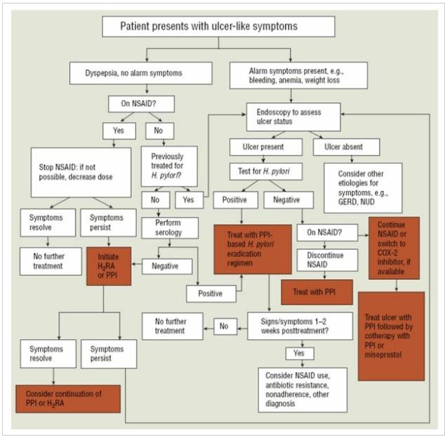

Slide 33
ERADICATION REGIMENS AFTER INITIAL TREATMENT FAILURE
After unsuccessful initial treatment with a PPI-amoxicillin-clarithromycin regimen, empiric second-line therapy should be instituted with bismuth subsalicylate, metronidazole, tetracycline, and a PPI for 10 to 14 days .
When metronidazole resistance is suspected, metronidazole may be replaced by furazolidone (100 mg four times a day) in either the proton pump inhibitor-based three-drug regimen or the bismuth-based four-drug regimen.
When furazolidone is used, patients should be counseled not to ingest alcohol or monoamine oxidase inhibitors.

Slide 34
CURLING ULCER (STRESS-INDUCED GASTRIC)
Stress ulcers are stress-induced gastritis or gastropathy where the gastric and sometimes esophageal or duodenal mucosal barrier is disrupted secondary to a severe acute illness.
The stress ulcers secondary to systemic burns are known as Curling ulcer, stress ulcers in patients with acute traumatic brain injury are known as Cushing ulcer.
The gastric body and fundus are common locations for stress ulcerations but can also be seen in antrum and duodenum.

Slide 35
EPIDEMIOLOGY
The incidence of stress ulceration and its complications are known to be declining with the advent of active prophylaxis methods for the prevention of stress-related gastritis.
Patients with GI bleeding secondary to stress ulceration have increased morbidity and mortality compared to those who do not have GI bleed.
Hence stress ulcer prophylaxis has been the center of many randomized clinical trials.
Very rarely (less than 1% of the times), stress ulcers can cause perforation and perforation related complications.

Slide 36
ETIOLOGY
The major risk factors for the development of stress ulcerations include:
Mechanical ventilation for more than 48 hours
Abnormal coagulation profile such as platelet count less than 50,000, INR greater than 1.5 and PTT greater than 2
times the control value
Sepsis or septic shock
Use of vasopressors
Use of high dose systemic corticosteroids (more than 250 mg or the equivalent of hydrocortisone per day)
Hepatic failure
Renal failure
Multi-organ failure
Burns of more than 30% of body surface area
Head trauma
Lack of sanitation during intensive care unit (ICU) stay
History of GI bleeds within a year

Slide 37
PATHOPHYSIOLOGY
Stress ulceration results from damage to the mucosal barrier secondary to systemic stress resulting in multiple superficial erosions of the gastric mucosa.
The possible pathological changes leading to ulceration can be an impaired mucosal barrier where the mucosal glycoprotein is denuded by increased concentrations of refluxed bile salts or uremic toxins due to a critical illness.
Increased secretion of gastric acid in response to higher secretion of gastrin hormone in patients is also thought to be responsible for stress ulceration.
However, this is more commonly seen in patients with acute neurological trauma than other stress-related diseases.

Slide 38
DIAGNOSIS
Gastric lavage can be used to confirm whether blood is present in the upper gastrointestinal tract or not. It also helps to quantify the amount of blood if found.
Esophagogastroduodenoscopy should be performed. Stress ulcers are seen as small superficial mucosal erosions or ulcerations in the gastric body and fundus. Testing for H. pylori infection like urease breath test or stool antigen test can also be undertaken for refractory stress ulceration.

Slide 39
MANAGEMENT
The nonpharmacological interventions include early enteral feeding, NG tube placement intravenous fluid resuscitation, blood transfusion, and reversal of coagulopathy by platelets transfusion or transfusion of fresh frozen plasma or cryoprecipitate.
The medication targeting acid peptic disease includes proton pump inhibitors, antihistaminic, and ulcer-healing drugs like sucralfate.
Surgical interventions are commonly indicated for patients with refractory bleeding despite endoscopic or angiographic treatment or patients with unstable hemodynamics to undergo endoscopic or angiographic procedures

