Slide 1





Slide 2

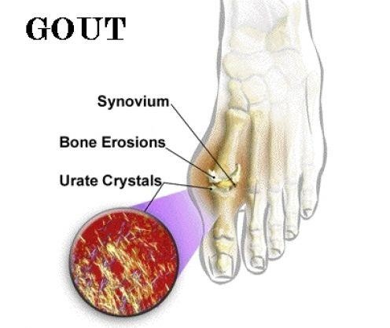


Slide 3
 Gout is a disease that most commonly manifests as recurrent episodes of acute joint pain and inflammation secondary to the deposition of monosodium urate (MSU) crystals in the synovial fluid and lining
 It is the result of an increased body pool of urate with hyperuricemia.
 It is typically characterized by episodic acute and chronic arthritis

Slide 4
The term gout describes a disease spectrum including
 Hyperuricemia,
 Recurrent attacks of acute arthritis associated with monosodium urate crystals in leukocytes found in synovial fluid,
 Deposits of monosodium urate crystals in tissues,
 Interstitial renal disease, and
 Uric acid nephrolithiasis.

Slide 5
 A urate concentration > 7.0 mg/dL is abnormal and associated
with an increased risk for gout.
 Hyperuricemia and gout arenot always concurrently present.
 Sustained elevation of serum urate is virtually essential for the development of gout
 However, hyperuricemia does not always lead to gout, and most patients with hyperuricemia remain asymptomatic.

Slide 6
Uric acid is the ﬁnal metabolite of endogenous and dietary
purine metabolism.

At a physiological pH of 7·4 in the extracellular compartment, 98% of uric acid is in the ionised form of urate.
Because of the high concentration of sodium in the extracellular compartment, urate is largely present as monosodium urate, with a low solubility limit of about 380 μmol/L.
 MSU Crystals forms in synovial fluid when its solubility limit exceeded

Slide 7
 The solubility of urate in physiologic saline is 6.8 mg per dL (400
 MSU solubility varies directly with temperature.
µmol/L) at 37°C but only 4.5 mg per dL (270 µmol/L) at 30°C.
 Joint temperatures decrease distally.The average temperature of the knee is 33°C; that of the ankle is 29°C.

Slide 8

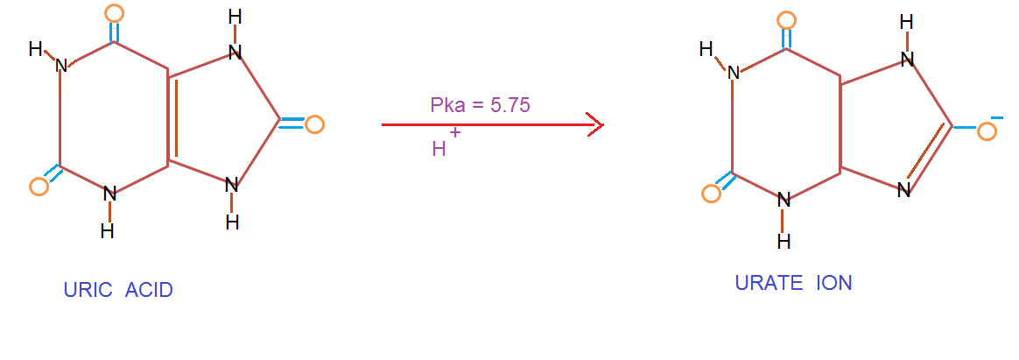


Slide 9
Types of gout
 Primary
 Secondary

Slide 10
RISK FACTORS OF GOUT
Heredity
Dehydration.
Obesity
Excessive alcohol consumption, and purines rich foods.
Gender & Age
Medications can also be causes of gout. Diuretics especially.
Abnormal Kidney function

Slide 11
Etiopathogenesis

Slide 12

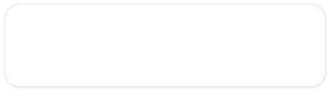



Purines

Purine
Adenine
Guanine
Purine is a Hetrocyclic compound.
Sources
  Dietary purine,
  Conversion of tissue nucleic acid to purine nucleotides,
  De novo synthesis of purine bases
Adenine and Guanine are the two principal purines found in both DNA & RNA.

Slide 13
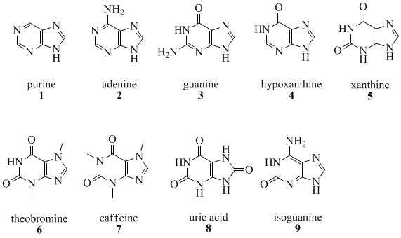
Purine Bases


Slide 14
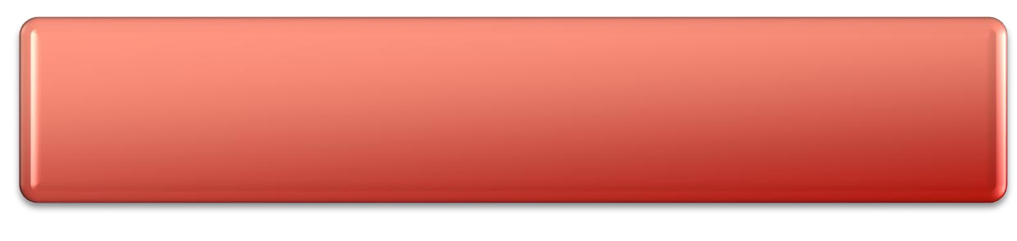



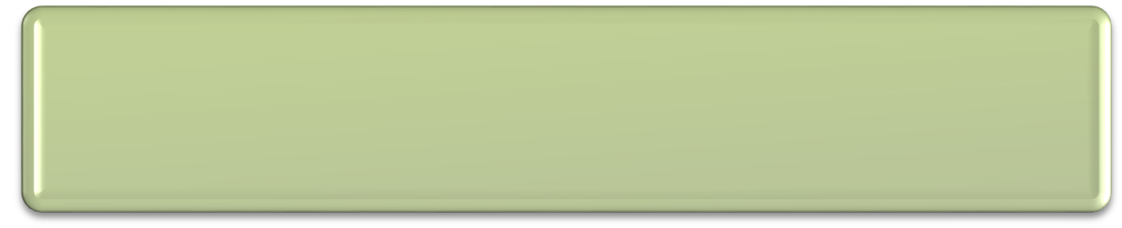
OVERPRODUCTION OF URIC ACID
1. PRPP

Phosphoribosyl
pyrophosphate (PRPP) synthetase
PRPP
Increase purine synthesis and thus uric acid production

Slide 15

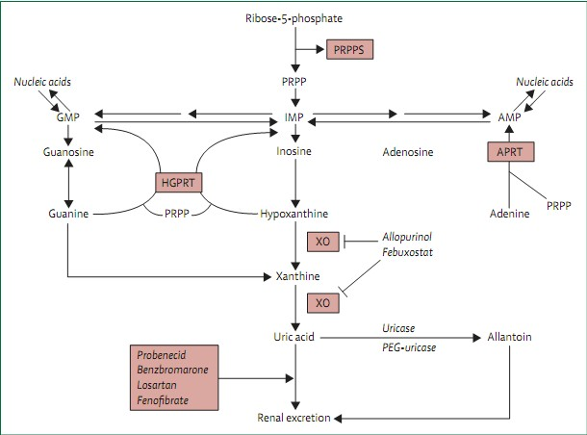


Slide 16
Deficiency of hypoxanthine–guanine phosphoribosyl transferase
2. HGPRT
(HGPRT)
Overproduction of uric acid.
 Complete absence of HGPRT results in the childhood Lesch- Nyhan syndrome characterized by choreoathetosis, spasticity, mental retardation, and markedly excessive production of uric acid.

Slide 17
3. Myeloproliferative and lymphoproliferative disorders(breakdown of tissue nucleic acids).
Cytotoxic drugs (Lysis and break

Slide 18
UNDEREXCRETION OF URIC ACID
Uric acid is eliminated in two ways.
 Two-thirds production/day excreted in the urine.
 The rest is eliminated through the GI tract after enzymatic degradation by colonic bacteria
 A decline in the urinary excretion of uric acid to a level below the rate of production leads to hyperuricemia

Slide 19
 Approximately 90% of filtered uric acid is reabsorbed in the proximal tubule mediated by speciﬁc anion transporters, including URAT1(active)and passive transport mechanisms.

 The protein GLUT9 (SLC2A9) was reported to function as an eﬄux transporter of urate from tubular cells
 Enhance sodium reabsorption (e.g., dehydration) also lead to increased uric acid reabsorption

Slide 20
Genetic predisposition
 Polymorphisms in the GLUT9 (SLC2A9) gene
 Polymorphism in the URAT1 gene
 Two new loci have been identiﬁ ed—ABCG2 and SLC17A3—
which also show an association with uric acid concentrations and risk of gout.

Slide 21
Drugs that decrease renal clearance of uric acid (modification of filtered load or one of the tubular transport processes)
 Diuretics,
 Nicotinic acid,
 Salicylates (less than 2 g/day),
 Ethanol,
 Pyrazinamide,
 Levodopa,
 Ethambutol,
 Cyclosporine, and cytotoxic drugs

Slide 22
Deposition of urate crystals in synovial fluid
Inflammatory mediators activation like
Increased vascular permeability, vasodilation,
complement activation, chemotactic activity for polymorphonuclear leukocytes
Phagocytosis & discharge of proteolytic enzymes
Intense joint pain, erythema, warmth, and swelling.

Slide 23

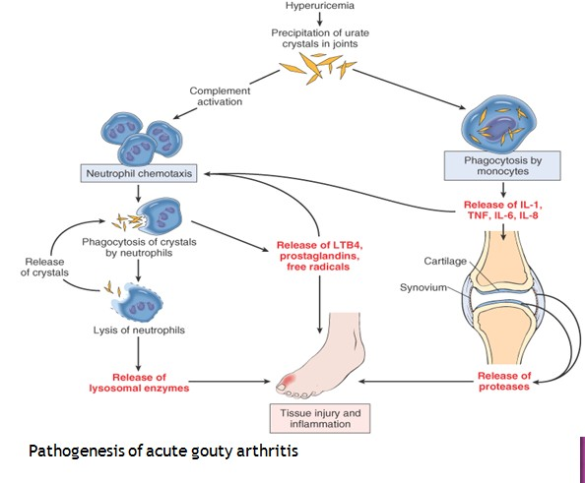


Slide 24
Clinical presentation

Slide 25
PHASES OF GOUT
 Acute gouty arthritis — Attacks of gout usually involve a single joint, most often the big toe or knee.This attack is known as
acute gouty arthritis
 Intercritical period — The time between gout attacks is known as the intercritical period. A second attack typically occurs within two years, and additional attacks may occur thereafter.
 Chronic tophaceous gout — People who have repeated attacks of gout over many years can develop tophaceous gout.
 Tophi accumulation of large numbers of urate crystals in masses
 Tophi may cause erosion of the bone and eventually joint damage and deformity.

Slide 26

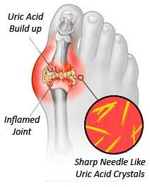


Slide 27
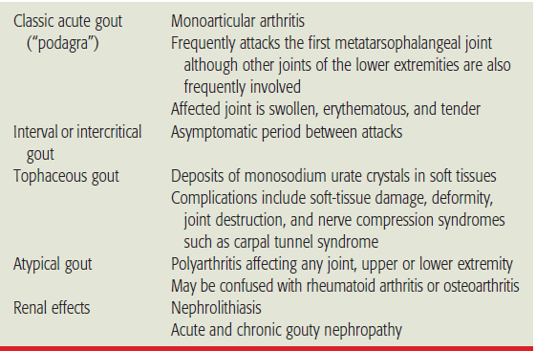
Clinical presentation


Slide 28
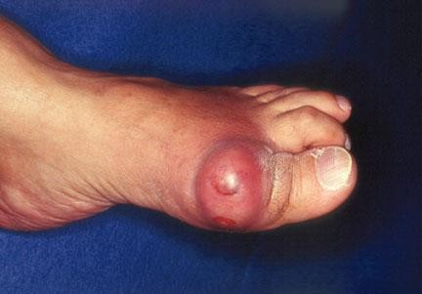
The first metatarsophalangeal joint is affected, a condition known as podagra


Slide 29
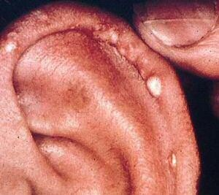
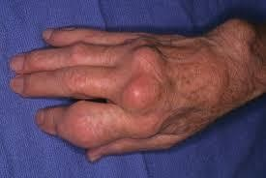

Slide 30
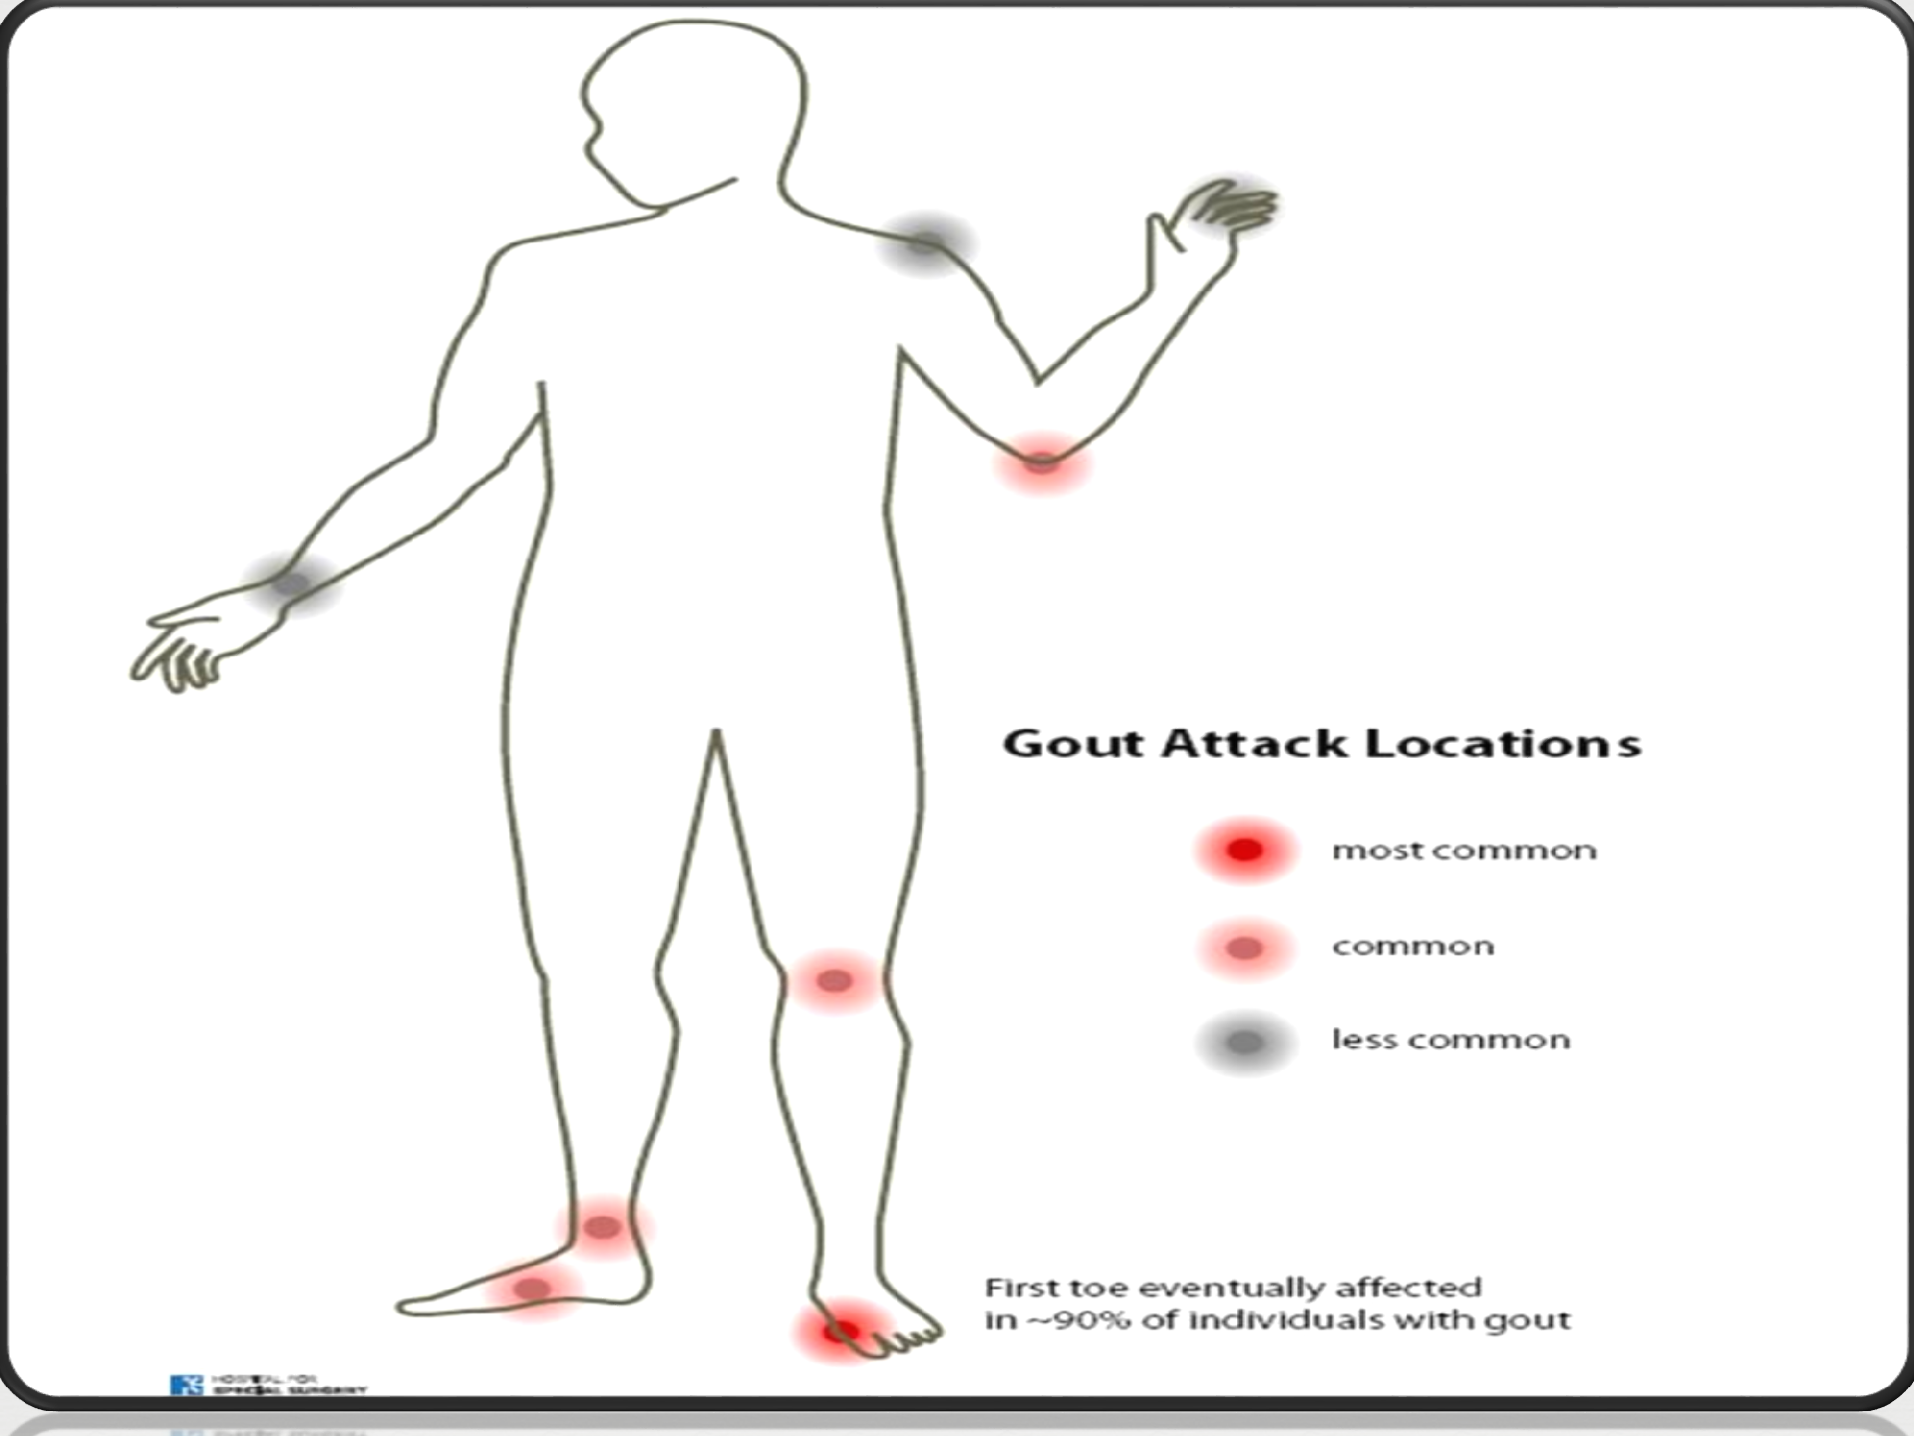

Slide 31

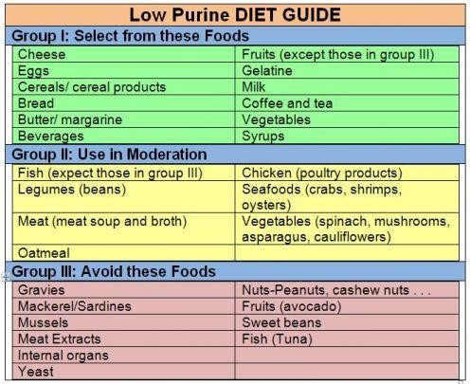


Slide 32
Thank you

