Slide 1

Gas Chromatography Infrared Spectrometry (GC/IR)
Instrumentation/Interface
Infrared Spectrophotometer determines the relative strengths and positions of the infrared region and plots the information on calibrated paper
Gas Chromatograph partitions the sample as it passes through the column
The two can be linked through glass column or vacuum tubes and other devices on more expensive equipment

Slide 2
Gas Chromatography / Infrared Spectrometry
Capillary GC with IR specs can enable the separation and identifying the compounds
The interface between the column and the detector is the main detail
Small pipe (length 10-40 cm, diameter 1-3 mm) connected to column by narrow tubing
Transmission of radiation occurs by multiple reflection off the wall

Slide 3
GC/ IR
Light pipe is heated in order to rid condensation and maximize path length for enhanced sensitivity
This also minimizes the dead volume to lessen band broadening
Detector - highly sensitivity, liquid nitrogen cooled
Scanning is started and a brief delay is needed for compound to travel form the detector region to the IR cell

Slide 4
More on General GCIR
Practical Uses
Very sensitive
very expensive
sample recovery
Pharmaceutical
Industrial
DNA Analysis of blood samples, other fluids
many others

Slide 5
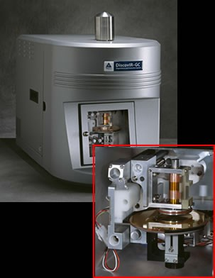
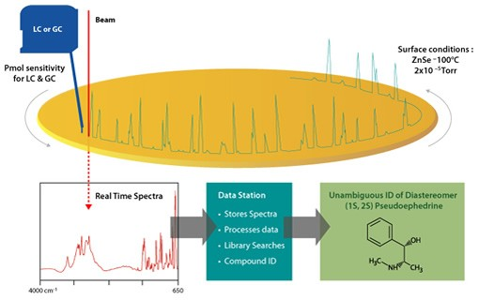
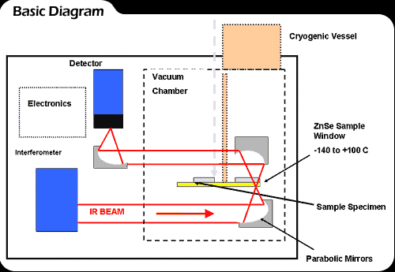

Slide 6
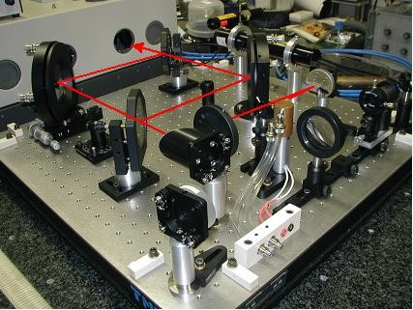
White-light interferometry
Fourier-transform Spectrometer
Mach-Zehnder Interferometer
φ (ω ) = k(ω )D
Photonic band dispersion
ω = ω (k )
₌ dω ₌ D dk dϕ / dω
v
g
Group velocity

Slide 7

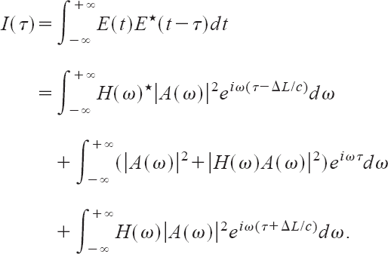

Slide 8
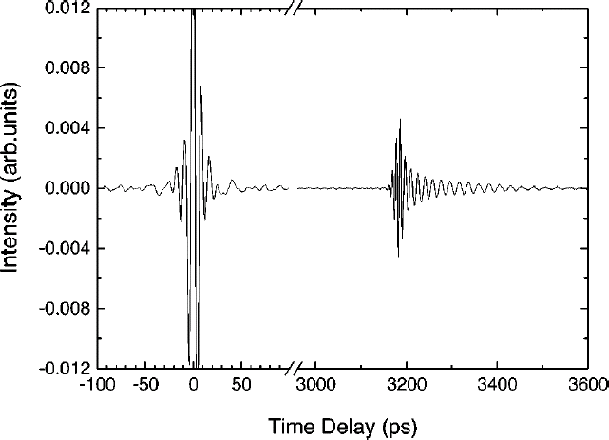


Slide 9
Interferometric determination of the anisotropic refractive index dispersion of poly-(p-phenylene-vinylene)
500 1.0
400
||
0.8
⊥
Phase shift (rad)
300
Transmittance
0.6
200
0.4
||
100
⊥
0.2
0
6000 8000 10000 12000 14000 16000 18000 20000
Wavenumber (cm⁻¹)
0.0
6000 8000 10000 12000 14000 16000 18000 20000
Wavenumber (cm⁻¹)
3.8
3.6
3.4
3.2
3.0
2.8
2.6
2.4
2.2
2.0
1.8
1.6
d=15.0 μm
Fringes intensity (arb.units)
0.0
refractive index
||
(b)
d=15.1 μm
(c)
7000
7500
13000
13500
(a)
⊥
0.0
6000 8000 10000 12000 14000 16000 18000 20000
Wavenumber (cm⁻¹)
8000
10000 12000
14000
16000
-1
Wavenumber (cm )

Slide 10
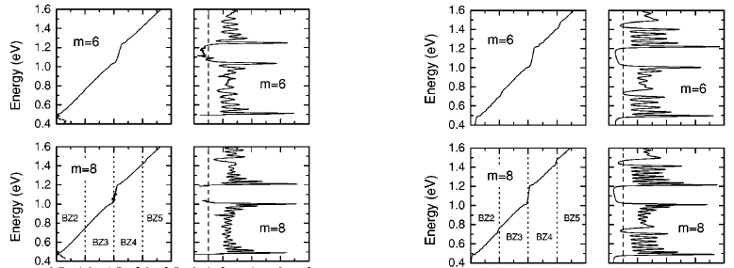
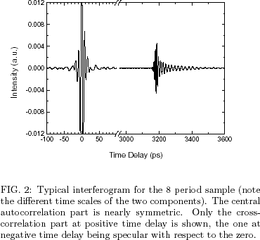

Misura del ritardo di fase con Interferometro di Mach-Zehnder
Rallentamen_{Δ}to_{ϕ}del₌le v²e^{π}loc[it_{d}à _{(n − 1)+ L ] = k d}
λ
Velocità superluminali all’interno del “gap fotonico”
Esperimento e Teoria (Andreani)
Curve di dispersione dei modi di propagazione della luce in strutture fotoniche

Slide 11
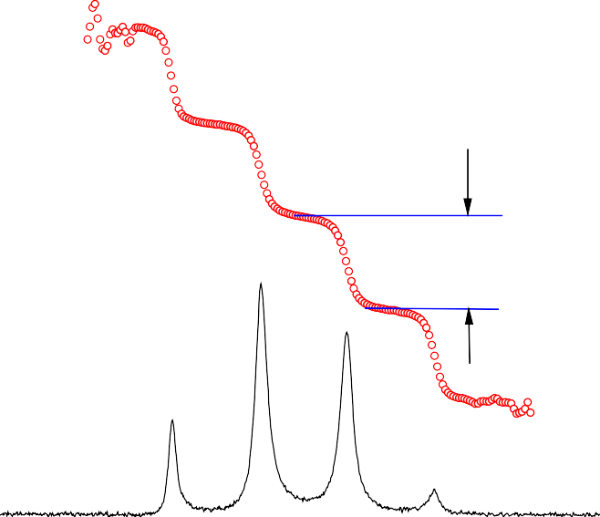
Porous Silicon coupled
microcavities
Low index High index
A B
Layer sequence: 6.5AB-AA-6.5AB-AA -6.5AB-AA -6.5AB-AA -6.5AB
1.0
40
25
slow-light
0.8
39
20
38
Phase (π rad)
Transmittance
15
0.6
37
c/v
g
0.4
Δφ = π
10
36
0.2
35
5
0.0 34
1460 1480 1500 1520 1540 1560 1460
0
1480 1500 1520 1540 1560
Wavelength (nm)
wavelength (nm)
fast-light
Ghulinyan et al. Appl. Phys. Lett. 88, 241103 2006
Superluminal group velocity!

