Slide 1
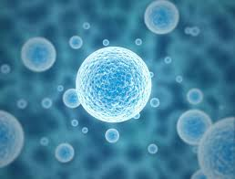
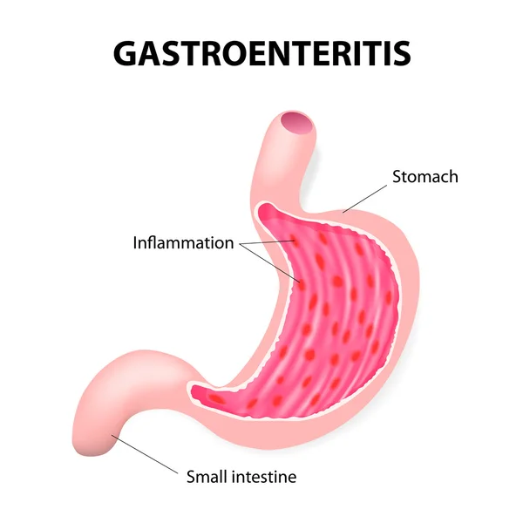
Gastroenteritis
Infection Disease
By Animesh Das

Slide 2
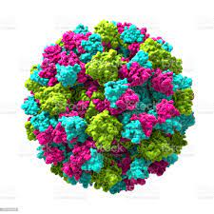
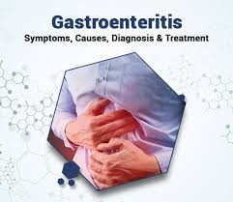
Definition
It is an intestinal infection disease also called as stomach flu , is typically spread by contact with an infected person or through contaminated food or water and marketed by Diarrhea , Cramps , Nausea , Vomiting and fever .
Causative Agent – Norovirus [ most common ]

Slide 3
Type / Classification
There are 4 type of gastroenteritis --
Viral gastroenteritis.
Bacterial gastroenteritis.
Amoebic dysentery.
Bacillary dysentery

Slide 4
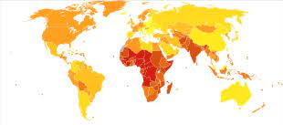
Epidemiology
One of the most common worldwide fecal oral route transmission disease water common reservoir .
it represent a major cause of morbidity and mortality .
Gastroenteritis zone – UK , India , Africa , Russia .

Slide 5
Sings and symptoms
Loss of appetite
Bloating
Nausea and Vomiting
Diarrhea
Abdominal pain
Body aches
Bloody stools

Slide 6
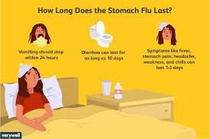
Risk factor
Infants , children
poor hygienic
improperly stored and cooked food
Non vegetarians
Swimming
Travellers
Immune compressed patient

Slide 7
Mode of transmission
Incubation period -- 12 to 48 hours [33 hours ]
the vomit or feces of an infected person

Slide 8
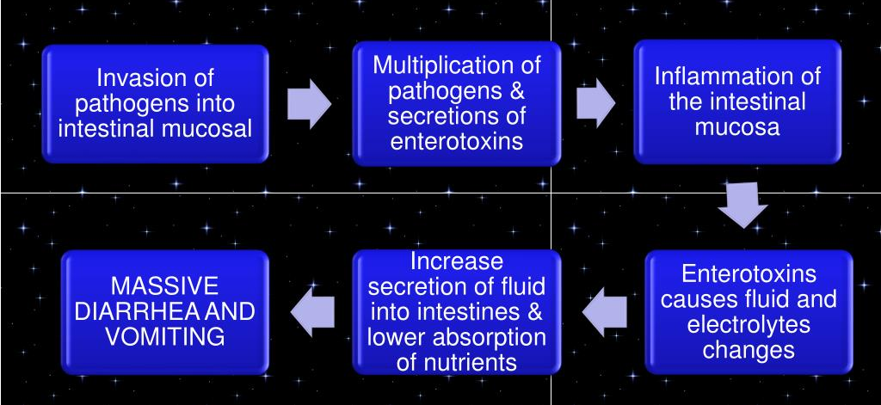
Pathophysiology

Slide 9
Management
Diagnosis
Treatment

Slide 10
Diagnosis
Physical examination
Stool testing
Serum electrolytes
Blood urea nitrogen [ BUN ]
Complete blood picture [ CBP ]

Slide 11
Investigations
Random blood sugar
Hemogram
Haemoglobin levels and hematocrit may be low
Serum electrolyte

Slide 12
Treatment
Category | Drug Name
5-HT3 receptor antagonists | ondansetron
Proton pump inhibitors | Esomeprazole
Quinolone antibiotics | ofloxacin
Antibiotics | Rifaximin
Antidiarrheal | Racecadotril

Slide 13
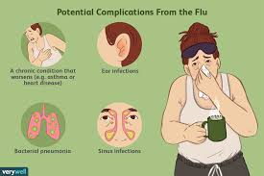
Complication
Dehydration.
Malabsorption.
Transient lactose intolerance.
Chronic Diarrhea.
Systemic infection (meningitis, arthritis, pneumonia)
especially with Salmonella infections.
Sepsis

Slide 14
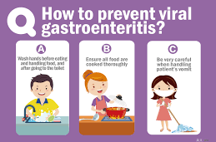
Prevention
Hand washing
proper food handling
complete cooking
Adequate sanitation
Safe water Supplies

Slide 15
Thank
you

