Slide 1
SUBJECT NAME – CLINICAL TOXICOLOGY
UNIT NO & NAME (FONT SIZE 20) – TIMES NEW ROMAN, ALL CAPS
15-09-2024
1

Slide 2
TOPIC NAME - GENERAL PRINCIPLE
Contents for topic-
General principle involve in management of poisoning
15-09-2024
2

Slide 3
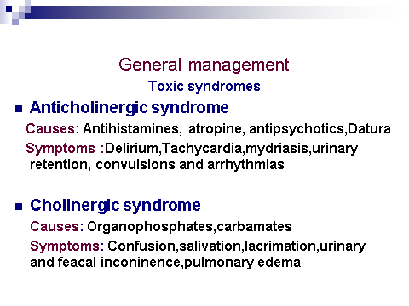
TOPIC NAME -GENERAL PRINCIPLE
15-09-2024
3

Slide 4
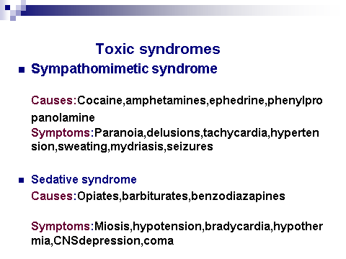
TOPIC NAMENT- GENERAL PRINCIPLE
15-09-2024
4

Slide 5
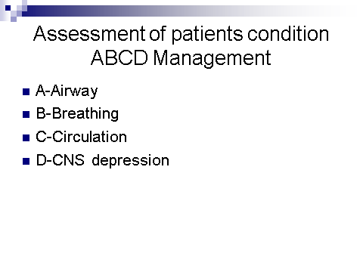
TOPIC NAME -GENERAL PRINCIPLE
15-09-2024
5

Slide 6
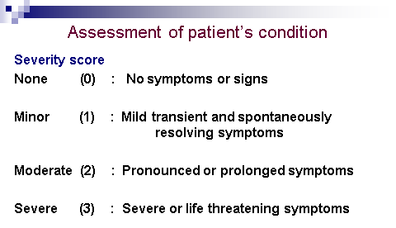
TOPIC NAME - GENERAL PRINCIPLE
15-09-2024
6

Slide 7
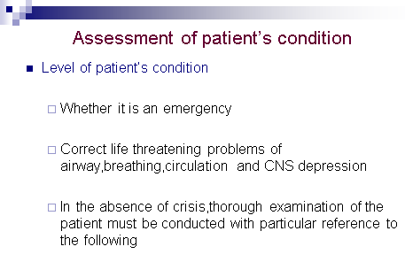
TOPIC NAME - GENERAL PRINCIPLE
15-09-2024
7

Slide 8
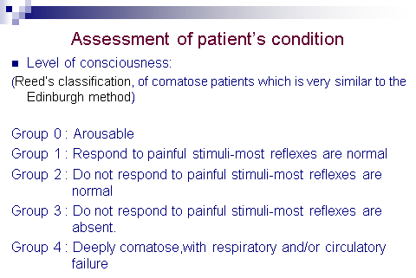
TOPIC NAME - GENERAL PRINCIPLE
15-09-2024
8

Slide 9
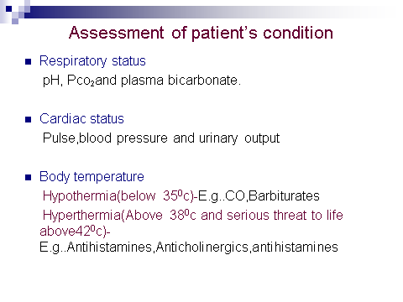
TOPIC NAME - GENERAL PRINCIPLE
15-09-2024
9

Slide 10
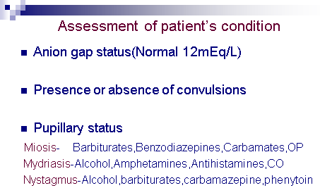
TOPIC NAME - GENERAL PRINCIPLE
15-09-2024
10

Slide 11
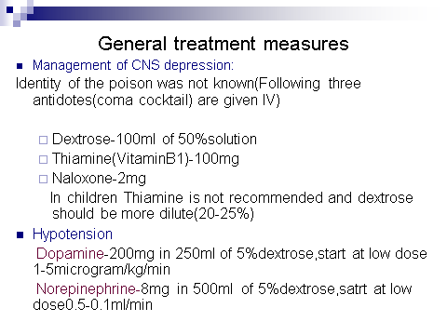
TOPIC NAME - GENERAL PRINCIPLE
15-09-2024
11

Slide 12
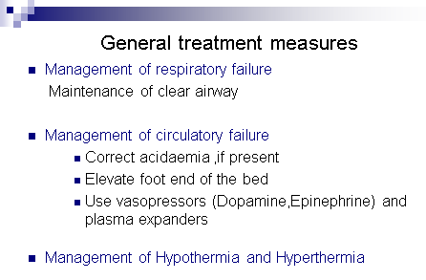
TOPIC NAME - GENERAL PRINCIPLE
15-09-2024
12

Slide 13
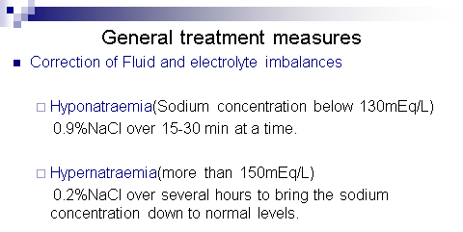
TOPIC NAME - GENERAL PRINCIPLE
15-09-2024
13

Slide 14
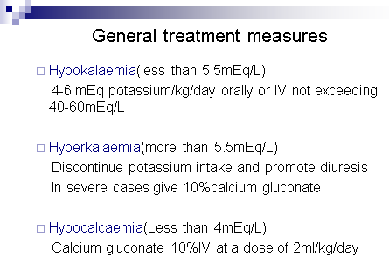
TOPIC NAME - GENERAL PRINCIPLE
15-09-2024
14

Slide 15
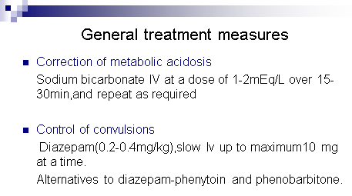
TOPIC NAME - GENERAL PRINCIPLE
15-09-2024
15

