Slide 1
PHARMACOGNOSY & PHYTOPHARMACEUTICALS
Macro, powder and microscopic study of Ginger.
17-09-2024
1

Slide 2
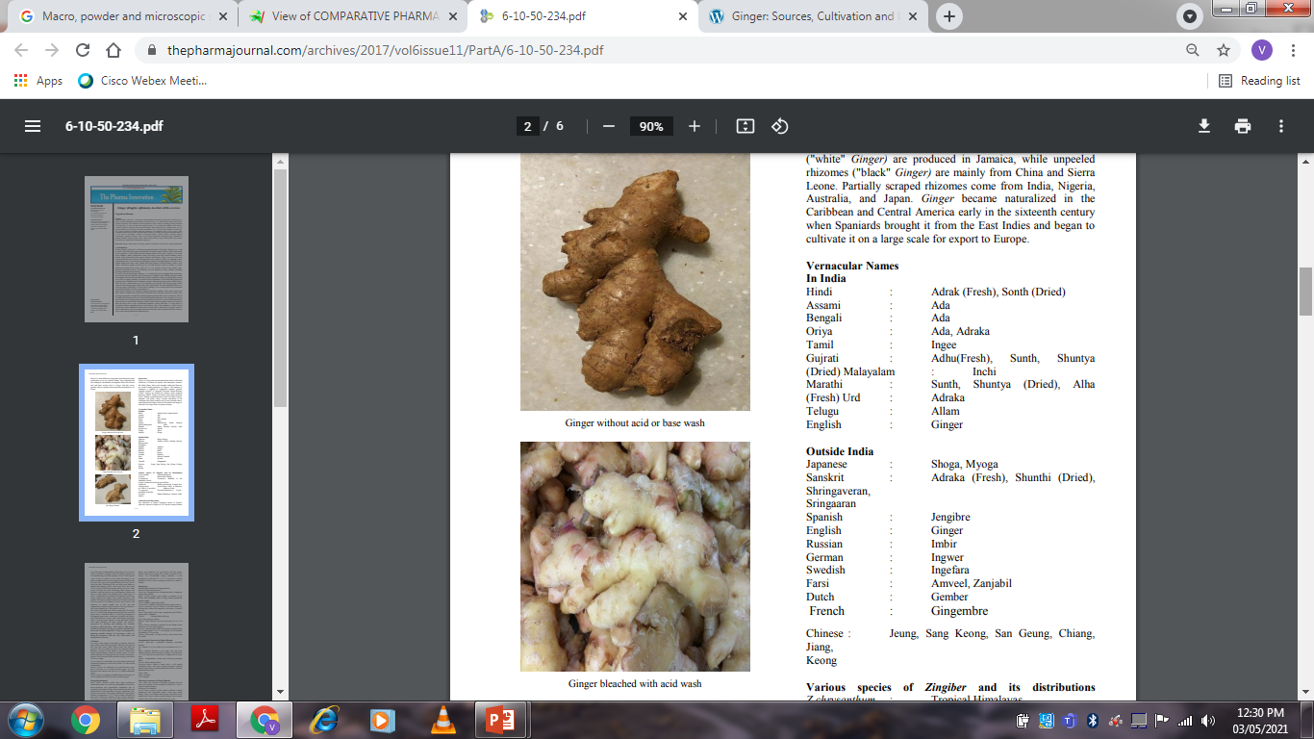
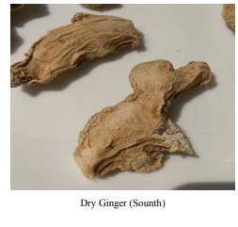
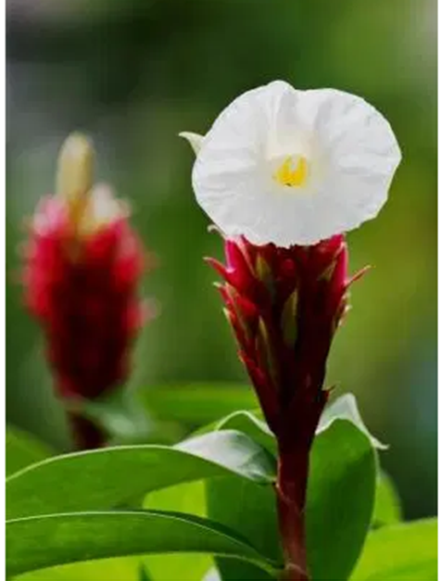
GINGER
Synonyms: Zinziber; Guj. – Soonth; Hin. – Saunth
Biological source: Ginger consists of the rhizomes of Zingiber officinale, Roscose and dried in the sun.
Family: Zingiberaceae
Geographical source: Jamaica, South India, Africa, Japan
17-09-2024
Costus speciosus
2

Slide 3
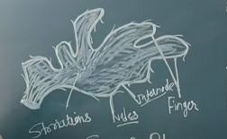
17-09-2024
3

Slide 4
Costus speciosus Koen. (Keu, Crape ginger), an Indian ornamental plant, belonging to family Costaceae. The plant is widely distributed in India in the tropical or sub-tropical climate from the sea level to the Himalayas, excluding the arid and semi-arid areas of Punjab, Haryana, Rajasthan, Gujarat and the peninsular India. It is found throughout the country in moist tropical evergreen forests, up to an altitude of 1200 m. It is common along roadsides, streams and in wastelands. It is widely distributed in Assam, Meghalaya, Bihar, Khasi and Jaintia Hills, Uttaranchal, Orissa, MP, North Bengal
The rhizomes are bitter and show anthelmintic, astringent, expectorant properties. The rhizome extract is used as a tonic and useful in relieving burning sensation, constipation, leprosy, asthma, bronchitis, anemia and other skin ailments, fever and has hepatoprotective properties. Rhizome paste is used for treating boils and also to make sexual hormones and contraceptive. Leaves are used for scabies and stomach ailments. Stems are ground into a paste and applied for blisters. Rhizome extract is used for treating snake bites. The rhizome is used internally in the treatment of abdominal pain, liver problems, jaundice, gall bladder pain, etc. The Leaves also possess hypoglycemic properties and insulin potentiating action in addition to decreasing blood glucose. The rhizome possesses antifertility, anticholinesterase, anti-inflammatory, antipyretic and antihelminthic activities. Pharmacological studies showed that the rhizomes of C. speciosus possess cardiotonic, hydrochloric, diuretic and CNS depressant activity.
Zingiber officinale was also one of the first oriental spices to be grown to the Europeans. But now it is found to grow extensively in the tropical and subtropical regions of the world particularly in Bangladesh, India, Taiwan, Jamaica, Africa, Mexico, China and Japan. It is a household remedy for dyspepsia, flatulence, colic and diarrhea1. Ginger rhizomes contain both aromatic and pungent compounds. It has been shown to have an antipyretic, hypotensive, cardiotonic, antiplatelet, antiangiogenic, anti-inflammatory and analgesic, cytotoxic, apoptotic and antitumor activities.
17-09-2024
4

Slide 5
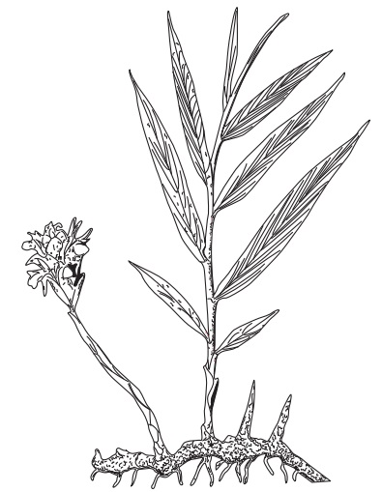
Macroscopical characters:
(i) General appearance: Sympodial branching, horizontal rhizome.
(ii) Size – Length 5-15 cm; width (height) 3 to 6 cm; thickness 0.5 to 1.5 cm.
(iii) Shape – Laterally flattened on the upper side with short flattened oblique, obviate branches or fingers. Each branch is 1 to 3 cm long and at its apex shows a depresses scar of the stem.
(iv) Surface – Longitudinally striated with occasional projecting fibres.
(v) Fracture – Short, starchy, fibrous.
(vi) Fractured surface – Show a narrow bark, a well-marked endodermis and a wide stele, showing numerous scattered grayish points (fibro vascular bundles) and smaller yellowish points (secretion cells).
(vii) Colour – Bufff
(viii) Odour – Agreeable and aromatic.
(ix) Taste – Agreeable and aromatic
Zingiber officinale
17-09-2024
5

Slide 6
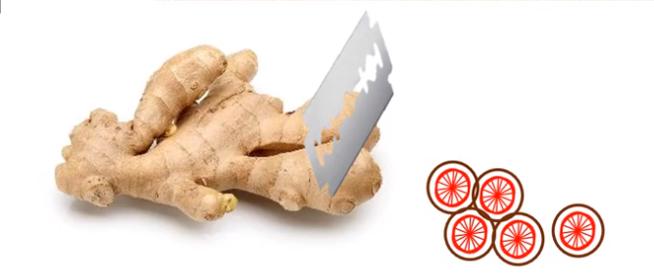
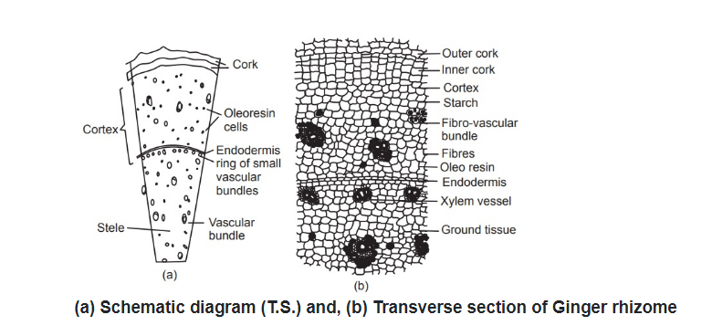
TRANSVERSE SECTION
17-09-2024
6

Slide 7
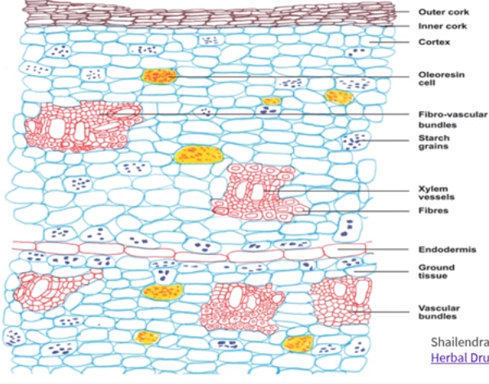
17-09-2024
7

Slide 8
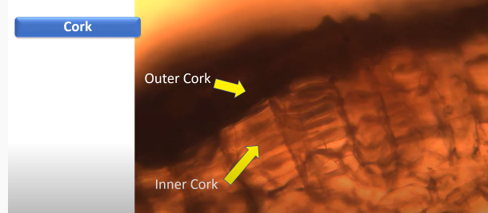
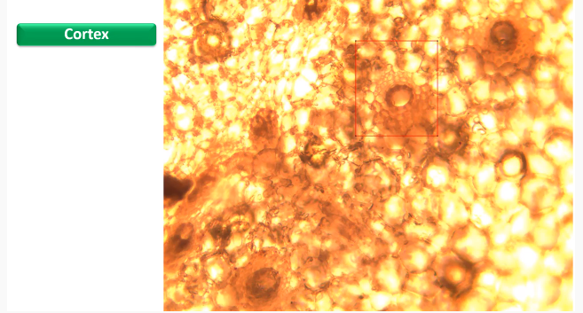
17-09-2024
8

Slide 9
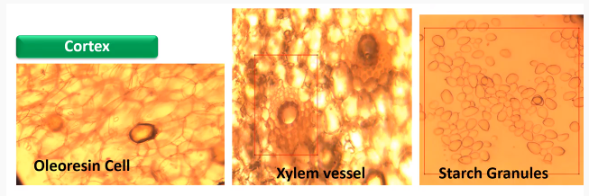
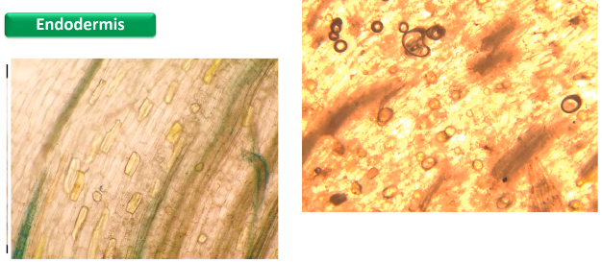
17-09-2024
9

Slide 10
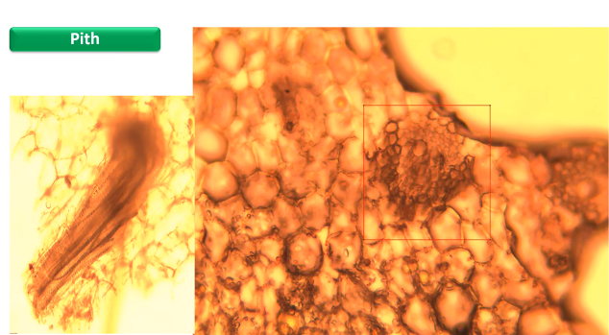
17-09-2024
10

Slide 11
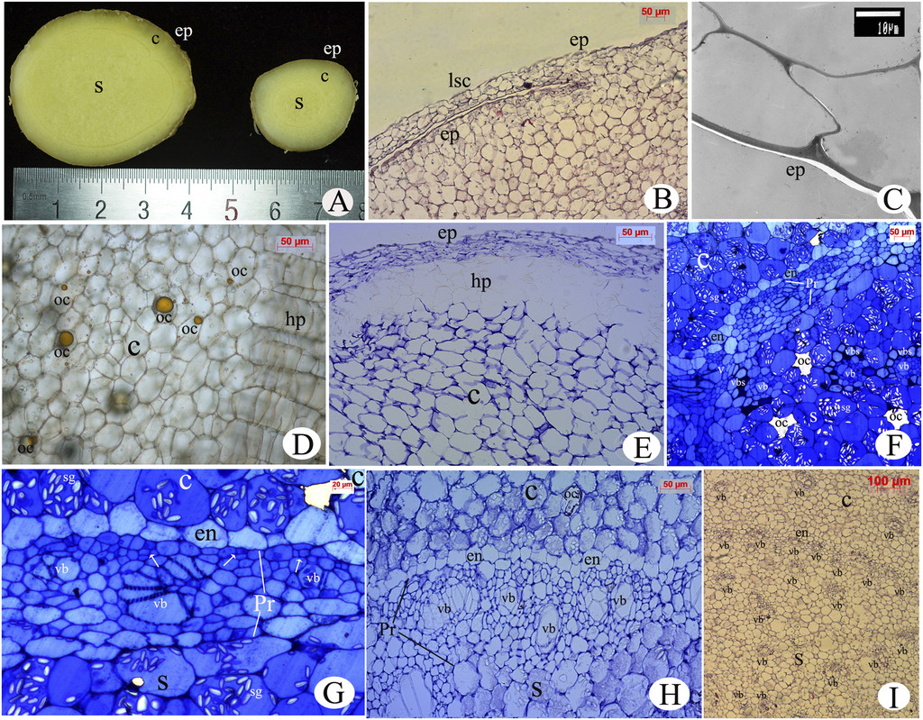
Anatomy of the rhizome.
(A) Transverse section of mature and young rhizome, consisting of epidermis, cortex, and stele
(B) Epidermis with leaf scar.
(C) Suberized epidermis.
(D) Multilayered hypodermis and oil cells present in cortex.
(E) Transverse section of mature rhizome.
F) Cortex and stele with many starch grains in them separated by endodermis and pericycle in young rhizome.
(G) Tangential and radial division (arrows) in the pericycle with vascular tissues generated from it in young rhizome.
(H) Vascular bundles collateral in a ring in the pericycle.
(I) Vascular bundles collateral in a ring and scattered more in pith than cortex in mature rhizome.
17-09-2024
11

Slide 12
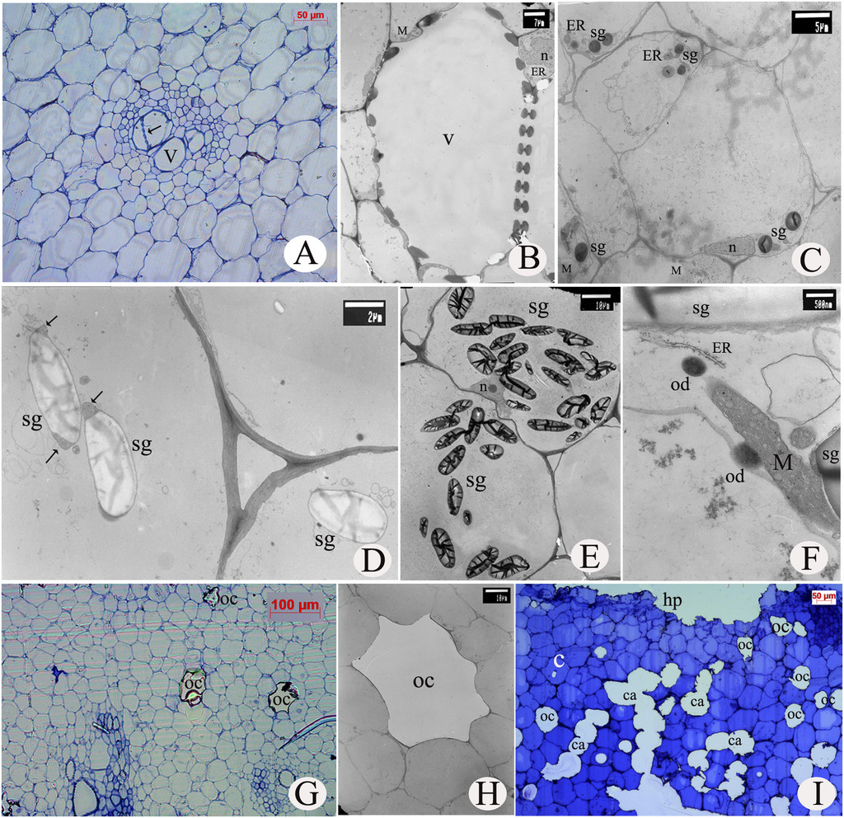
Anatomy of the rhizome.
Xylem vessels with scalariform perforation plates (arrow).
(B) Degraded vessel with surrounding parenchyma cells containing endoplasmic reticulum and mitochondria.
(C) Round starch grains with endoplasmic reticulum and mitochondria in young rhizome.
(D) Oval starch grains with plastid inclusions in its corner (arrows).
(E) Abundant starch grains in long and oval shape.
(F) Oil droplets with endoplasmic reticula and mitochondria around them.
(G) Oil cells in rhizome.
(H) Oil cell surrounded by parenchyma cells with few organelles.
Mature rhizome with oil cells and cavities.
(A, G, I) are semithin sections;
(B, C, D, E, F, H) are ultra-thin sections.
17-09-2024
12

Slide 13
The transverse section of the rhizome shows a zone of cork tissue which is differentiated on the arrangement of cells. The outer zone of cortical cells in the cork are suberized (deposited with suberin which can be stained with fluoral yellow) without division and hence are irregularly arranged.
The inner zone contains cortical cells which arrange in a radial row and produced by tangential division. The cork cambium is not differentiated.
Inner to the cork cells is the cortex composed of cortical cells. The cortical cells contain plenty of simple, ovoid (sack-shaped) starch grains (sized 5-60μm) which can be stained with iodine. Inner to the cork is a broad cortex.
The outer cortex is composed of mainly flattened parenchyma, while the inner zone is composed of mainly normal parenchyma.
The cortex also holds suberized oil cells which hold a yellow-brown oleoresin.
The inner cortex contains generally three layers of closed, collateral vascular bundles which contain phloem. The larger vascular bundles are protected in a sheath of nonlignified fibres.
The vascular bundles contain sieve tubes and a xylem with reticulate thickened vessels (these do not stain with phloroglucinol and HCl) which are some times accompanied by secretion cells (holding dark contents).
Inner to the cortex lies a single layer of endodermis which is devoid of starch.
17-09-2024
13

Slide 14
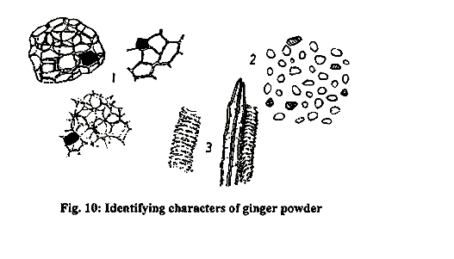
POWDER MICROSCOPY
1 Parenchyma: Some of the cells contain yellow- brown oleo resinous bodies which occur either in fragments of as droplets.
2. Starch grains: Characteristic, abundant, simple, ovoid or sack shaped, 5 to 60 microns in length and have a distinct eccentric hilum
3. Fibers and vessels: Septate fibres groups associated with vessels, fibres mostly non-lignified.
4. Organoleptic properties :
(i) Colour: Pale yellow to cream powder
(ii) Odour: Pleasant, aromatic.
(iii) Taste: Characteristic and pungent taste
17-09-2024
14

Slide 15
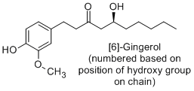
CHEMICAL CONSTITUENTS
An oily liquid comprising of homomlogous phenols called gingerol (cardiotonic compounds) accounts for the pungency as well as the pharmcological activity of ginger. Gingerols upon dehydration form shogaols and further degrade to zingerone.
17-09-2024
15

Slide 16
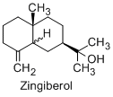
Apart from the gingerols ginger constitutes of 50-70% carbohydrates present as starch, 3-8% lipids which includes free fatty acids like linoleic, linolenic, palmitic, oleic, capric, lauric and myristic, triglycerides and lecithins. The resinous matter constitutes 5-8% and volatile oil around 1-2% of the constituents in ginger. The aroma of ginger is mainly due to oil of ginger which contains a mixture of over 50 constituents. Volatile oils consist mainly of the sesiquiterpenes (β-besabolene and zingiberene), monoterpenes (β-phelandrene, cineol, borneol, citral) and the sesquiterpene alcohol zingiberol.
17-09-2024
16

Slide 17
USES
Ginger is used as an anti-emetic and it has been proposed that the aromatic, carminative and possibly absorbent properties of ginger improve the effects of motion sickness directly in the GI tract unlike the anithistamines. It also is effective in the control of vomiting and nausea in hyperemesis gravidarum as well as postoperative nausea and vomiting.
The cardiovascular activity shown by ginger is mainly due to the gingerols and shogaols. The proposed mechanism for these activities is due to the inhibition of prostaglandin synthetase thus hampering prostaglandin biosynthesis by the gingerols.
Ginger also has antiplatelet aggregation property which is due to the inhibition of thromboxane synthesis.
Ginger also lowers cholesterol levels by inhibition of cholesterol biosynthesis under the assumption of inhibiting HMGCoA reductase.
Ginger also possess antitussive, anti pyretic and analgesic effects.
Ginger rhizome also has been reported to have fungicidal, antibacterial and anthelmintic properties.
Sesquiterpene hydrocarbons are responsible for the anti- ulcer activity.
17-09-2024
17

