Slide 1

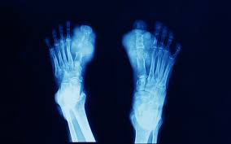
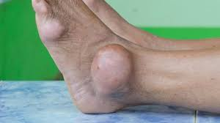
Gout
Musculo Skeletal Disorder
By Animesh Das

Slide 2
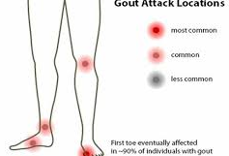
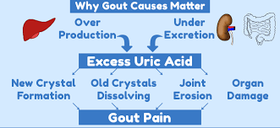
Definition
It is a muscular skeletal disorder of joint part of body , a from arthritis character by sever pain redness and tenderness in joints and inflammation occur when too much uric acid in crystalline from .
Affected organ – joint area of body part .

Slide 3
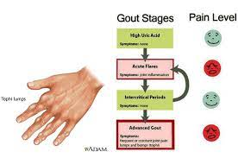
Type / Classification
There are two type –
Acute Gout
Chronic Gout

Slide 4
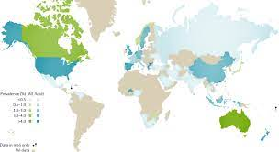
Epidemiology
About 10 % of people with hyperuricemia develop gout at some point in their lifetimes .
The prevalence of gout is 13 cases 1000 male and 6.4 cases 1000 female .
Gout zone – UK , America , India , Russia .

Slide 5
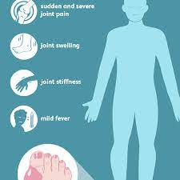
Sings And Symptoms
Intense joint pain.
Gout usually affects the big toe, but it can occur in any joint.
Lingering discomfort. After the most severe pain subsides, some joint discomfort may last from a few days to a few weeks.
Inflammation and redness.
Limited range of motion

Slide 6
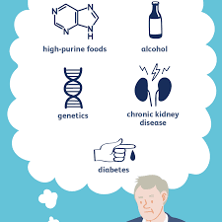
Risk factor
makes after the age of 20
Female after menopause
High BMI
diet rich in seafood
HTN
thiazide diuretics
Excess alcohol use

Slide 7
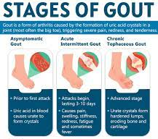
Stages of Gout
There are 4 stage is present in gout –
Asymptomatic
Acute
Intercortical
Chronic

Slide 8
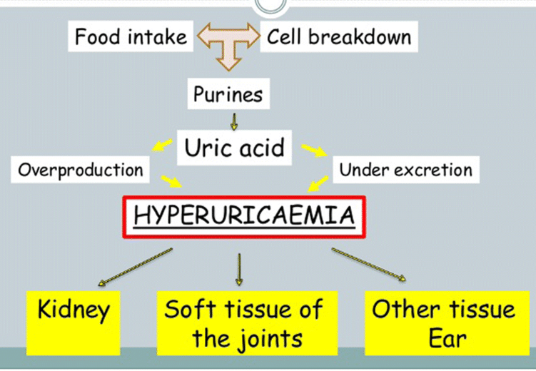
Pathophysiology

Slide 9
Management
Diagnosis
Treatment

Slide 10
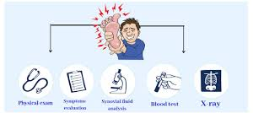
Diagnosis
History and physical examination
Family history
Diagnostic studies
ESR
Uric acid level
Xray of joint area

Slide 11
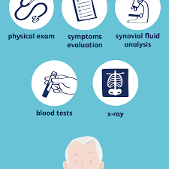
Investigation
Pain radiography
Serum Uric acid
BUN
Synovial biopsy

Slide 12
Treatment
Category | Drug Name
NSAIDs | ibuprofen
anti-gout agents | Colchicine
Uricosuric agent | Benzbromarone
xanthine oxidase inhibitors | Allopurinol

Slide 13
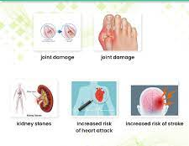
Complication
Joint deformity
Osteoarthritis
tophi may procedure draining sinuses that may become infected
renal stone
Pyelonephritis

Slide 14

Prevention
Get regular exercise and stay at a healthy weight. If you're overweight or obese, your body has more uric acid.
Get other health conditions under control.
Ask your doctor if you need to make changes to the medications you take.
Drink more fluids

Slide 15
Thank
you

