Slide 1
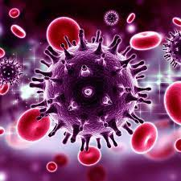
HIV
Infection Disease
By Animesh Das

Slide 2
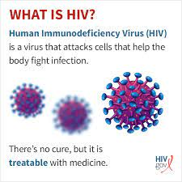
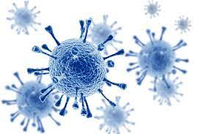
Definition
It also called as human immunodeficiency virus , HIV cause AIDS and interest with the body's ability to fight infection , it can be transmitted through contact with infected blood . It is a RNA virus and it is destroy ability to destroy T4 helper cells .

Slide 3
Type / Classification
HIV 1 [ THE MOST COMMON ]
HIV 2 [ RELATIVELY UNCOMMON AND LESS INFECTIONS ]

Slide 4
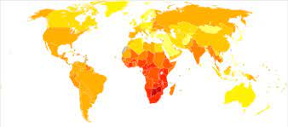
EPIDEMILOGY
HIV infected approximately 33 million people world wide .
most of these infections were acquired through heterosexual transmission .
HIV zone – Europe , America , India , Russia , Japan , Jarmani etc

Slide 5
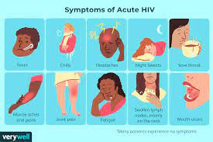
Sings and symptoms
Fever
Chilis
Rash
Night sweats
Muscle aches
Sore throat
Fatigue
Swollen lymph nodes
Mouth ulcers .

Slide 6
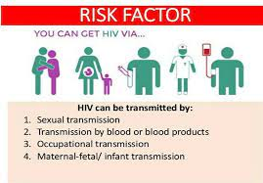
Risk factor
Sexual practices that promote disease transmission .
Exposure to blood / body fluids .
Use of infected drugs .
Occupational exposure
HIV infected mother to infants during pregnancy , delivery , breastfeeding .
Syphilis
Gonorrhoea
Trichomoniasis

Slide 7
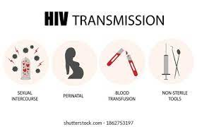
Mode of transmission
Sexual contact
Blood transfusion
Through organ transplantation
Sharing of needles .
Accidental needle sticks
From mother to child
Through breast milk
Incubation period – Till development of AIDS

Slide 8
Pathogenesis
Initial HIV infections
The distribution of HIV in human bodies
Parasite in different human cells , tissue or pathologic reservoirs

Slide 9

Critical pathways to inducing dys function of human immune systems
Emergency of AIDS symptoms / epis odes
Human mortalities

Slide 10
Management
Diagnosis
Treatment
Diagnosis
HIV antibody test
viral antigen test .
detection of viral nucleic acid in blood .
ICTC test [ Integrated Counselling and testing centre ]

Slide 11
Free HIV test
Confidential counselling
Referral to nearest ART .

Slide 12
Treatment
Category | Drug Name
Alcohol | Wine , beer
Opioids | Oxycodone
Benzodiazepines | Valium
Cannabinoids | Cannabis
Barbiturates | Pentobarbitol
Hallucinogens | DMT

Slide 13
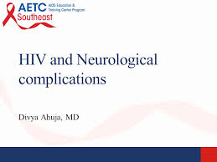
Complication
loss of appetite
Nausea and vomiting
fevers
wasting syndrome
tuberculosis
Diarrhea
changes in tests
metabolic and endocrine changes

Slide 14
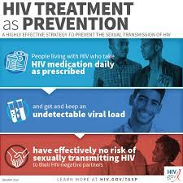
Prevention
avoid multiple partners – use condoms
use sterile needles each time for injection
never share needles .
Avoid unnecessary blood transfusion
all pregnant woman should be tested for HIV
proper disposal of biomedical waste

Slide 15
Thank
you

