Slide 1
HIV, SYPHILLIS and TYPHOID

Slide 2


Slide 3
AIDS is a retroviral disease caused by the ‘Human Immuno Deficiency’ (HIV) virus
It is characterized by profound immunosuppression with associated opportunistic infections, malignancies, wasting, and central nervous system (CNS) degeneration

Slide 4
Retroviruses are unable to replicate outside of living host cells because they contain only RNA and do not contain DNA
Two types of viruses – HIV type 1 and HIV type 2
HIV is transmitted from one person to another through sexual contact, blood-to-blood contact, or perinatally.

Slide 5
PATHOPHYSIOLOGY
HIV selectively attacks the CD4 T lymphocytes, the immune cells responsible for orchestrating and coordinating the immune response to Infection.
People with HIV infection have a deteriorating immune system and thus are more susceptible to severe infections with ordinarily harmless organisms.

Slide 6
HIV infects a limited number of cell types in the body, including a subset of lymphocytes called CD4 T lymphocytes also known as( T-helper cells or CD4 T cells), macrophages, and dendritic cells.
Once HIV has entered the bloodstream, it attaches to the surface of a CD4 T cell by binding to a CD4 receptor that has a high affinity for HIV.

Slide 7
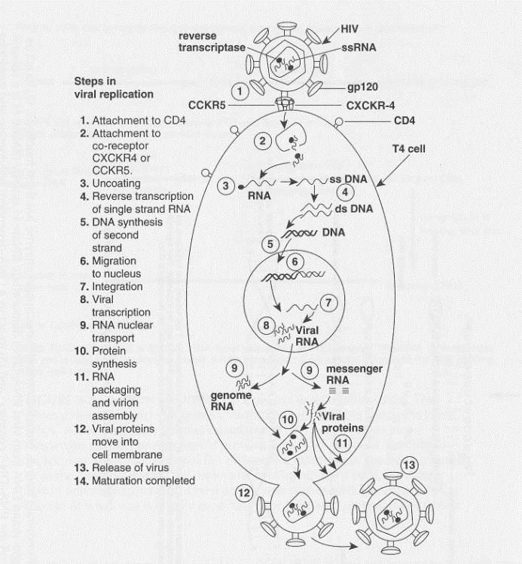

Slide 8
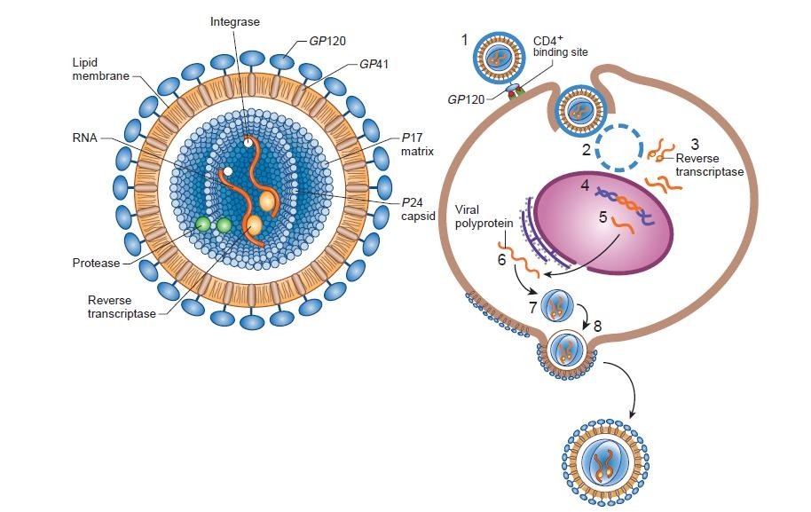

Slide 9
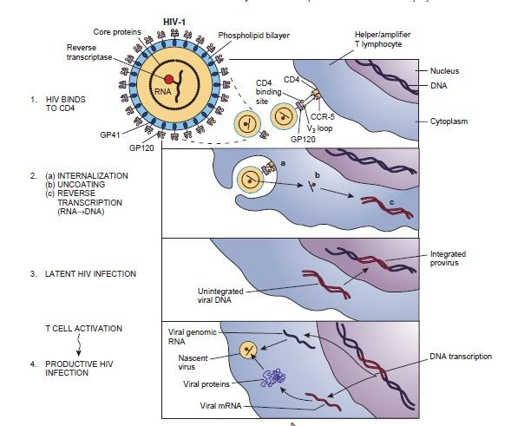

Slide 10
After attachment the viral envelope peptides fuse to the CD4 T-cell membrane results in an uncoating of the virus, allowing the contents of the viral core (the two single strands of viral RNA and the reverse transcriptase, integrase, and protease enzymes) to enter the host cell.
DNA synthesis from RNA by using reverse transciptase enzyme. The result is double- stranded DNA that carries instructions for viral replication.

Slide 11
Integration, the new DNA enters the nucleus of the CD4 T cell and, with the help of the enzyme integrase, is inserted into the cell’s original DNA.
Transcription of the double-stranded viral DNA to form a single-stranded messenger RNA (mRNA) with the instructions for building new viruses.
➢

Slide 12
To finish the cycle ribosomal RNA (rRNA) uses the instructions in the mRNA to create a chain of proteins and enzymes called a polyprotein.
The cleavage -During cleavage, the protease enzyme cuts the polyprotein chain into the individual proteins that will make up the new viruses.
Finally the proteins and viral RNA are assembled into new HIV viruses and released from the CD4 T cell.

Slide 13
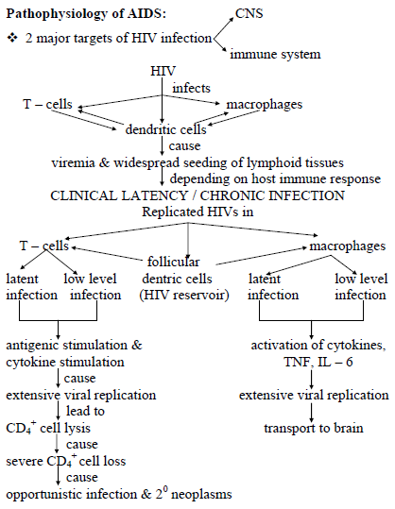

Slide 14
The multiple effects of HIV infection:
Loss of T – cells & macrophages cause,
Decreased response to antigens
Disturbed cytokine, IL secretion
Decreased specific cytotoxicity
Decreased killing of tumor cells (cause 2⁰neoplasm)
Decreased Ig production in response to new antigens
(opportunistic infections)
Decreased chemotoxins (Specific killers of cancer cells,etc)

Slide 15
Phases of HIV Infection
The three phases are
Primary infection phase,
  high viral loads, sometimes greater than 1,000,000 copies/ mL, and a decrease in the CD4+ T-cell count.
Chronic asymptomatic Latency phase (10YRS)
  latent period during which the person has no signs or symptoms of illness.
  CD4+ T-cell count 200 cells/μL or lower
Overt AIDS phase
  CD4+ cell count of less than 200 cells/μL or an
AIDS-defining illness.
  The risk of opportunistic infections and death increases significantly when the CD4+ cell count falls below 200 cells/μL

Slide 16
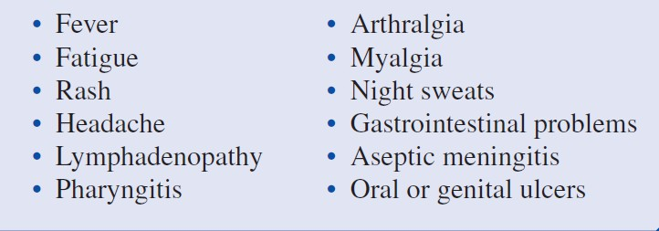
Symptoms of acute HIV infection

Slide 17
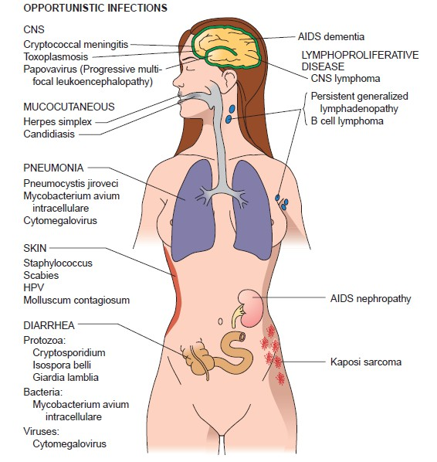

Slide 18
Syphillis

Slide 19
Spirochetes are Gram-negative, corkscrew-shaped bacteria with flagella; an outer sheath membrane can mask bacterial antigens from host immune responses.
Syphilis is an infectious venereal disease caused by the spirochete Treponema pallidum.
Syphilis is transmissible by sexual contact with infectious lesions, from mother to fetus in utero, via blood product transfusion, and occasionally through breaks in the skin that come into contact with infectious lesions.

Slide 20
If untreated, it progresses through 4 stages:
Primary,
Secondary,
Latent, and
Tertiary.
It can be either acquired or congenital

Slide 21
Primary syphilis occurs about 3 weeks after contact:
A firm, non-tender, raised, red lesion (chancre) forms on the penis, cervix, vaginal wall, or anus;
This will heal even without therapy.
Treponemes spread lymphohematogenously throughout the body even before the chancre appears.

Slide 22
Secondary syphilis occurs 2 to 10 weeks later in 75% of untreated patients, with spread and proliferation of spirochetes in skin (including palms and soles) and mucocutaneous tissues (especially mouth)
Lymphadenopathy, mild fever, malaise, and weight loss are common.

Slide 23
Tertiary syphilis occurs in one third of untreated patients, after a long latent period (more than 5 years).
Cardiovascular syphilis (more than 80% of tertiary syphilis) results in aortitis and aortic valve insufficiency.
Neurosyphilis can be symptomatic (meningovascular disease) or asymptomatic (cerebrospinal fluid [CSF] abnormalities only, with pleocytosis, increased protein, and decreased glucose).

Slide 24
“Benign” tertiary syphilis is associated with necrotic rubbery masses (gummas due to delayed type hypersensitivity to the organisms), which form in various sites (bone, skin, oral mucosa).
Congenital syphilis usually occurs when the mother has primary or secondary syphilis.
Intrauterine or perinatal death occurs in 50% of untreated cases.

Slide 25
“Early (infantile) congenital syphilis includes nasal discharge, a bullous rash with skin sloughing, hepatomegaly, and skeletal abnormalities (nose and lower legs are most distinctive).
Diffuse lung or liver fibrosis can also occur.
Late (tardive) manifestations include notched , deafness, and interstitial keratitis with blindness (Hutchinson triad).

Slide 26
Serologic tests for syphilis:
Treponemal antibody tests measure antibodies reactive with T. pallidum.
Non treponemal tests (i.e., VDRL, RPR) measure antibody to cardiolipin, a phospholipid in treponemes and normal tissues.

Slide 27
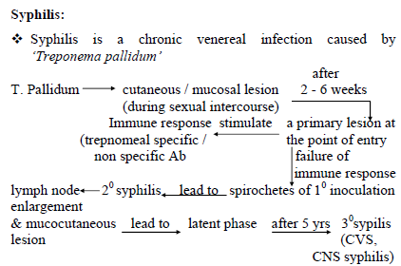

Slide 28
"primary syphilis“ symptoms .
Small, painless sore or ulcer called a chancre on the penis, vagina, or around the anus.

Slide 29
Later symptoms of syphilis
A blotchy red rash that can appear anywhere on the body,
Small skin growths on women these often appear on the vulva and for both men and women they may appear around the anus
White patches in the mouth
flu-like symptoms, such as tiredness, headaches, joint pains and a high temperature (fever) swollen glands occasionally, patchy hair loss

Slide 30
Complications ?????

Slide 31
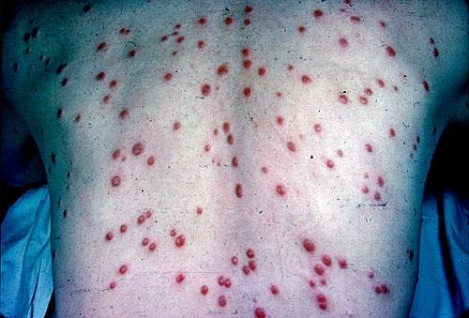

Slide 32
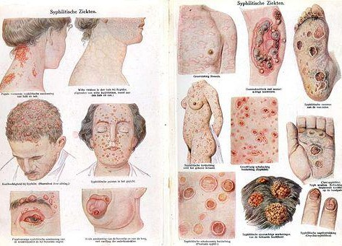


Slide 33
Typhoid

Slide 34
Typhoid fever, also known as enteric fever, is a potentially fatal multisystemic illness caused primarily by Salmonella Caused by S. typhi, S. paratyphi A, B and rarely C
Salmonella – flaggellated, gram negative bacteria
Food borne and water borne
S. typhi seen only in human

Slide 35
Pathophysiology
Salmonella species, when present in the gut are engulfed by phagocytic cells, and present them to the macrophages in the lamina propria.
With toll-like receptor (TLR)–5 and TLR-4/MD2/CD-14 complex, macrophages recognize pathogen-associated molecular patterns (PAMPs) such as flagella and lipopolysaccharides.
Macrophages and intestinal epithelial cells then attract T cells and neutrophils with interleukin 8 (IL-8), causing inflammation and suppressing the infection

Slide 36
Nontyphoidal salmonellae are phagocytized throughout the distal ileum and colon
S typhi and paratyphi have specialized fimbriae that adhere to the epithelium over clusters of lymphoid tissue in the ileum (Peyer patches), the main relay point for macrophages traveling from the gut into the lymphatic system.
The bacteria then induce their host macrophages to attract more macrophages.

Slide 37
S typhi has a Vi capsular antigen that masks PAMPs, avoiding neutrophil-based inflammation
Typhoidal salmonella co-opt the macrophages' cellular machinery for their own reproduction as they are carried through the mesenteric lymph nodes to the lymphatics and then through to the reticuloendothelial tissues of the liver, spleen, bone marrow, and lymph nodes.
There, they pause and continue to multiply until some critical density is reached.
Afterward, the bacteria induce macrophage apoptosis, breaking out into the bloodstream to invade the rest of the body.

Slide 38
The bacteria then infect the gallbladder via either bacteremia or direct extension of infected bile.
The result is that the organism re-enters the gastrointestinal tract in the bile and reinfects Peyer patches
Bacteria that do not reinfect the host are typically shed in the stool and are then available to infect other hosts
Chronic carriers are responsible for much of the transmission of the organism.

Slide 39
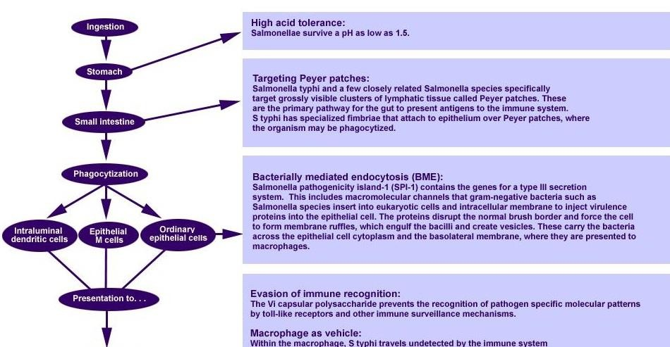

Slide 40
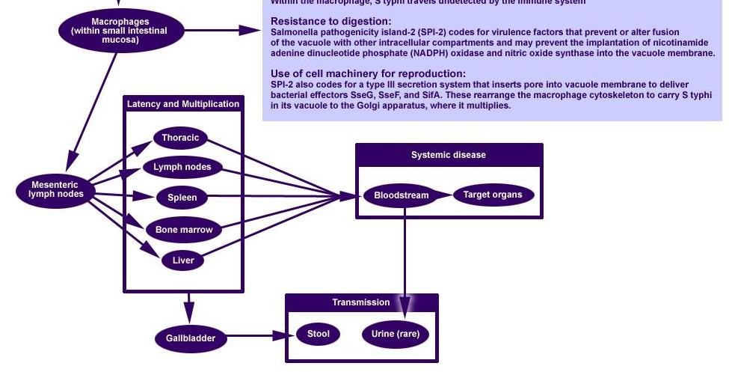

Slide 41
The following are modes of transmission of typhoidal salmonella:
Oral transmission via food or beverages handled by an often asymptomatic individual—a carrier—who chronically sheds the bacteria through stool or, less commonly, urine
Hand-to-mouth transmission after using a contaminated toilet and neglecting hand hygiene
Oral transmission via sewage-contaminated water or
shellfish (especially in the developing world). ^{[10, 11, 12]}

Slide 42
Signs and symptoms
An initial dysentery is followed by bacteremia (90% of patients),fever, and abdominal pain that can persist for 2 weeks without antibiotic treatment (typhoid fever).
Systemic dissemination can cause extra intestinal complications including:
Encephalopathy,
Meningitis,
Endocarditis,
Myocarditis,
Pneumonia, and
Cholecystitis.

