Slide 1

HOSPITAL PHARMACY
HOSPITAL FORMULARY

Slide 2
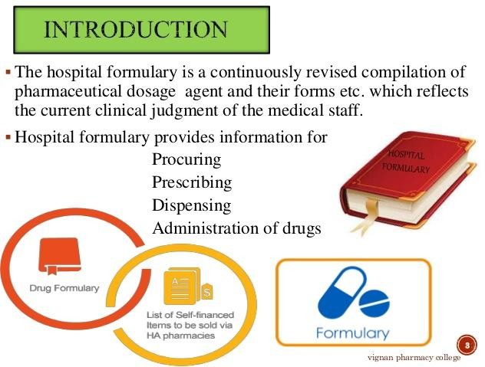

Slide 3
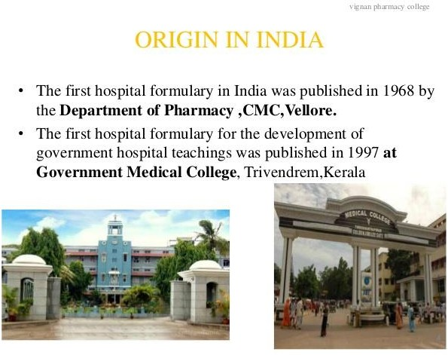

Slide 4
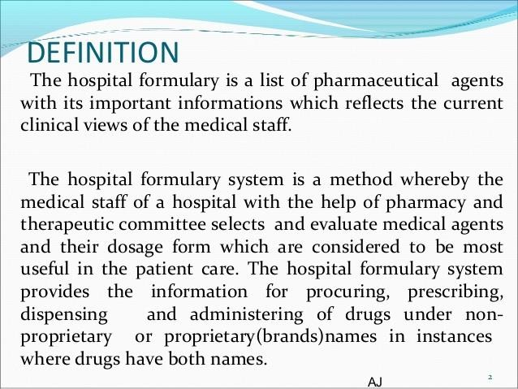

Slide 5
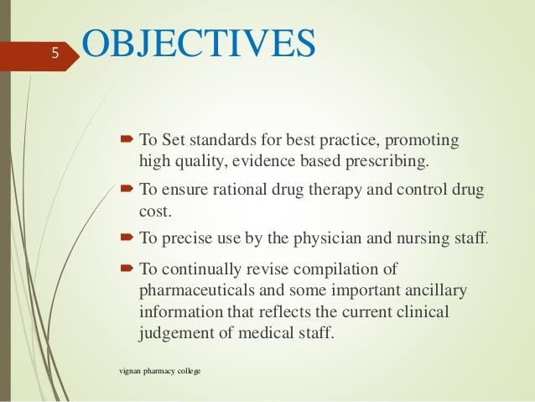

Slide 6
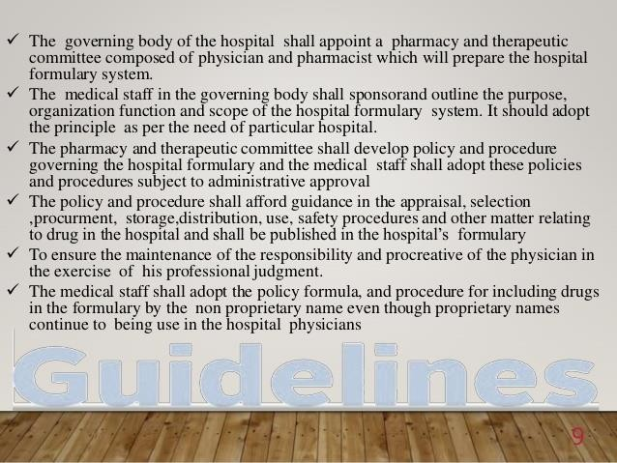

Slide 7
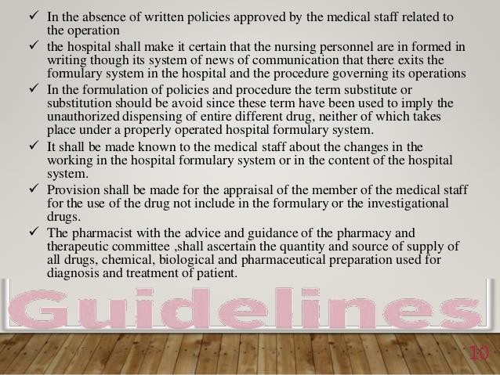

Slide 8


Slide 9
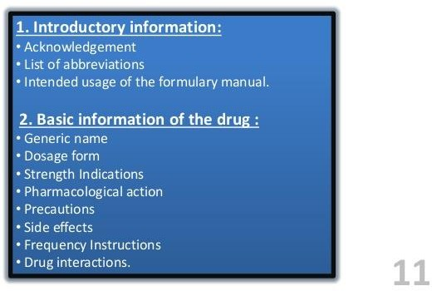

Slide 10
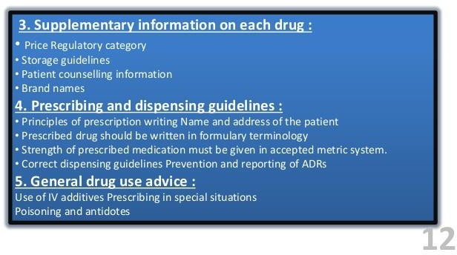

Slide 11
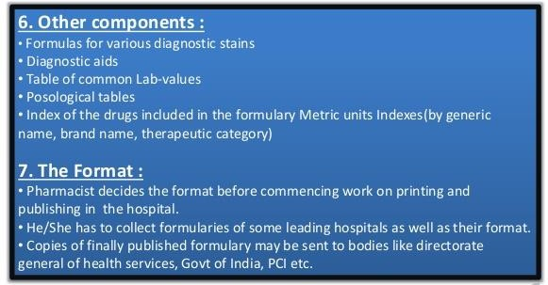

Slide 12
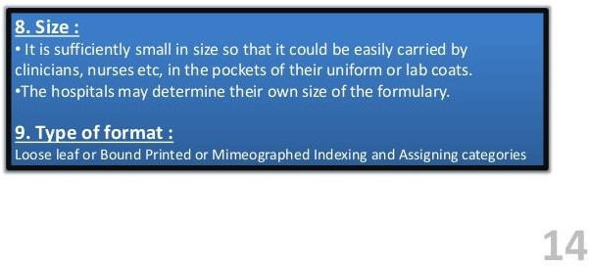

Slide 13
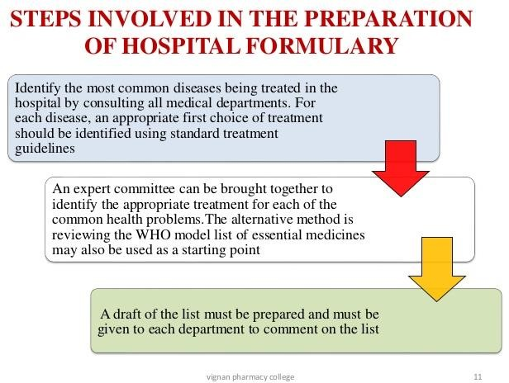

Slide 14
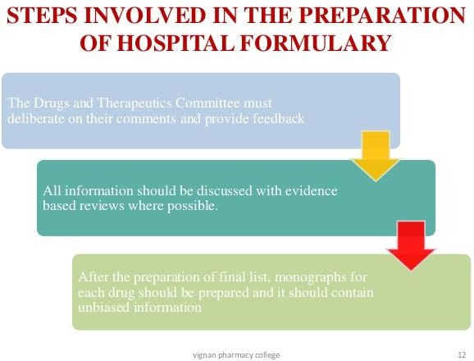

Slide 15
Guiding principles for admitting or deleting of drugs
It should be established whether the local general or specialist has considered the drug to be of proven clinical value based on their experience with it.
The drug must be recognized by the pharmacopoeias and formularies approved under the Drugs and Cosmetic Act and Rules and the National Formulary of India.
The manufacturer of the drugs must be licensed under the drugs and cosmetic act and rules and should not have been punished for any serious offence under any laws pertaining to drugs.

Slide 16
4) No preparation of secret composition will be considered or admitted to the formulary.
5) No product of a multiple ingredients shall be admitted if the same therapeutic effect can be achieved through the use of a single drug preparation. This is a very important and complicated task for the pharmacy and therapeutic committee to provide a basis of drugs to be added or deleted in the formulary.
The committee should be free to invite specialist to attend particular committee meetings for the purpose of evaluation of preparations commonly used in his specialized practice for including in the formulary.

Slide 17
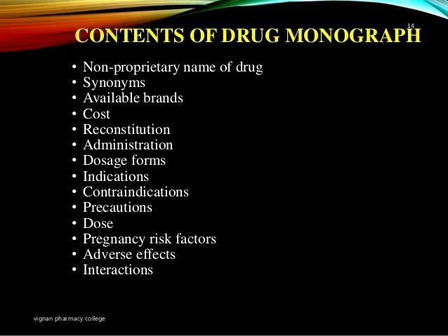

Slide 18
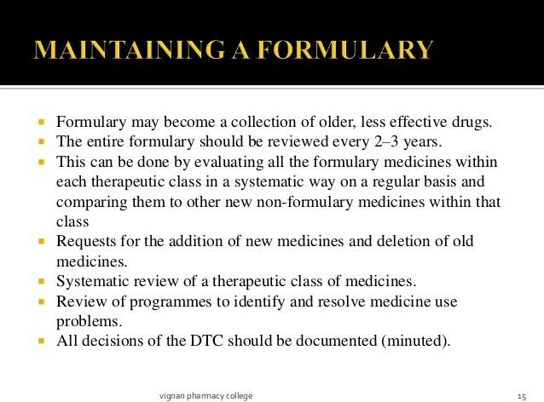

Slide 19
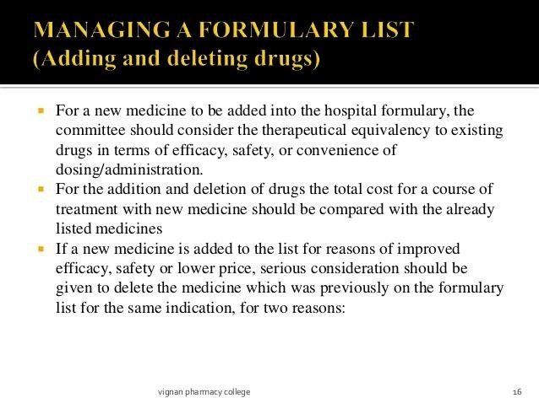

Slide 20
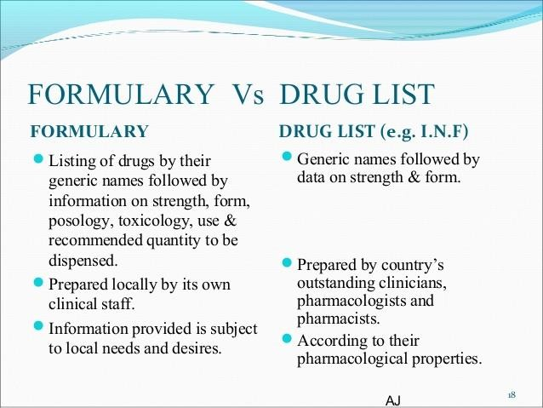

Slide 21

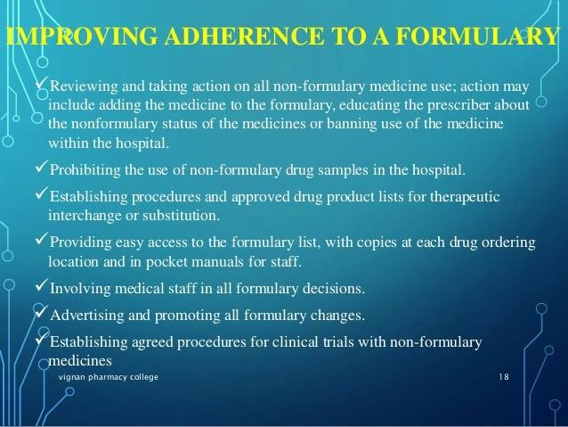

Slide 22
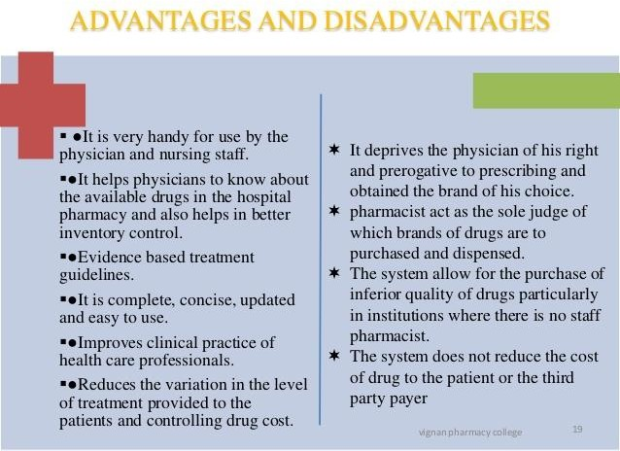

Slide 23

DISADVANTAGES OF HOSPITAL FORMULARY
The ground on which hospital formulary is not favored are-
The hospital formulary system deprives the physician of his right and prerogative to prescribing the brand of his choice.
The hospital formulary system in many instances, permit the pharmacist to act as the sole judge of which brands of drugs are to purchased and dispensed.
The system allow for the purchase of inferior quality of drugs particularly in institutions where there is no staff pharmacist.
The system does not reduce the cost of drug to the patient because most institution purchase large volume of drug at reduce rate but do not pass on the patient any reduction in their cost.

Slide 24
Advantages of Hospital Formulary
It can be stated however ,that in an institution which has established pharmacy and therapeutic committee all of the objection raised above will disappear because the committee will naturally consist of persons interested primarily to assist the committee in the task of selection of most suitable types of drugs and their formulations.
They will surely be concerned to ensure that drugs are selected at economic cost both to the hospital as well as to the patients.
This kind of philosophy, any where in the world, combined with the inherent integrity of physician and pharmacist will go a long way to protect the rights and interest of all concerned.

Slide 25
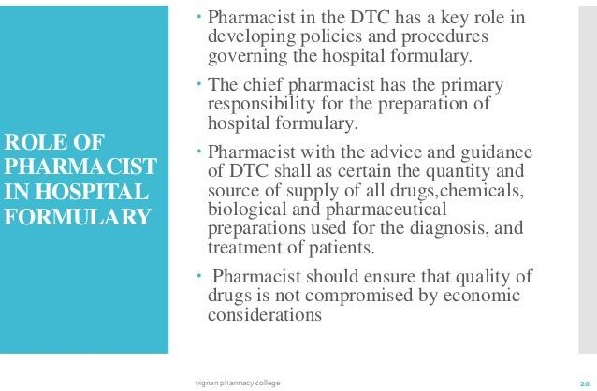

Slide 26
