Slide 1
BIOPHARMACEUTICS AND PHARMACOKINETICS
Hepatic Clearance
14-09-2024
1

Slide 2
Hepatic clearance :
Hepatic clearance may be defined as volume of the blood that perfuses the liver that is cleared of drug per unit.
Clh = QhEh
Where, Clh= Hepatic clearance
Qh= Blood flow to the liver
Eh= Extraction ratio of the liver
Hepatic clearance may also be expressed as the rate of drug removal divided by the plasma drug concentration in the artery.
Rate of drug removal by the liver
CLh= ----------------------------------------------------
Plasma concentration of the drug
It should be noted that only free drug in blood is available for hepatic extraction.
Therefore, protein binding of drugs has to be considered in calculating the hepatic clearance
14-09-2024
2

Slide 3
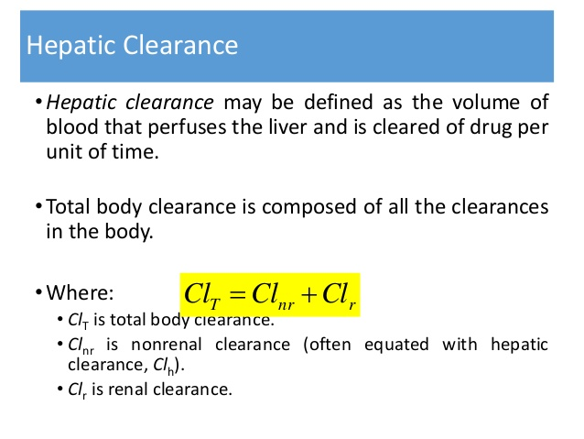
14-09-2024
3

Slide 4
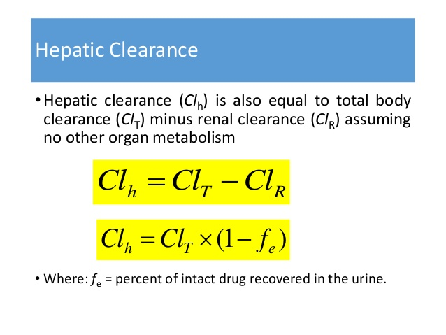
14-09-2024
4

Slide 5
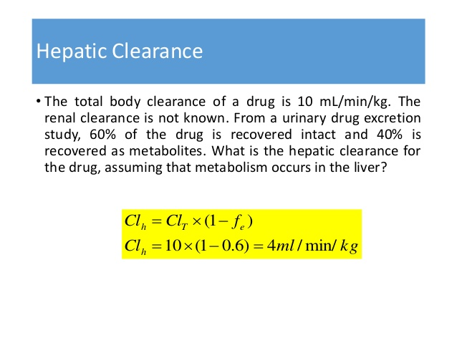
14-09-2024
5

Slide 6
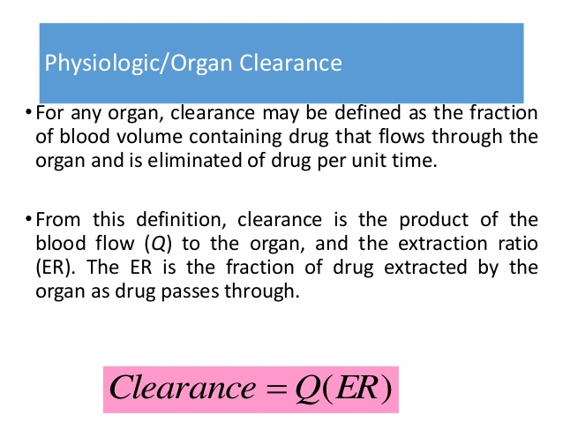
14-09-2024
6

Slide 7
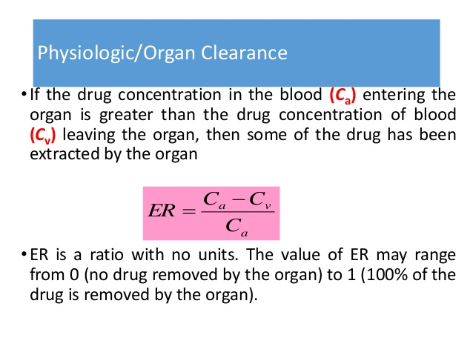
14-09-2024
7

Slide 8
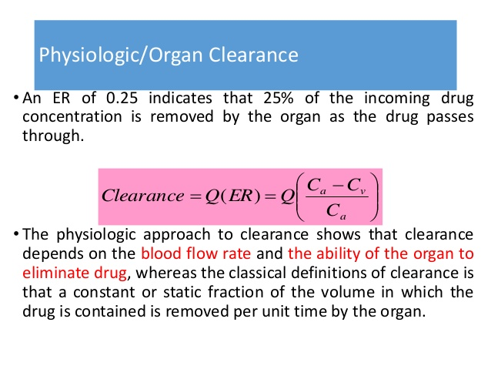
14-09-2024
8

Slide 9
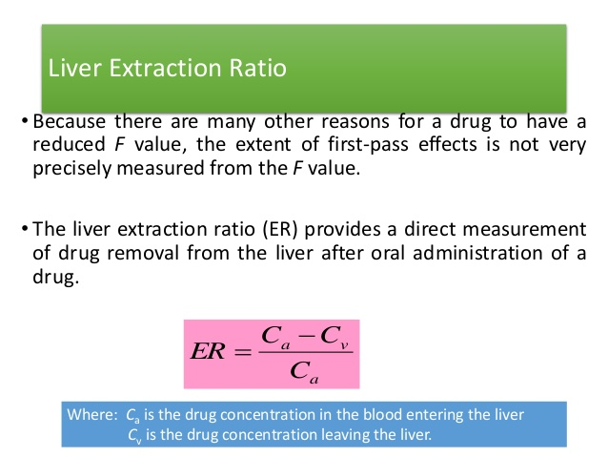
14-09-2024
9

Slide 10
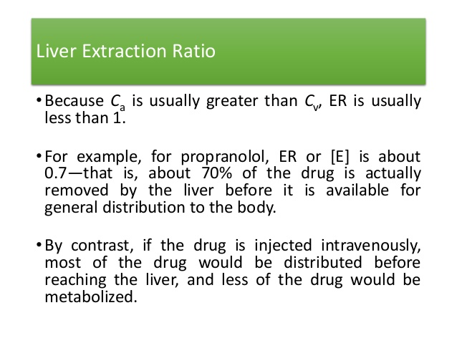
14-09-2024
10

Slide 11
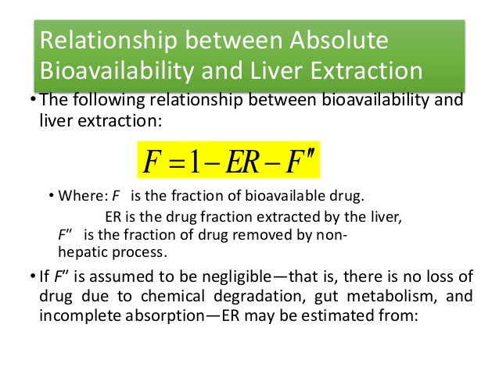
14-09-2024
11

Slide 12
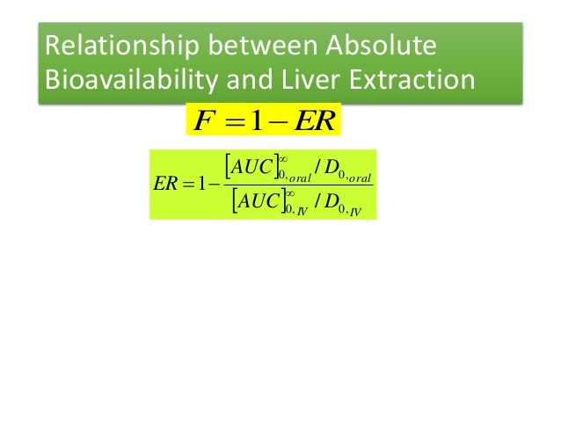
14-09-2024
12

Slide 13
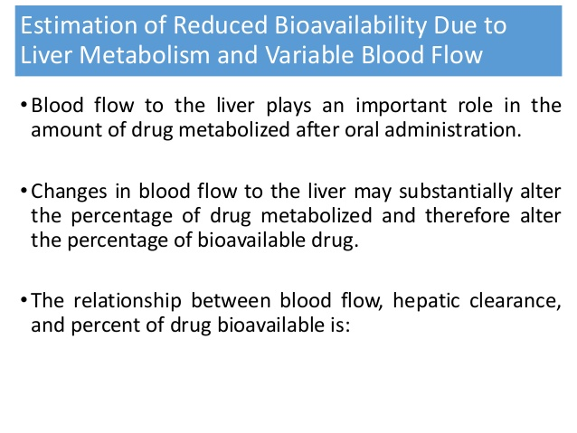
14-09-2024
13

Slide 14
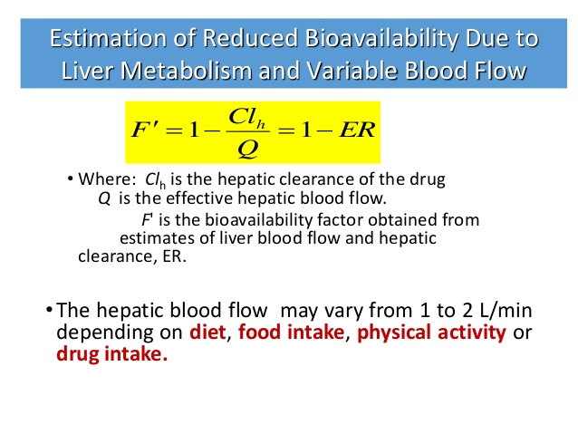
14-09-2024
14

Slide 15
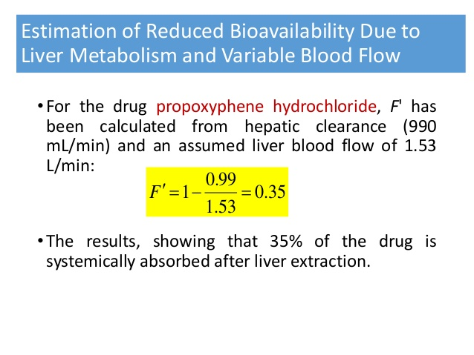
14-09-2024
15

Slide 16
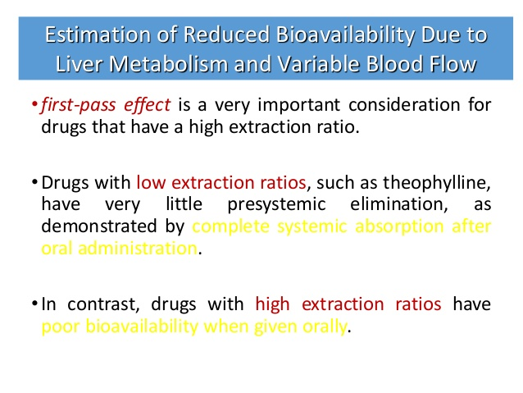
14-09-2024
16

Slide 17
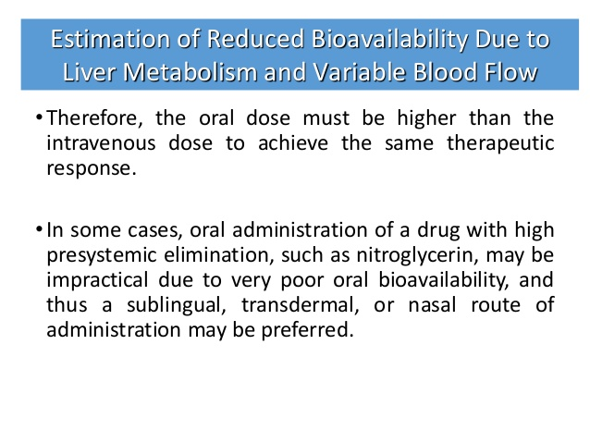
14-09-2024
17

Slide 18
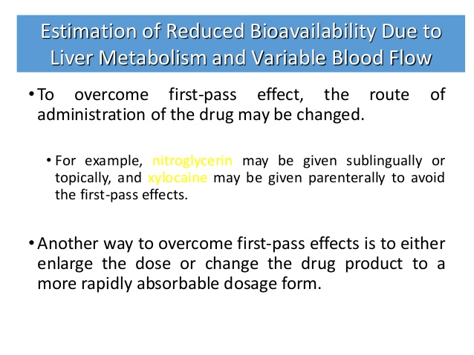
14-09-2024
18

Slide 19
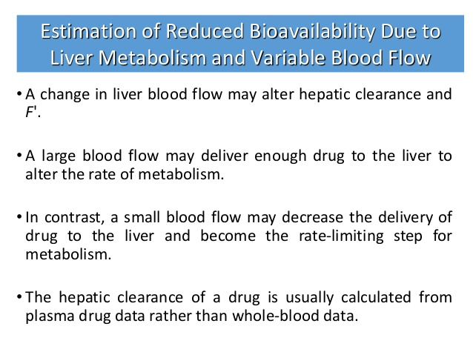
14-09-2024
19

Slide 20
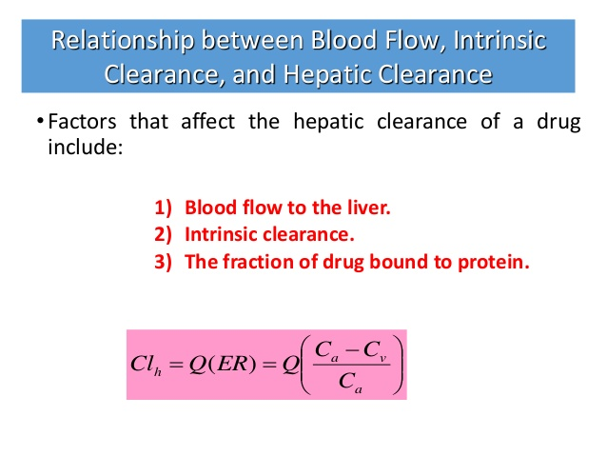
14-09-2024
20

Slide 21
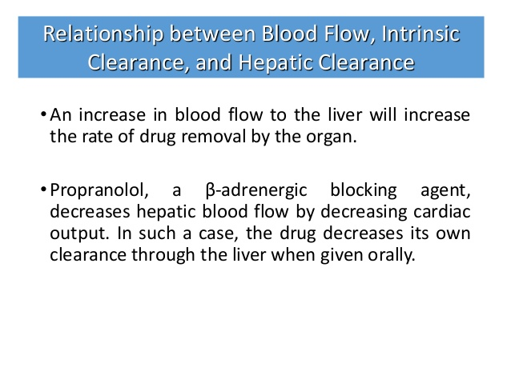
14-09-2024
21

Slide 22
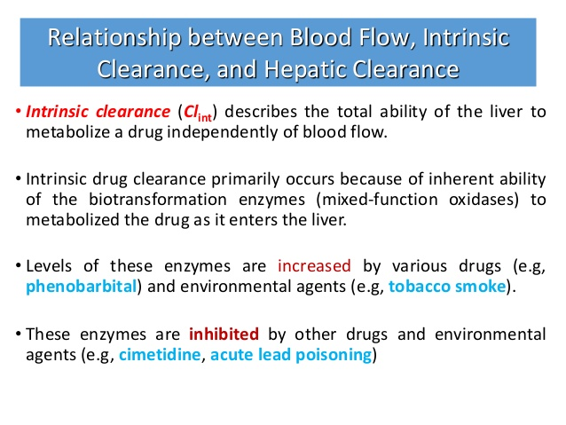
14-09-2024
22

Slide 23
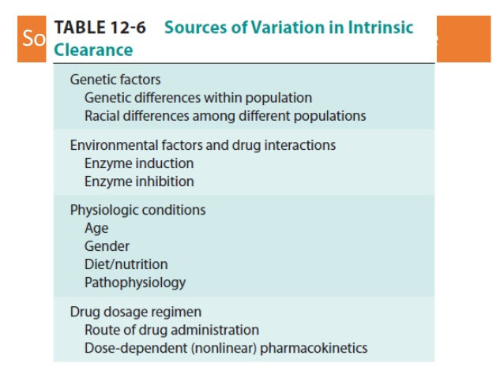
14-09-2024
23

Slide 24
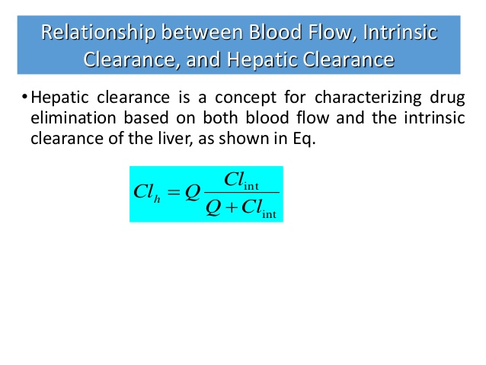
14-09-2024
24

Slide 25
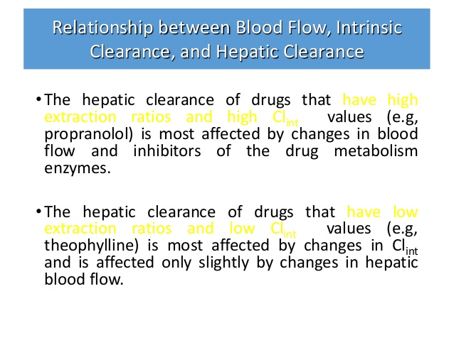
14-09-2024
© R R INSTITUTIONS , BANGALORE
25

