Slide 1
PHARMACOTHERAPEUTICS-III
VIRAL HEPATITIS
16-09-2024
1

Slide 2
TOPIC NAME – HEPATITIS
  Hepatitis is an “inflammation of the liver” that can cause a range of health problems and can be fatal.
  There are five main strains of the hepatitis virus, referred to as types A, B, C, D and E.
  While they all cause liver disease, they differ in important ways including modes of transmission, severity of the illness, geographical distribution and prevention methods.
  In particular, types B and C lead to chronic disease in hundreds of millions of people and, together, are the most common cause of liver cirrhosis, cancer and viral hepatitis-related deaths.
  Some types of hepatitis are preventable through vaccination.
16-09-2024
2

Slide 3
VIRAL HEPATITIS
Viral hepatitis is a systemic disease with primary inflammation of the liver by any one of a heterogeneous group of hepatotropic viruses.
The most common causes of viral hepatitis are the five unrelated hepatotropic viruses Hepatitis A, Hepatitis B, Hepatitis C, Hepatitis D, and Hepatitis E.
In addition to the nominal hepatitis viruses, other viruses that can also cause liver inflammation include Herpes simplex, Cytomegalovirus, Epstein–Barr virus, or Yellow fever.

Slide 4
CLINICAL TERMS
Hepatitis: inflammation of liver;
Acute Viral Hepatitis: symptoms last less than 6 months
Acute Hepatic Failure: is the appearance of severe complications rapidly after the first signs of liver disease (such as jaundice), and indicates that the liver has sustained severe damage (loss of function of 80-90% of liver cells).Massive hepatic necrosis with impaired consciousness within 8 weeks of onset of illness.
Chronic Hepatitis: Inflammation of liver for at least 6 months
Cirrhosis: Replacement of liver tissue→ fibrosis(scar tissue).These changes lead to loss of liver function.
Fulminant Hepatitis: severe impairment of hepatic functions or severe necrosis of hepatocytes in the absence of preexisting liver disease.

Slide 5
EPIDEMIOLOGY
Viral hepatitis occurs in all parts of world, higher in resource poor countries of Asia &Africa.
High population density, poor water quality & sanitation, financial constraints, lack of education.
India- HAV & HEV infection common.
1-3%- chronic HBV infection.
0.5-1.5%- chronic HCV infection.
10-20% of chronic HBV infection carries HDV infection.

Slide 6
HEPATITS A

Slide 7
HEPATITIS A
Hepatitis A is a viral liver damage that can cause mild to severe illness.
Unlike hepatitis B & C, hepatitis A infection does not cause chronic liver disease and is rarely fatal, but cause debilitating symptoms and lead to acute liver failure, which is associated with higher mortality.
The disease is heralded by non-specific symptoms such as fever, chills, headache, fatigue, generalized weakness and aches and pains, followed by anorexia, nausea, vomiting, dark urine and jaundice.

Slide 8
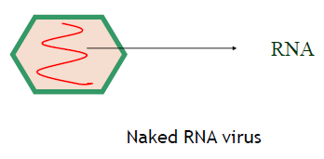
EPIDEMIOLOGICAL DETERMINANTS
AGENT FACTORS
AGENT: The causative agent, the hepatitis A virus, is an enterovirus of the Picornaviridae family. It multiplies only in hepatocytes.
RESISTANCE: The virus is fairly resistant to heat and chemicals.
-Withstands heating to 600 C for 1 hr and is not affected by chlorine in doses usually employed for chlorination.
  -Formalin is stated to be an effective disinfectant.
  -The virus is inactivated by ultraviolet rays and by boiling for 5 minutes or autoclaving.
RESERVOIR OF INFECTION: The human cases are the only reservoir of infection.
PERIOD OF INFECTIVITY : The risk of transmitting HAV is greatest from 2 weeks before to 1 week after the onset of jaundice.
INFECTIVE MATERIAL : Mainly man’s faeces.
VIRUS EXCRETION: HAV is excreted in the faeces for about 2 weeks before onset of jaundice and for up to 2 weeks thereafter.

Slide 9
HOST FACTORS
AGE: Infection with HAV is more frequent among children than in adults. However, people from all ages may be infected if susceptible.
SEX: Both sexes are equally susceptible.
IMMUNITY: Immunity after attack probably lasts for life.
ENVIRONMENTAL FACTORS
Cases may occur throughout the year.
In India the disease tends to be associated with periods of heavy rainfall.

Slide 10
INCUBATION PERIOD
10-50 days (usually 25 to 30 days).
MODE OF TRANSMISSION
a) FAECAL-ORAL ROUTE: Major route of transmission.
-By contaminated water, food or milk.
b) PARENTERAL ROUTE (Rarely):
-By blood and blood products or by skin penetration through contaminated needles.
c) SEXUAL TRANSMISSION:
-May occur mainly among homosexual men because of oral-anal contact.

Slide 11
PATHOGENESIS
After ingestion, the HAV survives gastric acid, moves to the small intestine and reaches the liver via the portal vein.
Replicates in hepatocyte cytoplasm
  Not a cytopathic virus
  Immune mediated cell damage more likely
Once mature the HAV travels through sinusoids and enters bile canaliculi, released into the small intestine and systemic circulation, excreted in faces.

Slide 12
SIGNS AND SYMPTOMS
Hepatitis A infection has four clinical phases, although these do not occur in all patients
FIRST STAGE
  An incubation period of 15 to 50 days (mean 28 to 30 days)
  Asymptomatic
  Infected person may be actively shedding the virus in the stool.
SECOND STAGE (PRE-ICTERIC )
  Several days to weeks that may precede the onset of jaundice.
  Prodromal period is characterized by nonspecific symptoms
  Followed by gastrointestinal symptoms such as anorexia, nausea, vomiting, abdominal pain, fatigue, malaise, and fever.
  Myalgia, arthralgia , cough, pharyngitis, constipation, diarrhea, pruritus, and urticaria. Dark urine caused by elevated bilirubin levels usually occurs prior the onset of jaundice.

Slide 13
SIGNS AND SYMPTOMS
THIRD STAGE
Characteristic yellowing of the skin and eyes of jaundice appear
Most symptoms subside
Clinical signs such as hepatomegaly and hepatic tenderness are found in about half of patients
There is no treatment for HAV infection. Jaundice usually resolves within a few weeks .
FINAL STAGE
• Convalescent period during which the patient recovers

Slide 14
COMPLICATIONS
Fulminant hepatitis A/ acute liver failure is a rare but devasting complication of HAV infection.
HAV- Liver parenchymal cells- release of toxins.
The cell then produces new viral components that are released into the bile capillaries- hepatic necrosis.
The fulminant form of hepatitis occurs when this necrotic process kills so many liver cells.
Fulminant hepatic failure can also lead to encephalopathy and cerebral edema.

Slide 15
DIAGNOSIS
1. Demonstration of Virus in feces, blood, bile:
By: Immunoelectron microscopy
2. Virus Isolation:
3. Detection of Antibody :By ELISA
4. Biochemical tests:
  i) Alanine aminotransferase (ALT)
  ii) Bilirubin
  iii) Protein
5. Molecular Diagnosis : RT PCR of feces

Slide 16
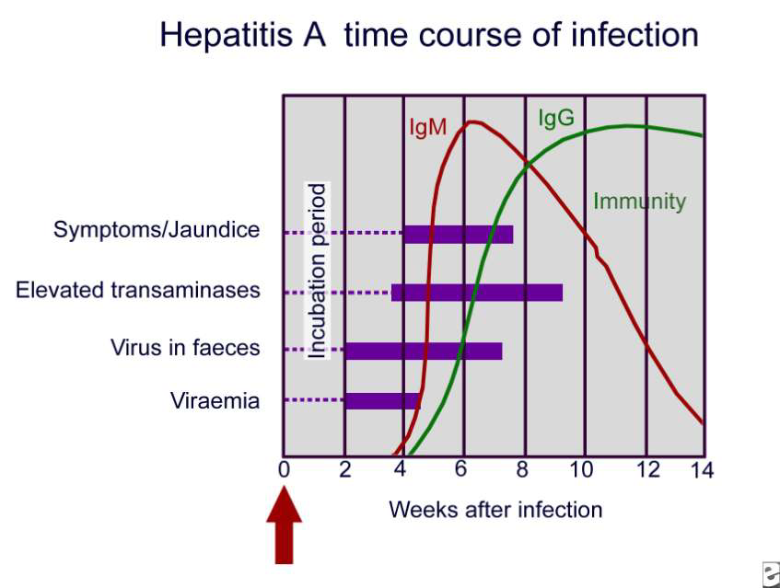

Slide 17
PREVENTION:-
hygienic measures and sanitation
passive immunization (Human Immunoglobulin Gamma globulin given before exposure to virus or early during the incubation period, will prevent or attenuate a clinical illness.
active immunization : Several inactivated or live attenuated vaccines against hepatitis A have been developed.
TREATMENT:
no specific, dietary food and long rest

Slide 18
HEPATITIS A VACCINE
Several hepatitis A vaccines are available internationally (similar in terms protection and their side-effects)
No vaccine is licensed for children younger than one year of age
Nearly 100% of people develop protective levels of antibodies to the virus within one month after a single dose of the vaccine
After exposure to the virus, a single dose of the vaccine within two weeks of contact with the virus has protective effects
No serious adverse events
Can be given as part of regular childhood immunizations programs, eg (Argentina, china, Israel and the united states of America have)
For travelers to endemic areas

Slide 19
HEPATITIS A VACCINATION-INDIA
At present there is lack of evidence for recommending universal vaccination against hepatitis A in India
Data from india indicate that the population is no longer homogeneous for HAV exposure profile
Occasional outbreaks of HAV and higher proportions of symptomatic cases are reported amongst older children and adults from different regions of the country
The challenge is to recognize the susceptible pockets and take pre-emptive steps
The vaccine will be useful in individuals and populations who remain unexposed to the HAV infection during early childhood
1.Mathur P, Arora NK.Epidemiological transition of hepatitis A in India: issues for vaccination in developing countries.Indian J Med Res. 2008 Dec;128(6):699-704

Slide 20
VACCINES IN INDIA
Sl. No | Brand name | Manufacturees | Type
1 | Avaxim | Aventis Pasteur India Ltd | Injection
2 | Avaxim 80U Paediatric | Aventis Pasteur India Ltd | Injection
3 | Havrix | Glaxo Smithline Pharmaceuticals Ltd | Injection
4 | Havrix (360) | Glaxo Smithline Pharmaceuticals Ltd | Injection
5 | Havrix (720) | Glaxo Smithline Pharmaceuticals Ltd | Injection

Slide 21
HEPATITS B

Slide 22
HEPATITIS B
Hepatitis B (formerly known as ―serum‖ hepatitis) is an acute systemic infection with major pathology in the liver, caused by hepatitis B virus.
Transmitted by the Parenteral route.
The acute illness causes liver inflammation, vomiting, jaundice, and, rarely, death. Chronic hepatitis B may eventually cause cirrhosis and liver cancer.
Hepatitis B is endemic throughout the world, especially in tropical & developing countries.

Slide 23
EPIDEMIOLOGY DETERMINANTS
AGENT FACTOR
a) AGENT: Hepatitis B Virus (HBV)
-It is a complex, 42 nm double-shelled DNA virus originally known as ―Dane Particle.
-It replicates in liver cell.
HBV occurs in 3 morphology form in serum:
i. Small spherical particles with an average Diameter of 22nm.
ii. Filamentous or Tubules of varying length & of 22 nm diameter.
iii. Dane particle.
Out of 3 morphology forms, only the Dane particle is considered infectious, other circulating morphology forms are not infectious.

Slide 24
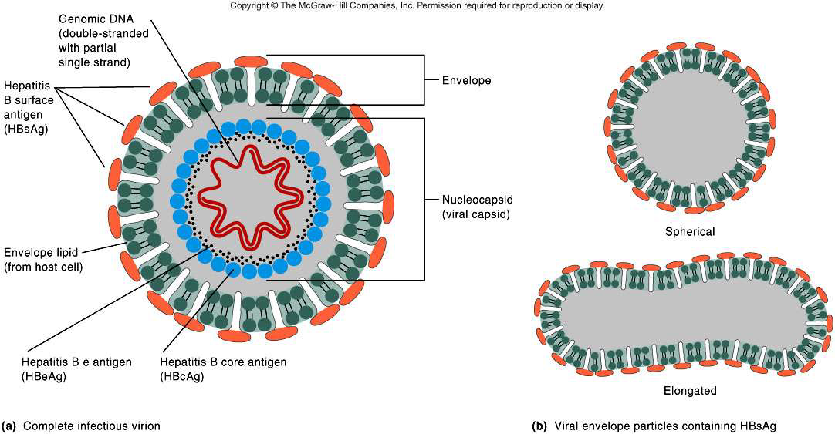
HBV : STRUCTURE

Slide 25
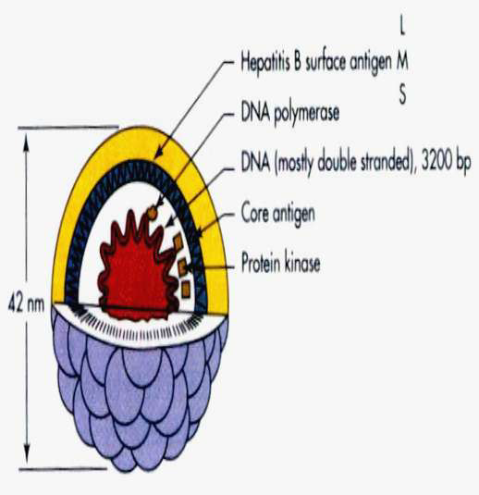

Slide 26
b) RESERVOIR OF INFECTION:
-Men is the only reservoir of infection which can be spread either from carriers or from cases.
c) Infective material:
-Contaminated blood is the main source,
-Virus has been found in body secretion such as saliva, vaginal secretion & Semen in infected material.
d) Resistance:
-Readily destroyed by sodium hypochlorite, as is by heat sterilization in an autoclave for 30-60 min.
HOST FACTOR
a) AGE:
-Acute hepatitis B
90% resolve by themselves; <1% develop
fulminant hepatic failure.
-occurs in approx.:
Perinatal -1%
Childhood -10%(1-5 yr. age)
Late infection -30%(>5 yr. age)
-Chronic hepatitis B
2-10% progress to chronic state.
-occur in approx.
Perinatal -95%
Childhood -80%
After 5 yr. of age -5-10%

Slide 27
B. RISK FACTORS
Have unprotected sex with multiple sex partners or with someone who's infected with HBV
Share needles during intravenous (IV) drug use
Are a man who has sex with other men
Live with someone who has a chronic HBV infection
Are an infant born to an infected mother
Have a job that exposes you to human blood
Travel to regions with high infection rates of HBV, such as Africa, Central and Southeast Asia, and Eastern Europe

Slide 28
C) HUMORAL AND CELLULAR RESPONSE:
-HBV has 3 distinct antigen:
i. HBsAg, also known as ―Australian antigen,
ii. HBcAg antigen (core antigen)
iii. HBeAg envelope antigen
They stimulate production of corresponding antibody.
Incubation Period
45-180 days (usually 60-90 days)

Slide 29
PATHOGENESIS
Hepatitis B virus is not directly cytopathic to hepatocytes.
The fact that patients with defects in cellular immune competence are more likely to remain chronically infected rather than to clear HBV supports the role of cellular immune responses in the pathogenesis of hepatitis B–related liver injury.

Slide 30
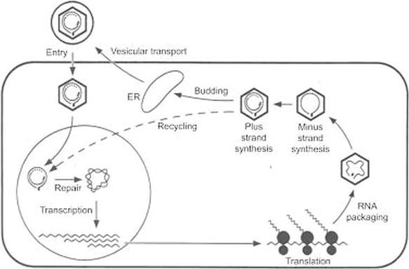

Slide 31
MODE OF TRANSMISSION
✓ Parenteral- IV drug abusers, health workers are at increased risk.
✓ Sexual- sex workers and homosexuals are particular at risk.
✓ Perinatal (Vertical) – mother (HBeAg+) →infant. Mothers who are HBeAg positive are much more likely to transmit to their offspring than those who are not. Perinatal transmission is the main means of transmission in high prevalence populations.

Slide 32
CLINICAL MANIFESTATIONS
2 forms of Hepatitis B exists:
  Acute Hepatitis B
  Chronic Hepatitis B

Slide 33
ACUTE HEPATITIS B
Definition
Acute Hepatitis B is an infectious disease caused by hepatitis B virus, which developes within 6 months after entering virus to the organism. Disease has symptomatic (with jaundice and without jaundice) and asymptomatic course. In >90% of cases acute hepatitis B is self-limited disease.

Slide 34
MAIN SYMPTOMS
Discomfort in Abdominal cavity
Jaundice
Dark urine
clay-colored stools
Fever
Joint pain
Loss of appetite
Nausea and vomiting
Weakness and fatigue
And others

Slide 35
NATURAL HISTORY OF HEPATITIS B
Acute HBV Infection
>90% Recovery
< 10% Persistent infection
Chronic replicate form
Healthy carriers
20-35% cirrhoses
5-7% HCC

Slide 36
The prodromal symptoms of acute viral hepatitis B are systemic and quite variable.
Constitutional symptoms:
  • anorexia,
  • nausea and vomiting,
  • fatigue, malaise,
  • arthralgias, myalgias,
  • headache, photophobia, pharyngitis,
May precede the onset of jaundice by 1–2 weeks.
Dark urine and clay-colored stools may be noticed by the patient from 1–5 days before the onset of clinical jaundice.

Slide 37
With the onset of clinical jaundice , the constitutional prodromal symptoms usually diminish, but in some patients mild weight loss (2.5–5 kg) is common and may continue during the entire icteric phase.
The liver becomes enlarged and may be associated with right upper quadrant pain and discomfort.
Infrequently, patients present with a cholestatic picture, suggesting extrahepatic biliary obstruction.
Splenomegaly are present in 10–20% of patients with acute hepatitis B. Rarely, a few spider angiomas appear during the icteric phase and disappear during convalescence.

Slide 38
RECOVERY PHASE
During the recovery phase, constitutional symptoms disappear, but usually some liver enlargement and abnormalities in liver biochemical tests are still evident.
The duration of the posticteric phase is variable, ranging 2–12 weeks, and is usually more prolonged in acute hepatitis B.
Complete clinical and biochemical recovery is to be expected 3–4 months after the onset of jaundice in self-limited cases of hepatitis B.

Slide 39
CHRONIC HEPATITIS B
DEFINITION
Chronic hepatitis B is a chronic infection caused by HBV which develops after 6 months from acute phase of infection. Chronic hepatitis B usually progresses slowly and is characterized with non-specific clinical symptoms.

Slide 40
CLINICAL SPECTRUM OF CHRONIC HBV INFECTION (VARIANTS)
Chronic hepatitis B
– HBe Ag positive chronic hepatitis B
– HBe Ag negative chronic hepatitis B
– Nonactive healthy carriers (HBsAg)
– Occult HBV infection

Slide 41
SEROLOGIC AND VIROLOGIC MARKERS
HBsAg
HBeAg
Anti HBs
Anti HBc IgG
Anti HBc IgM
Anti Hbe
HBV DNA
Qualitative and
Quantitative
Blood
Liver

Slide 42
HBsAg
After a person is infected with HBV, the first virology marker detectable in serum within 1–12 weeks, usually between 8–12 weeks, is HBsAg
Circulating HBsAg precedes elevations of serum aminotransferase activity and clinical symptoms by 2–6 weeks and remains detectable during the entire icteric or symptomatic phase of acute hepatitis B and beyond.
In typical cases, HBsAg becomes undetectable 1–2 months after the onset of jaundice and rarely persists beyond 6 months.
After HBsAg disappears, antibody to HBsAg (anti-HBs) becomes detectable in serum and remains detectable indefinitely thereafter. (self-limited case of HBV)

Slide 43
ANTI-HBs
The temporal association between the appearance of anti-HBs and resolution of HBV infection as well as the observation that persons with anti-HBs in serum are protected against re-infection with HBV suggests that anti-HBs is the protective antibody.
Patients with HBsAg and without anti-HBs should be categorized as having chronic HBV infection.

Slide 44
Anti-HBc IgM & Anti-HBc IgG
Anti-HBc of the IgM class (IgM anti-HBc) predominates during the first six months after acute infection, whereas IgG anti-HBc is the predominant class of anti-HBc beyond six months.
Therefore, patients with current or recent acute hepatitis B, have IgM anti-HBc in their serum.
In patients who have recovered from hepatitis B, as well as those with chronic HBV infection, anti-HBc is predominantly of the IgG class.
Infrequently, in 1–5% of patients with acute HBV infection, levels of HBsAg are too low to be detected; in such cases, the presence of IgM anti-HBc establishes the diagnosis of acute hepatitis B.

Slide 45
HBeAg
The other readily detectable serologic marker of HBV infection, is HBeAg.
HBeAg appears concomitantly with or shortly after HBsAg.
Its appearance coincides temporally with high levels of virus replication and reflects the presence of circulating intact virions and detectable HBV DNA (with the notable exception of patients with precore mutations who cannot synthesize HBeAg)
In self-limited HBV infections, HBeAg becomes undetectable shortly after peak elevations in aminotransferase activity, before the disappearance of HBsAg, and anti-HBe then becomes detectable, coinciding with a period of relatively lower infectivity

Slide 46
HBV DNA
During acute and early chronic HBV infection, HBV DNA can be detected both in serum and in hepatocytes.
This replicative stage of HBV infection is the time of maximal infectivity and liver injury;
HBeAg is a qualitative marker and HBV DNA a quantitative marker of this replicative phase.
In the non-replicative phase of chronic infection, when HBV DNA is demonstrable in hepatocyte nuclei, it tends to be integrated into the host genome.
In this phase, liver injury tends to fall down.
Most such patients would be characterized as inactive HBV carriers.

Slide 47
Occasionally, nonreplicative HBV infection converts back to replicative infection.
Such spontaneous reactivations are accompanied by reexpression of HBeAg and HBV DNA, and sometimes of IgM anti-HBc, as well as by exacerbations of liver injury.

Slide 48
ACUTE HBV INFECTION
HBs Ag (+) - positive
Anti-HBs (-) - negative
HBe Ag (+) - positive
Anti- HBe (-) - negative
Anti-HBc(total) (+) - positive
Anti-HBcIgM (+) - positive
HBV DNA (+) - positive
Infectious Diseases,

Slide 49
CHRONIC HBV INFECTION
HBe Ag (+) positive
HBs Ag (+) positive
Anti-HBs (-) negative
HBe Ag (+) positive
Anti- HBe (-) negative
Anti-HBc(total) (+) positive
Anti-HBcIgM (±) positive/negative
HBV DNA (+) positive

Slide 50
CHRONIC HBV INFECTION
HBs Ag (+) positive
Anti-HBs (-) negative
HBe Ag (-) negative
Anti- HBe (-) negative
Anti-HBc(total) (+) positive
Anti-HBcIgM (-) negative
HBV DNA (-) negative

Slide 51
AFTER VACCINATION
HBs Ag (-) negative
Anti-HBs (+) positive
HBe Ag (-) negative
Anti-HBe (-) negative
Anti-HBc(total) (-) negative
Anti-HBcIgM (-) negative
HBV DNA (-) negative

Slide 52
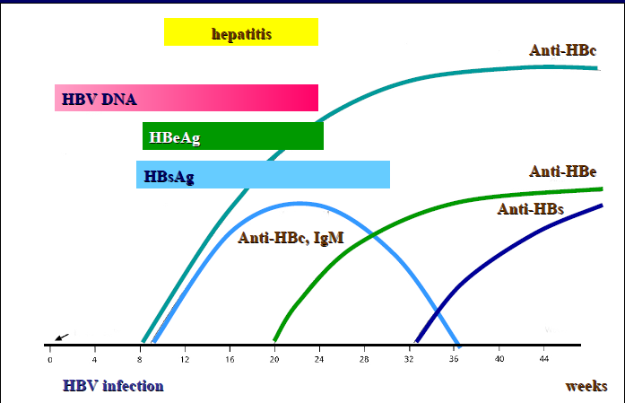
Clinical and laboratory markers of acute HBV infection

Slide 53
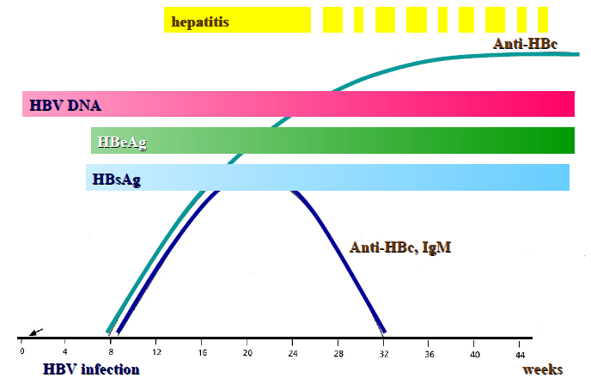
CLINICAL AND LABORATORY MARKERS OF CHRONIC HBV INFECTION

Slide 54
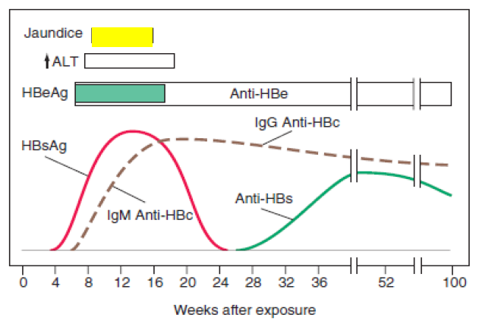
SEROLOGIC AND VIROLOGIC MARKERS

Slide 55
DIAGNOSIS
✓ Serology
✓ Liver Chemistry tests- AST, ALT, ALP, and total Bilirubin
✓ Histology-Immunoperoxidase staining
✓ HBV Viral DNA--Most accurate marker of viral DNA and detected by PCR
✓ Liver Biopsy--to determine grade(Inflammation) and stage(Fibrosis) in chronic Hepatitis

Slide 56
SEROLOGIC EVENTS
1) HBsAg :- It is the first marker to appear in blood after infection.
2) Anti-HBs(HBsAb) :-Disappearance of HBsAg and the appearance of anti-HBs signals recovery from HBV infection, non-infectivity.
3) Anti-HBc :- IgM anti-HBc appears shortly after HBsAg is detect (HBcAg alone dose not appear in serum)
  IgM-HBc may also or can persist for 3-6 months or longer.
  IgG-HBc also appear during acute hepatitis B but persist indefinitely.
4) HBeAg :-
  HBeAg appear in blood concurrently with HBsAg, or soon afterwards.
  HBeAg is a soluble protein found only in HBeAg positive serum.
  HBeAg indicate viral replication and infectivity.
  Persistence of HBeAg in serum beyond 3 month indicate an increased likehood of chronic hepatitis B.

Slide 57
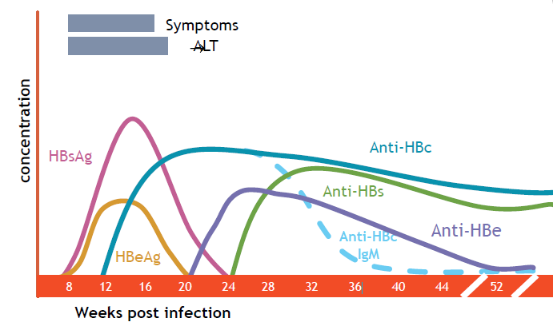

Slide 58
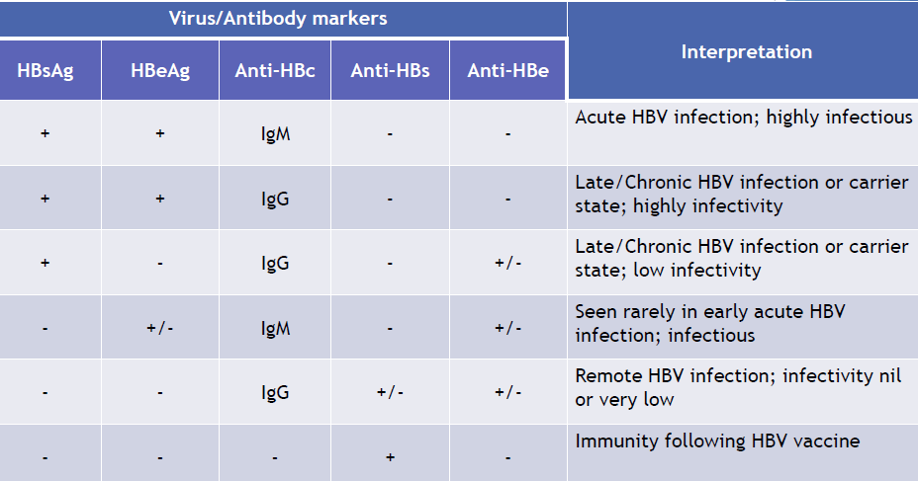
INTERPRETATION OF COMMON SEROLOGICAL PATTERNS IN HBV INFECTION

Slide 59
PREVENTION
❑ Vaccination
- highly effective recombinant vaccines
❑ Hepatitis B Immunoglobulin (HBIG)
-exposed within 48 hours of the incident/ neonates whose mothers are HBsAg and HBeAg positive.
❑ Other measures
-screening of blood donors, blood and body fluid precautions.

Slide 60
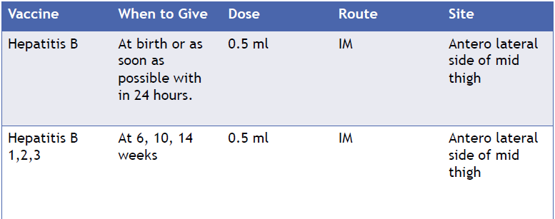
NATIONAL IMMUNIZATION SCHEDULE

Slide 61
TREATMENT
✓ Interferon Alfa (Intron A)- Response rate is 30 to 40%.
✓ Lamivudine (Epivir HBV)- (relapse ,drug resistance)
✓ Adefovir dipivoxil (Hepsera)

Slide 62
HEPATITS C

Slide 63
HCV is a single stranded RNA virus
Genus Hepa-civirus, (HCV)
Family Flavi-viridae
Characterized by a high spontaneous mutation rate
11 genotypes (90 sub-types) , (1a, 1,b, 2a, 3b etc)
USA:
Genotype 1 (subtypes 1a, 1b, and 1c) 70%–75%.
Genotypes 2 (subtypes 2a, 2b, and 2c) and 3 (3a and 3b) are less common
KSA:
Genotype 4 is common
Ia And Ib less common
Genotype 2, 3, 5 and 6 are least common

Slide 64
HCV genotype 1 is the most prevalent worldwide (49.1%),
Genotype 3 (17.9%),
Genotype 4 (16.8%) and
Genotype 2 (11.0%).
Genotypes 5 and 6 are responsible for the remaining < 5%.

Slide 65
EPIDEMIOLOGY
Worldwide seroprevalence 3% based upon anti- HCV) up to 180 million people infected chronically.
Variation in distribution 0.4% to 1.1% in North America to 9.6% to 13.6% in North Africa.
A primary cause of death from liver disease
The leading indication for liver transplantation in the United States
Deaths as a result of liver failure or HCC) will continue to rise in the next two decades
Responsible for 85% of cases associated with post-transfusional NANB hepatitis
Occurs among persons of all ages, highest between 20 to 39 years, with a male predominance.
Blacks have a substantially higher prevalence of chronic HCV infection than do whites.

Slide 66
TRANSMISSION
Mainly blood-borne (transfusion, intravenous drug abuse)
High risk: Transfusion, intravenous drug abuse
Low risk:
Hemodialysis continuous
Snorting cocaine or other drugs
Occupational exposure needle stick , health workers
Body piercing and acupuncture with unsterilized needle
Tattooing
From pregnant mother to child
Nonsexual household contacts (rare)
Sharing razors and/or toothbrushes

Slide 67
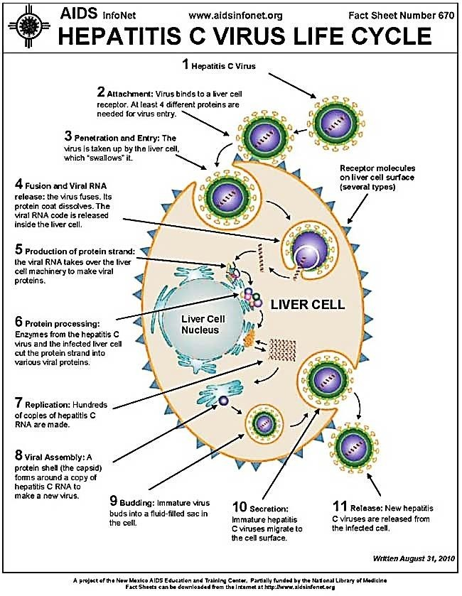
PATHOGENESIS: REPLICATION IN LIVER CELLS

Slide 68
Direct cell injury due to viral replication
Genotype 1 is associated with higher viral replication,
Genotype 1b associated with more progressive liver disease
Immune mediated cell injury:
CD8+ and CD4+ lymphocytes in portal, peri-portal, and lobular areas in patients with HCV infection

Slide 69
CLINICAL PRESENTATION
Acute: less than 6 months
Usually asymptomatic;
if Symptoms do appear, they are generally nonspecific: fatigue, weakness, anorexia, and jaundice; typically appear within 4–12 hours after exposure.
Rapid progression to fulminant liver disease is infrequent.
Diagnosis of acute infection is extremely rare.
Chronic: more than 6 months
Most chronically ill patients with HCV infection remain asymptomatic for years, presenting with symptoms during the fifth and sixth decades of life
Most who present for medical attention have chronic infection;
Anorexia, abdominal pain, fever, jaundice, malaise, nausea,
Symptoms associated with hepatocellular carcinoma and liver cirrhosis.
Extrahepatic disease (e.g., cryoglobulinemia, glomerulonephritis) may also be present.
The level of virus in the serum (HCV RNA) is not highly correlated with stage of disease.

Slide 70
HCV INFECTION: COURSE OF DISEASE
Asymptomatic: 30%
Moderate to severe hepatitis in 30%
Acute: Antibodies against HCV (anti-HCV) in the blood indicate infection. About 15% to 45% of patients have acute hepatitis C that resolves without any further complication
Chronic: In 70% of cases: when infection persists for more than 6 months and viral replication is confirmed by HCV RNA levels, because of Ineffective host immune system, with cytotoxic T lymphocytes unable to eradicate the HCV,
Approximately 55% to 85% of chronic cases progress to mild, moderate, or severe hepatitis (Child-Pugh score).
In 15% to 30% Persistent damage to hepatic cells leading to cirrhosis after several decades of infection
Factors for cirrhosis: obesity, diabetes, heavy alcohol use, male sex, and coinfections with HIV or HBV. Age over 40 years at the time of infection
5-year mortality with compensated cirrhosis 9%,
5-year mortality with Decompensated cirrhosis 50%  Once cirrhosis is confirmed, the risk of developing HCC is about 2% to 4% per year

Slide 71
COURSE OF THE DISEASE
Hepatocellular Carcinoma in HCV infection
1% to 4% of patients per year during the first 5 years after cirrhosis develop hepatocellular carcinoma
7% after 5 years of cirrhosis
14% at 10 years;
Higher in men
Higher in older patients

Slide 72
SPONTANEOUS RESOLUTION
Early studies
15–25% of persons who developed transfusion associated acute hepatitis C,
14–29% HCV-infected blood donors, persons with ‘community-acquired’ infection, IV drug abusers and children with leukemia
Later studies:
42 and 45%. among infected children, young women and even some persons with community-acquired hepatitis C
Young age at the time of infection is an important determinant of the likelihood of spontaneous recovery

Slide 73
EXTRA-HEPATIC MANIFESTATIONS
Rheumatoid arthritis
Glomerulonephritis
Cryo-globenemia

Slide 74
LAB TESTING IN HCV INFECTION
Antibody to HCV (anti-HCV)
Used for screening and diagnosing HCV infection. Positive result should be confirmed by HCV RNA testing.
Unable to differentiate between acute, chronic, and resolved infection
Testing should be done with an FDA-approved test including laboratory based assays and point-of-care assay (i.e., Ora Quick HCV Rapid Antibody Test).
HCV nucleic acid test (NAT) Active disease
Tests HCV RNA in blood to detect viremia, to confirm current (active) infection
HCV RNA: only quantitative is uses
Used to detect and/or quantify viral nucleic acid in the following individuals:
Positive HCV antibody test result
Negative HCV antibody test result and suspected of having liver disease
Negative HCV antibody test result and who might have been exposed to HCV within the past 6 months
Those who are immunocompromised
All assays are 98%–99% specific
International reporting standard for HCV RNA is in international units per milliliter

Slide 75
DIAGNOSIS
Clinical Signs and symptoms: not suggestive, unless thorough history and Labs
Serum anti-HCV antibodies:
99% sensitivity and specificity..ndicate HCV can be detected 8–12 weeks post exposure
Serum HCV RNA: can be detected 2 weeks post exposure
Quantitative: used for Confirmation of Diagnosis, Monitoring response to therapy
Qualitative: only to confirm diagnosis 50 IU/ml: 100 copies/mL to confirm diagnosis 98% specificity
Liver biopsy: for cirrhosis, prognosis
ALT: Non specific
Genotype: for treatment duration and response

Slide 76
WHO SHOULD BE SCREENED
Persons who have injected illicit drugs in the recent and remote past
Persons with conditions of a high prevalence of HCV infection including:
With HIV infection
With hemophilia who received clotting factor prior to 1987
Who have ever been on hemodialysis
With unexplained abnormal aminotransferase levels
Immigrants from countries with a high prevalence of HCV infection
Prior recipients of transfusions or organ transplants prior to July 1992:
Persons who were notified that they had received blood from a donor who later tested positive for HCV infection
Persons who received a transfusion of blood or blood products
Persons who received an organ transplant
Children born to HCV-infected mothers
Health care, emergency medical and public safety workers after a needle stick injury or mucosal exposure to HCV-positive blood
Current sexual partners of HCV-infected persons

Slide 77
PREVENTION
No Vaccine is available
Risk factor modification
Intravenous drug abuse: treatment with oral methadone
Sexual contact: appropriate barrier contraception
Avoid blood exposure: Occupational (universal precautions) or other contact
Avoid sharing toothbrushes or razors or receiving a tattoo
HAV and HBV vaccine to prevent further progression of liver disease

Slide 78
Educate about the following
Avoid sharing toothbrushes and dental or shaving equipment Cover any bleeding wound to prevent possibility of others coming into contacted with infected blood Counsel to avoid using illicit drugs and enter substance abuse treatment Counsel to avoid reusing or sharing syringes, needles, or any supplies for those continuing to use injectable drugs • Avoid donating blood In those coninfected with HIV, consider using barrier precautions to prevent sexual transmission Proper cleaning of contaminated surfaces with a dilution of 1 part household bleach to 9 parts water Always wear gloves when cleaning up blood spills

Slide 79
Treatment of Chronic HCV infection
Difficult patient population: individualized consideration Normal ALT (treatment dependent on genotype, degree of fibrosis, symptoms) Liver biopsy indicating no or mild fibrosis Advanced liver disease (fibrosis or decompensated cirrhosis) Recurrence after liver transplantation Patients younger than 18 years Co-infection with HIV or HBV Chronic Kidney Disease Non responders or relapses

Slide 80
ACUTE HCV INFECTION
PEG- INF α based therapy for 12-24 weeks  Ribavirin may be added: but no study is available to favor improve SVR  Treatment can be delayed for 8-12 weeks for to assess for spontaneous resolution  Meta-analysis of 16 trials resulted in a risk difference of 49% (95% CI 33-65), for developing chronic infection between treated and untreated patients

